Slide 1
Building Tiny LArTPC to Measure Low Energy Events
Raisa Tasnim Raofa
Supervisors: Joseph Zennamo & Fernanda Psihas
Neutrino Department
SIST Internship 2022

Slide 2
DUNE (Deep Underground Neutrino Experiment) :
The detectors are in
Fermi National Accelerator Laboratory, Batavia, Illinois
Sanford Underground Research Facility, Lead, South Dakota
Objective
Accelerator neutrino
Neutrino oscillations
Supernova neutrino
Fig 1: Operational Diagram of DUNE (Source)
Notes:
Fermilab has one detector. This one is finalized.
Sanford has multiple detectors and the R&D questions focused in our project is more directly related to these detectors.

Slide 3
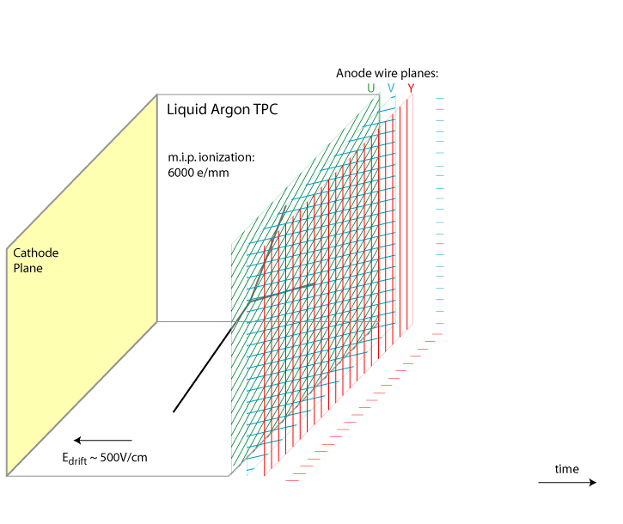
LArTPC (Liquid Argon Time Projection Chamber) :
An incoming neutrino interacts with an Ar nucleus which results in Ar ions & Charged particle/s
Energy and trajectory are measured by ionization signal
Time is measured though scintillation light
Fig 2: Scientific Diagram of the LARTPC (Source)
Notes:
DUNE is a LArTPC
Using energy and trajectory path of the charged particles’ and the scintillation for time information in order to create a 3D picture
Ar ions produce light and the charged particles get drifted.
My readout is pixel plan instead of a wire plane as shown in this gif.

Slide 4
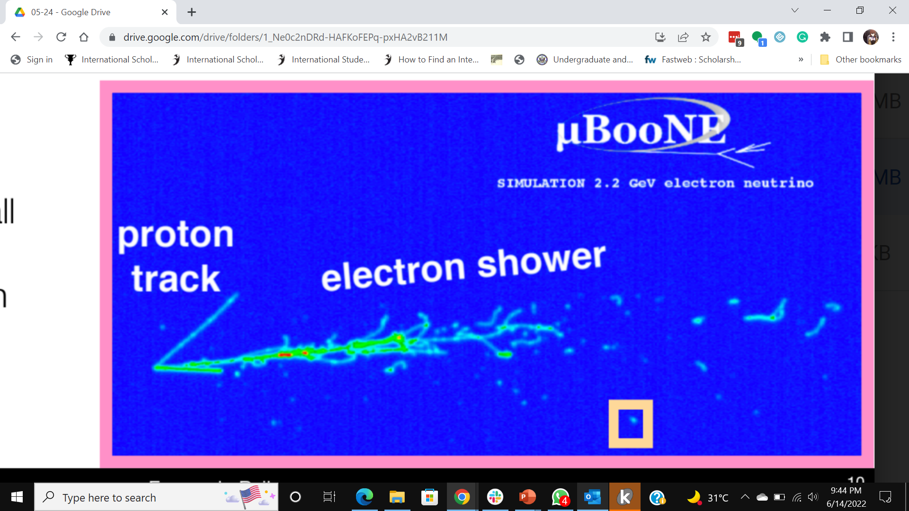
Objective: Low Energy in LArTPC
Energy measurement will need to combine the light and charge measurements
Light is collected with very low efficiency
Propose adding photosensitive dopants to convert some of the scintillation to light
Fig 3 : MicroBoone Simulation (Source: Stolen from Fernanda Psihas)
Notes:
Dune could do more low energy physics
Our project is focused on low energy R&D questions devoted to lowering the existing threshold and improve the precision to search for new physics -> possibility to use in DUNE

Slide 5
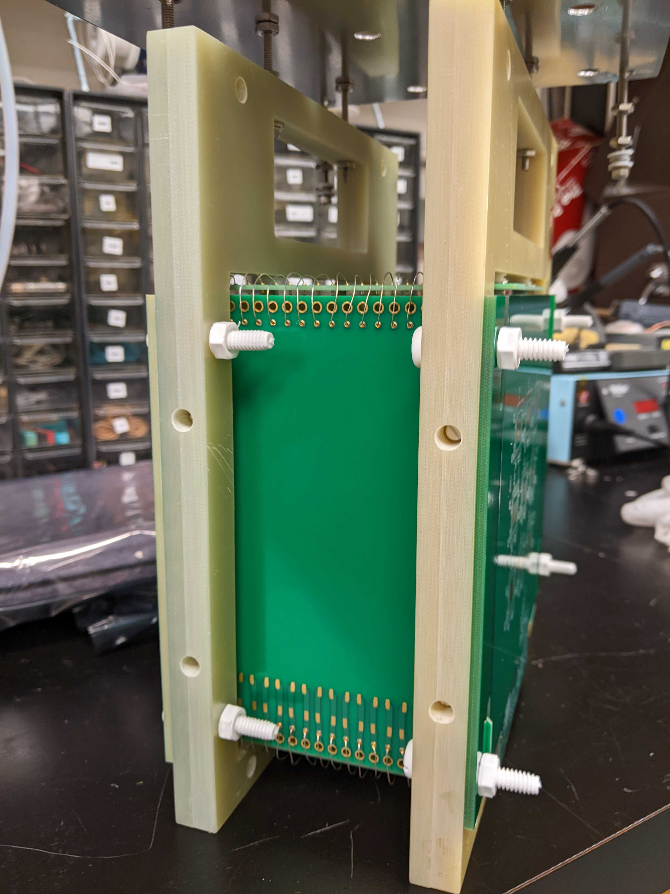
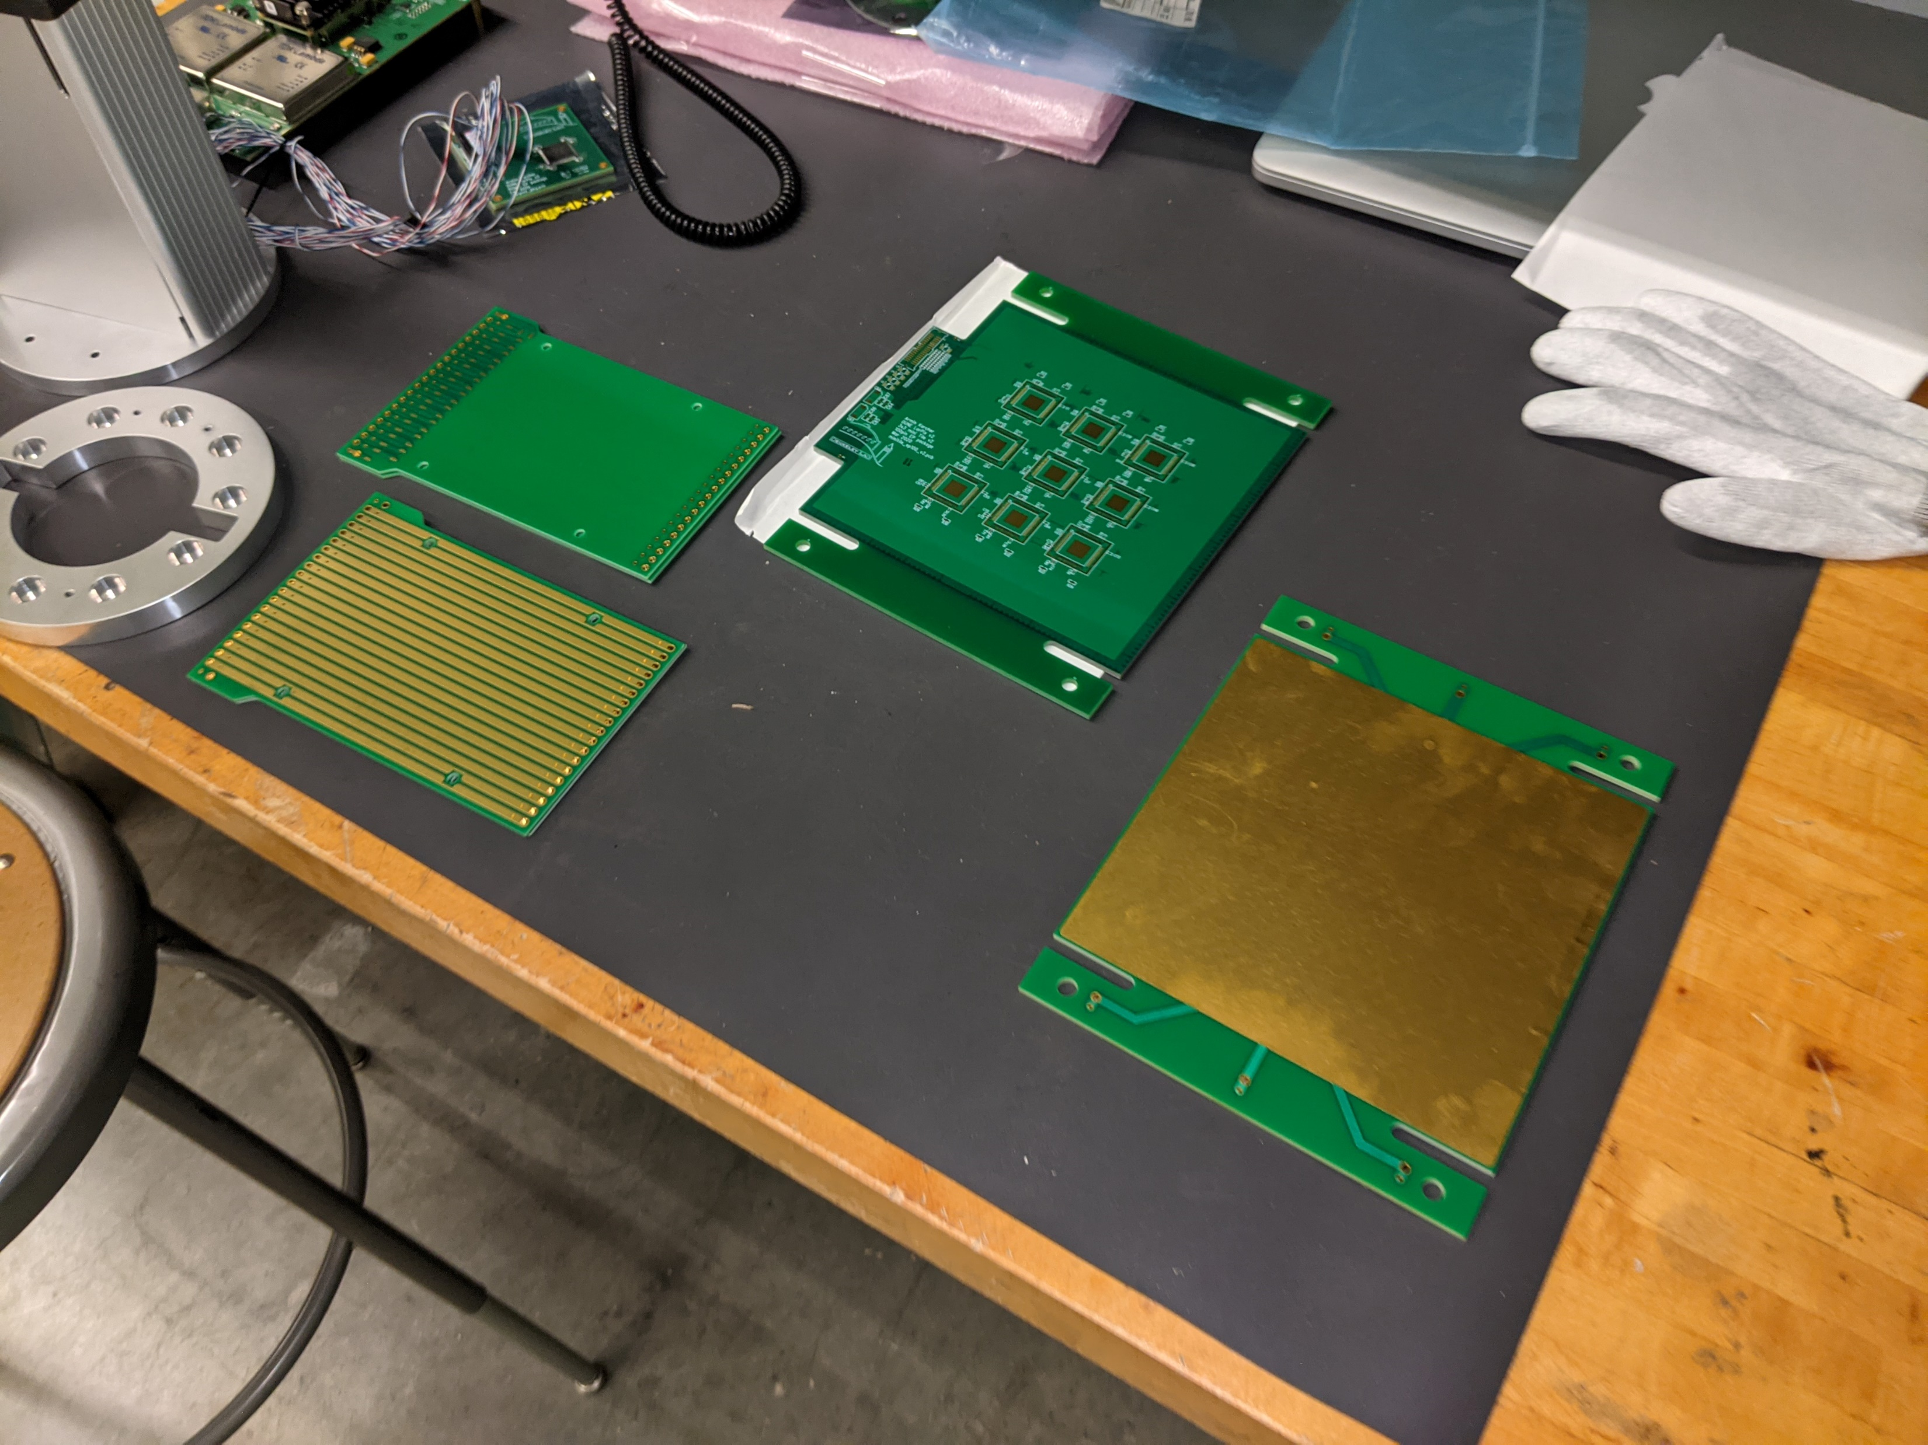
Objective : LArTPC Test Stand
TPC is deployed in Balance in PAB
Measure the energy of low energy events in LArTPCs
Background/cosmic data
Radioactive source
Photosensitive dopants
Analyze the data
Fig 3 : Completed Tiny LARTPC (Source: LArPix documentation)
Anode or readout plane: the pixel is in the back
Field cages
Fig 5 : Blanche Cryostast (Source)
Fig 4: Components Tiny LARTPC (Source: LArPix documentation)
Notes:
PAB = Proton Assembly Building (where we employ test stands not protons)

Slide 6
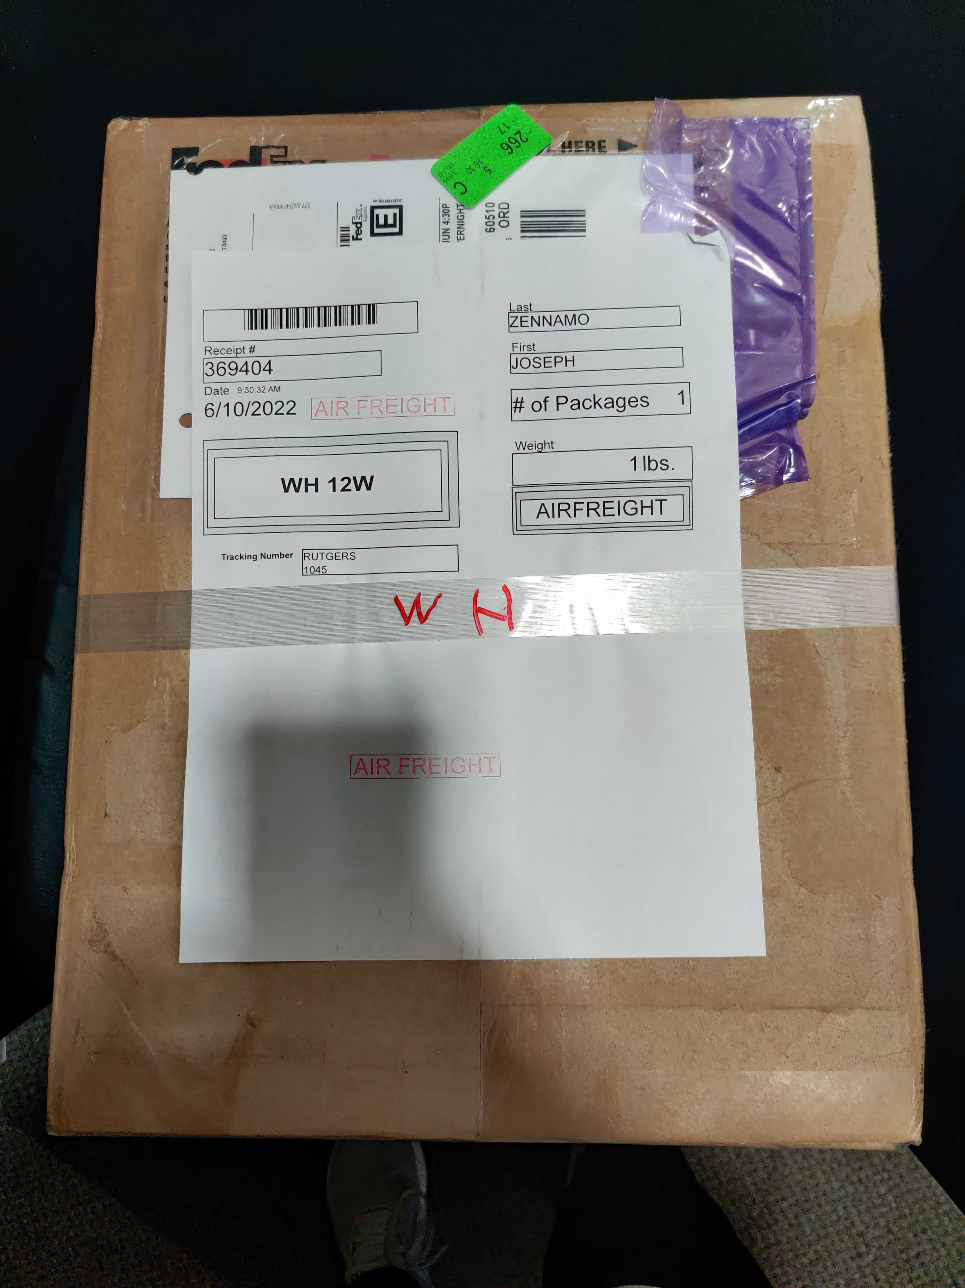
Progress
Developing Technical Scope of Work & Preparing work area in PAB
Familiarize with background
Neutrino Detection
LArTPC
Low Energy Signal
Learning/Reviewing software tools
Bash Basics
C++ & Root
Python & Matplotlib
Creating mechanical designs to support TPC in cryostat
Package
Notes:
Prepare work area -> getting all the equipment (i.e. oscilloscope, cables, etc.) that have the correct thermo coefficients

