Slide 1
Simulating Neutrino Flux and Detector Geometry
Santanu Antu
Supervisor: Joshua Issacson
Theory Division, Fermilab
SIST-2022

Slide 2
Why DUNE?
Basic Facts About Neutrinos:
Neutrinos are the lightest particles in the universe (rest mass ~0.1 eV)
Almost as abundant as photons on the surface of the earth.
Only interacts with weak force and gravity.
5 ly thick lead block to have 50-50 chance of interaction.
About the DUNE Experiment:
Consists of two detectors- one at Fermilab and the other at Lead, SD– 800 miles away!!
Fermilab will shoot the most intense beam of neutrino towards the other detector.
Improve our understanding of Neutrino Oscillation.
Improve our understanding of the asymmetry between matter and antimatter.

Slide 3
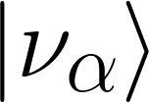
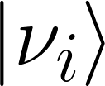
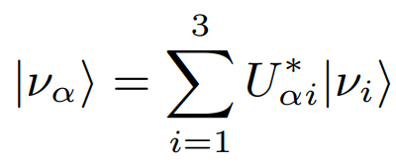
Little More About Neutrino
Neutrinos have 3 flavor eigenstates: , where
And 3 mass eigenstates: , where
The flavor eigenstates represented as a linear combination of mass eigenstates and vice-versa:
Probability of to oscillate to :
Then,

Slide 4
A Simulation
In our simulation, we will-
Propagate the neutrinos through the detector.
Calculate the probability of interaction.
Determine the interaction points.
A simple tool for interfacing neutrino flux simulation and detector geometry!
How are we modeling this?
Following the properties of reflection and propagation of light!

Slide 5
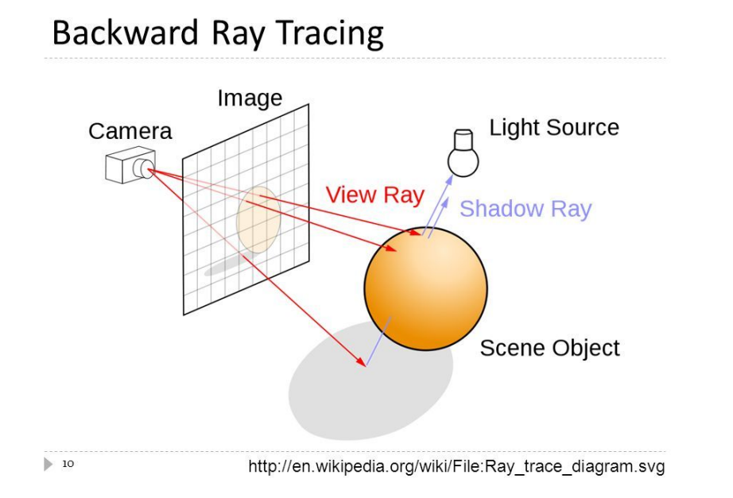
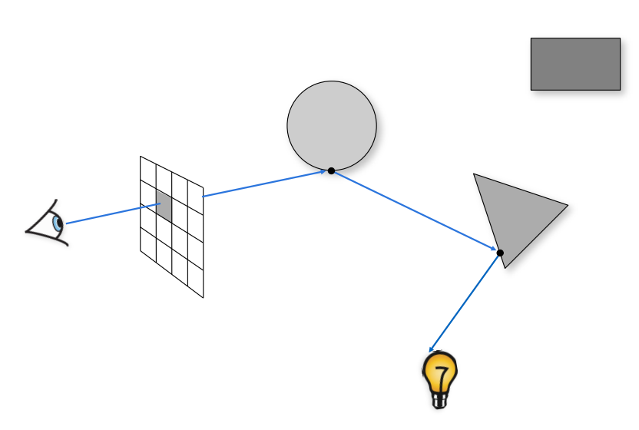
Ray Tracing and Reflection of Light
Ray tracing and shading (cmu.edu)

Slide 6
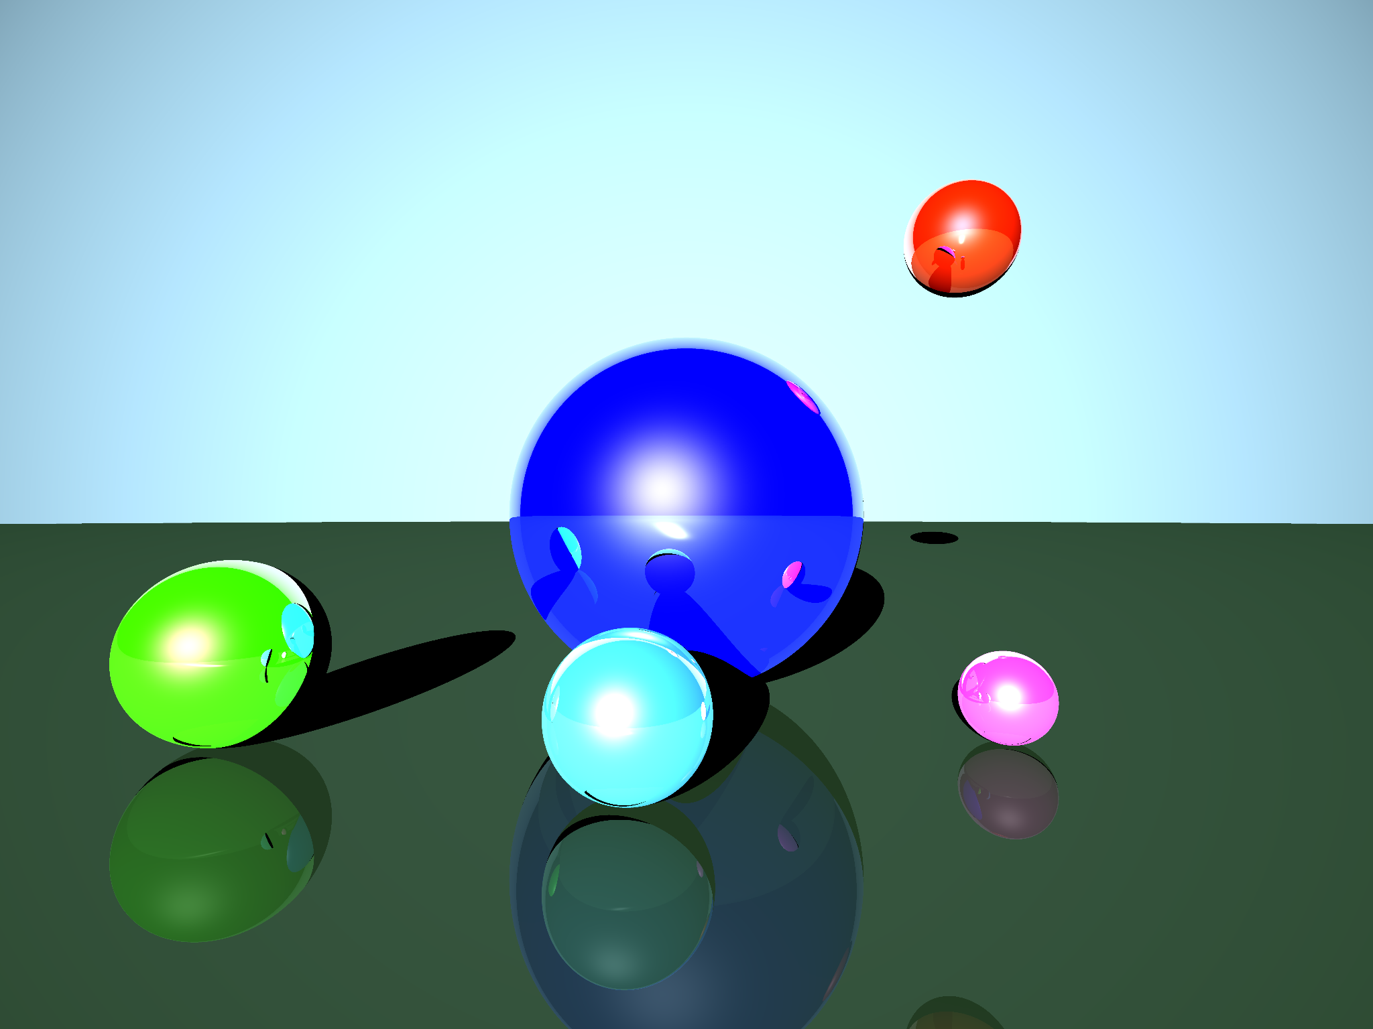
A Basic Ray Traced Image

