Slide 1
Field Mapping of PIP-II Superconducting Solenoids
Jay Hayman
Supervisor – Cristian Boffo
5 Minutes / 5 Slides
17 June 2022

Slide 2
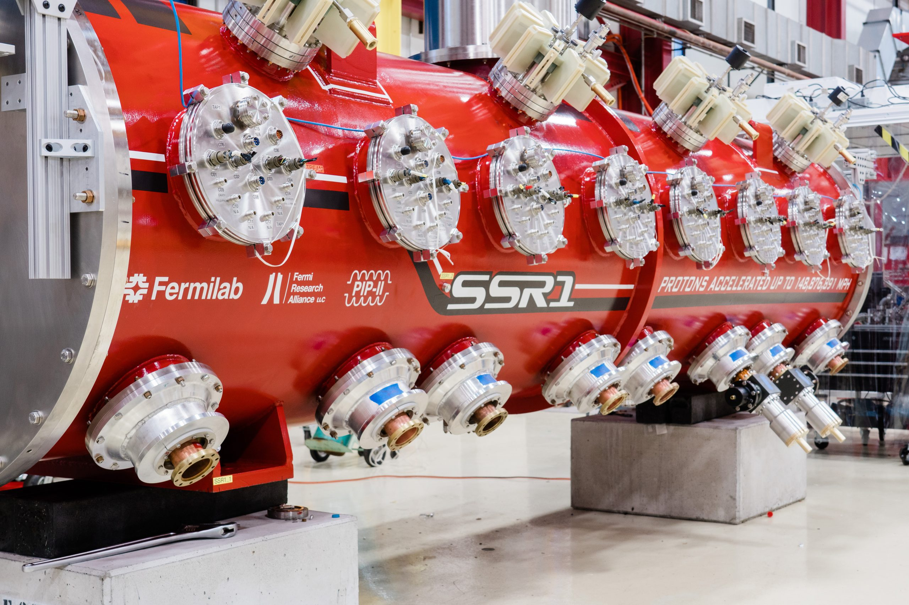
Overview
Goal: 3D mapping of the magnetic field within superconducting magnets
Application: qualification of the SSR focusing lenses for PIP-II
Environment: test stand 7 in IB1 – vacuum and 4 K temp

Slide 3
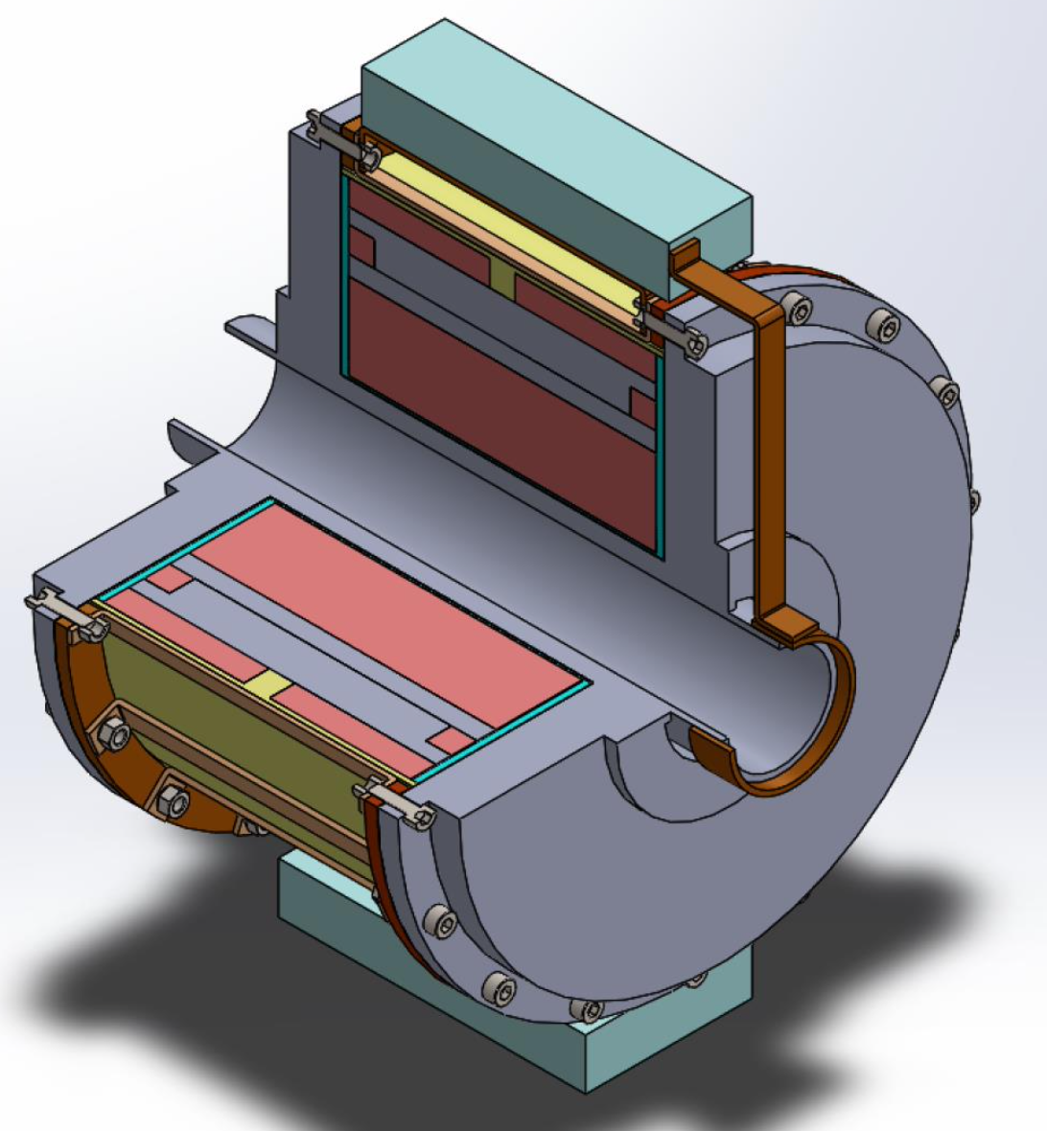
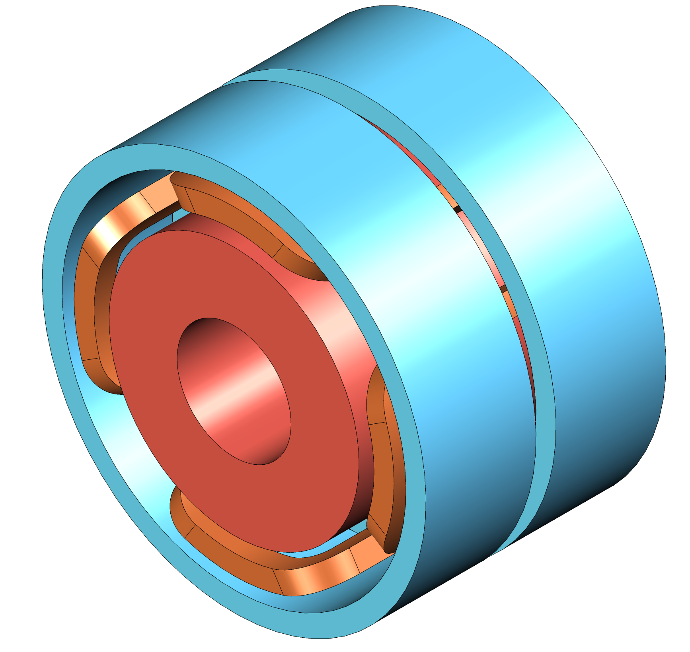
Background
Magnets are used to steer and shape a particle beam
The SSR focusing lenses for PIP-II are combined magnets that include a solenoid to focus the proton beam and dipole correctors to steer it.

Slide 4
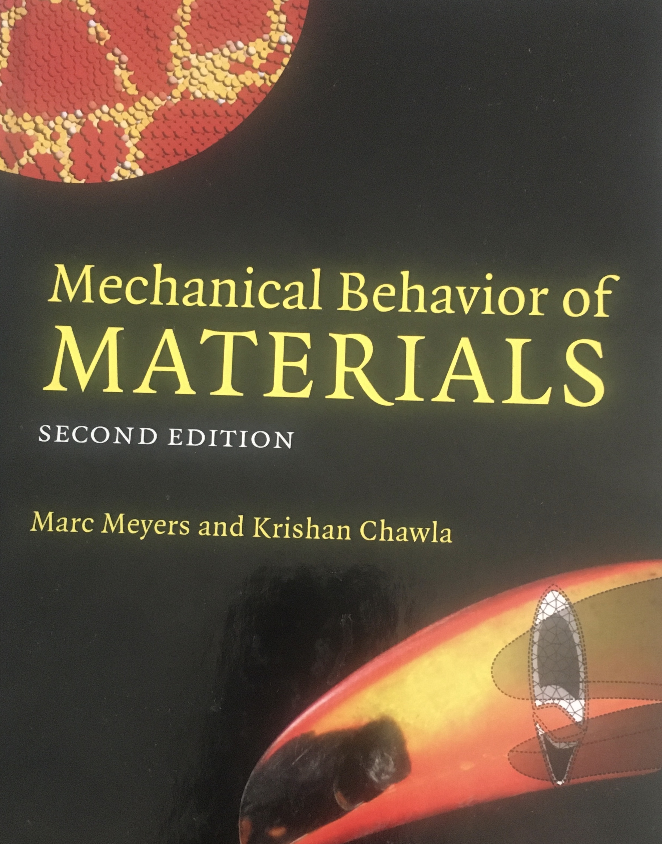
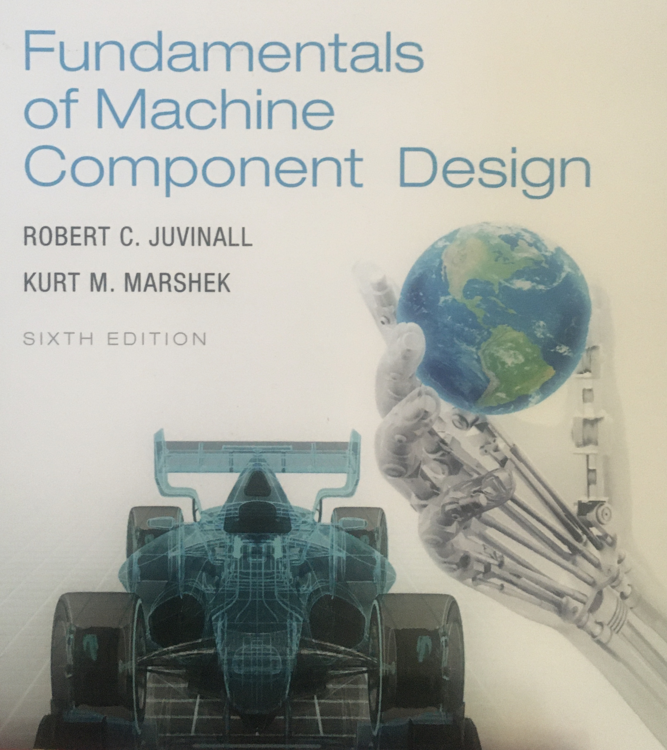
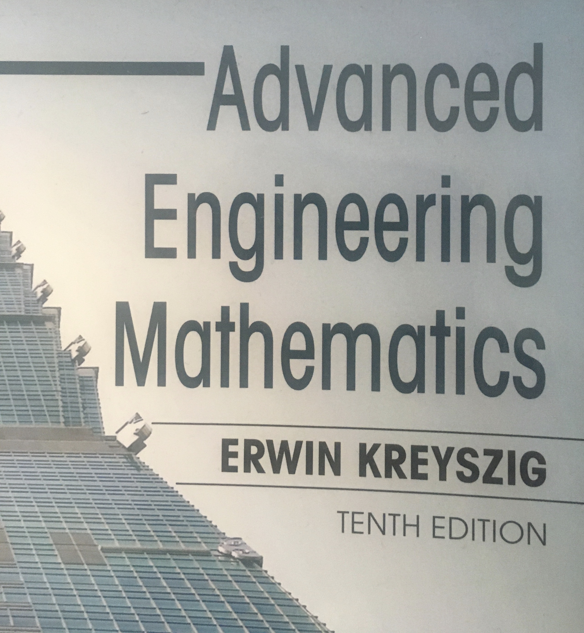
I Don’t Like Electronics
Background in math, materials, and machine design
Fell asleep in instrumentation class (stuffy room right after lunch)
Saving probe design for after more reading
Focus on structure and motility

Slide 5
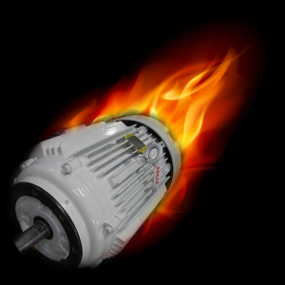
Motors Don’t Like Vacuum
Air cooling is assumed for most motor designs
Most lubricants are liquid
More heat + less pressure = lubricant might vaporize
Also need linear motion (~half meter) without breaking vacuum anywhere

Slide 6
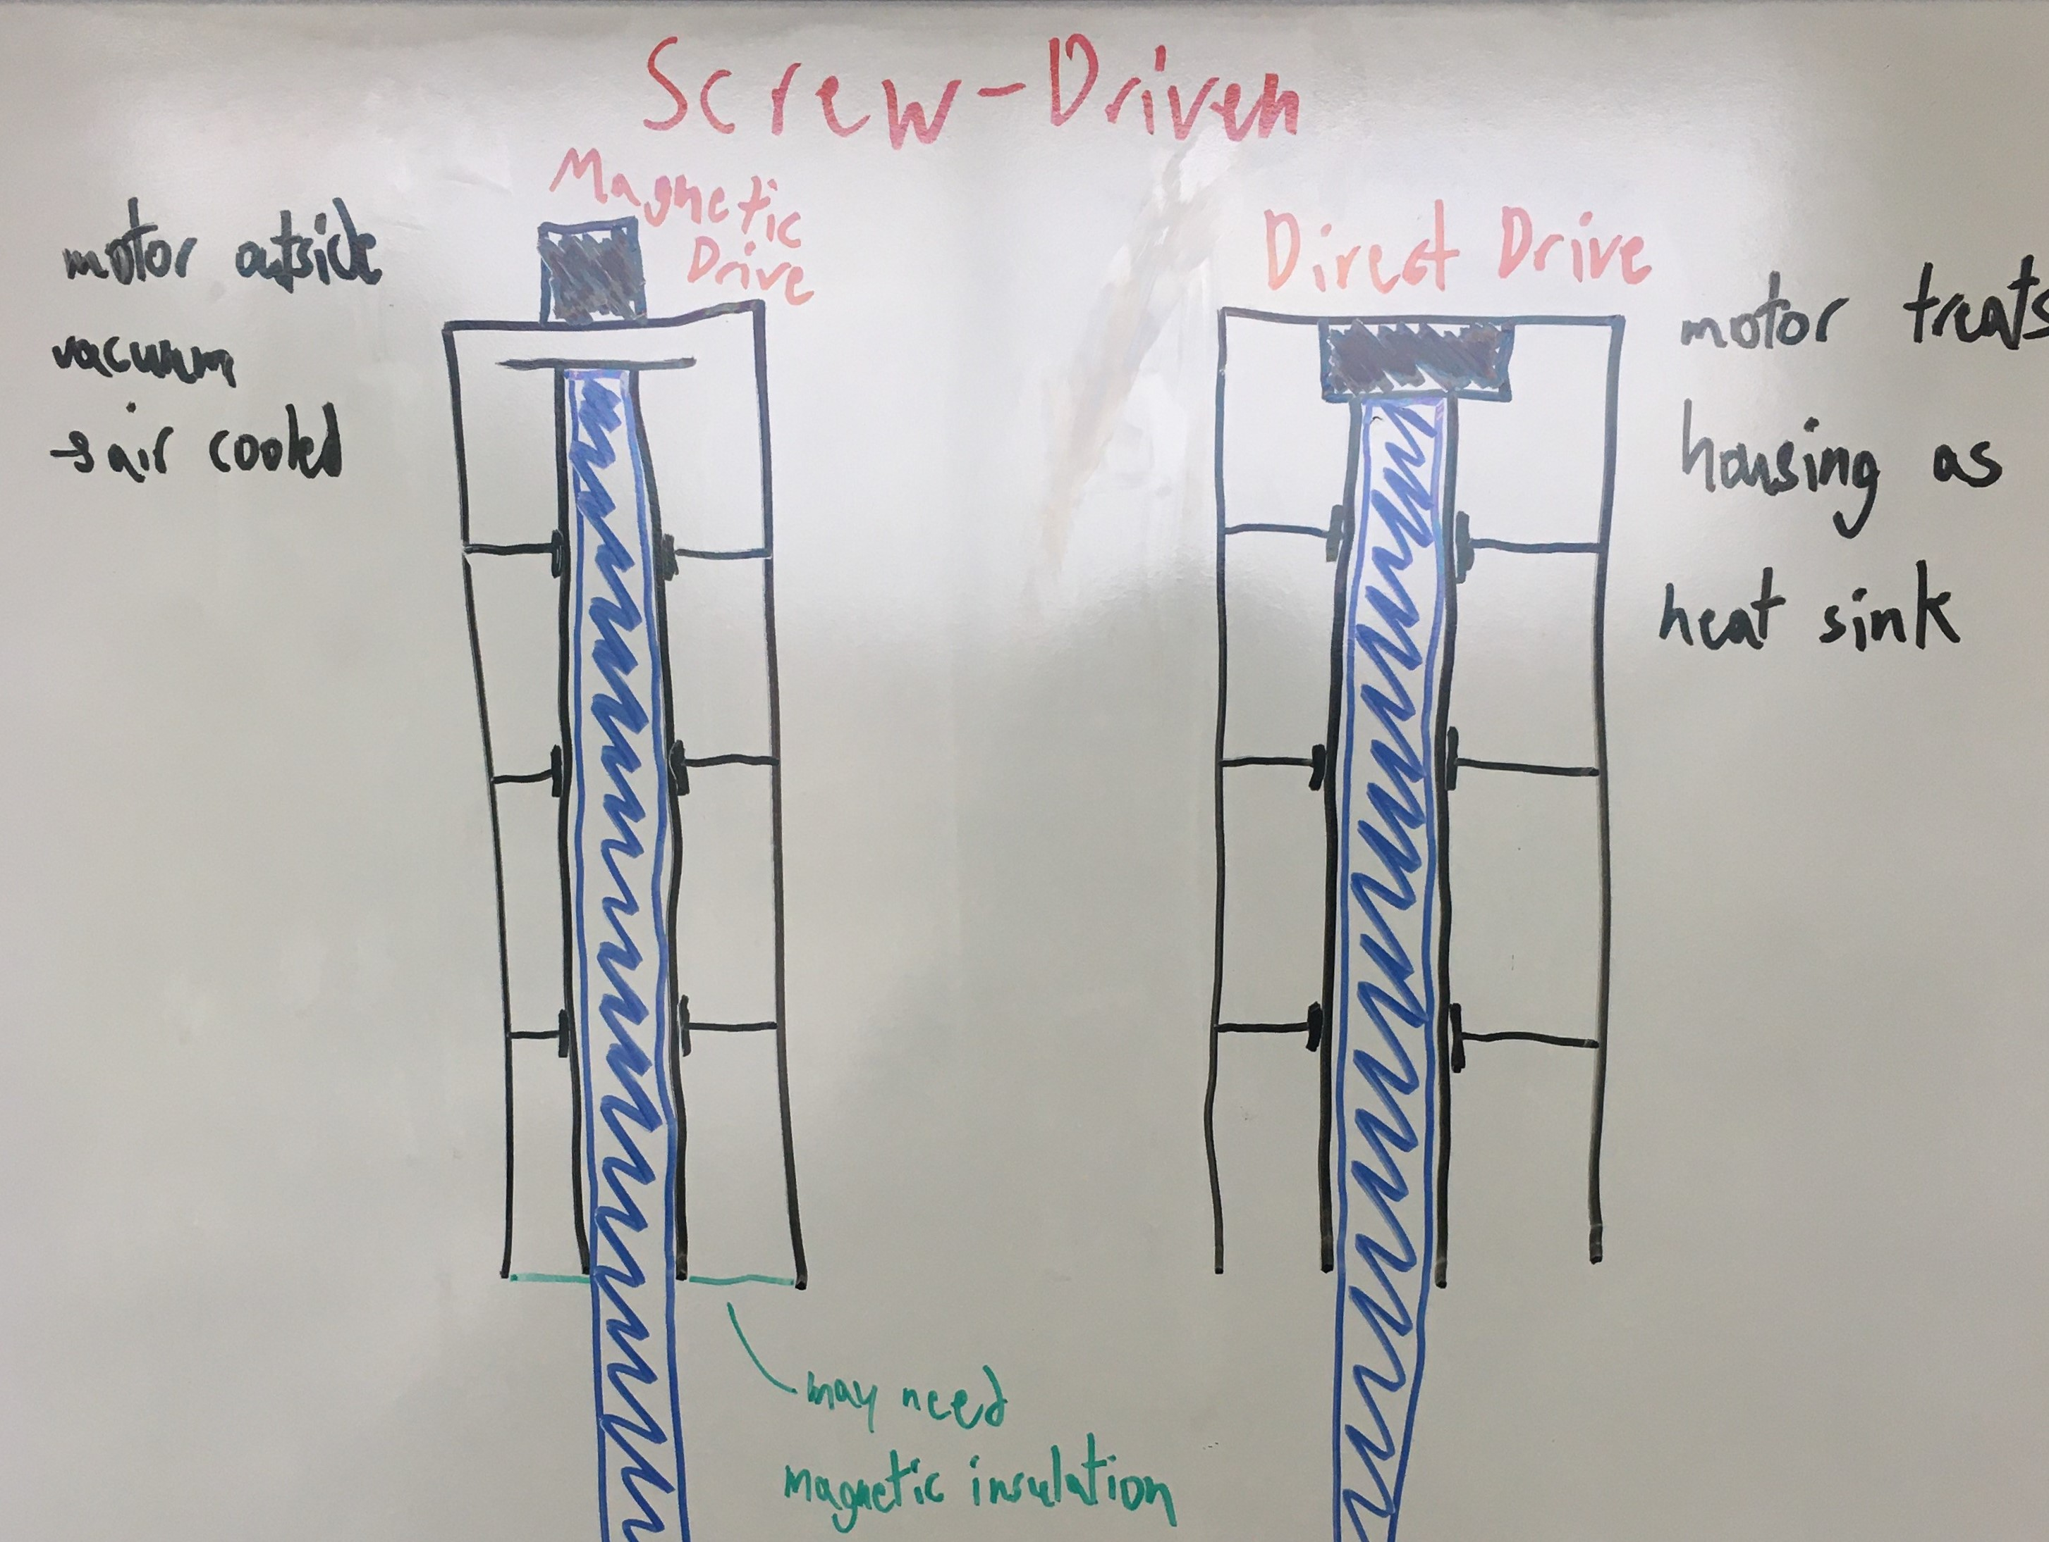
Current Concept
Rigid riser
Top-mounted motor
Screw driven Z-control

Slide 7
Thanks!

