Slide 1
Quantum Sensors for detection of Dark Matter
Divas Subedi, Trinity College
Supervisor : Dr. Kelly Stifter
06/15/2022

Slide 2
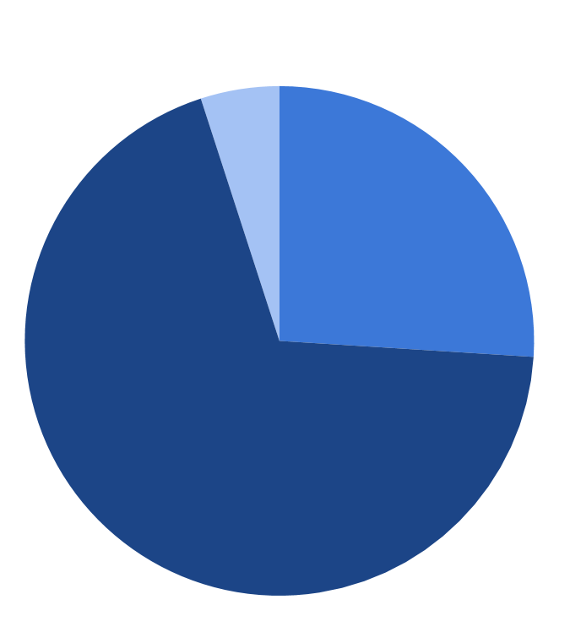
Dark Matter
Regular matter
4.9%
Dark matter
25.9%
Dark energy
69.1%
Composition of our Universe
Source: Planck

Slide 3
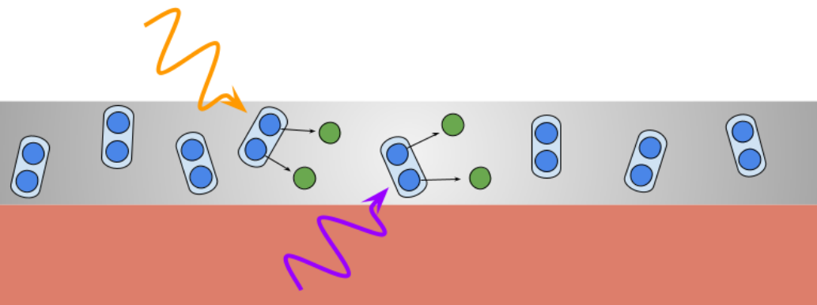
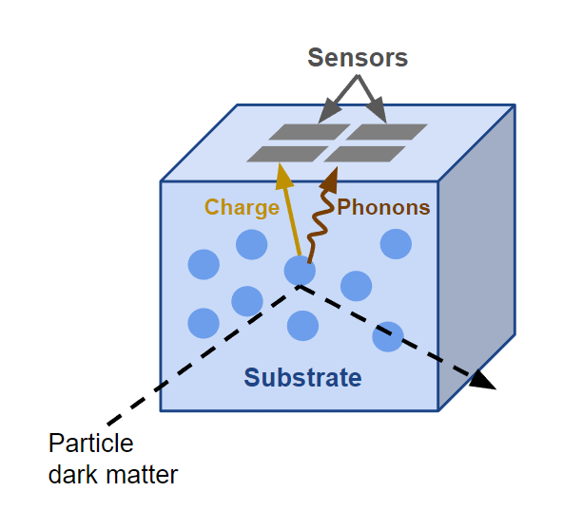
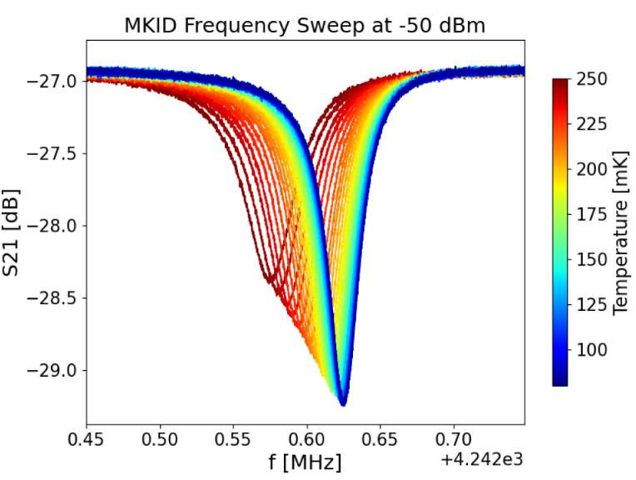
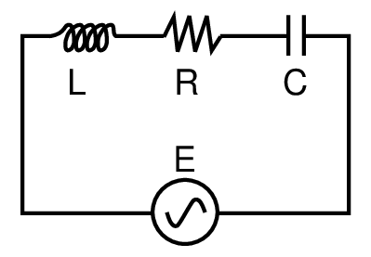
Quantum Sensors
Photon
Superconductor (Al)
Phonon
Substrate (Si)
Microwave Kinetic Inductance Detector (MKID)

Slide 4
Simulation
Understand the theoretical model
Backtrack the interaction from readings
Geant4 / G4CMP
Photon Transport and Decay
Model Detector

Slide 5
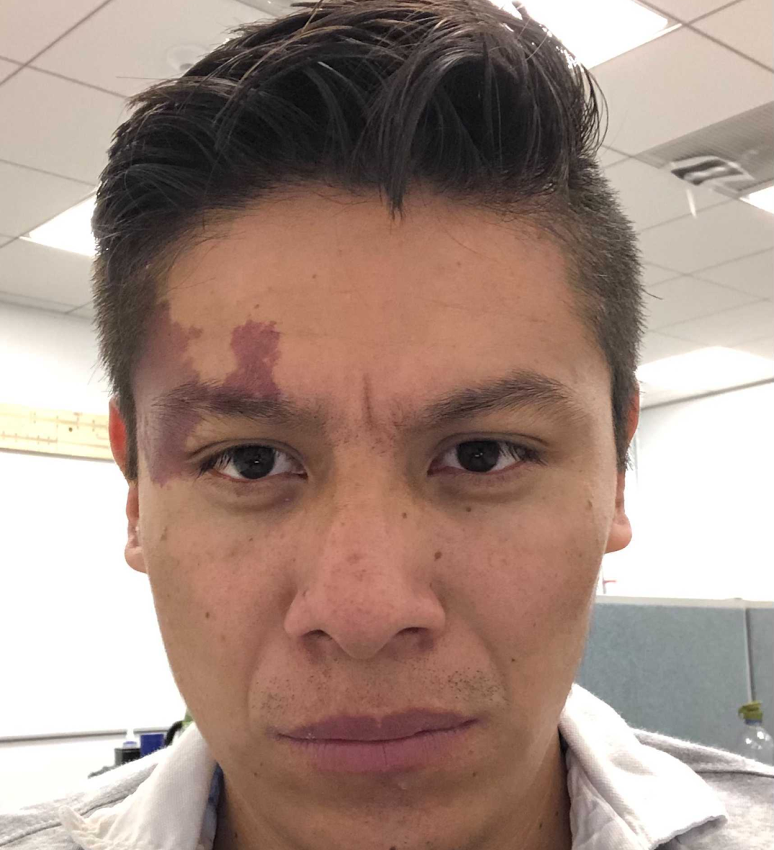
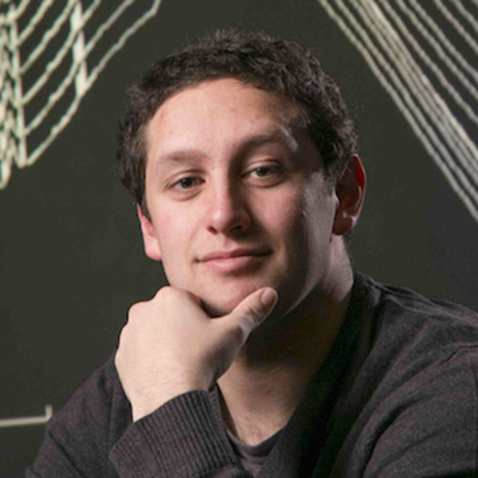
What I have been doing?
Getting familiar with background concepts
Dark Matter Interaction
Kinetic Inductance
MKIDs
Learning implement and analyze simulations
Geant4/G4CMP
Future Works
Use G4CMP to determine the phonon collection efficiency as function of position of detector
Optimize Pre-existing codebase for batch processing of the simulation
Package and Document the code for future purpose
Far-future:
Integrate G4CMP models with larger simulation framework that includes particle interaction and detectors
Israel Hernandez
Noah Kurinsky
Kelly Stifter

