Slide 1
[Clifton Terwilliger 5min presentation ~ Multi Threaded Framework
Clifton Terwilliger
Meeting Title
Day Month Year

Slide 2
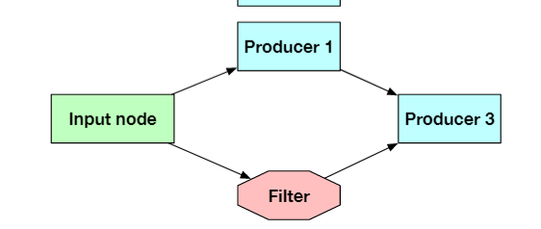
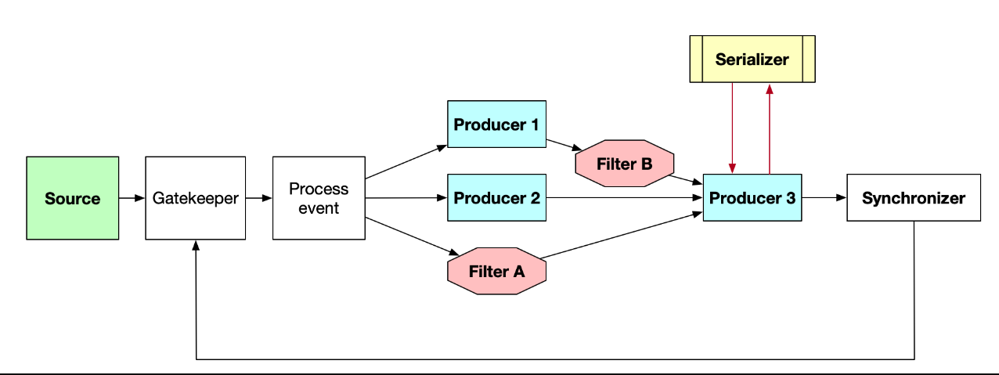
What?
Goal: is to create framework that is working, optimized light weight and most importantly easy to use framework
Can include very simple graphs or complex graphs.

Slide 3
Why(Ease of Use)
As it stands, writing multi-threaded code is:
Time consuming to write
Hard to debug
Hard to make Thread safe
Hard to optimize
Thus, we want a framework that is
Easy and Fast to use
Easy to make tread safe

Slide 4
Why(Computational Resources)
Additionally, poorly written multi threaded code tends to be:
memory intensive
Large overhead
Does fully utilize all available resources

Slide 5
Why(Resources)
Overall, the creation of this framework should:
Reduce code development time
Decrease required computing resources
Reduce bugs due to poorly written code
Ultimately this can lead to cost reduction for FERMI

Slide 6
How
The framework is currently being written in c++ for speed and memory control (hopefully is adapted to other languages in the future)
First, we are going to take an existing public library and adapt it to our own use.
Then create the framework so that meets all of the requirements

