Slide 1
Mechanical Design of the OSCURA vessel
Kodjo Akouedjinoude
kakoued1@fnal.gov
Date: 06/15/2022
Mentor: Nate Saffold
Supervisor: Juan Estrada

Slide 2
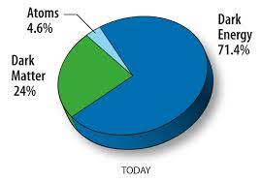
What is Dark Matter?
A large body of evidence points to the existence of dark matter (DM), but the nature of DM remains a mystery.
Current measurements indicate that 80% of the matter in our universe is Dark Matter
There has not been any direct observation of Dark Matter yet

Slide 3
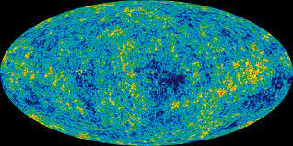
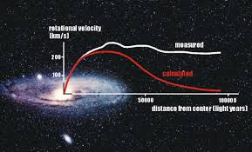
How do we know DM exists?
Rotational curves of galaxies
The cosmic microwave background
Gravitational Lensing
Galaxy formation simulations
For some references on DM observations:
What is dark matter?
La matière noire
https://en.wiktionary.org/wiki/Dunkle_Materie

Slide 4
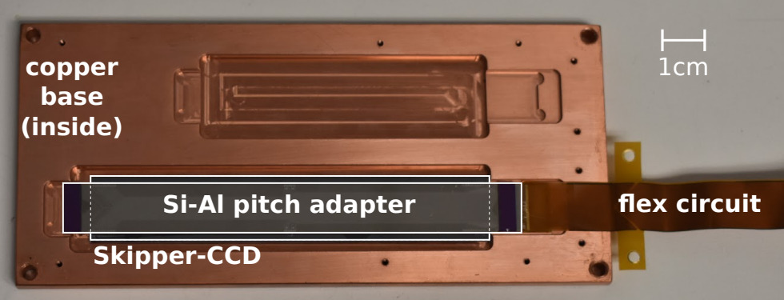
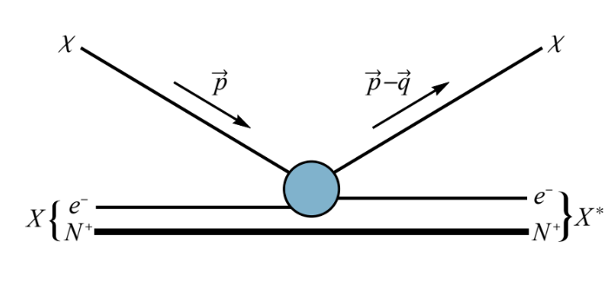
History of the DM searches
There are many experiments for DM using different detector technologies
One of the most recent DM particle research is the SENSEI experiment (Sub-Electron-Noise Skipper-CCD Experimental Instrument)
The SENSEI experiment developed highly sensitive sensors (skipper-CCDs) with ultra-low readout noise for the detection of low-mass DM particles
arXiv:2004.11378
arXiv:1509.01598

Slide 5
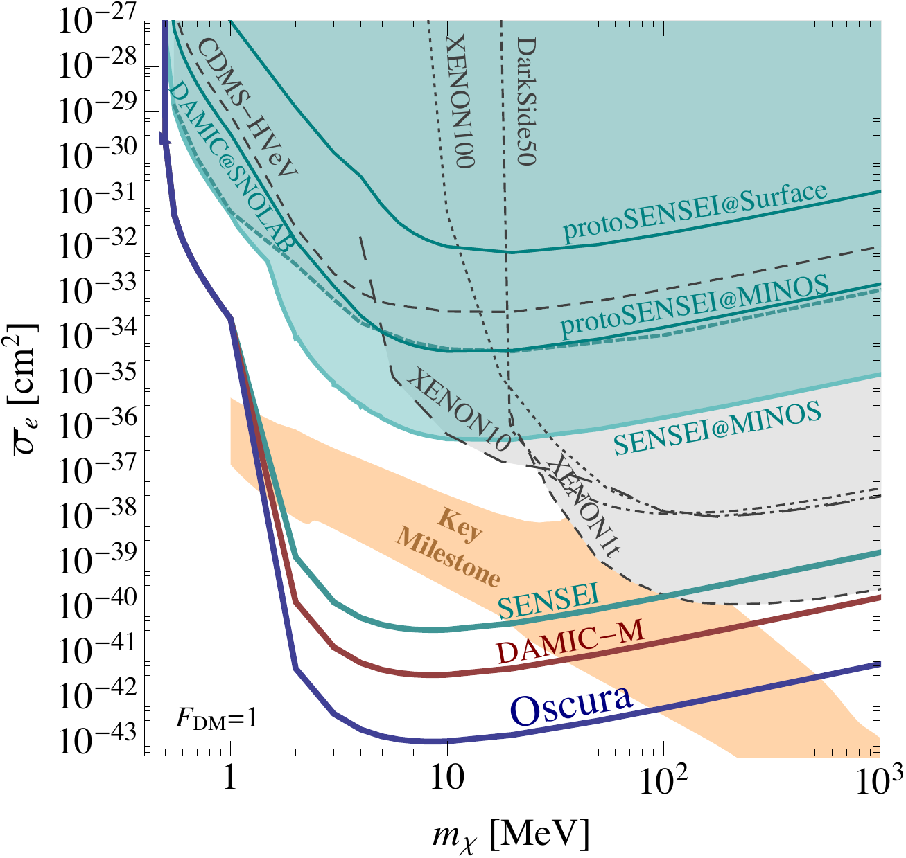
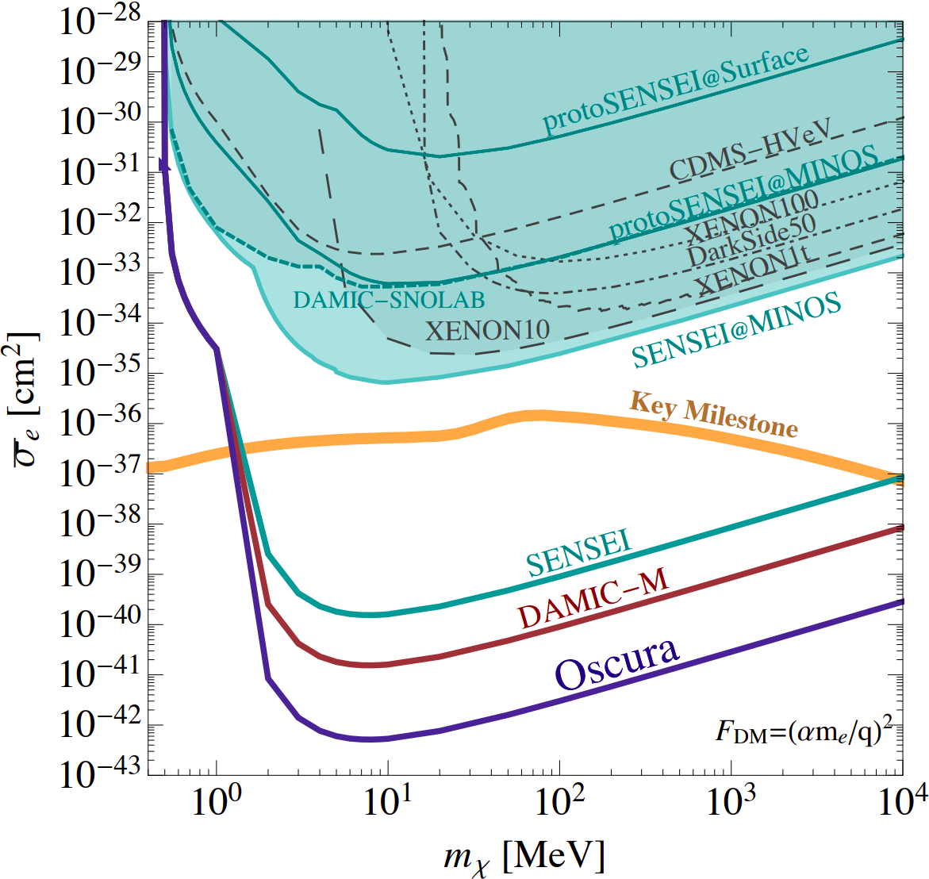
CCD searches for dark matter
DAMIC (40 g, ongoing): first CCD DM experiment
SENSEI (O(100) g started in 2021): first DM experiment using skipper-CCDs
Several physics results (most recent 2020) from prototypes and test runs; full-scale experiment being commissioned at SNOLAB
Active mass and radiopurity similar to DAMIC
DAMIC-M (O(1) kg starting 2023): next-generation Skipper experiment
Scaling up in mass, with the corresponding improvement in radiopurity
Oscura (O(10) kg, in development): next-generation Skipper experiment
Major R&D for readout, cooling, integration
arXiv:2202.10518

Slide 6
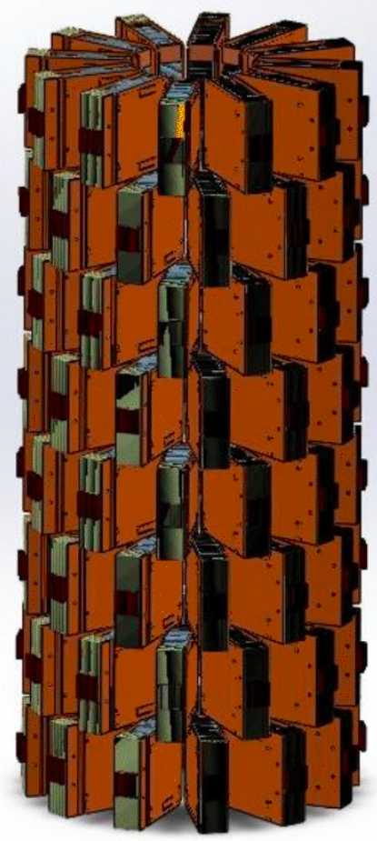
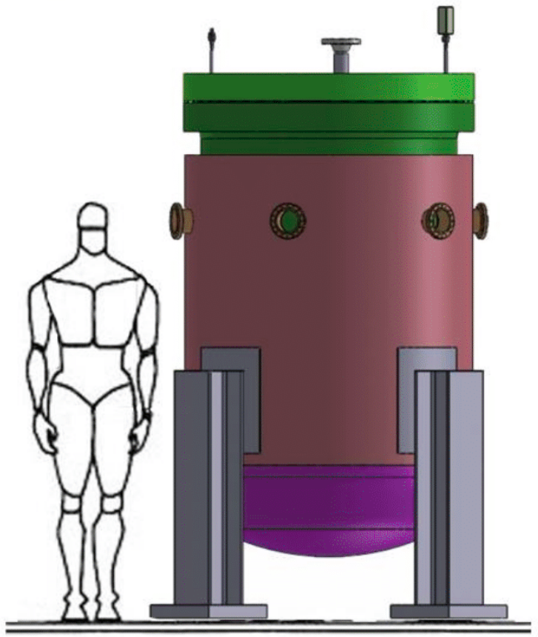
Oscura: 10-kg skipper-CCD experiment
Science goal: electron recoil low-mass direct DM search (1 MeV-1 GeV)
Technology: skipper-CCD array at underground lab (planning for SNOLAB)
R&D: scale the existing technology towards a 10 kg experiment
Plan: 30 kg-yr exposure with final background level of 0.01 dru
Recent Oscura review paper: arXiv:2202.10518
detector payload
10 kg vessel with external shield
10 kg vessel

Slide 7
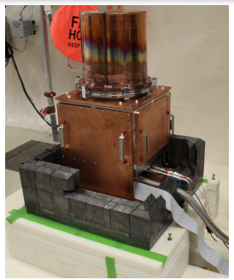
Objectives
The objective of this study is to assess the feasibility of scaling up the existing SENSEI vessel to house 10 kg of CCDs for the Oscura experiment
Proven technology: stable operation of skipper-CCDs in vacuum has been demonstrated by DAMIC and SENSEI
Requirements:
Thermal requirements: for optimal performance, skipper-CCDs must be operated between 120-140 K
Spatial constraints: the vessel must fit in the allotted space for Oscura at SNOLAB
The existing SENSEI Vessel

Slide 8
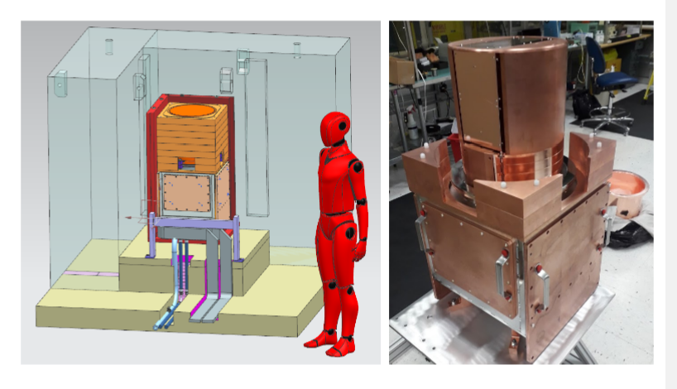
Scaling up the SENSEI Vessel
Scaling up the vessel requires an understanding of its different components:
Top-level inner
2. Under vessel services (cables)

Slide 9
Understanding the main Assembly

Slide 10
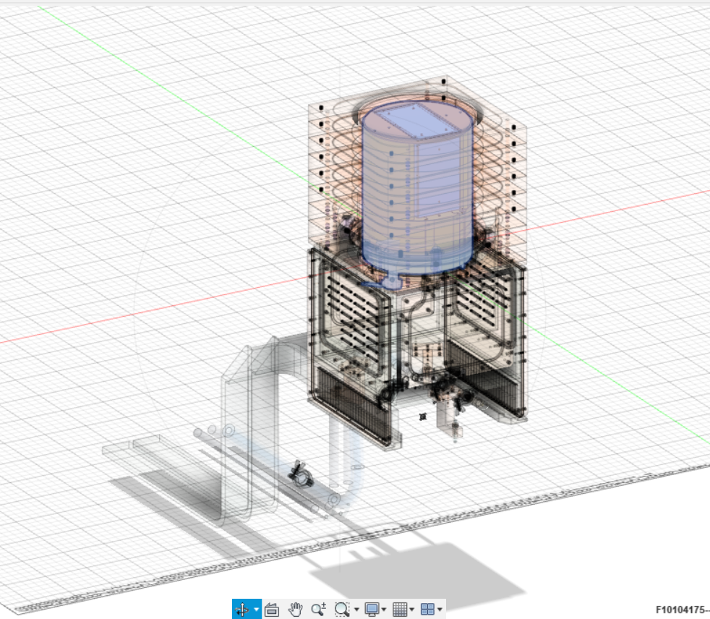
TOP-LEVEL INNER assembly
The TOP-LEVEL INNER assembly has two main sub-assemblies that each include different components.
Upper vessel to house the CCD modules (which is the main focus of this study and also the most complex)
2. Lower vessel assembly houses CCD readout electronics

Slide 11
Main Assembly
Under Vessel Services
Cables
Hoses
Top-level Inner Assembly
Lower Vessel Assembly
Upper Vessel Assembly
Internal Shield
Outer Temperature Shield
Cold Box
Modules (sensors)
Most important component of the assembly

Slide 12
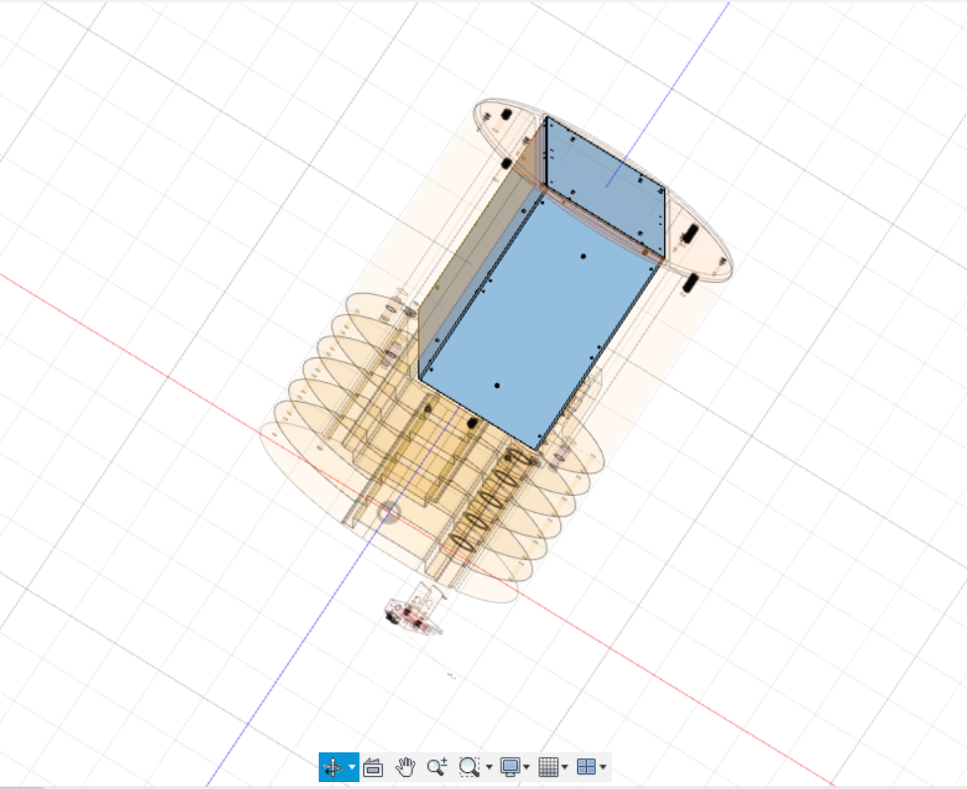
Internal Shield
Outer temperature shield

Slide 13
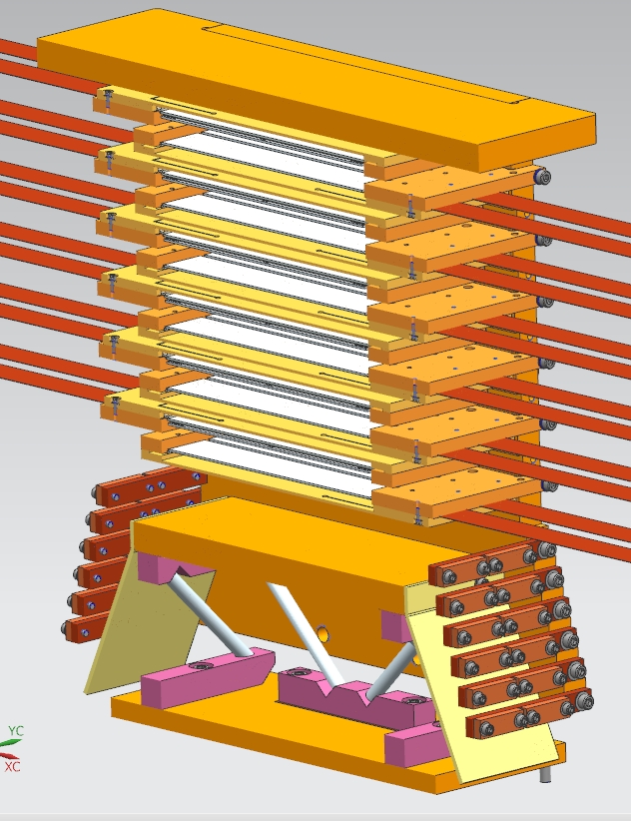
Outer Temperature Shield and Cold Box

Slide 14
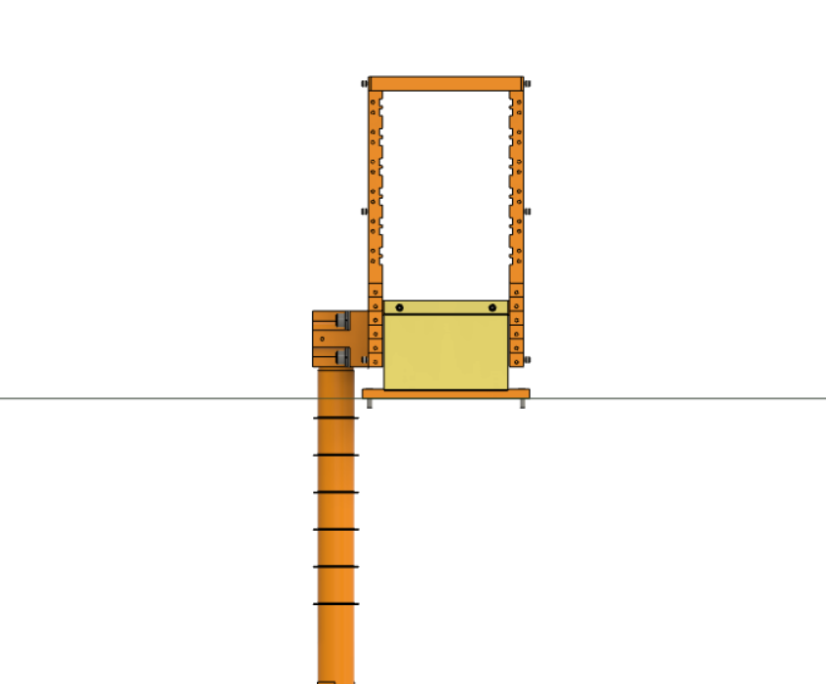
Cold Box
Need to scale up (make taller) the Cold Box to house as many CCDs as possible

Slide 15
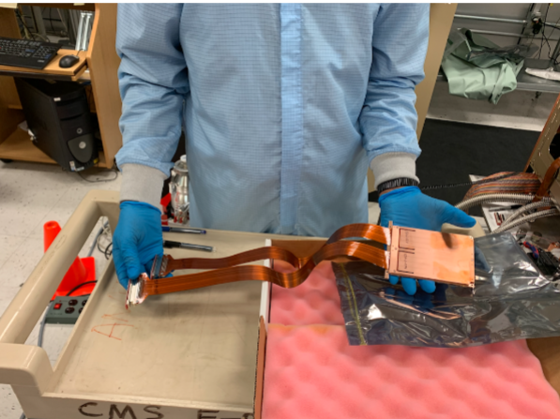
CCD Package
Initial SENSEI packages with 2 CCDs each
We will use this modified version of the SENSEI packages with 4 CCDs each to maximize space.

Slide 16
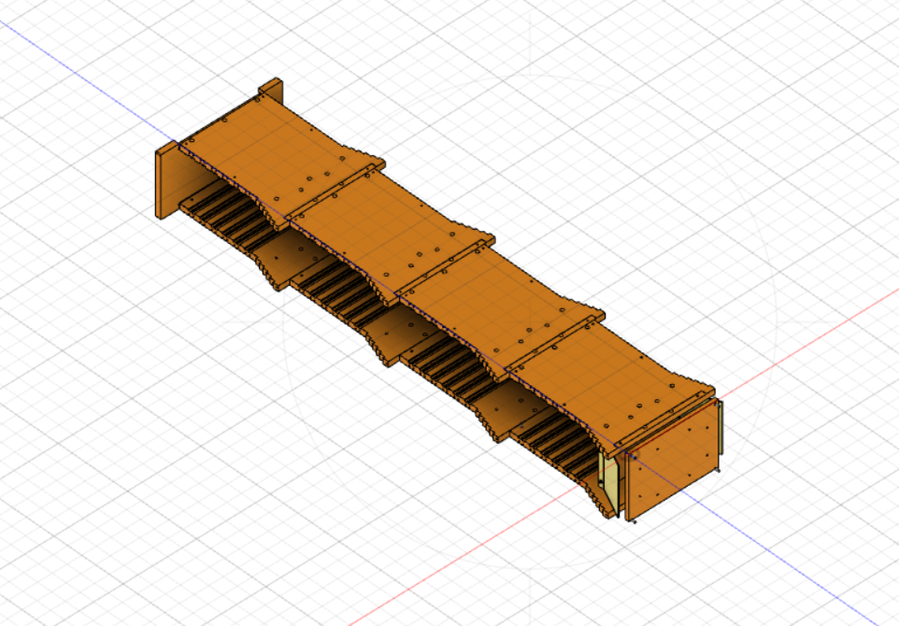
Design Challenges

Slide 17
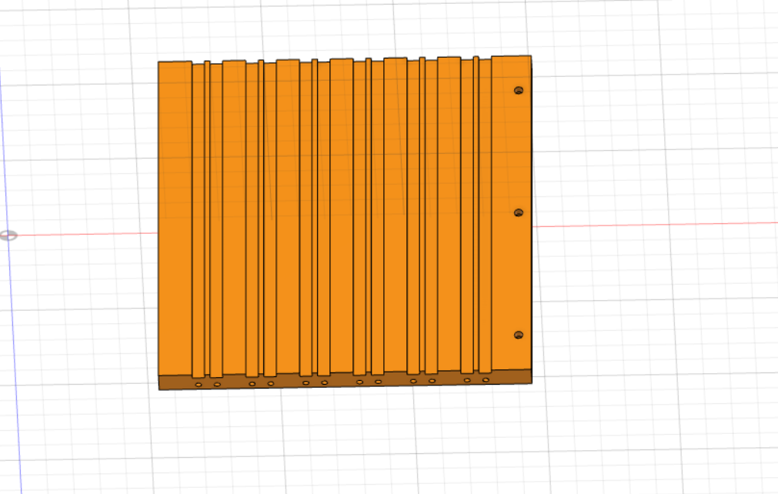
Design Challenges

Slide 18
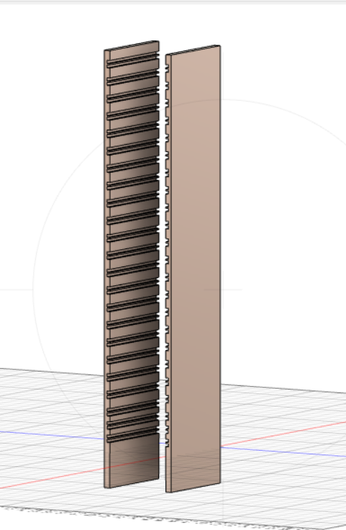
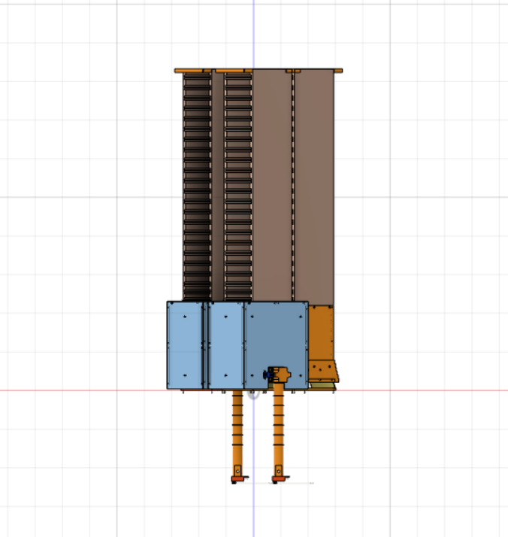
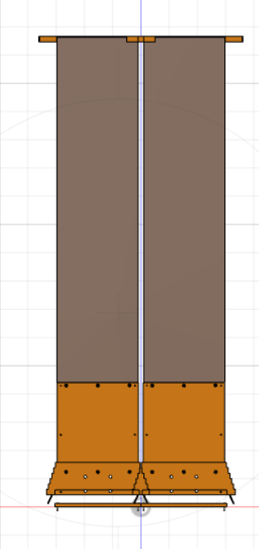
Results

Slide 19
Results
Each CCD has a mass of 1.93 g and the new design can include up to 240 CCDs in each tower
We have four towers for a total of 960 CCDs
The total active mass of CCDs is 1.85 kg towards the intended 10 kg.
The cold box height is now 825 mm so its height could be further increased while satisfying the space requirements at SNOLAB.

Slide 20
Conclusion
This work developed a modified design for the SENSEI vessel that can house ~2 kg of skipper-CCDs for the Oscura experiment.
This design can be further extended to house the full 10 kg Oscura payload.
Future studies will model the thermal management of this design to ensure that it meets the thermal requirements of the Oscura experiment.
Further refinements to this design will be made based on the thermal modeling results.

Slide 21
Acknowledgment
I would like to extend my thanks to Nate Saffold and Juan Estrada for their guidance and support this summer. I would also like to thank the SIST/GEM Committee for providing the opportunity for me to conduct this research.
Final thanks to Charles Orozco and Brian Vaughn for their mentorship, and Hemanth Gutti and Javier Tiffenberg for the engineering support.

Slide 23
Backup

Slide 24
SERVICES
VAC VESSEL: CRYOMECH HE HOSES
HOSE: VACUUM LINE
2 PLATES: VIB CABLE SUPPORTS
2 CABLES: VIB SERVICES
Main challenges
Size and weight constraints
Temperature uniformity across the detector array

Slide 25
Portions of the scaled-up vessel
Procedure: Isolate and scale up the size of each component, then reassemble.
Bell Jar
Internal Shield Stack Assy
Bell Jar External Shield
Cable junctions
Copper box
Lower vessel box
Modules
Services
VIBs

Slide 26
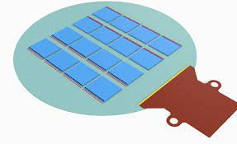
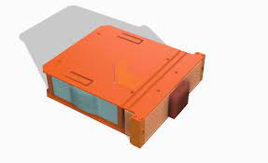
Sensors Package Possibilities
Current SENSEI modules have 2 CCDs each
New OSCURA super modules have 256 CCDS each
It will be easier and more practical to use the new SMs and adapt them to the ColdBox
The new super modules have a different design that cannot fit in the ColdBox
Either redesign the package of the super modules or the fit of the ColdBox
Current SENSEI super modules with 2 CCDs each
New Multi-Chip Module (MCM):
16 CCDs mounted on one silicon wafer
New Super Module (SM):
16 MCMs housed in electroformed copper

Slide 27
Disadvantages with the new Super Modules
Although being very compact the new Super Modules present some disadvantages
The package would NOT facilitate the cooling (with cryocooler) because of the low thermal conductivity
The CCDs included in the package have fewer pixels and it would require a larger array to reach the desired mass of sensors (10kg).
The experiment has to be conducted in a range of 120K and 140K; the thermal aspect of the vessel is very important therefore we will continue with the initial design of the Super Module
New Super Module (SM):
16 MCMs housed in electroformed copper

Slide 28
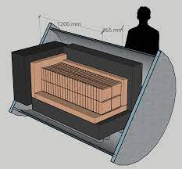
Overview
What is Dark Matter?
History of the DM searches
The Oscura Project
The existing SENSEI Vessel
Scaling up the SENSEI Vessel
Advantages & Inconveniences
Comparing the scaled-up vessel
to the cylindrical OSCURA vessel
Educated decision of a vessel

