Slide 1
Directional Dark Matter Detection With Scintillating Crystals
Anthony Brown
Wilberforce University
SIST Final Presentation
08 August 2022
In Collaboration With: Alex Drlica-Wagner, Daniel Baxter, Edgar Marrufo Villalpando

Slide 2
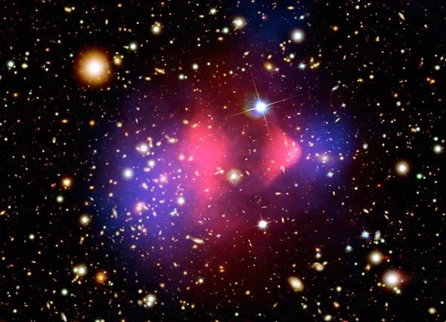
Dark Matter
Figure 1: This is an image of a bullet cluster.
Dark matter is a nonluminous material that is composed of particles that do not absorb, reflect, or emit light.
Dark matter is measured through its influence on other objects through gravity.
An example of this can be seen in the distribution of matter in a collision of galaxy clusters.

Slide 3
Characteristics Of Dark Matter In Space
Dark matter makes up approximately 27% of the universe.
A large region called a “halo” of dark matter hosts the Milky Way Galaxy.
There is still a mystery about what dark matter is made of, but several theoretical models exist including Weakly Interacting Massive Particles, Axions, or Ultralight Bosons.
Weakly interacting massive particles are heavy electromagnetically neutral subatomic particles that may constitute dark matter.
Axions are hypothetical elementary particles that have low mass and low energy.
Ultralight Bosons are hypothetical elementary particles that have fluid like characteristics and can cause gravitational waves.

Slide 4
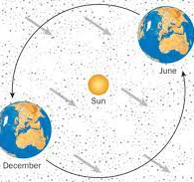
Characteristics Of Dark Matter In The Laboratory
Dark matter is constantly passing through our laboratories (and our bodies, etc.) We are interested in observing the energy that could be deposited by dark matter.
This energy could be deposited by rare scattering of dark matter particles off normal matter.
The direction and speed of dark matter passing through us changes daily and annually.
Dark matter could hit nuclei or electrons in sensitive detectors.
Figure 2:

Slide 5
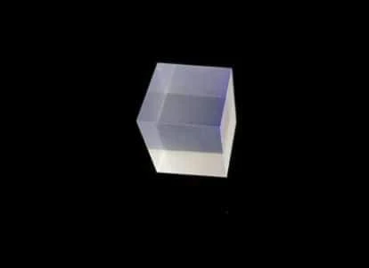
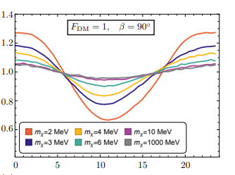
What Is A Scintillating Crystal
The scintillating crystal that we are interested in absorbs high energy photons and converts their energy into visible light. It can also absorb energy from a dark matter collision and convert the energy to visible light.
A scintillating crystal is made of anisotropic aromatic organic compounds that would emit different amounts of light based on the direction of dark matter collisions.
We can use a Charged-Coupled Device (“CCD”) to measure faint scintillating light outputs.
Figure 3:
Figure 4:

Slide 6
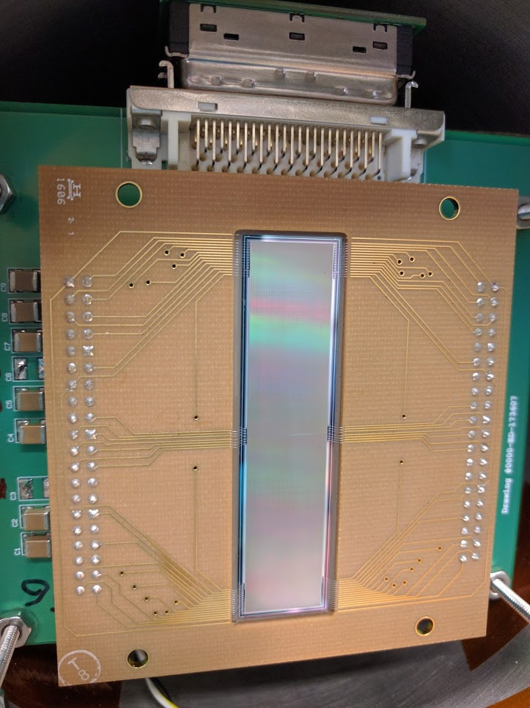
What Is A CCD
A Charged-Coupled Device also known as a CCD is a light sensitive integrated circuit that captures images by converting photons to electrons.
A CCD sensor holds pixels which are the elements of an image. Each pixel collects electric charge. The amount of charge is related to the intensity of light captured by that pixel.
Like stated before, the CCD will be used to measure visible light that is emitted by the scintillating crystal.
Figure 5: This is an image of a Charged-Coupled Device.

Slide 7
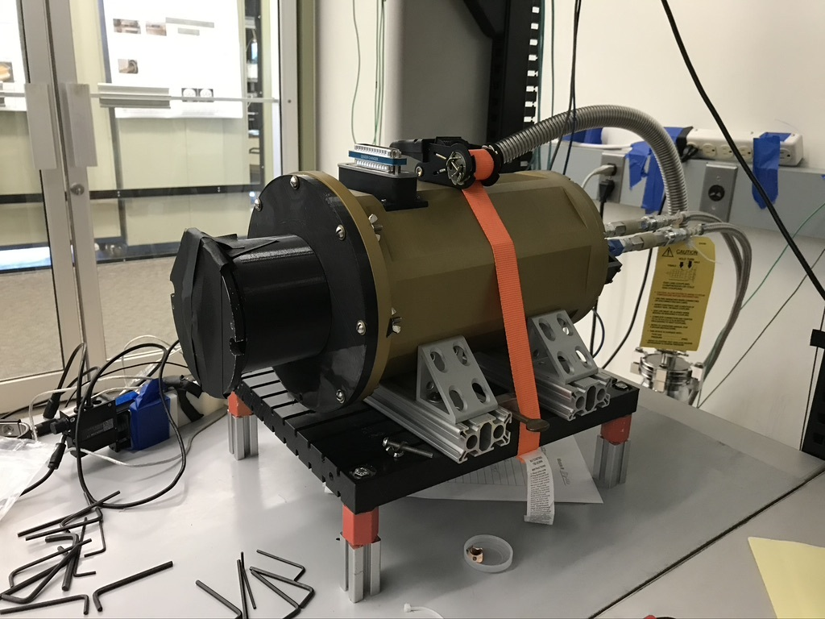
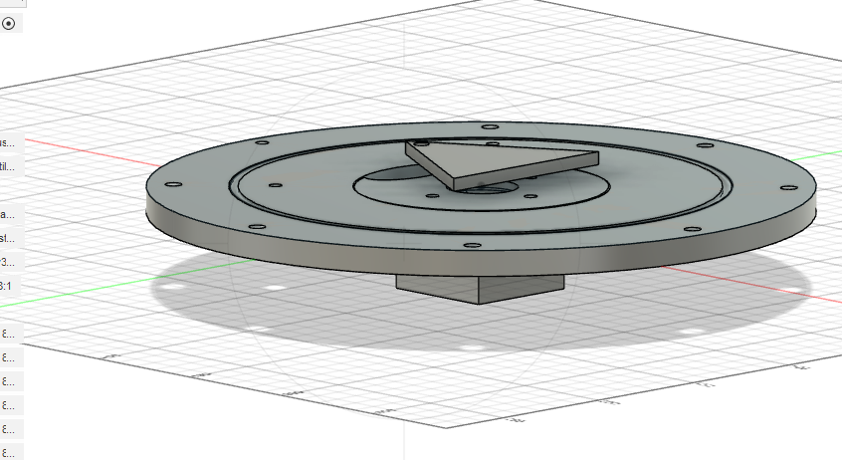
Objective Of Research
The objective of this research project is to use a Computer Aided Design Software (CAD) called AutoDesk Fusion 360 to create a housing component for the Scintillating Crystal that would be compatible with the front end of the Astro Dewar holding a CCD.
A fiber optic cable will be connected to the back of the housing component to emit light onto the scintillating crystal to calibrate the scintillation output.
The housing component will also consist of a shutter mechanism to allow and prevent light from hitting the CCD.
Figure 6: This is an image of an Astro Dewar.
Figure 7: This is the base of the housing component, and the crystal will be held in the square holder located below.

Slide 8
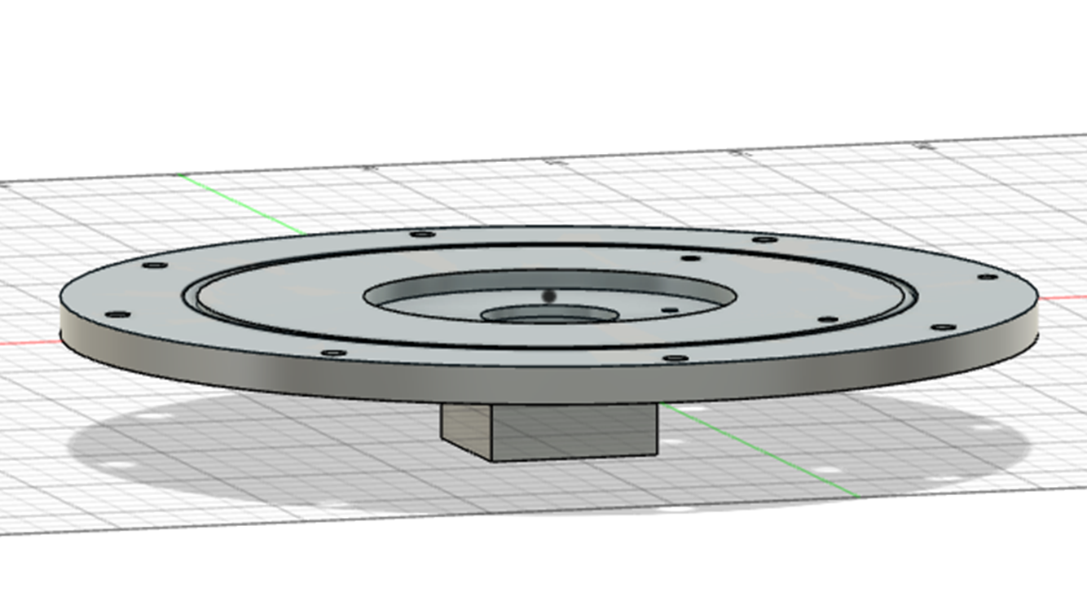
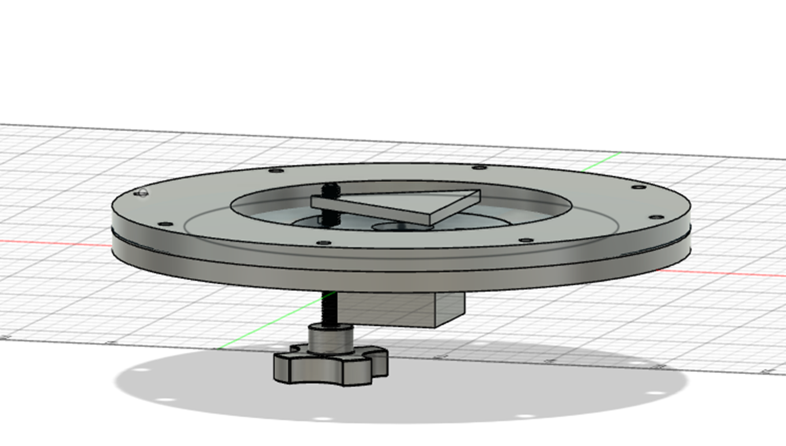
Housing Component CAD Design
The scintillating crystal housing component base has a circular shape to clamp on the end of the Astro Dewar.
Figure 8: An O-ring groove was added to the base to seal the various pieces of the component together and to prevent light from leaking out.
A turning shutter mechanism was added to the base of the component to allow and prevent light from hitting the CCD.
The shutter can only turn 70 degrees clockwise and counterclockwise to prevent excessive rotation while inside the component.
Figure 9: This turning shutter mechanism allows you to precisely measure the scintillating crystal’s output.

Slide 9
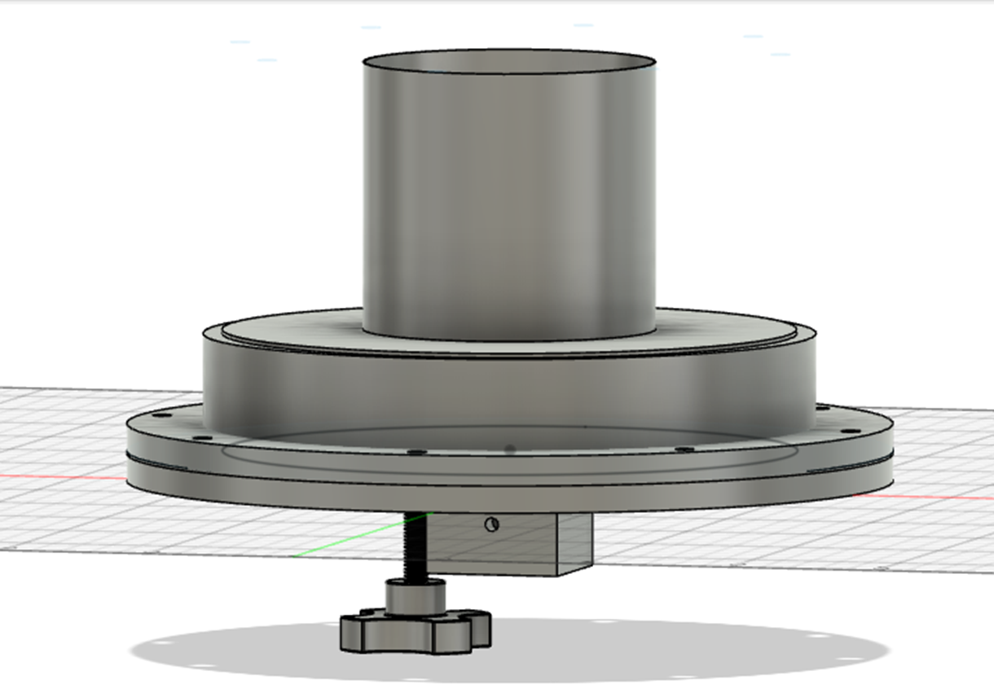
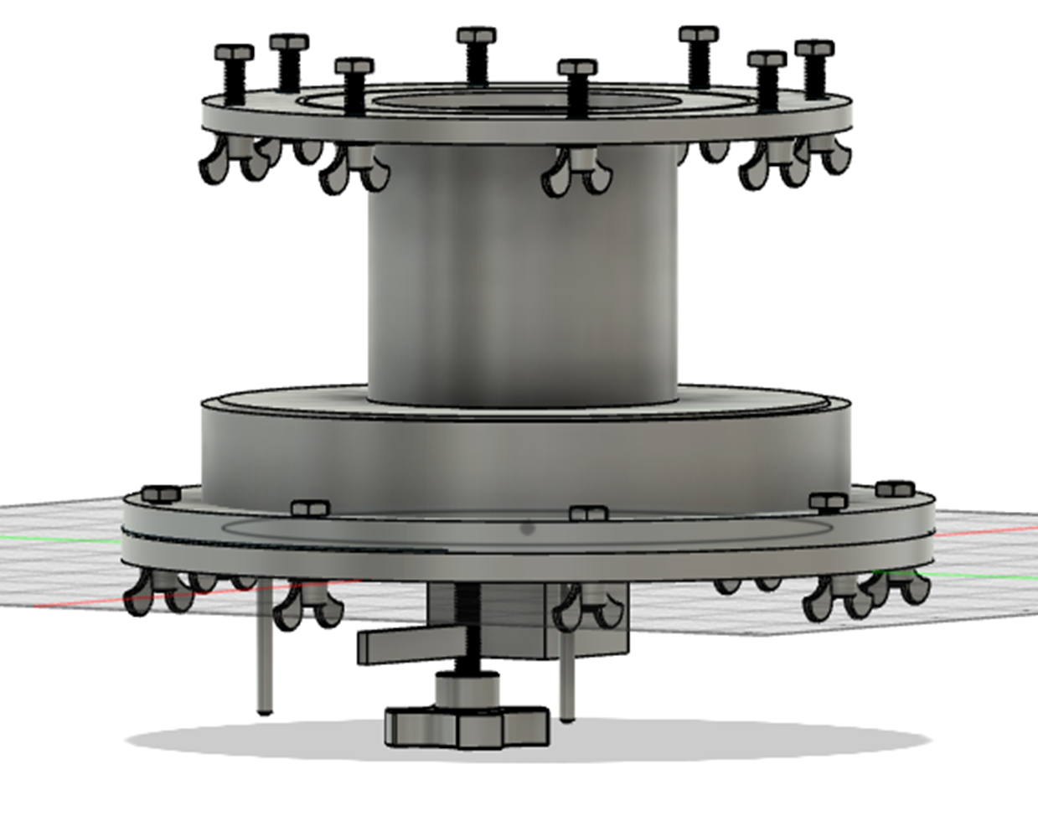
Housing Component CAD Design
A top cylinder was added to the housing component to prevent light from leaking out. An optic fiber cable hole was also added onto the square holder at the bottom of the housing component base. The fiber cable will be connected to emit light onto the scintillating crystal to calibrate the scintillation output.
Figure 10: This top cylinder functions as an unilluminated pathway for the uv light to reach the CCD.
A top clamp was added to attach the component to the end of the Astro Dewar. I also added a fin to the shutter’s turning knob, which prevents excessive rotation of the shutter inside the component.
I added two screws on both ends of the shutter knob, so when it turns it meets the fin which then stops the shutter from rotating inside the component.
Figure 11: This is the complete 3D CAD design of the scintillating crystal housing component.

Slide 10
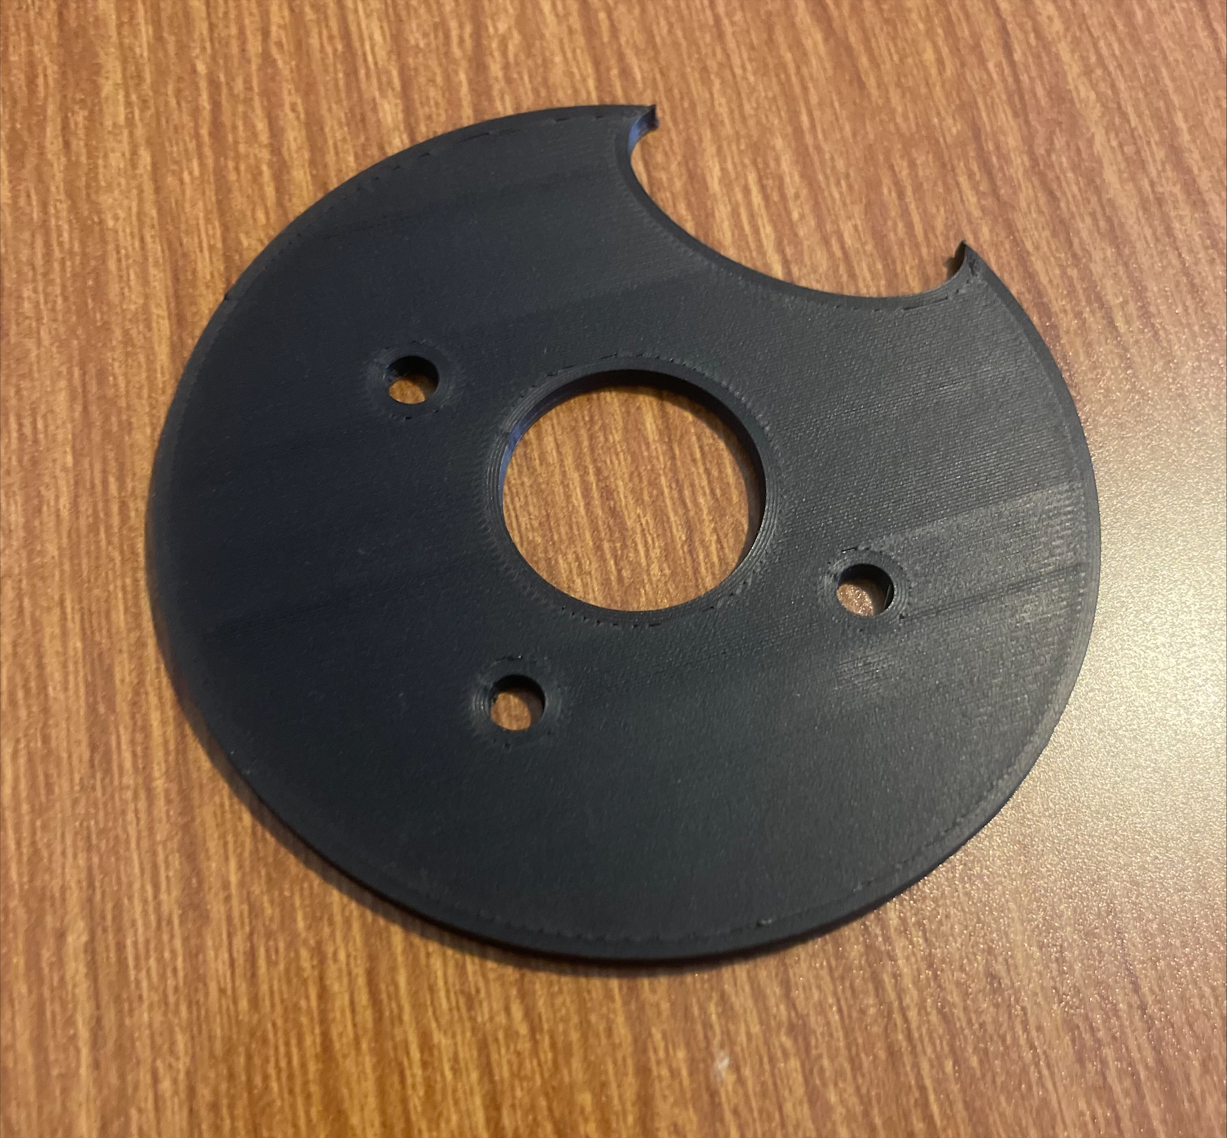
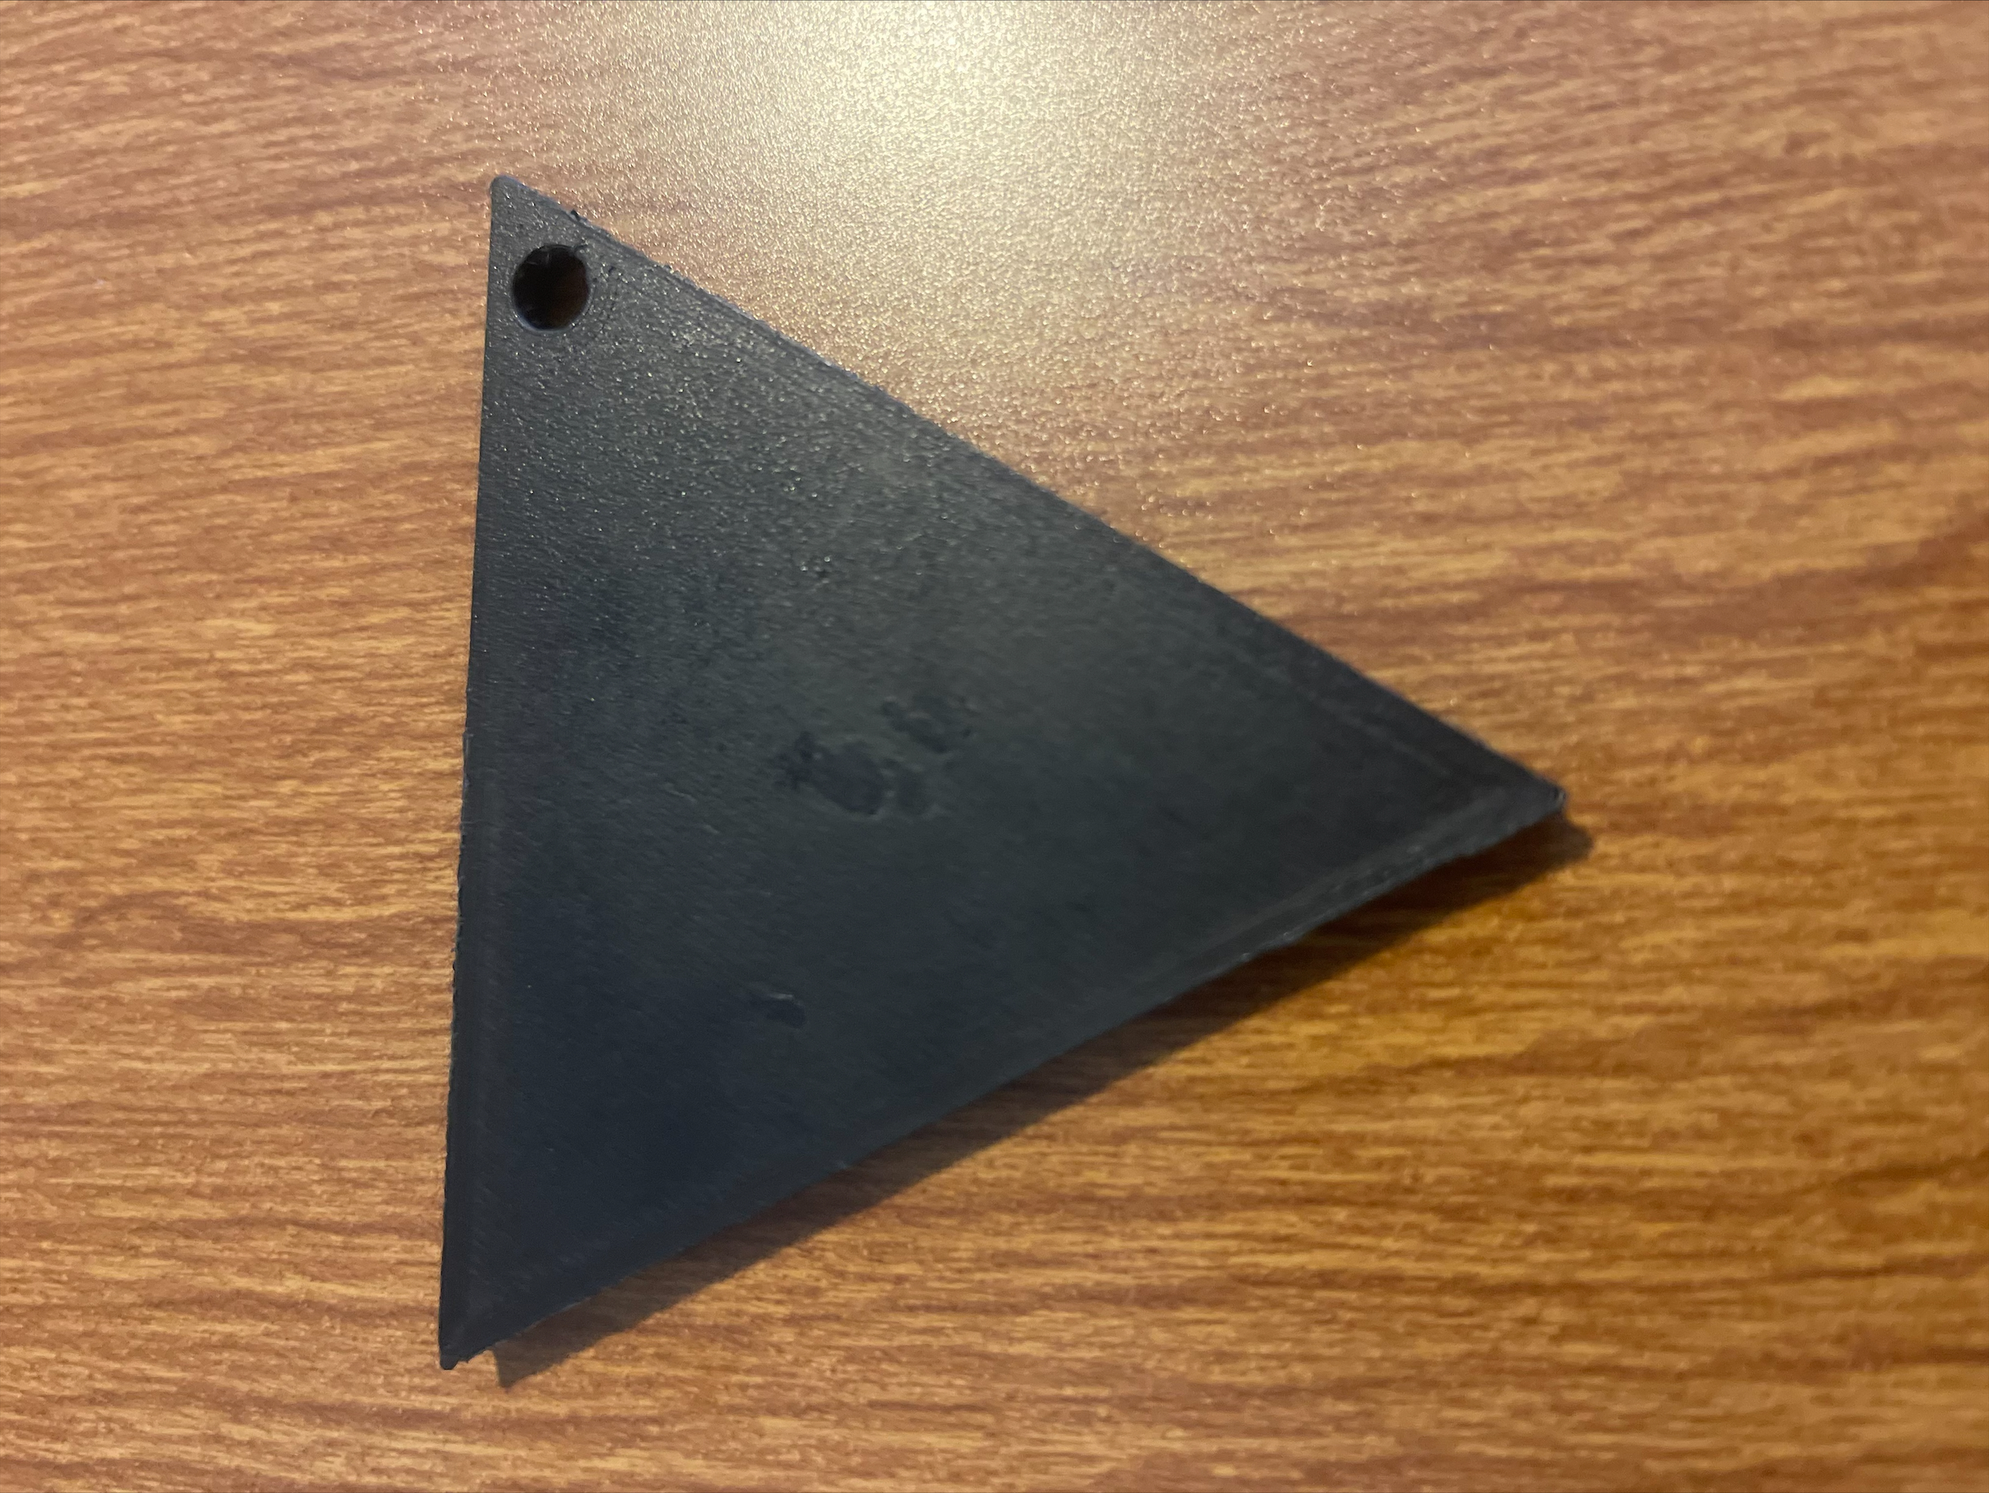
Challenges Of Housing Component CAD Design
While creating this housing component, the overall challenge that I faced was determining the placement of the scintillating crystal to ensure all visible light given off could be captured and measured.
The scintillating crystal was placed in the square holder to allow the optic fiber cable light and dark matter particles to directly hit it to create visible light.
The 3D printed washer is to be placed in the center of the component in front of the crystal to restrict its movement.
The 3D shutter is to be placed over the opening of the washer to allow or block the visible light coming from the crystal to reach the CCD.
Figure 12: This is the 3D printed washer.
Figure 13: This is the 3D printed rotating shutter.

Slide 11
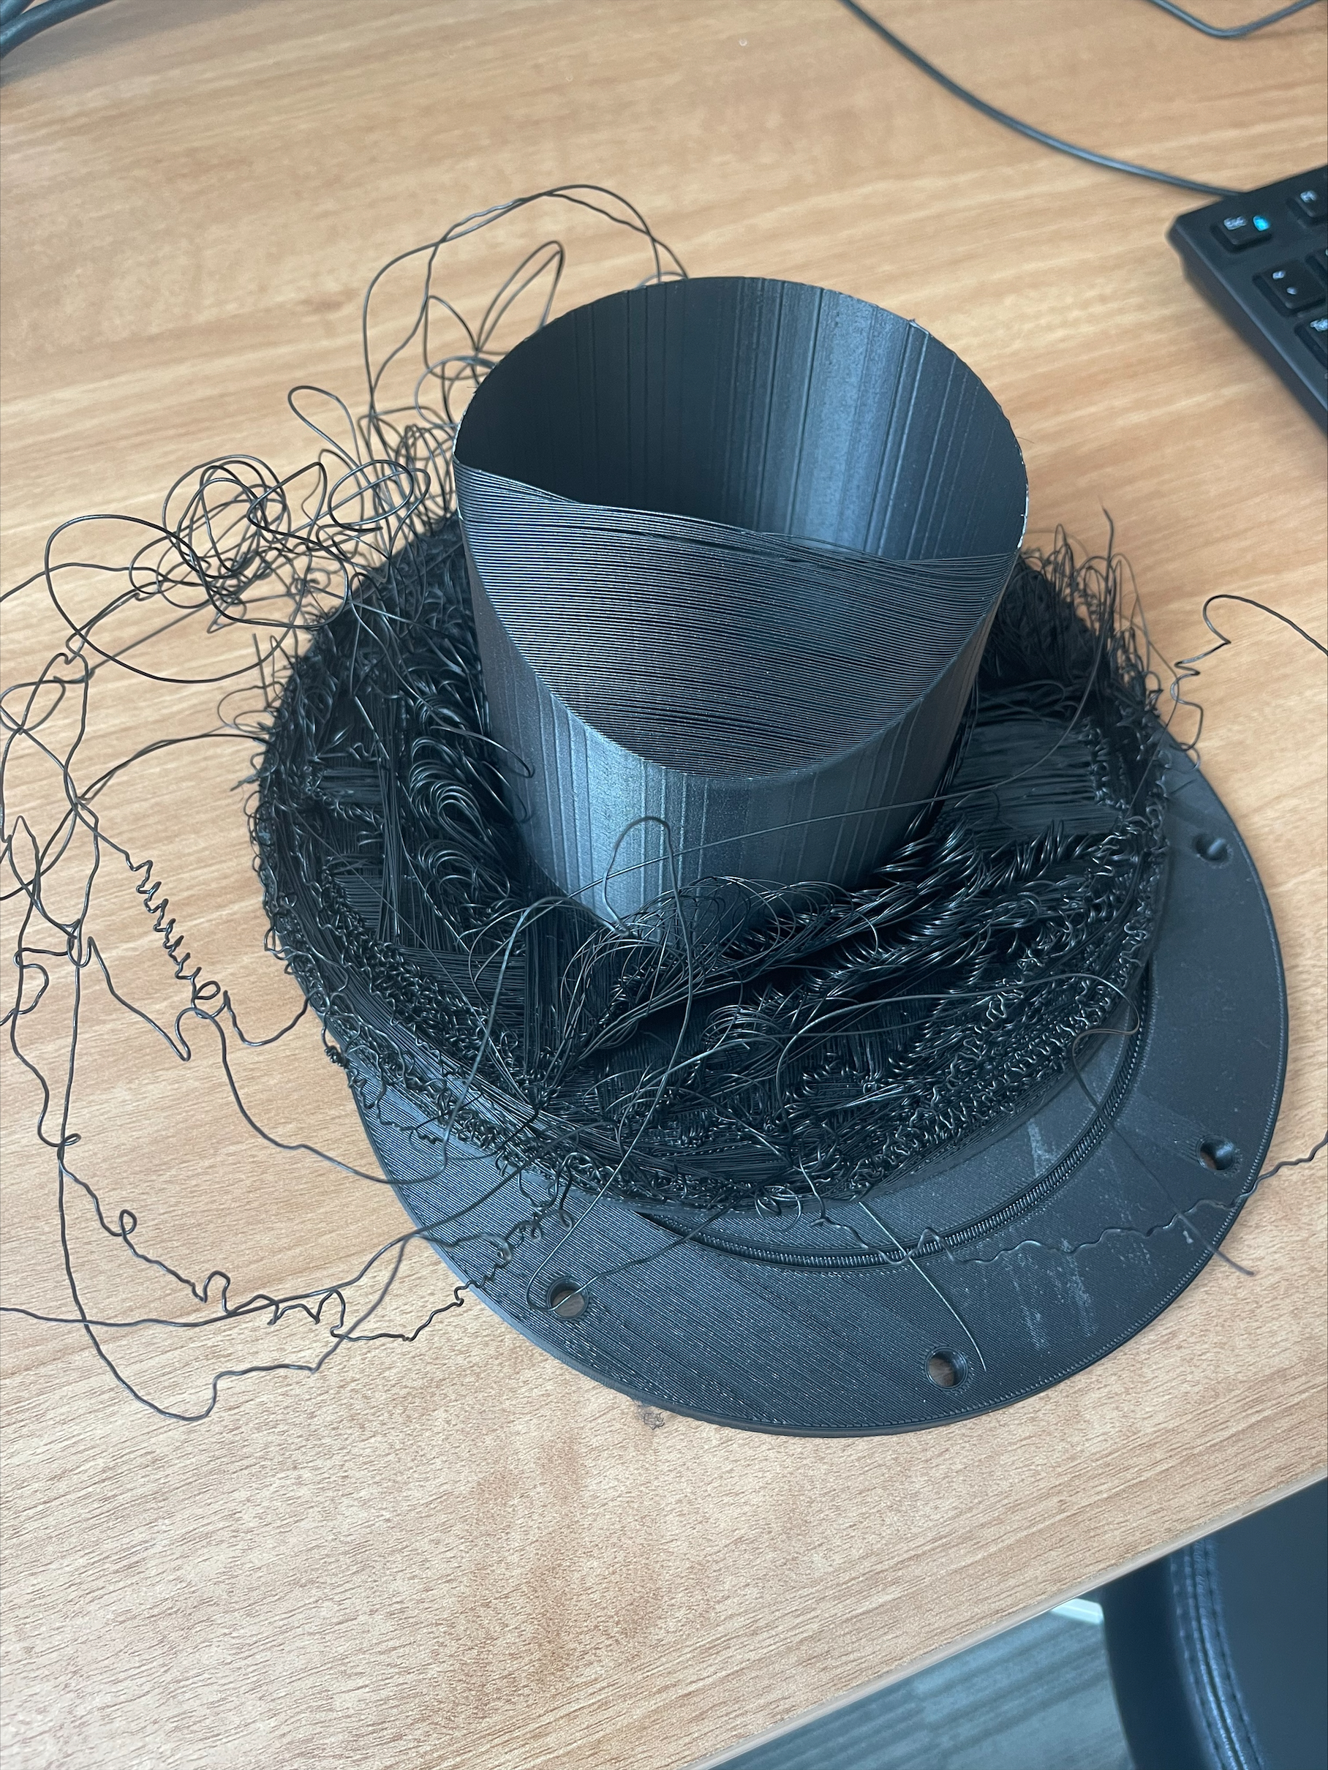
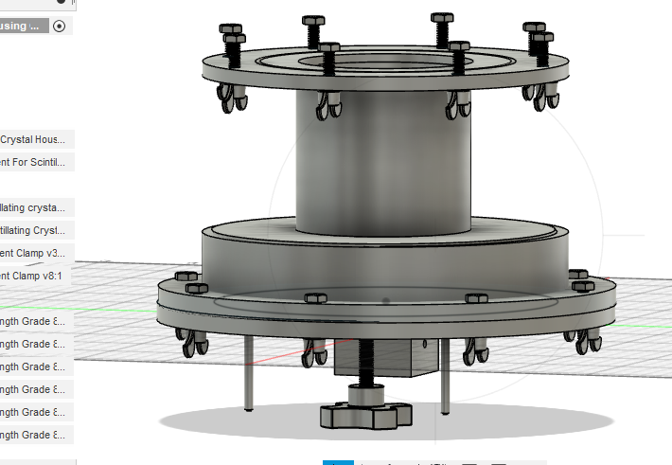
Housing Component CAD Design
How It Works
For this research project, we were able to produce a machine with the ability to capture and calibrate small amounts of energy emitted from the scintillating crystal. The crystal is to be placed in the square holder that is connected to the bottom of the component. The shutter mechanism in the component can be rotated to allow and prevent light from hitting the CCD. The dark matter particles traveling through the laboratory are supposed to hit the scintillating crystal which will then convert the dark matter energy into visible light that can be measured. Scintillating crystals could eventually be used to measure the daily or annual modulation of dark matter collisions.
Figure 14: This is the failed 3D print of the housing component.
Figure 11: This is the complete 3D CAD design of the scintillating crystal housing component.

Slide 12
Acknowledgments
I would like to thank SIST committee for giving me the opportunity to complete my first internship. I deeply appreciate all the help given from those I contacted for assistance, I’m glad that you helped and encouraged my growth as a scientist and developer. I also want to thank my supervisors Alex, Dan, and Edgar for their assistance and advice with this project. Even though the internship was virtual, I still had an amazing experience and I hope I will get the chance to experience being on site everyday in the near future.

Slide 13
References
What is a charge-coupled device (CCD)? (techtarget.com)
Scintillation Crystals for X-Ray, Gamma Ray & Neutron Detection | Dynasil (hilger-crystals.co.uk)
What Is Dark Matter? An Astrophysicist Explains | Edge Of Knowledge | Ars Technica - YouTube
Bullet Cluster: Direct Proof of Dark Matter (harvard.edu)
[1605.04909] A History of Dark Matter (arxiv.org)
SENSEI (sensei-skipper.github.io)
[2103.08601] Dark Matter Daily Modulation With Anisotropic Organic Crystals (arxiv.org)

