Slide 1
650 MHz Coupler Test Stand Redesign
Brayden Bahnke
Mechanical Engineering, University of Alaska--Fairbanks
Supervisor: Josh Helsper
Final Presentation
August 8, 2022

Slide 2
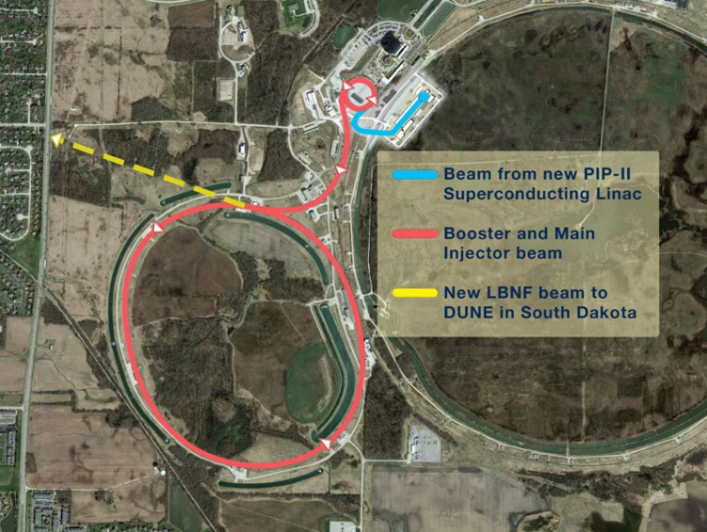
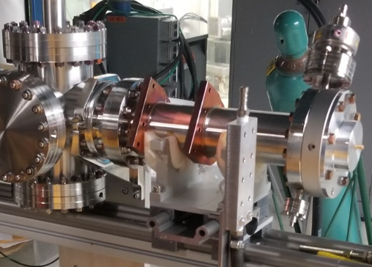
Background
PIP-II
Cryomodule
Couplers
Each coupler tested before install
Radio Frequency Performance
Plan for PIP-II to supply neutrino beam to LBNF/DUNE
Coupler mounted to test cavity assembly

Slide 3
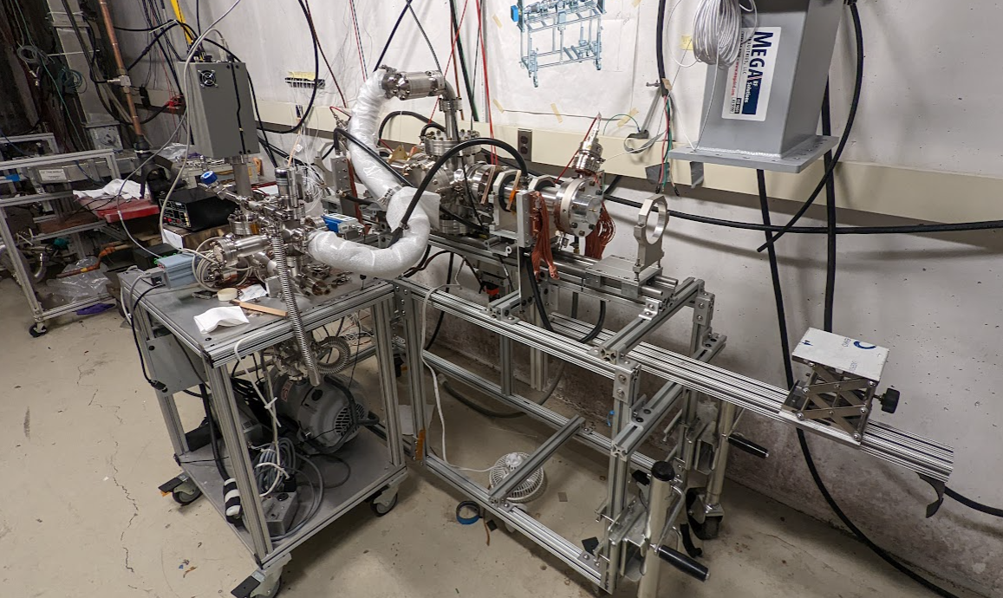
Purpose
Test Stand Shortcomings
Increased testing load
Goals:
Save Time
Equipment
Reduce Risks
Current Test Stand in use with hastily sketched air side components in red and blue arrows indicating their attachment points

Slide 4
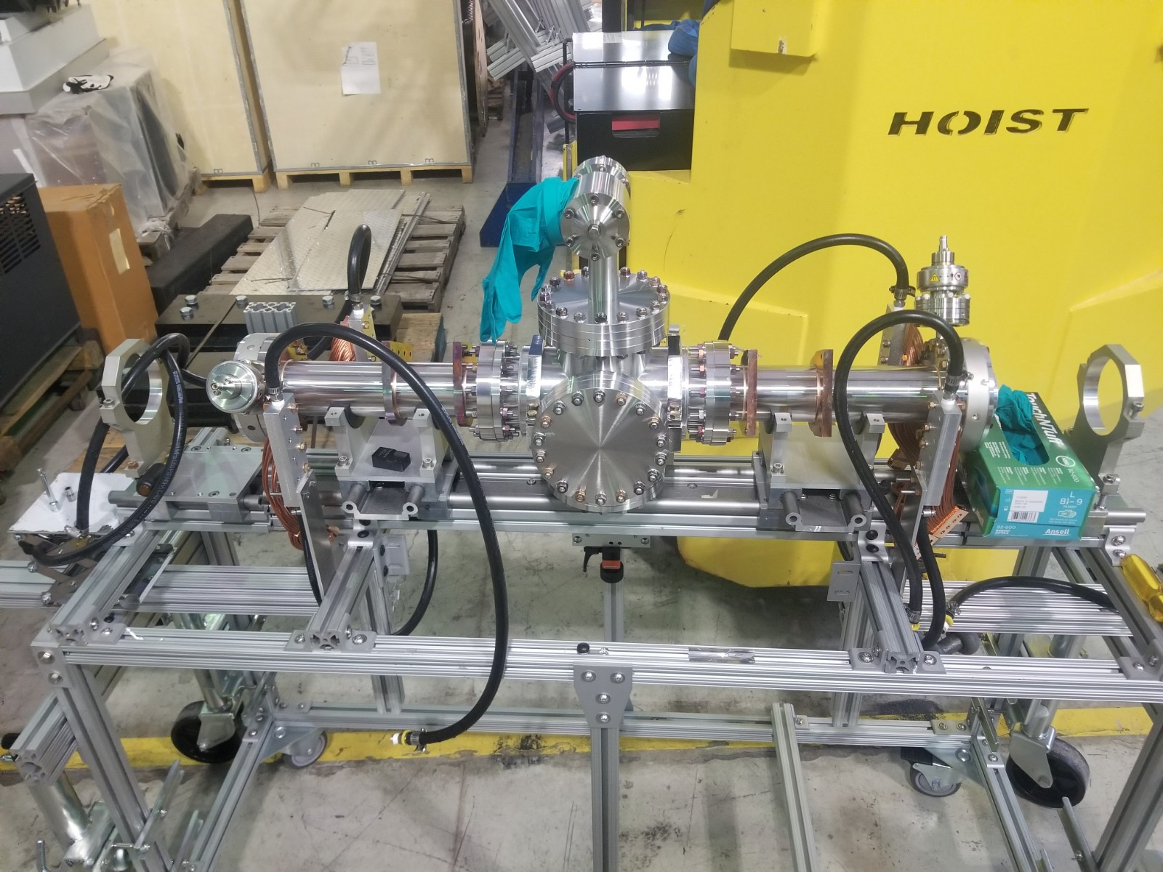
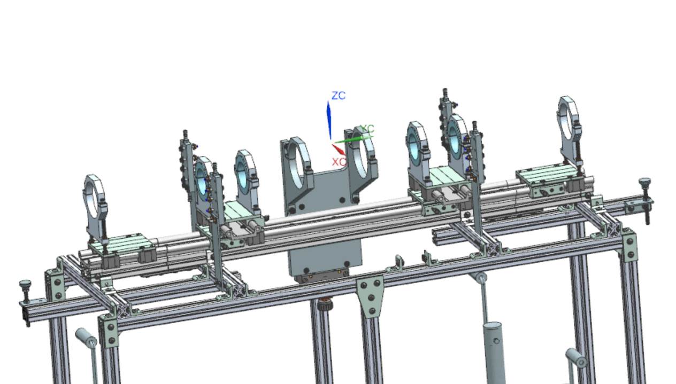
Shortcomings
Difficult to assemble
Labor intensive
Lack of axial deviation compensation
Components added post-design
Photo of test stand with vacuum assembly installed (above)
CAD model of test stand (left)

Slide 5
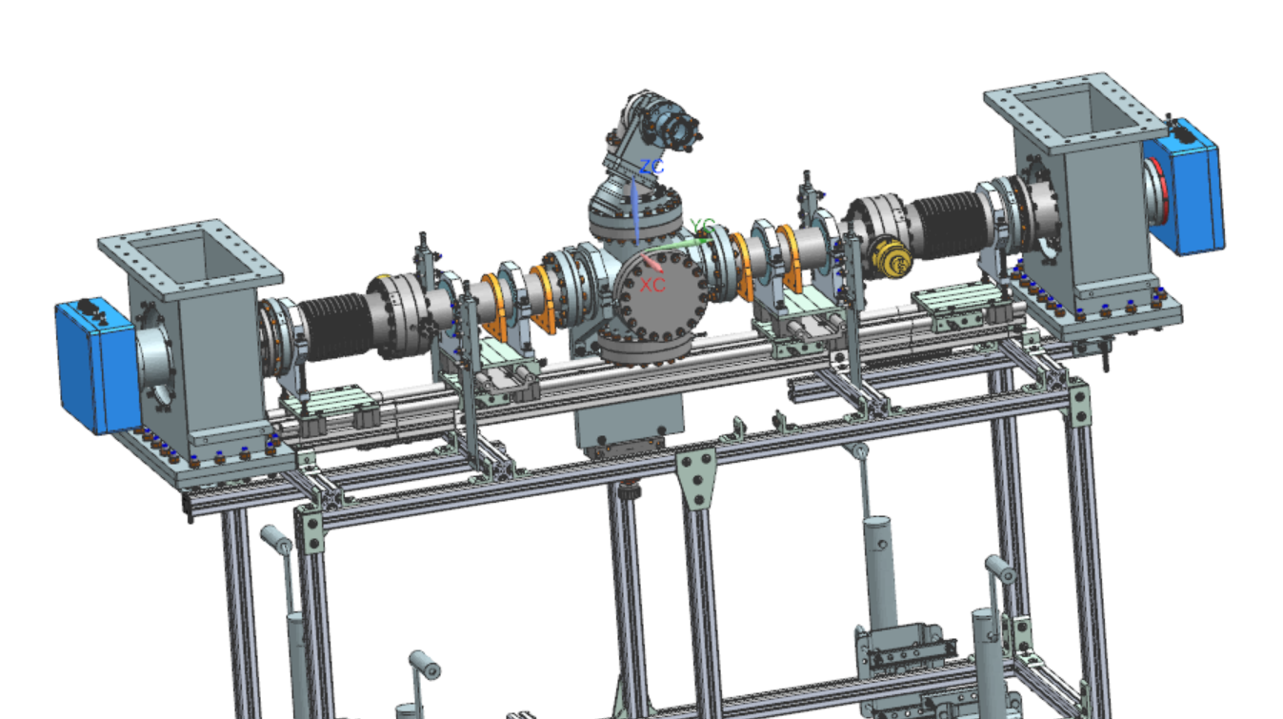
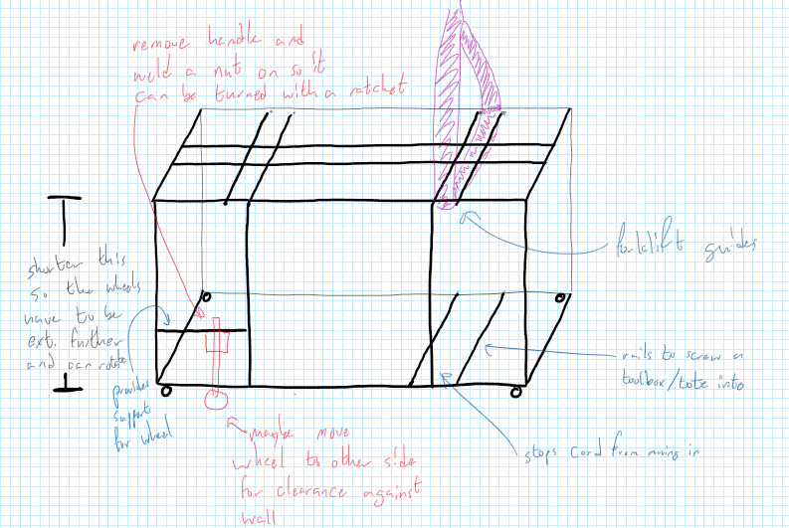
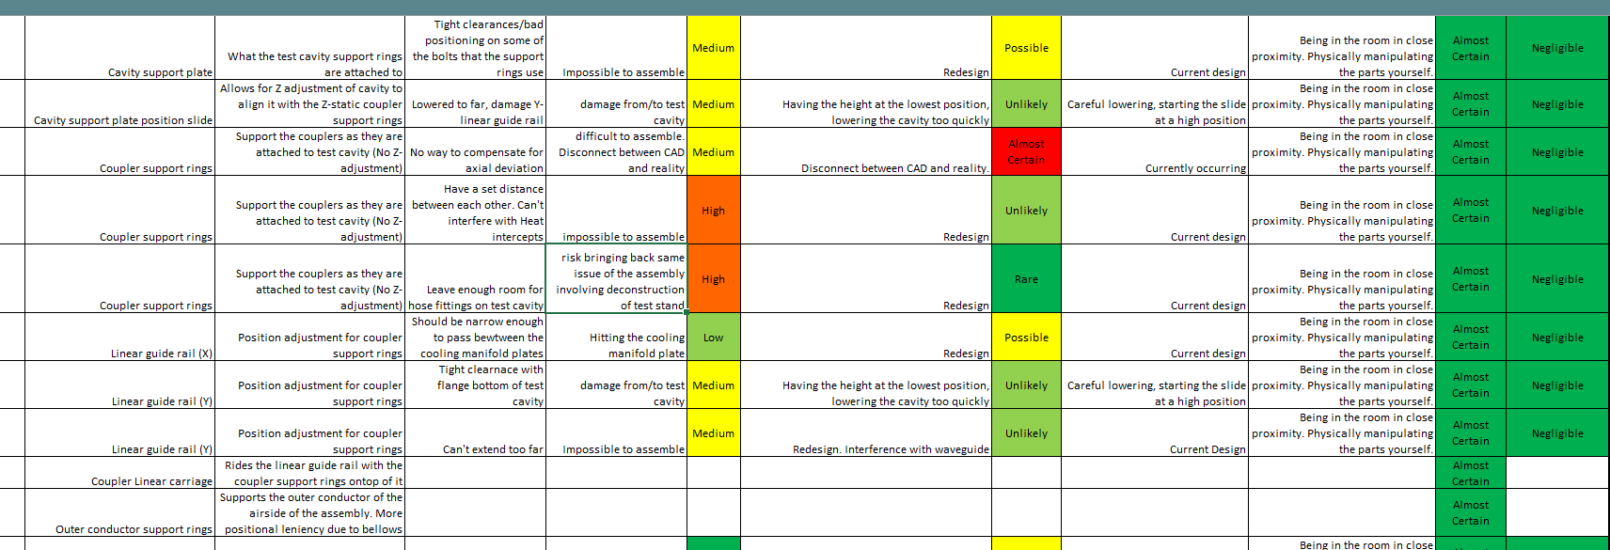
Methods
User Feedback
Failure Mode Effects Analysis
Design
Process
Brainstorming
Other Coupler Stands
3 designs for each mechanism
Teamcenter and NX
NX Master model of the test stand with coupler highlighted
A rough sketch done during the brainstorming phase
A small portion of the FMEA

Slide 6
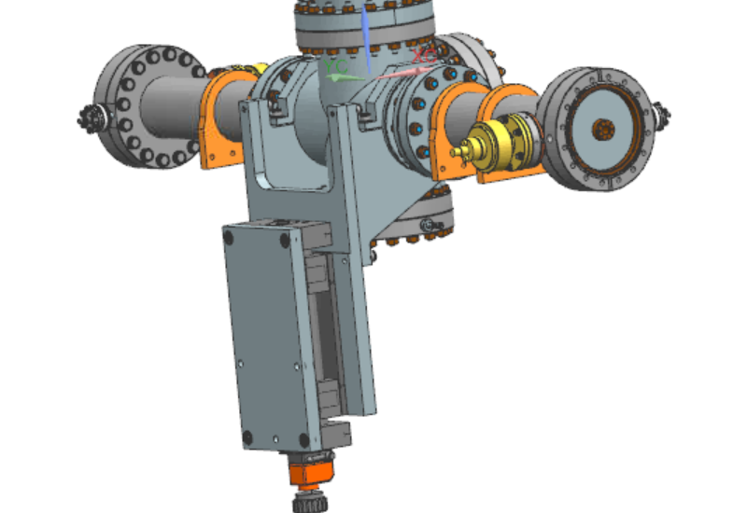
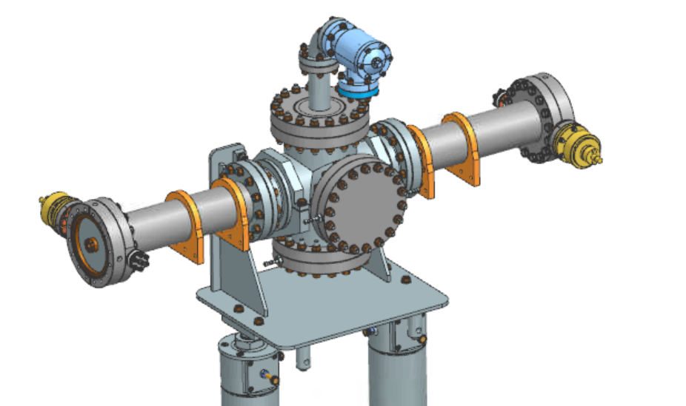
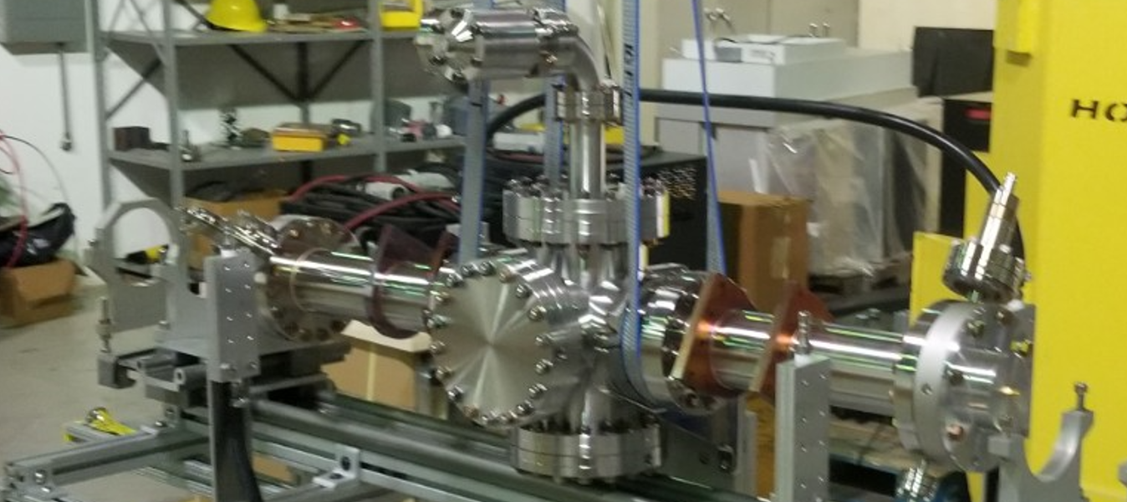
Former Test Cavity Mechanism
Difficult to mount to test stand
Tight clearances
Left: Former Test Cavity Assembly Test Stand Mounting Mechanism
Below: Test Cavity Assembly being lowered onto the test stand
Former Test Cavity Assembly Clean Room Stand Mounting Mechanism

Slide 7
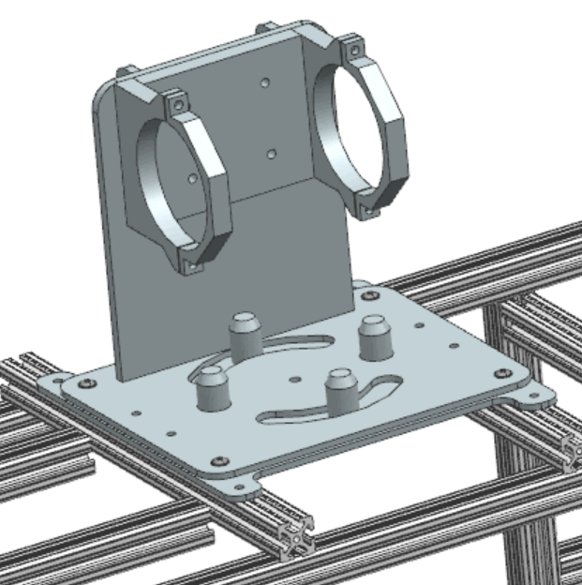
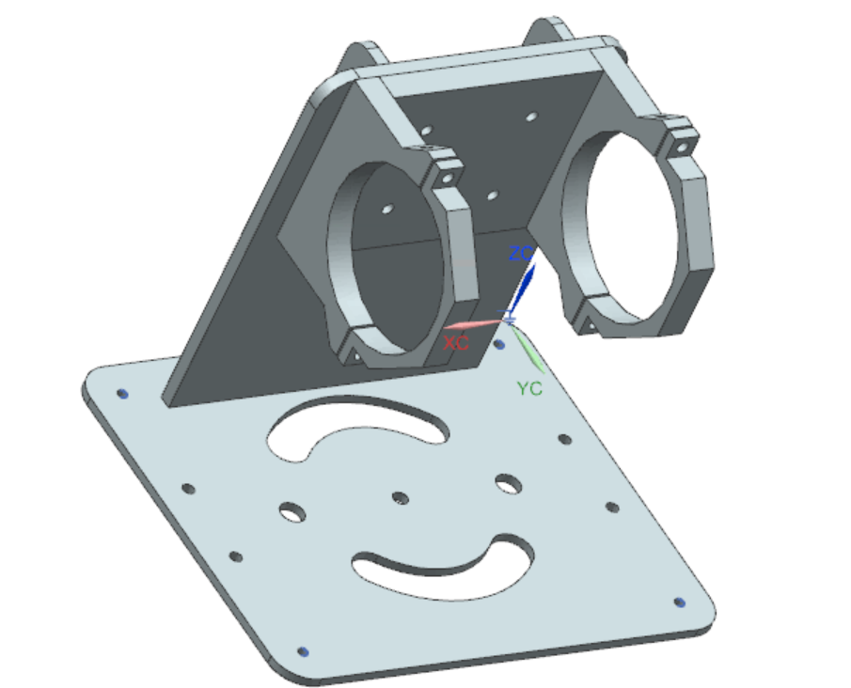
Redesigned Test Cavity Mechanism
Mobile Test Stand
Semi-Permanent Bracket
Pin guides
Pitch Adjusters
Redesigned Test Cavity Assembly Mounting Mechanism
Redesigned Test Cavity Assembly Mounting Mechanism

Slide 8
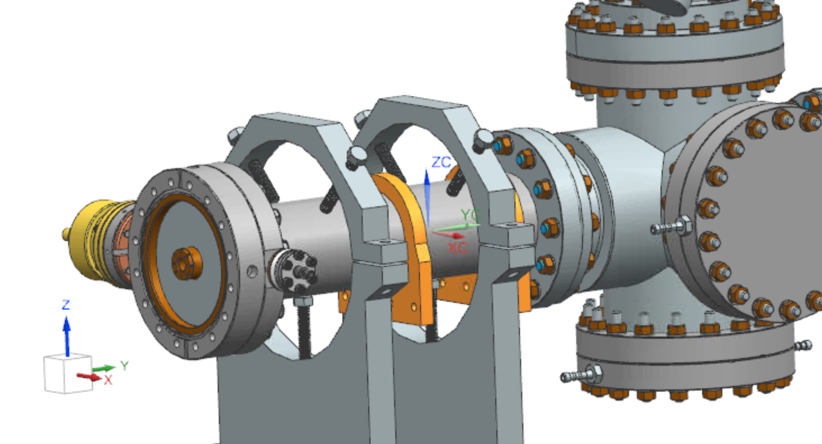
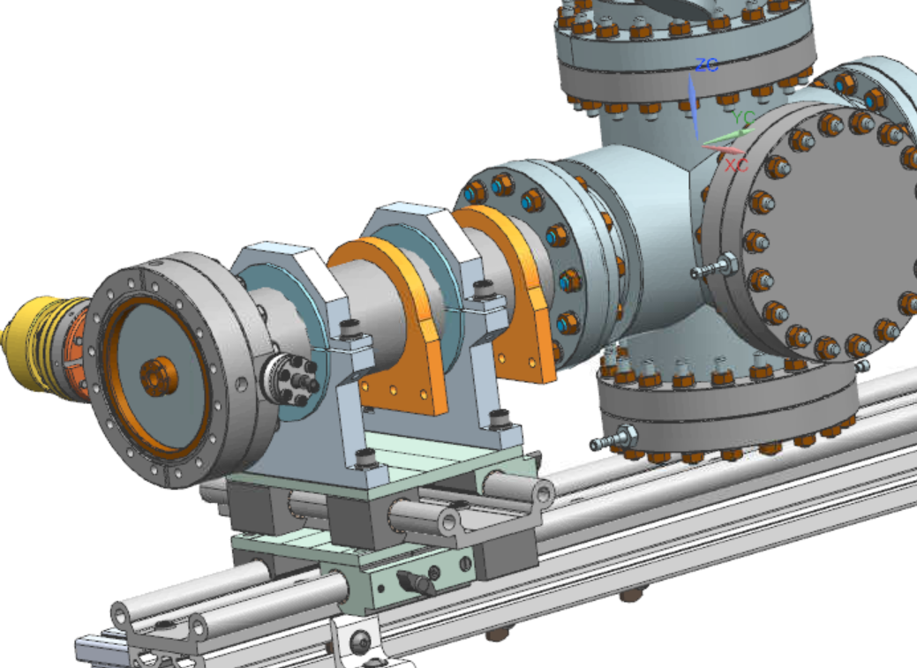
Coupler Supports
Holder Bolts
8020 Linear Rail
Former Coupler Supports
Redesigned Coupler Support

Slide 9
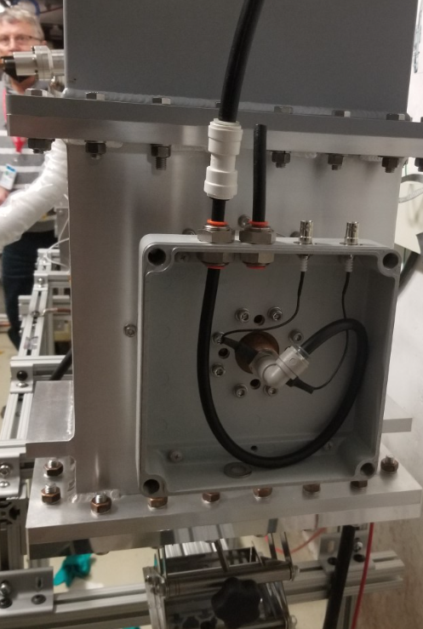
Waveguide Support
Linear movement
Inner conductor
Height Adjustment
Air Side Outer Conductor Support
Bellow Brackets
Waveguide support as it is currently
Redesigned Waveguide Support

Slide 10
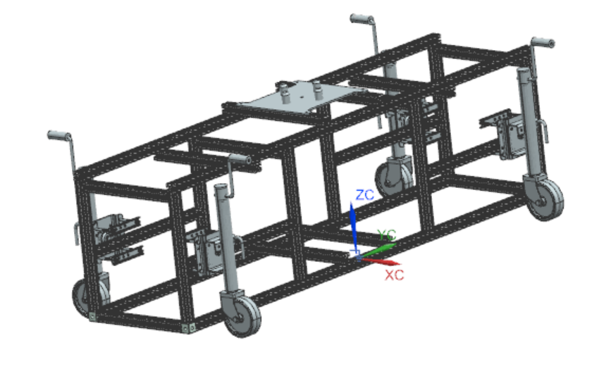
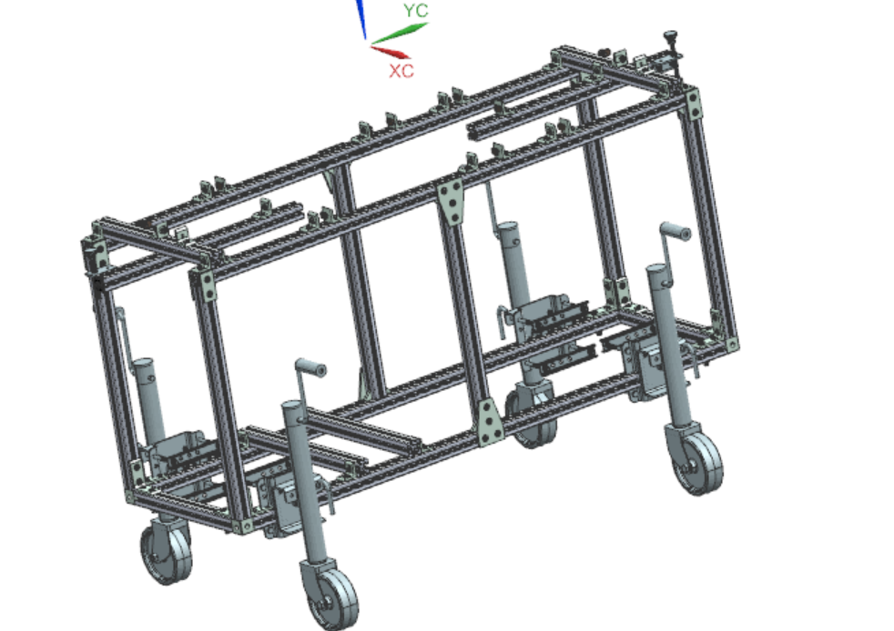
Mobility Changes
Wheel height/rotation
Castors
Forklift guides
Strap guides
Former Test Stand.
Redesigned Test Stand

Slide 11
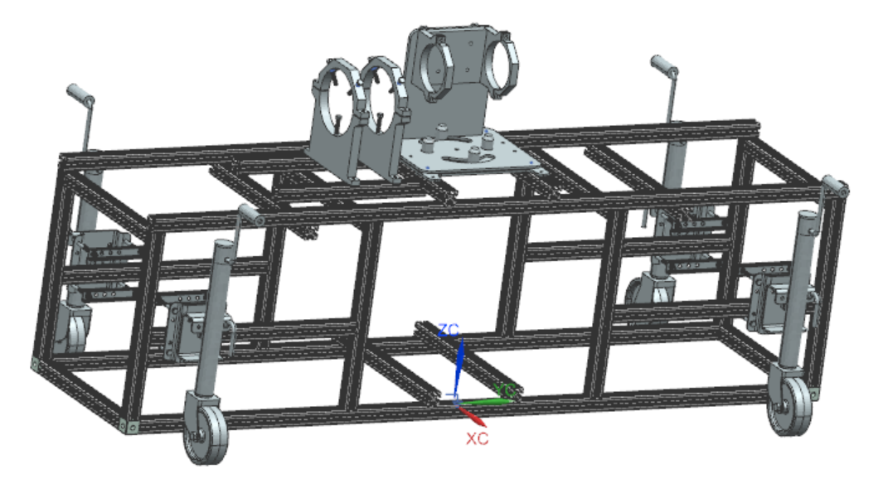
Remaining Work
Drafting
Final Design Review
Procurement of Materials
Production
Use
Current state of the test stand assembly

Slide 12
Thank you
Josh Helsper (Supervisor)
Carrie McGivern (Mentor), Donovan Tooke (Mentor), and the members of Group 2
SIST Committee

