Slide 1
Cluster Cosmology
Ebtihal M. Abdelaziz
Supervisor: Jim Annis
SIST Final Presentation
8/8/2022

Slide 2
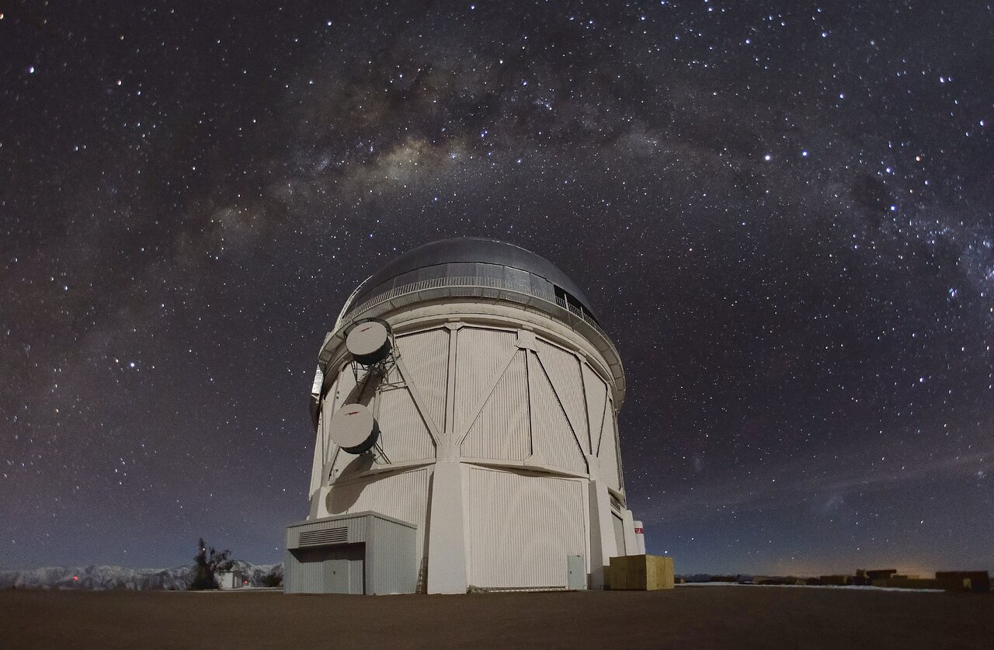
The Dark Energy Survey (DES)
Aims to explore the nature of dark matter and dark energy of the universe.
Relies on the 4-meter Blanco telescope in Chile for its data collection.
Collects optical images of clusters and galaxies to constrain cosmological parameters.
Aims to explore the nature of dark matter and dark energy of the universe.
Relies on the 4-meter Blanco telescope in Chile for its data collection.
Collects optical images of clusters and galaxies to constrain cosmological parameters.
Picture of the Blanco telescope and the southern sky including the milky way.

Slide 3
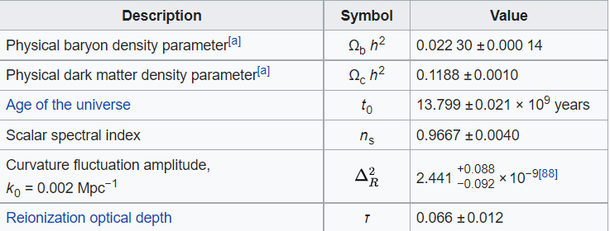
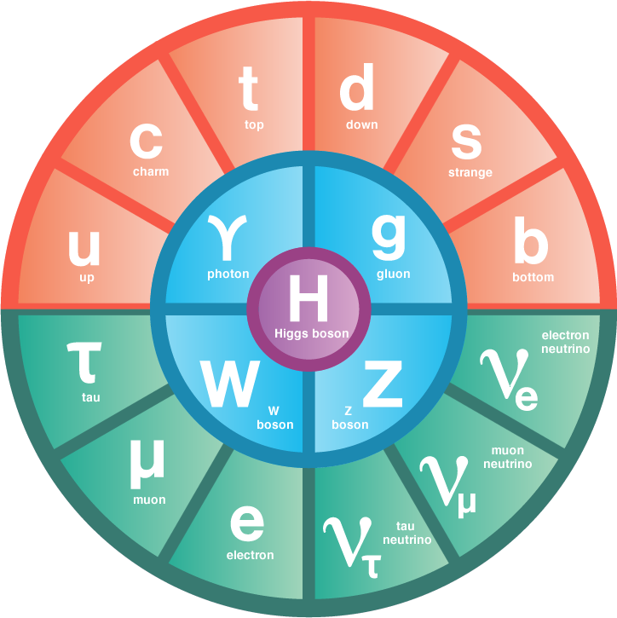
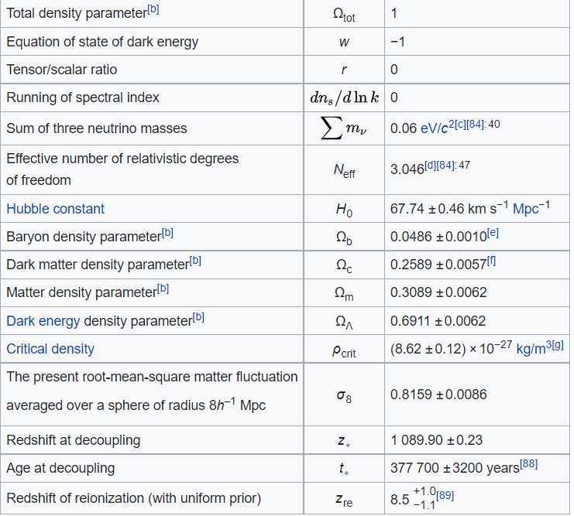
ΛCDM
Standard model of cosmology

Slide 4
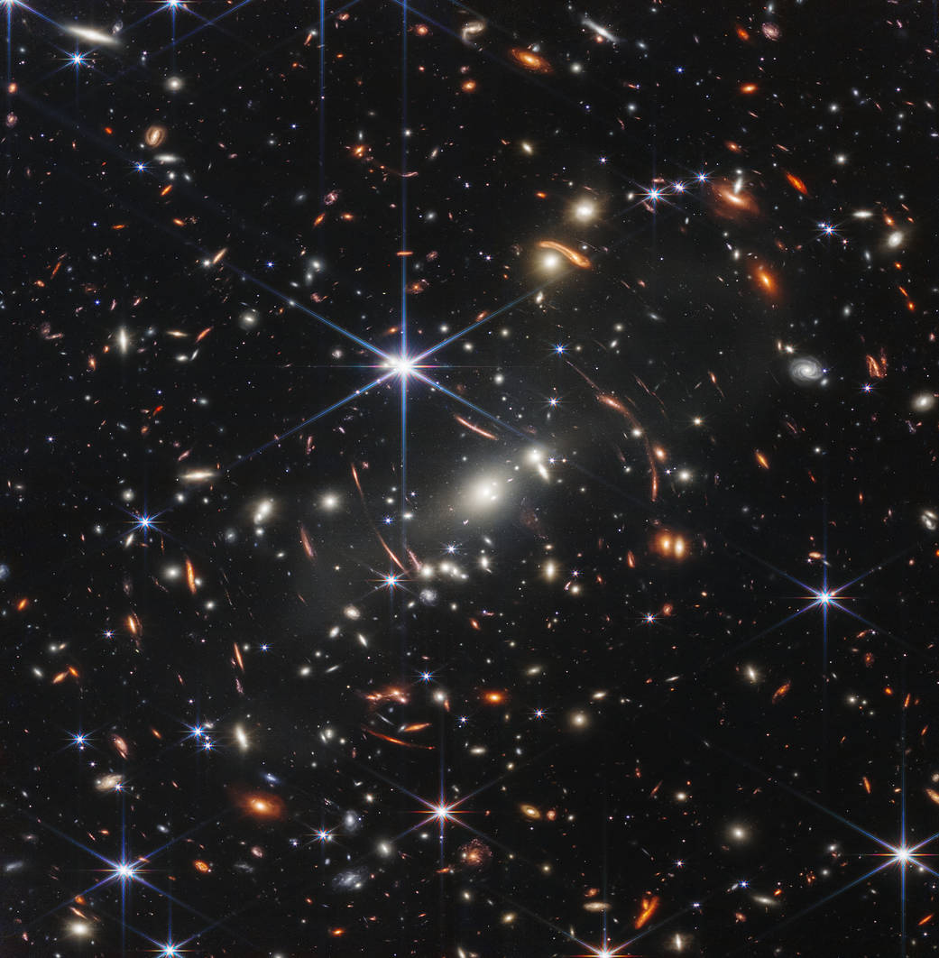
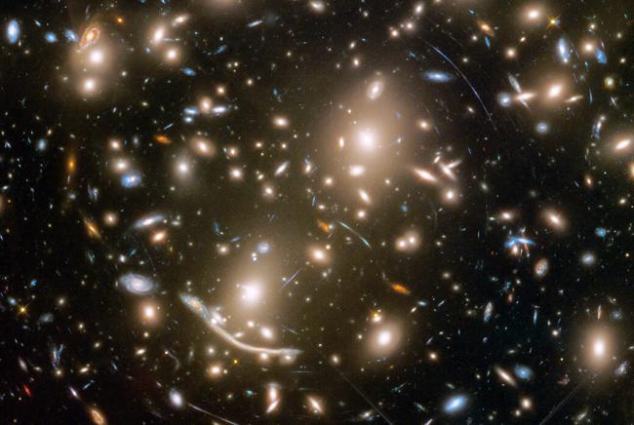
Galaxy clusters and weak lensing
Structures with the largest scale in the Universe
Measuring the mass of galaxy clusters tightly constrain the matter density parameter.
Weak lensing is used along with a mass proxy (richness) to estimate the mass of clusters.
Picture of a galaxy cluster taken by the James Webb Space Telescope.

Slide 5
Cluster Cosmology
In 2020, the DES cluster group measured $Ω_{m}=0.19.$
Table of systematics in DES Y1 from (McClintock et al. 2018)
Table of systematics in DES Y1 from (McClintock et al. 2018)

Slide 6
Computation and Boost factor model
All analysis were done on NERSC’s Perlmutter (the fifth fastest supercomputer in the world)
Used CosmoSIS (software to calculate posterior probabilities) to obtain MCMC chains.
$$ℬ\left(R\right)=\left\{\begin{aligned}1+B_{0}\frac{1−F(x))}{x^{2}−1} :x ≠1 \\ \frac{B_{0}+3}{3} :x=1\end{aligned}\right.$$
$$F\left(x\right)= \left\{\begin{aligned}\frac{\tan^{−1}{\sqrt{x^{2}−1}}}{\sqrt{x^{2}−1}} :x >1 \\ 1 :x=1 \\ \frac{\tanh^{−1}{\sqrt{1−x^{2}}}}{\sqrt{1−x^{2}}} :x<1\end{aligned}\right.$$
And $x=\frac{R}{R_{s}}$

Slide 7
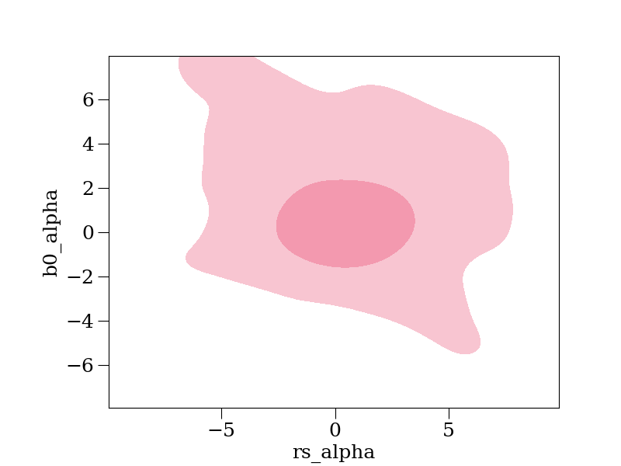
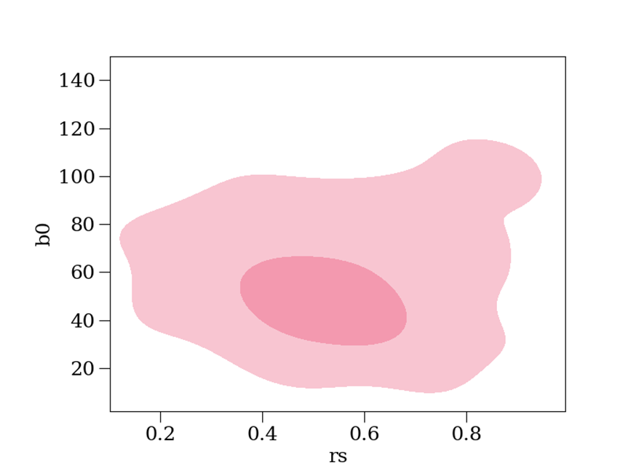
Analysis
Model for free parameters:

Slide 8
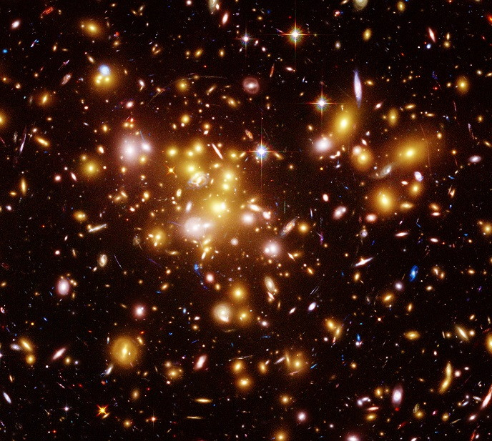
Future work
Using real cluster boost factor data.
Calculating the cosmology using real boost factor and shear data.
Eventually, my modules and results will be used for the DES Y3 cluster analysis.

Slide 9
References
Acknowledgments
I would like to thank my wonderful supervisor, Jim Annis, for all his support and encouragement this summer!
And, my mentor, Michael Geelhoed, for being an awesome mentor!
Special thanks to the SIST committee, Judy, and Mallory for bringing me for another fun educational summer!
Abbott, T. M. C., and others. "Dark Energy Survey Year 1 Results: Cosmological constraints from cluster abundances and weak lensing".Phys. Rev. D 102, no.2 (2020): 023509.
Frieman, Joshua, Michael, Turner, and Dragan, Huterer. "Dark Energy and the Accelerating Universe".Ann. Rev. Astron. Astrophys. 46 (2008): 385–432.
Costanzi, Matteo, Francisco, Villaescusa-Navarro, Matteo, Viel, Jun-Qing, Xia, Stefano, Borgani, Emanuele, Castorina, and Emiliano, Sefusatti. "Cosmology with massive neutrinos III: the halo mass function and an application to galaxy clusters".JCAP 12 (2013): 012.
Thank you! ☺

