Slide 1
Gravity Offload Tool for PIP-II
Lilly Herbst
Supervisor: Curtis Baffes
Final Talk
9 August 2022

Slide 2
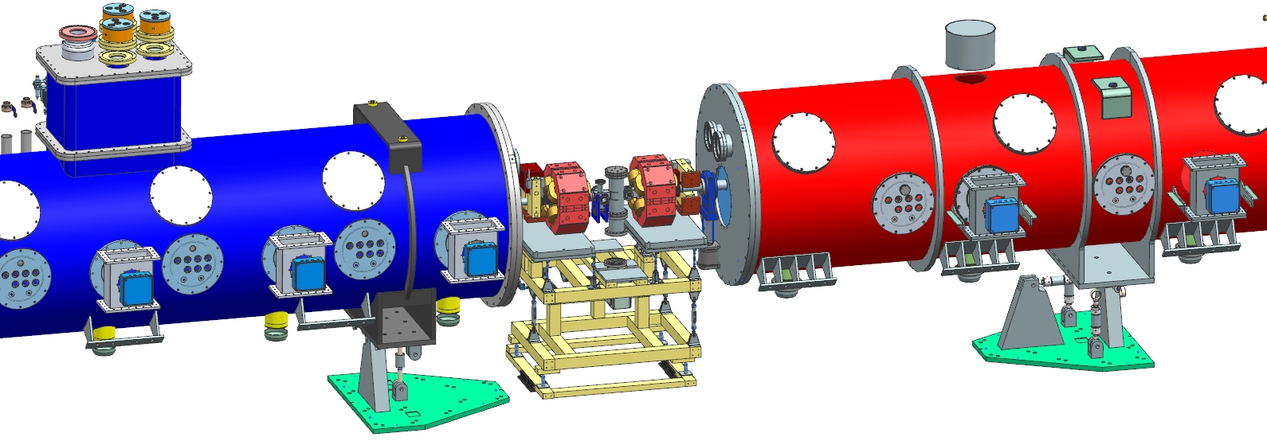
PIP-II Project
PIP-II will enable the world’s most intense beam of neutrinos to the international LBNF/DUNE project, and a broad physics research program, powering new discoveries for decades to come.

Slide 3
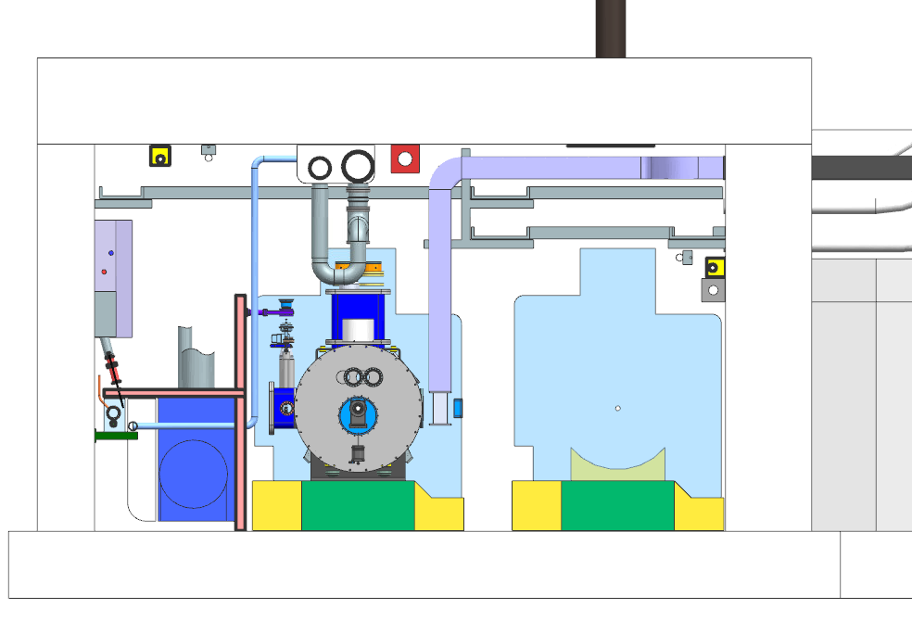
PIP-II Project
Beamline
Aisle
Notes:
Cryomodule tunnel transportation system that’s being designed that will eventually get the cryomodules to the beamline location. There are currently a lot of restrictions in these areas, so a crane is not possible

Slide 4
Offloader Compliance
Cryomodule is 30,000 lbs
Range for spring constant: 5,000-10,000 lbs/in
Notes:
Cryomodule tunnel transportation system that’s being designed that will eventually get the cryomodules to the beamline location. There are currently a lot of restrictions in these areas, so a crane is not possible

Slide 5
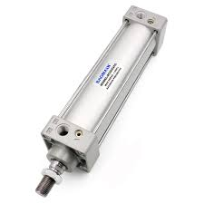
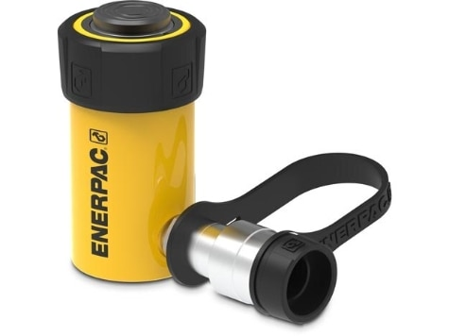
Primary Concept Ideas
Both the pneumatic and hydraulic cylinder would be primary options for the gravity offload tool as they are easy to adjust with different types of pumps.
Pneumatic Cylinder
Hydraulic Cylinder
Notes:
Both easy to adjust with different types of pumps. With that, we need to find their spring constant to see which is more ideal

Slide 6
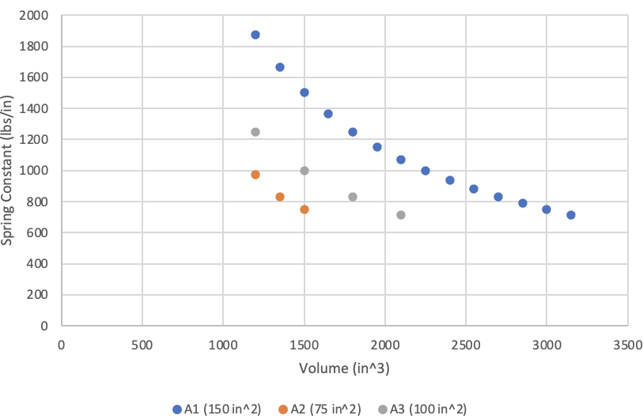
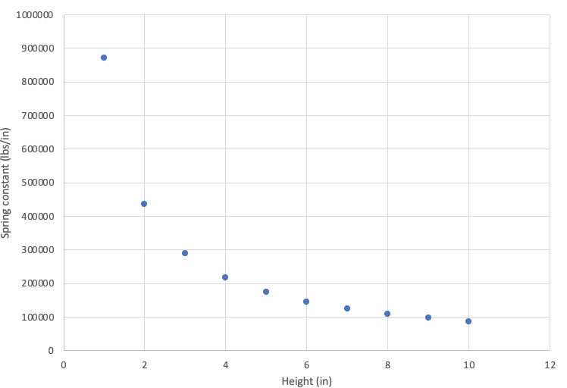
Pneumatic vs Hydraulic Spring Constants
Pneumatic Spring Constants for Different Areas vs Volume
Hydraulic Spring Constants vs Height
Notes:
The pneumatic spring constants ended up being between 800-2000 lbs/in. the hydraulilc spring constants varied from 100,000-900,000 lbs/in. pretty big difference.

Slide 7
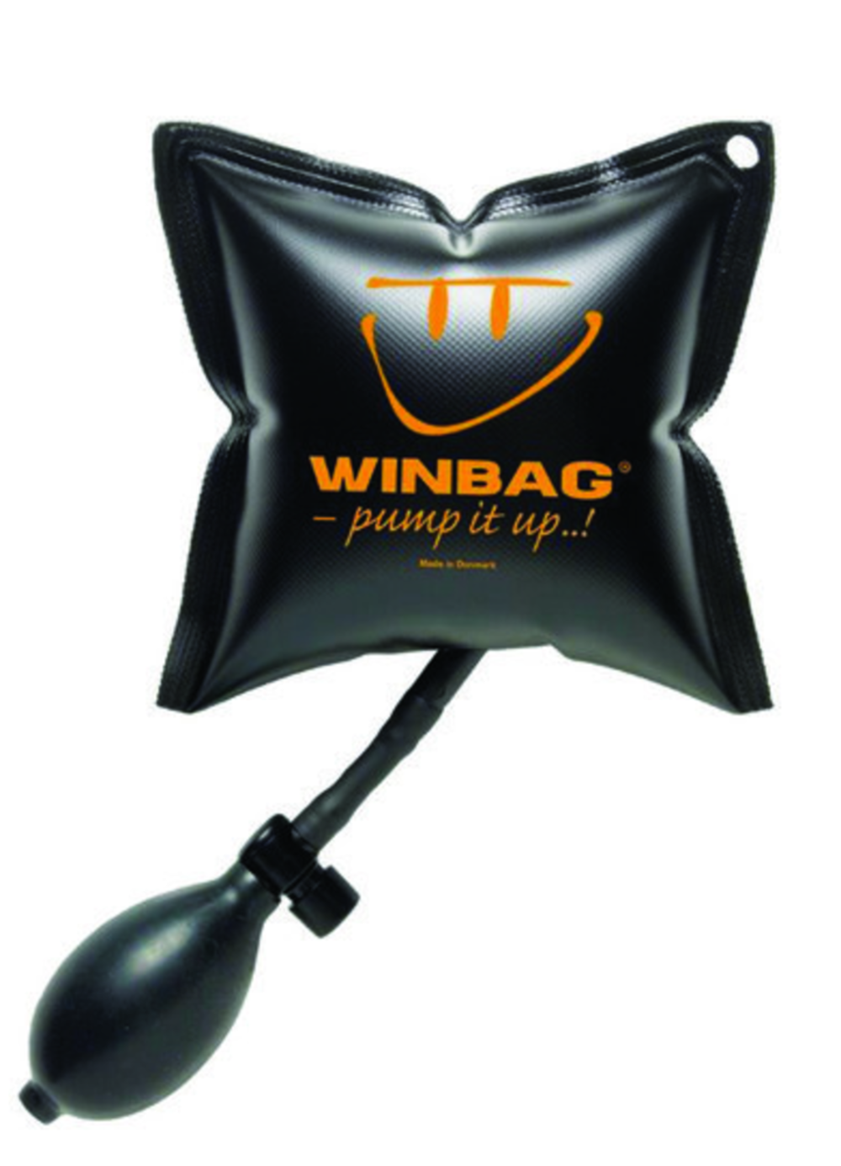
Secondary Concept Ideas
These options are also valuable but are not as easy to adjust or remove from a tight space.
Compression Spring
Disc Spring
Inflatable Wedge
Notes:
These are also valuable options we are considering, but are not as easy to adjust or remove from a tight space. It may be useful to make a combined primary and secondary gravity offload tool in order for the spring constant and adjustability to be ideal

Slide 8
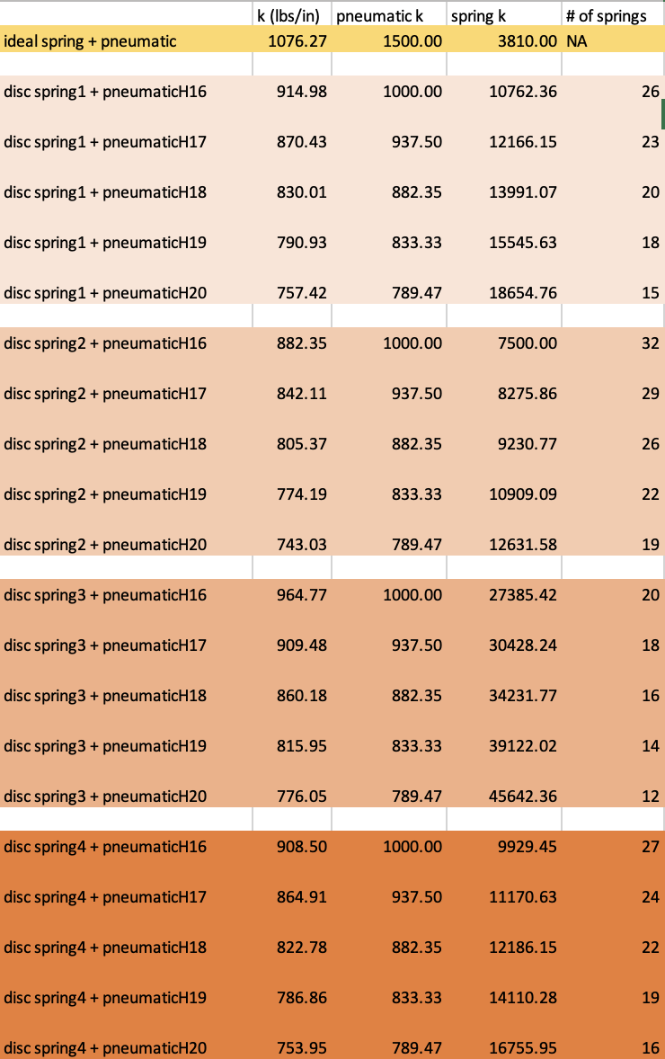
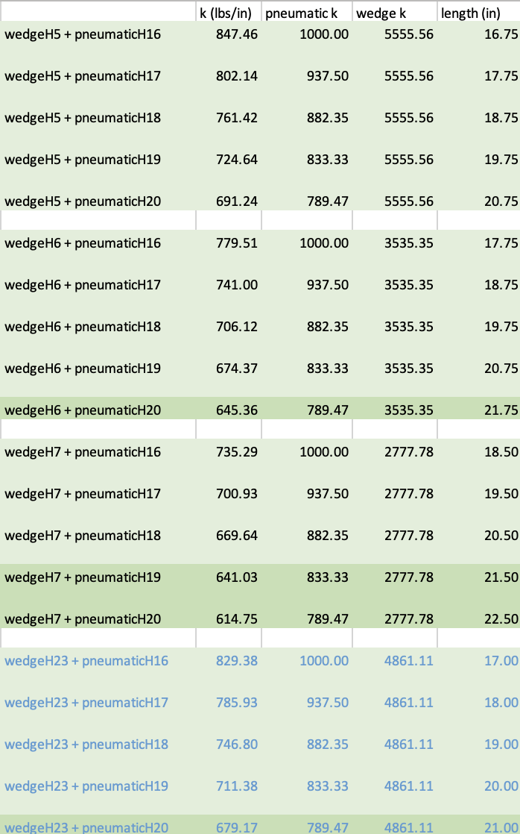
Pneumatic Concepts & Combined Spring Constants
Pneumatic + Disc Spring
Pneumatic + Inflatable Wedge
Notes:
With that in mind, we separately calculated the constants compression spring, disc spring, and inflatable wedge. We combined each type with the pneumatic spring constants to see if a combination would alter the spring constant. As you can see, the pneumatic cylinder is actually softer than each of these secondary options. This means that the combined spring constant will essentially be less than both the primary and secondary spring constant, and that is not ideal.

Slide 9
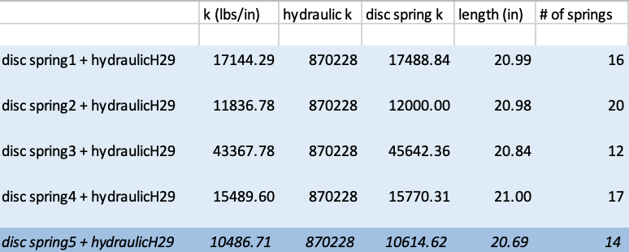
Hydraulic Concepts & Combined Spring Constants
Hydraulic + Disc Spring
Notes:
However, the hydraulic cylinder is much stiffer, which leads to the disc spring overtaking the combined spring constant.
POSSIBLE QUESTION: why not just use disc springs if it’s a great spring constant?: this spring constant for the disc spring would not be correct as the number of disc springs used helps determine what the spring constant will be. The length would be too short if we were to use 14 disc springs, and if we were to just use disc springs, the spring constant would be different. We would also have to figure out a way to place and remove those disc springs and how they would hold together, and how to compress or decompress them.

Slide 10
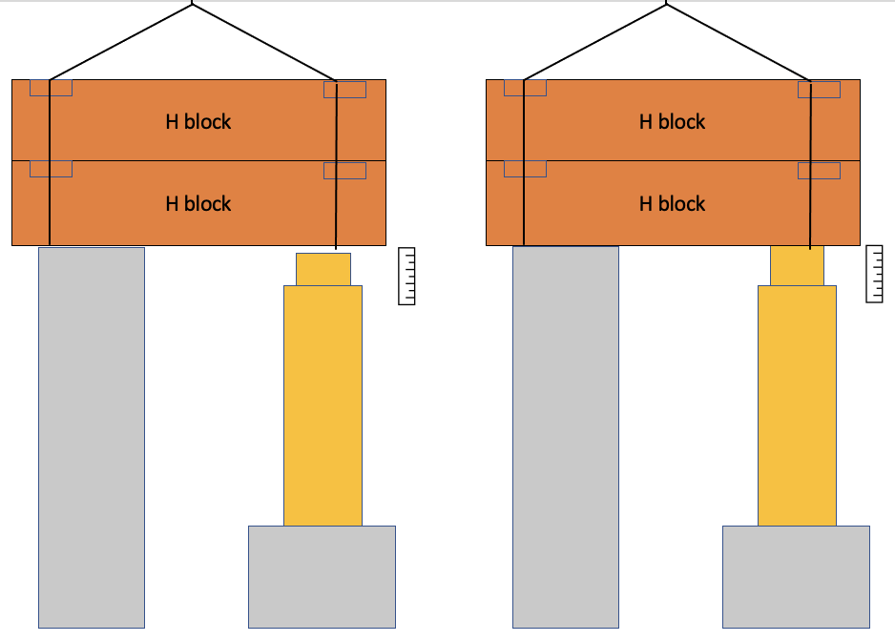
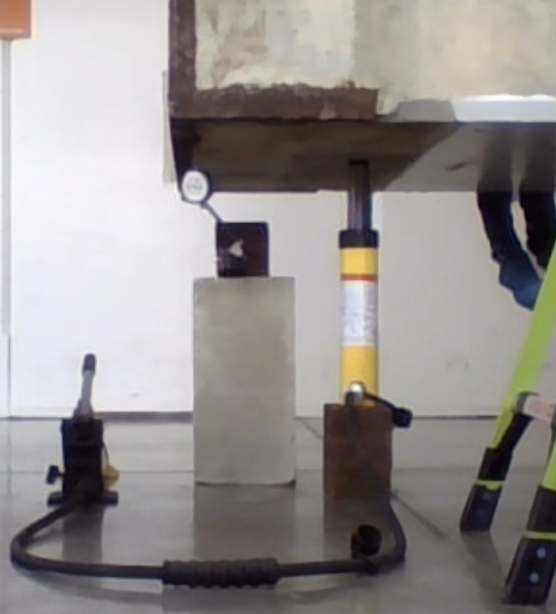
Hydraulic Test
Potential Hydraulic Test Diagram
Enerpac RC158 Hydraulic Test at Fermilab
Notes:
To confirm the spring constant of the hydraulic cylinder, we conducted a test at Fermilab with the Enerpac RC158 hydraulic and 2 H blocks. On one side, the H blocks would sit on a rigid body, and on the other side would be the hydraulic cylinder and another rigid body. At first, the load was being carried by a crane that lifted the H blocks. We then released the crane and had the hydraulic cylinder extend until it would carry the whole load of both H blocks. We ended up getting data such as the deflection and stroke, which let us calculate the spring constant of that hydraulic cylinder.

Slide 11
Hydraulic Test
18 ft
$$\frac{w_{H}}{∂}=k$$
H block
1.5 ft
$w_{H}=$ weight of 1 H-block
$∂=$deflection
$k=$ spring constant
12,000 lbs

Slide 12
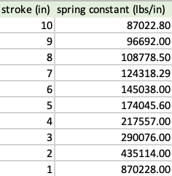
Hydraulic Concepts & Combined Spring Constants
Hydraulic + Disc Spring
Results from Calculations vs Hydraulic Test
Notes:
We found that the hydraulic spring constant was actually less by a fact of 3 than what we calculated. The light green is what we calculated the hydraulic cylinder’s spring constant would be if it was 5 inches vs 4 inches (going down).

Slide 13
Hydraulic Concepts & Combined Spring Constants
Hydraulic + Disc Spring
Results from Calculations vs Hydraulic Test
Final Hydraulic + Disc Spring Calculations
Notes:
Here is the final calculations with the tested spring constant, bringing it down to 9000 lbs/in

Slide 14
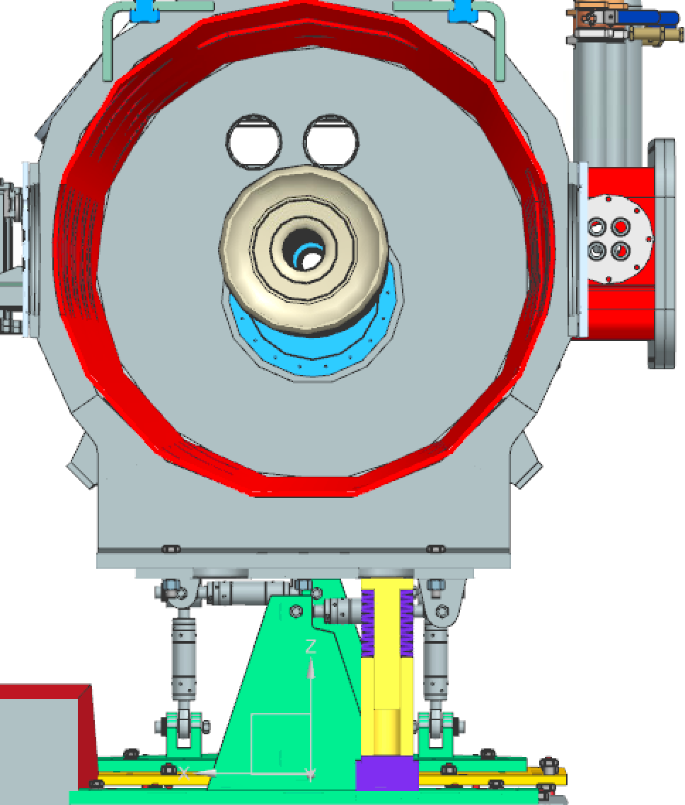
Conceptual Design
SCL101TB Enerpac
3.47 in hydraulic cylinder
14 Belleville disc springs
“Plunger”
NX 3D CAD Model of the Hydraulic Cylinder + Disc Spring System
Notes:
The final design will be a 3.47 in hydraulic cylinder that has a stroke of 1.5 in.and we will also have 14 Belleville disc springs. The Gravity Offload Tool will be placed in the _____ under the cryomodule.

Slide 15
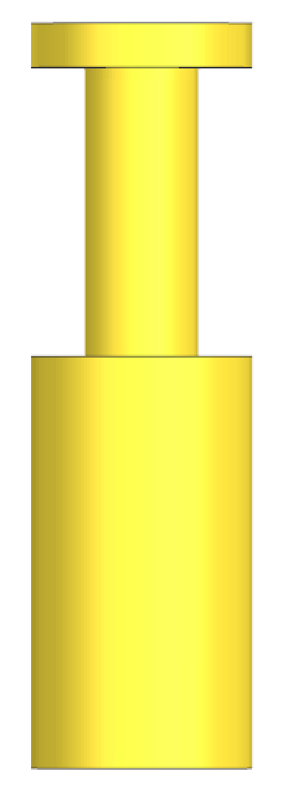
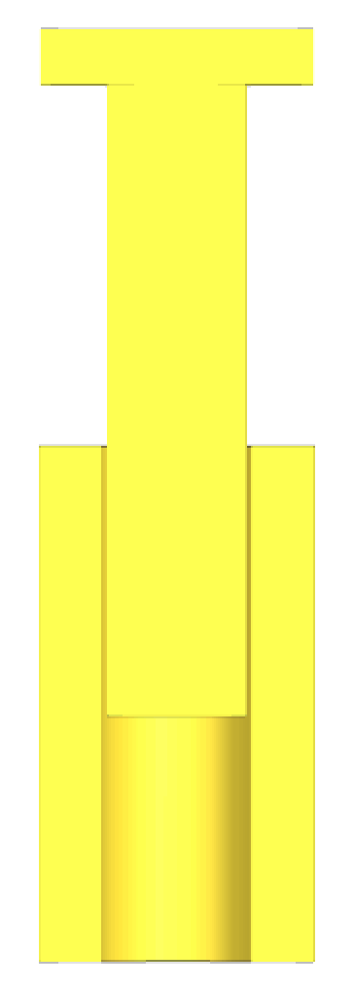
Retain
All dimensions are in inches
1.0000
R 2.5
11.4053
9.3116
R 1.2810
Gravity Offload Tool
Plunger
Plunger
Cross-section
R 2.5
R 1.3750
Notes:
We also needed to design how we will keep these disc springs together and how to compress them. Disc springs are commonly used with clevis pins which gave me the idea to use something similar. this plunger will essentially hold the disc springs through their inner diameter and can be compressed by the top part. The bottom part has a deep enough hole for the disc springs to be compressed to their maximum compression state. This is another reason why we had to shorten the hydraulic cylinder. Thankfully, with the hydraulic cylinder I found, it will have a similar spring constant as it can carry that same load and because the disc springs are softer, the combined spring constant will lean towards the disc springs instead of the hydraulic.

Slide 16
Next Steps
Material selection
Plunger
Base
FEA Analysis
Procurement and Fabrication
Test and Verify
Notes:
Both easy to adjust with different types of pumps. With that, we need to find their spring constant to see which is more ideal

Slide 17
Questions?
Gravity Offload Tool Under Cryomodule

