Slide 1
LAPPD Performance Analysis for the ANNIE Experiment
James Morrissette
Supervisors: Matthew Wetstien,
SIST Final Presentation
9 October 2022

Slide 2
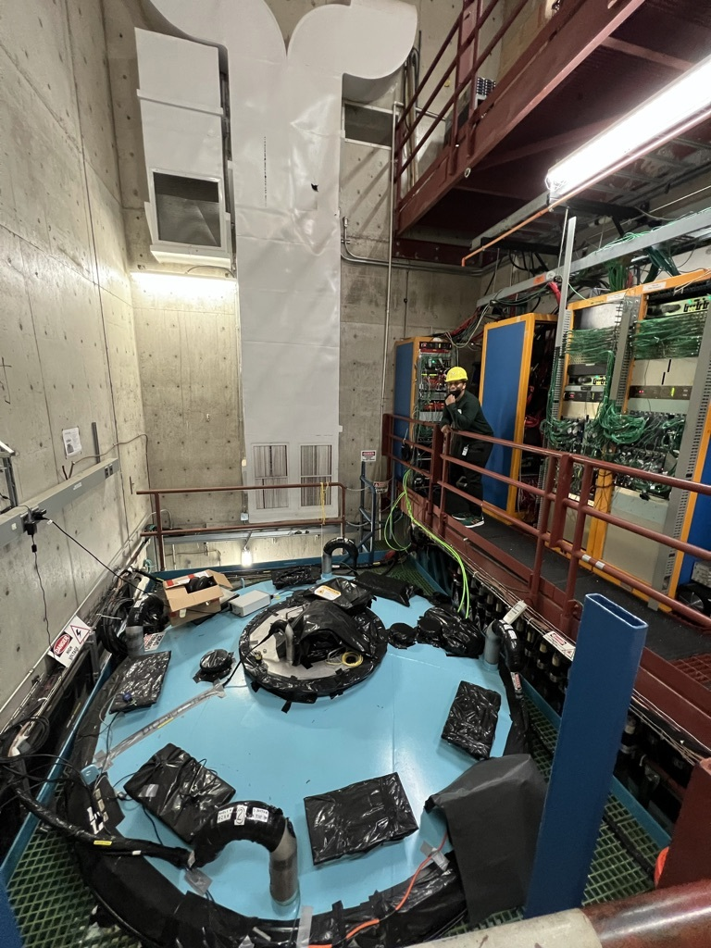
What is ANNIE?
ANNIE, Accelerator Neutrino Neutron Interaction Experiment, seeks to better understand neutrino-nucleus interactions and demonstrate new technologies, such as LAPPDs (Large Area Picosecond Photo-Detectors) and gadolinium-enhanced water.
Notes:
Mention that annie is setup is a water Cherenkov detector

Slide 3
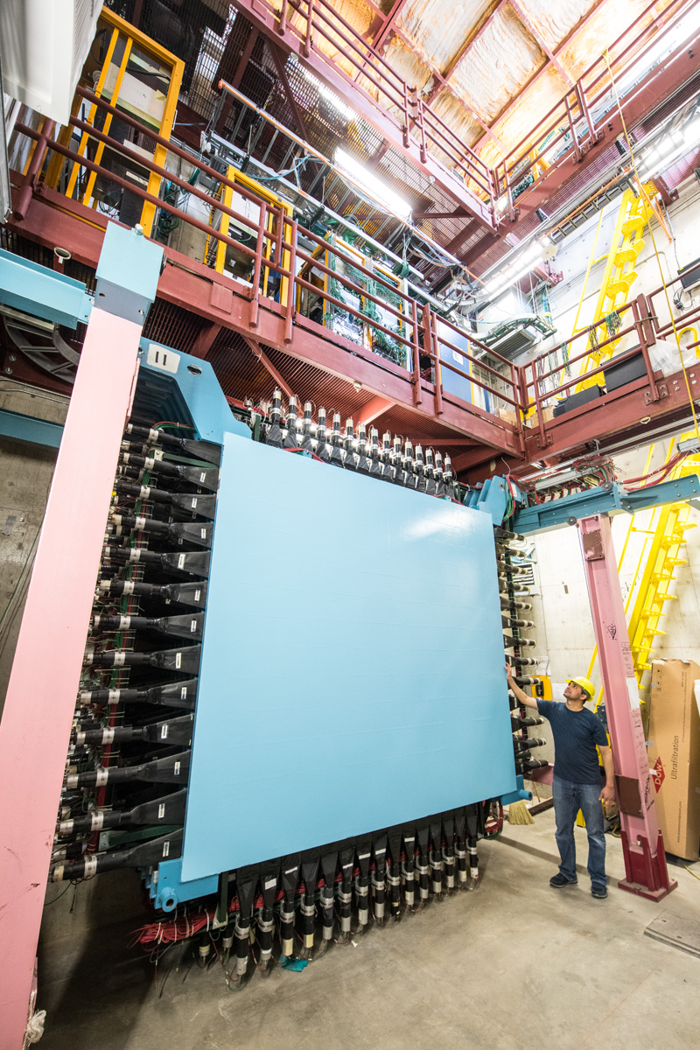
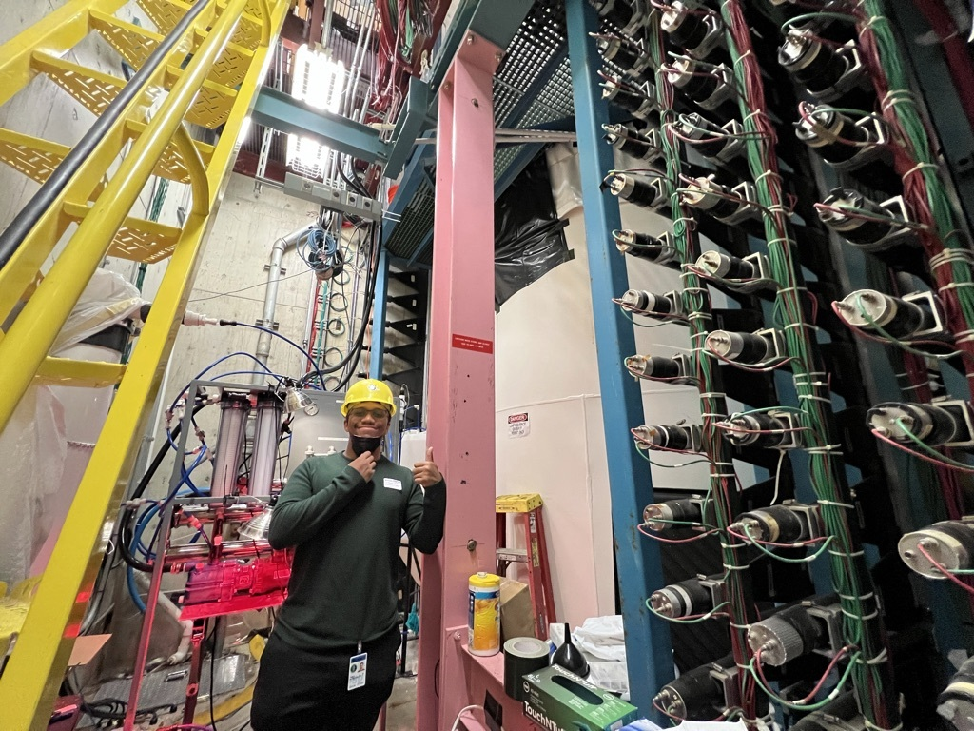
What is ANNIE?

Slide 4
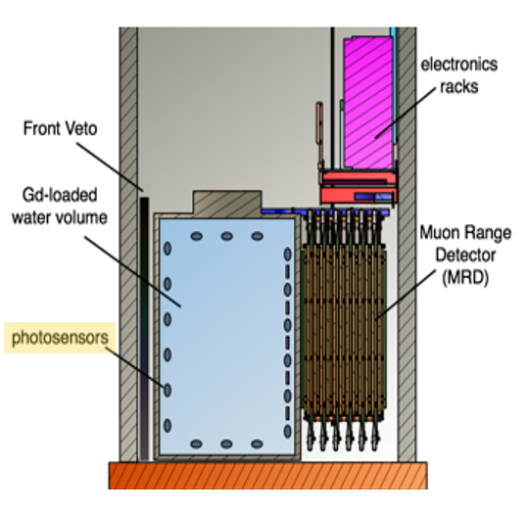
Experimental Setup
Any neutrinos that interact upstream of the detector are rejected by Front Muon Veto.
High energy muons produced from collision produce Cherenkov light in the tank before entering MRD, where they are slowed to a stop.
Of the particles, final state neutrons will be “eaten” by Gd, generating photons.
BEAM
Notes:
Muon is mu, photon is Y, n is neutron, N is nucleus, v is neutrino
Very high neutron crossection
Nuetron is considered to help understand where “lost energy is”

Slide 5
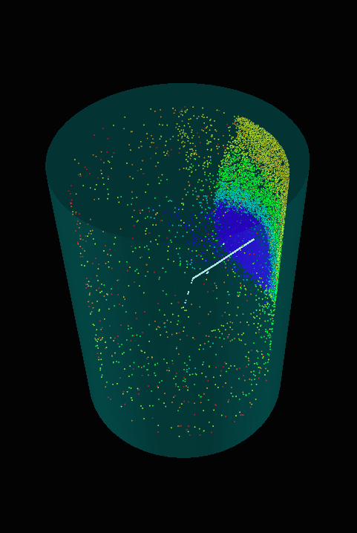
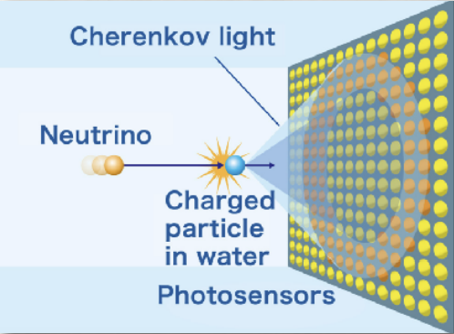
Photon Detection
The conical shape of light will act as a track pointing back to the collision
Simulation
Animation of the Wave propagation of a particle generating Cherenkov radiation.*
Pattern of (Cherenkov) light hitting wall of the tank.
Cherenkov gif - Sheldon, H. “Cherenkov_radiation-Animation.gif.” Wikipedia .
Notes:
Cherenkov radiation is when a particle is traveling faster than light in a medium.

Slide 6
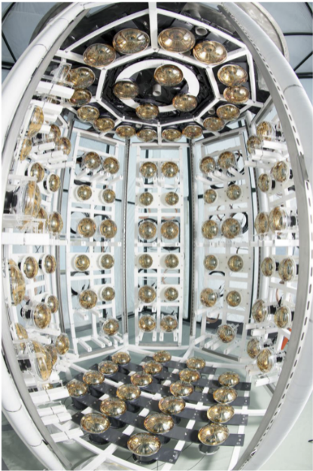
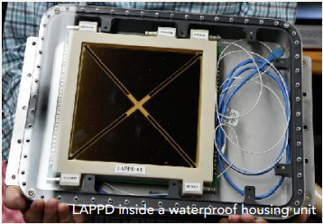
Enabling Technologies
10 ft (3 m) dia., 13 ft (4 m) tall cylindrical, water Cherenkov detector
Equipped with 132 Photo Multiplier Tubes and 5 LAPPDs
Diameters 8in & 10in
Loaded with 26 tons of 0.1% Gadolinium 157 and 159 solution
Fisheye view of empty tank without LAPPDs.
Notes:
Gd Have really high neutron capture cross sections

Slide 7
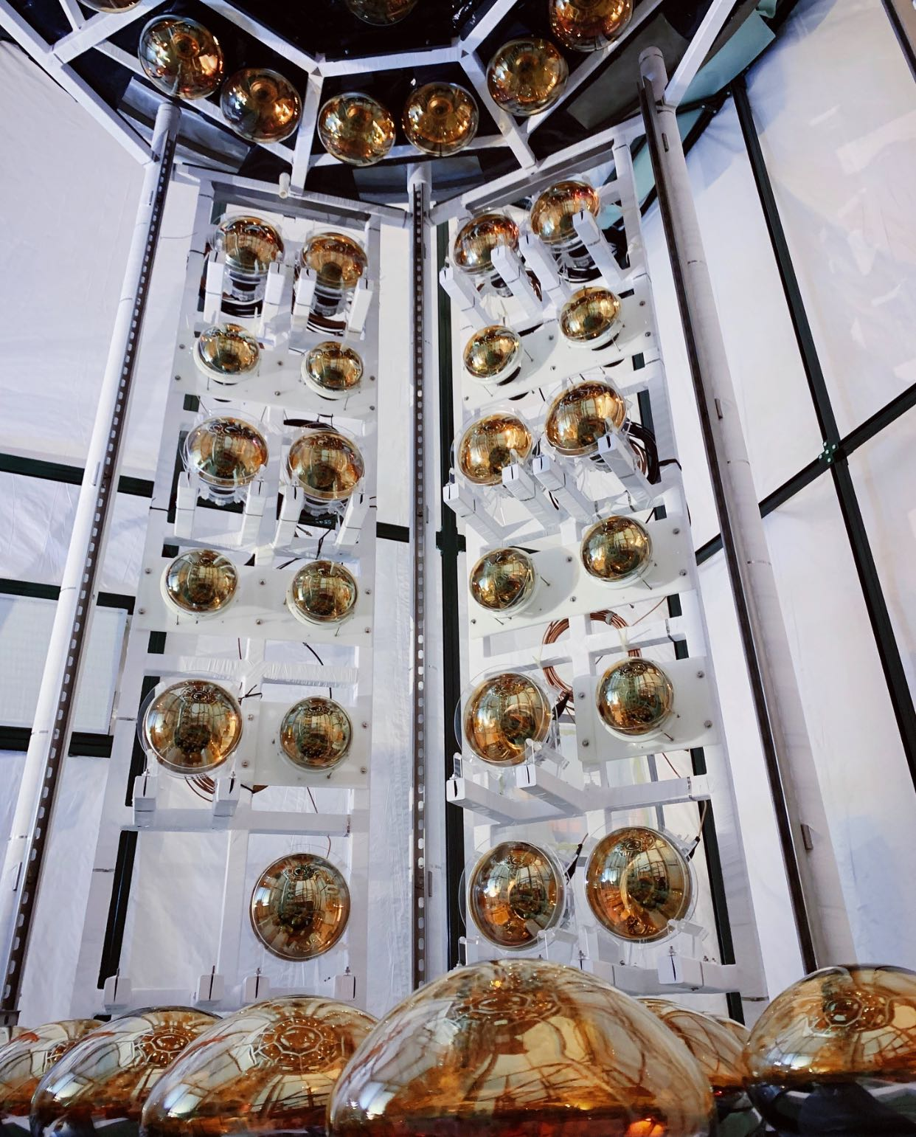
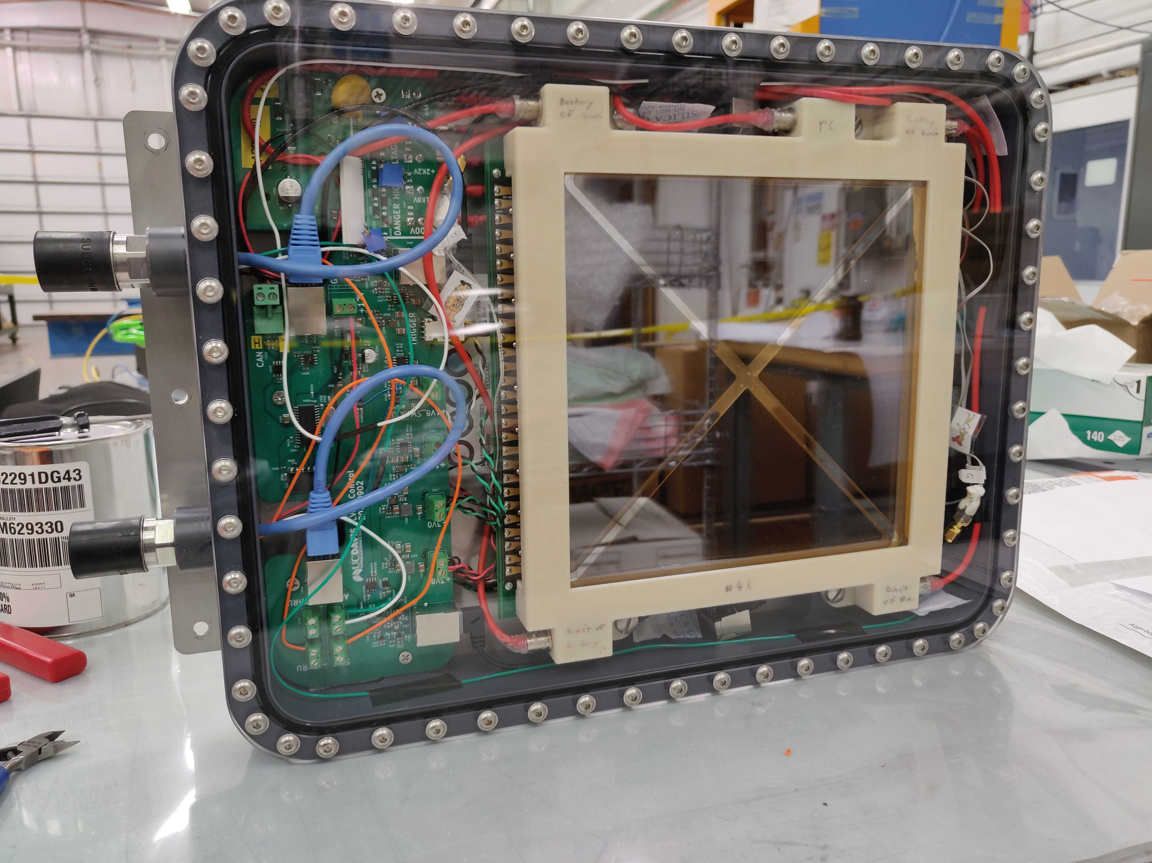
Photodetectors
Conventional Photomultiplier Tubes.
Single pixel.
Nanosecond time resolution.
LAPPDs which are capable of spatial resolution below a cm and 100 times faster than PMTs.
Notes:
Pmt only tell you light hit and is 100 times slower. No spaitial.

Slide 8
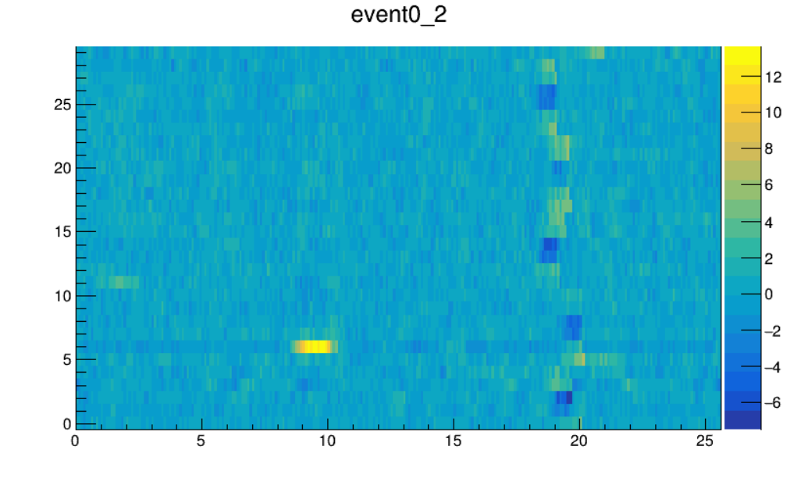
Project Goals
Photon patterns on LAPPDs can only be indirectly inferred from the voltage signals produced by the detector.
We need to understand the single photoelectron (PE) response in order to extrapolate where, when, and how many photons hit the LAPPD.
The single PE response is difficult to measure from in situ data
neutrino events can produce many hundreds of photons
trigger threshold is too high to see small signals in situ laser calibration data.
Stripline number
voltage
Notes:
Format:
Problem – why can’t we
Soultion direction

Slide 9
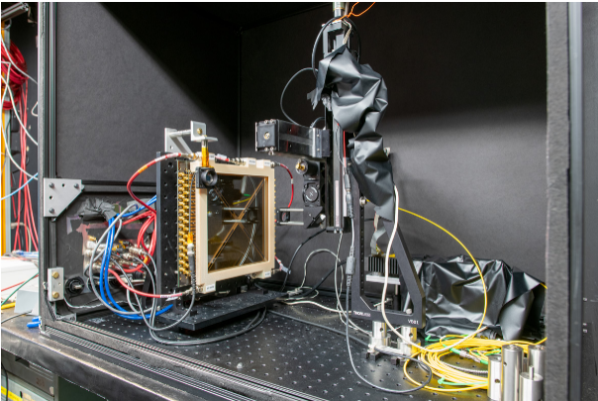
Project Goals
Determining the single PE response is most straightforward using data from the dark box. It offered the most controlled data and is not impeded by a threshold trigger.
Notes:
Format:
Problem – why can’t we
Soultion direction

Slide 10
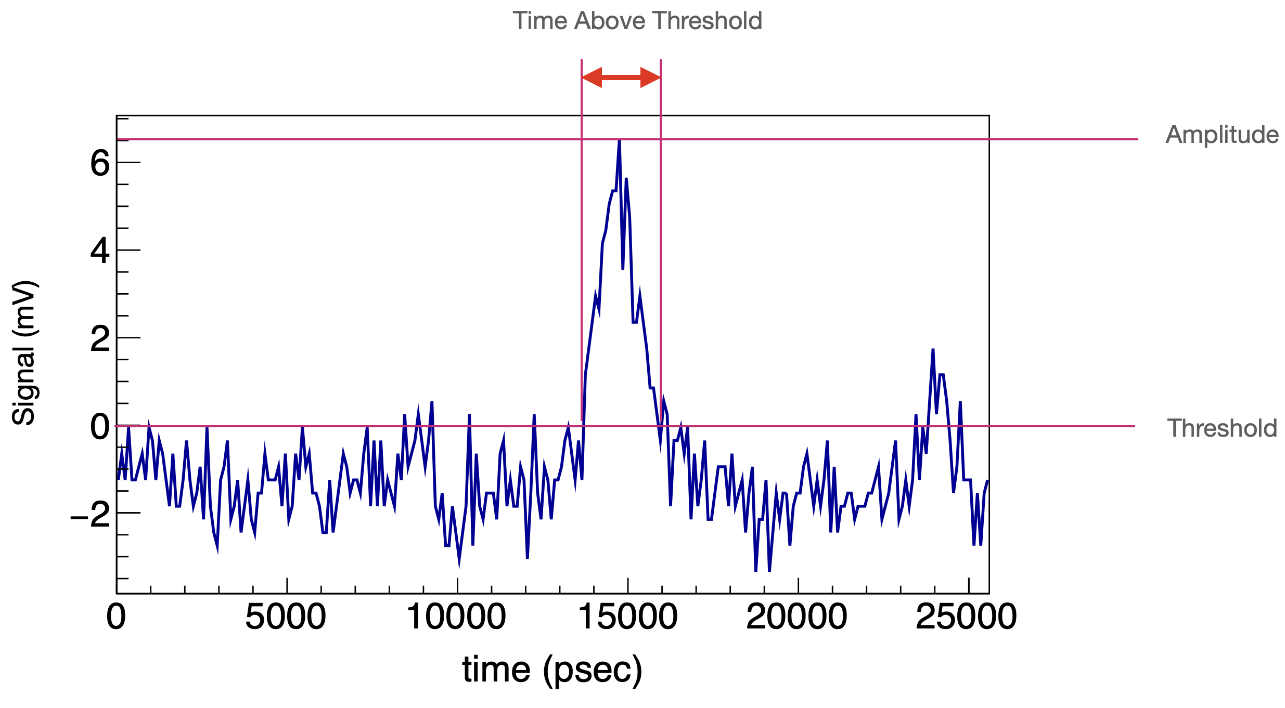
Processing the Single PE response
Calibration data from the dark box was processed with ToolAnalysis.
Generated wave forms like the one above.
Custom root script was used to observe maximum amplitude of the signal by fitting one landau and two gaussian curves. Representing the background noise and multiples of PE peaks respectively.

Slide 11
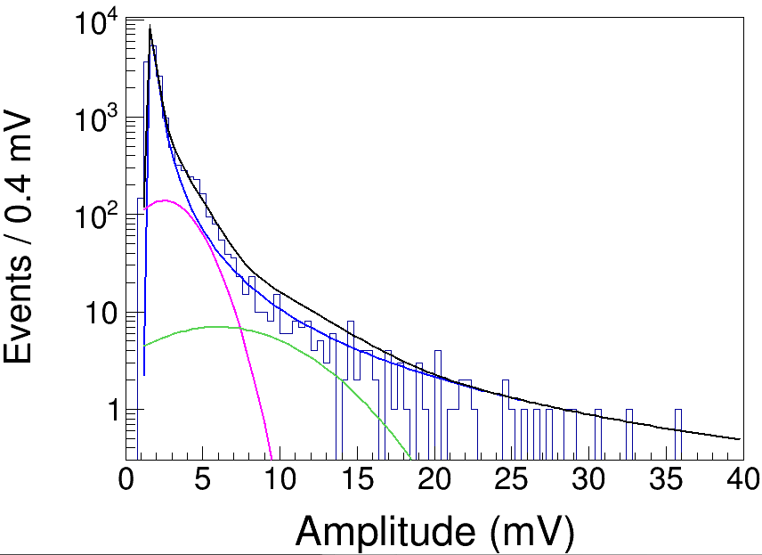
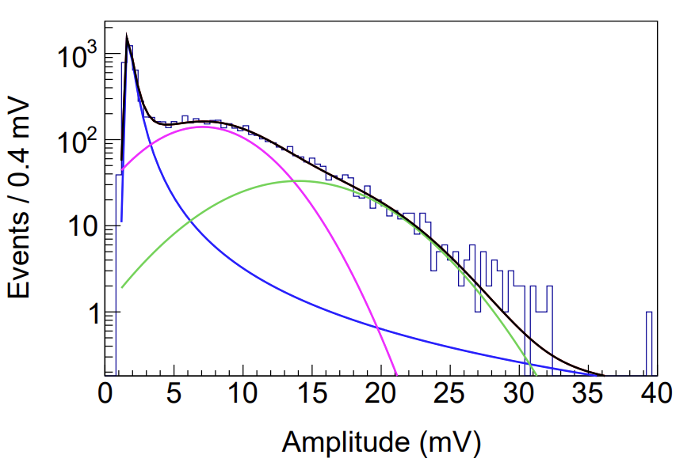
Understanding the Single PE response
Noise
LAPPD 40
LAPPD 25
Single PE
Double PE
A histogram of the amplitudes of LAPPD pulses (log(y)), for LAPPD25 (right) and LAPPD40 (left), fitted with a model of the detector response.
Notes:
Pedistal peak is much more separated from the single pe in LAPPD25. Read as there is LAPPD40 has lower gain compared to 25 and other LAPPDs. May be because the operational voltage was turned down, due to concerns with photocathode there are other concerns as well. Gain estimate for lapd 40 was below 10^6 but Expected p x 10^6. They are looking to get 64 in to estimate the next four lappds looking for more gain estimates.

Slide 12
Next Steps
Study other operational voltages for the next four LAPPDs.
Implement the new single PE response fits into our LAPPD simulations.
Verify that the LAPPD simulations reproduce what we see in data for large signal events.

Slide 13
Acknowledgments
Special thanks to my mentor Matthew Wetstein, Yue Feng, Marvin Ascencio, Emily Pottebaum, Julie He Cortez Watkins, Carrie McGivern, the ANNIE collaboration, Fermilab, and Iowa State.

Slide 14
Thank you for your time and attention!

