Slide 1
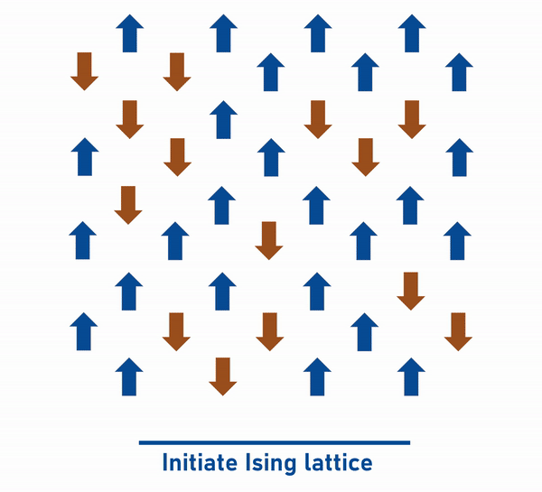
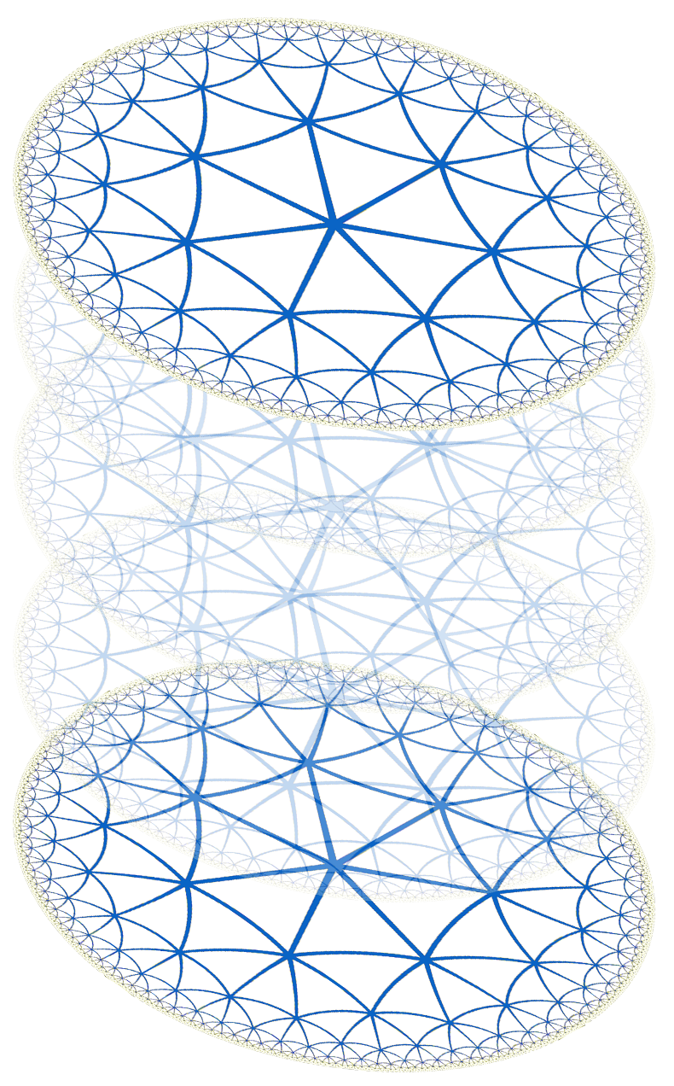
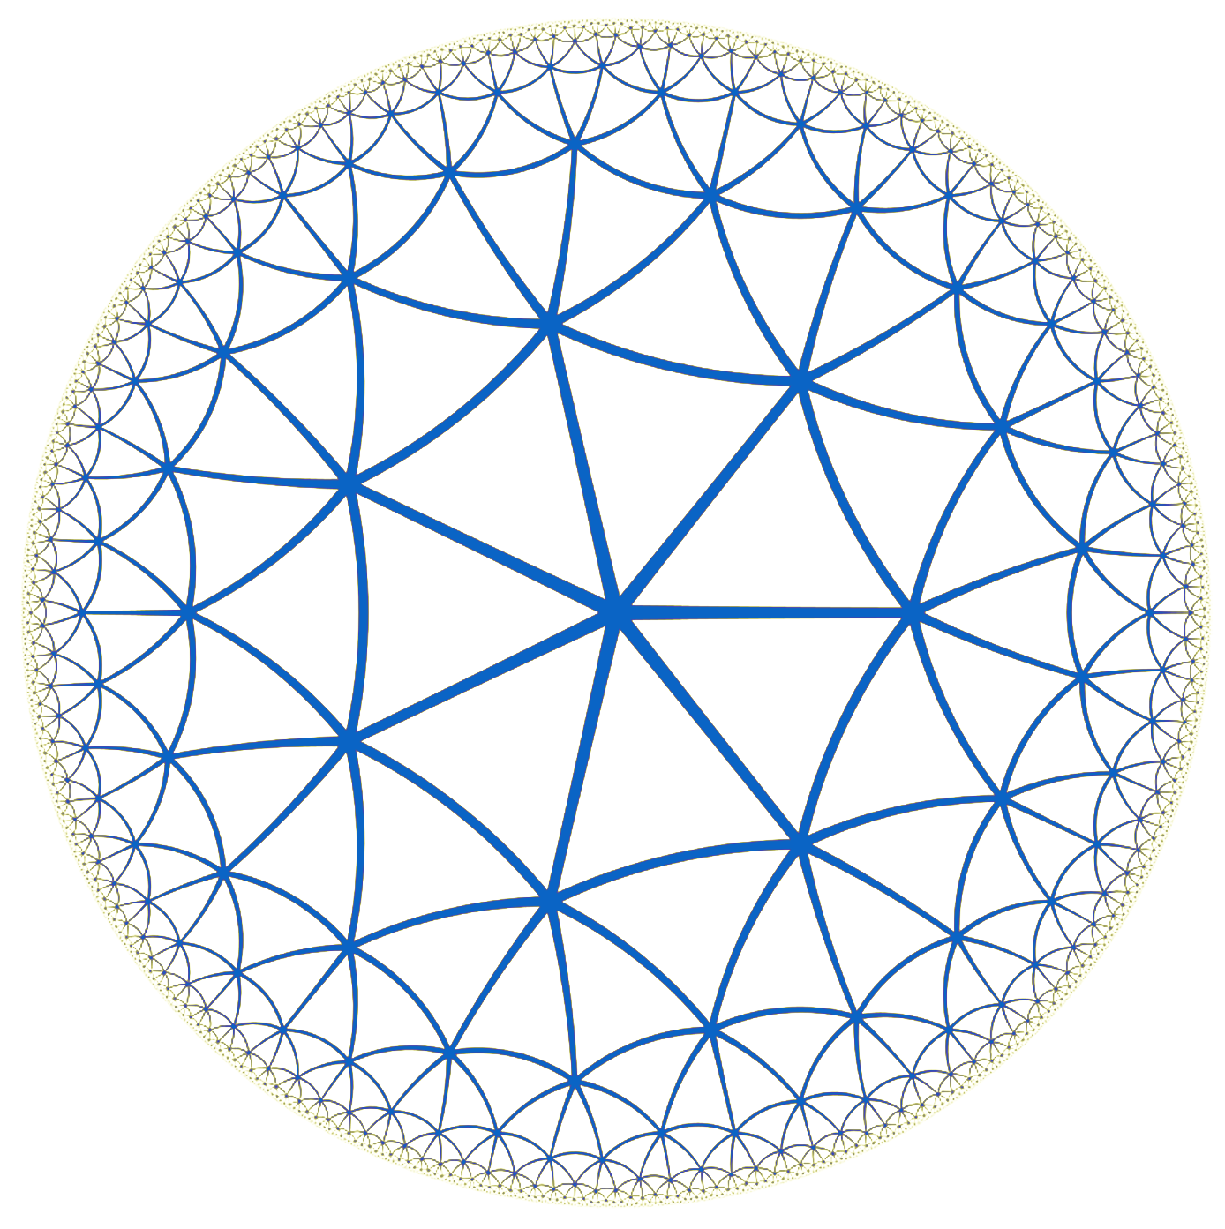
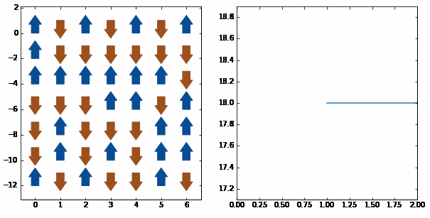
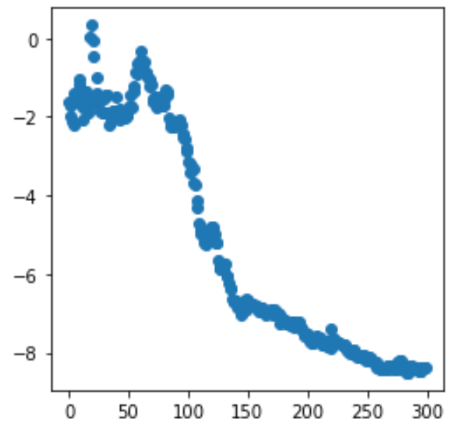
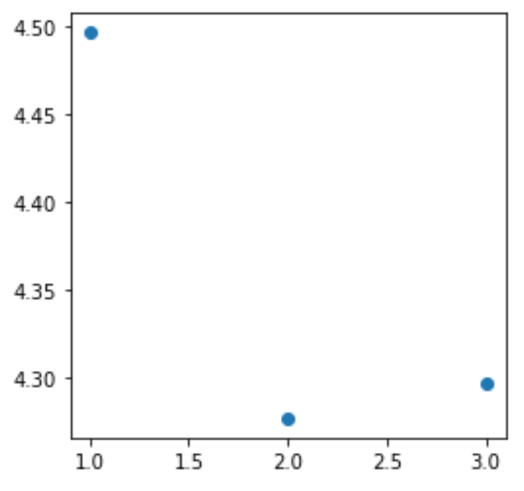
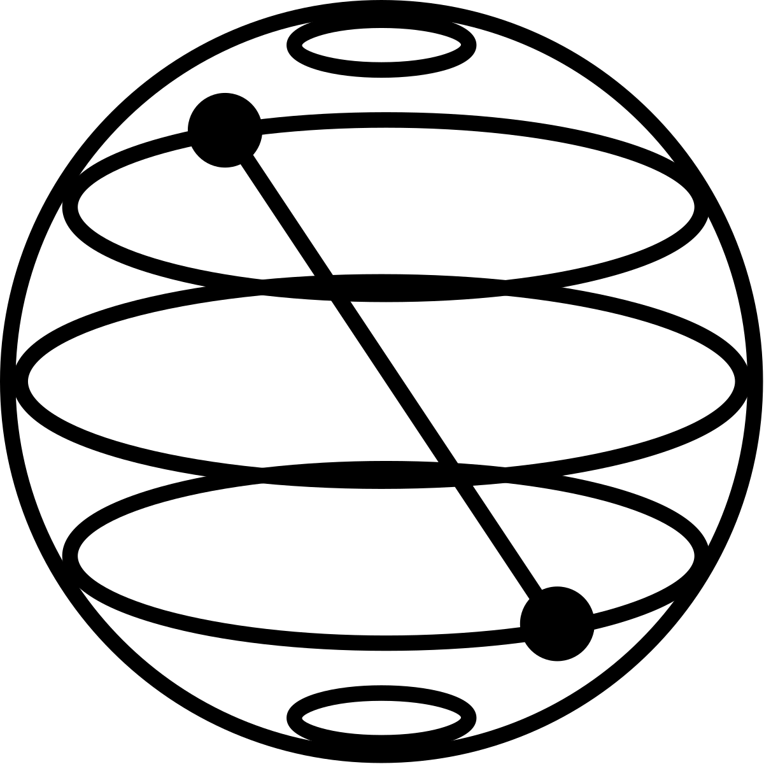
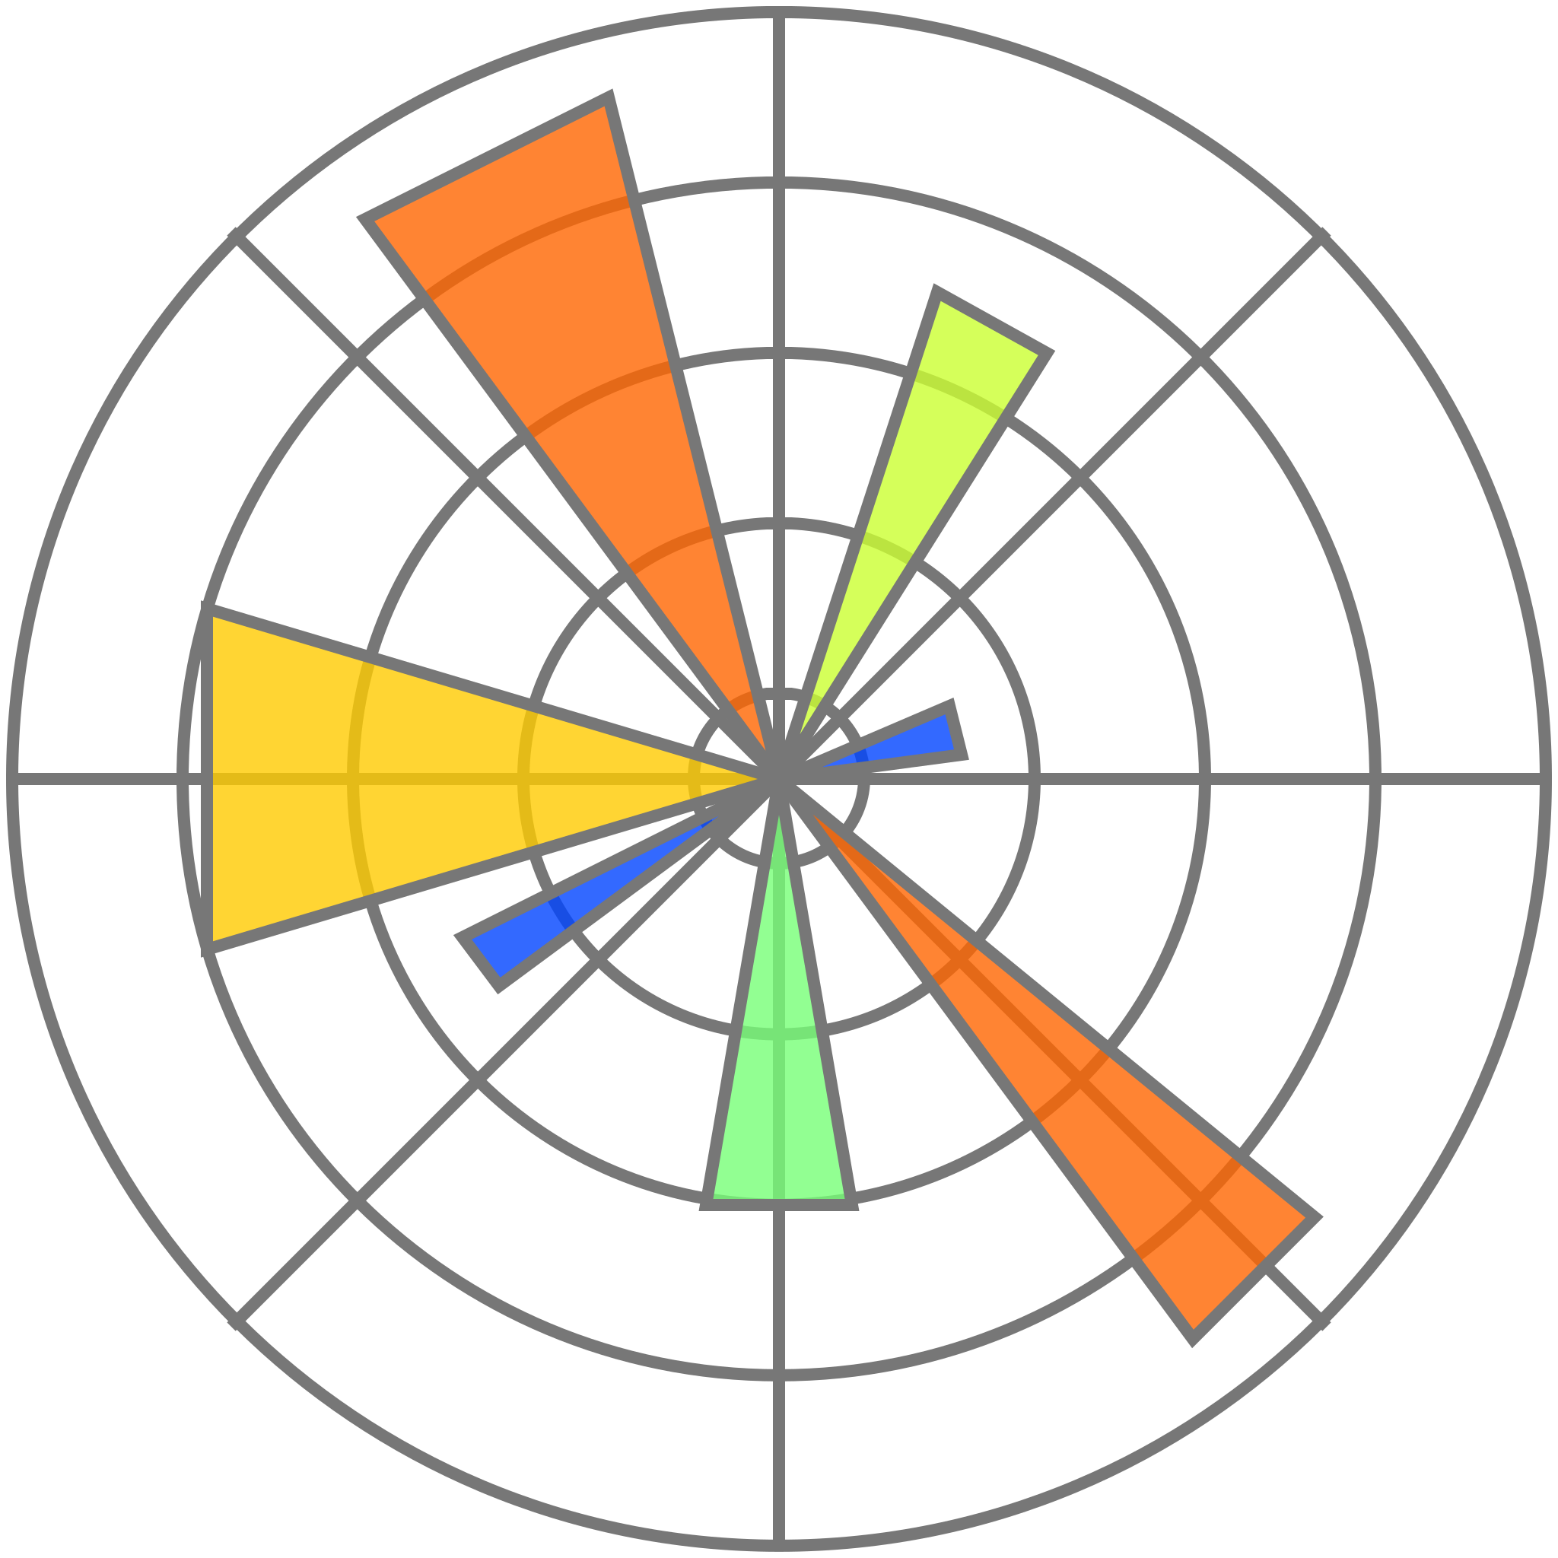
Using variational methods and hyperbolic lattices to find the ground state of gapless systems
Introduction
Approach
Another Approach
The AdS/CFT correspondence is a nonperturbative theory which provides a duality between strongly coupled d dimensional critical systems and weakly coupled d+1 dimensional gravitational theory on a negative curved background.
We propose a semi classical, near-term quantum algorithm to simulate a hyperbolic quantum lattice to its ground state. The built-in nature of conformal boundary of a hyperbolic space provides us a possible way to find the ground state of gapless systems. We then aim to explore correlations at the conformal boundary.
We use an order-7 tiling {3, 7} hyperbolic lattice to represent our negative curved bulk. The hyperbolic can be reconstructed using the formulation defining number of bits in each layer. With $n\left[1\right]=q, n\left[0\right]=1:$
$n\left[L\right]=\left(q−4\right)n\left[L−1\right] −n\left[L−2\right]$
Our ansatz consisted of 14 layers of hyperbolic lattice with alternating single and two qubit gates to maximize entanglement.
Another interesting approach is to represent quantum systems as tensor networks. Tensor Renormalization Group theory could be applied to our network to rescale and coarse-grain our model. This renormalization could be used to handle large quantum systems.
CFT boundary
Model
We use the simple and effective Ising model to represent our quantum systems. The model assumes each particle having a spin of |0> or |1>, or a superposition of both states. The Hamiltonian is given as follows:
$$ℋ_{Ising}=−\sum_{i=1}^{N_{q}−1}{\left(σ_{i}^{z}σ_{i+1}^{z}\right)−\sum_{i=1}^{N_{q}}{\left(σ_{i}^{x}\right)}}$$
Time
AdS bulk
a) Three-dimensional AdS bulk represented as stacks of hyperbolic lattice at different points in time. A lower dimensional CFT lies on the boundary. b) Two gate distribution of one instance in time for the first layer.
Renormalization from a 4x4 lattice to a 2x2 lattice using TRG transformations.
Method
We essentially want to replicate the natural process of annealing. The process is the cooling down of a system due to random fluctuations as time progress with some magnetization.
Our algorithm is inspired by the MCMC Metropolis Sampling method. A 7x7 lattice would look as follows over time:
Further research
Results
The tensor renormalization can be applied to reduce a large hyperbolic lattice to a smaller lattice. A triad-network tensor can be used to reduce the number of qubits by 3. This approach would help renormalizing a large bulk in a bulk involving lesser computational power.
Another application of tensor renormalization group I am interested in exploring is image classification. The algorithm can be used to obtain major image features for neural networks.
We ran the algorithm on the first layer of the hyperbolic lattice consisting of 7 qubits. The number of qubits increase exponentially as we increase the layers.
Acknowledgements
This manuscript has been authored by Fermi Research Alliance, LLC under Contract No. DE-AC02-07CH11359 with the U.S. Department of Energy, Office of Science, Office of High Energy Physics
a) A 7x7 classical Ising lattice as it goes through our algorithm. b. Average energy of the lattice.
a) First layer of hyperbolic lattice reaching its ground state around average energy of -8.4. b) ZZ correlation of the boundary theory at ground state.
Muhammad Omer Sajid, Judah Unmuth-Yockey
FERMILAB-POSTER-22-128-STUDENT

