Slide 1
Mechanical Design of Magnetic Field Measurement Instrumentation
Jay Hayman – Masters Student in Mechanical Engineering at UAHuntsville
Supervisor – Cristian Boffo
Final Presentation
9 August 2022

Slide 2
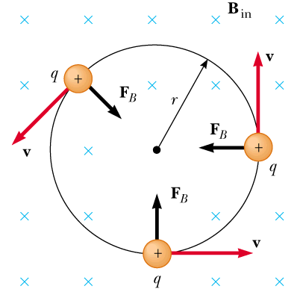
Background – Magnets
Field lines normal to the direction of travel generate a force
Spatial field variations relative to the particle have the same effect

Slide 3
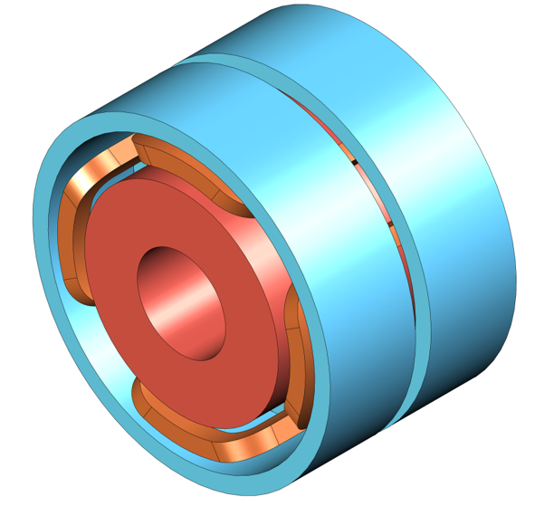
Background – Focusing Lenses
Bucking coils
Focusing from main solenoid
Corrector magnets can act as steering dipoles
Bucking coils to minimize fringe field
corrector magnets (controlled separately)
Main Solenoid

Slide 4
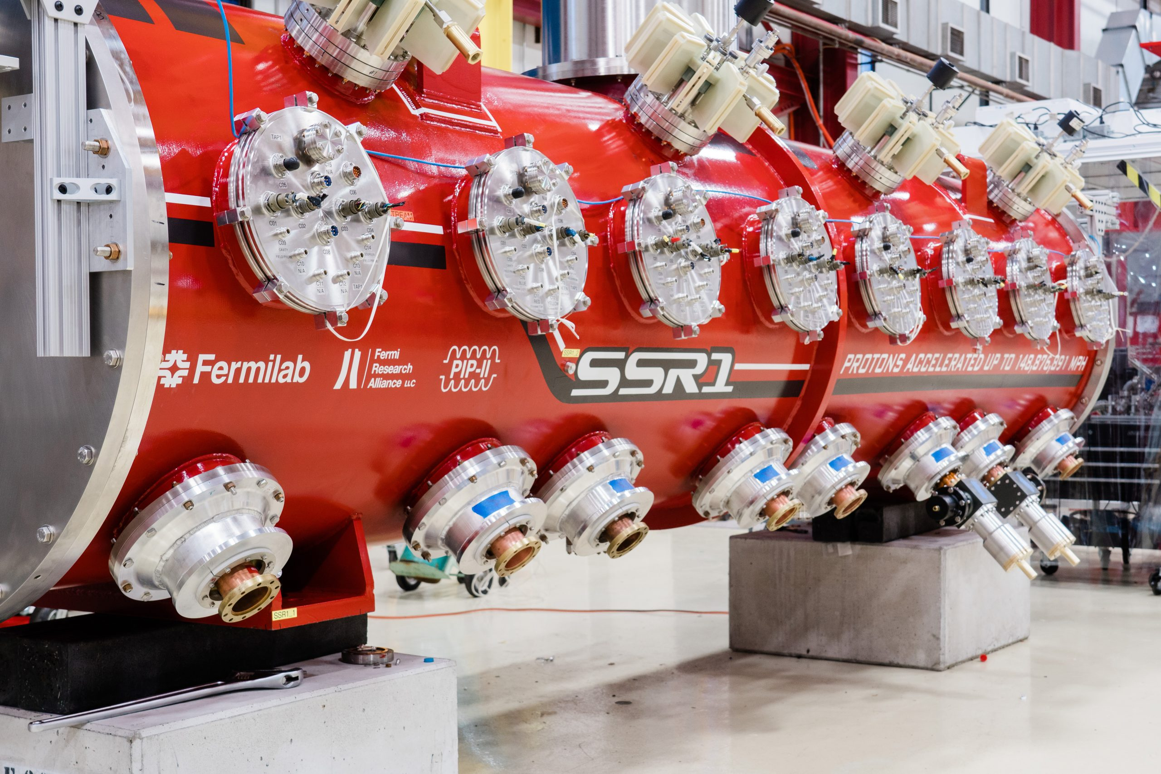
Project Objective
Goal: 3D mapping of the magnetic field within superconducting magnets
Application: qualification of the SSR focusing lenses for PIP-II
Environment: test stand 7 in IB1 – vacuum and 4 K temp

Slide 5
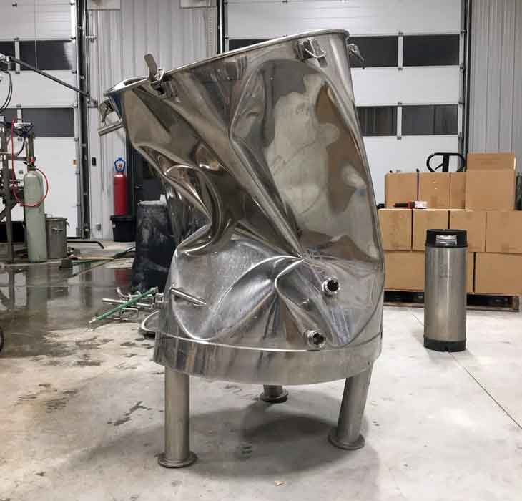
Constraints – Vacuum
Any enclosed portion needs to be reinforced
Motors either need to be outside the vacuum or have some alternative cooling

Slide 6
Constraints – Temperature
Top of system is room temperature (300 K), magnet is liquid helium temp (4 K)
Large temperature gradient causes non-linear thermal contraction
Limited cooling power (1.5 W) means components could compromise operation of the system

Slide 7
Conceptual Design
Need to move a probe array (designed separately) at least 500 mm
By positioning probes differently in xy-plane, system movement can be kept to z-direction (fewer points of failure)
Copper is a diamagnetic metal, so its alloys interact weakly with magnetic fields while being strong and formable
A hollow tube has most of the stiffness of a solid rod with proportionally less material
Pulsed laser time-of-flight device to measure distance agnostic of thermal contraction
Electrical design will be a later project – need to maintain some design flexibility

Slide 8
Concept #1: Rigid Tower
A rigid shell with reinforcing ribs will house a top-mounted motor and a screw-driven bronze shaft
The motor will use the shell as a large cooling fin
PROS: looks kinda cool
CONS: may be very difficult to manufacture, will need temperature monitoring, could still collapse if not overbuilt, etc.

Slide 9
Concept #2: Bellows & Legs
Three legs will support a plate fixed to flexible vacuum bellows, allowing the motor to sit outside the vacuum and move with the system
PROS: looks really cool, bellows available off the shelf
CONS: will need very thick legs to maintain necessary rigidity, every component will need testing and calibration

Slide 10
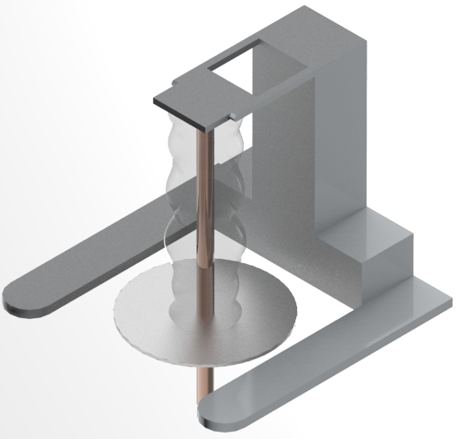
Concept #3: Bellows & Stage
A ready-made stage will move a plate and bellows
PROS: mostly off the shelf, meaning the parts come pre-certified
CONS: very boring design to execute

Slide 11
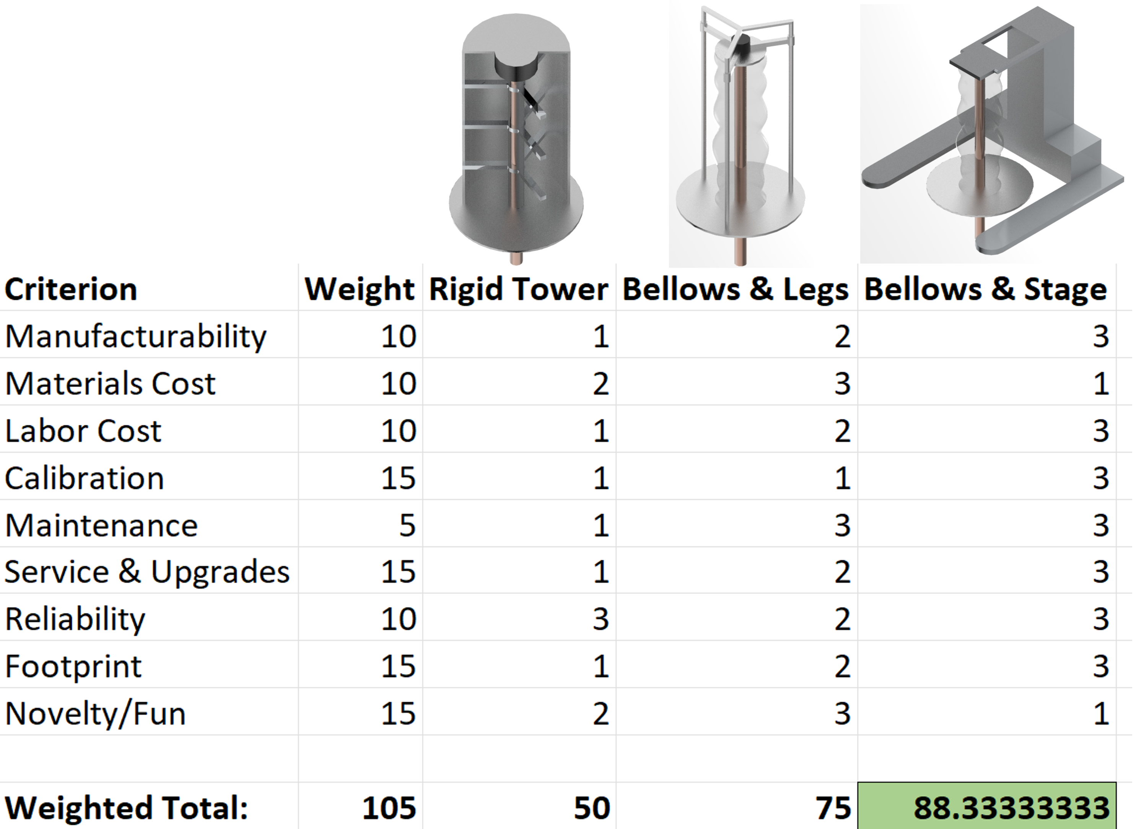
The Big Decision

Slide 12
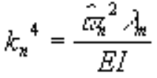
System Analysis – Methods
Geometry & Material Properties:
Stock dimensions of rods from vendors
Published properties for high silicon bronze and other relevant materials
Dynamic Response:
Free vibration of a cantilever beam (neglecting probe head)
Natural frequencies calculated for each stock rod
Thermal Behavior:
Total thermal energy calculated for high silicon bronze at 300 K with a ground state of 4 K
Radiative heat load from mylar wrapping at 300 K to polished SS 316L at 4 K (infinite concentric cylinder model)

Slide 13
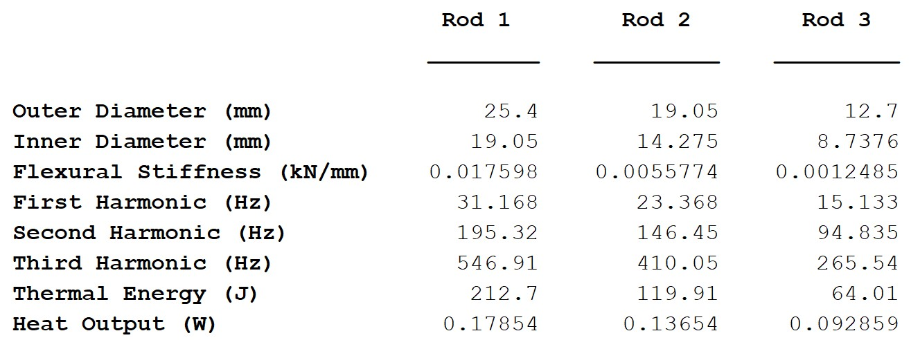
System Analysis – Results

Slide 14
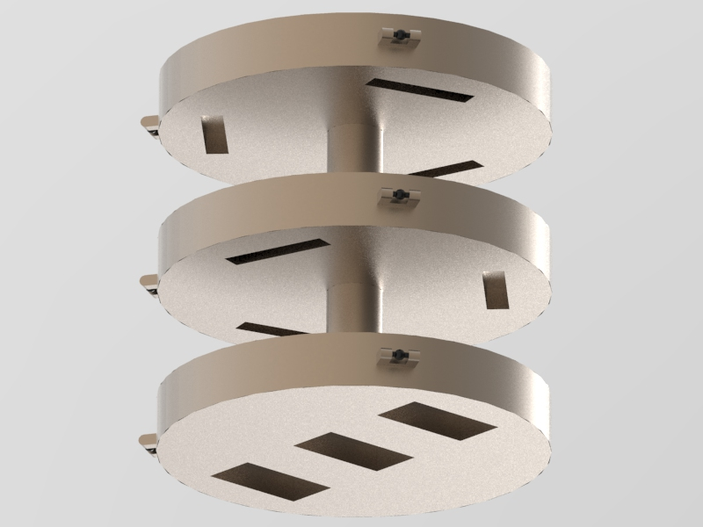
Probe Array Concept
Cutouts represent Hall probes in different orientations
Rollers on each level to align with the magnet bore
Material TBD, depending on electrical requirements

Slide 15
Next Steps
Continue analysis to establish tolerances
Design wiring setup and integrate with mechanical design
Design DAQ and controls for integrated system

Slide 16
Acknowledgements
Cristian Boffo, my supervisor
Dr. Judy Schneider, Brody Montgomery, and my UAH research group
Darren Crawford, Karie Badgley, and my Group 6 colleagues
The National GEM Consortium

Slide 17
Thanks!
Questions?
Comments?

