Slide 1
Multi-Threaded Graph Framework Exploration for DUNE
Clifton Tyler Terwilliger
SIST Presentation
August 9th, 2022

Slide 2
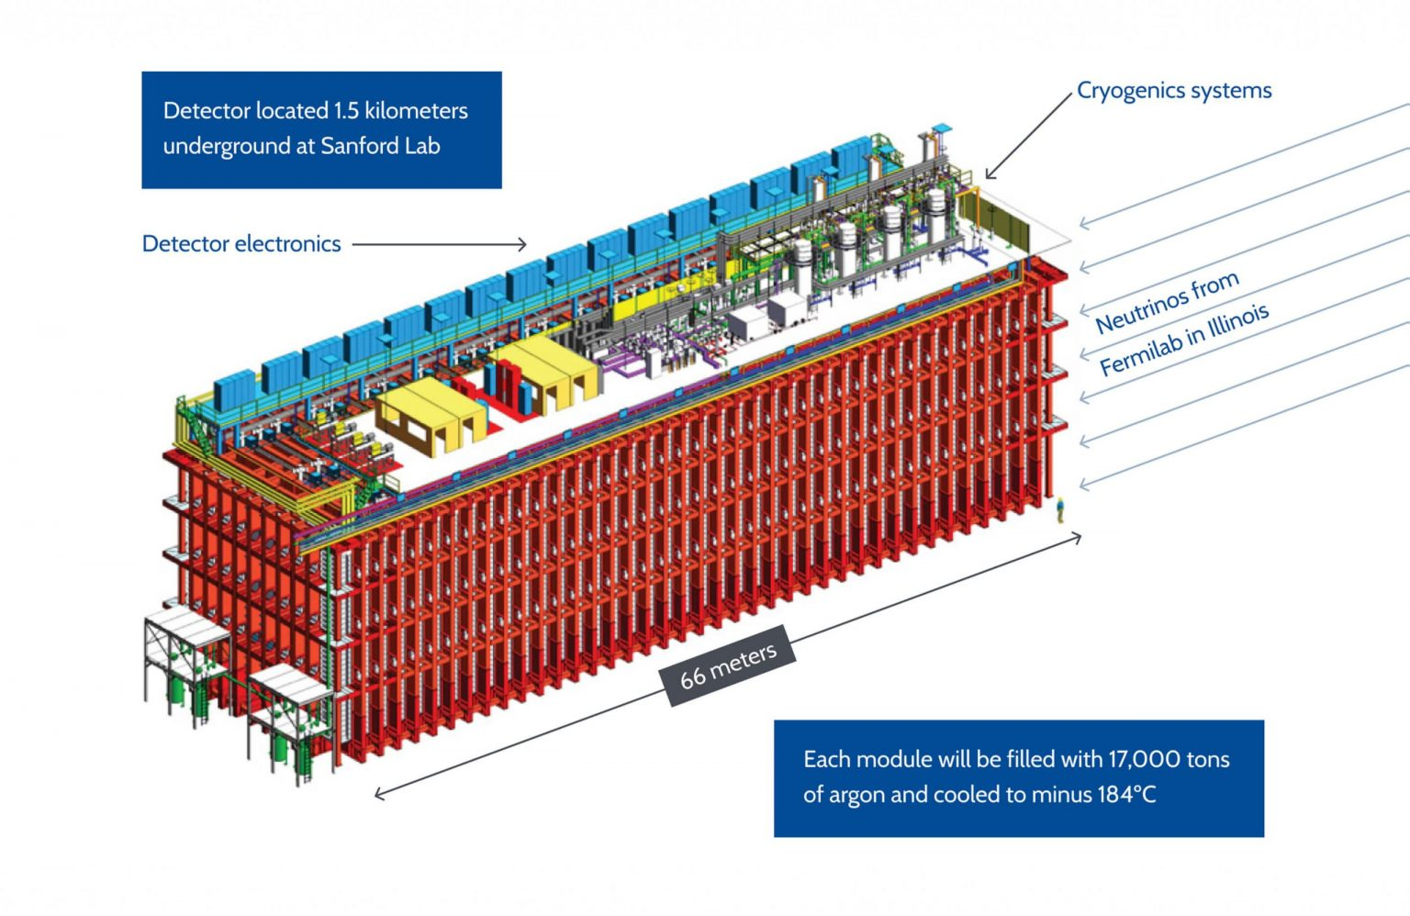
Introduction to DUNE and DUNE Data Processing
The Deep Underground Neutrino Experiment, DUNE for short, is Fermilab’s leading-edge neutrino experiment.
DUNE is expected to produce terabytes a second
Data will have to be handled in real time
Data needs to be reduced to a manageable gigabytes a second.
Data may require further processing and analysis
To efficiently process such enormous amounts of data, a multi-threaded procedure will likely be required.
DUNE Detector at Sanford Lab

Slide 3
Overview of Multi-threaded Processing
Multi-Threaded processing uses multiple “threads” simultaneously to utilize multiple processors to work together
Multi-threading can help speed up processing, scaling nearly linearly with processor count.
Multi-threading allows for more utilization of available resources
However, writing multi-threaded code can be time consuming, is hard to create quality code, and can be very hard to debug.
Multi-threaded code has to written so that processors do not interfere with each other, also known as thread-safe
Most High Energy Physics code is not written with multi-threading in mind, often resulting in code that cannot be multi-threaded

Slide 4
Good versus poor Multi-threaded Code
Good multi-threaded code is:
Fast
Correct
Shares memory across threads
Poor multi-threaded code is:
Slow
Potentially Incorrect
Cannot share memory across threads

Slide 5
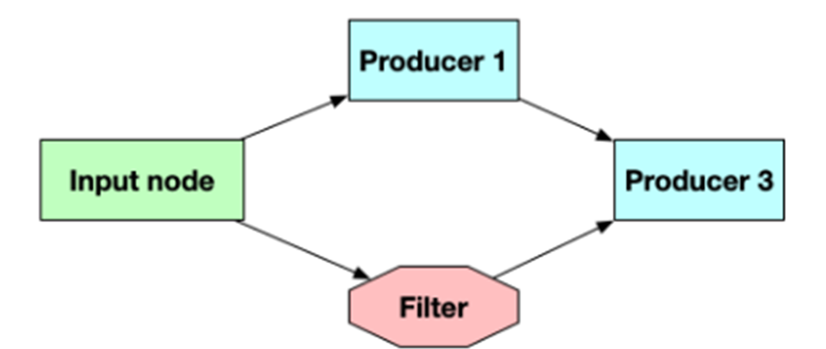
Framework Introduction
The advantages of multi-threading cannot be ignored, however the issues make multi-threading intimidating.
An exploratory multi-threaded framework has been created
To make writing multi-threaded code simpler
Simplify debugging multi-threaded code
Written in C++ for speed
Uses modern C++ Features
Based on directed flow graph processing
Most importantly, seeks to make it easier to make correct code
Ultimately making multi-threading easier for DUNE to Adopt
Very basic Directed Graph.

Slide 6
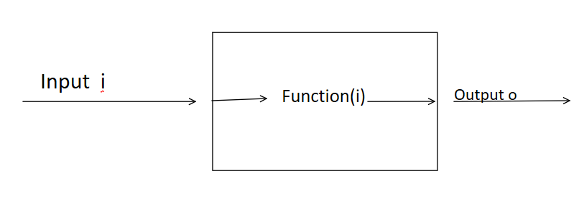
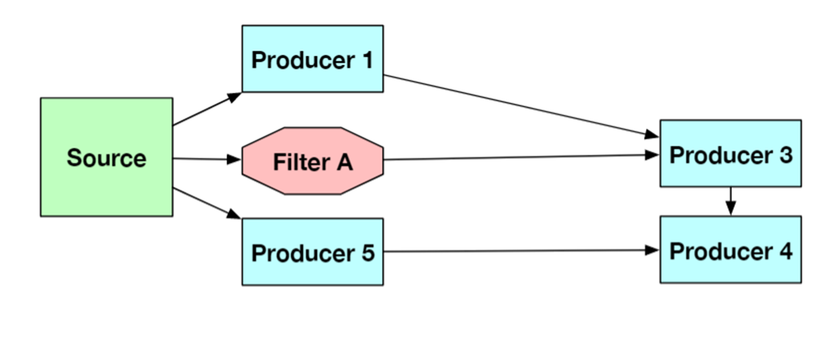
Directed Flow Graph-Processing
Direct Graph Processing is a way to lay out logic for a program. Starts from the source and follows the graph until end.
Each box represents a node
Each node has an input, function, and output
Data is sent from one to another
The framework supports two main node types:
Producer node, runs a user defined function and returns the output
Filter node, allow data to be filtered out based on user defined condition
Overview of Node
Example Graph.

Slide 7
User Data Store
The framework passes around a predefined data type between nodes; the user data store
Allows a universal type as input and output to each node
Owns all user data
User access their data through a key system
Each execution of graph uses it own data store
Efficient memory usage; no unnecessary copies
Automatic data clean-up

Slide 8
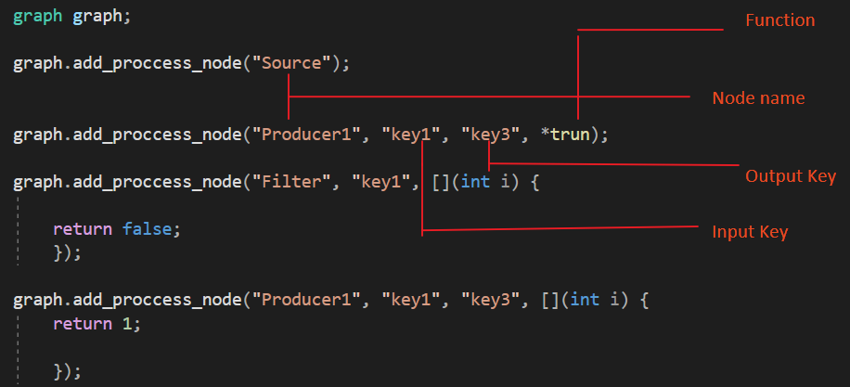
Desired input from user
Click to add caption text [11pt Bold]
First level bullet [16pt Regular], the quick brown fox jumps over the lazy dog.
Second level bullet [14pt Regular], the quick brown fox jumps over the lazy dog.
Third level bullet [14pt Regular], the quick brown fox jumps over the lazy dog.
Fourth level bullet [12pt Regular], the quick brown fox jumps over the lazy dog.
Fifth level bullet [12pt Regular], the quick brown fox jumps over the lazy dog.

Slide 9
Internal Framework Graph
The framework creates additional nodes to provide expected behavior
User Specified Graph
Framework Generated Graph

Slide 10
Modern Type C++ and Type Deductions
The Framework relies on modern C++ features to automate and simplify many parts of the framework
Uses deduction guides to automatically deduce input and output type/s for each node
Uses Parameter Packs to allow any number of inputs of any type, and any number of outputs of any type
Allowed for things that were not previously possible
Uses C++ meta programming techniques

Slide 11
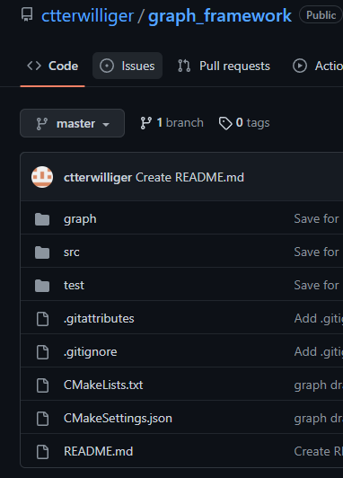
Results
The framework does appear to be a potential solution to making multi-threading more desirable.
When compared to creating traditional multi-threaded code, the framework appears to make multi-threaded coding easier to produce:
High quality code
Efficient code
Clean code
Correct code
Additional features, and testing will likely be needed to
Implement the framework for DUNE
Code Available on github at: https://github.com/ctterwilliger/graph_framework/tree/master

Slide 12
Acknowledgements
Special Thanks to:
The SIST committee for making this project and internship possible
To my supervisor Kyle Knoepfel, for guiding me, and giving me aid through out this project.
To Arden Warner, and Jonathan Eisch, my mentors during this internship

