Slide 1
Analog Readout Design & DAQ
David Christian
Fermilab
May 3, 2022

Slide 2
Readout development started 14 months ago
Five joint meetings were held with DARKSIDE in Feb-Mar 2021
DARKSIDE was developing an optical analog readout
Goals: Fast rise time (<8 ns), SNR>10 (1PE=20mV at receiver), dynamic range = 100 (2V max at receiver)
Light source = 1300 nm InGaAs LED (SiPMs are blind to 1300 nm light)
Extreme requirement on radiopurity
Problems included LED nonlinearity in LN2 and poor light coupling to the fiber.
At Fermilab, we started by exploring the use of COTS parts (SFP+ modules) in the context of a digital readout option.
(this was done following work done earlier at SMU for DUNE (Jingbo Ye’s group) and in consultation/collaboration with the SMU group)
The group at APC, Paris (Sabrina Sacerdoti, et al.) decided early on to concentrate on the analog readout option.

Slide 3
FNAL: Mixed Success with COTS Optical Parts
None of the SFP+ modules that we tested worked in LN2
At least one type of module transmitted successfully (at 10 Gbps) in LN2 if turned on at RT and then cooled down, but none worked after a power cycle in LN2
The Rx side of all modules failed in LN2.
We decided to test individual components and relatively quickly identified a number of 1310 nm laser diodes and at least one commercial laser driver that worked well in LN2.
Two types of 1310 nm laser diodes are made, examples of each work in LN2:
Fabry-Perot (FP) & Distributed Feedback (DFB)
The diode characteristic (light vs bias current) is very different in LN2
Much less current is required in LN2 than at RT

Slide 4
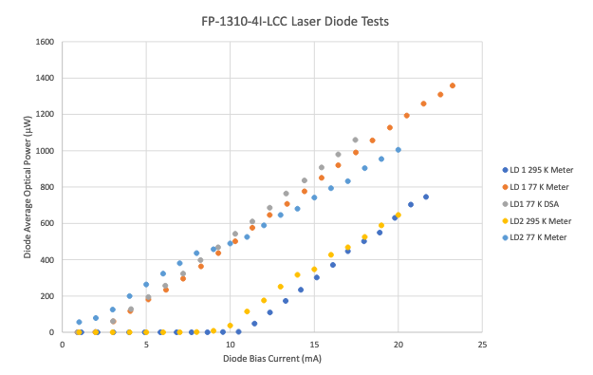
Laser Diode Characteristic (Room Temp & LN2)
These are some of the earliest measurements we made; response is very linear both warm and cold.

Slide 5
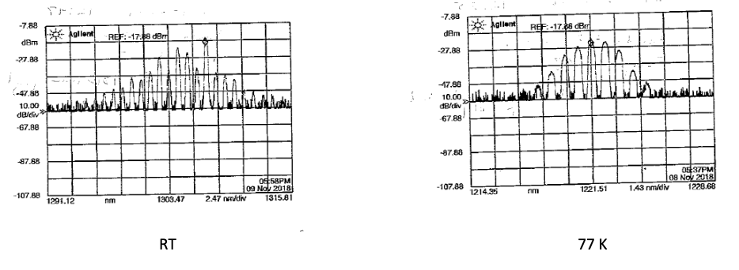
Aside: laser frequency also changes
Measurements of a Newport Fabry-Perot pigtailed LD

Slide 6
APC: Focus on analog readout
DUNE specs will differ from DARKSIDE
Single PE SNR>4
Dynamic Range goal = 2000 PE
Rise time < 100 ns
Bandwidth ~ 5-35 MHz
Power consumption < 100 mW
Design focus:
Laser driver
Also testing laser diodes
VCSELs (most did not work well in LN2)
1310 nm (results agreed with FNAL tests)
Identified a commercial warm photodiode board (Koheron PD100)

Slide 7
Joint APC/FNAL Development (May, 2021 - …)
Concentrated on 1310 nm laser diodes from a number of vendors
Pigtailed lasers are available only coupled to single mode fibers
Multimode fiber often captures more light and may be preferred (50 micron core vs 9 micron core)
Most development has used Lasermate lasers; pigtailed, and in FC receptacles
First near-final circuit (APC design “Argon”) presented on June 9:
Input = 1 – 4 hybrid-ganged groups of 20 SiPMs
THS4131 amplifies signal from SiPMs (following design by Gustavo Cancelo)
OPA354 opamp and SiGe bipolar transistor form the laser driver
“Argon 2x2” finalized mid-August
First FNAL layout – mounting holes for Lasermate FC or pigtailed laser diodes
2 channels (sufficient for a 60cm x 60cm X-Arapuca with 160 SiPMs (2 x 4 x 20)

Slide 8
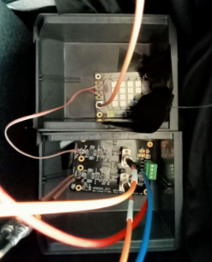
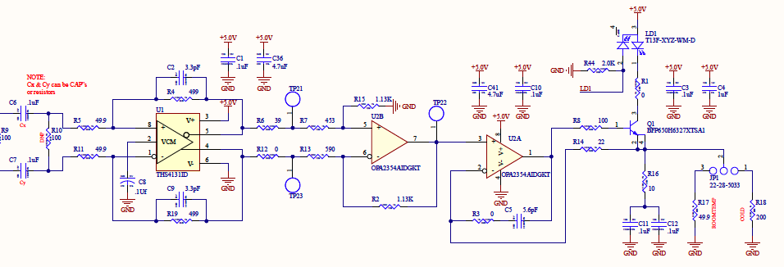
Argon 2x2
20 SiPM test board
Argon 2x2 under test in Paris in early September, 2021
Jumper option sets laser bias either for warm or cold operation

Slide 9
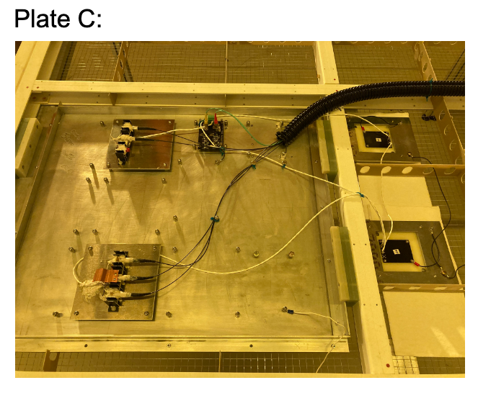
At CERN in late September, 2021 (on the VD Coldbox cathode)
Argon 2x2
PoF for Argon 2x2
“Mini Arapucas”
PoF for SiPM bias

Slide 10
Focus since the first coldbox test
Refinement of the Argon 2x2 circuit
Facilitate testing/optimization by enabling separate control of LD bias and total channel gain (proven unnecessary in the process)
Redesign board to facilitate mounting on the cathode (right angle mount for laser diodes to allow large fiber bending radius)
Enable automatic mode switching (warm/cold)
Include PoF and DC/DC converters on the same PCB as Argon 2X2
Enables compact self contained package next to X-Arapuca
Allows for the possibility of distributing SiPM bias and LV power to other cathode-mounted modules.

Slide 11
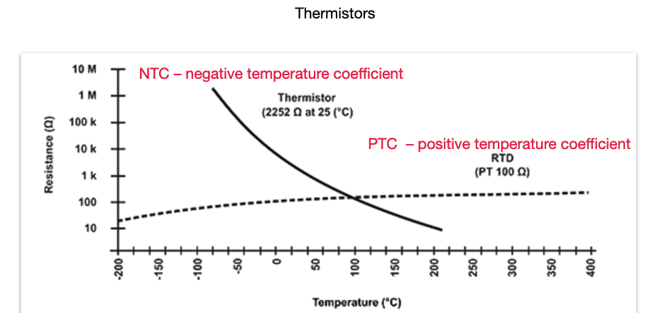
Automatic mode switching
Solution suggested and demonstrated by Alex Kish
Use resistors with large temperature dependance of passively switch between “warm” and “cold” configurations

Slide 12
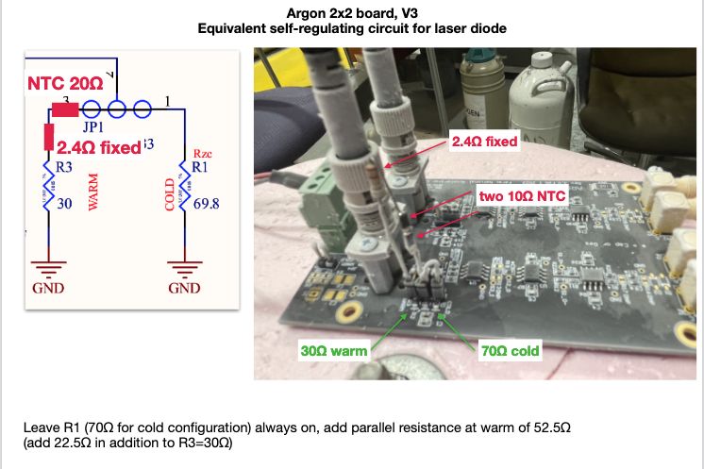
Proof of Concept

Slide 13
New PCB for “Coldbox 3” Test in July
DC/DC converters in SIMM connectors
Up to 8 PoF Photovoltaic receivers (silicon or GaAs)
Argon 2x2 with lasers & laser driver on daughter card

Slide 14
Ongoing Development
When laser diode is operated at a depth of more than ~30 cm of liquid argon, the light coupling to the optical fiber gets much worse (observed first in December coldbox test).
If the laser-fiber coupling is potted, this light loss is not observed.
We are exploring potting materials and methods.
We are also exploring alternative solutions.
The THS4131 is a bipolar amplifier and should have a very long lifetime at cryogenic temperature. The SiGe bipolar transistor and laser diode should also both have very long lifetimes cold.
However, the OPA354 is a CMOS part, so its lifetime will need to be demonstrated or we will need to find an alternative part.
We are considering circuit modifications that would allow the OPA354 to be operated with greatly reduced bias voltage (now operated at 5V; 7.5V is rated max).

Slide 15
Warm Electronics
In tests to date we have used the Koheron PD100. This board includes a GaAs photodiode and a transimpedance amplifier with a single ended output.
In December we captured data from up to four readout channels using a digital oscilloscope.
Going forward we expect to use the DAPHNE readout being developed for the FD1 (horizontal drift) photodetector system.

Slide 16
DAPHNE 40 Channel Readout Board
Uses an “analog front end” IC intended for use in ultrasound (TI AFE5808A).
The DUNE 62.5 MHz master clock is used to generate the waveform sampling clock.
14-bit data is output in a serial format for each channel in parallel.
Data is collected by an inexpensive Xilinx FPGA and transmitted to FELIX using one or two 4.8 Gbps optical links.
A microprocessor is used for configuration and control.

Slide 17
DAPHNE Status
12 DAPHNE boards were produced in 2021
A modest number of design/layout errors were found, but boards are usable. The analog channel has been proven to work well (next 3 slides).
Firmware development has been slowed by Covid, but is beginning to converge. A software and firmware build is now available that will enable DAPHNE to be used in QC of SiPMs and cold electronics. Full integration with the DAQ is unlikely until after most if not all of the FD1 coldbox testing of APAs for ProtoDUNE-II has been completed.
A minor design revision has been completed that corrects the errors and enables the use of up to 4 output links to FELIX as well as a gigabit Ethernet output that can be used in bench tests.

Slide 18
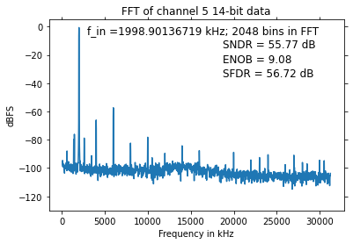
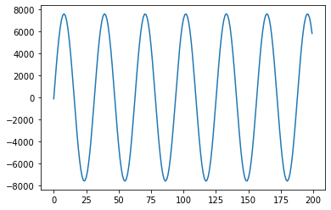
DAPHNE Analog Performance (1/3)
Differential input 800mV_{pp} (matches FD1 CE); DAPHNE channel gain adjusted to yield close to full-scale ADC output. Differential to single-ended conversion at input; 100 Ohm termination of SE input to AFE chip.
Measured ENOB reflects AFE non-linearity for large signals.

Slide 19
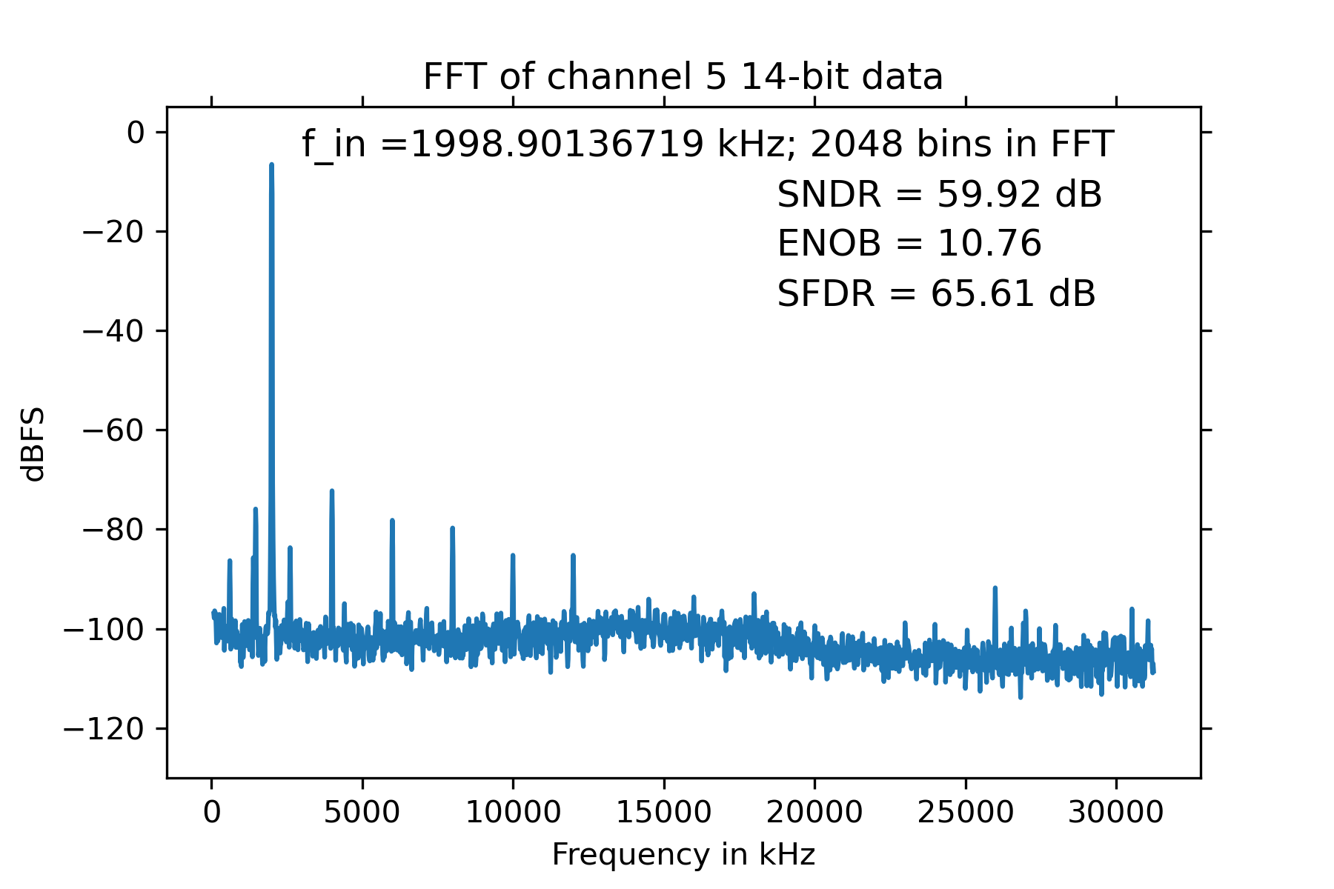
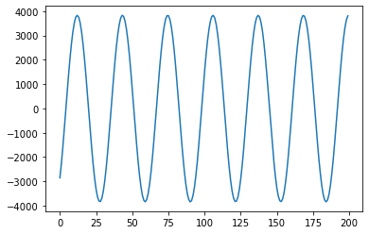
DAPHNE Analog Performance (2/3)
Linearity is significantly better in central part of ADC range (consistent with evaluation board measurements)

Slide 20
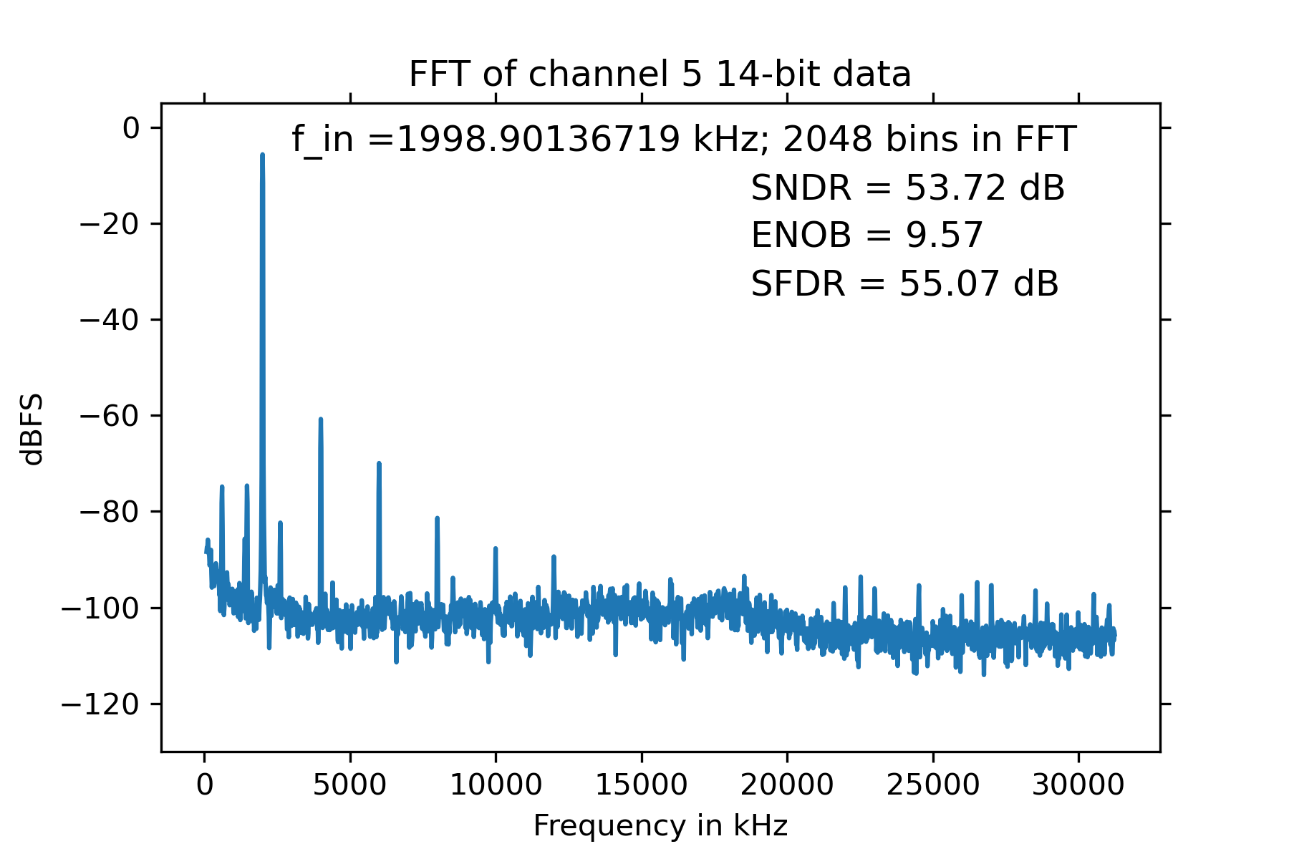
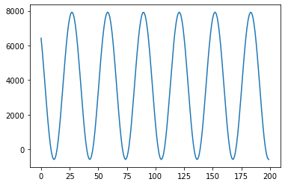
DAPHNE Analog Performance (3/3)
DAPHNE allows the pedestal to be offset from 0 so that (close to) the 14-bit dynamic range of the ADC can be used.
Each channel can be adjusted individually.

Slide 21
Use of DAPHNE with Cathode-Mounted PDS
Some DAPHNE features will not be used (SiPM bias).
One modification will be required:
The optical signal is single ended.
It will be necessary either to bypass the differential to single ended input stage of DAPHNE or to add a single ended to differential converter to the photodiode output (Koheron).
In the longer term, one might produce a version of DAPHNE in which the transformer chips are replaced by photodiode arrays so that the optical signal can be accepted directly. This version could be simplified by removing the SiPM bias circuitry.

