Slide 1
FD2-VD Photon Detection System Mechanical Design
David Warner
FD2-VD Photon Detector Preliminary Design Review
3-4 May 2022

Slide 2
Preliminary Design Definition
Charge question 5:
“The preliminary design maturity level for the sub-system to be recommended to proceed to final design is typically 40%-60%. Is the system at this level or is it less (e.g. 30%)?”
We present the Cold Box 1 design which meets basic PD system requirements. Drawings and specifications are available for this design.
Alternative designs are still in play, both in detector mechanics and other facets of the design. We will show that the CB1 est module is a credible baseline design, and a plan to evaluate the alternates. Drawings and specifications exist where appropriate.
We discuss design alternates to be studied in the cold box testing arc prior to presenting a final design in late 2022-early 2023
We point out that the project schedule requires very rapid progress which significantly constrains out review schedule
We will continue to exploit the similarities between FD1 and FD2 photodetectors both for nearly duplicated components (for example SiPMs and WLS plates) and for testing plans (for example cold electronics validation

Slide 3
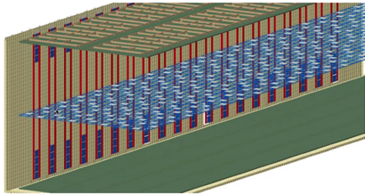
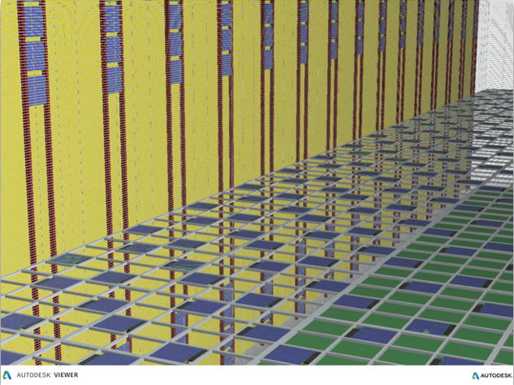
Photon Detector System Layout
Photon detectors mounted in two locations:
Inside the cathode plane assemblies “Cathode mount modules”.
Behind the cathode planes near the anode planes to increase efficiency far from the cathode “Membrane mount modules”.
Configuration details:
320 cathode mounted double sided X-ARAPUCAs (detect light from both sides). These utilize power and readout over fiber.
320 membrane mounted single sided X-ARAPUCAS (detect light just from one side). May use conventional readout. 70% transparent field cage to increase photon collection through field cage.

Slide 4
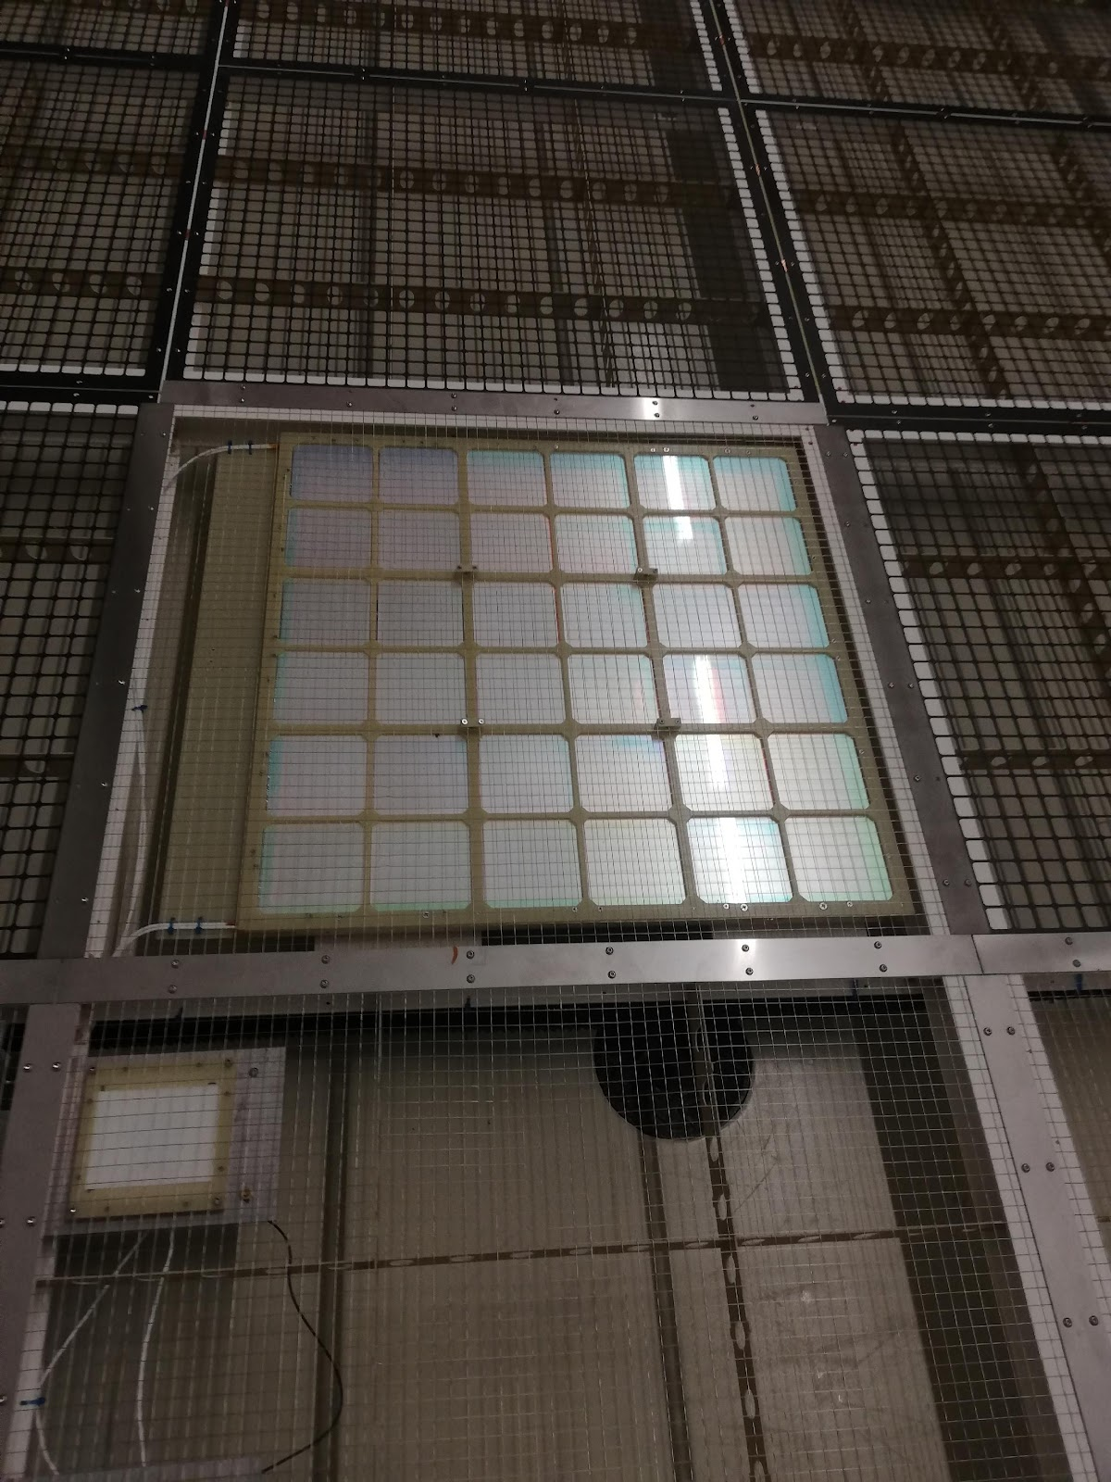
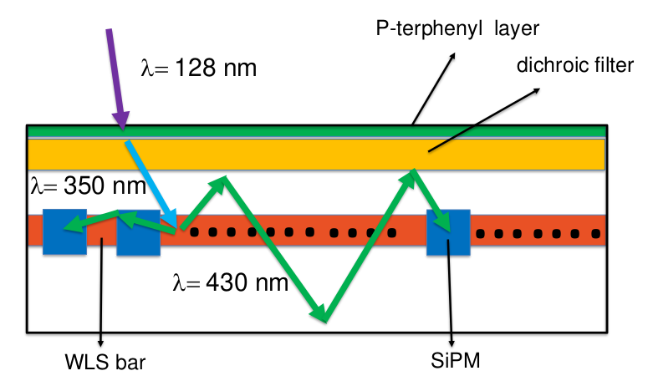
FD2-VD X-ARAPUCA Concept
60 cm X 60 cm active area X-ARAPUCA
Light detected with 160 SiPMs (ganged in groups of 80 to two channels.
Groups of 20 SiPM passively ganged (hybrid series-parallel scheme).
4 groups of 20 SiPMs actively ganged to a single readout channel.
SiPMs mounted to kapton flexible board to better match WLS plate thermal contraction.
Dichroic filter coated with pTP.
High efficiency light guide developed by G2P and INFN (Milano Bicocca).
Note: Not to
scale)
CB1 Prototype

Slide 5
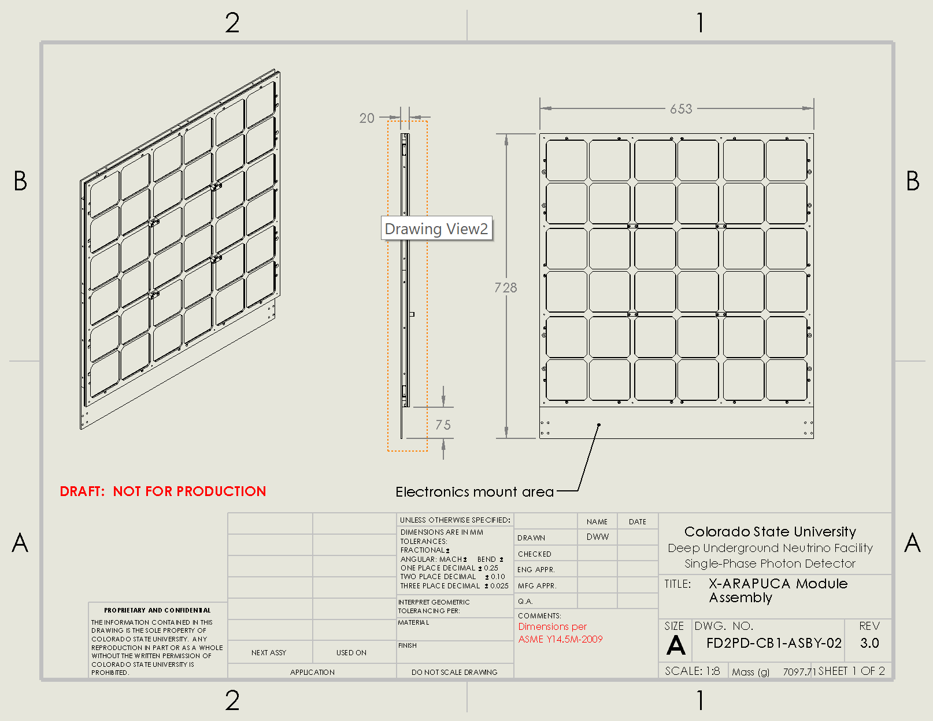
Module Assembly Drawing (CB1)
Mechanical drawings and .STEP models of initial prototype (Cold Box 1) available in review documentation. Initial .STEP model of CB3-4 module (but no drawings) also available
FR-4 frame housing 653 X 728 X 20mm³ frame.
Approximately 7.1 kg mass (dry) neglecting electronics (< 15kg required by cathode).
Approximately 600 X 600mm² active area (36 dichroic filter plates ~100 X 100mm² ).
Electronics mounting platform integral to design.

Slide 6
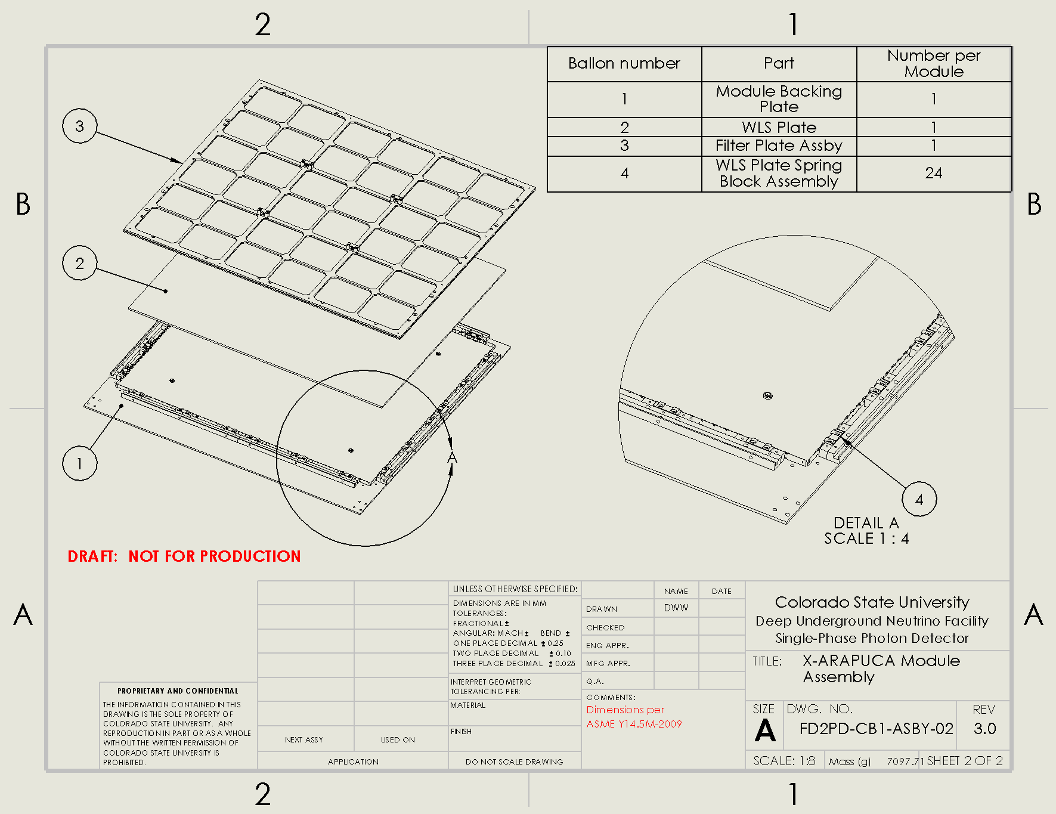
Module Assembly Exploded (CB1)
Major mechanical elements of module include:
(1) Module backing plate (can be replaced by second filter plate assembly for 2-sided readout).
(2) 599 X 599 X 4mm³ WLS plate.
(3) FR-4 frame housing and locating 36 dichroic filters (separate sub-assembly).
(4) Spring-loaded SiPM mounting system for ensuring contact with WLS plate warm and cold.
Interesting point: ~6mm relative contraction

Slide 7
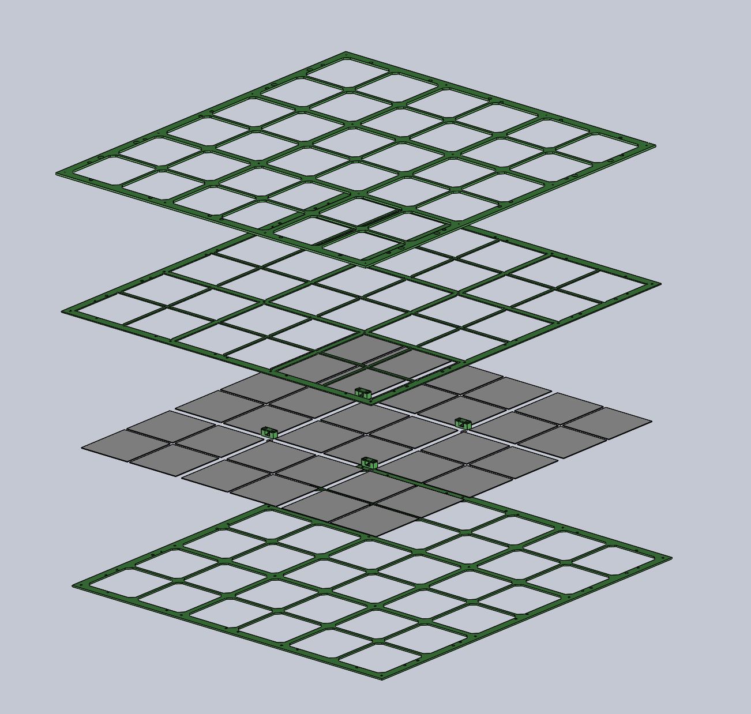
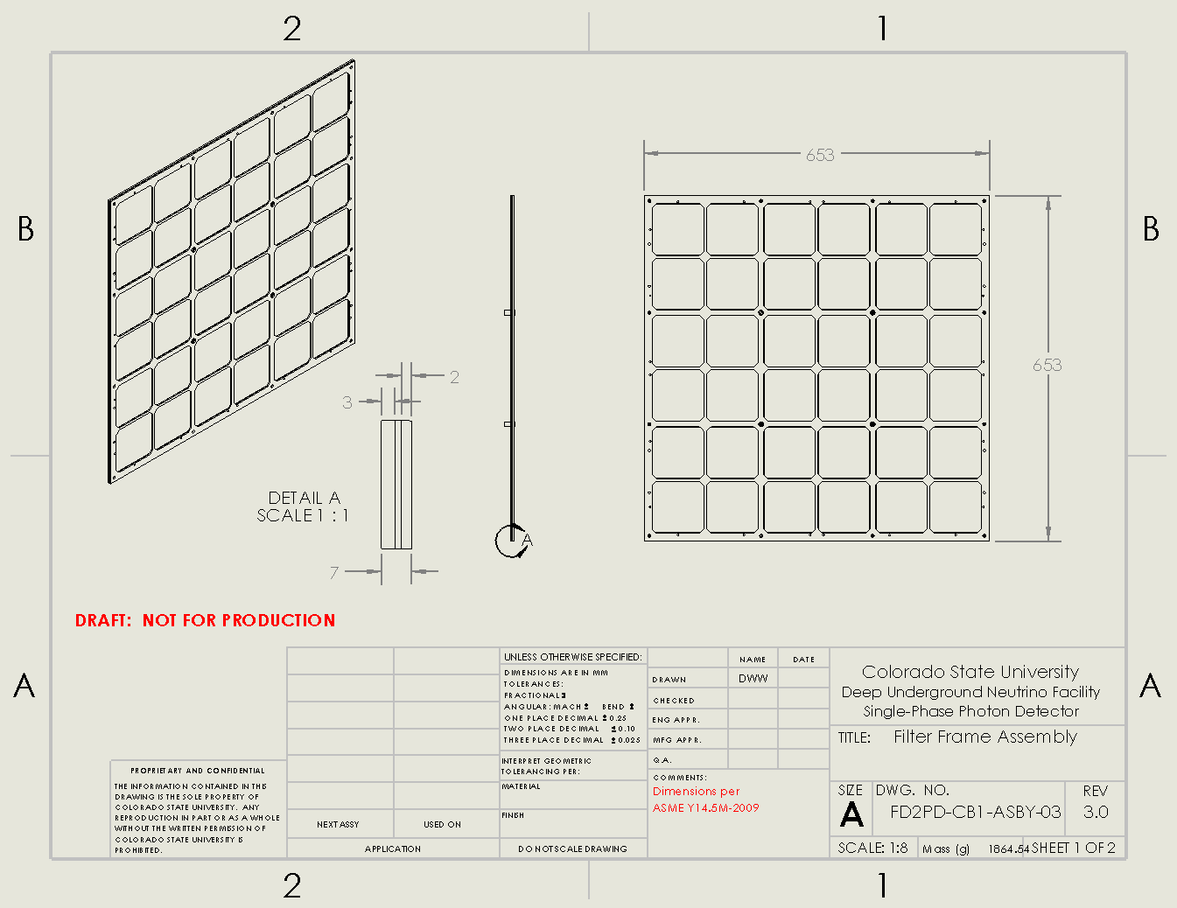
Dichroic Filter Plate Assembly
Outer support
Plate
Independent support frames for filter plates.
Can be installed on one side (membrane mount) or both sides (cathode mount) of a PD module.
Filter locating
plate
Dichroic filter
Plate array
Inner support
Plate

Slide 8
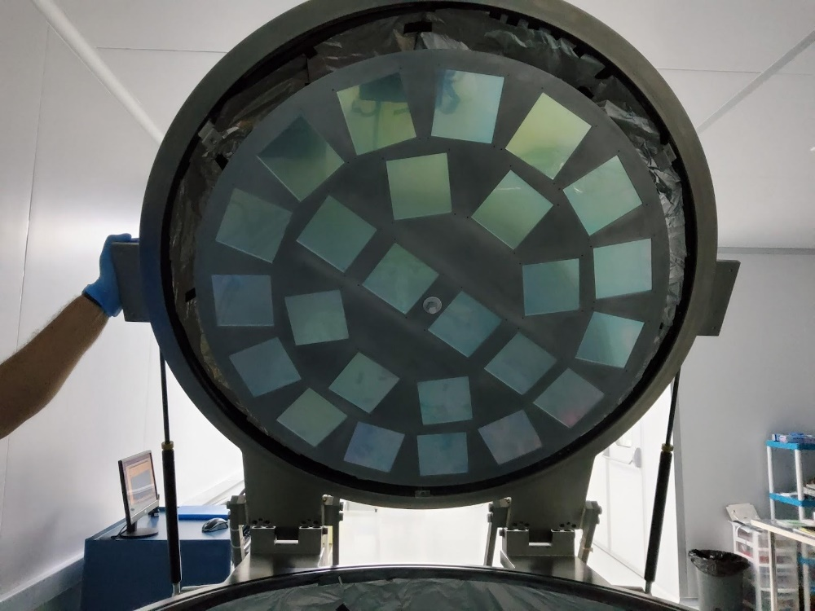
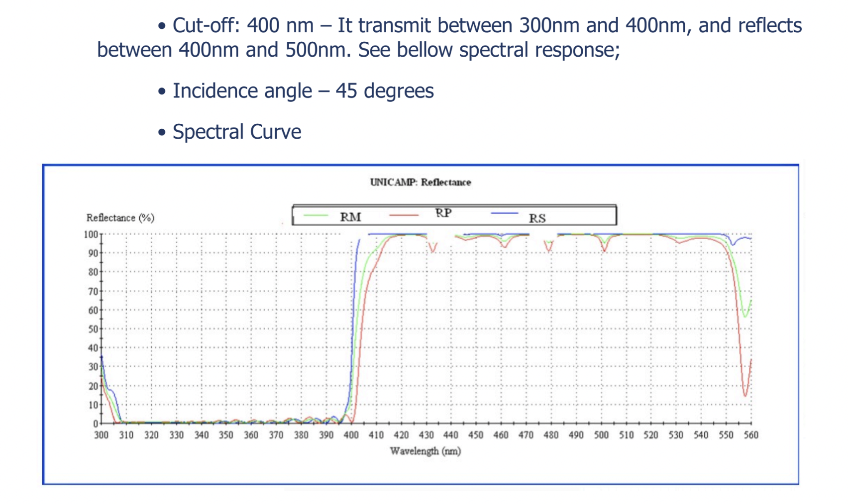
Dichroic filters (CB1) A. Machado, UNICAMP
CB 1 filters:
Dimensions: 97mmX97mmX1mm
Subtrate: Schott B270
(https://www.schott.com/en-ua/products/b-270-p1000313)
Dichroic film produced by OPTO (Brazil) - 40 layers of Tantalum Oxide (Ta2O5) and Silicon Dioxide (SiO₂)
Cutoff: 400nm
Designed for a angle of incidence of 45º
Coated on the glass side with p-Terphenyl by a vacuum evaporator chamber at UNICAMP (average thickness 400 ug/cm²)
Evaporation production: 25 filters per cycle (3hours)
Vacuum deposition station at UNICAMP

Slide 9
Dichroic filters (optimizations for CB3 and 4)
Filter optimizations for CB3, 4
Comparison tests between multiple vendors: OPTO (BR) – ZAOT (IT) – Photon Export (SPA)
Examine filters optimized to different AOI → Improve the trapping efficiency of X-ARAPUCA
different substrate (B270, B33) → to optimize the transmission and adhesion of the pTP film
different dimension and thickness (e.g 200mm X 200mm X 2mm) to optimize the fill factor of the X-ARAPUCA tile and robustness

Slide 10
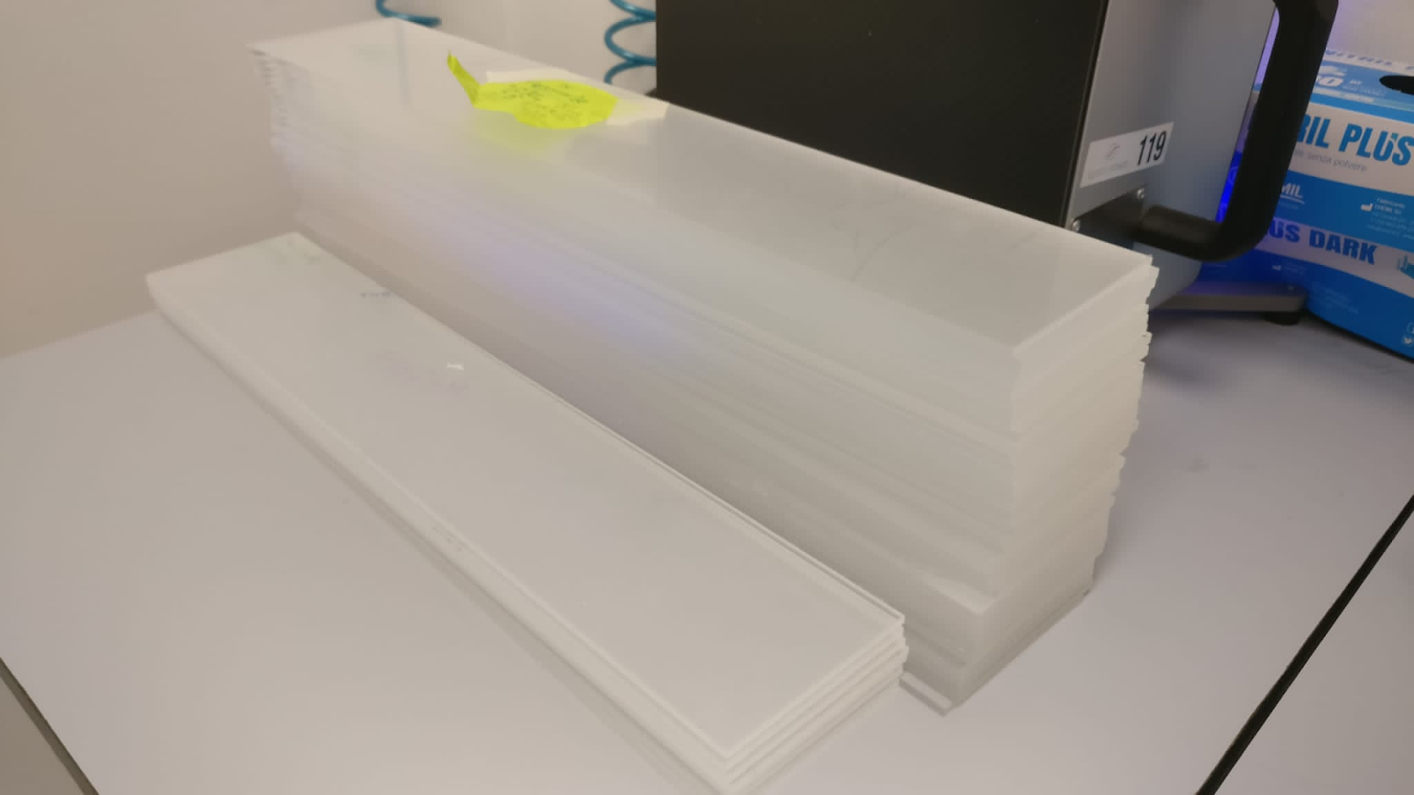
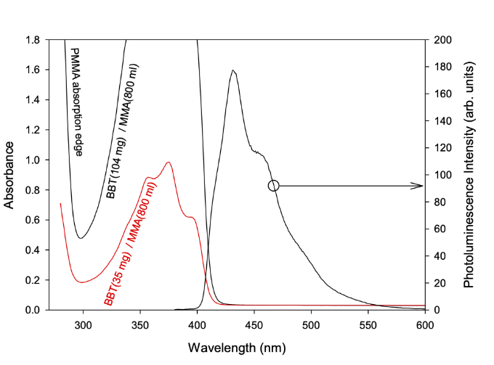
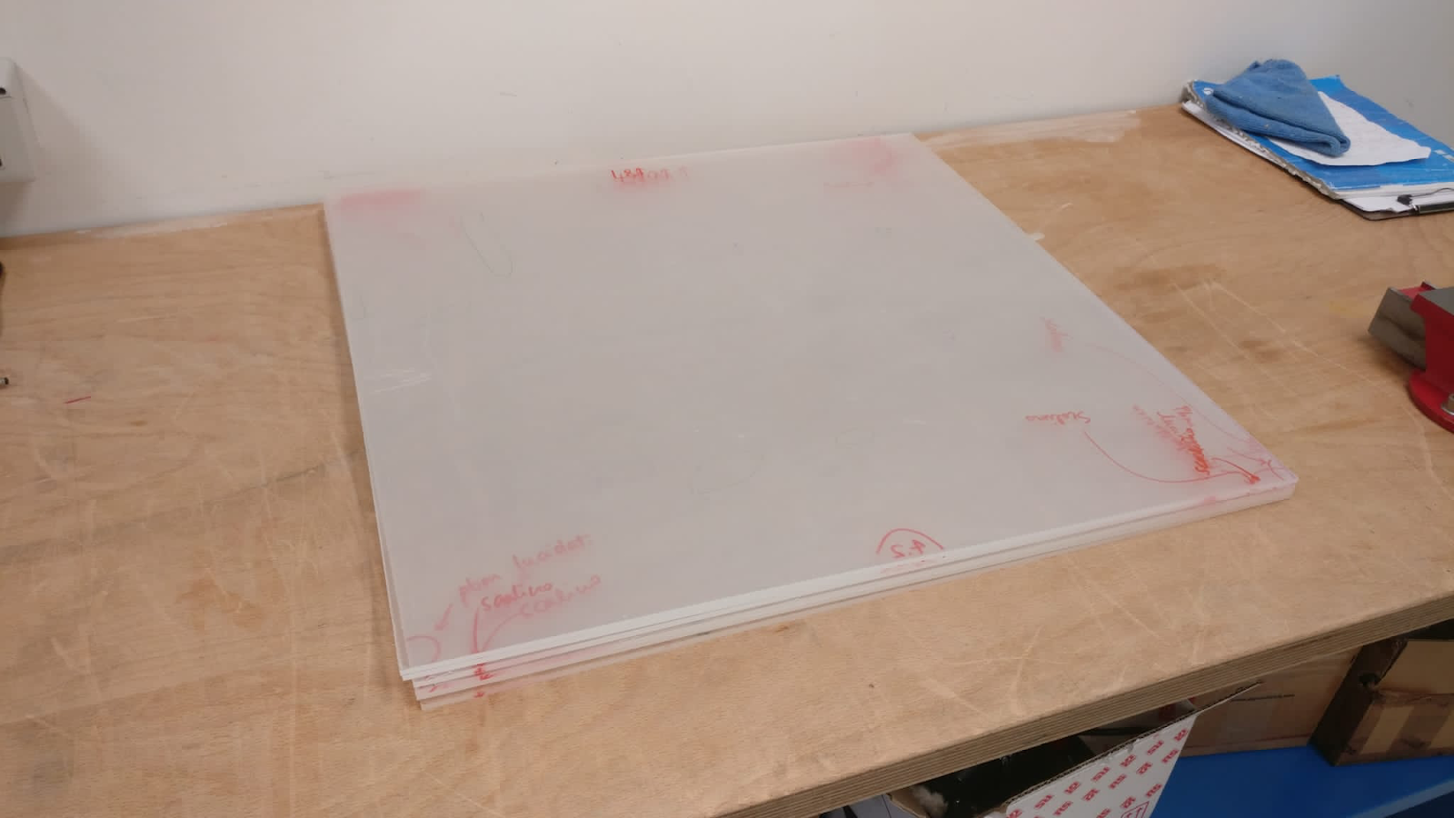
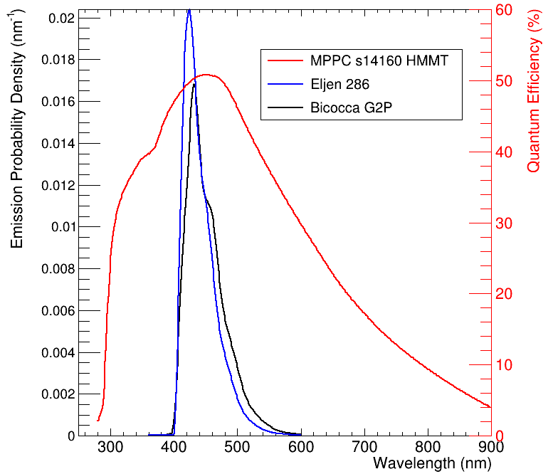
WLS Plate detail C. Cattadori, Milano Bicocca
Large size High efficiency WLS Tiles
Fabricated from PMMA base resin:
Proven to be cryoresiliant in FD1-HD testing.
Cast from monomer syrup.
Cromophore tuned to minimize absorption/emission spectra overlap.
Absorption length >=1 m.
Laser cut and polished at the edges.
90 WLS light guide slabs for the DUNE HD-PDS: 480 x 93 x 4 mm²
Optimized for dichroic filters…
5 WLS slabs for VD-PDS: 600 x 600 x 4 mm²
…and for SiPMs

Slide 12
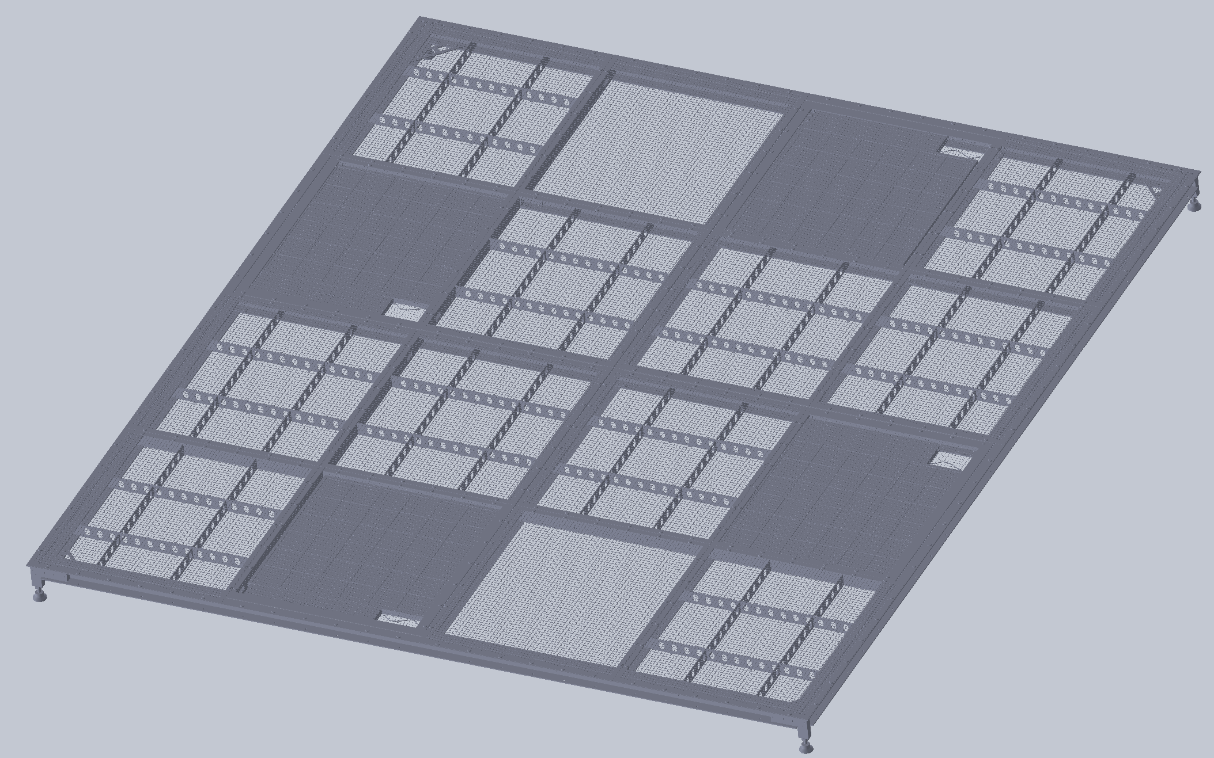
Module frame support-- Cathode
Cathode-mount PD modules are supported on the G-10 cathode frames (inside mesh), 4 modules per frame.
Four G-10 supports will be mounted to the inside of the cathode frame and the module mounted to those (exact positions TBD).
Exact module configuration within the cathode plane is still under discussion (See R. Rivera talk), but is not foreseen to impact the design.
PD Module frame and cathode frame both manufactured from G-10 to minimize CTE issues.
G-10 fiber plane configuration considered.
Power and signal fibers routed through frame (see D. Pushka presentation.

Slide 13
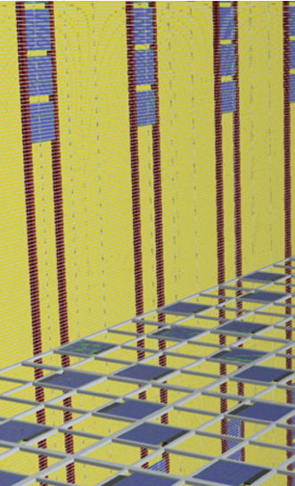
Membrane Mount Module Design and Mounting
Membrane mount modules are primarily a EU responsibility, and as such are only just beginning to move into the design phase.
P6 costing and cold box test planning foresee using a very similar module design and mounting scheme for the membrane mount modules.
Significant
Since membrane mount modules are single-sided, we have significant flexibility to add mounting points to the rear side of the modules.
Infrastructure for cable trays exists in this region of the detector. Significant effort will be taken to leverage this infrastructure to support the PD modules. Additional supports will be added if needed.
Since the membrane mount modules do not need to mount inside the cathode frame nor operate at HV, additional flexibility for module design exists. Design teams in Spain and Italy are beginning to study if we want to leverage this flexibility to re-optimize the module design.
Shared cable trays (with bottom CE) or independent supports

Slide 14
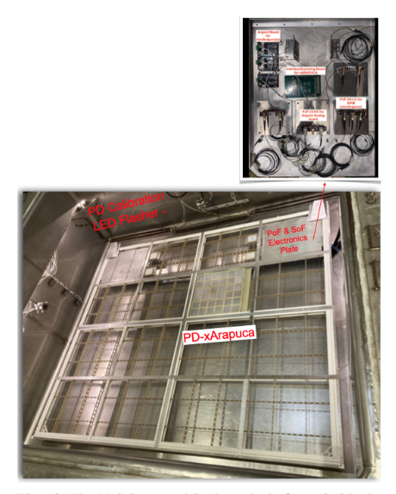
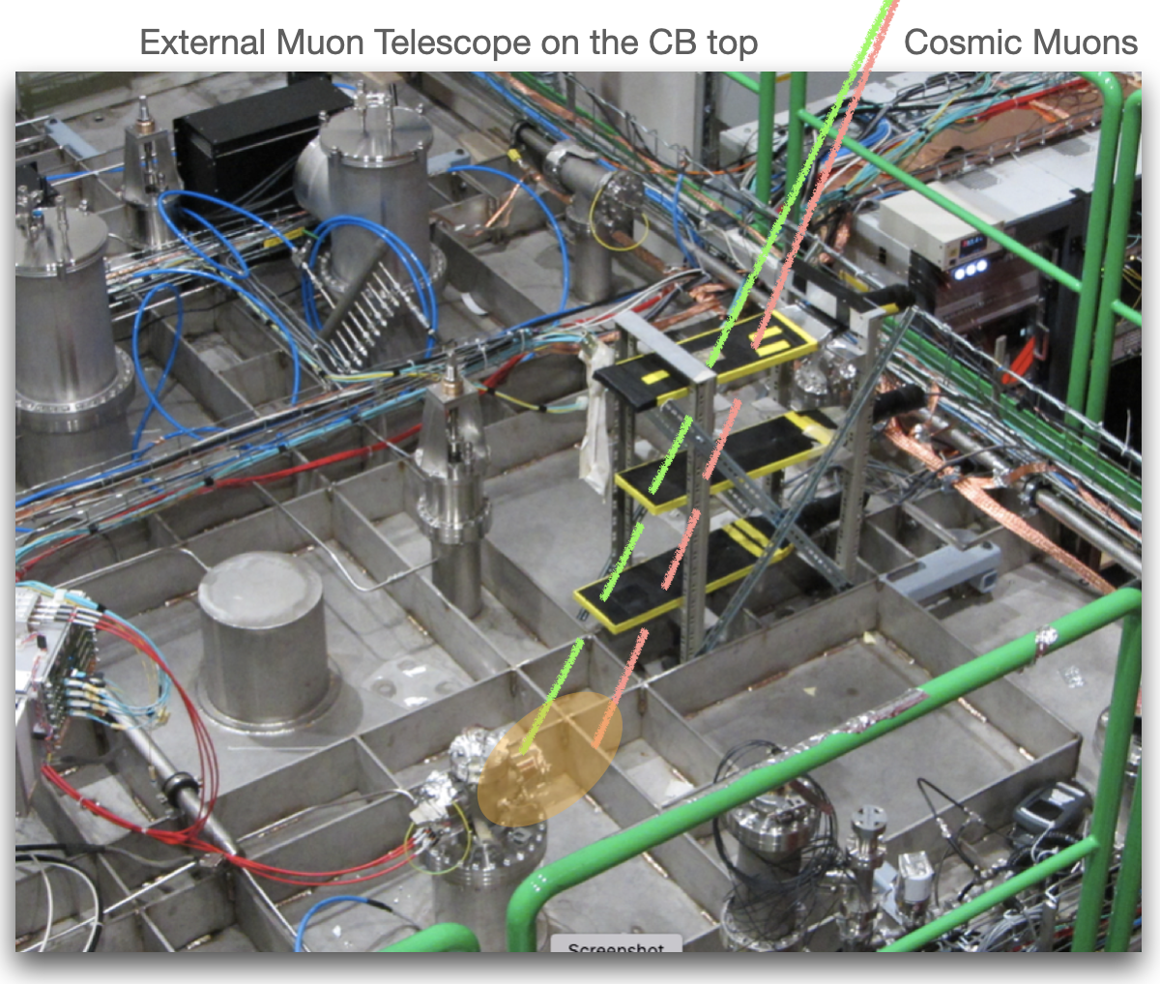
Mechanical Prototyping Path
Cold Box 1 at CERN:
Demonstration of full scale X-ARAPUCA
One 60 cm X 60 cm X-ARAPUCA tile installed on the cathode.
Successful operation in LAr at HV on cathode represents initial design validation.
Validation of spring-loaded SiPM mounting concept for SiPMs (with significant lessons learned!).
Will inform continuing designs.

Slide 15
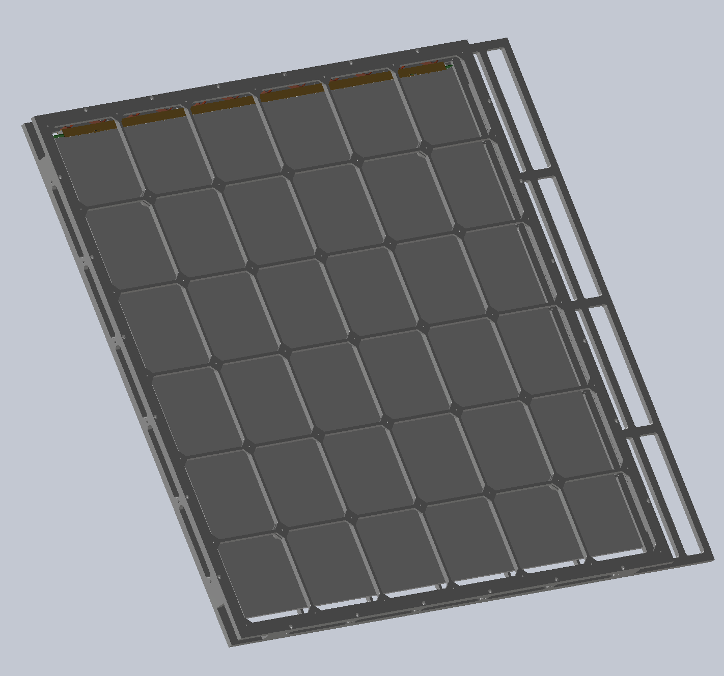
Towards a Final Module: Cold Box 3 and 4
Proposed module improvements to be tested in CB 2 and 3 include:
Larger dichroic filters (200 X 200mm², 2mm thick) to minimize mechanical light loss (Has impacts of frame strength, mass. Under investigation)
Direct optical coupling (epoxying) of SiPMs to WLS plate (Requires validation of epoxy performance cryogenically)
Light-focusing cutouts (“Divots”) in the side of WLS plates to improve spring-loaded light collection (Thermal expansion issues. Under investigation)
Mechanical improvements to reduce part count, reduce mechanical dead areas, and improve manufacturability.
P. Debbins
U of Iowa)

Slide 16
Design improvements: Leaf springs and Cathode HV Shielding
As a result of CB1 testing, we are in the process of improving the module design for later cold box tests.
Revisions include HV shielding and improved SiPM spring loading.
Possible shield locations (Outer cover preferred optically, inner cover may be electrically superior).
Drawings from P. Debbins
U of Iowa)

Slide 17
2022/2023 Progression
Cold Box progression:
July ‘22 CRP CB3 ⇒ test of SiPM mounting and improved mechanical design
Min Viable product ⇒ one full module works on the cathode
Extra CB3+ possible -- Sep ‘22 PDS CB ⇒ Flex, Better packaged PoF & readout.
Min Viable product ⇒ one full chain works on the cathode
Min Viable product ⇒ one full chain works on the membrane
Nov ‘22 CRP CB4 ⇒ Preliminary module-0; Components moved to module-0.
Min Viable product ⇒ one full chain works on the cathode
Min Viable product ⇒ one full chain works on the membrane
Extra CB4+ planned -- July ‘23 PDS CB ⇒ Final packaging PoF & readout.
Min Viable product ⇒ one full chain works on the cathode
Min Viable product ⇒ one full chain works on the membrane
Module-0 demonstration:
Install March ‘23
Survival of HV discharge
Mechanical installation procedure
Small-scale Cold Tests:
Downselect filter configuration
Downselect SiPM mounting

Slide 18
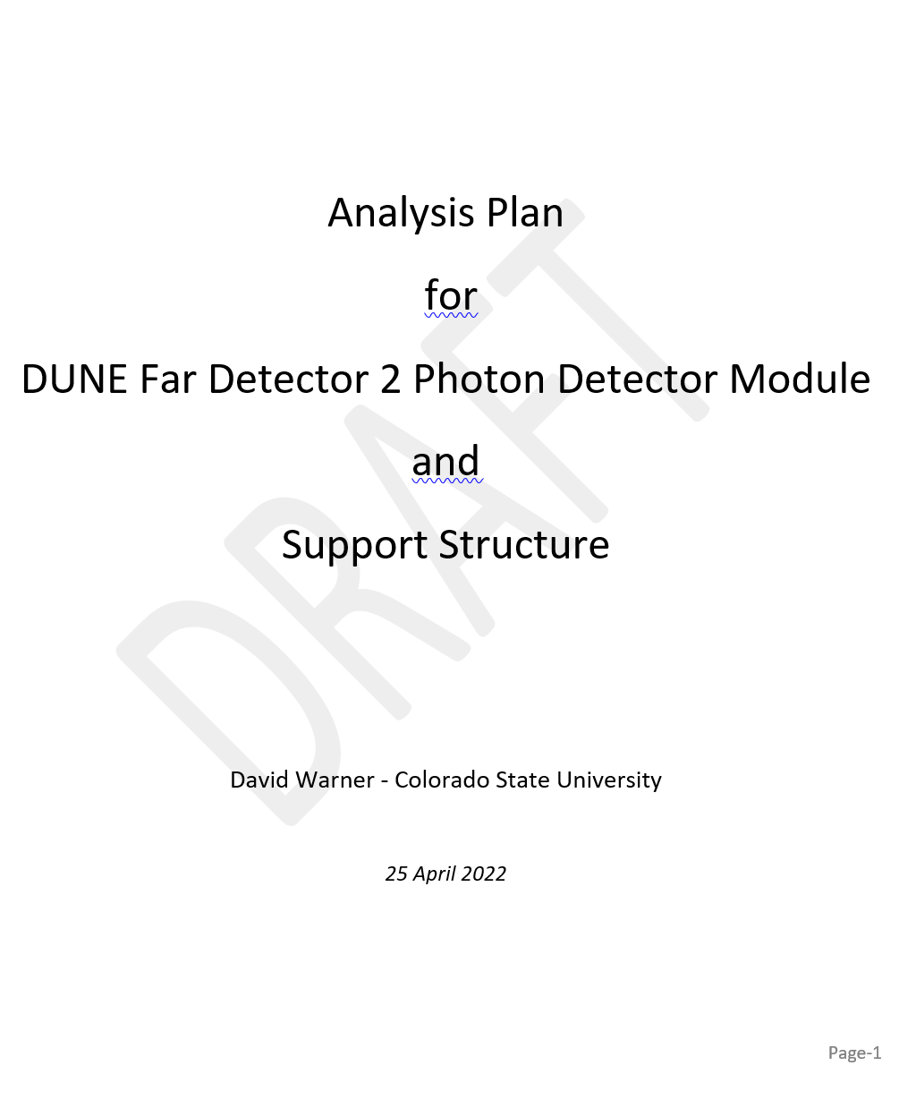
Analysis Plan
Initial draft of analysis plan document (mechanical) is with the compliance office now.
Initial (Brief!) conversation with Olga Beltramello held at CERN 4/26. Initially positive discussion.
Main PD consortium responsibilities include:
(LC-2.2.1-A) Loads due to relative thermal expansion of the module relative to the CPA frame, particularly as related to module/frame mechanical tolerances and the need to maintain electrical contact following cool-down
(LC-2.2.2-B) Loads due to detector masses and support cable self-load of the membrane mount PD system. This load will also include any cable and/or fiberoptic mass (I&I interface).
(LC-2.2.2-C) Loads due to relative thermal contraction between the cryostat, support cables, and optical fibers due to differential cooling during cryostat filling and different coefficients of thermal expansion (CTEs)
Critical point: Need to confirm that Cathode consortium and I&I will include PD modules in their analysis of load cases.
Expected to be recommendation from compliance office.
Will be coordinated through project office.

Slide 19
Summary
A mechanical design has been developed, mounted in a cathode frame, and operated at HV
This design provides the basis of estimate for the FD2-VD PD
No “Show-stoppers” were found
Significant opportunity for improvements exist, and will be tested in the cold box tests at CERN prior to Module 0.
Membrane mount design optimization is beginning now as additional consortium resources come online. No significant modifications are REQUIRED, but opportunities may exist.

Slide 20
Backup

Slide 21
xARAPUCA
Cold Box pictorial schedule
mini-ARAPUCA
Cold Box
Test stand
Parasitic ARIADNE run
CRP2 PDS install is 18 April 2022
CRP3 Cold Box PDS install is July 2022
Cold Box #4 PDS install is October 2022
Cold Box #5 (no CRP) PDS install is June 2023
21

