Slide 1
FD2_Vertical Drift PSD Fiber Install Sequence
Dave Pushka
DUNE FD2 PDS Installation
3-May-2022

Slide 2
Assumptions:
CRP and Cathode are installed before Field Cage
Cathode has PDS pre-mounted and PDS Fiber Optic are terminated to the electronics of the PDS on the Cathode
It is superior to work from ground level rather than from elevated platforms:
  Higher efficiency
Constraints on going down or thru the field cage and unbalances weights on FC
Goal is to avoid permanent mechanical failure (bubbling or contamination):
  Conservative bending radius of 20cm (17cm target; 13cm minimum)

Slide 3
Assumptions (continued):
No fiber optic couplers are used; the fibers are continuous from the PDS to the cryostat feed thrus.
The current installation plan was chosen under the assumption that a patch panel in the cryostat is not viable.
The validity of this assumption is under study.
If a patch panel is shown viable, then the alternative installation path of preinstalled fibers on the membrane and patch panel on the floor will be reconsidered along with cost, schedule, and risks.
Inefficient connector
mating can cause
runaway heating.

Slide 4
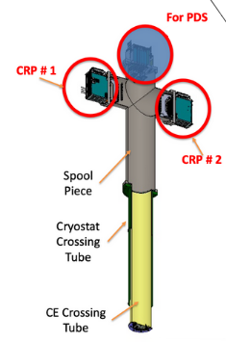
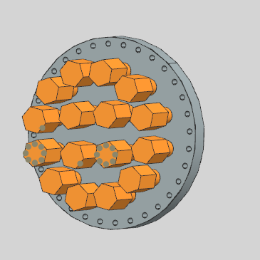
Connections at the penetrations
PDS shares penetration space with the CRP.
PDS uses the top of a cross to avoid bending of the fibers.
Fiber guides (as yet not designed) will guide fibers thru the penetration and in to the right position along the length of the detector.
Using commercial compression type feed thru into a conflat flange

Slide 5
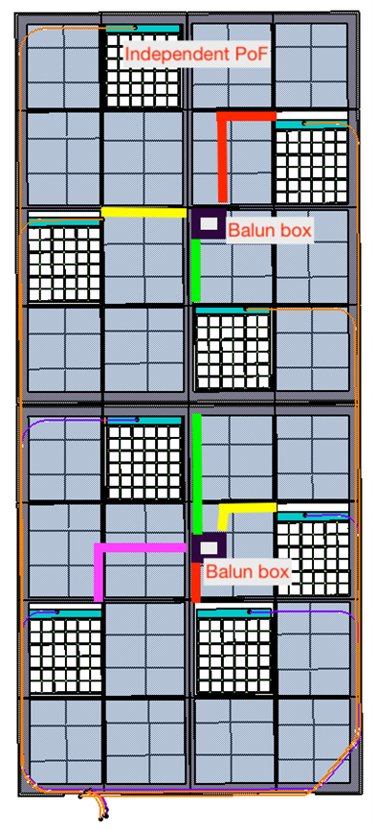
Interface to cathode
Routing of PDS fibers on Cathode courtesy of Phillipe Rosier
Fibers for eight ARAPUCAS are routed to one location.
Exceeding the minimum bend radius of the fibers requires some effort and compromises, but necessary.

Slide 6
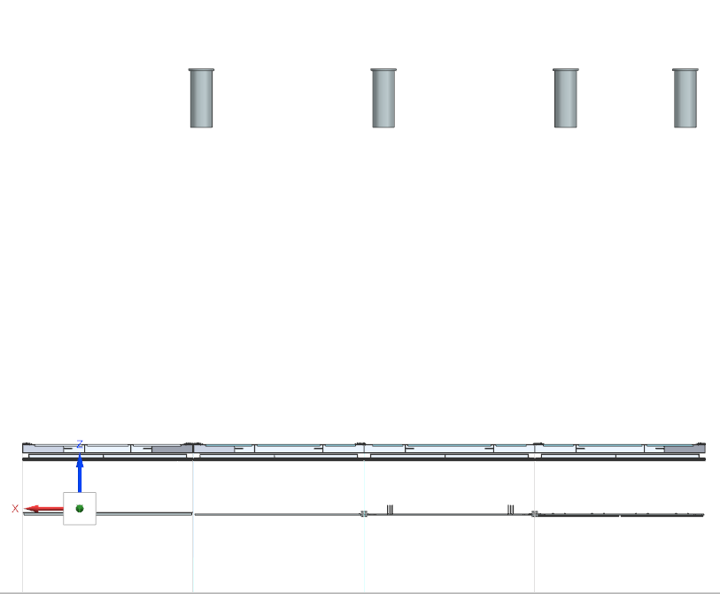
Initial Preparation Steps
CRP is suspended about 2 meters above the floor.
Cathode with the PDS is placed on rolling tables rolled below it.
PDS fibers are already terminated on the cathode.
Coil of PDS fiber is placed on cathode (about 3 to 4 kg of fiber).
Floor

Slide 7
Second Set of Preparation Steps
A fiber pull cord is dropped down from the penetration, thru a guide to align with the right spot on the CRP superstructure to the elevation of the CRP superstructure.
This fiber guide is only necessary because of the difference in the penetration location w.r.t. to the cathode suspension wire location.
Floor

Slide 8
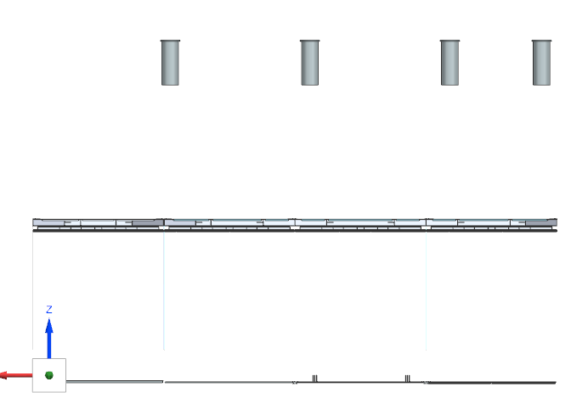
Third Set of Steps
PDS fiber bundle is firmly attached to the CRP superstructure.
Approximately 6 meters of fiber remain between the attachment and the cathode.
Free end of PDS fiber bundle atop the CRP super structure is attached to the pull cord from the penetration.

Slide 9
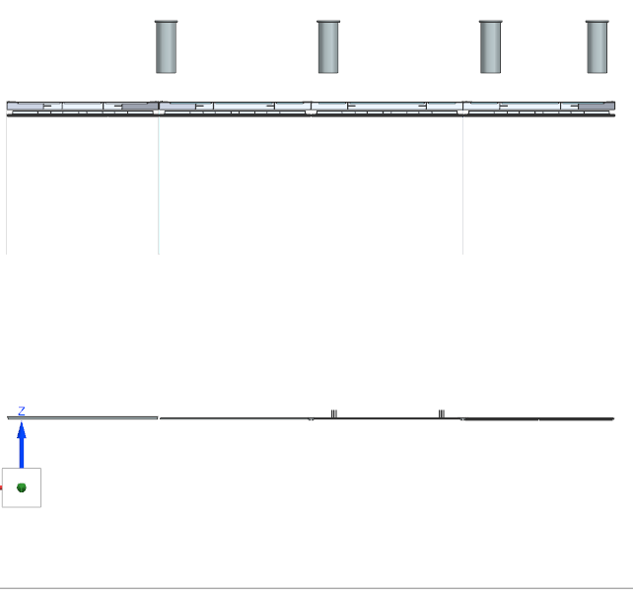
Forth Set of Steps
CRP super structure is raised to final elevation
Cathode lifted to final elevation by suspension cable.
PDS Fibers attached to CRP superstructure and to the cathode suspension cables.
Pull cord is used to draw PDS fibers into penetration and off of the CRP superstructure.
Floor

Slide 10
Efforts to Date
95% of Efforts to Plan the PDS installation has been to understand the geometry.
  No single source of Geometric Data exists
  CAD Data on the EDMS is not all up-to-date
  It appears that each group is building and maintaining their own active assembly model.
  Therefore, Sharing Model files and STEP files between key contributors; A Big Thank-You to:
    Field Cage (Bo Yu at BNL),
    Cathode (Philippe Rosier at IJCLAB)
    CRP (Dominique Duchesneau at LAPP)
    Superstructure Cat Walk (Nicolas Geffroy at LAPP)
    To these teams for sharing their up-to-date CAD models
  Effort expending on model file creation and maintenance represents an opportunity cost, slowing the development of parts, components and using the models to develop installation plans.

