Slide 1
FD2 BDE Installation and Cabling Manhong Zhao, BNL FD2 Bottom Drift Electronics Preliminary Design Review
April 25, 2022

Slide 2
Outline
CE box and installation
Bottom CRP patch panel and cabling
Cryostat Penetration and Cryostat cabling

Slide 3
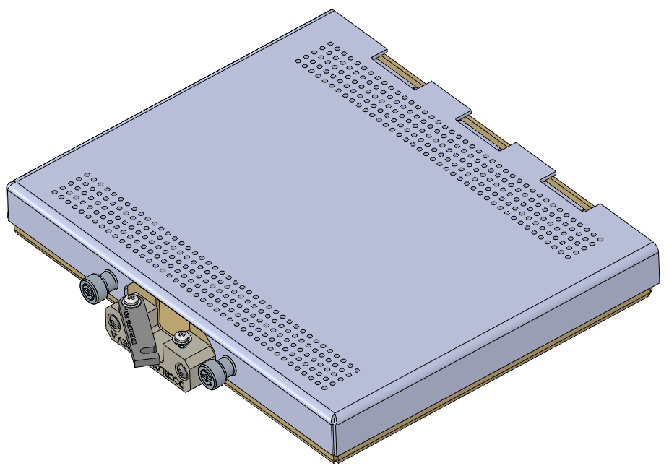
CE Box and Installation
Bottom CRPs are read out by FEMBs. Each FEMB is enclosed in a metallic CE box for electromagnetic shielding and mechanical support. The CE box also provides a strain relief mechanism to secure the cable connection.
Each CE box is installed on a CRP with four mounting screws. Four access holes on the FEMB facilitates installing and removing CE box on/from CRP.
Access holes
Mounting screws
Two 96-pin sockets
Cable strain relief

Slide 4
CE Box and Installation
A bottom CRP consists of two CRUs. Each CRU is readout by 12 CE boxes. In total, 24 CE boxes per CRP. The FEMBs are plugged into the CRP adapter boards via two 96-pin sockets.
Exploded view
Composite frame
CE box
Adapter board
FEMB in CE box
Anode plane
CRU
CRP

Slide 5
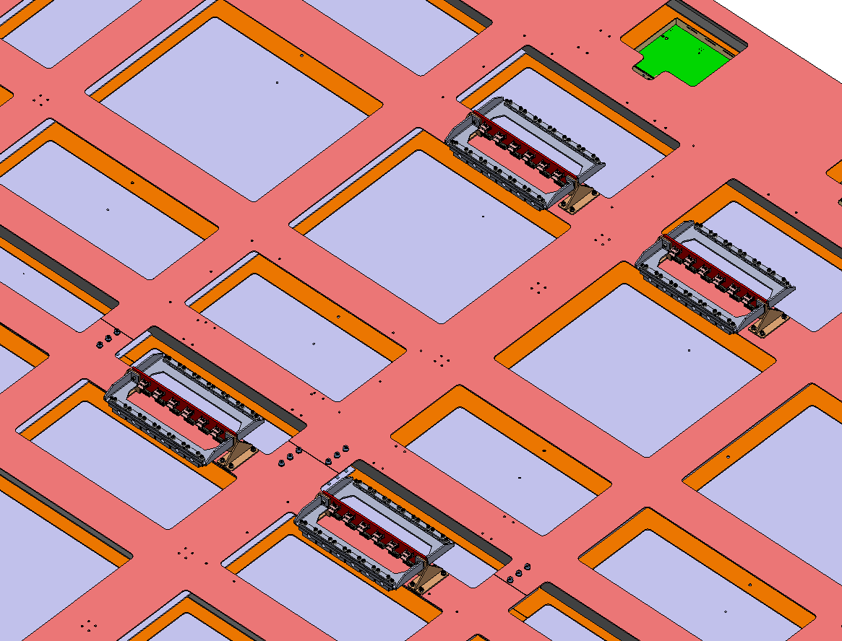
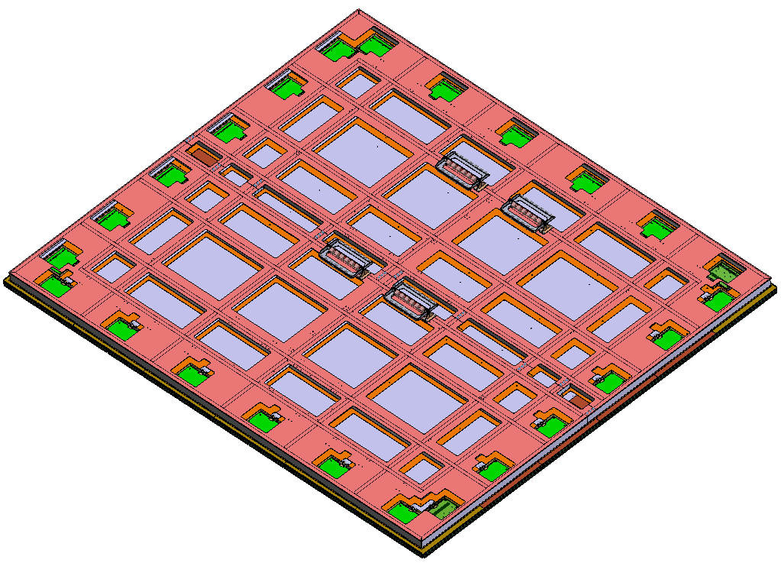
Bottom CRP Patch Panel and Cabling
Patch panels are mounted on the CRP composite frame. A patch panel provides an interface between the CRP cabling and the cryostat cabling. One side of the patch panel receives Mini-SAS cables from the CE boxes. The other side of the patch panel receives Samtec cables from cryostat cabling.
Patch panel assembly
Patch panels installed on CRP composite frame
To FEMBs
To Feedthrough

Slide 6
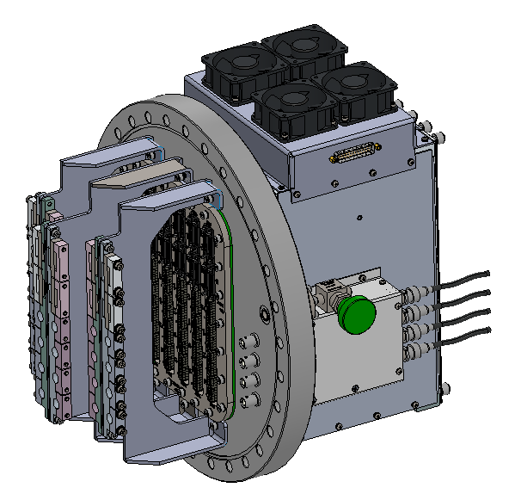
Bottom CRP Patch Panel and Cabling
Cable strain relief brackets of the patch panel adopt a proven design of CE flange brackets in protoDUNE-I.
Cable strain relief brackets of a patch panel
CE flange assembly
To FEMBs
To Feedthrough
Cable strain relief brackets
Exploded View

Slide 7
Bottom CRP Patch Panel and Cabling
Low profile design of the patch panel can easily fit in the space between the CRP and the cryostat corrugation floor.
167mm
56mm
338mm
To Feedthrough
To FEMBs
46mm
282mm

Slide 8
Bottom CRP Patch Panel and Cabling
Patch panel and cable layout*
Four patch panels are needed for one CRP. Each patch panel receives cables from six FEMBs.
Max cable length required to connect the FEMBs to the patch panel is 2m ~ 2.5m.
*It doesn’t show the actual cable length or exact location. It only schematically shows the connections between CE boxes and patch panels.

Slide 9
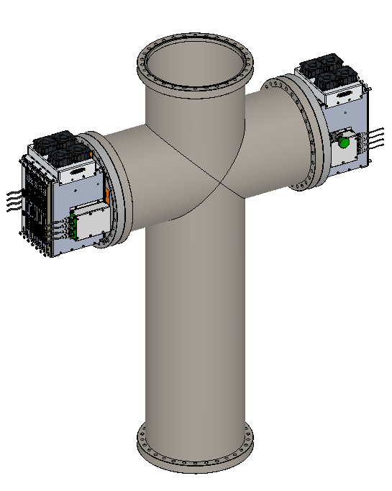
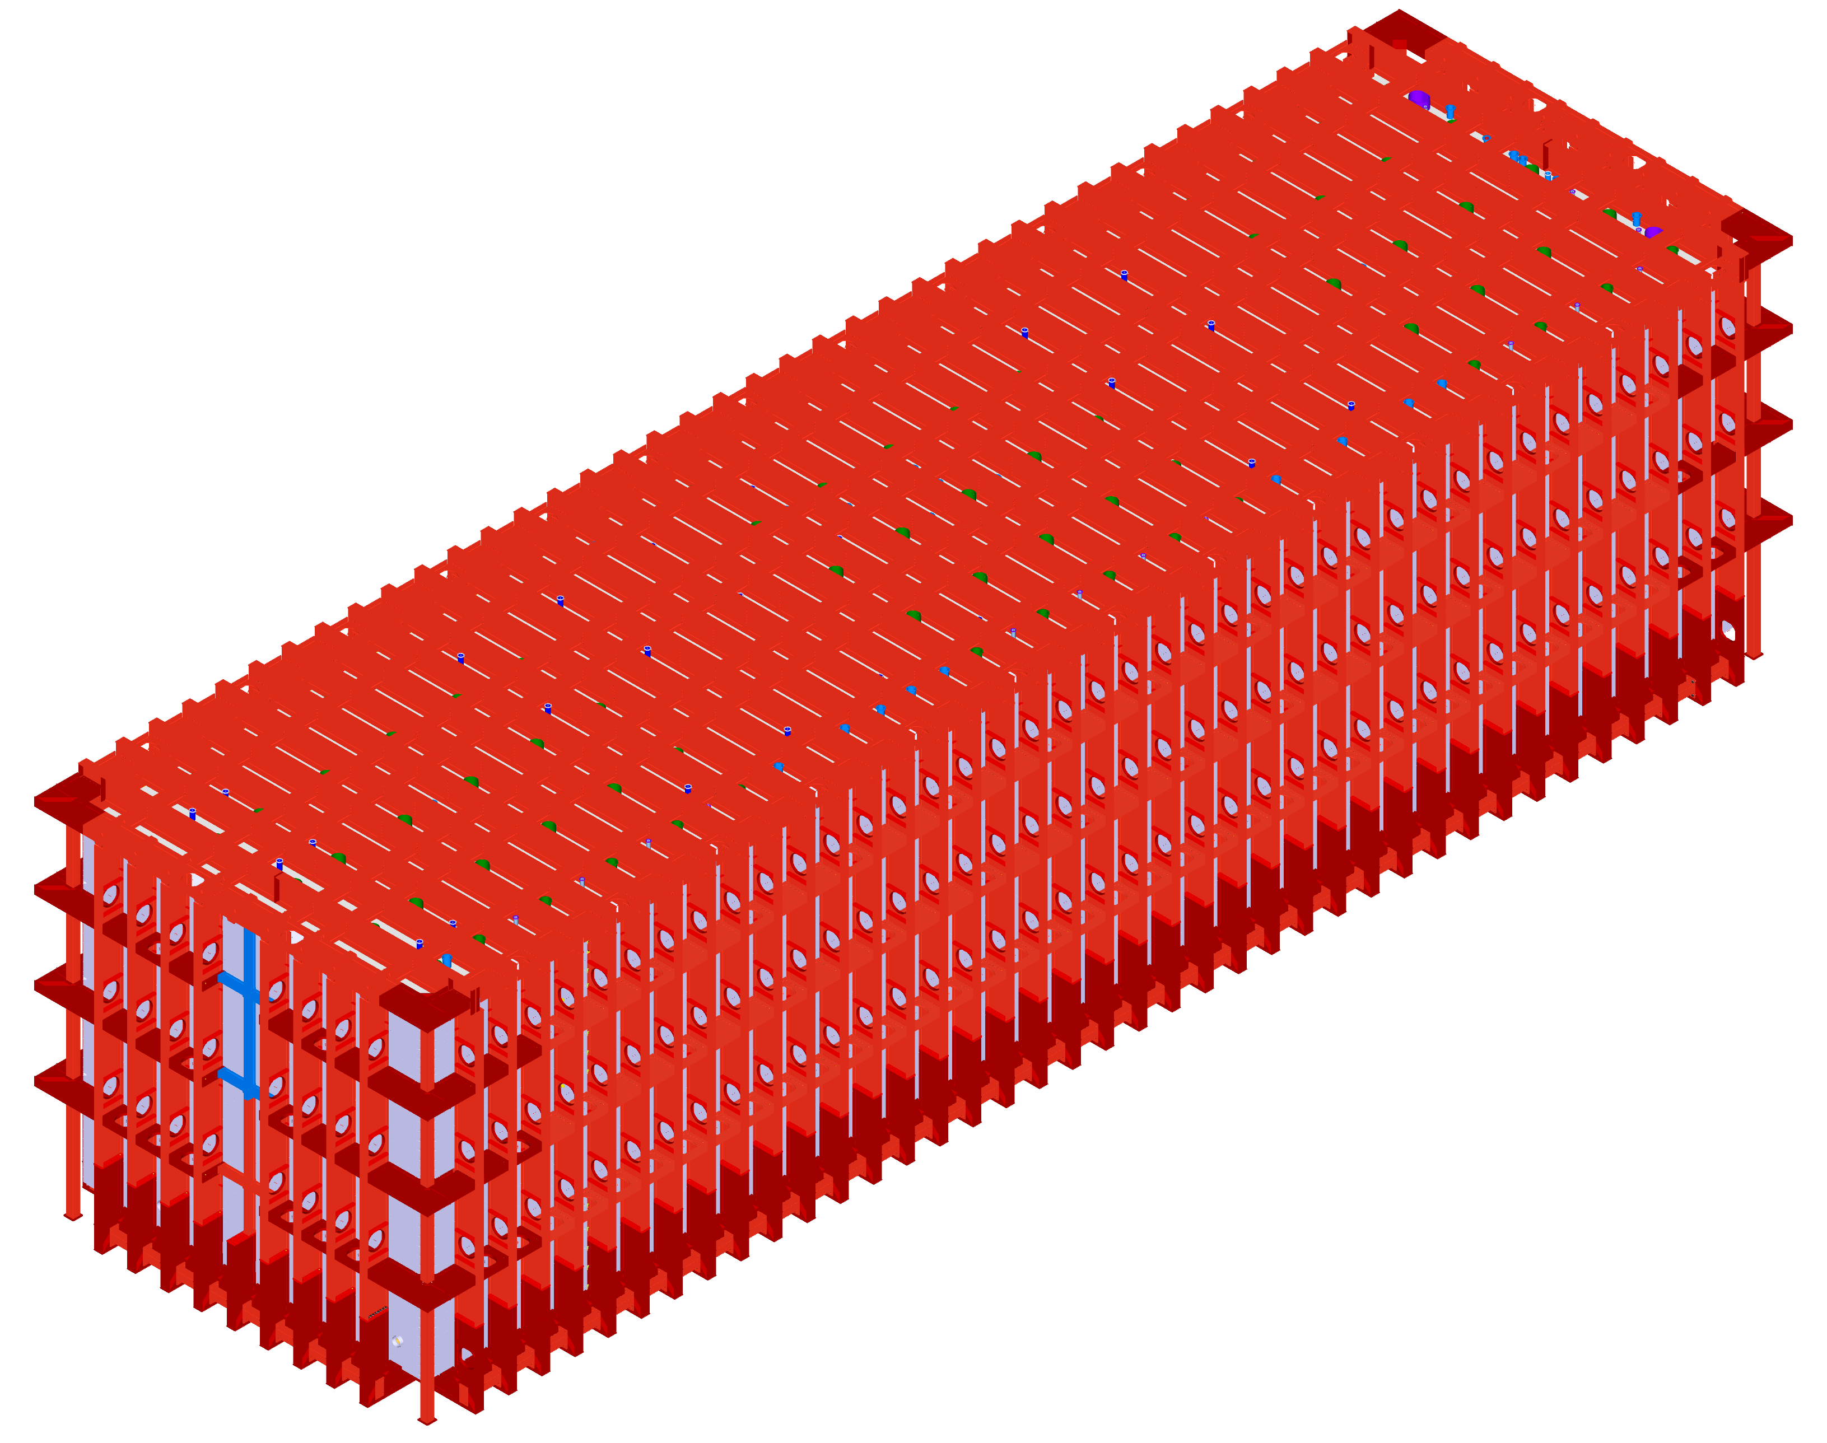
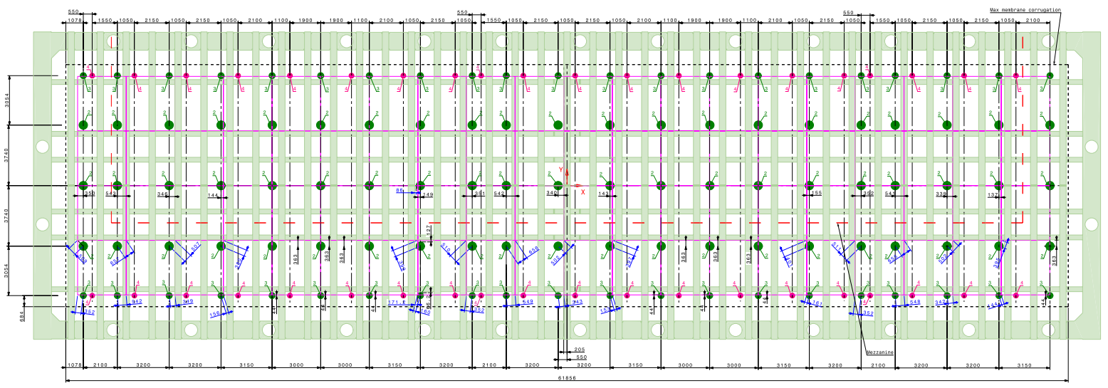
Cryostat Penetration and Cryostat Cabling
40 penetrations on the VD cryostat are provided for bottom CRP cables and PDS. A cross tube is installed on each penetration, with two side ports for bottom CRP cables and the top port for PDS.
Top port for PDS flange
CE crate and flange
CE crate and flange

Slide 10
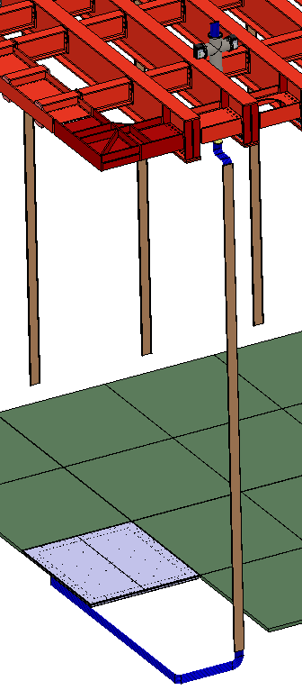
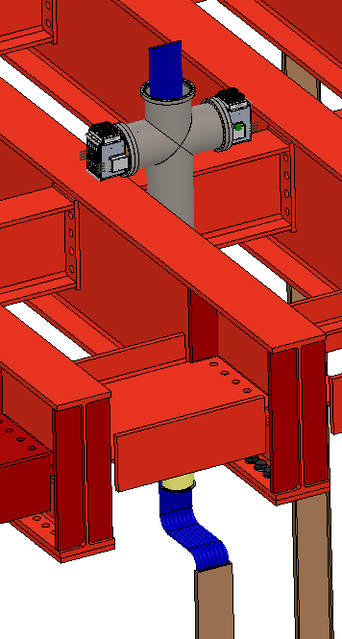
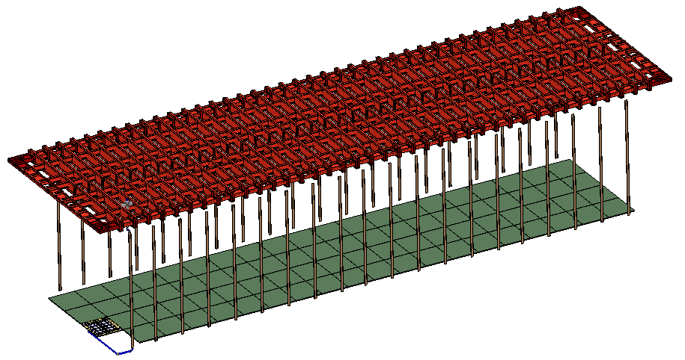
Cryostat Penetration and Cryostat Cabling
SAMTEC CE cables run from CE flanges to CRP patch panels. The cables are tied to the cable trays along the cryostat wall and laid down on the cryostat floor. When installing the bottom CRPs, the cables are then connected to CRP patch panels.
Cryostat roof
Signal feedthrough
Cable trays for BDE cables
20x4 CRPs

Slide 11
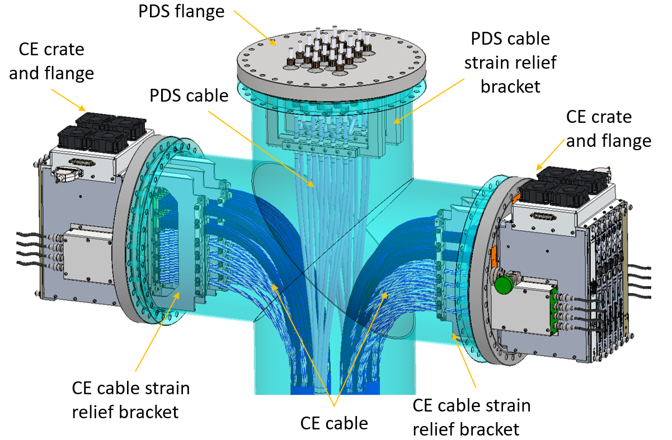
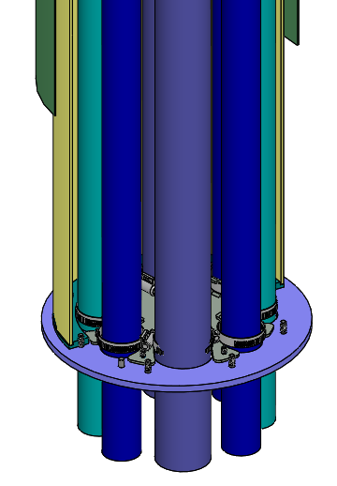
Cryostat Penetration and Cryostat Cabling
The cables from bottom CRP are connected to the CE flanges and strain relieved on the CE cable brackets.
In HD FD1, a cable clamp plate is mounted on the bottom flange of the CECT to provide secondary cable support.
Several alternative designs of secondary cable strain relief are being evaluated.
CSSP
Cryostat crossing tube
Cable clamp plates
CECT

Slide 12
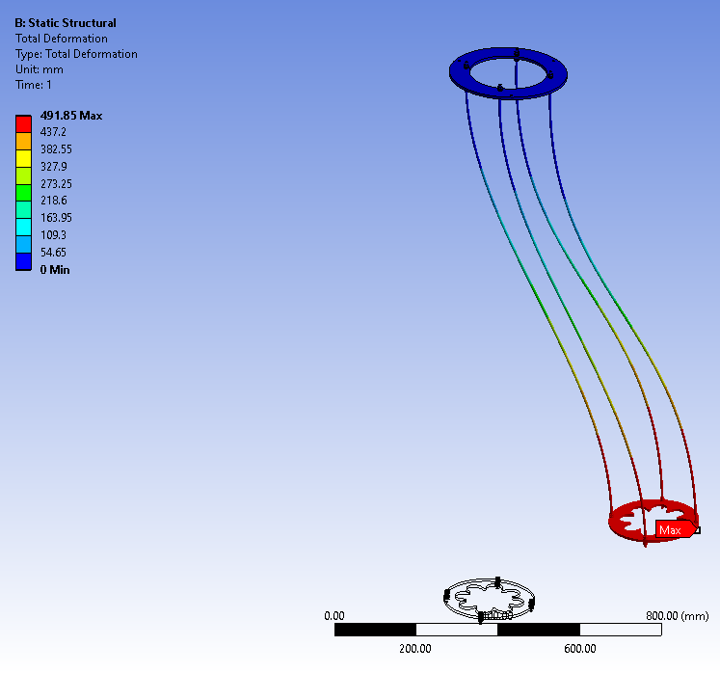
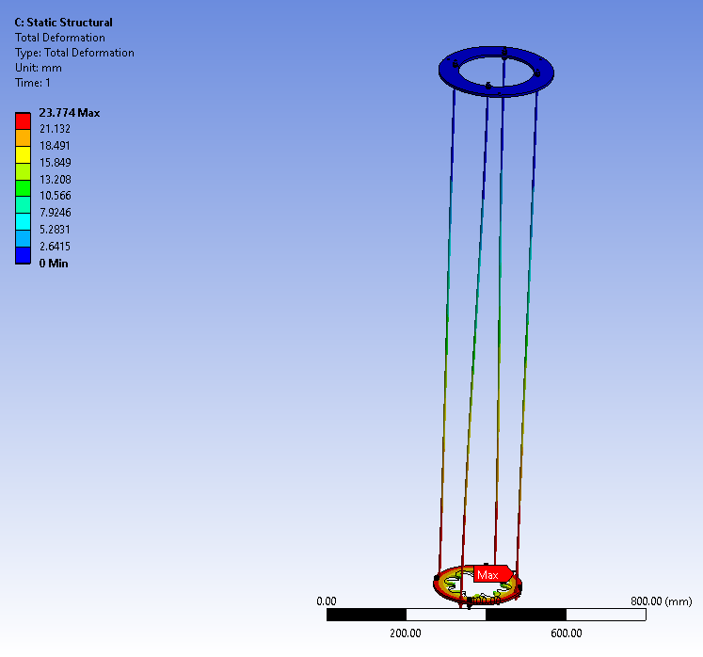
Cryostat Penetration and Cryostat Cabling
Alternative design of secondary cable strain relief (1A)
491.9 mm
100 N
23.8 mm
100 N-m

Slide 13
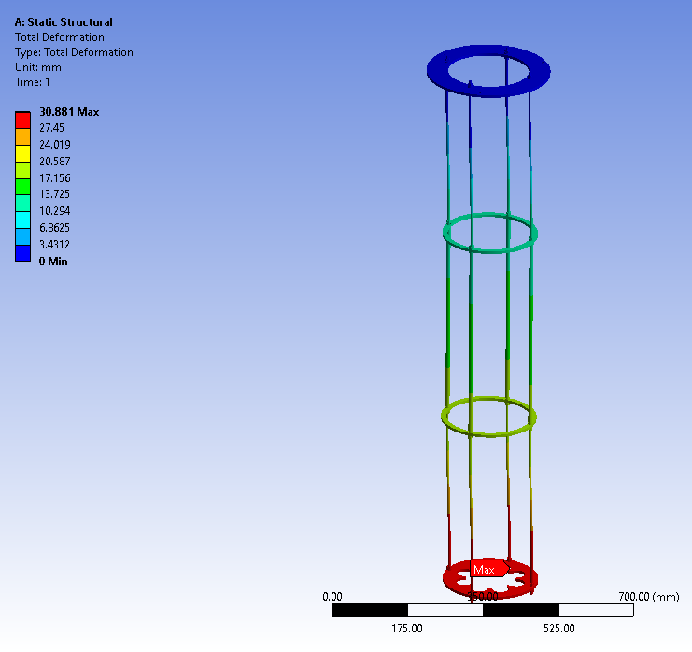
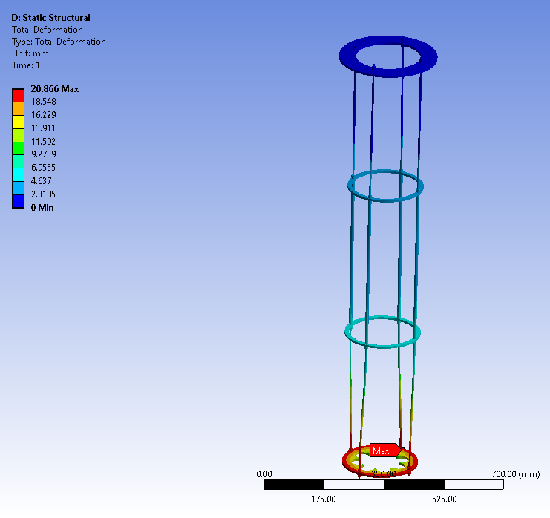
Cryostat Penetration and Cryostat Cabling
Alternative design of secondary cable strain relief (1B)
30.9 mm
100 N
20.9 mm
100 N-m

Slide 14
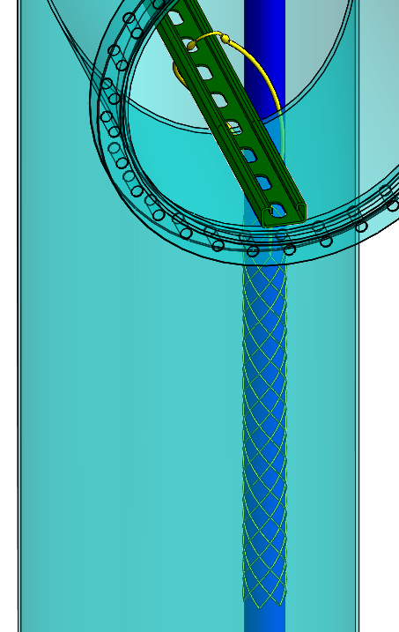
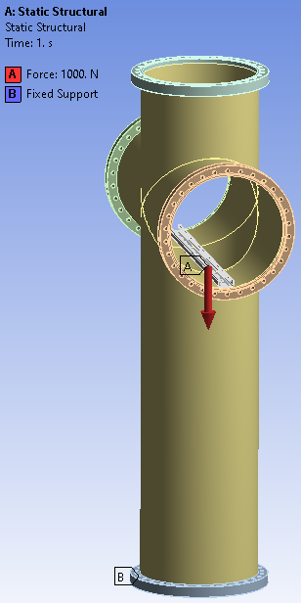
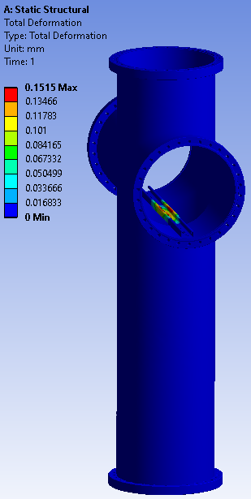
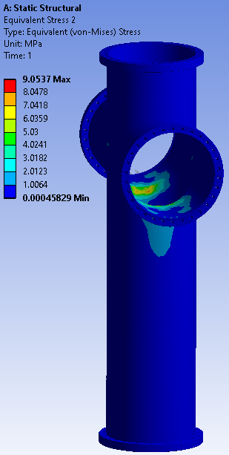
Cryostat Penetration and Cryostat Cabling
Alternative design of secondary cable strain relief (2)
Support bar
1000 N
cable weight
Max deflection: 0.2 mm
Max Stress: 9 MPa
Cable grip on cable bundle

Slide 15
Conclusion
CE boxes provide electromagnetic shielding and mechanical support to FEMBs. A strain relief mechanism secure cable connection to FEMB.
CE box is installed on CRP adapter board. Screw access holes facilitate CE box installation.
Patch panel provides interface between the CRP cabling and the cryostat cabling.
Signal feedthrough on cryostat roof provides CE flanges for cable connection.
SAMTEC CE cables connect CE flanges and CRP patch panels.

