Slide 1
LArASIC and ColdADC Lifetime Studies
Jianming Bian
University of California, Irvine
FD2 BDE Preliminary Design Review
April 25, 2022

Slide 2
Content
LArASIC lifetime study
ColdADC lifetime study

Slide 3
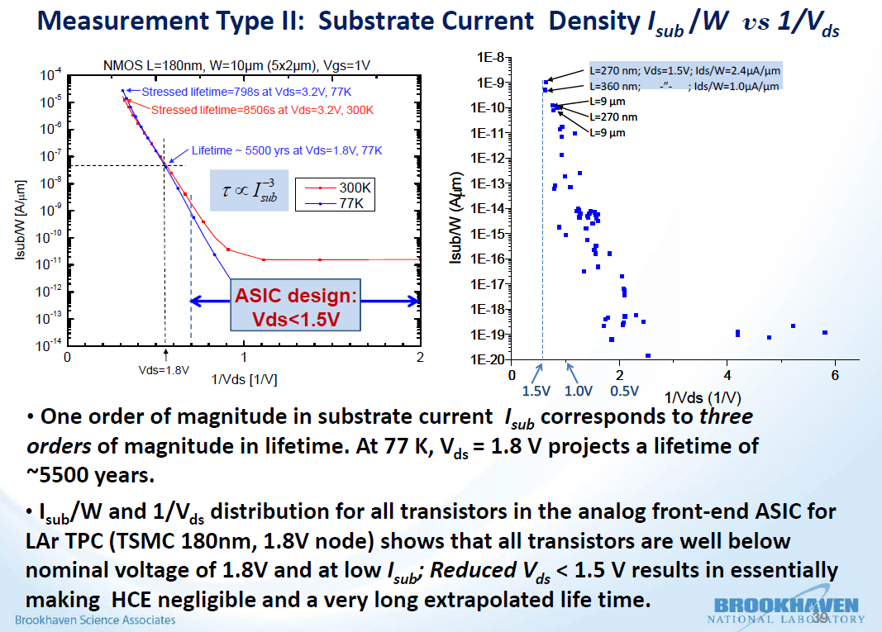
LArASIC Lifetime study
The remaining mechanism that may affect the lifetime of CMOS devices at cryogenic temperature is the degradation (aging) due to channel hot carrier effects (HCE)
LArASIC is designed for long lifetime at cryogenic temperatures
  Low voltage and current in each transistor
To alleviate the lifetime risk, custom ASIC should be designed for one or two orders of magnitude longer lifetime than 30 years
Any transistor falling in the region V_{ds} <1.5 V and I_{sub}/W < 10⁻⁹ A/m should have a very long lifetime
S. Li, et al, “LAr TPC Electronics CMOS Lifetime at 300K and 77K and Reliability under Thermal Cycling,” IEEE Transactions on Nuclear Science, Volume: 60, Issue: 6, Part: 2, Pages: 4737-4743 (2013)
Notes:
The HCE effect affects cmos devices lifetime at cold. BNL has started to study lifetime at cold more than 10 years ago.
DUNE far detectors are expected to operate 20~30 years. The published study shows that the Low voltage and current in each transistor can significantly increase the lifetime.
LArASIC was thus designed for long lifetime at cryogenics temperature.

Slide 4
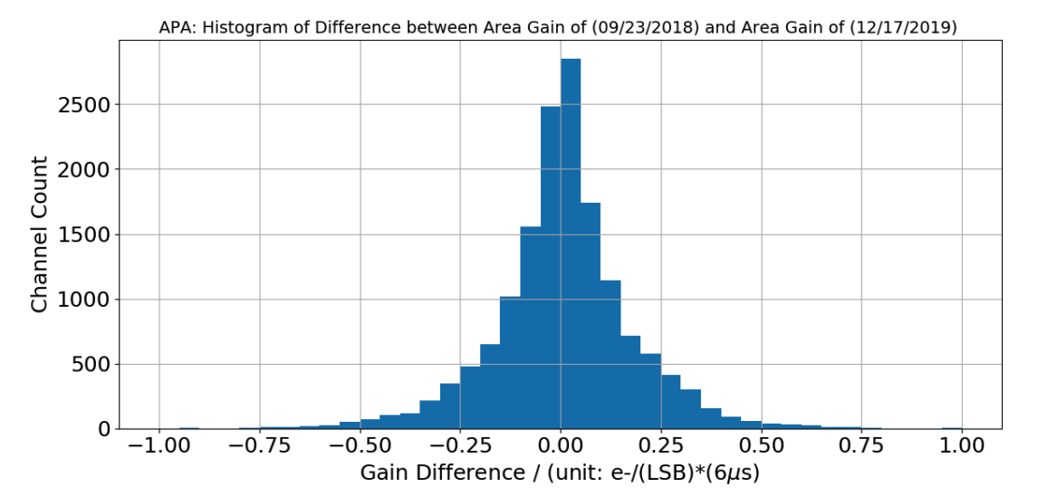
LArASIC Lifetime study
LArASIC in MicroBooNE: No observable change after seven years
ProtoDUNE-I (SP): No measurement degradation is observed over a year
  The measured gain shift is around 0.13% and 0.4%RMS, with an excellent agreement between 2018 and 2019 (around 0.01% shift with 0.3% RMS)
The lifetime study of LArASIC will take place in two different phases, the exploratory phase and the validation phase. Before that, we will need to prepare the test stand to make it suitable for lifetime study, which is the preparation phase. The most time and effort will focus on the exploratory phase, we will gain (or lose) confidence based on the test results in this phase. Validation phase will be useful to validate what we would learn in the exploratory phase, and collect more information to prepare for future review(s)
  A P5 LArASIC was stressed at 3.0V over 300 hours in liquid nitrogen, no significant change in current drawn is observed.
  The recommended voltage for CM018/G is 1.8 V + 10%, which limits the stress voltage
    commercial chips designed in TSMC 180 nm, e.g., AD9265 and AD9650, the absolute maximum rating is 2.0 V which is consistent with 1.8V + 10%
  Test setup will be optimized with the dual-dut test board to observe more performance parameters
  More tests will be carried out after the busy ProtoDUNE-II production
ProtoDUNE-SP: Good reliability over a year operation
Notes:
The previous LArASIC used in MicroBooNE, which is also TSMC 180nm process, no observable change after about seven years in liquid argon.
The over 1 year operation of ProtoDUNE phase I also demonstrate there isn’t any change.
Even though, the lifetime study of LArASIC is still under our plan.
The difficult of this study is that the maximum stress voltage can’t be set to high.
We have stressed a P5 LArASIC at 3.0V over 300 hours in liquid nitrogen, no significant change in current drawn is observed.
Thus its lifetime should not be an issue, we will continue more tests after the busy ProtoDUNE-II cold electronics production.

Slide 5
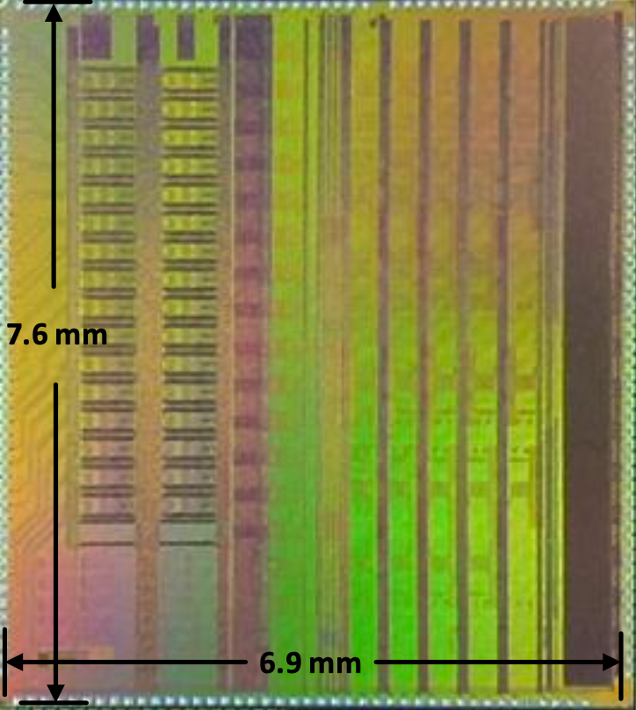
Introduction to ColdADC
A bare die photograph
ColdADC_P2 is a 16-channel, 12-bit, 2 MS/s digitizer
  It’s redesigned to correct several design errors, to improve performance and to add new features based on the first prototype of the ASIC (CodeADC_P1)
It will be used inside the DUNE Far Detector, and intended for operation without replacement
  Required to have long-term reliability in cryogenic environments
  Also required to have low noise, good linearity and low crosstalk

Slide 6
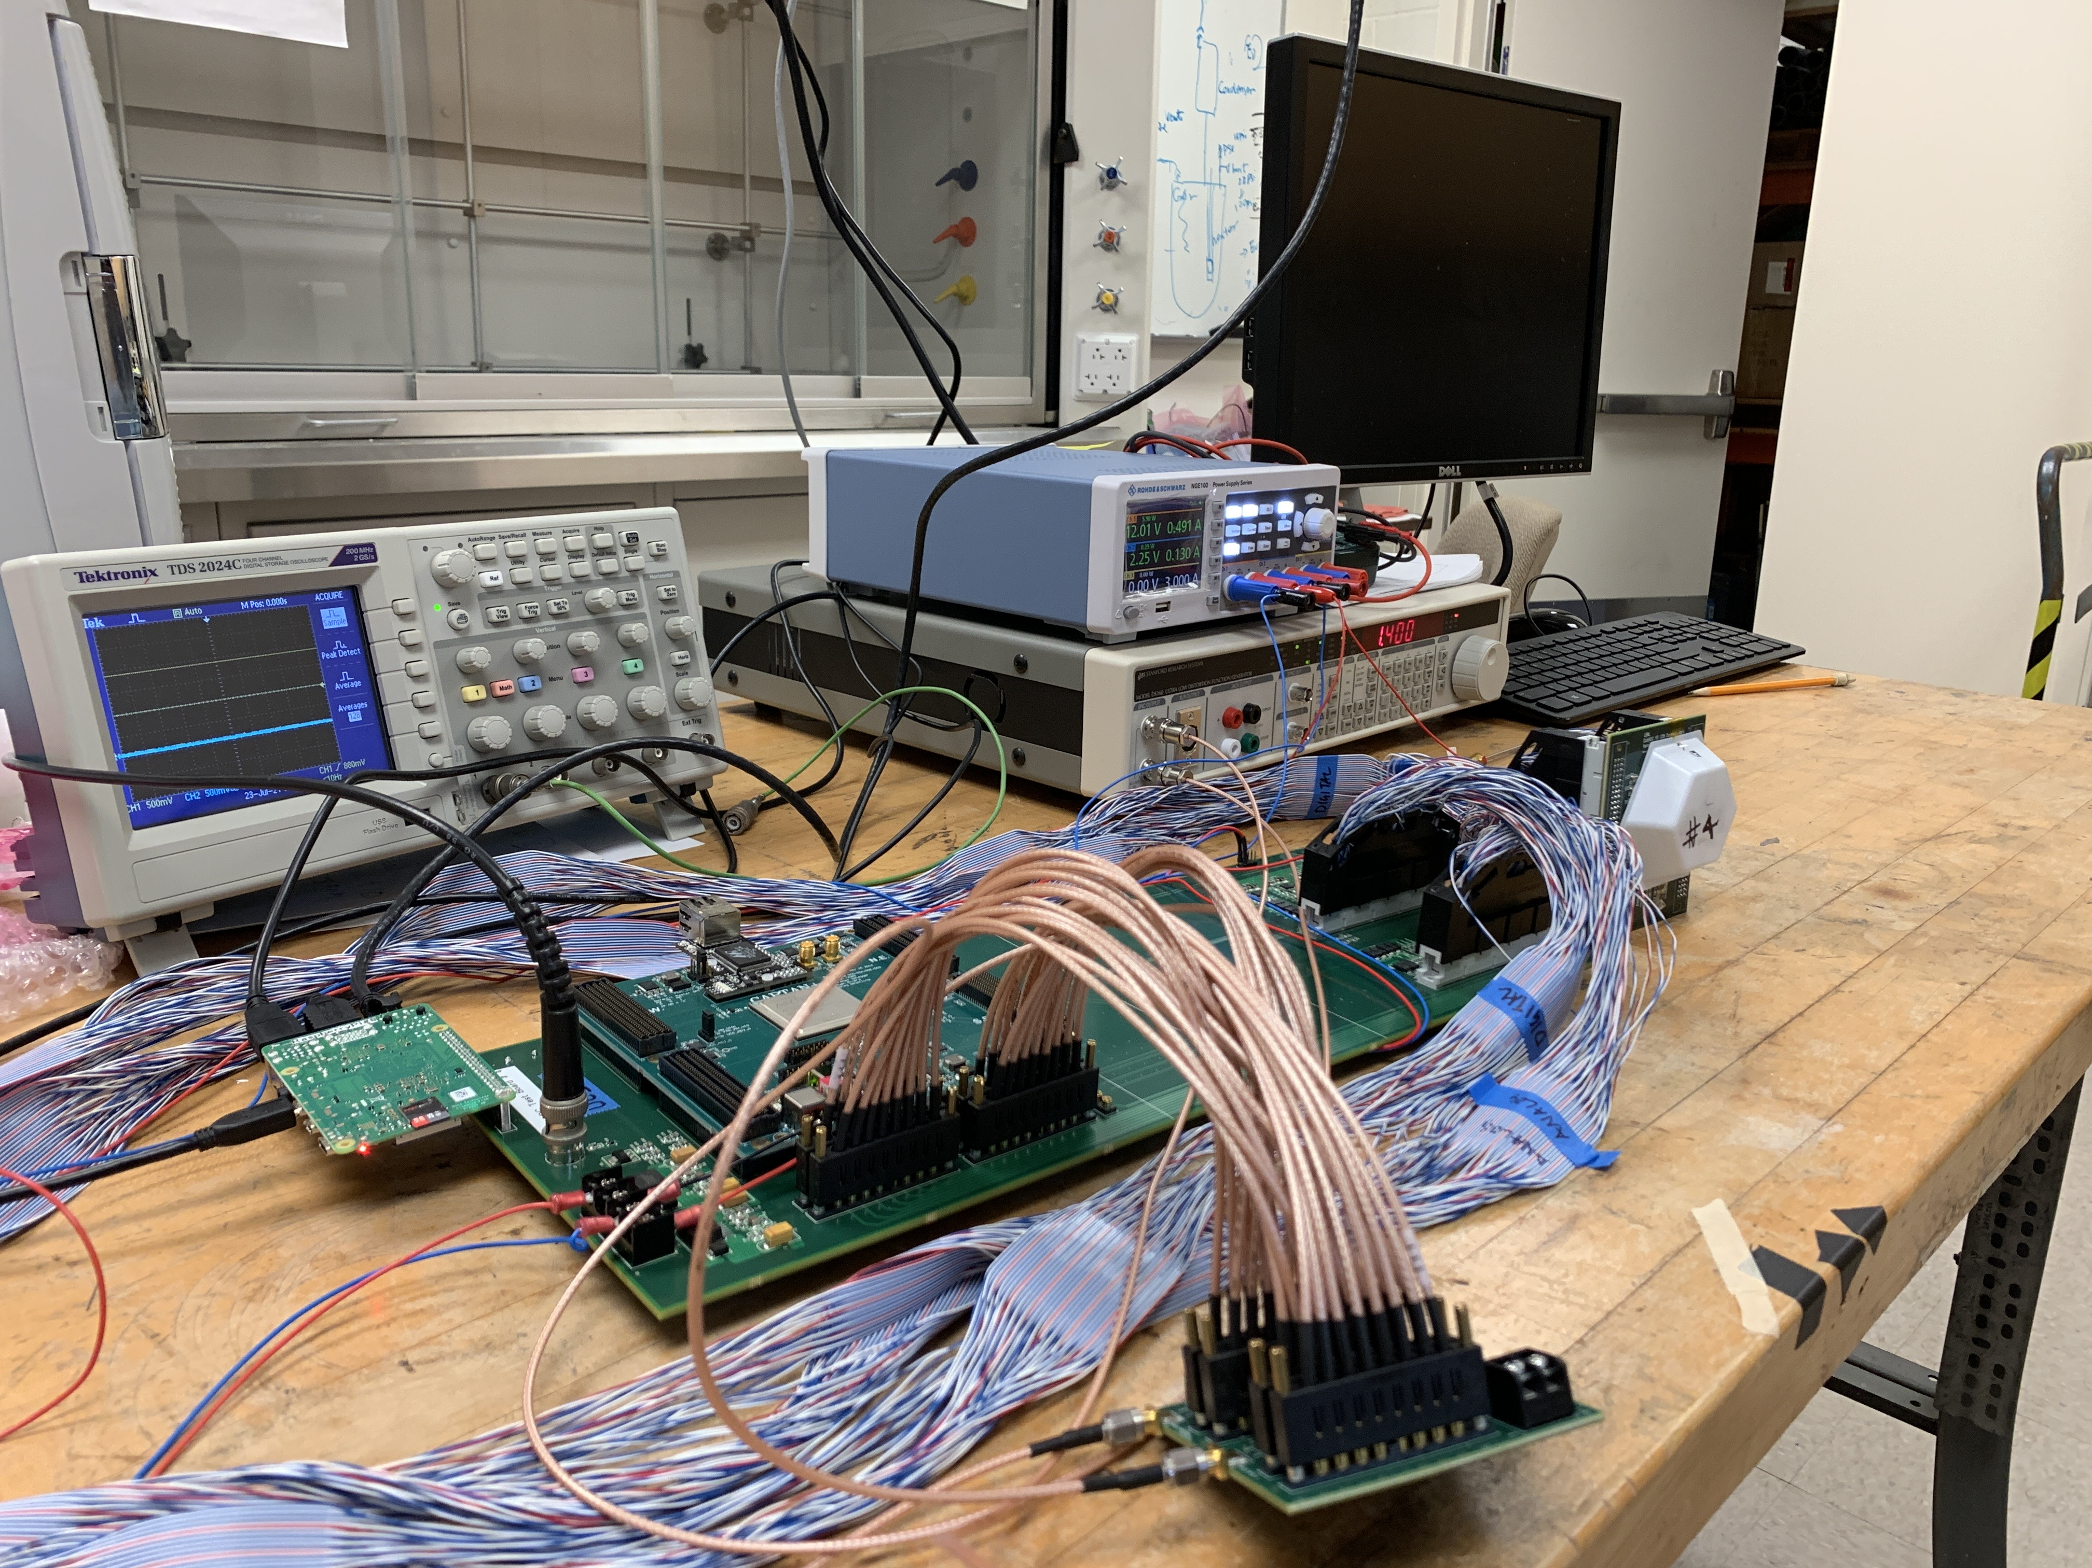
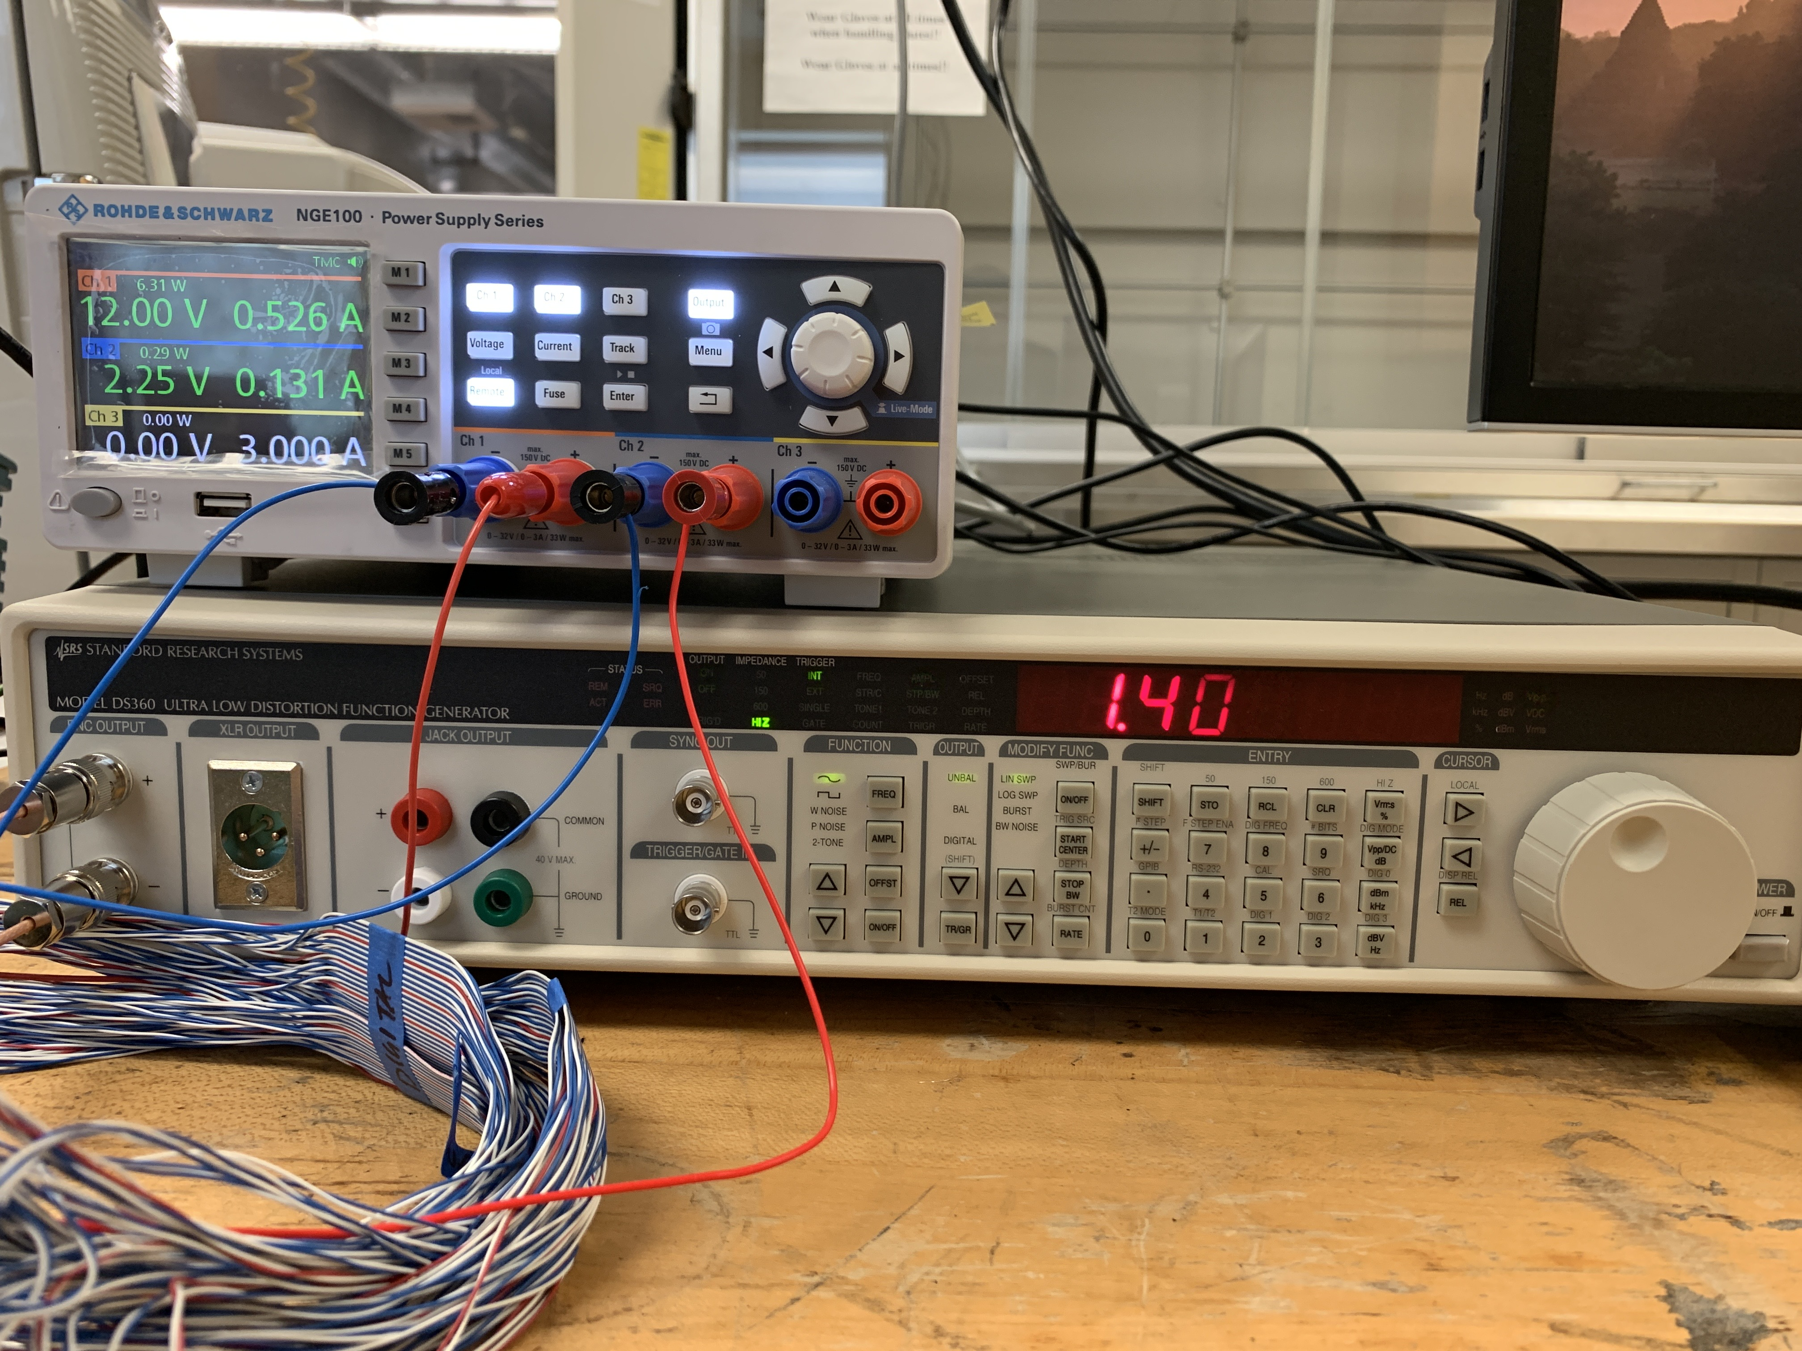
Preparation for the lifetime study
Setup the ColdADC test stand
  Power supply (Rohde&Schwarz NGE 100), SRS DS360 Ultra-Low Distortion Function Generator
  With USB interface, the setup can be remotely operated

Slide 7
Testing setup
Raspberry Pi
Write/Read
Power
Remote control
Sinusoid waveform
16 channels
Splitter board
(Fan in - Fan out)
Power
Function generator
Mother board
Power supply
Long cable
analog in - ADC - digit out
ColdADC
LN2 Temp (~77 K)

Slide 8
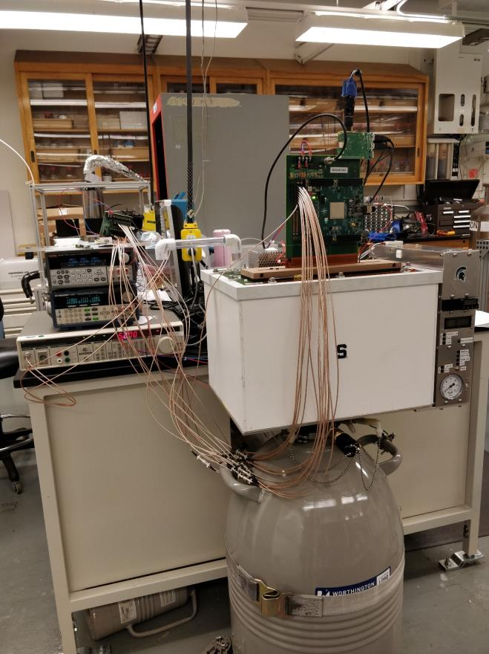
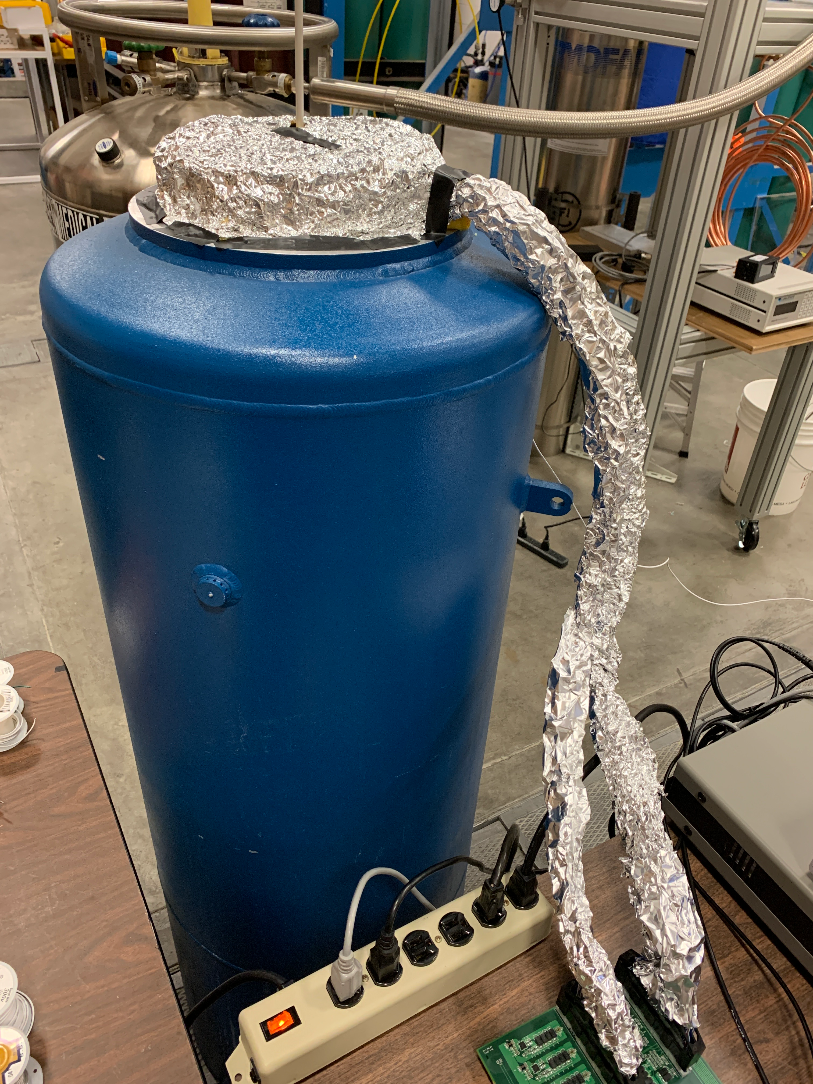
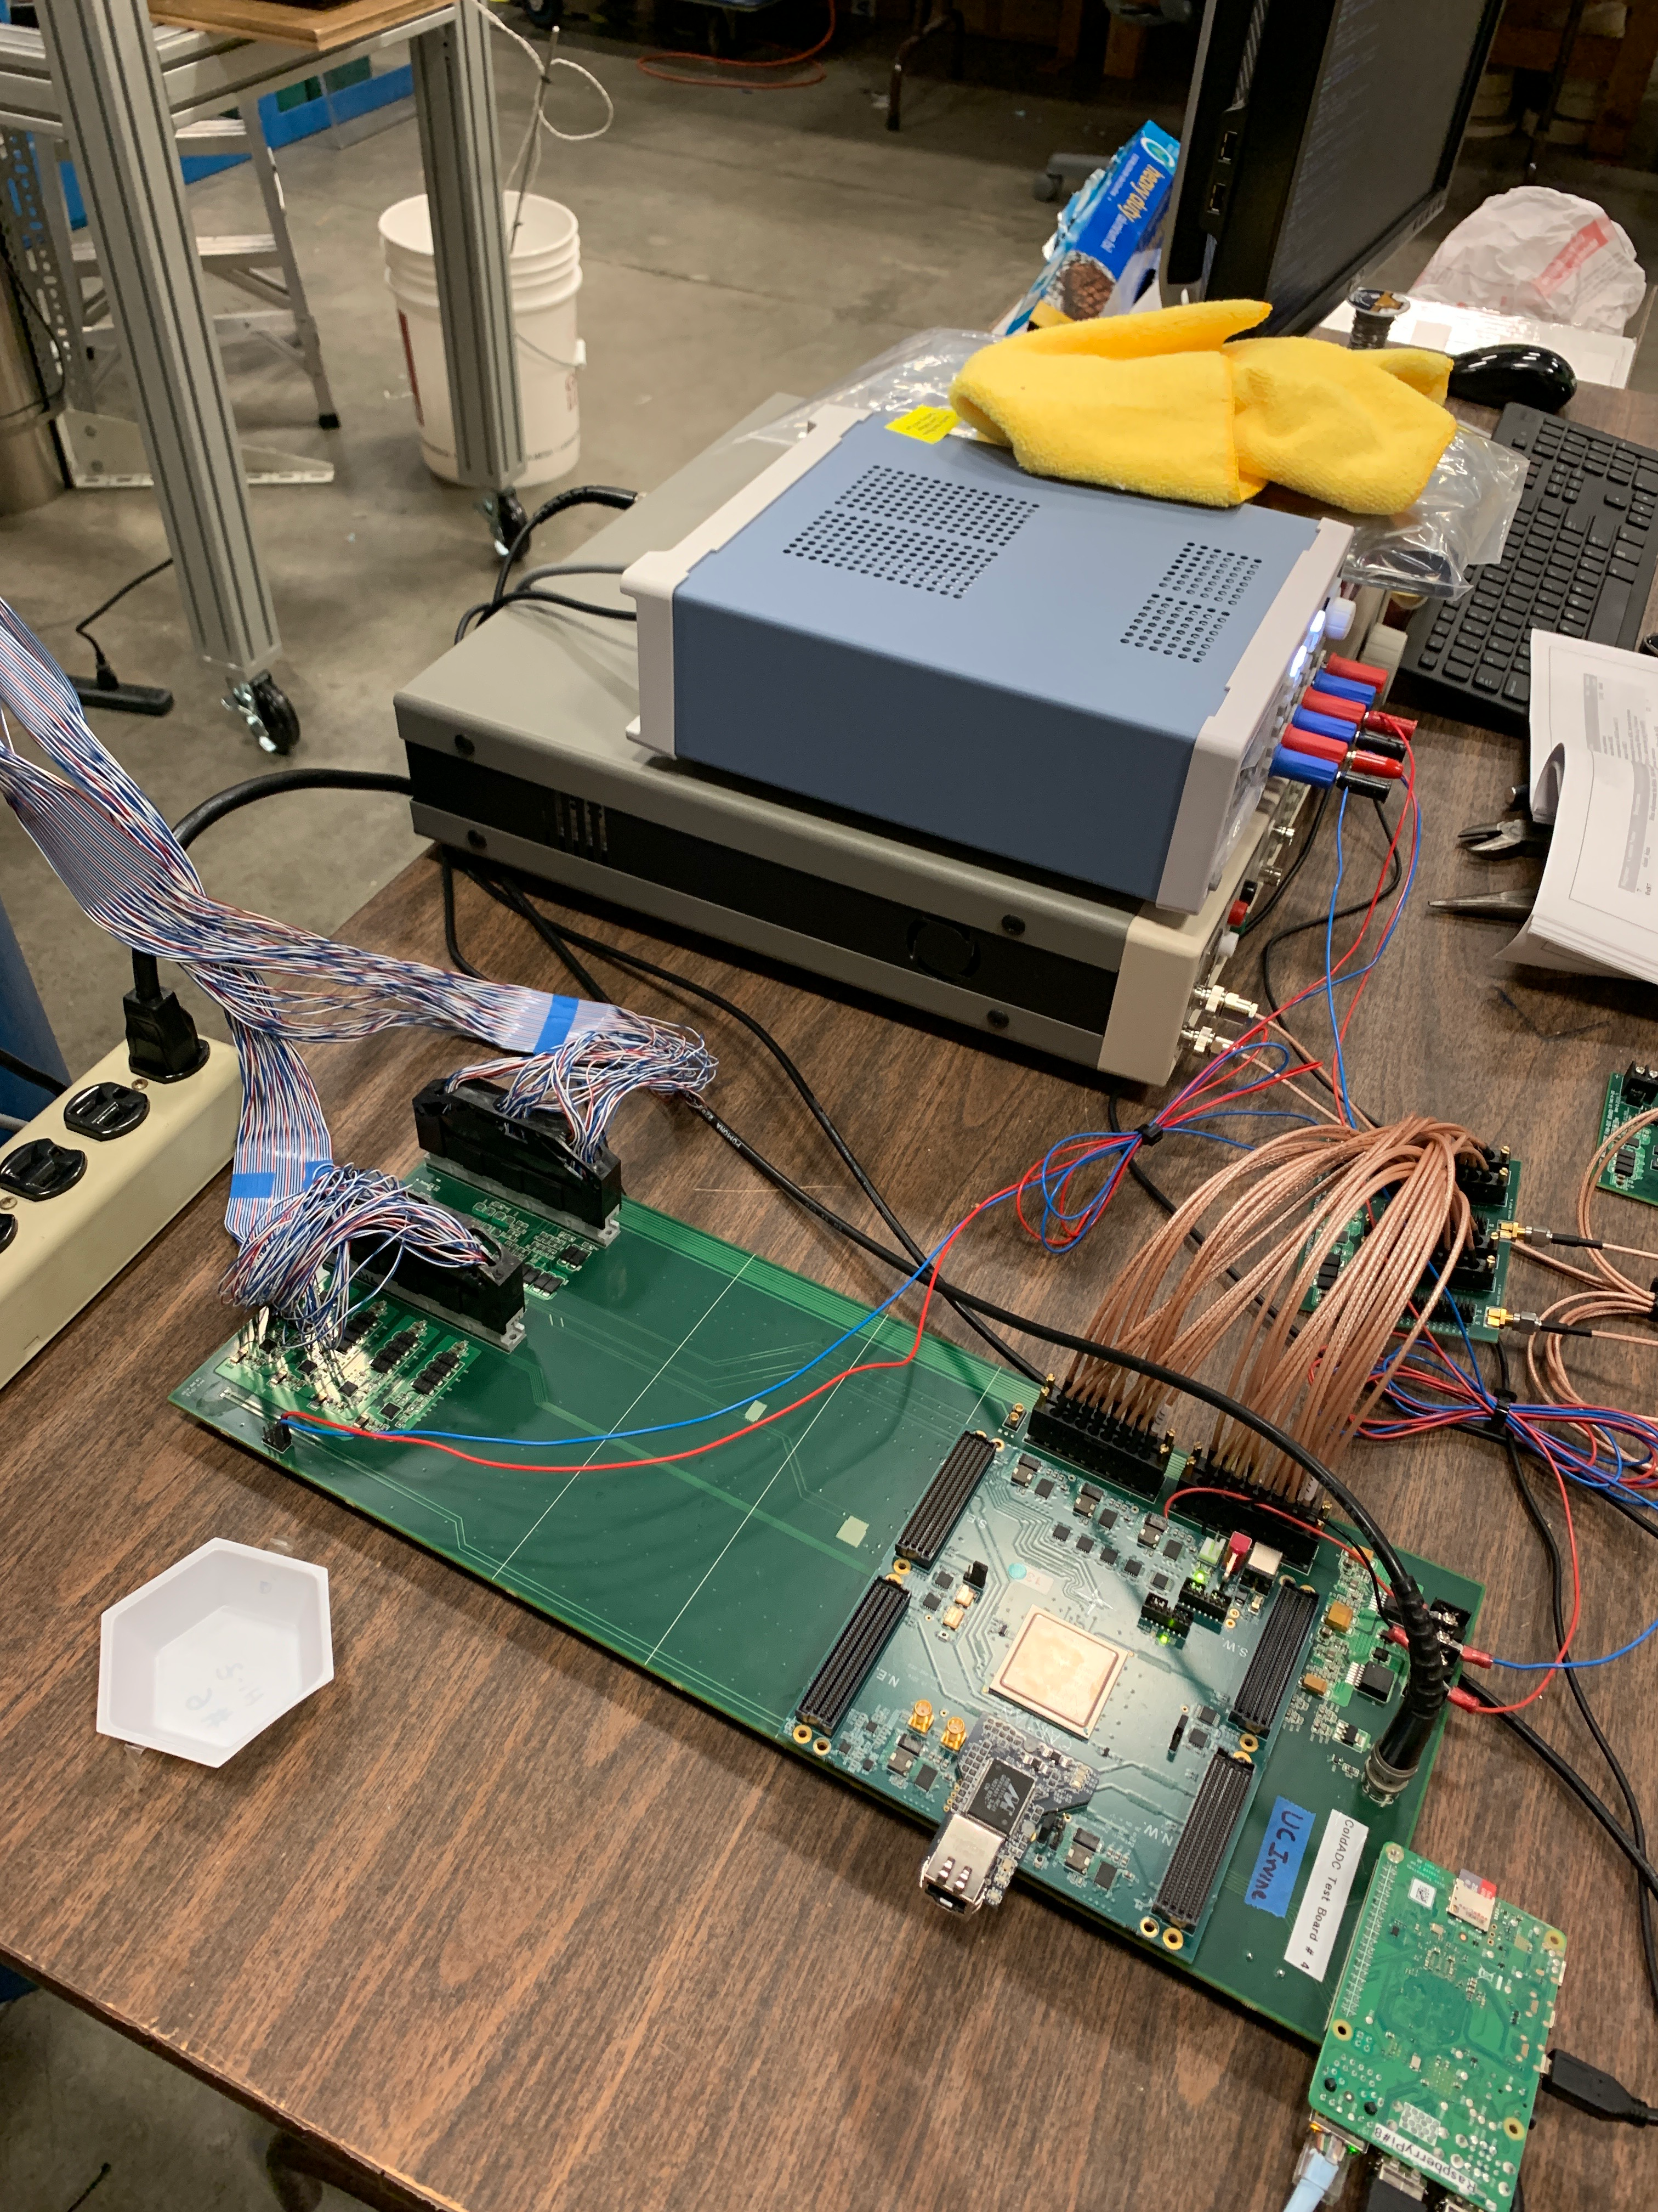
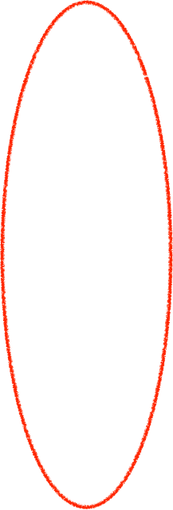
Test stand
CTS:
half of the mother board with the ColdADC is immersed in LN2
Test stand at Irvine: we have the long cable in order to deploy the ColdADC into LN2

Slide 9
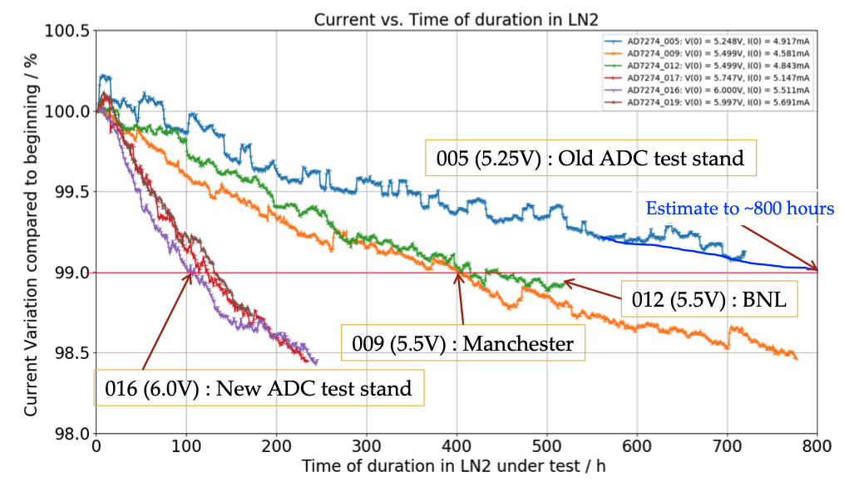
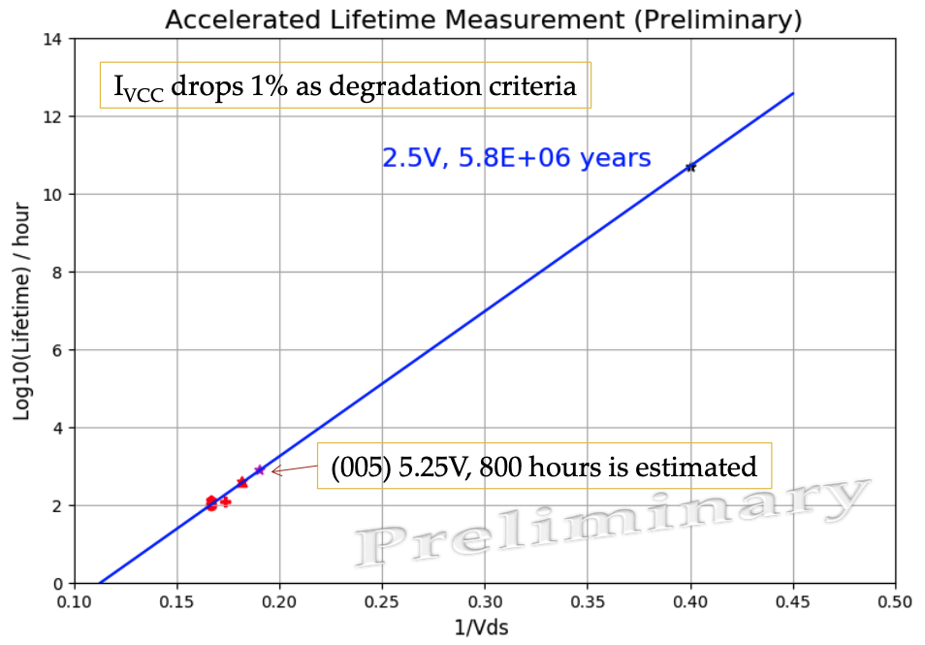
Lifetime study: Methodology
Accelerated lifetime measurement
  ColdADC normally work at 2.25 V for long-term reliability. The lifetime at 2.25 V is at the level of decades.
  In order to perform the lifetime study, we purposely increase the working voltage, such as 4.2 V and study the lifetime of ColdADC under the high voltage, then extrapolate the results to low voltage.
Measurements of the Cold COTS ADC for SBND TPC Readout from H. Chen

Slide 10
Lifetime study
We improved the test stand and stabilized the data acquisition as the preparation for the lifetime study
  Tuned the parameter to truncate ADC code in order to exclude outliers of DNL
  Using averaged FFT results to alleviate the fluctuation of ENOB
  Shielded the long cable and the dewar with aluminum foil
  Adjusted the hanging position of the ADC
Monitoring parameters
  Dynamic linearity: effective number of bits (ENOB)
  Static linearity: differential nonlinearity (DNL) and integral nonlinearity (INL)
Status
  The method to test lifetime is to increase the stress voltage (4.2V, 4.0V, 3.8V, 3.6 V) and study the degradation of performance
  Two chips were stressed at 4.2 V, another three were stressed at 4.0 V, 3.8 V and 3.6 V respectively for the last several months

Slide 11
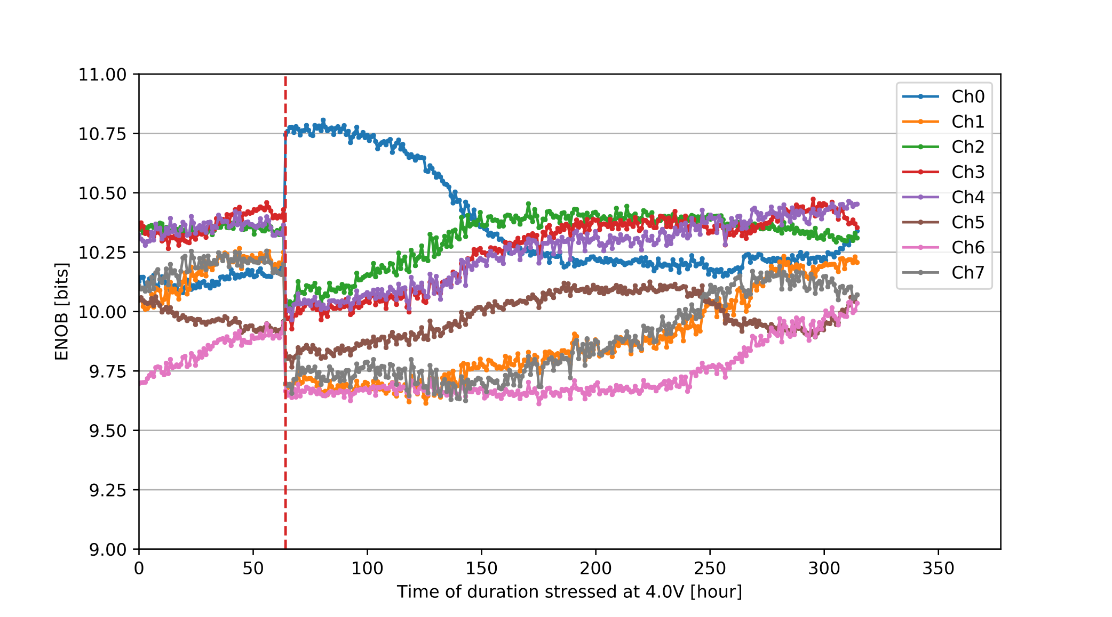
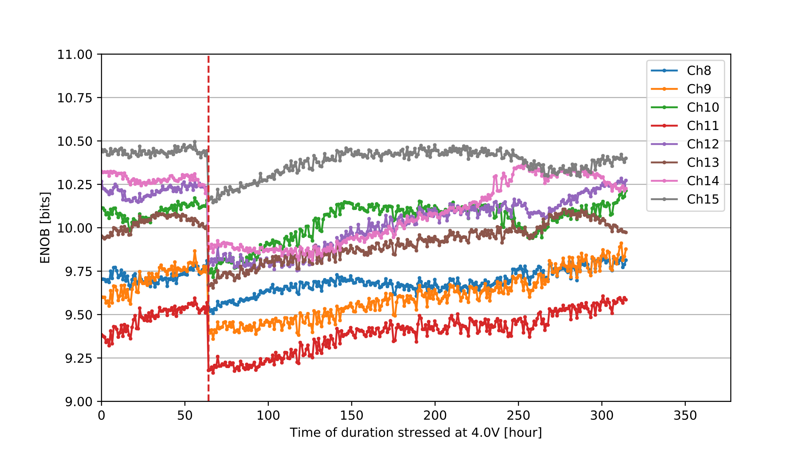
ENOB
refill
refill

Slide 12
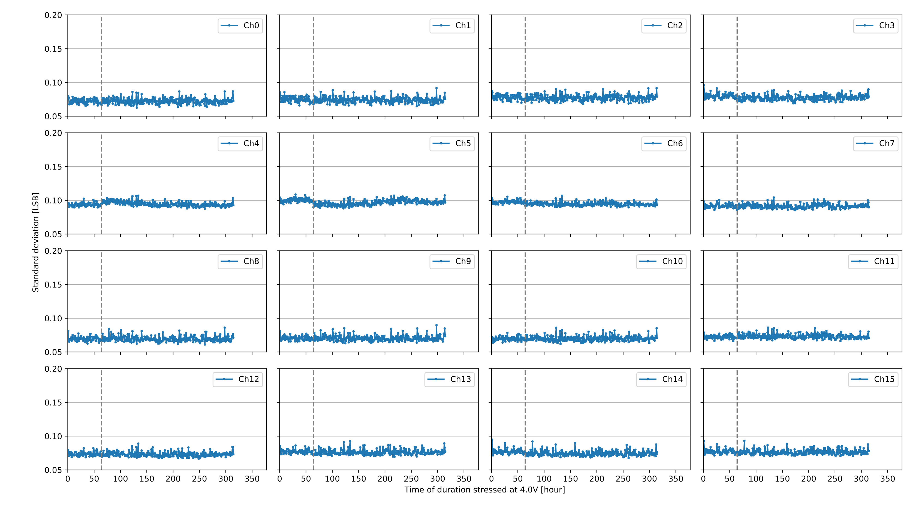
DNL: standard deviation

Slide 13
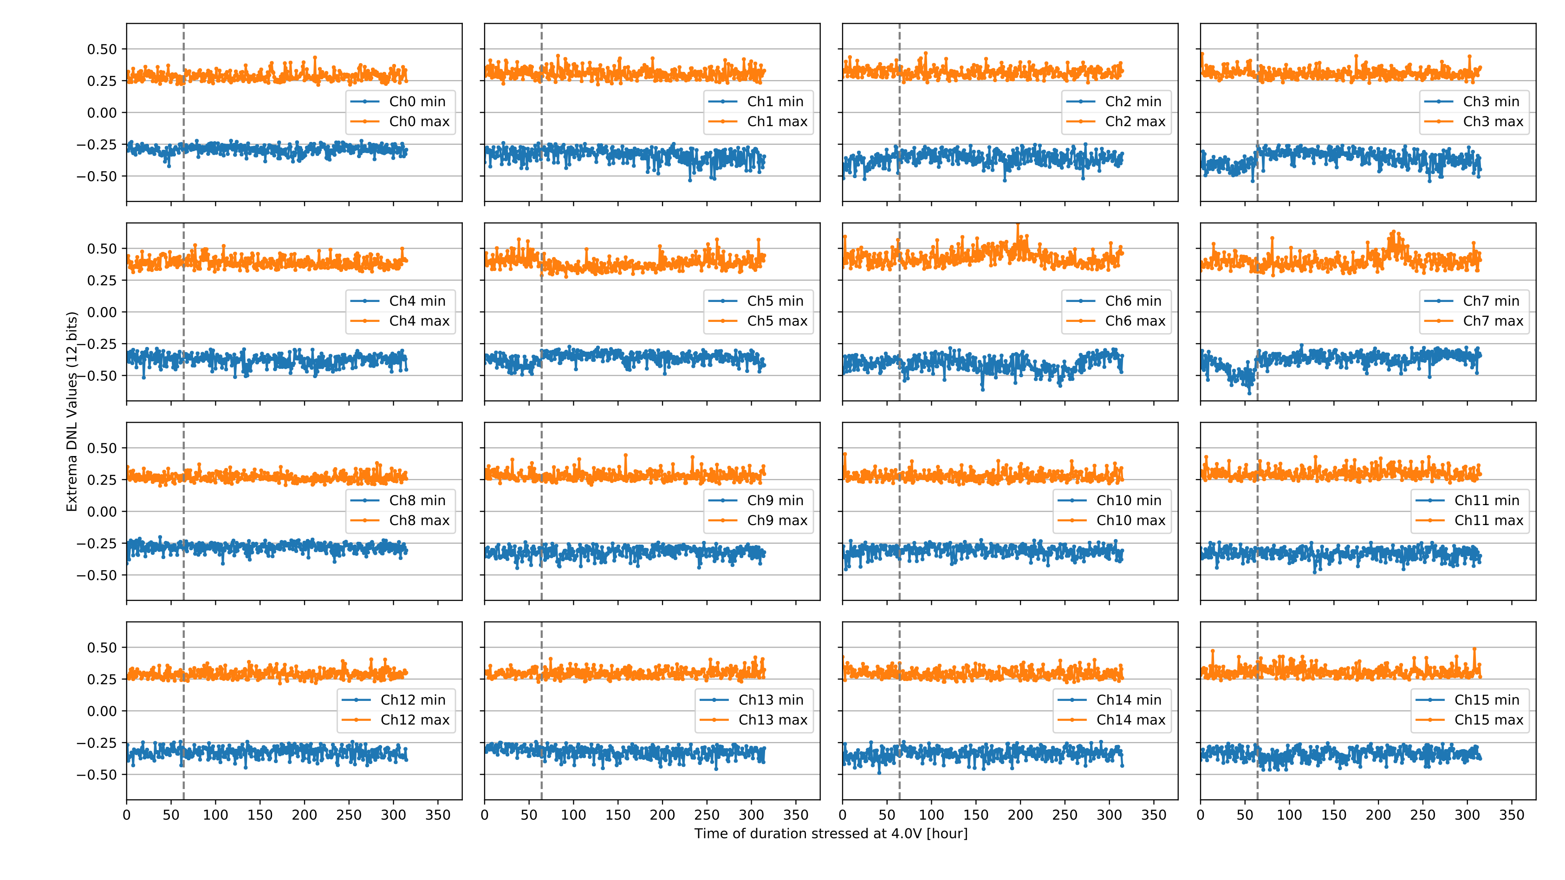
DNL: Extrema

Slide 14
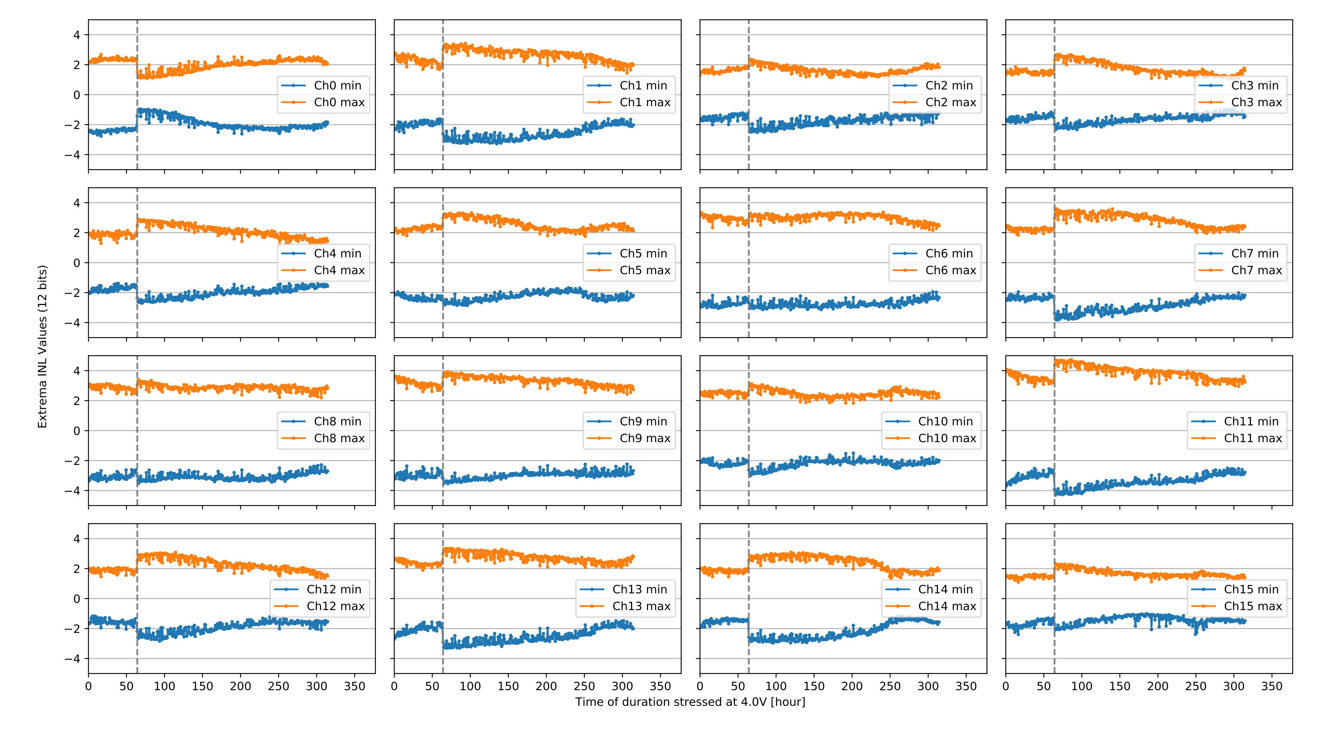
INL: Extrema

Slide 15
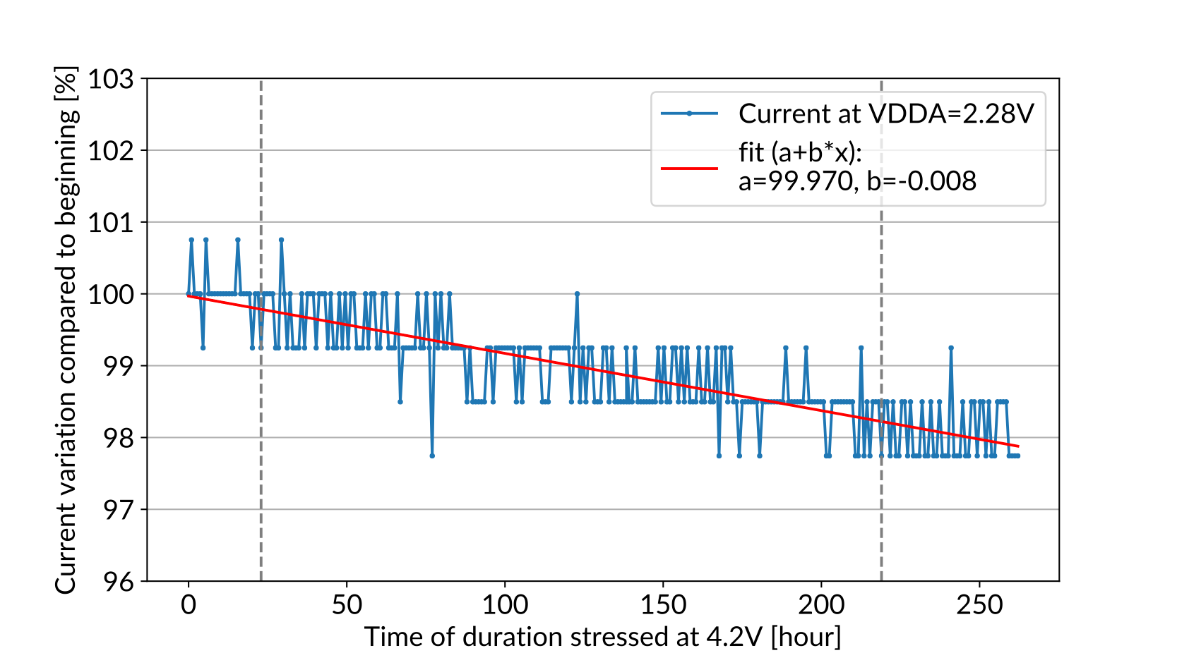
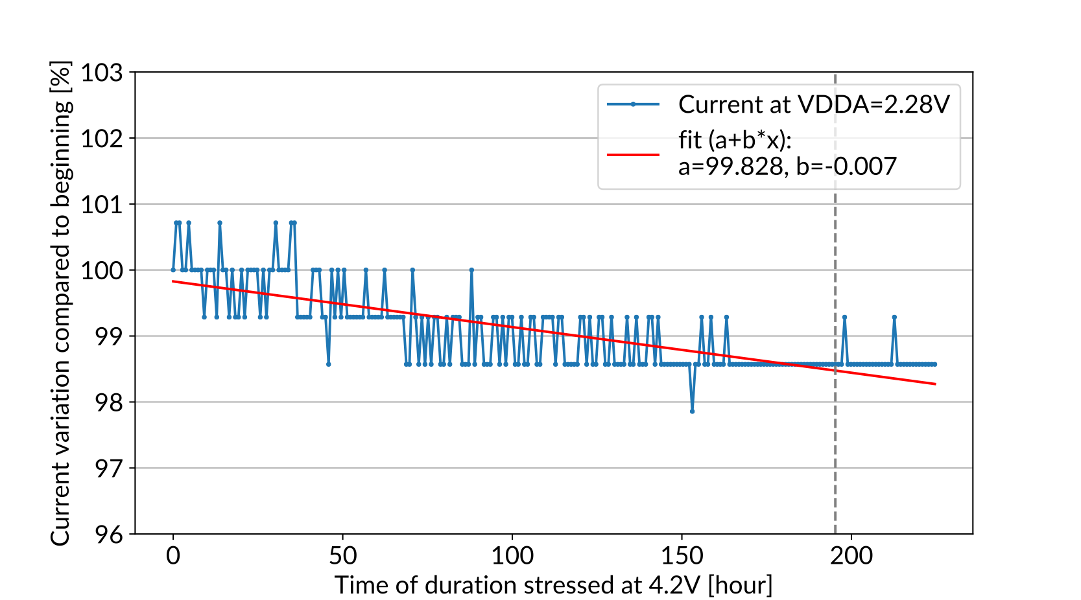
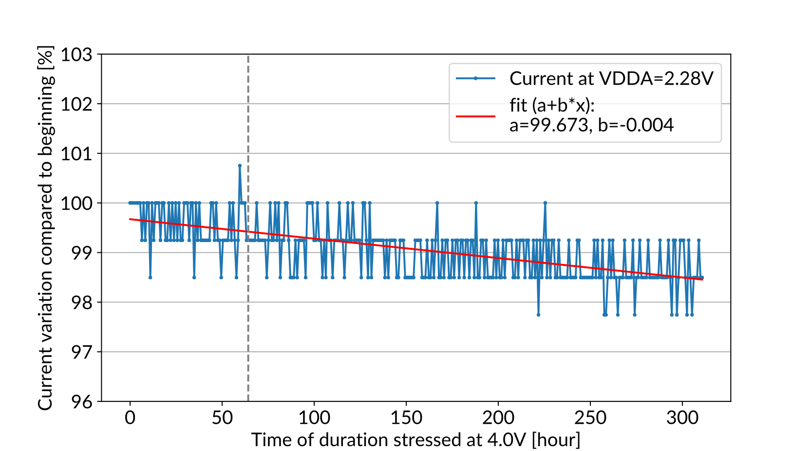
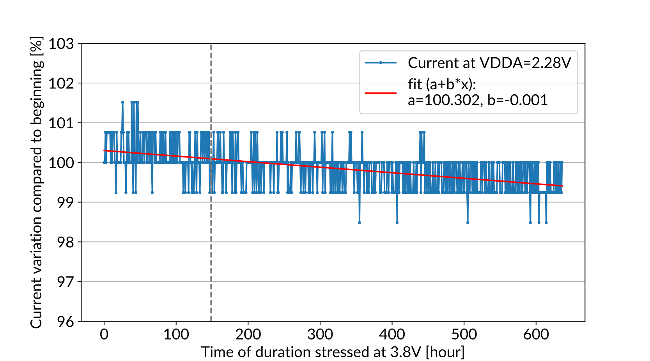
Current at 2.28V VDDA

Slide 16
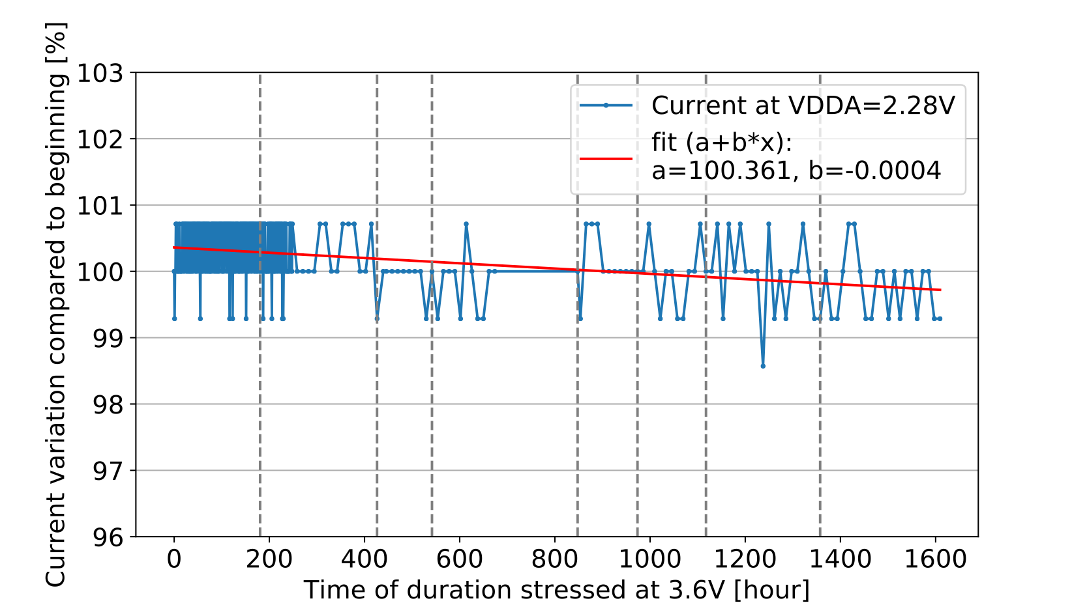
Current at 2.28V VDDA

Slide 17
Lifetime
No obvious degradation of the performance (ENOB, DNL, INL) after hundreds of hours testing
Given no ADC failed the stress test at the moment, a conservative lower bound on lifetime is extracted by using "current drop of 1%" as the failure threshold (note: ADC performs fine at 1% current drop)
Use the difference between two measurements stressed at 4.2 V as the uncertainty from chip-to-chip. Use the error output from the fitting as the uncertainty of the measurements. Treat them as uncorrelated
It gives a lifetime of 4.2x10⁴ years at 2.25 V
3.6 V
3.8 V
4.0 V
Extrapolate to 2.25 V
4.2 V

Slide 18
Summary for the lifetime study
Accelerated lifetime test at any temperature were performed for both LArASIC and ColdADC (well-established by foundries)
  transistor is placed under a severe electric field stress (large V), to reduce the lifetime due to hot-electron degradation to a practically observable range
  It is widely used in industry
The positive lifetime results on LArASIC suggest for its use in LAr, the lifetime shouldn’t represent a concern
A conservative lower bound on lifetime for ColdADC was measured to be 4.2x10⁴ years
  There is a large uncertainty on the extrapolated lifetime due to lack of data points

Slide 19
Backup

Slide 20
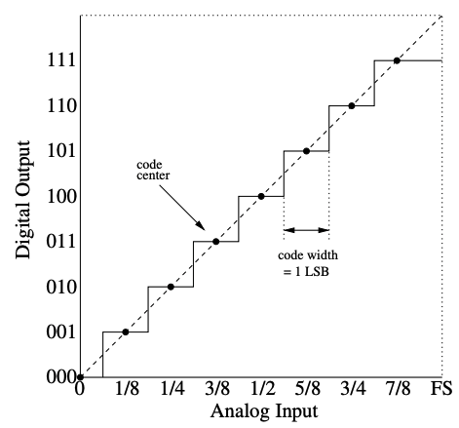
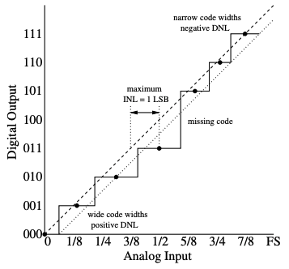
Monitoring parameters
Static linearity: differential nonlinearity (DNL) and integral nonlinearity (INL)
  DNL is the deviation of the code transition width from the ideal width of 1 LSB. All code widths in the ideal ADC are 1 LSB wide, so the DNL would be zero.
  INL is the distance of the code centers from the ideal line. If all code centers land on the ideal line, the INL would also be zero

Slide 21
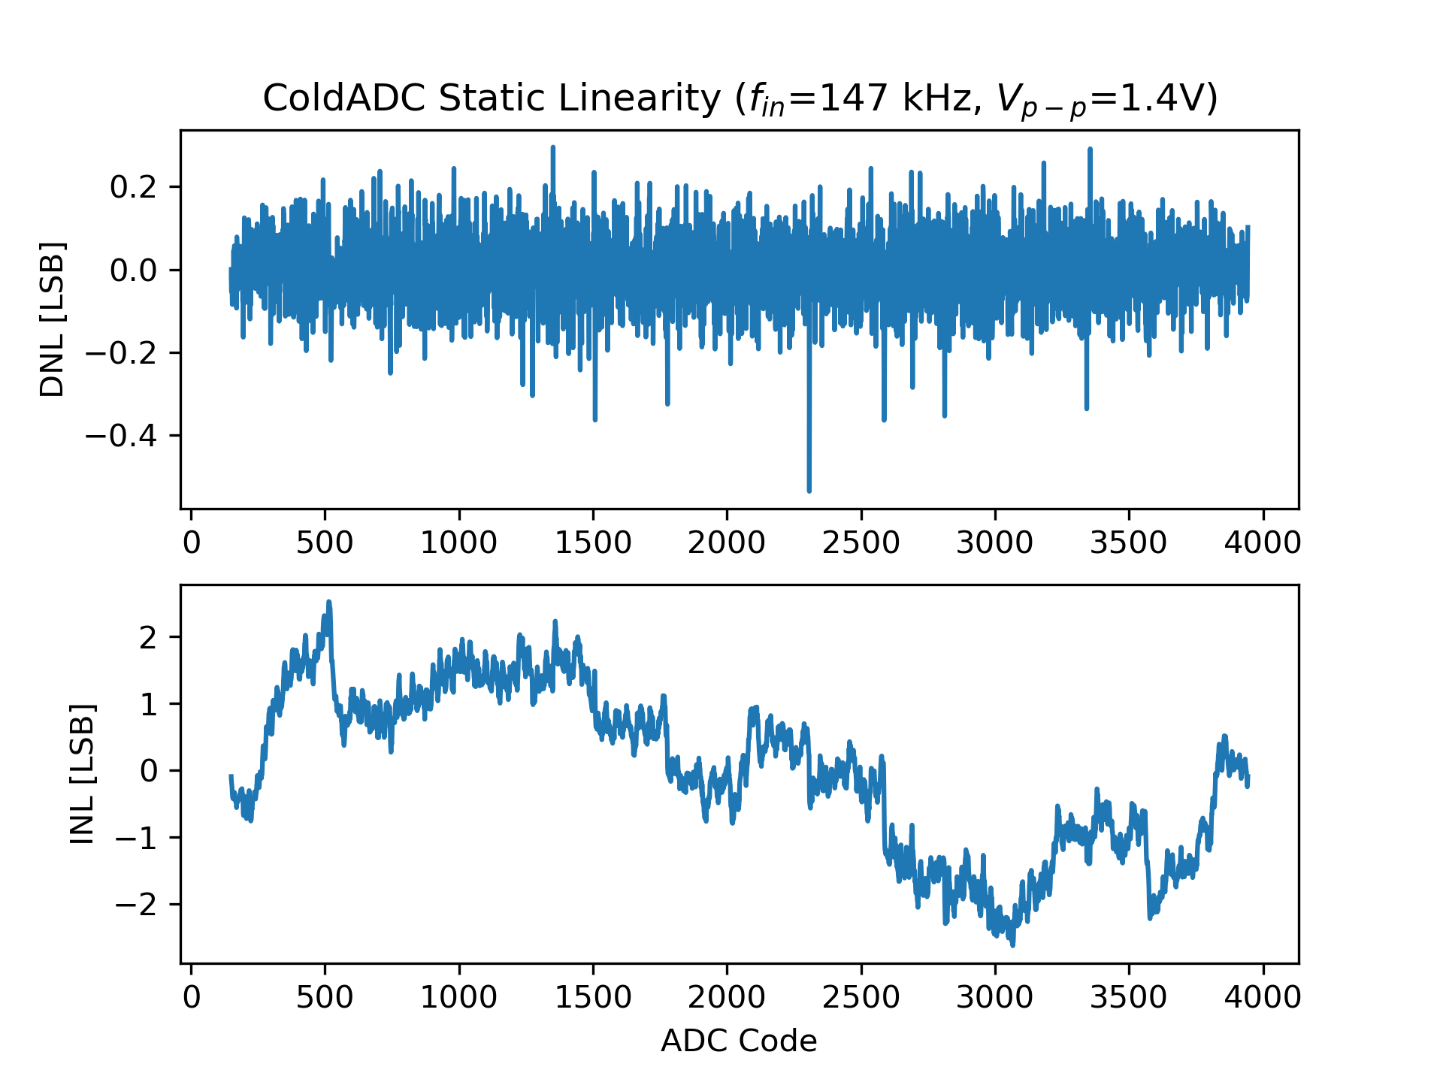
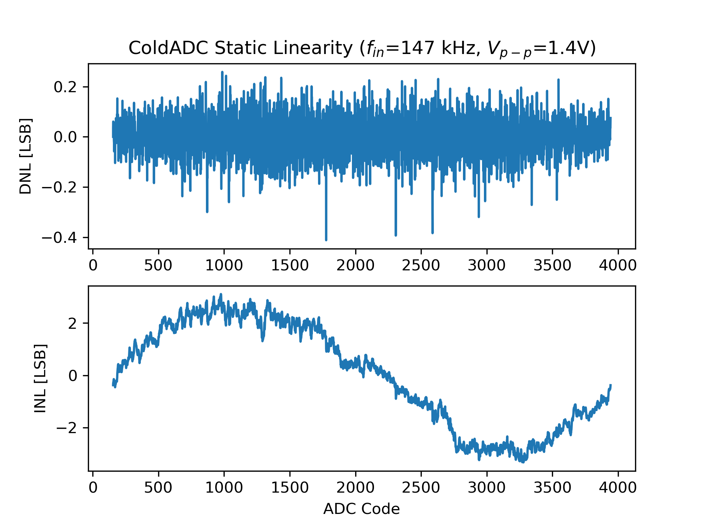
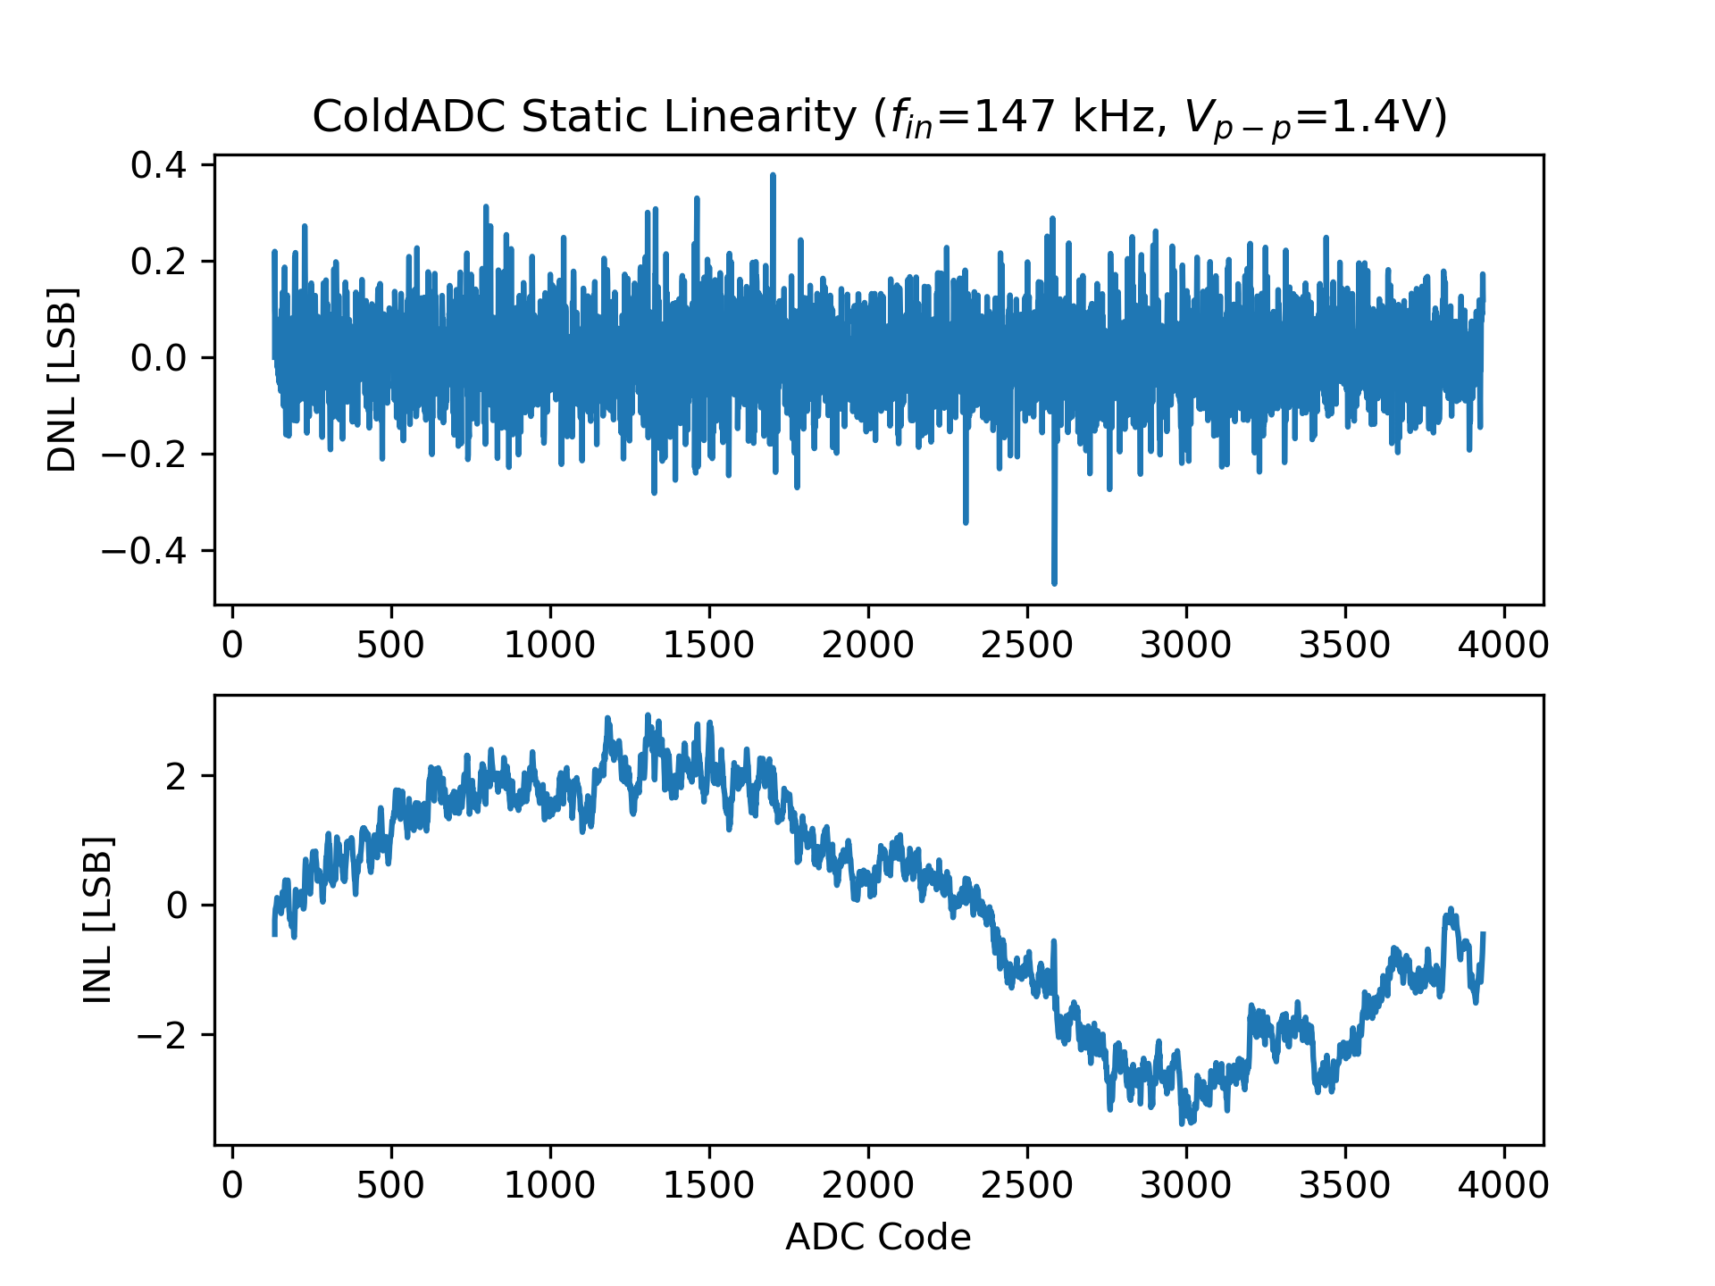
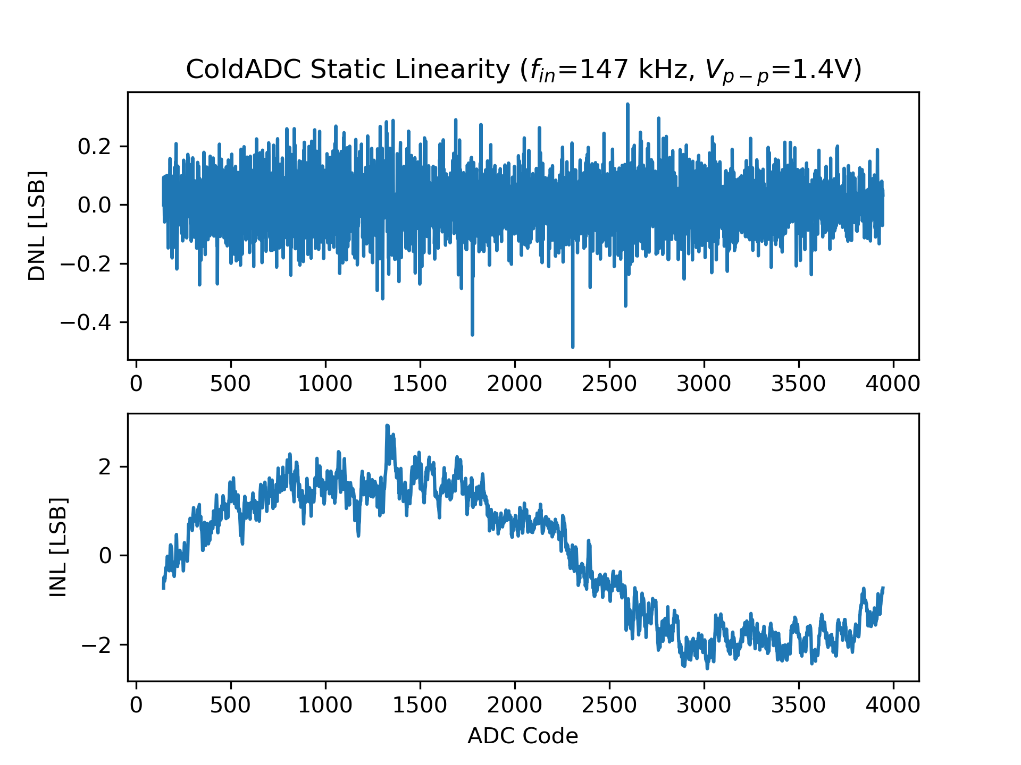
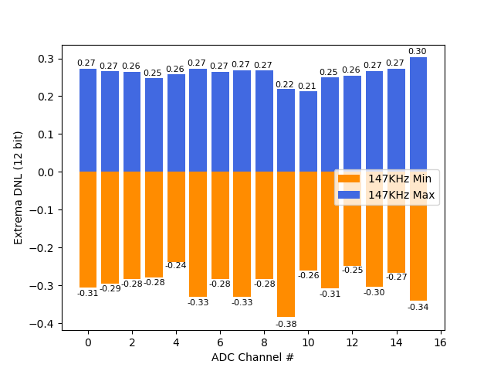
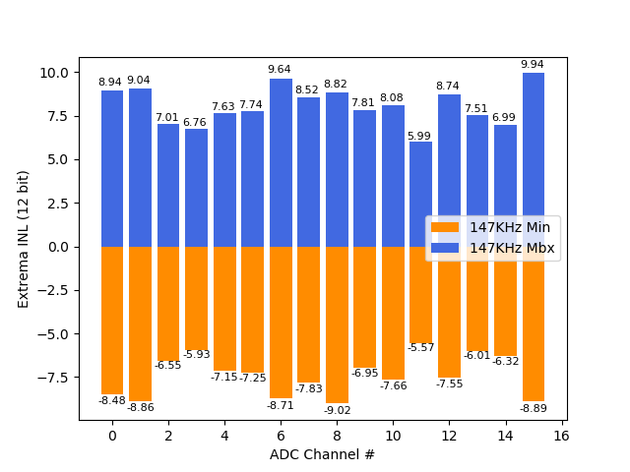
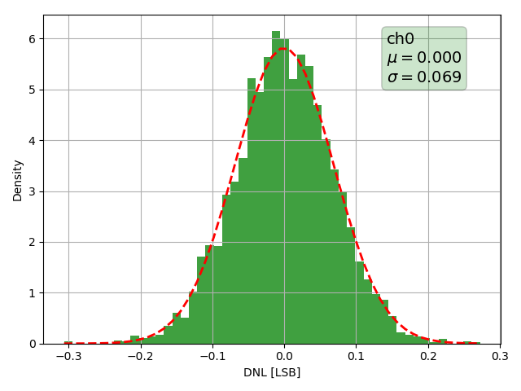
Monitoring parameters
Ch0
Ch2
Ch4
Ch6
Extrema DNL for each ADC channel
Extrema INL for each ADC channel
Standard deviation of DNL for each ADC channel

Slide 22
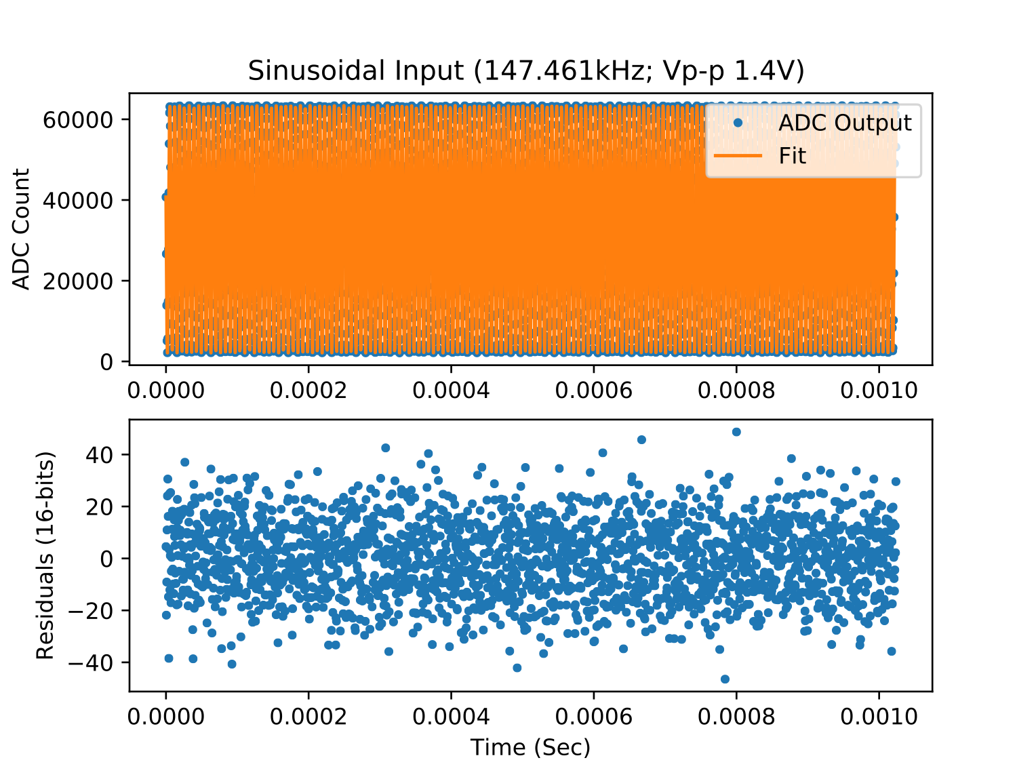
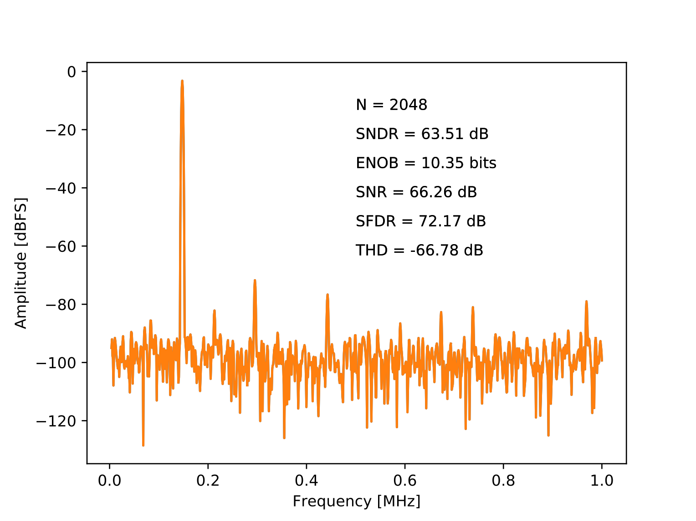
Monitoring parameters
Dynamic linearity: effective number of bits (ENOB)
  It’s the ratio of the input signal amplitude to the rms sum of all other spectral components
  It’s a measure of the combination of nonlinearity and noise

