Slide 1


MQXFA11 Structure and Status
Dan Cheng, for the AUP team
17-Mar-2022
LBNL

Slide 2
MQXFA11 Structure Assembly
Coil Pack Assembly Plans
Pion machining
Preload Assembly Operations
Status and Expected Completion

Slide 3
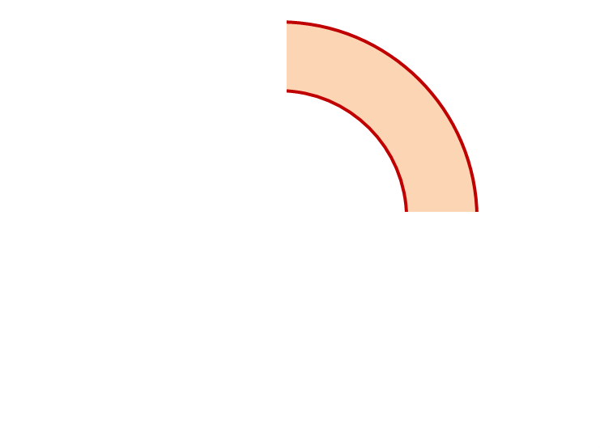
MQXFA11 Proposed Coil Arrangement
8 x δ_{midplane} = 2 π x δR_{OR}
~0.001” Undersized R
neglected
~.004” Undersized per Midpl.
Add 0.002” + 0.002” shim per side
~0.001” Undersized R
Neglected
~0.004” Undersized per Midpl.
Add 0.002” + 0.002” shim per side
222
223
Q2
Q1
Q3
Q4
134
135
~-.002” Undersized R
Neglected
~-.005” Undersized per Midpl.
Add 0.002” + 0.003” shim per side
~.002” Undersized R
Neglected
~0.005” Undersized per midpl.
Add 0.002” + 0.003” shim per side
Coil Electrical Order: A :223 – 135 – 222 – 134: B
Conforms to a favorable order based on RRR data
(see Indico page for info)

Slide 4
MQXFA11 Coil Pack Build 1 (Fuji)
Nominal Collar R: 114 mm
Nominal Coil R: 113.376 mm
Nominal Radial shim = 0.025” (0.624 mm)
  But we still target ~0.020”
Fuji radial stack up is ~0.021” (~0.54 mm)
  0.0045” Coil GPI + 0.007” Fuji + 0.005” Kapton & 0.005” G11
Add 0.004” to 222, 223 midplanes
Add 0.005” to 134, 135 midplanes
 | 223 | 222 | 134 | 135
Kapton Ground plane insulation | 0.0045” (0.114 mm)
Coil Specific Radial Shim | 0 | 0 | 0 | 0
Coil-specific midplane shim | 0.004” 0.100 mm | 0.004” 0.100 mm | 0.005” 0.125 mm | 0.005” 0.125 mm
Fuji paper | 0.007” (0.175 mm)
Radial Shim | 0.005” Polyimide + 0.005” G11 (~0.25 mm)

Slide 5
MQXFA11 Coil Pack Build (Final)
Nominal Collar R: 114 mm
Nominal Coil R: 113.376 mm
Nominal Radial shim = 0.025” (0.624 mm)
  But we still target ~0.020”
Actual radial stack up is ~0.020” (~0.51 mm)
  0.0045” Coil GPI + 0.005” Kapton + 0.005” Kapton & 0.005” G11
Add 0.004” to 222, 223 midplanes
Add 0.005” to 134, 135 midplanes
 | 223 | 222 | 134 | 135
Kapton Ground plane insulation | 0.0045” (0.114 mm)
Coil Specific Radial Shim | 0 | 0 | 0 | 0
Coil-specific midplane shim | 0.004” 0.100 mm | 0.004” 0.100 mm | 0.005” 0.125 mm | 0.005” 0.125 mm
Fuji paper | 0.000” (0.0 mm)
Radial Shim | 0.005” Polyimide + 0.005” Polyimide + 0.005” G11 (~0.38 mm)

Slide 6
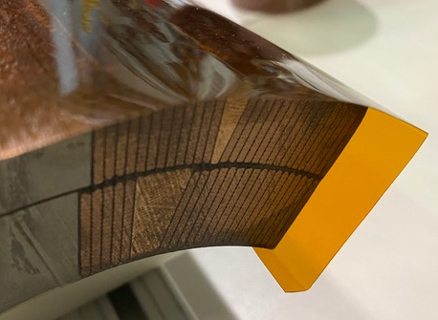
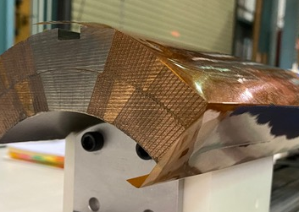
Fuji Assembly Notes (1)
GPI Layers will have ID fold
  Process was developed and incorporated into MQXFA07 and later coils
Preventing a repeat of the MQXFA09 NCR:
  Fuji build will have Kapton tape holding fold down on the ID
  Final build will use Araldite spots of glue with tape removed
  Inspection step after the upper coil pair is placed on top of bottom coil pair will verify no foldback condition is present

Slide 7
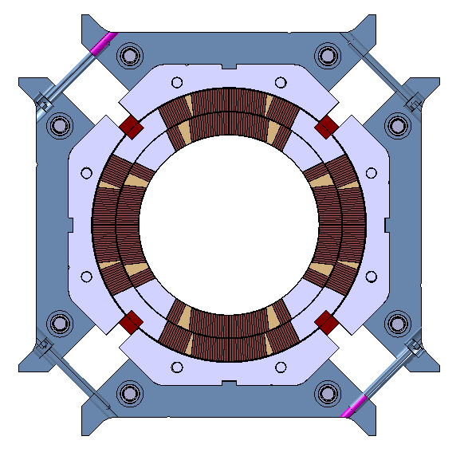
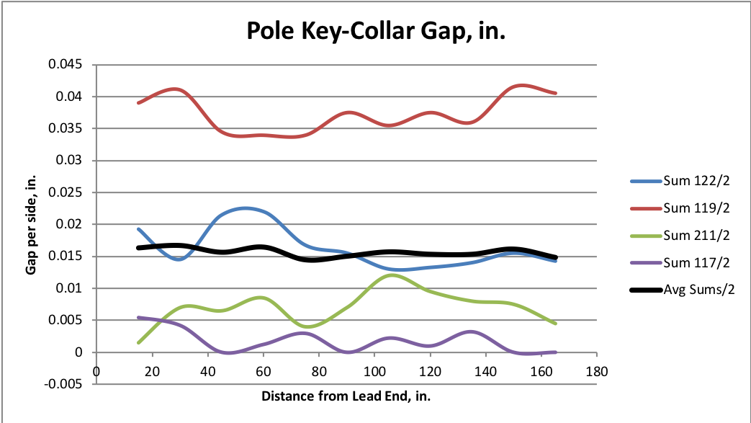
Fuji Assembly Notes (2)
The Fuji paper build, along with mechanical measurements, is an important QC check in the coil pack build, but the following notes apply:
  Some mechanical measurements may not be square due to not shifting/squaring up pads
    Standard torque values achieved, but we avoid sliding surfaces which may cause inaccurate Fuji exposures
  Gaps will be larger
    The Kapton radial shim will only be partially present, therefore the expected average pole key gap will be ~0.015” larger than that of the final build
Large gaps
Large gaps
Q2
Q1
Q3
Q4
Small gaps
Small gaps
Depiction not to scale
MQXFA06 Fuji Gaps

Slide 8
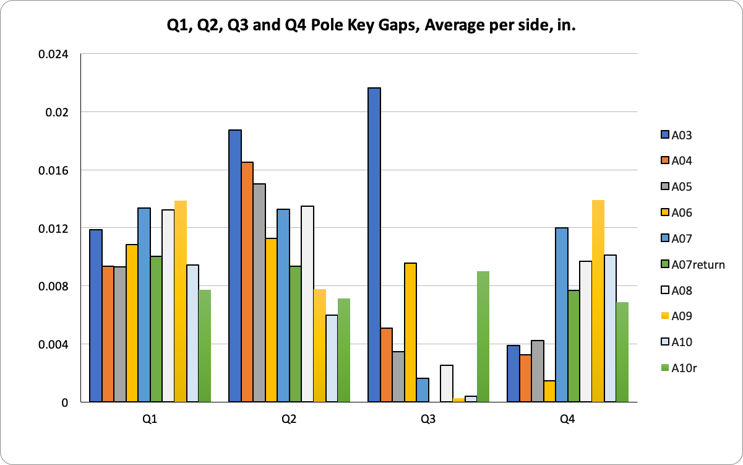
Final Coil Pack Assembly Notes
Lessons learned from MQXFA07 disassembly and MQXFA10 rebuild
  A revised process for squaring and torqueing the Coil Pack was developed
  Greater emphasis on squareness and gap uniformity throughout the entire torqueing process
  Torque target is 75 +/- 25 in-lbs., depending on gaps
  Repeated measurements throughout build will ensure and verify that the gaps and coil pack squareness specifications are met
Uniform gaps
Q2
Q1
Q3
Q4
Improved squareness
See next slide

Slide 9
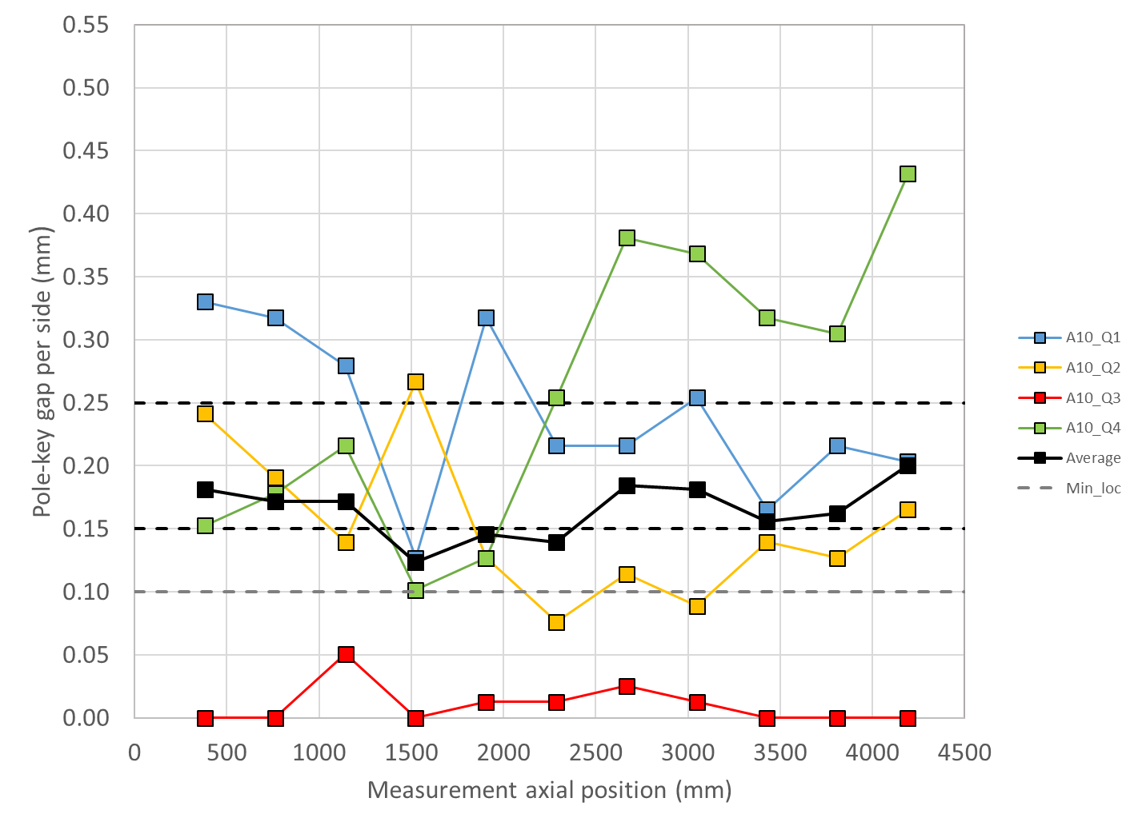
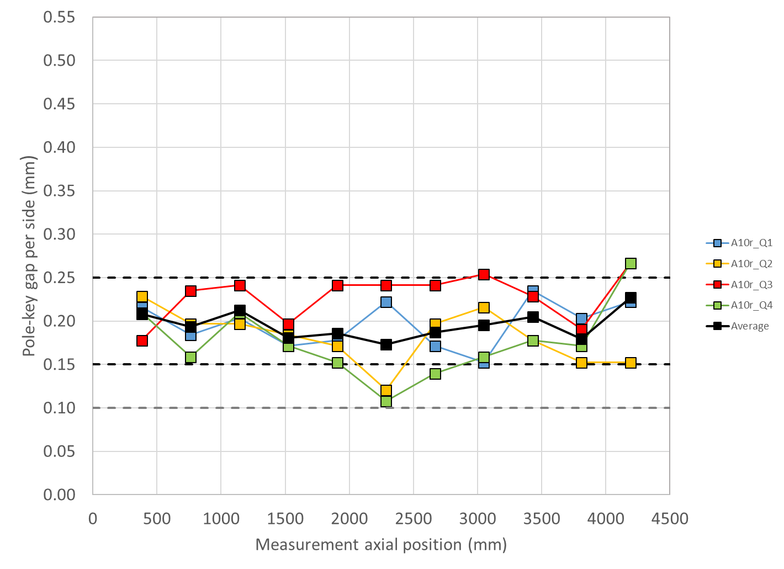
MQXFA10 (Rebuild) Gap Measurements
For the pole key gap:
  The average pole key gap (per side) among the four coils on each longitudinal location shall be +0.200 ±0.050 mm.
  The minimum pole key gap (per side) in any quadrant and in any longitudinal location shall be > +0.100 mm.
MQXFA10 initial coil pack
MQXFA10 rebuilt coil pack

Slide 10
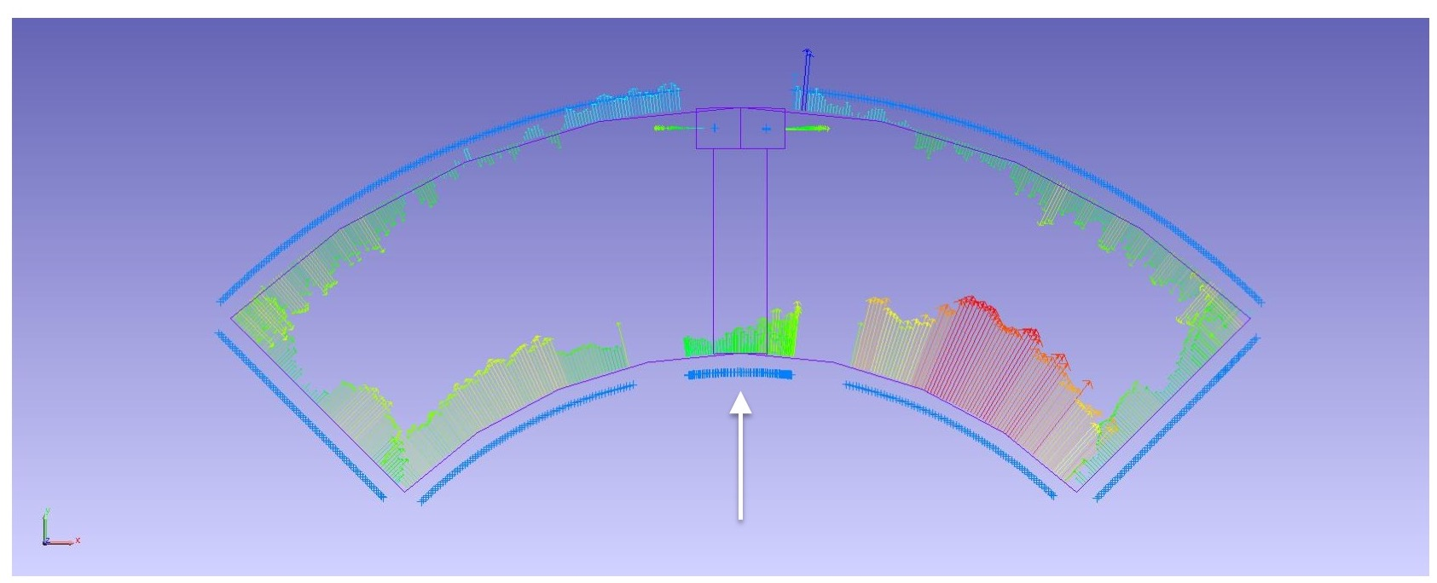
Pion Machining, Details
Used “average” values as starting point
  Measurements based on best-fit of combined Outer Radius and Midplane deviations
Positive deviations = extra material in bore
  This is what needs to be removed from a nominal 1.2 mm thick pion
Negative deviations will not require “addition” of material
  Nothing will be done to these pions
For MQXFA11 several pions need to be modified from nominal

Slide 11
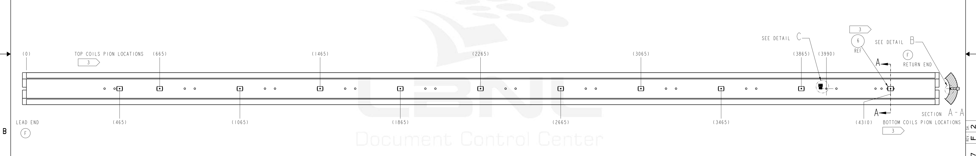
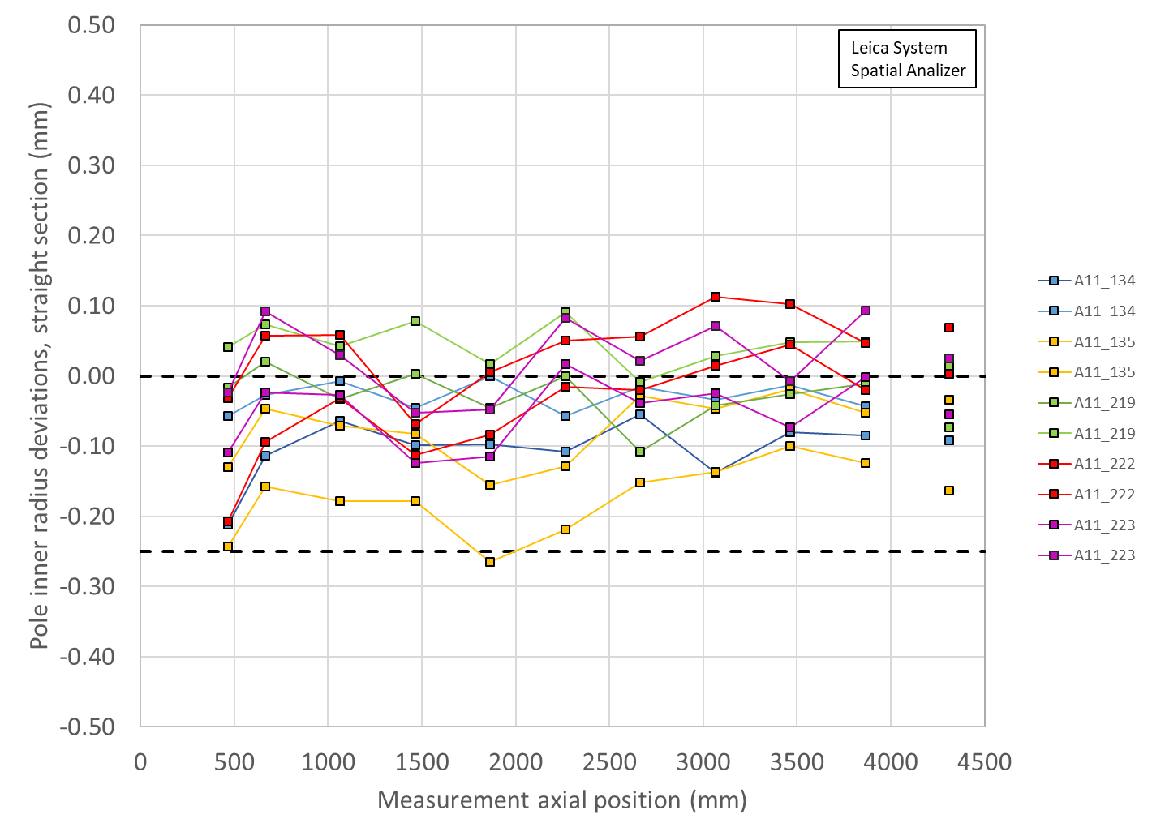
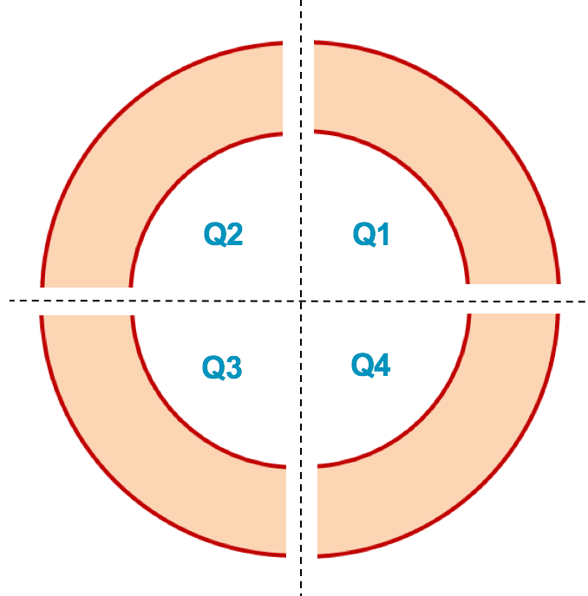
Pion Machining Positions
Upper Coils, Pion thickness (mm)
Loc. | 665 | 1465 | 2265 | 3065 | 3865
223 | 1.1 | 1.2 | 1.1 | 1.13 | 1.1
222 | 1.15 | 1.2 | 1.15 | 1.08 | 1.15
Lower Coils, Pion thickness (mm)
Loc. | 465 | 1065 | 1865 | 2665 | 3465 | 4310
134 | 1.2 | 1.2 | 1.2 | 1.2 | 1.2 | 1.2
135 | 1.2 | 1.2 | 1.2 | 1.2 | 1.2 | 1.2
Upper Coils
Upper Coils
222 223
Lower Coils
Lower Coils
134 135

Slide 12
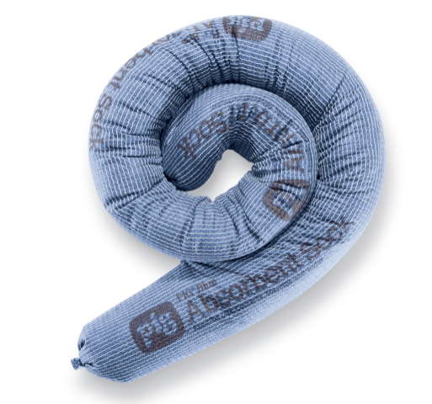
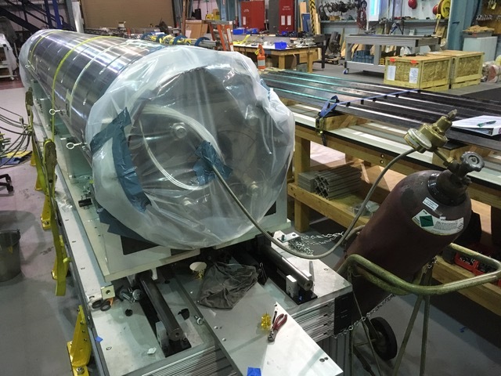
Avoiding Electrical Issues
Updated procedures first used in magnet MQXFA05 will continue to be used
  Avoiding water in the system due to bladder failures
    Absorbent socks in cooling holes to better dam and prevent pooling of water
    Dehumidifiers on hand during bladder operations to bag and flow immediately after operations are complete
    Increase load key step sizes to 0.005” (reduces the number of bladder cycles)
  NOTE: Dehumidifier (along with absorbent socks) was used on MQXFA08, which experienced 50% bladder failures; EQC tests passed without issue
3” dia. absorbent sock

Slide 13
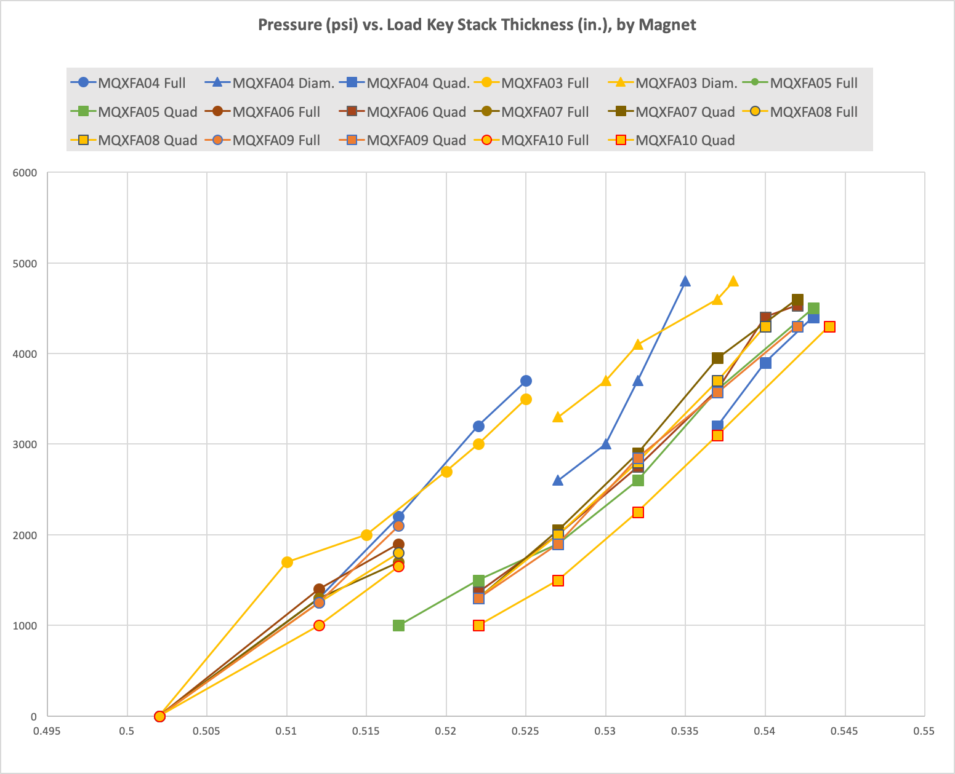
Reducing Bladder Cycles
Based on the bladder failure/load key incident experienced in MQXFA04 we successfully introduced procedural changes starting with MQXFA05
Magnet preload operations will continue to implement the following:
  A pressure check at the beginning of operations
  A “stable hold” at target pressures
  Fewer pressure cycles by using 0.005” thick shim steps (about 8 steps expected)
  Spare keys on hand to replace as needed, and/or second set of keys ready to replace
50% Azimuthal load
Starting with MQXFA06 an additional 0.005” step was added using all bladders before transitioning to quadrant loading.
MQXFA11 will continue following that experience

Slide 14
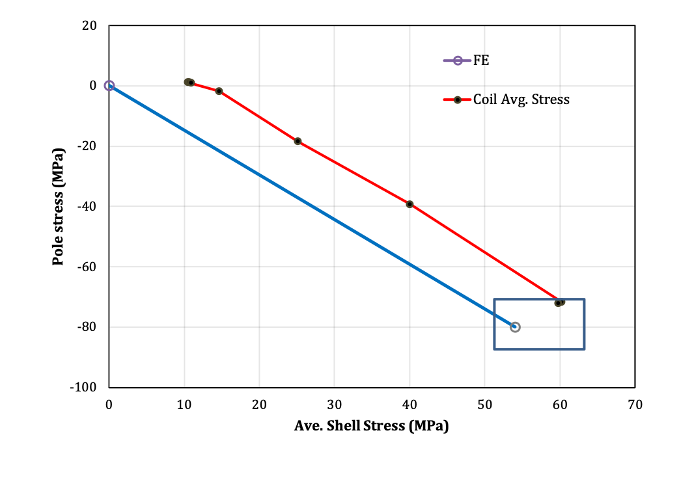
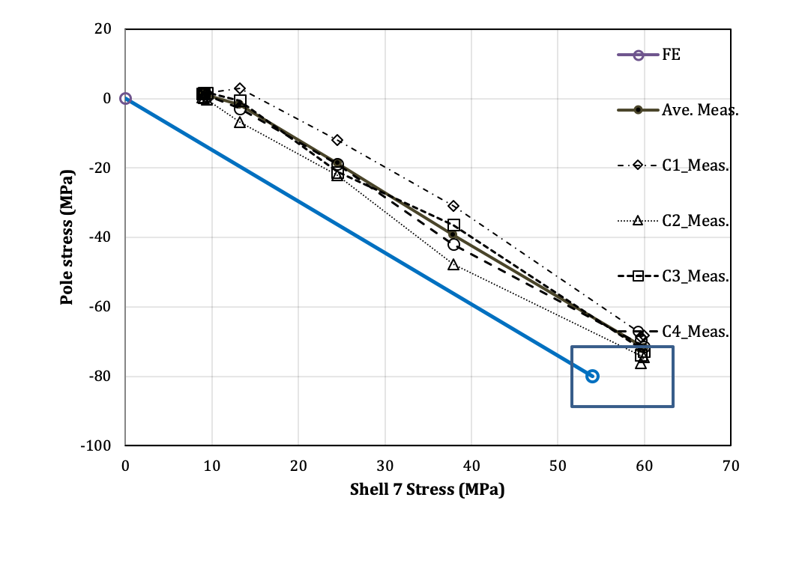
MQFXA10 Preload 2 Transfer Function Plots
Achieved a small spread of coil stresses, with average at 72 MPa (within target of 80 +/- 8)
See earlier slides for pole key gap dimensions

Slide 15
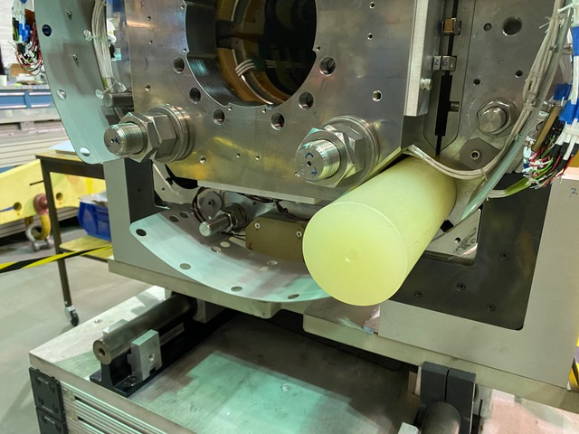
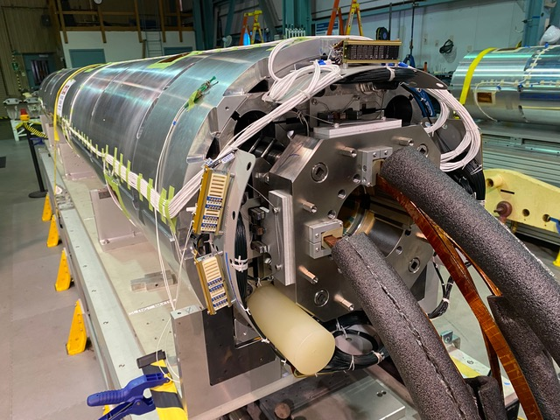
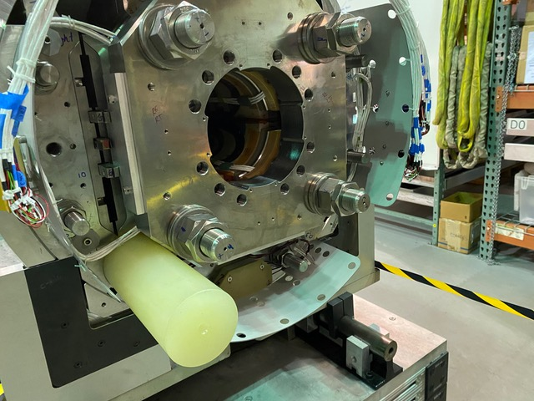
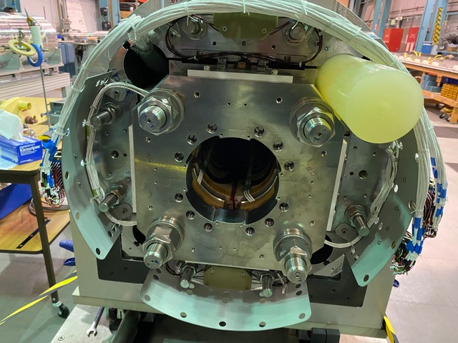
Cooling Hole Bore Check
The improved coil pack squareness of MQXFA10 is also evident with the cooling hole bore check
All cooling hole bores are clear and more uniform

Slide 16
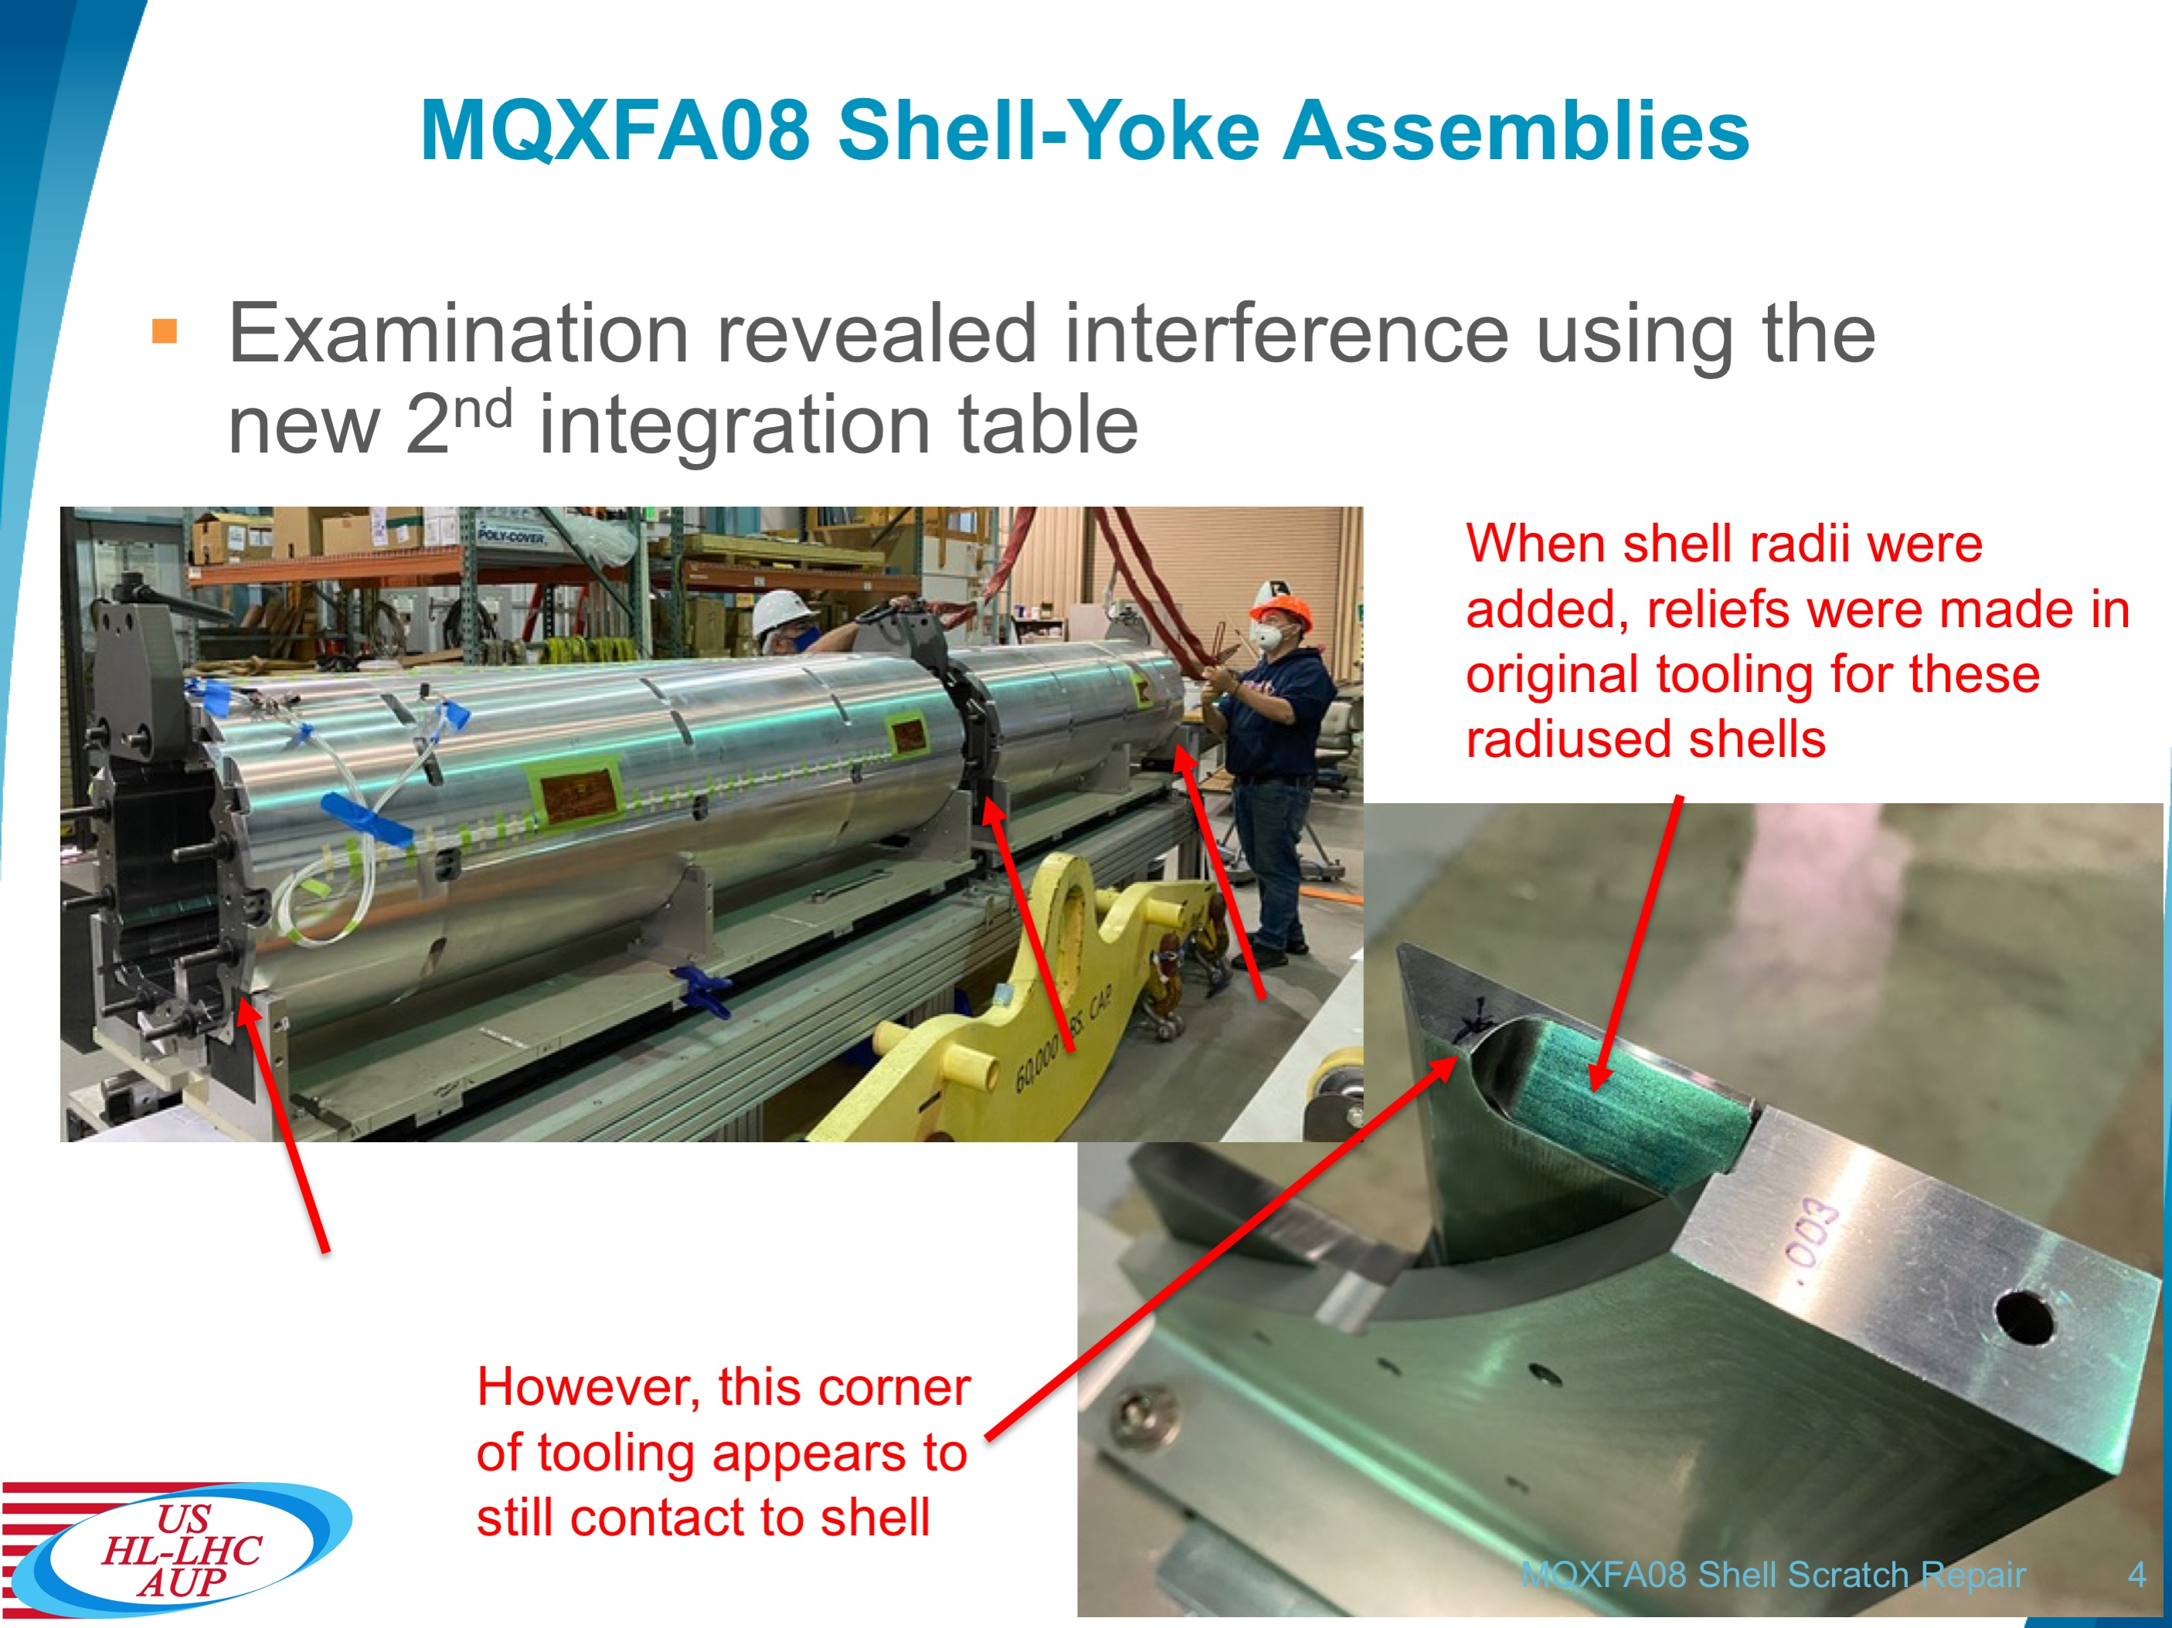
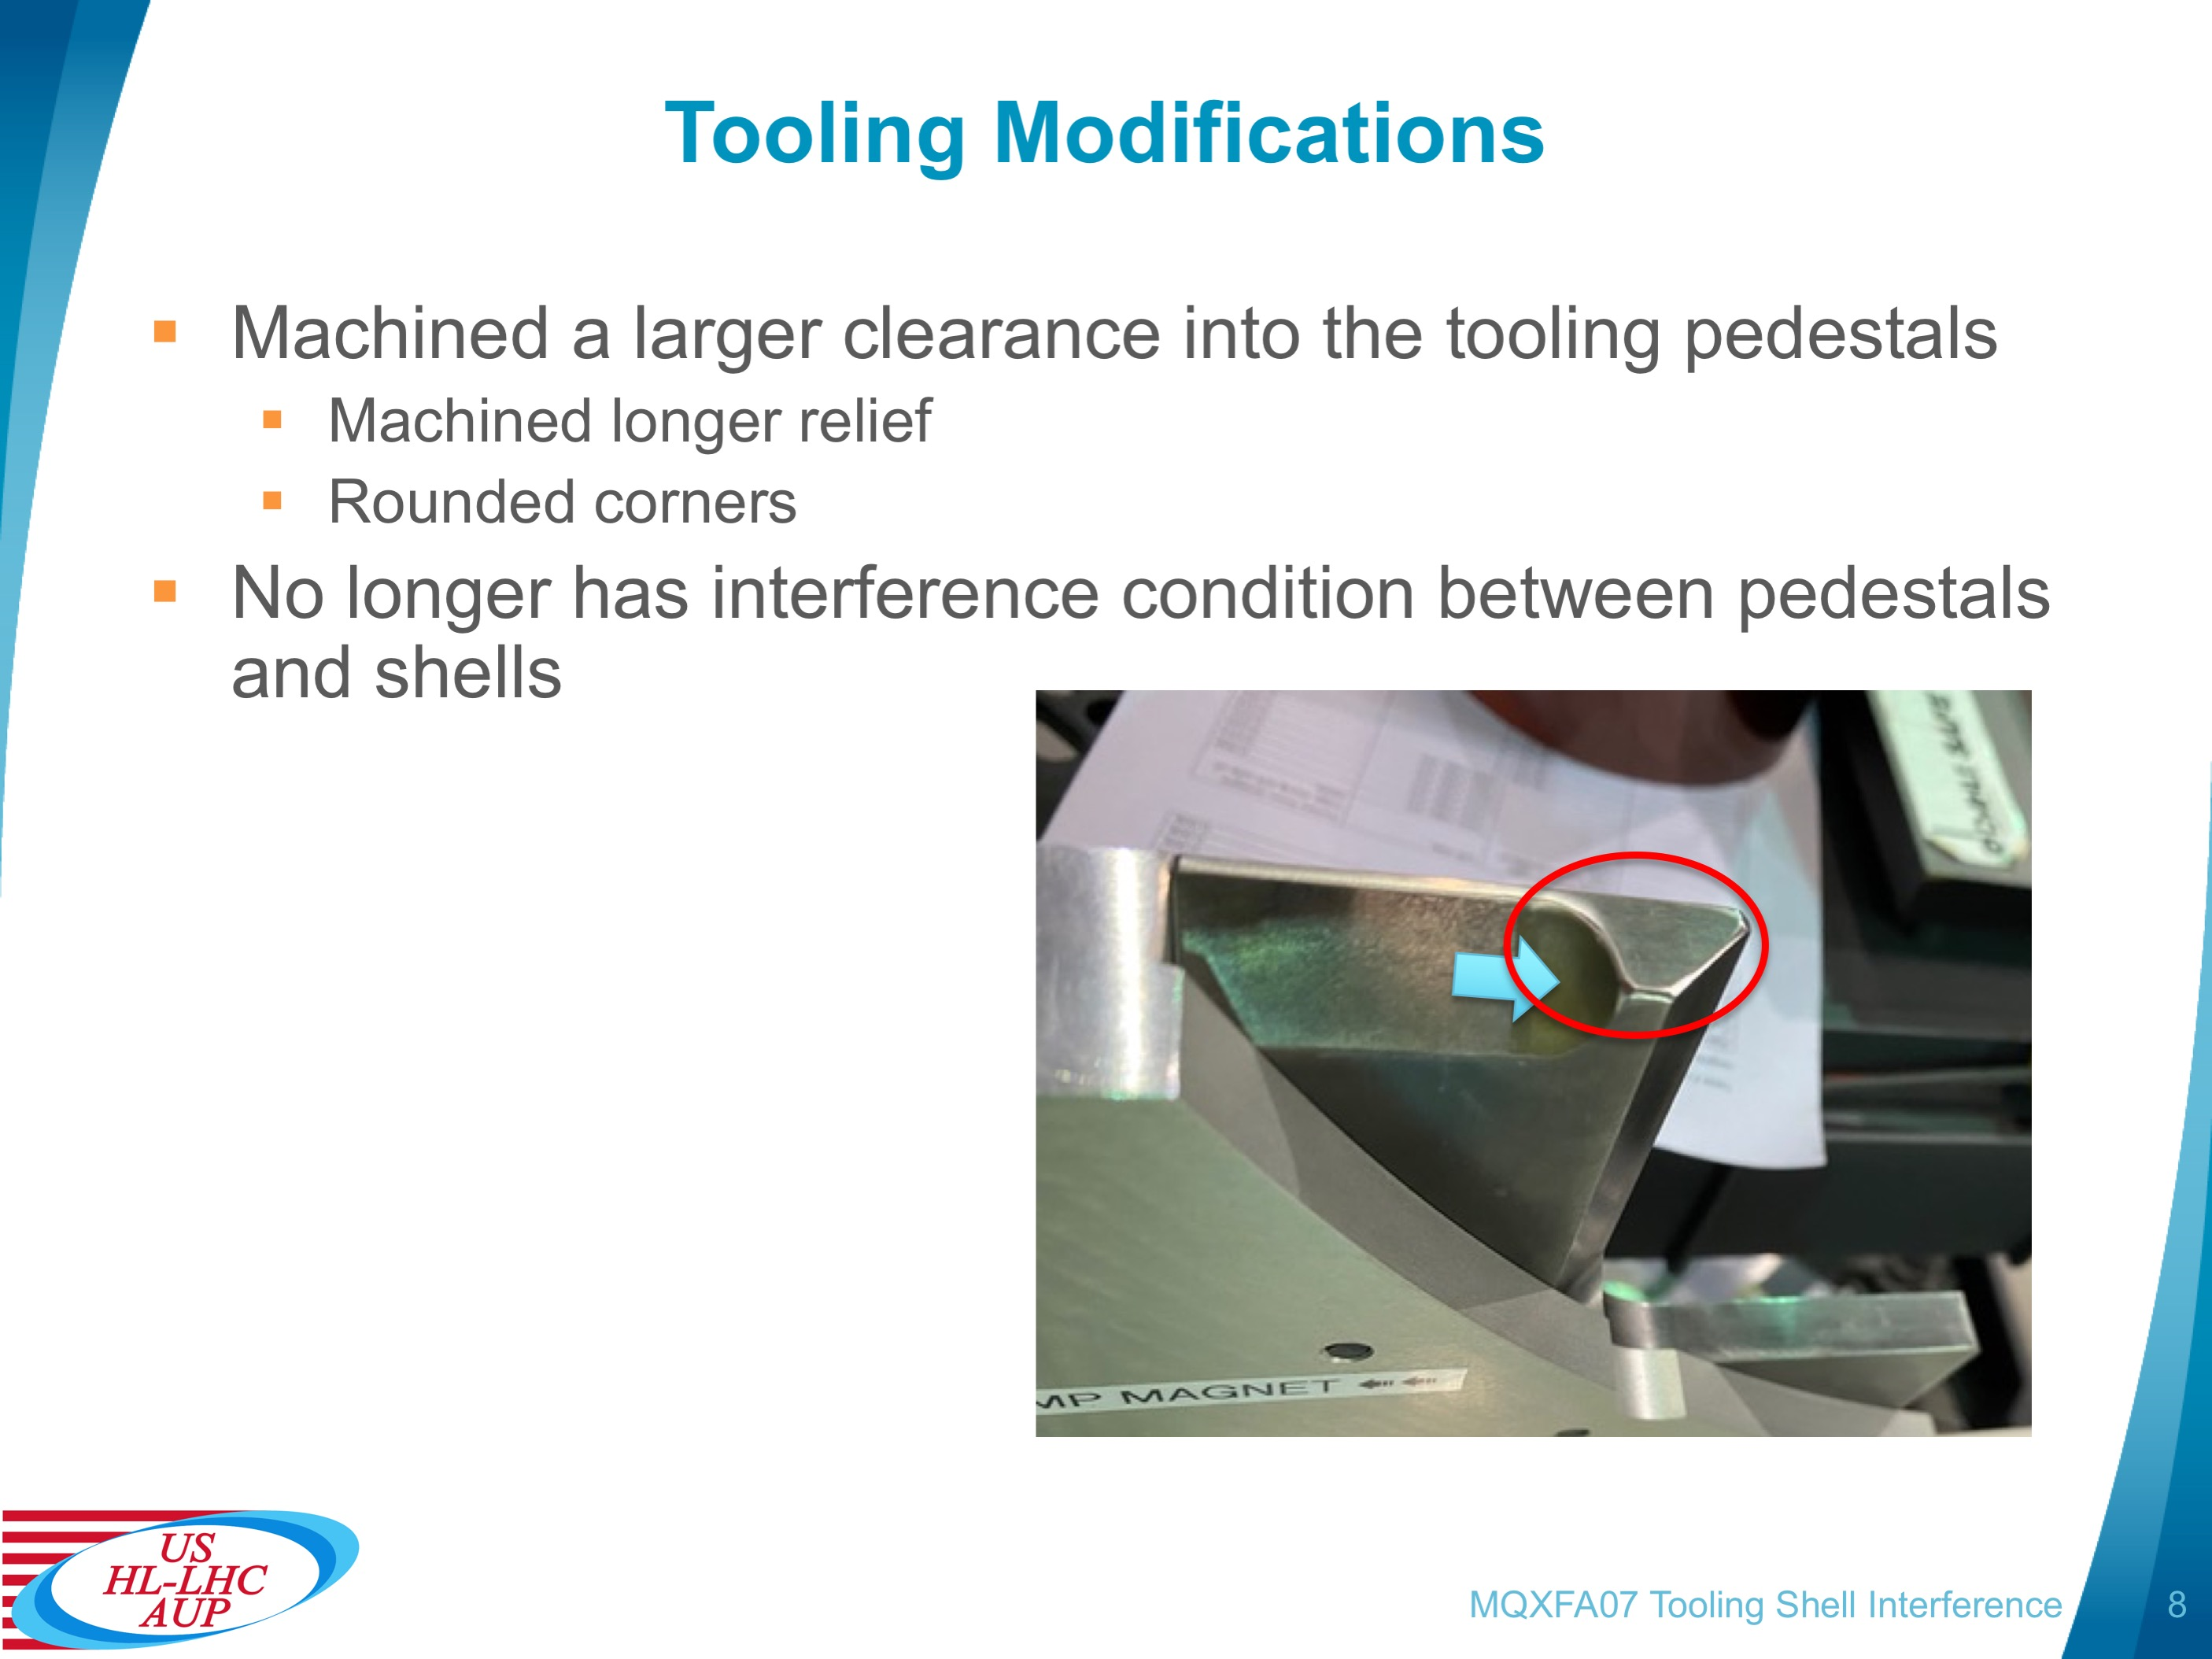
Integration Table Interference Modifications
During the survey of the new magnet integration table with MQXFA08 shell-yoke assemblies an interference was found in the tooling that contacted the radii of the shells
Pedestal supports were machined and dressed to ensure clearance and no further contact to the shells
All magnets since MQXFA08 will not have this issue

Slide 17
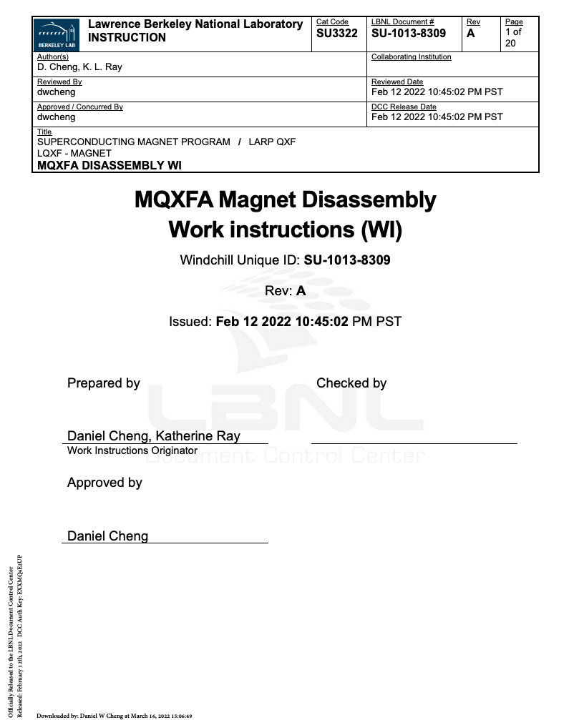
MQXFA09 Disassembly Activities
Developed Work Instruction SU-1013-8309 for the MQXFA07 disassembly
  Redline revisions will be approved and released prior to disassembly of MQXFA09 magnet
Coils will be examined for any possible damage from the folded in Kapton
  Then the coils will be stored until analysis is completed to determine disposition of these coils
Parts will be reused for the MQXFA11 magnet

Slide 18
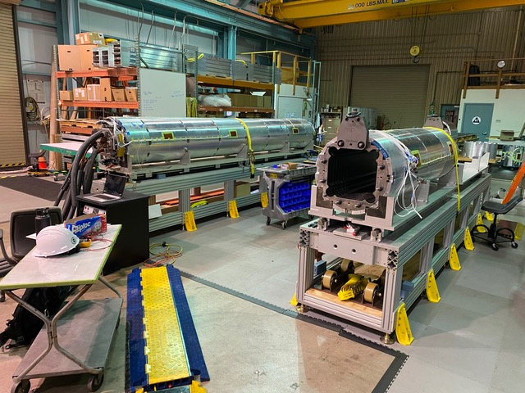
MQXFA09/A11 Structure Status
MQXFA07
  Is still being disassembled and packaged up for storage
  Crane issue has been resolved; work is ongoing
MQXFA09 magnet will be moved to the integration table after MQXFA07 parts have been shipped to storage
A11 Coils
  134, 135, 222, 223 (219 is spare)
  Ready for coil instrumentation and dressing operations
  Instrumenting FBG strain gauges prior to coil pack build
2nd magnet assembly line will be used for MQXFA10/A08b
Both magnet lines will be worked on concurrently
Second Magnet assembly line for (MQXFA10 shown)
First Magnet assembly line MQXFA09/A11
(MQXFA07 shown)

Slide 19
Projected Schedule for Completed Assembly
MQXFA07 is being packaged up for storage
  Completed 4th week of March
MQXFA09 structure will be prepped for disassembly
  Starting 4th week of March
  Disassembly to start beginning of April
MQXFA11 coils preparations
  Will start as early as April 1
MQXFA11 Magnet
  Coil pack complete First week of May
  Integration completed 2nd week of June

Slide 20
Summary
MQXFA09 will be disassembled and the parts will be reused for the MQXFA11 coils
  Procedure developed for the MQXFA07 process will be employed
MQXFA11 will apply lessons learned
  From the MQXFA07 disassembly and MQXFA10 re-squaring of the coil pack
  From the MQXFA09 critical NCR of the folded GPI layer inside the bore
Pion locations were identified that require modification
MQXFA11 will continue the use of techniques that were successfully applied in MQXFA05-08 Preventing significant moisture (affecting electrical QC)
  Also prevents a repeat of a partially inserted load key
MQXFA11 is expected to be completed mid-June while MQXFA08 is expected to return

Slide 21
Additional Slides

Slide 22
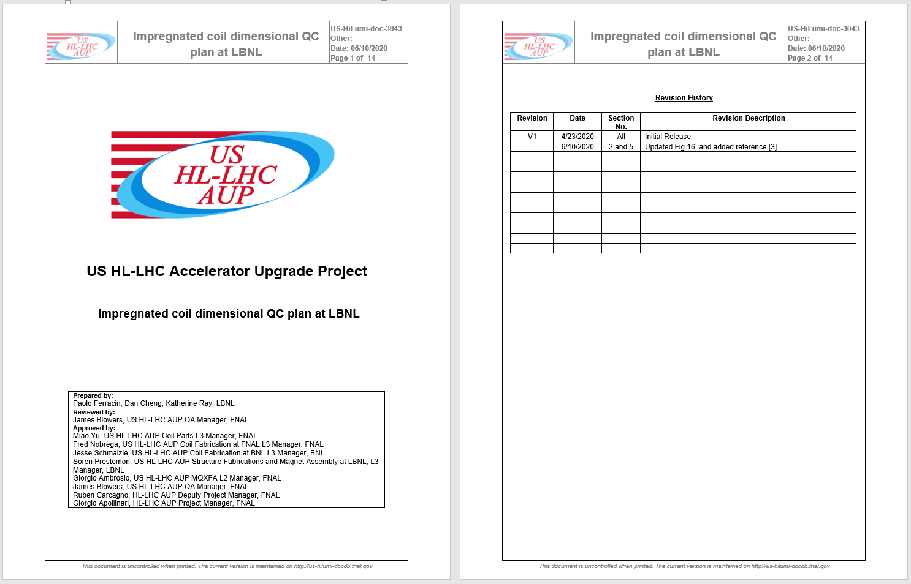
Impregnated coil dimensional tolerances
(for series coils)

Slide 23
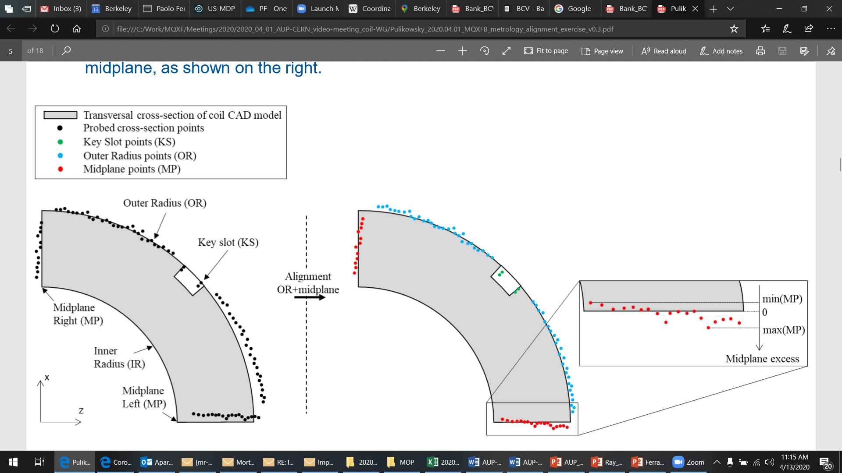
Impregnated coil dimensional tolerances
Arc length excess
The impregnated coil is accepted for use in MQXFA if its arc length excesses along the straight section are within the following tolerances: +0.150/-0.250 mm
The arc length excess, which is difference between the measured coil arc length and the nominal one, is determined by fitting outer radius and mid-planes points with the nominal profile, with equal weighting and imposing as symmetrical the two mid-planes offsets. The sum of the two measured mid-plane offsets provides the arc length excess

Slide 24
Impregnated coil dimensional tolerances
Outer radius profile deviation
The impregnated coil is accepted for use in MQXFA if its outer radius profile deviations along the straight section are within the following tolerances: +0.200/-0.250 mm
The outer radius profile deviation, which is given by the variation of each point on the outer radius with respect to the nominal outer radius, is determined by fitting outer radius and mid-planes points with the nominal profile, with equal weighting and imposing as symmetrical the two mid-planes offsets. Positive deviation indicates more material than nominal, negative indicates less material than nominal.

Slide 25
Impregnated coil dimensional tolerances
“Coil blocks” inner radius profile deviation
The impregnated coil is accepted for use in MQXFA if its “coil blocks” inner radius profile deviations (E-F in next slide) along the straight section are within the following tolerances: +0.150/-0.250 mm
The “coil blocks” inner radius profile deviations, which is given by the variation of each point on the inner radius with respect to the nominal radius, is determined by fitting outer radius and mid-planes points with the nominal profile, with equal weighting and imposing as symmetrical the two mid-planes offsets. Positive deviation indicates more material than nominal, negative indicates less material than nominal.

Slide 26
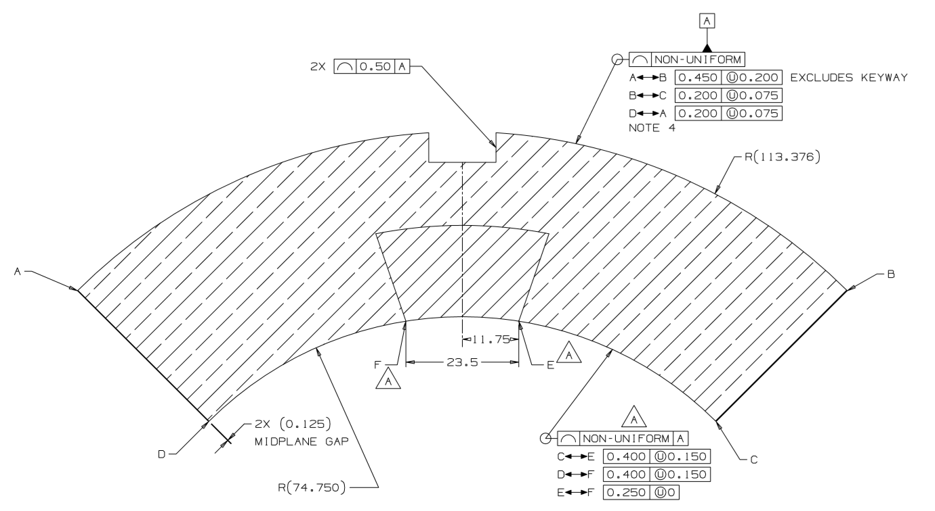
Impregnated coil dimensional tolerances

Slide 27
Impregnated coil dimensional tolerances
“Pole” inner radius profile deviation
The impregnated coil is accepted for use in MQXFA if its “pole” inner radius profile deviations (C-E and D-F in next slide) along the straight section are within the following tolerances: +0.000/-0.250 mm*
The “pole” inner radius profile deviations, which is given by the variation of each point on the inner radius with respect to the nominal radius, is determined by fitting outer radius and mid-planes points with the nominal profile, with equal weighting and imposing as symmetrical the two mid-planes offsets. Positive deviation indicates more material than nominal, negative indicates less material than nominal.

Slide 28
Impregnated coil dimensional tolerances
* Cross-section measurements shall be taken close to all possible bumper locations. In addition, data shall be taken on the surface surrounding the pole holes where bumpers are inserted and projected on the closest measured cross-section.

Slide 29
Impregnated coil dimensional tolerances
Pole key slot mis-alignment
The impregnated coil is accepted for use in MQXFA if its pole key slot mis-alignment along the straight section are within the following tolerances: +0.250/-0.250 mm
The pole key slot mis-alignment, which is the misalignment of the center of the pole key slot with respect to the nominal position, is determined by fitting outer radius and mid-planes points with the nominal profile, with equal weighting and imposing as symmetrical the two mid-planes offsets.
  View from LE, positive shift towards left

Slide 30
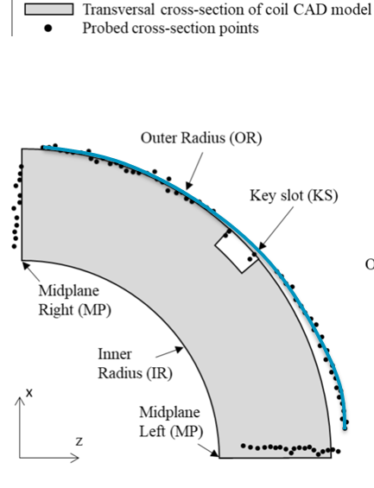
Best-fit outer radius
The best-fit outer radius is determined by best-fitting only the outer radius points.
No tolerance is specified
  Used to monitor coil-to-collar contact surfaces (“LQ effect”)

