Slide 1
EM simulation for mutual coupling effects in cylinder
Shijie Sun

Slide 2
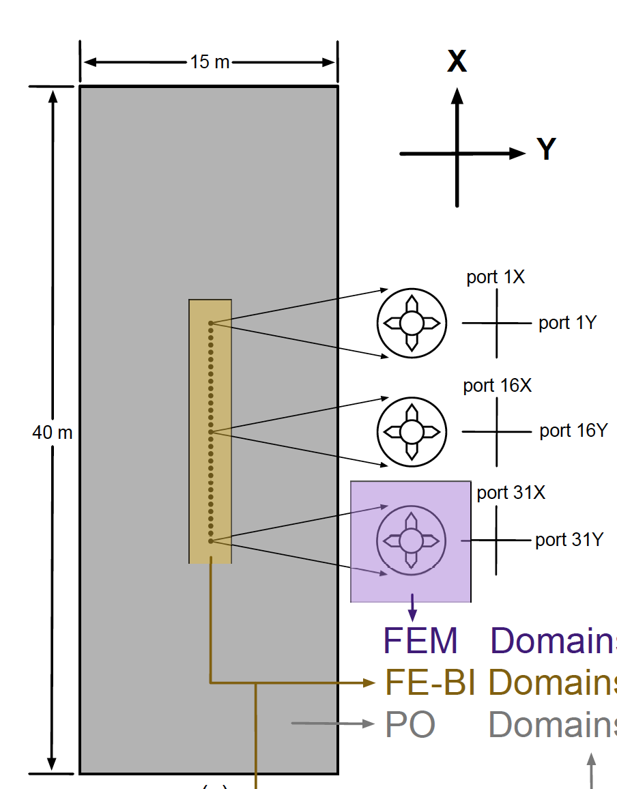

Slide 3
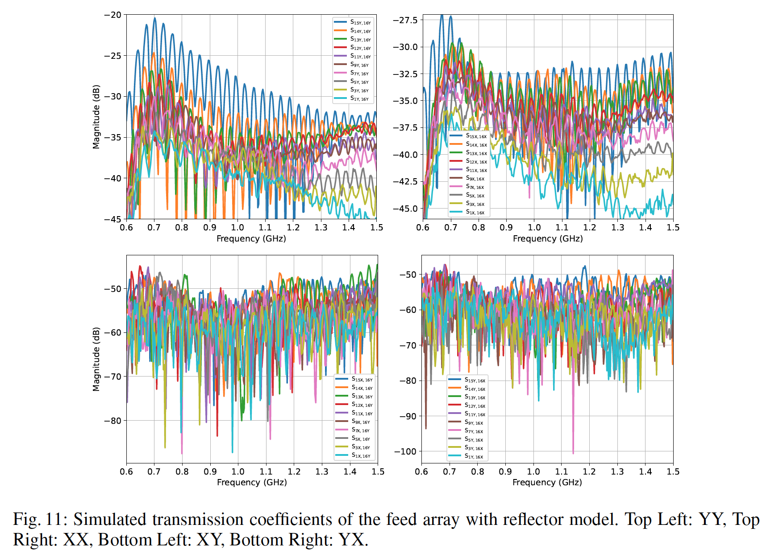

Slide 5
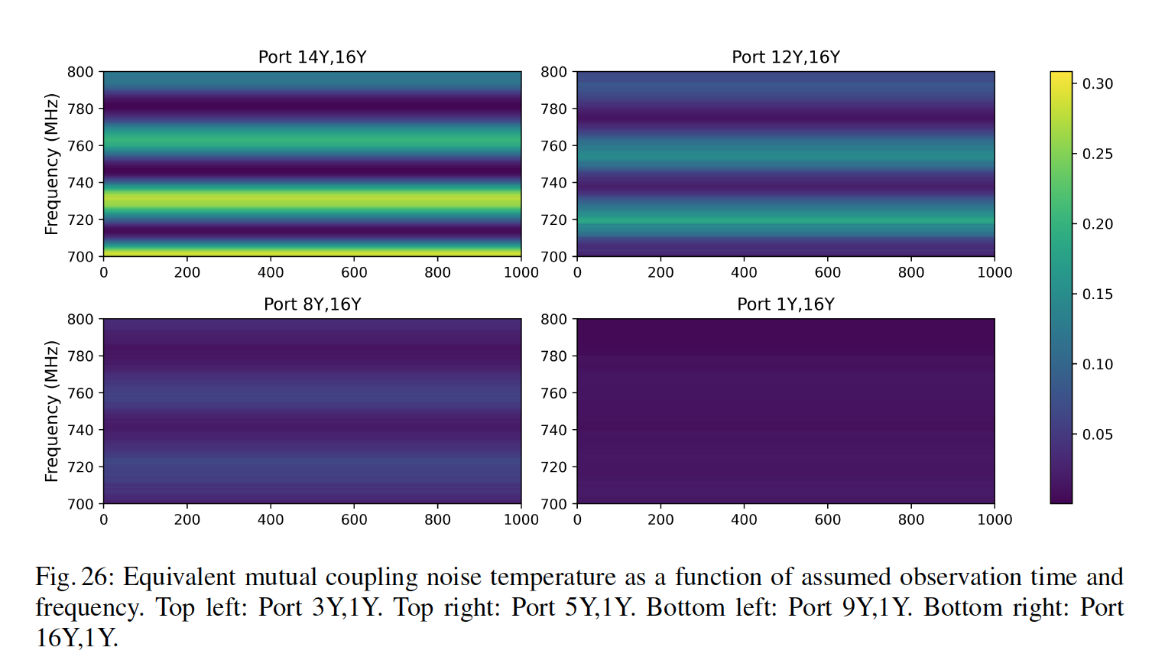

Slide 6
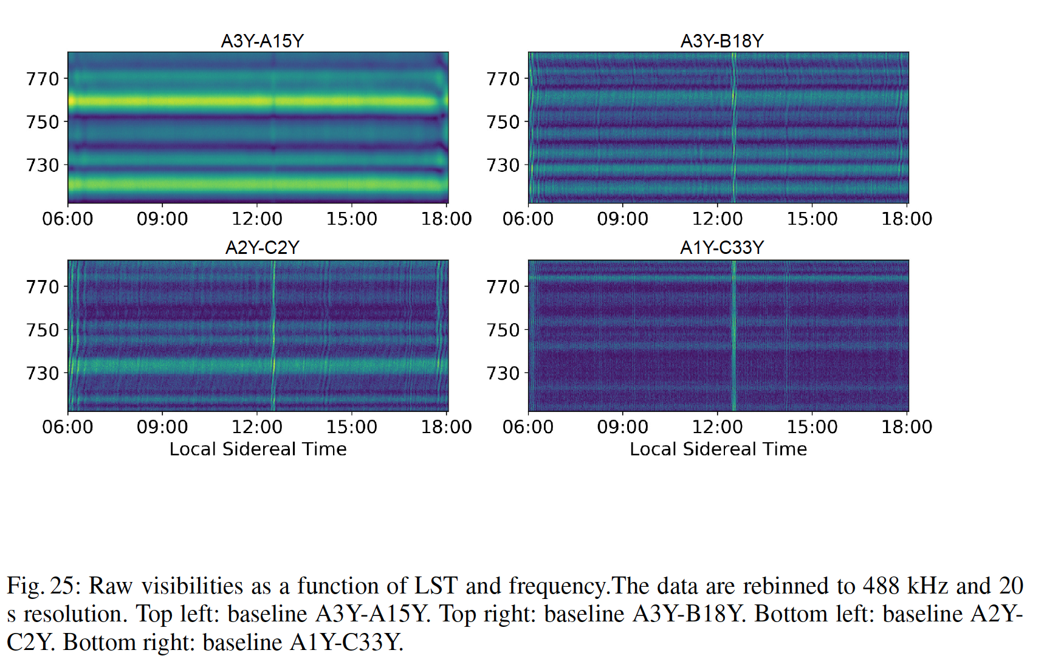

Slide 7
Questions
It seems crosstalk in observation is larger than simulation;
Any other methods to quantify crosstalk temperature?

