Slide 1
NuComp News
Lee Lueking
March 14, 2012
π-day

Slide 2
Outline
Maintenance day stuff
IF Computing Resource Summary

Slide 3
Maintenance Day: Tomorrow Thursday 3/15
Reboots: All SLF6 systems will be rebooted to get the latest kernel update. All SLF5 systems will be rebooted next month.
Grid: Condor will be upgraded to Condor 7.6.6 on all head nodes and worker nodes. VDT software will be upgraded on head nodes. All jobs will be drained from the cluster beginning at noon on March 14, 2012 and no new job submissions will be accepted from that time until the upgrade is complete.
DNS: all gpcf VM’s will see a very short DNS interruption between 7 and 7:30 AM to re-assign VM ID numbers.
Networking Services: On Thursday March 15th from 6:30am – 7am as part of CHG 3443 we will be moving several network links from the old FCC2 distribution switch to the new FCC2 Nexus switch. Sensitive applications may see some brief interruptions.
One of the switches being moved is r-s-fcc2-server3 and you have been identified as having devices on this switch.
Things of note on this switch: minos-nas-0, mbdata01 through 8, cdcvs4

Slide 4
Maintenance Day: May 1st
BlueArc Firmware upgrade
The NuMI beam will be shut-off at on April 30.
BlueArc Maintenance will start at 7pm on May 1 and be completed before 6am on May 2.
afs software will be upgraded, sometime later in May.

Slide 5
BlueArc and AFS upgrades from Andy Romero (2/15/2012)
BlueArc Firmware Upgrade
Current Version v6.1 Proposed Version v8.1 -bug fixes -support for 512 LUNs/cluster
Impact drain-jobs / no new jobs till end of upgrade
AFS Upgrade Current Version openafs 1.4.11 Proposed Version openafs 1.4.14
Support for Compound Kerberos principal, used with kcron to access AFS space
Proposed Date Several days after BlueArc upgrade. Downtime estimate (approx): 2-4 hours during early morning hours Impact
We believe that AFS is mainly used interactively; however, groups that do use it for batch will have to refrain from running jobs during maintenance window.

Slide 6
IFront Computing Resource Summary
Central Storage
GP Grid Cluster
GPCF VM load averages

Slide 7
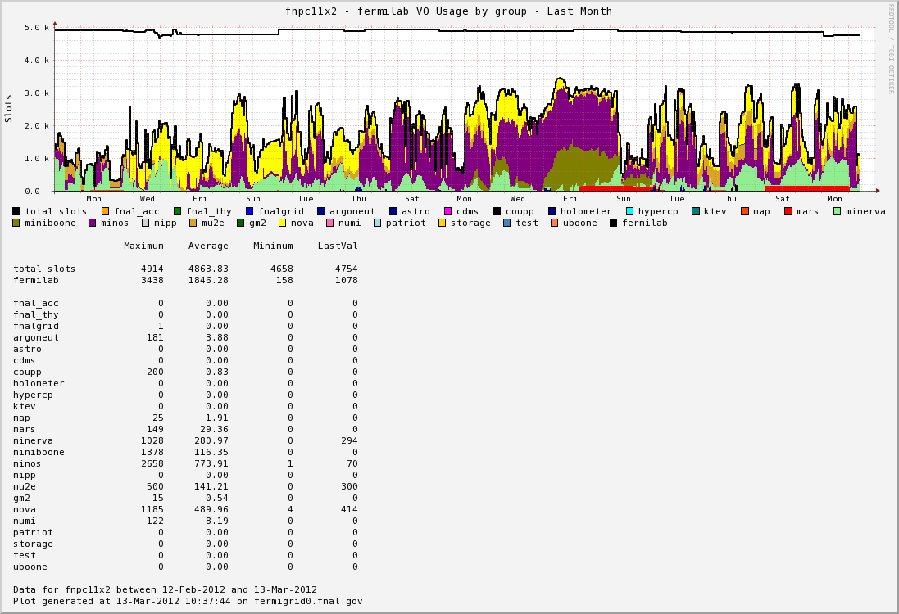
GP Grid Cluster Use Last Month

Slide 8
Blue Arc Disk stats
http://nusoft.fnal.gov/ifmon/bluearc/
GPVM Ganglia 1minute Load Avg Stats for the last 30 days
http://nusoft.fnal.gov/ifmon/gpcf/table.html

Slide 9
April NuComp
Small file archiving
???
Let me know if there are additional topics to discuss.

Slide 10
finish

