Slide 1
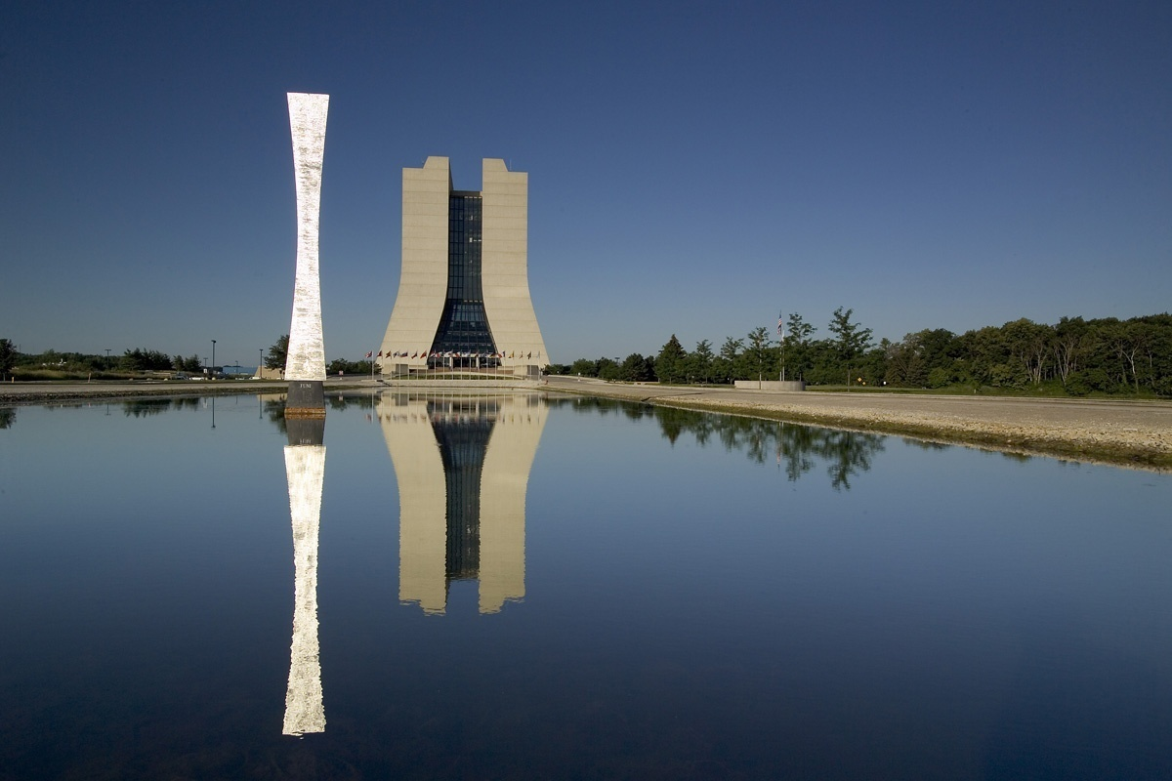
Meeting Kickoff
Stuart Henderson
LBNL-FNAL Joint Meeting
March 15, 2012

Slide 2
Fermilab Capabilities in Accelerator Science and Technology
Accelerator Engineering and Design from Component-level to System-level
Superconducting Radio-frequency components and systems
Superconducting Magnets
Superconducting Component Testing
Radio-frequency Systems
Cryogenic Systems
Mechanical and Electrical Engineering of accelerator components
Beam Instrumentation and control systems
Accelerator Science, Beam Dynamics, Modeling and Simulation, Energy Deposition, …
Modern construction project management practices including formal engineering design process, integrated quality assurance, EVMS, project controls

Slide 3
Accelerator Sector Organization
Accelerator Sector
Stuart Henderson
Associate Laboratory Director
69
Accelerator Support
Accelerator Physics Center
V. Shiltsev Head
Accelerator Division
Technical Division
R. Dixon Head
G. Apollinari Head
440
225

Slide 4
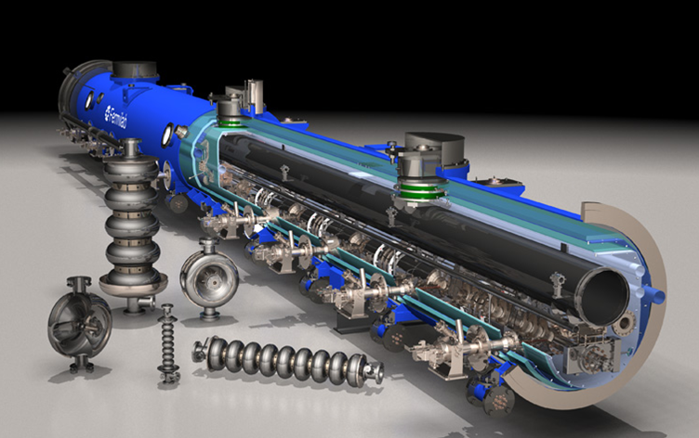
Capabilities Relevant to NGLS: Superconducting RF Systems
World-class expertise in Superconducting Radiofrequency System Design, Engineering, Construction, Testing
We have built up a very substantial capability in the last ~5 years, motivated largely by the International Linear Collider
~105 FTEs engaged in SRF activities
~40M$ per year in SRF R&D and infrastructure
~100M$ investment in infrastructure and reuse of buildings and ~40M$ of equipment

Slide 5
Mission of the Fermilab SRF Program
Support the strategic goals of the U.S. HEP program
Energy frontier: International Linear Collider
Intensity frontier: Project X
Develop β=1 SRF cavities and cryomodules for ILC and/or the Project X pulsed linac (3-8 GeV)
Develop β<1 SRF cavities and cryomodules for the acceleration of high intensity Proton beams
Subharmonics of 1.3 GHz
Leverage capabilities and infrastructure to serve the needs beyond HEP within Office of Science
Collaboration with LBNL on NGLS serves this larger vision and mission

Slide 6
Context of SRF Activity at Fermilab
The FNAL SRF effort started small for several years as part of the TESLA collaboration but ramped up substantially in 2006 in support of ILC R&D (thru FY12)
Because of emphasis on ILC R&D ➔There has been substantial investment in 1.3 GHz technology
R&D on gradient, quality factor, and manufacturing yield
Development of US cavity vendors (ARRA procurements)
Cavity inspection, processing, and test infrastructure
Construction of cryomodules for RF Unit test at New Muon Lab
We received one-time ARRA SRF funds of ~$53 M in FY09 which has helped enormously with building FNAL infrastructure and with U.S. industrialization

Slide 7
Context of SRF Activity at Fermilab
The 3 GeV CW linac design for Project X requires the development of six β<1 SRF structures at subharmonics of 1.3 GHz
In spite of the demise of ILC R&D in FY13, Fermilab will continue to devote substantial resources to SRF development
We have an ongoing SRF R&D Program that will continue to fund SRF cavity and CM development so that our experience and skills will continue to improve over time as the schedule for NGLS gets better defined.

Slide 8
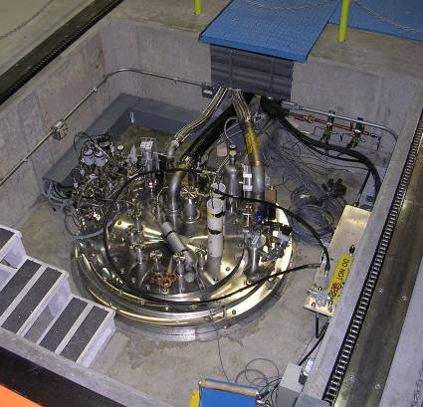
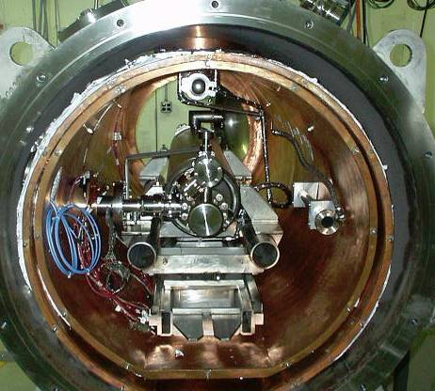
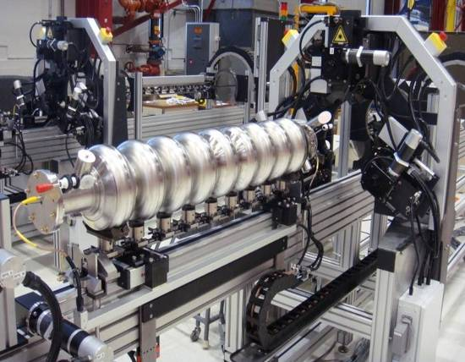
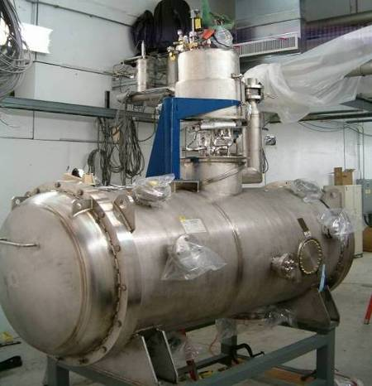
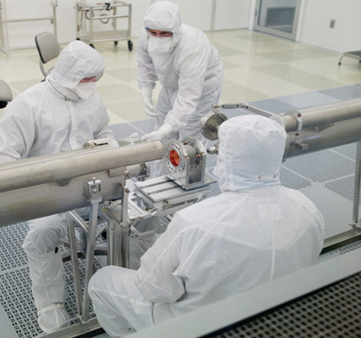
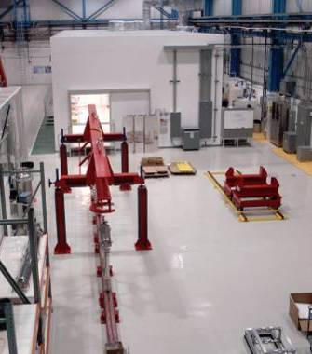
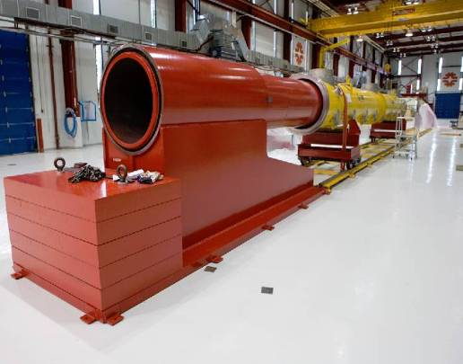
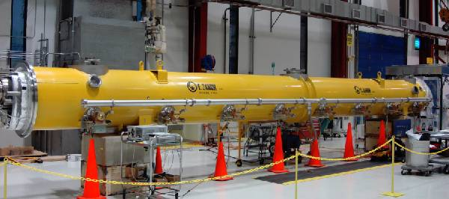
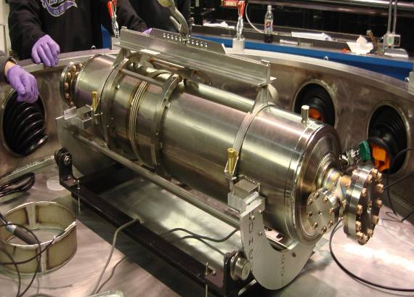
1st Dressed Cavity
Fermilab SRF infrastructure
Cavity tuning machine
VTS
HTS
VTS
String Assembly
MP9 Clean Room
Final Assembly
1st U.S. built ILC/PX Cryomodule

Slide 9
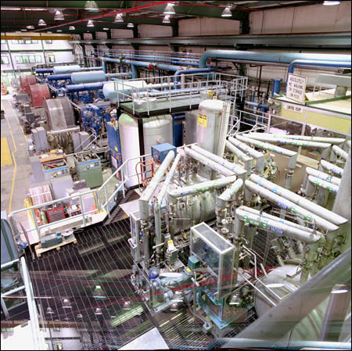
Capabilities Relevant to NGLS: Cryogenic Systems
World-class expertise in Cryogenic System Design, Engineering, Construction, Commissioning and Operation
Fermilab has built and operated large cryogenic systems for more than 30 years
When built in 1983, the Tevatron cryogenic system, the largest in the world at the time, doubled the world’s capacity to liquify helium
Our Cryogenic Systems Department consists of ~40 scientists/engineers/ technicians

Slide 10
Capabilities Relevant to NGLS: Beam Test Facilities
We are constructing the Advanced Superconducting Test Accelerator (ASTA) to prove ILC technology
~1-1.5 GeV superconducting linac delivering ILC beam parameters:
9 mA peak current
1 msec pulse, 5 pulses/second
ASTA will serve as a powerful R&D testbed for the AARD user community, with relevance to NGLS

Slide 11
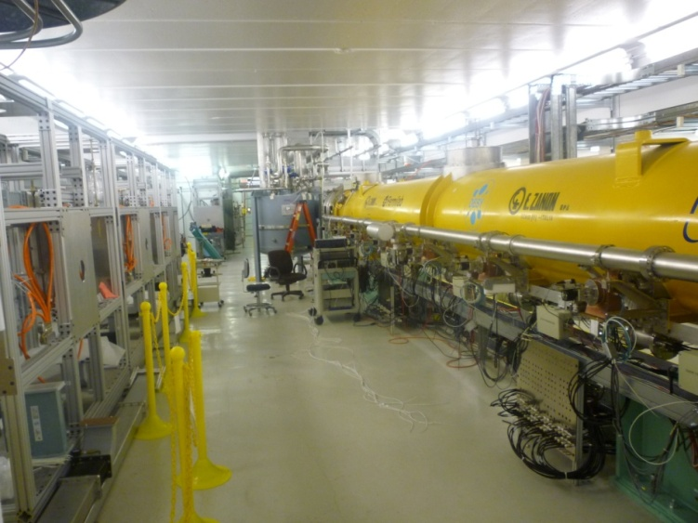
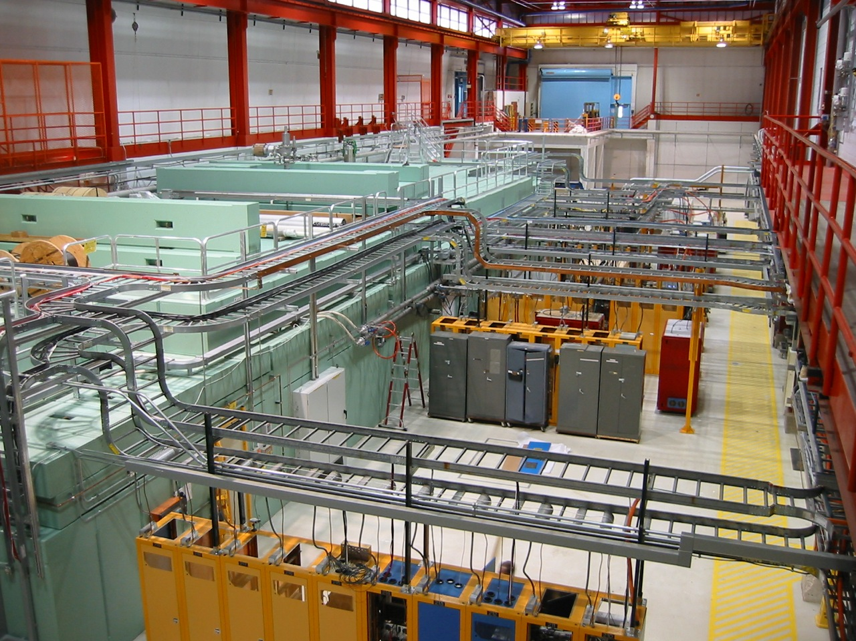
Advanced Superconducting Test Accelerator

Slide 12
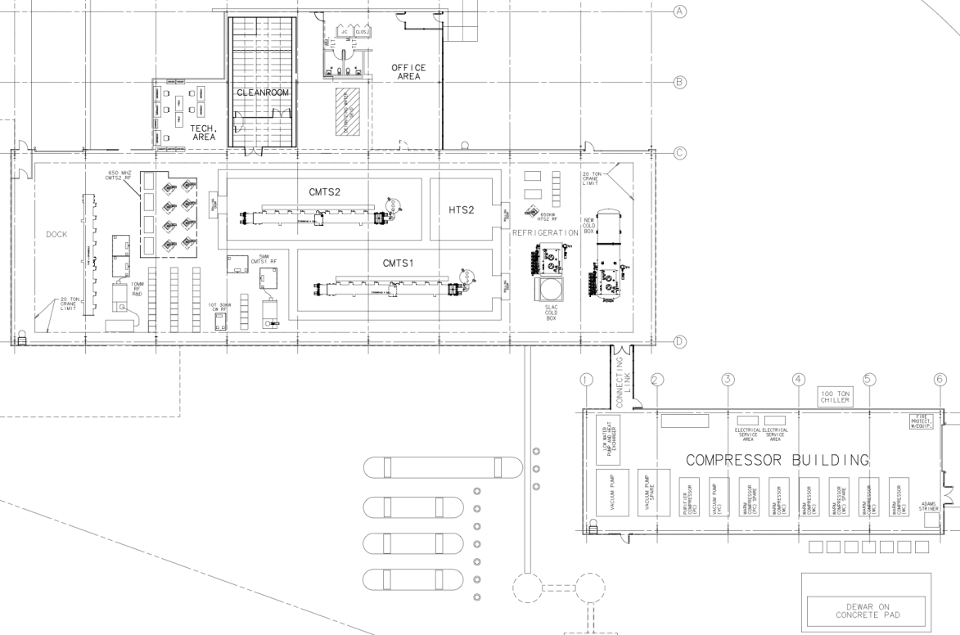
NML/ASTA Facility Layout
New Cryoplant & CM Test Facility
(300 W Cryogenic Plant, Cryomodule Test Stands, 10 MW RF Test Area)
Funded by ARRA
New Underground Tunnel Expansion
(Space for 6 Cryomodules (2 RF Units), AARD Test Beam Lines)
Existing NML Building

Slide 13
Finally….
Fermilab has a strong history in large accelerator construction projects, and has grown a substantial capability in SRF
Fermilab is well accustomed to collaborative scientific and engineering work
There is considerable synergy between our 1.3 GHz SRF activities and NGLS
We are excited and enthusiastic about the possibility of contributing to NGLS

Slide 14
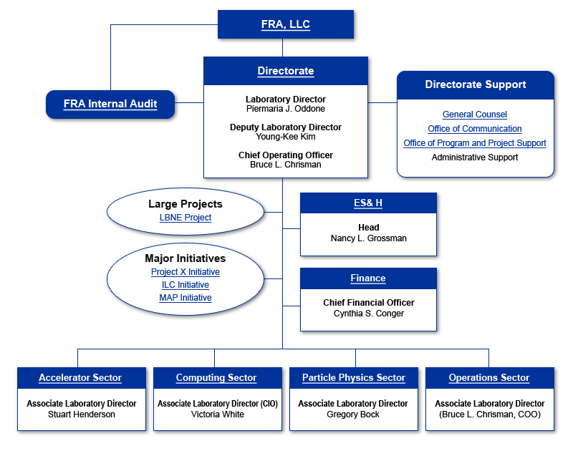
Fermilab Organization

