Slide 1
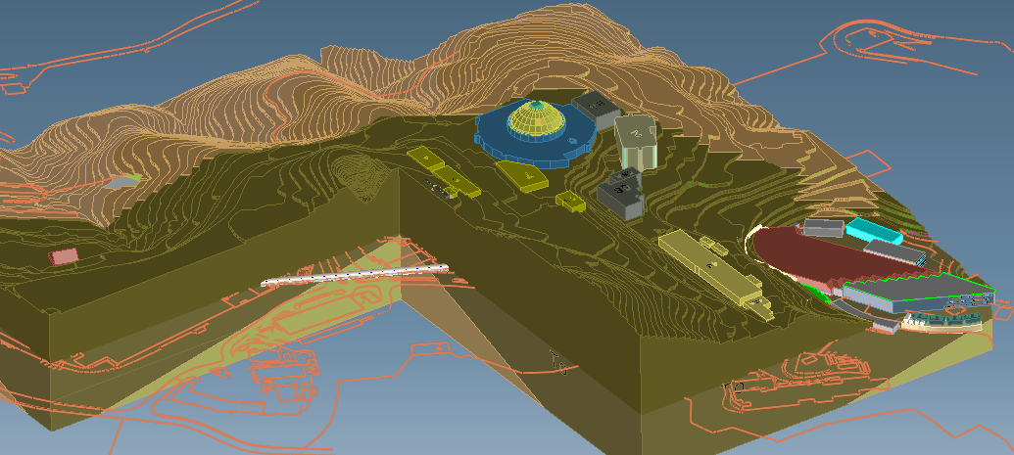
NGLS Layout and Cryomodules Russell Wells - NGLS Integration Fermi National Accelerator Laboratory March 15, 2012
Orinda
Great Valley Group

Slide 2
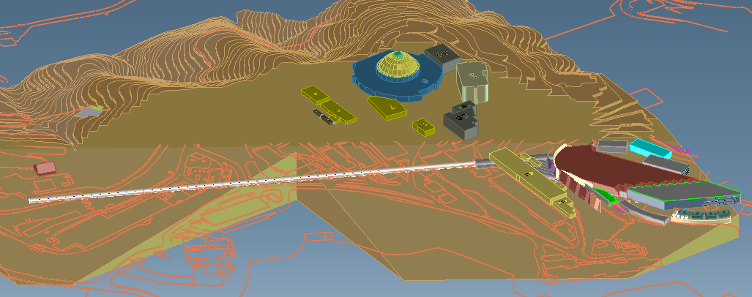
Tunnel Through Single Rock Formation
ALS
Linac Tunnel
Orinda Formation Removed, Tunnel Fully Exposed

Slide 3
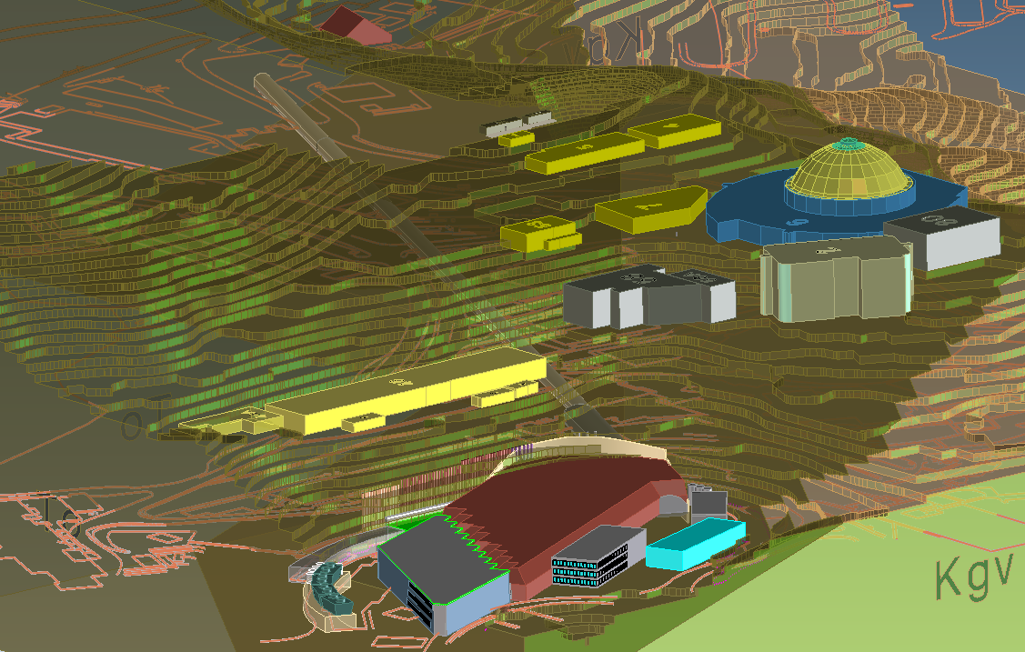
NGLS Viewed From Bevatron Flat
Chicken Barn
(Excavation Shaft)
Linac Tunnel
Spreader Cavern
Bevatron Flat

Slide 4
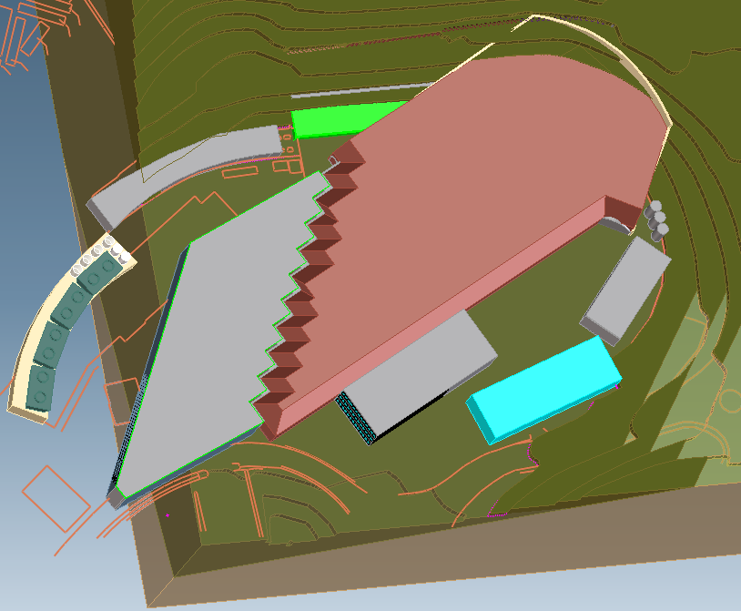
Buildings on Bevatron Flat
Cryomodule Acceptance Test Facility
Earth Cover
(radiation shielding)
Electrical Utilities
Cryosystem
Mechanical
Utilities
Experimental
Hall
BLOC
Office Space
Technical
Assembly

Slide 5
NGLS Overlay on Hill Topo
Assumptions:
2.4 GeV electron energy
36 deg. Cumulative bend angle
Level tunnel
No added photon drift length
15m FEL – e-Dump drift length
53m Photon beam lines
Photon Beam lines
Bevatron Flat
Electron gun
Tunnel orientation defined by shape of Bevatron Flat and location of Chicken Creek
Chicken Ck
Excavation shaft

Slide 6
FEL - Photon Beam lines on Bevatron Flat
Roadway
Parking Lot
(at grade)

Slide 7
Possible Linac Expansion
Electron Gun
Distance to Lab Boundary
277 meters
Lab Property
Lab Property
Lab Boundary

Slide 8
Electron Beam line
Branch Tunnels
Branch 10
Spreader Cavern
Branch 1
Bremsstrahlung shielding
Electron dump
Dipole magnet pair,
electron beam offset

Slide 9
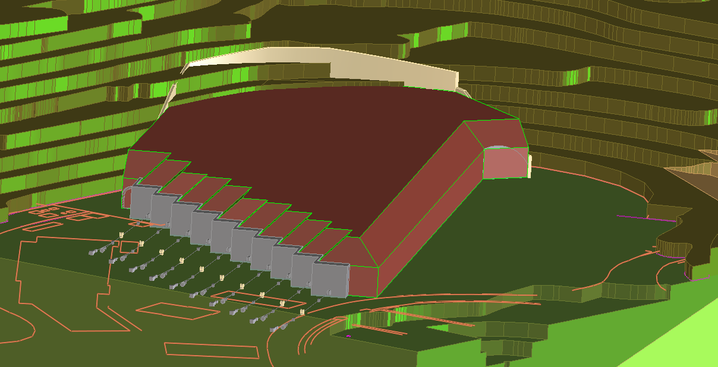
Earth Provides Cover over FEL Tunnels
Earth Cover
End Shield Wall
(no electrons pass this wall)
Photon Beam Lines
(multiple “end stations” per beam line)
Shielding required to attenuate radiation generated by stopping stray high energy electrons

Slide 10
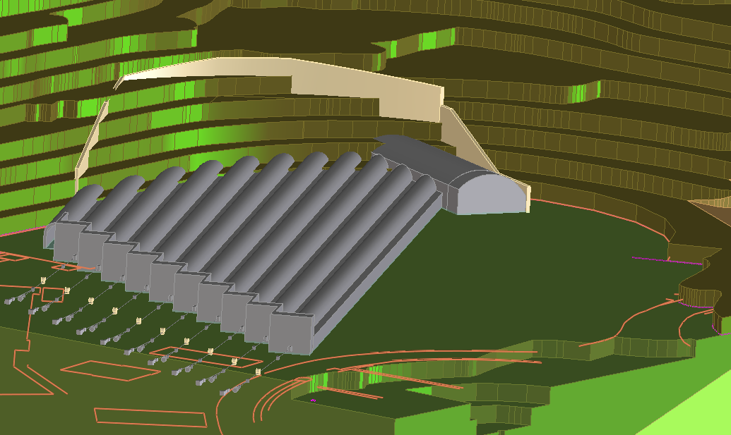
Free Electron Laser (FEL) Tunnels
Secant Wall
Spreader Cavern
FEL Tunnels
10 ft Steps

Slide 11
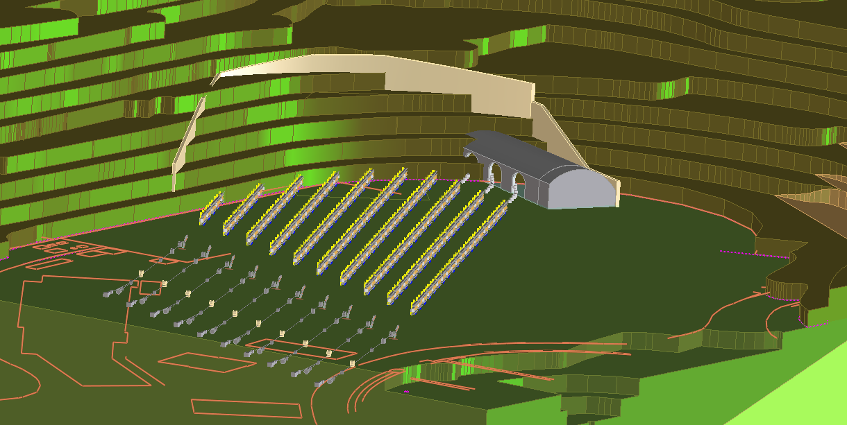
Tunnels removed showing FELs
Undulator arrays

Slide 12
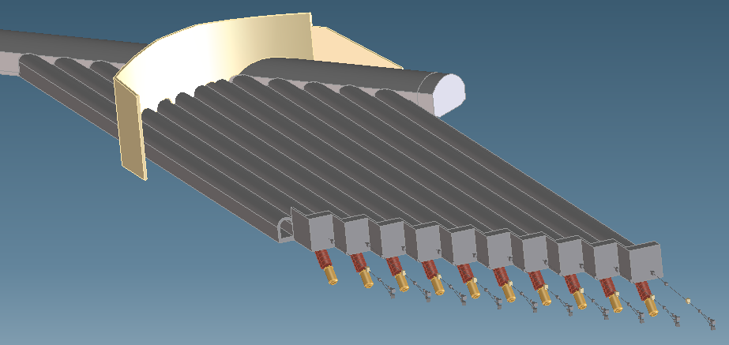
Electron “Dumps” Located Below Grade
Beam dump
Electrons are magnetically deflected out of the photon beam path at the end of the FEL. The electrons are absorbed in “dumps” several meters below grade to take advantage of earth shielding.

Slide 13
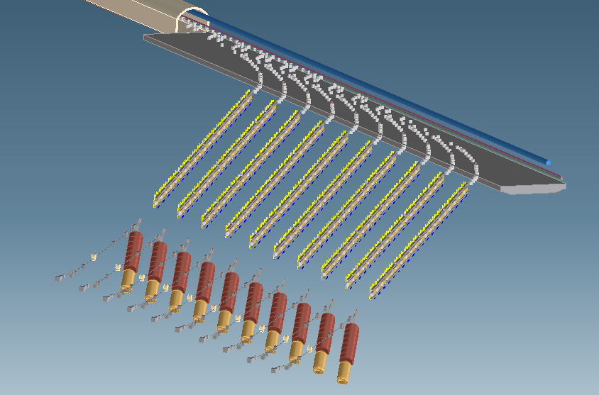
Electron Beam is Distributed to 10 FELs via the “spreader”
Beam Spreader
(beam distribution magnets)
Concrete shielding

Slide 14
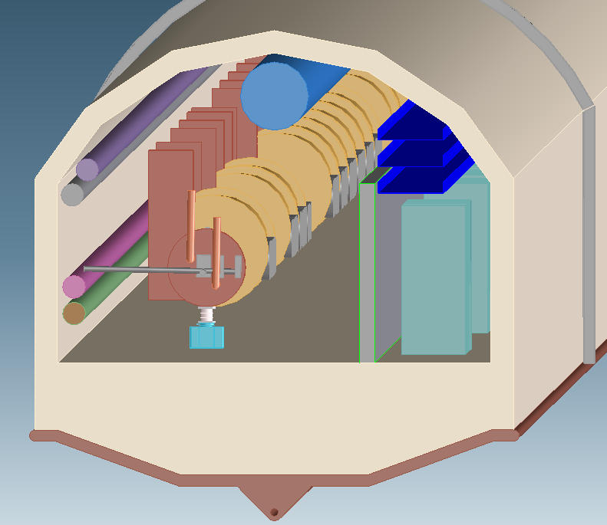
Linac Tunnel Cross Section
HVAC
Duct
Cable tray
Cryogenic
Distribution
Cryomodules
Electronics Racks,
Includes RF power
supplies
Concrete Tunnel
Water
Radiation
Shield Wall
Electron Gun
Extra thick invert to minimize differential settlement
Drain, for tunnel exterior

Slide 15
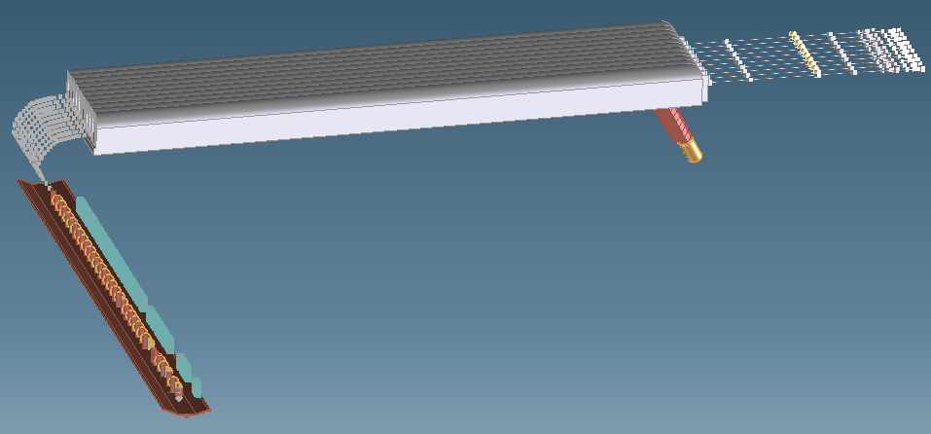
Single Tunnel Design
Power supplies and accelerator modules must coexist. In tunnel maintenance and trouble shooting during operation is not possible due to radiation hazard. Current thinking is to modularize all “in-tunnel” equipment for rapid removal and replacement.

Slide 16
Flaws and omissions in layout
Gas Storage for Cryosystem
Size of Cryosystem building may be insufficient
“Cold boxes” housed in external vacuum enclosures. Suggested by Jlab but atypical
Compressor building may be under-sized, remote location may be preferred due to vibration.
High Power Beam Dump
Evaluation of absorber options: Water vs. solid vs. gas
Beam dump handling (radioactive material)

Slide 17
Summary of Key Dimensions
Linac Tunnel 5.8 m wide x 3.82m tall (max)
Spreader Cavern 12 m wide x 6.2m tall (max)
Earth Cover ~7500 m² x 5 m thick (?)
BLOC 2775 m² (total, three floors)
Technical Prep Bld 768 m² (highbay)
Elect Utility 622 m²
Mech Utility 1586 m² (includes roof)
Cryosystem Bld 429 m² (highbay), plus 3 ea. 2m dia. vacuum enclosures
CATF 435 m² + 3 m wide x 124 m long tunnel
FEL tunnels 3 m wide x 124 m long, 10 each
Size and layout of structures under review
SmithGroup (A&E Firm) contracted to do a civil “Programming” study
Evaluate space requirements for office and technical areas
Size mechanical and electrical utilities
Review tunnel cross section, incorporate utilities and address fire safety and egress issues

Slide 18
NGLS Dimensions
Photon Beam
Electron Drift Region
FEL
L3
L2
L1
BC2
BC1
Spreader
Linac
Laser Heater
Injector

Slide 19
Cryomodule Locations within Linac
Laser Heater
Harmonic Linearizer
(3rd Harmonic Cavity)
Bunch Compressor 1
Bunch Compressor 2

Slide 20
Some Open Issues
Linac Length
HOM absorbers may be needed within cryomodules, adds length
Accelerating gradient TBD, higher gradient reduces length
Cryosystem size (He refrigerator and distribution)
Helium Refrigerators for 2K - limit appears to be ~4.5MWe
Effficiency increases with scale
Cost doubles with number of refrigerators
Spreader
New kicker/septum design may reduce length
Bend angle may have flexibility, allows better fit on Hill site
30 deg bend preserved beam quality, 36 deg being evaluated.

Slide 21
Initial Conceptual NGLS Cryomodule

Slide 22
Background
Cryosystem and cryomodule systems combined are ~30% of the total machine cost.
The cryomodule design has a strong influence on conventional facilites.
Cryomodule acceleration energy, stability and reliability are key machine parameters.
Cryosystem and cryomodule systems are inseparable
Developments in one typically influence the design of the other.
Typically the cryomodule design drives the system optimization but CW acceleration my change the balance due to high energy consumption.

Slide 23
Initial NGLS Concept Cryomodule
Linac Composed of Independent Cryomodules (full segmentation)
7 TESLA 9 Cell Cavities per CM
No magnets within CM
Cryomodules length limited to about 12.5 meters for easy transport and installation
Moderate Gradient, 14 – 16 MV/m at 1.8 – 1.9K
2.4 GeV from 27 CMs

Slide 24
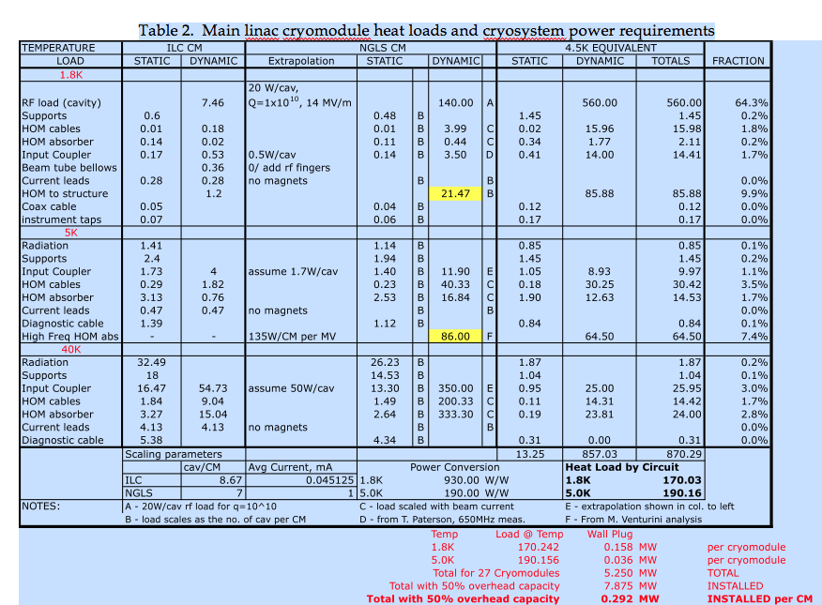
Cryomodule Heat Load and Power Required

Slide 25
General Issues
Operating gradient (function of Q, effects cryoplant capacity, construction costs, reliability…)
Operating temperature (effects Q, cryoplant and distribution costs)
Cryomodule segmentation (single vs. string) has implications on space utilization, transportation, installation, maintenance, machine reliability/availability.
Pressure stabilization of helium baths in CM’s and optimization of controls for the cold compressors.
Real time monitoring of cryomodule performance.
Cryomodule design (numerous variables and options)

Slide 26
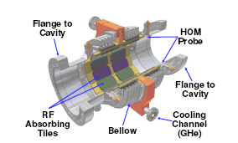
Cryomodule Design Issues
HOM power dissipation structures
Number of cavities within a single module
Shield temperature and arrangement
Final cryogenic stage internal or external to module
Cold vs. warm magnets
Type of main power coupler (wave guide vs. coaxial)
Nucleate boiling bubble suppression (pressurized cryostat)
Tuner type and access
Selection and sizing of cryogenic circuits.
Minimization of acoustic noise.
Compact warm to cold transitions.
Cornell HOM
absorber

Slide 27
R&D vs. Design Studies
Most of the issues listed previously fall into the category of design studies, a subset require research effort to inform the design.
Plan to use existing designs where possible.
R&D tasks typically require a facility that has a significant existing installed infrastructure.
Helium cryoplant
Test cryostats capable of single cavity tests
RF measurement equipment
RF power (in some cases)
Temperature and pressure measurement systems adapted for cryogenic applications

Slide 28
Cryomodule R&D – Major issues
Cavity Q as a function of cavity processing at moderate gradient
Possible improvements in surface processes (BCP, CBP, EP, heat treatment, HP rinse) and raw material processing (RRR, inclusions, large grain vs. fine grain, etc).
Needed by CD1
HOM power absorption structures
Presently being studied by Cornell for ERL up to 10GHz
Short pulses in the NGLS design generates HOM into the THz range.
Needed by CD1
Cavity Q as a function of acoustic noise (from localized nucleate flow bubble formation/collapse )
Single cavity in test cryostat with heater and acoustic monitoring equip.
Effects geometry of two-phase flow pipe, cryoline and cryoplant design.
Needed by CD1

Slide 29
Cryomodule R&D – Technically significant
“In module” heat exchanger assembly.
Validate concept via design study by CD1
Cold test of heat exchanger in prototype cryostat required
Needed by CD2
Tuner motor, 80K option.
Bench test with thermal shock capability
Preliminary warm vs. cold down select by CD2
Cold option prototype validated by CD3

Slide 30
Summary
NGLS Layout takes advantage of LBNL Hill features:
Experimental Hall is on grade
Linac is buried under hill (natural radiation shielding)
Utilizes recently cleared Bevatron flat, the largest level spot at LBNL.
NGLS fits the Bevatron flat without reliance on improvements in undulator technology.
The Linac tunnel has room for future extension.
NGLS Cryomodules exist only in conceptual form
No existing cryomodule is a perfect fit for NGLS
Dynamic heat loads have a major impact on the global optimization of NGLS
Major questions regarding the cryomodule design are yet to be answered
Where possible the CM design will leverage existing knowledge and expertise.

