Slide 1
Linac/FEL Physics Design and
Beam Dynamics Issues
P. Emma, for the NGLS team
March 15, 2012
FNAL Visit

Slide 2
NGLS Accelerator Design
Need ~2.4 GeV e⁻ linac at 1-MHz beam
rate (CW, 0.3-1 mA)
Must generate & preserve e⁻ brightness (cathode, gun, CSR, wakes, etc)
Two magnetic chicanes compress bunch in 2 stages (600 A)
RF phase and amplitude jitter tolerances are demanding (~0.01% & ~0.01 deg rms)
Switchyard distributes electrons to one of 3 FELs at 0.1-1 MHz each (baseline) – 10 FELs in long term
Many design issues similar to LCLS, but lower energy & MUCH higher beam rate (120 Hz → 1 MHz)

Slide 3
Linac Layout “10/25/11”
L0
ϕ = …
I_{pk} = 50 A
L1
ϕ = −28º
I_{pk} = 50 A
Lh
ϕ = 180º
L2
ϕ = −31º
I_{pk} = 150 A
L3
ϕ = +14º
I_{pk} = 600 A
CM1
CM2
3.9
CM3
CM9
CM10
CM30
GUN
1 MeV
Heater
85 MeV
R₅₆ = 4 mm
σ_{δ} = 0.19%
BC1
168 MeV
R₅₆ = 75 mm
σ_{δ} = 0.57%
BC2
640 MeV
R₅₆ = 48 mm
σ_{δ} = 0.57%
SPRDR
2.4 GeV
R₅₆ = 0
σ_{δ} = 0.09%
670 m
to spreader end
~13 MV/m gradient (increase to 16+ MV/m?)
26-30 ~12-m long cryo-modules (22-26 @ 16 MV/m)
7 RF cavities per module?
2 bunch compressors (2nd optional)
1 laser heater (damps micro-bunching instability)
3 identical spreader beamlines + straight-ahead dump

Slide 4
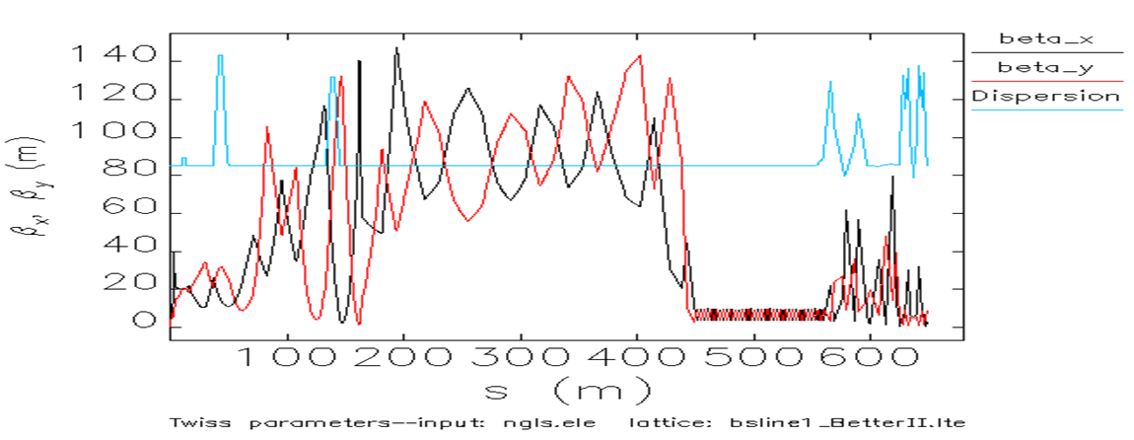
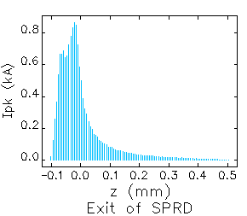
Linac Layout in MAD (Inj. to Spreader)
M. Venturini
BC2
Spreader
Heater
BC1
Tracking
(600 A)
85 MeV
2.4 GeV

Slide 5
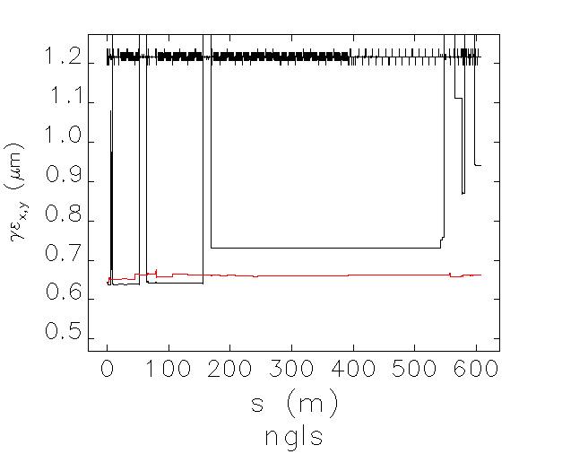
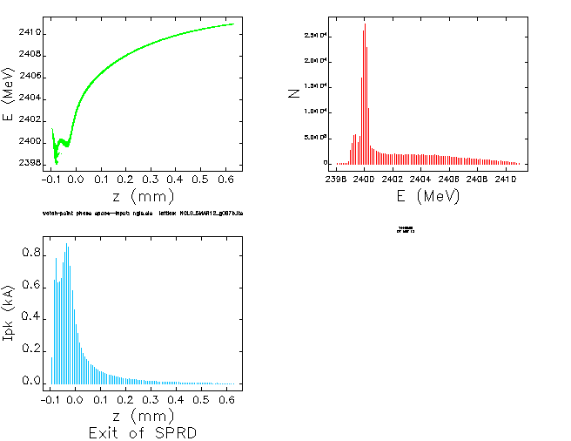
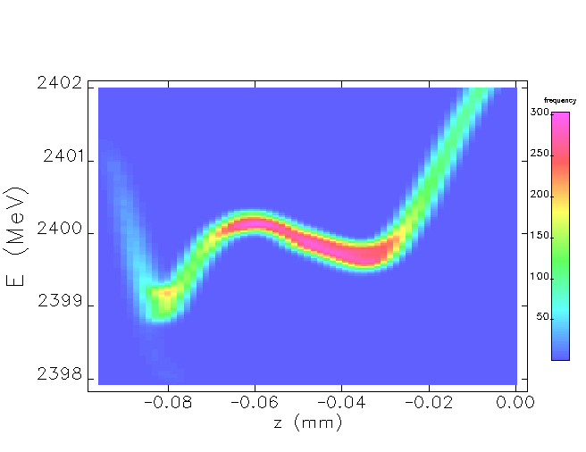
Start-to-End Simulations for NGLS…
Longitudinal Phase Space at 2.4 GeV
Emittance growth (CSR)
M. Venturini
Q ≈ 0.3 nC
I_{pk} ≈ 600 A
σ_{z} ≈ 0.03 μm
σ_{E} ≈ 100 keV

Slide 6
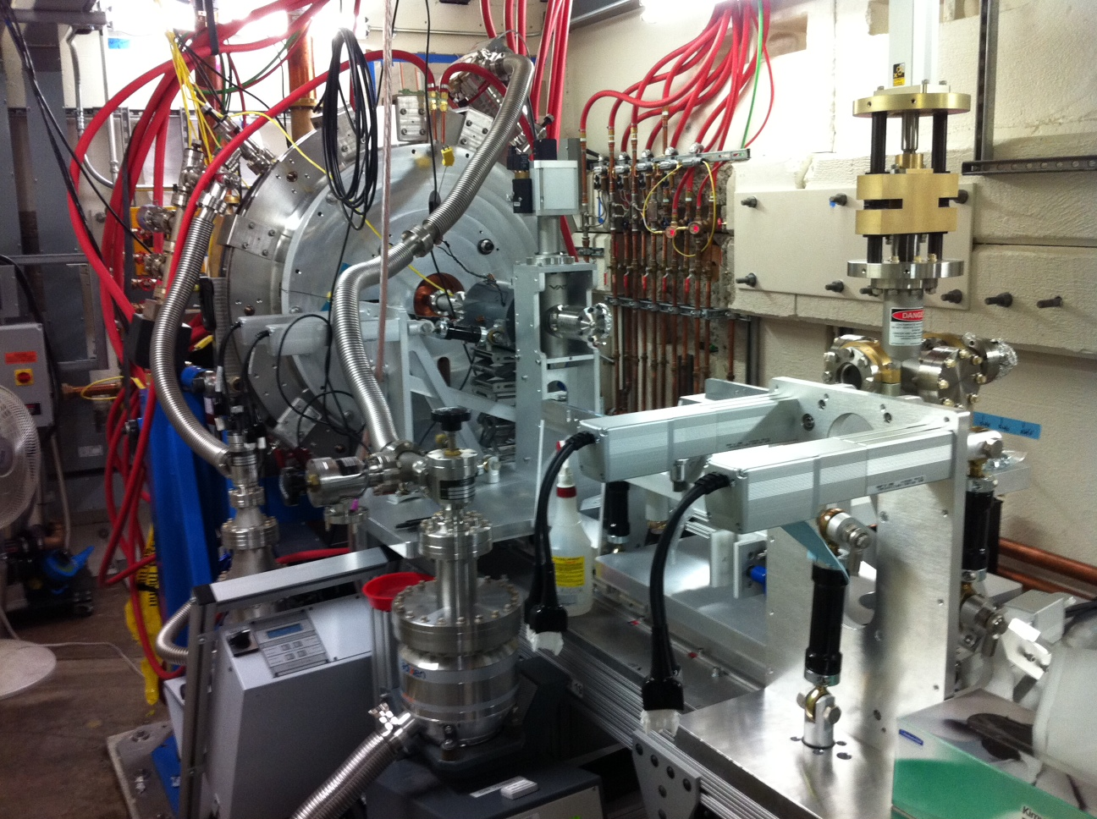
APEX Gun: High-Brightness MHz e⁻ Source
APEX R&D project well underway at LBNL with full RF power and CW operation achieved - F. Sannibale, R. Wells
Notes:
Repetition rate 1 MHz
Charge per bunch from ~10 pC to ~1 nC
Emittance <10⁻⁶ mm-mrad (normalized)
Electric field at the cathode ≥~10 MV/m (space charge emission limit)
Beam energy at the gun exit ≥~500 keV (space charge control)
Bunch length ~100 fs to ~10 ps for handling space charge effects, and for allowing different modes of operation
Compatible with magnetic field control within the gun (emittance exchange and compensation)
10⁻¹¹ Torr vacuum capability (cathode lifetime)
Accommodates a variety of cathode materials

Slide 7
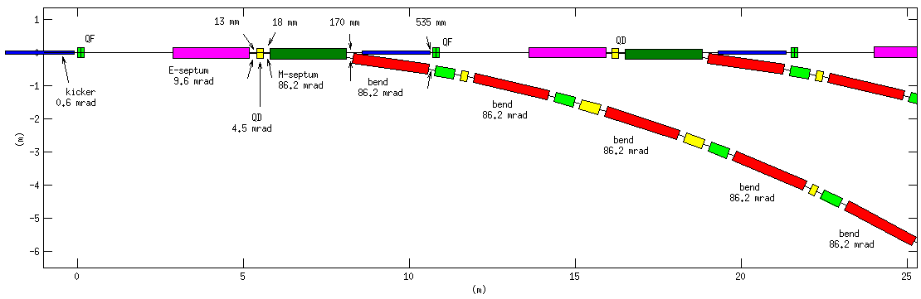
Optimizing the Beam Spreader
M. Placidi,
C. Sun,
W. Wan, et al.
Electrostatic
Septum (FNAL)
Kicker
(0.6 mrad,
was 3 mrad)
Magnetic
Septum
DC Bends
Electrostatic septum allows weak kicker (~0.04% rms stability tolerance)
Overall footprint reduced by optimization ~1/3

Slide 8
Three FEL Design Options
Electron beam
E (GeV) 2.4
γε (μm) 0.6
I_{pk} (A) 600
σ_{Ε} (keV) 100
FEL Photon Energy Tuning Range:
1.2 – 0.27 keV (+ 3rd & 5th harmonics)
Name | Gap (mm) | Und. Period (mm) | Mag. Und. Length (m) | Und. Type | Comment
102511DP | 7.5 | 29, 23 | 39+24 = 63 | HPM | “Conservative”
102511SC | 7.5 | 19 | 43 | Nb₃Sn | Needs R&D
122011DPSC | 6.0 | 18, 13 | 35+20 = 55 | Nb₃Sn | Enhances 6 keV
G. Penn, M. Reinsch

Slide 9
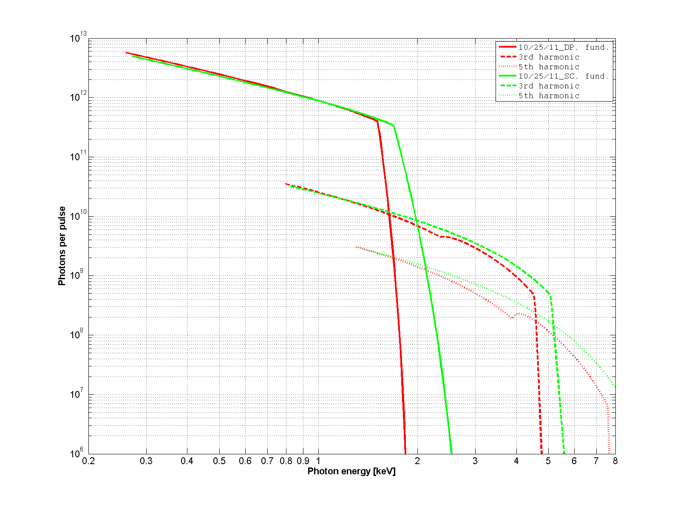
Photon Flux over Wavelength Tuning Range for Two NGLS Designs
fundamental
requirements
Perm. Mag. Und.
SC-Undulator
3rd harm.
Photons/pulse
E = 2.4 GeV
g_{m} = 7.5 mm
λ = 19 mm
L_{mag} = 43 m
5 harm.
Photons energy (keV)

Slide 10
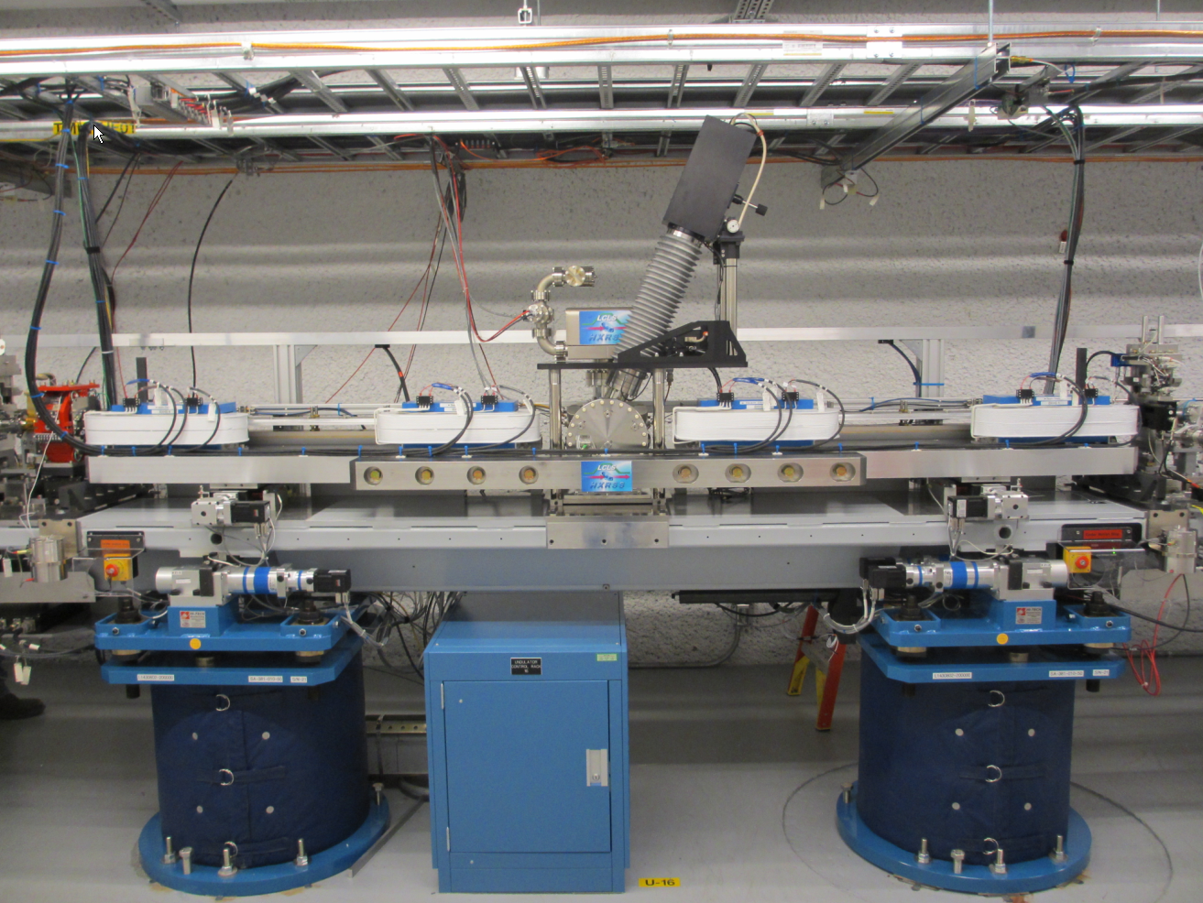
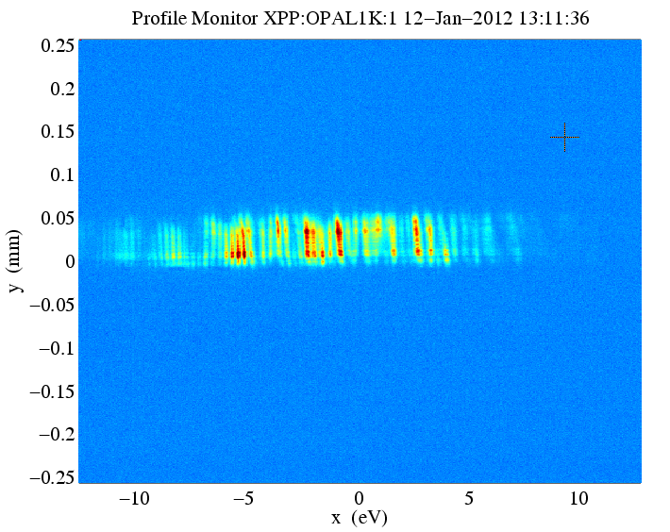
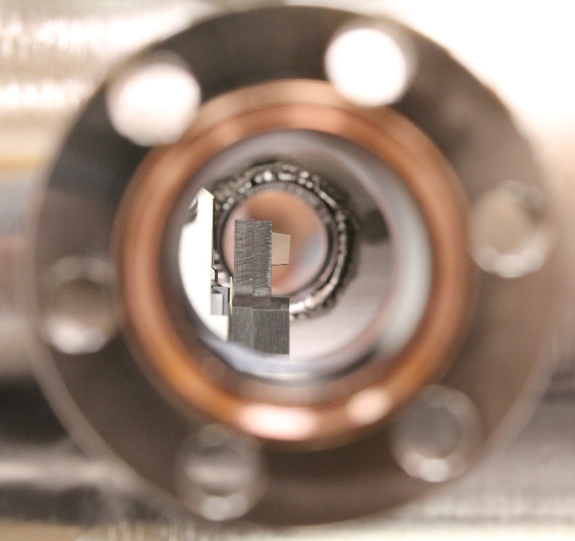
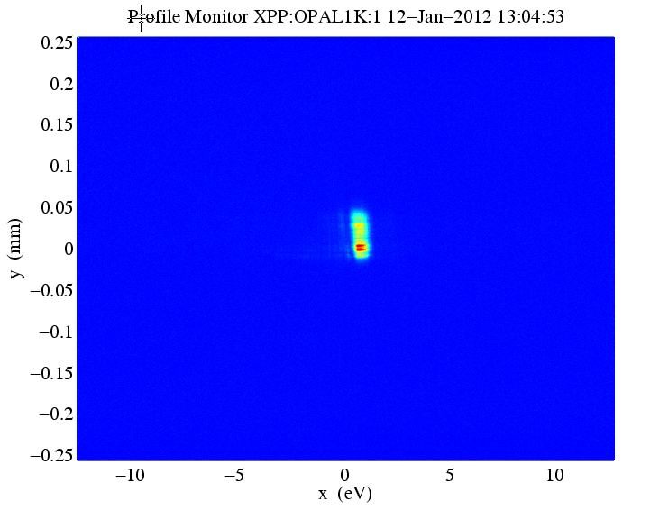
Self-Seeding Demonstrated at LCLS
diamond OUT
20 eV
diamond
crystal
diamond IN
0.5 eV
Factor of 40 BW reduction

