Slide 1
Higher Order Mode Power Loss from NGLS RF Structures
John Byrd, Marco Venturini
15 March 2012

Slide 2
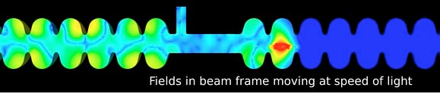
Bunches radiate in the RF structures
Electron bunches will radiate up to wavelengths comparable with the bunch length.
For NGLS, this could extend to ~30 microns (10 fsec/100 THz)
Frequencies below beam pipe cutoff (~2.5 GHz) are trapped and do not propagate.
Frequencies above typically propagate out of the cavity and into the beam pipe.
Goal:
  Damp trapped modes enough to avoid beam dynamics problems.
  Absorb propagating HOM power in non-cryogenic load.

Slide 3
NGLS HOM Power Loss
HOM power loss is given by
Loss factor is bunch shape dependent
Bunch repetition frequency (1 MHz)
Bunch charge (300 pC)
Loss factor (V/C)
Bunch spectrum
Impedance
Wake Function

Slide 4
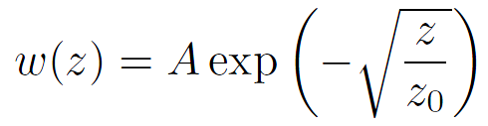
Short Range Wake for RF Structure
  Use diffraction wake model and find coefficients from fitting computed wake from MAFIA.
    With A=301 V/pC, z0=7.4 mm based on I. Zagorodnov, EPAC 06 calculation for TESLA-cavity cryomodule, and scaled to reflect presence of 7 cavities/CM JLAB-design)

Slide 5
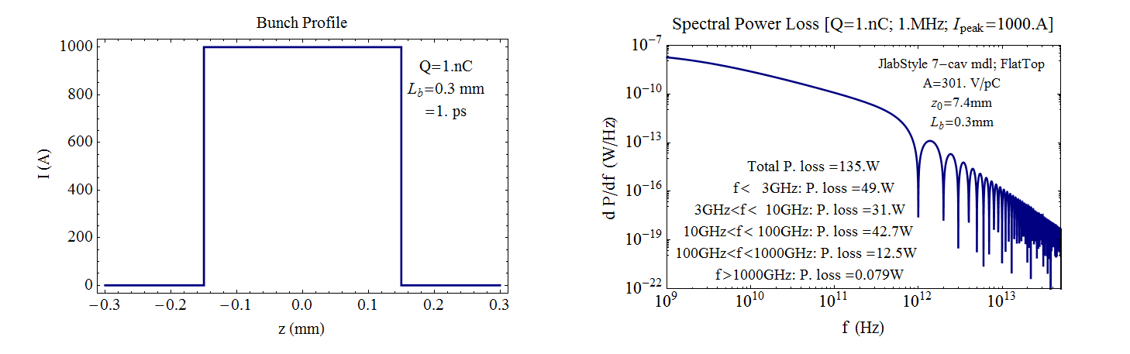
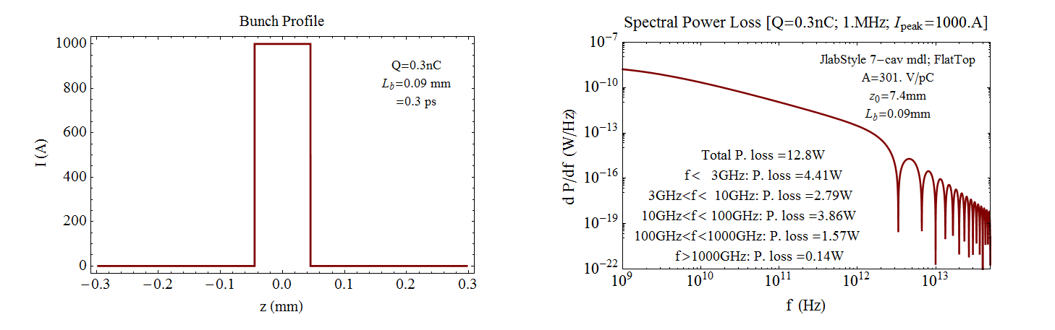
Power loss into JLAB-style module 1 vs. 0.3 nC for I=1 kA
1 nC
0.3 nC

Slide 6
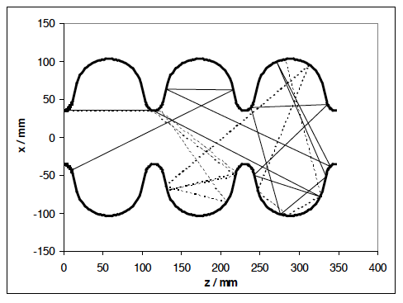

Terahertz Wakefields and SCRF
Wakefield radiation above 750 GHz can affect the superconductivity by breaking Cooper pairs. Brinkmann, et al. have a model where the radiation is uniformly spread over the cavity surface from scattering with a negligible reduction of the Q₀.
Brinkman, et al. EPAC00

Slide 7
HOM Damping Challenges
Depending on project, the HOM damping scheme must
  Efficiently handle high power up to several kW per cavity
  Provide very strong HOM suppression of monopole, dipole, quadrupole modes with Q=100 - 10,000
  Be broadband (up to ~100 GHz)
  Be inexpensive / require little beam line length
Fortunately, usually not all of these are required at the same time
Different requirements -> different solutions
Introduction

Slide 8
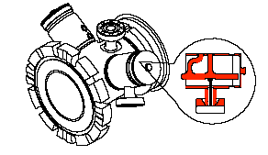
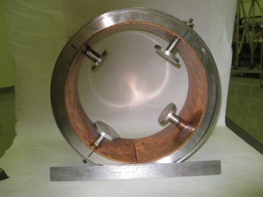
Why consider Antenna HOM Couplers?
Require no extra beamline length
  But filter is needed to suppress coupling to fundamental mode
Relatively easy to clean
HOM power can be absorbed at room temperature
Antenna / Loop HOM Couplers

Slide 9
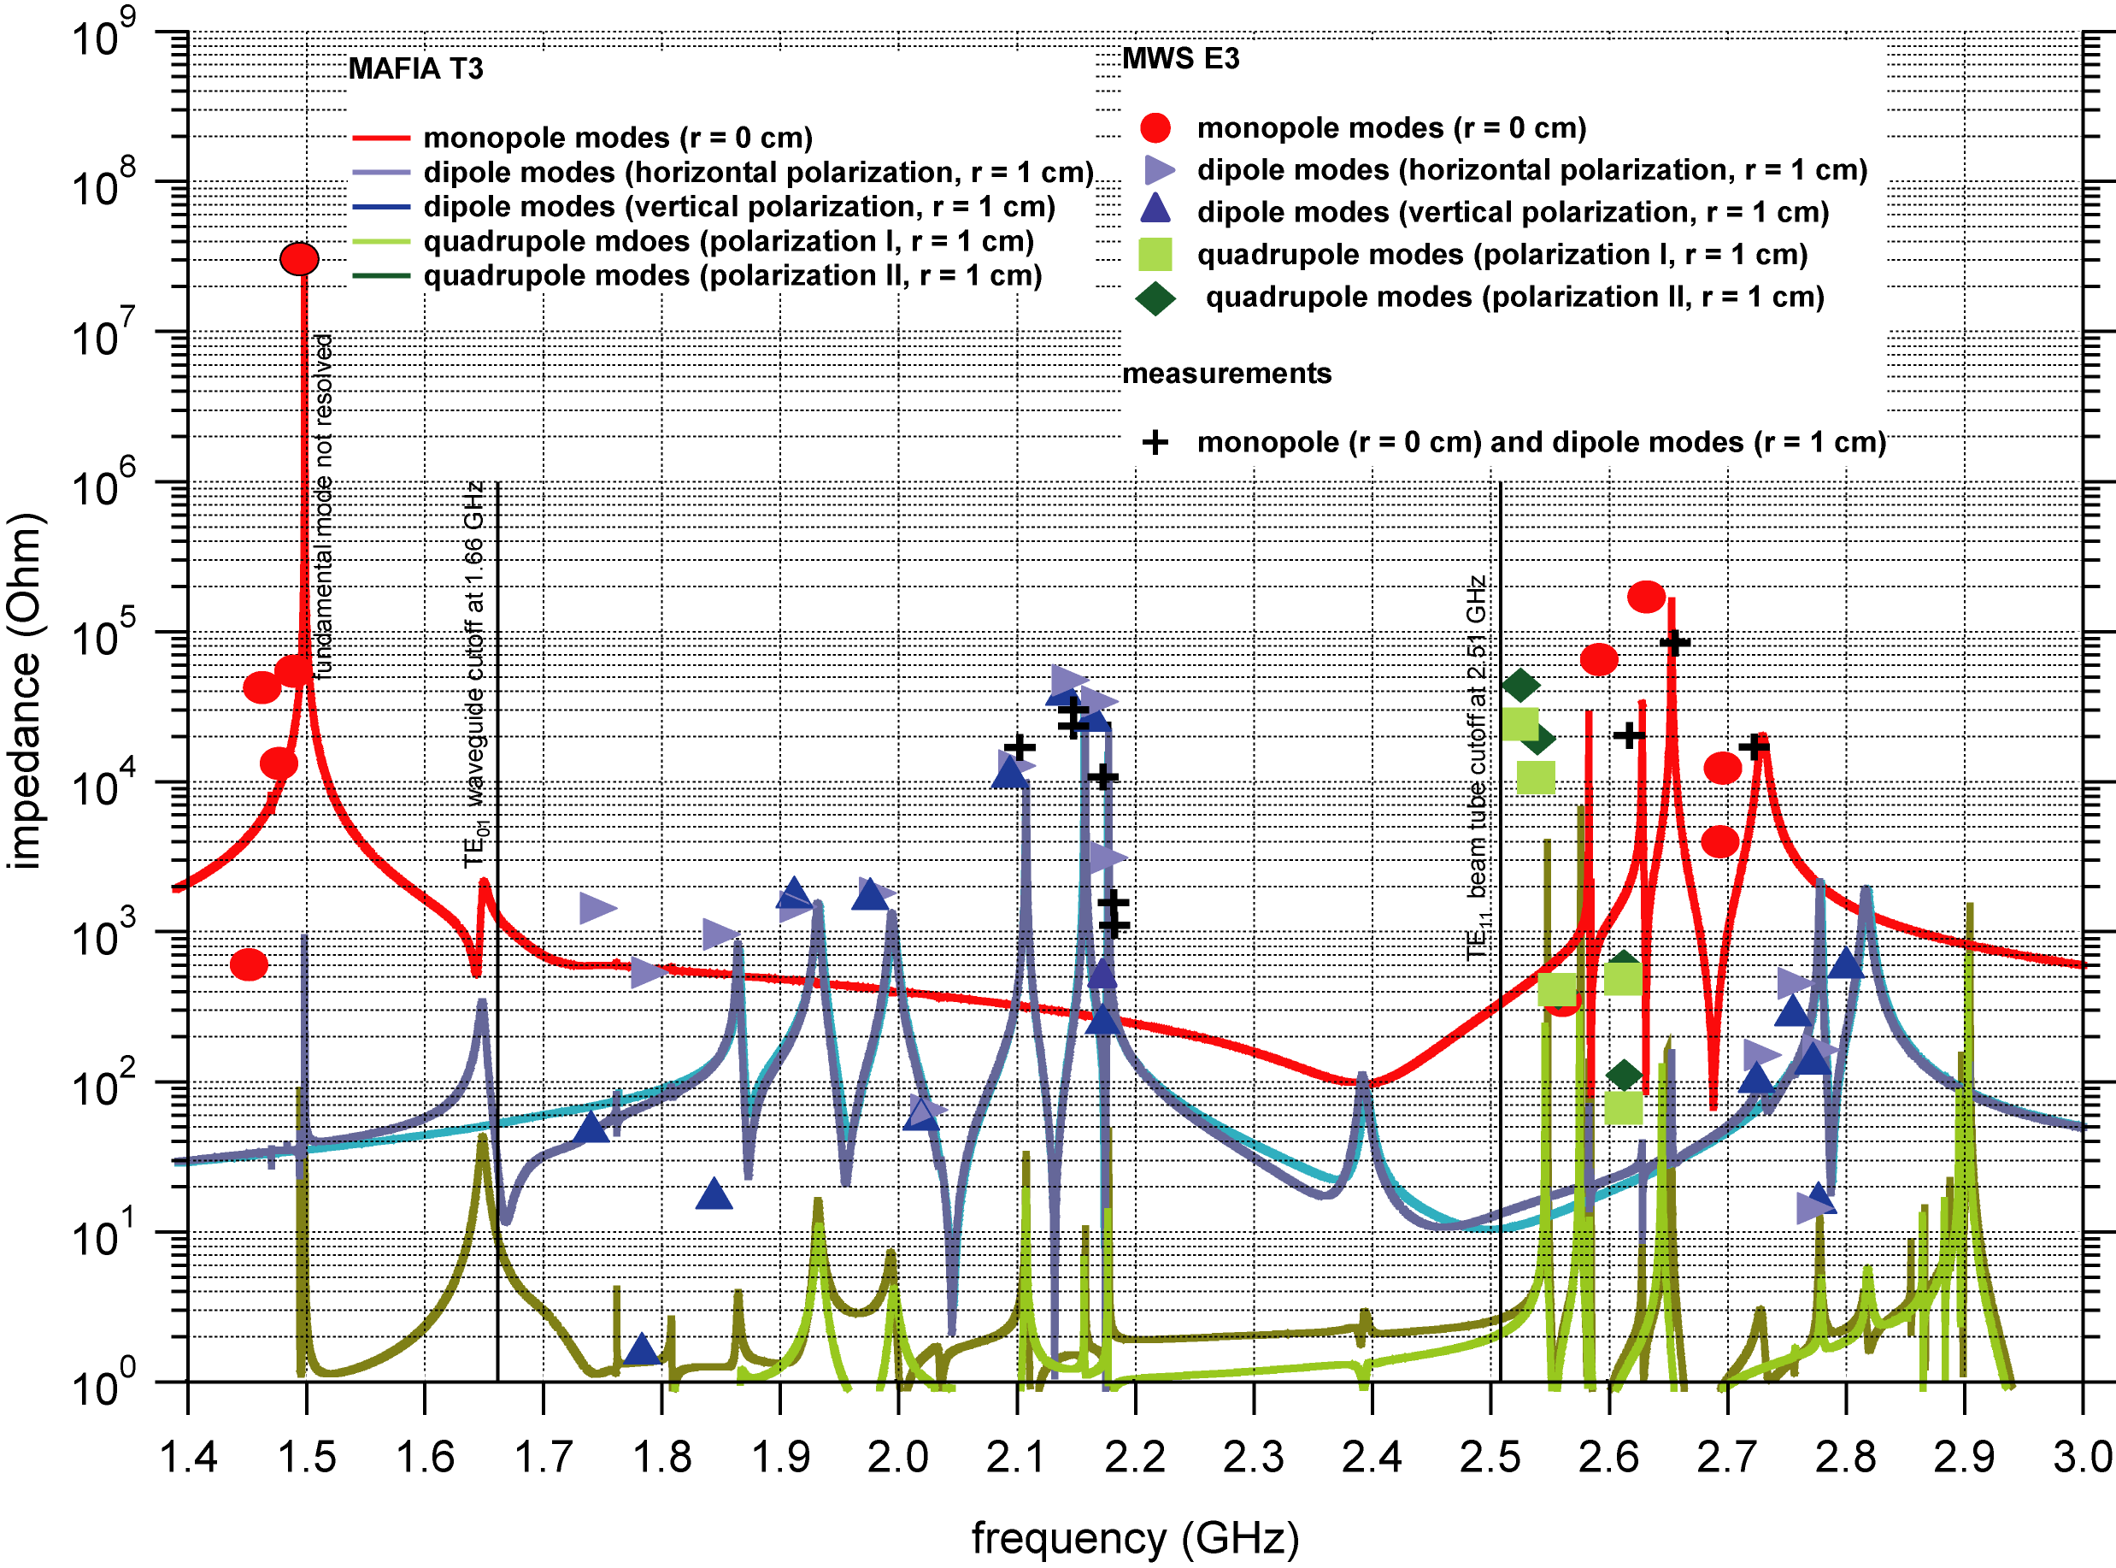
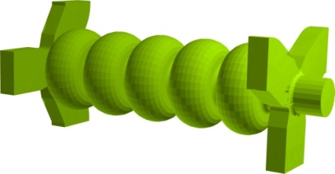
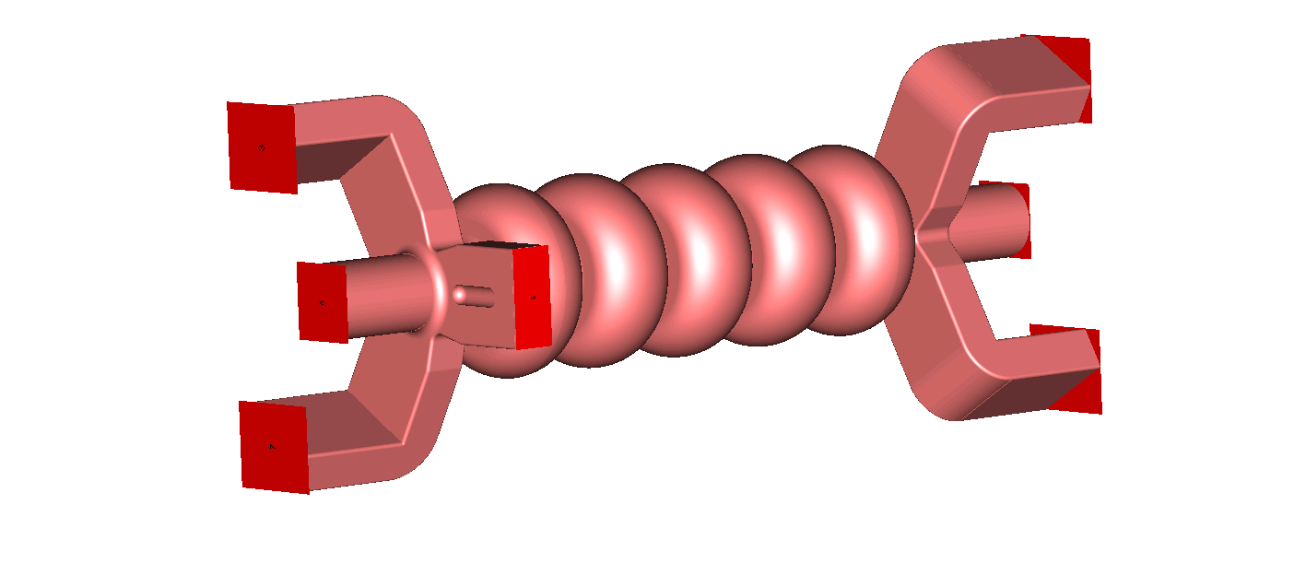
JLAB HC Cryomodule Development:
Broadband HOM Damping Efficiency
Most parasitic HOMs measured on warm model
Simulation also performed with Eigenmode solver of CST Microwave Studio (MWS)
Conclusion: HOM damping requirements can be met to support Ampere-level of current
Simulation and measurement in good agreement
ideal absorbing boundaries
at waveguide ports
R. Rimmer et. al. HOM10
CST MAFIA model
CST MWS model
Q_{ext} with beam tube
and waveguide ports

Slide 10
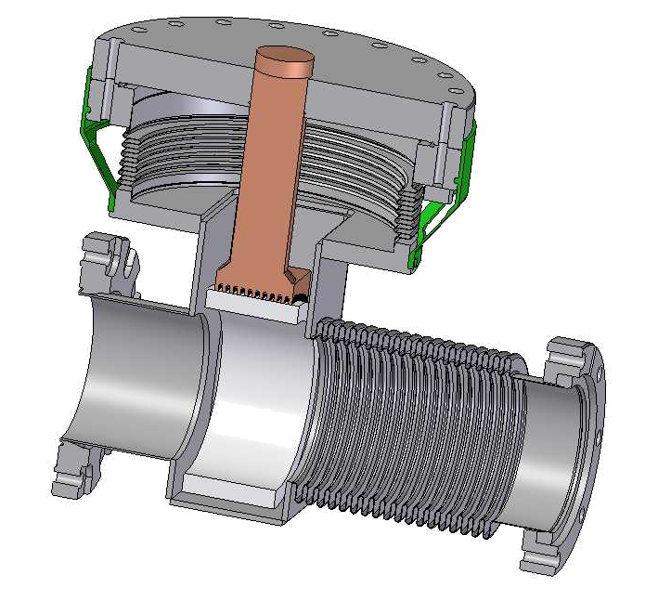
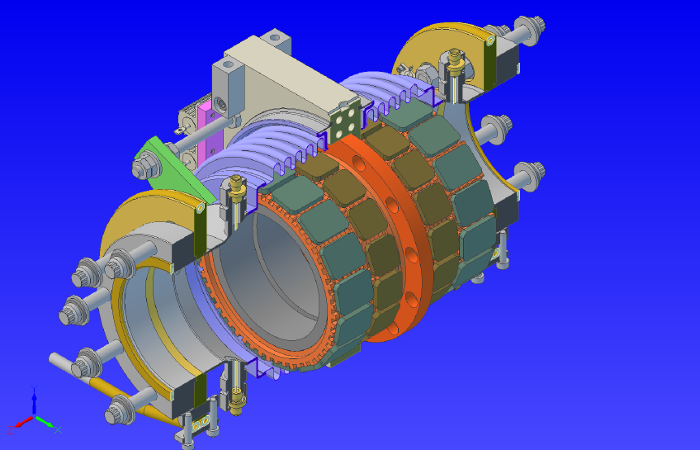
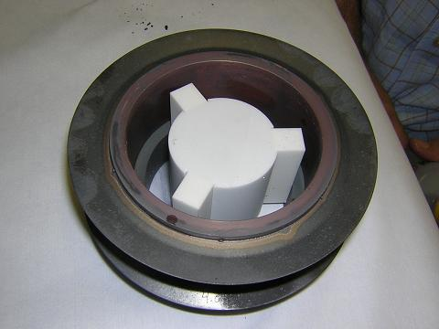
FLASH/XFEL and Muon Inc. Beamline Loads
FLASH/XFEL HOM Load
Muon Inc. HOM Load
J. Sekutowicz, R. Johnson
Absorbing ceramic ring brazed to Cu stub
At “80” K
Low cost
Capacity ~ 100 W
Tested with beam at FLASH
Modified version of Cornell ERL injector HOM load
Solid rings inside, tiles outside
Studied hot compression ring assembly of inner absorber ring (no braze)

Slide 11
R&D Issues-Beamline HOM Absorbers
Better values for wakefield/power loss for NGLS Structures over range of operating conditions. Don’t forget harmonic cavities.
Is HOM absorber warm or 70-80 deg-K?
Does HOM absorber absorb all of CM HOM power?
  Geometry, absorber properties up to 1 THz, etc.
Effect of HOM power above 750 GHz on Q₀.

Slide 12
R&D Issues-HOM dampers
Understand requirements for damping of trapped modes in accelerating and harmonic cavities.
Estimate extracted HOM power.
RF model of structure. Waveguide/loop couplers?

