Slide 1
Cryosystem design
March 15th 2012
Torsten Koettig
Lawrence Berkeley National Laboratory

Slide 2
Cryogenic issues
Separate Cryomodules
Operating temperature 1.8 K, generated separately inside CM’s
Heat load per CM =f(Q₀, operating gradient, …)
Cryoplant size (1 vs. 2 units). Estimated load >4.5 kW @ 1.8 K
Heat load from HOM, power coupler etc.
Cooling capacity for SC undulators at 4.5 K => 200 W per beamline
Critical heat flux - Cavitation

Slide 3
Cryosystem
Cryogenic efficiency assumptions
Temperature level in K | COP in W_{el/}W_{cooling p.} | Source | ~ Multiplier to 4.5 K equivalent
1.8 | 930 | CERN | 4
2.0 | 773 | FNAL | 3
4.5 | 230 – 245 | CERN | 1
5 - 8 | 190 | FNAL | 0.75
40 - 50 | 16.5 | KEK | 1/14
40 - 80 | 18.4 | FNAL | 1/13

Slide 4
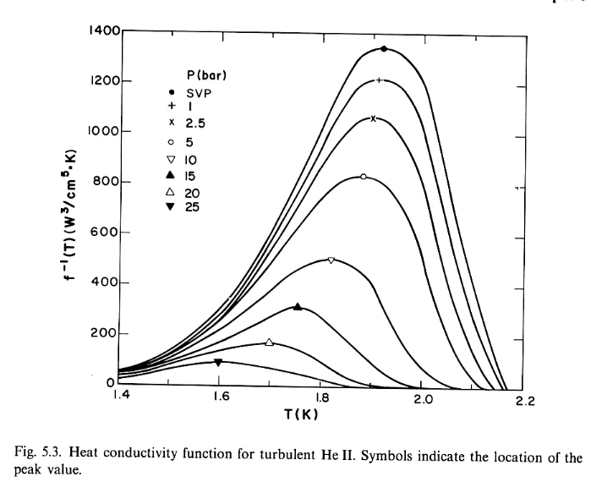
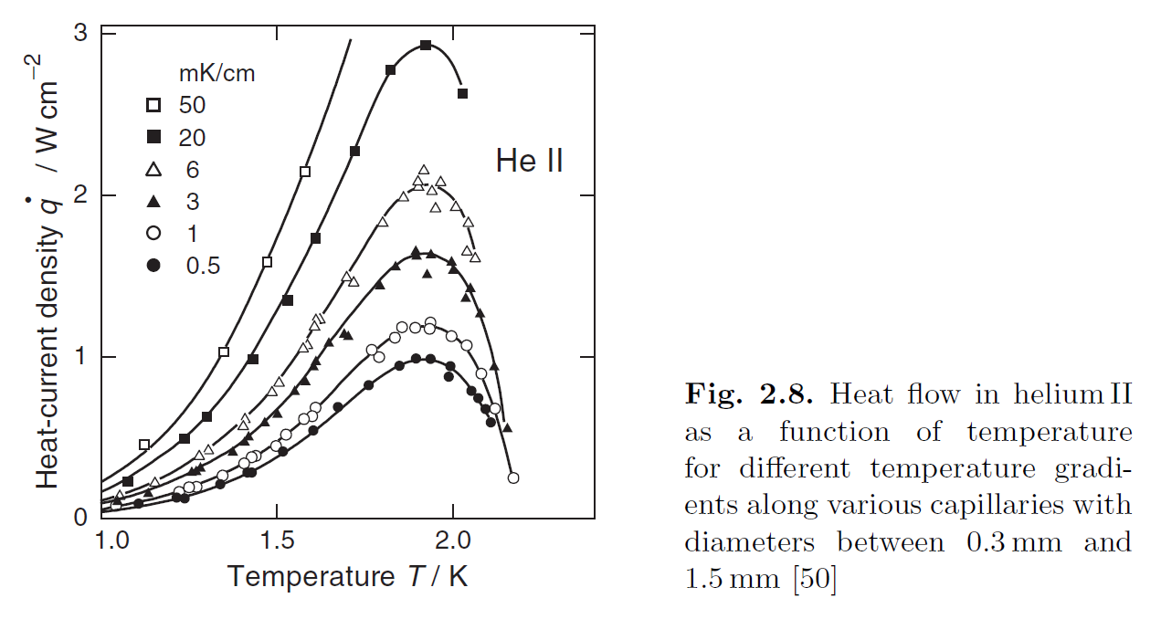
He II transport properties
Large cross section
„van Sciver, Helium cryogenics“
Mini-channels
„Ekin, Experimental Techniques for lowTemeperature Measurements“
m = 3 … 3.4

Slide 5
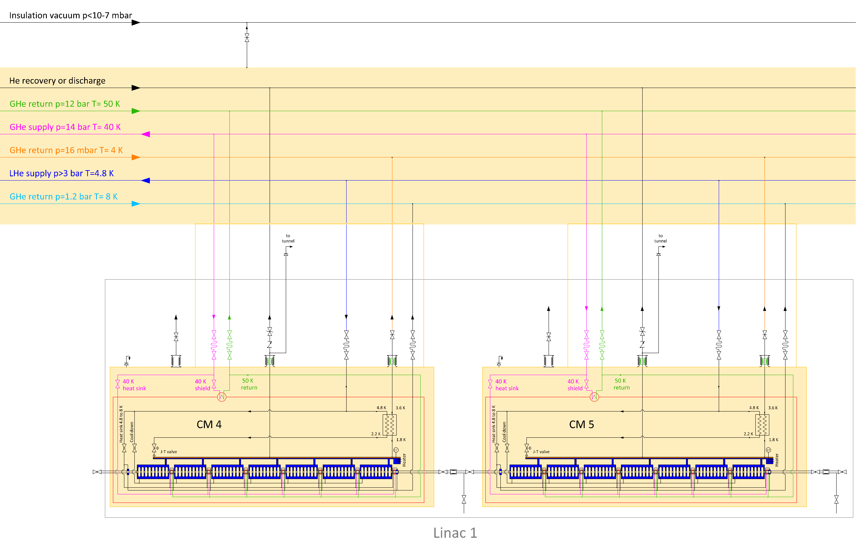
Cryogenic circuit

Slide 6
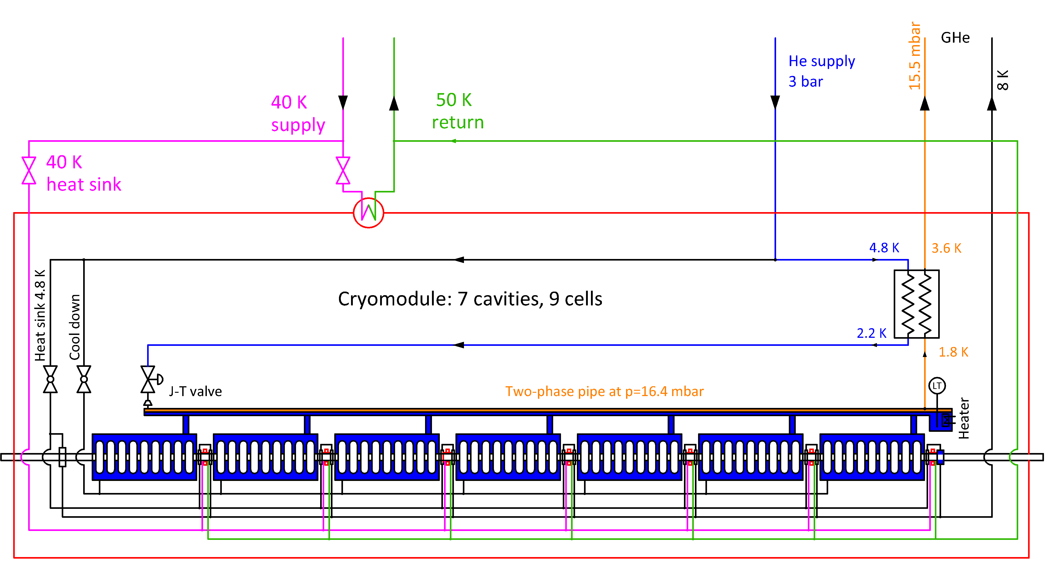
Feed pipe of a cavity
Cryogenics for CM’s

Slide 7
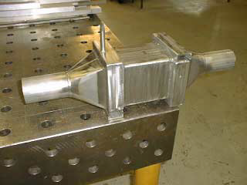
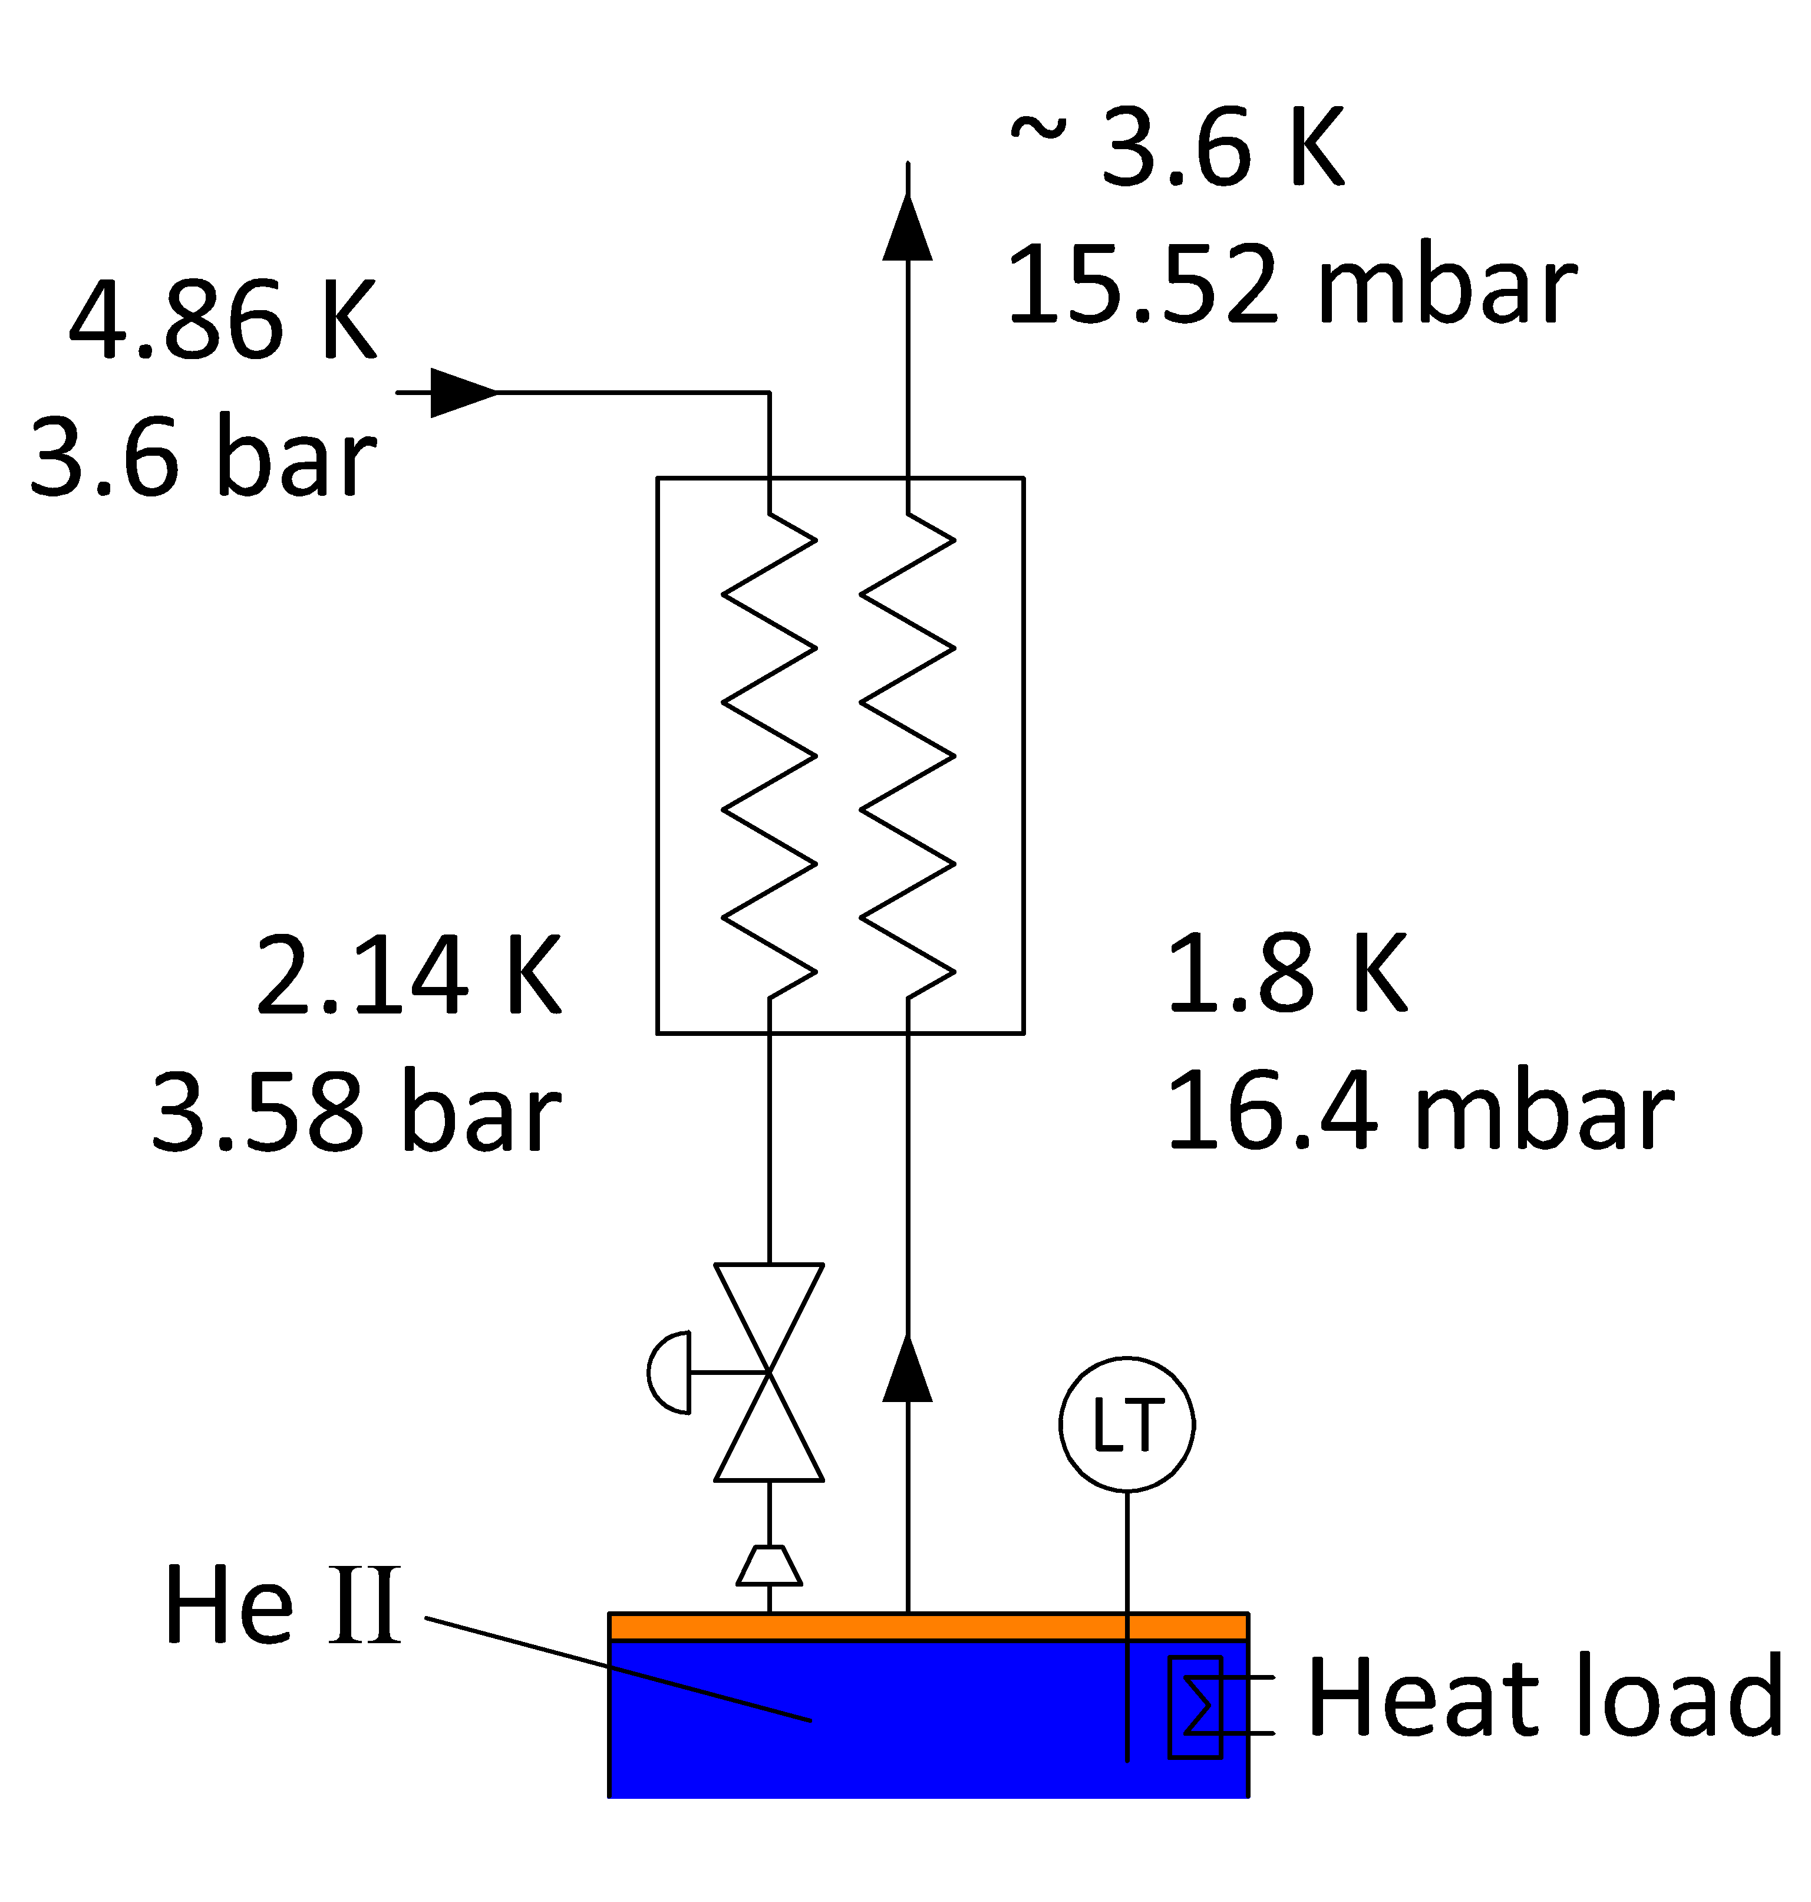
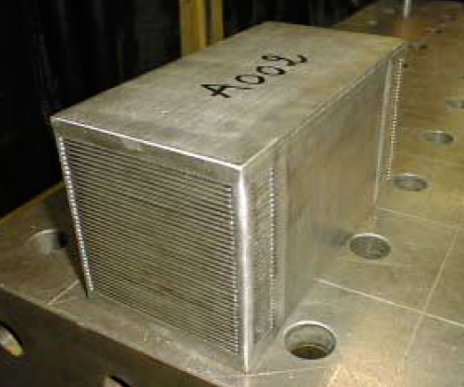
CM heat exchanger
.
Plate heat exchanger m=4.5 g/s
Δp_{VLP} = 88 Pa
= 0.88 mbar

Slide 8
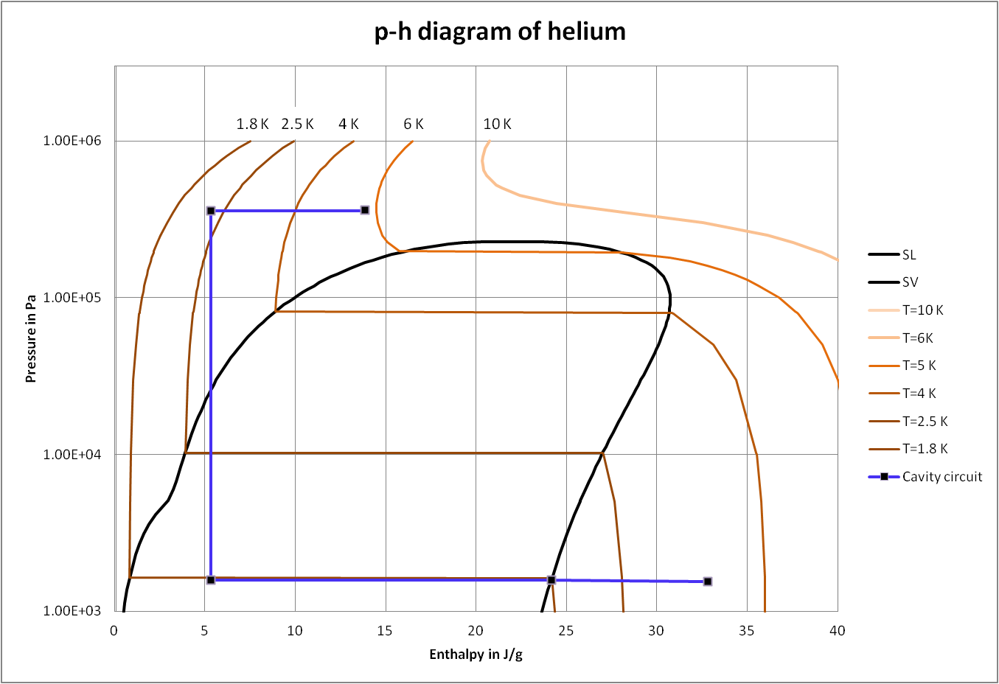
CM heat exchanger
1.8K 2.5K 4K 5K 6K
Δh=19 J/g
=> 180 W => 9.5 g/s

Slide 9
Feed pipe of a cavity
Cryogenics for CM’s

Slide 10
Two phase pipe diameter
Input parameter: - v_{vapor}= 5 m/s vapor space is upper half of the pipe
- T_{SVP}= 1.8 K
- L_{2phase-p}= 11 m
- Q_{cavity}= 25.7 W/cavity, 7 cavities per CM, Q = 180 W
d_{2phase-p}= 94 mm
.
.

Slide 11
Feed pipe of a cavity
Feed pipe diameter
T₁=1.8 K, ΔT=20 mK, L=0.25 m, Q=25 W
=> d=6 cm
.
OFHC Cu: d=75 cm

Slide 12
Cryogenic transfer line
NGLS layout
Cryoplant at ~400 m
Cryogenic distribution line

Slide 13
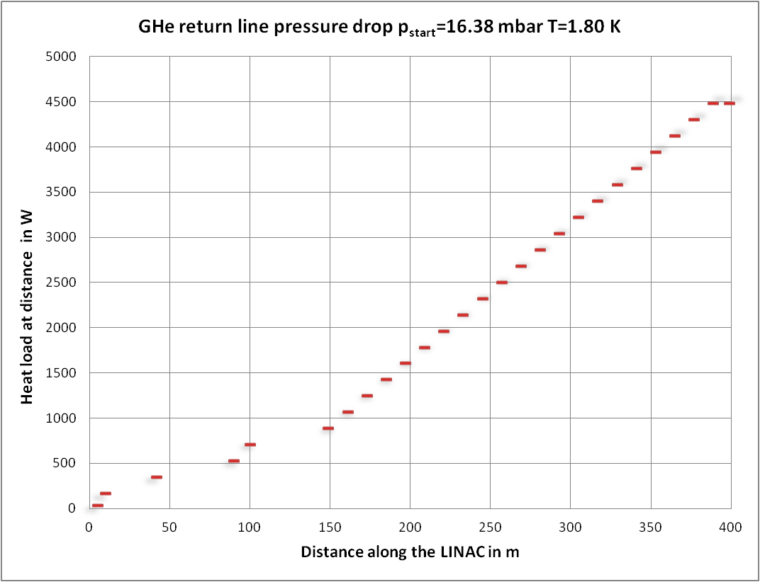
Cryogenic transfer line - GHe return pipe
d_{i}=360 mm

Slide 14
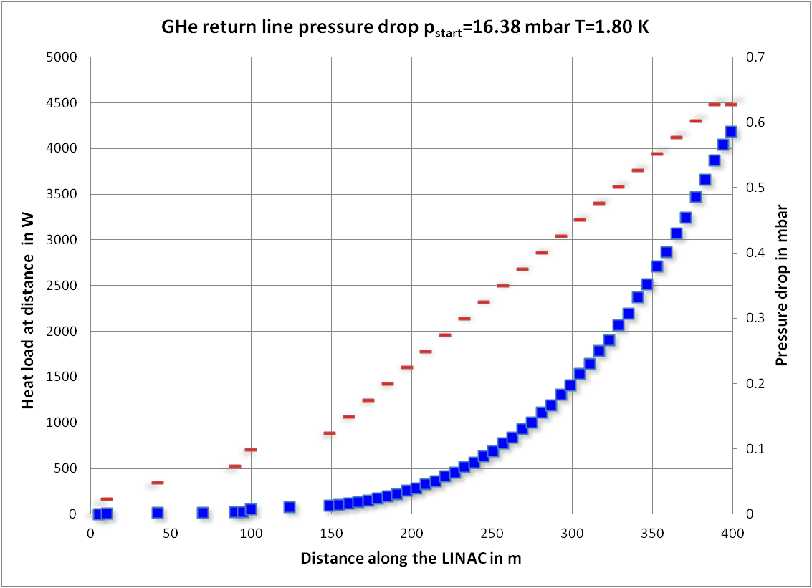
Cryogenic transfer line - GHe return pipe
d_{i}=360 mm

Slide 15
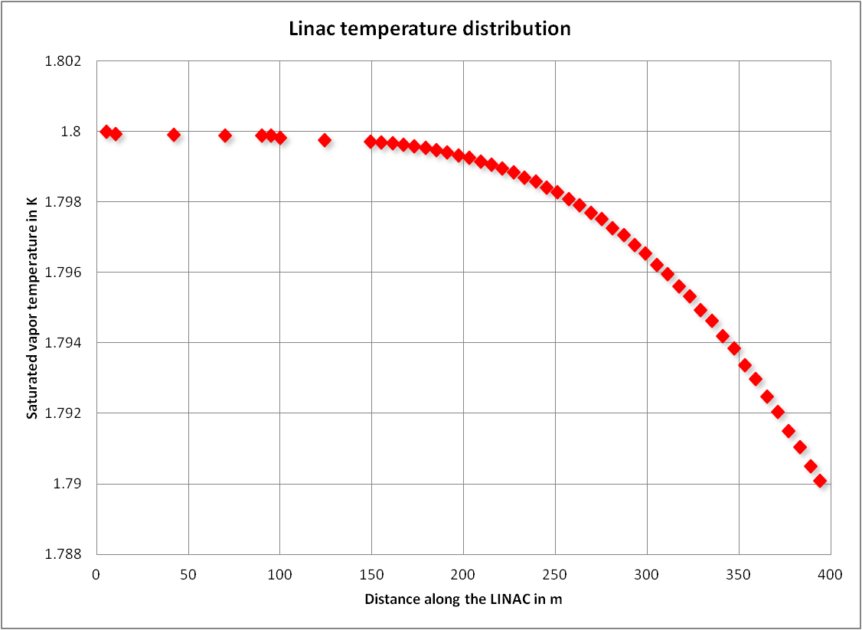
Cryogenic transfer line - GHe return pipe
d_{i}=360 mm

Slide 16
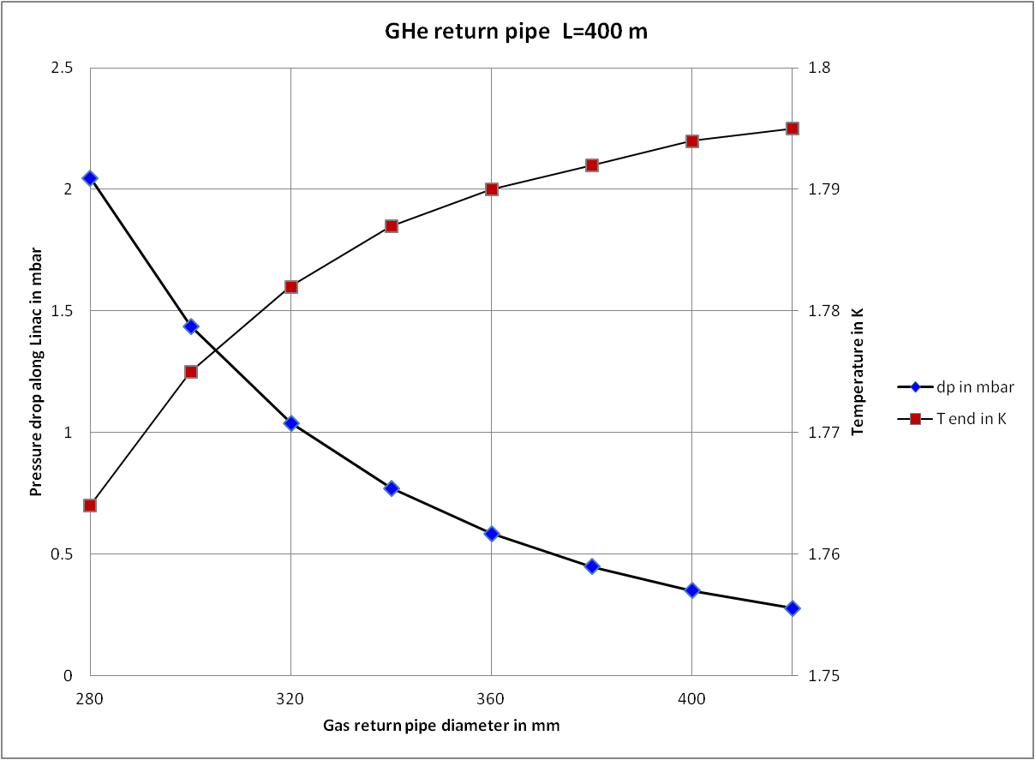
Cryogenic transfer line - GHe return pipe

Slide 17
Critical heat flux - cavitation
Critical heat flux
Heat and mass flow are
limited by a critical velocity:
v > v_{cr}
Superfluid behavior becomes
non-linear
k and η
Formation of gas bubbles at
the surface of the heater
In He II recondensation of
the vapor
Surface tension let the bubbles
implode
Implosion speed exceeds v₁
Shock wave => cavitation
Power supply
He II level
Heater
Cryostat

Slide 18
Critical heat flux

Slide 19
Normal fluid cooling

Slide 20
Thank you for your attention.

Slide 21
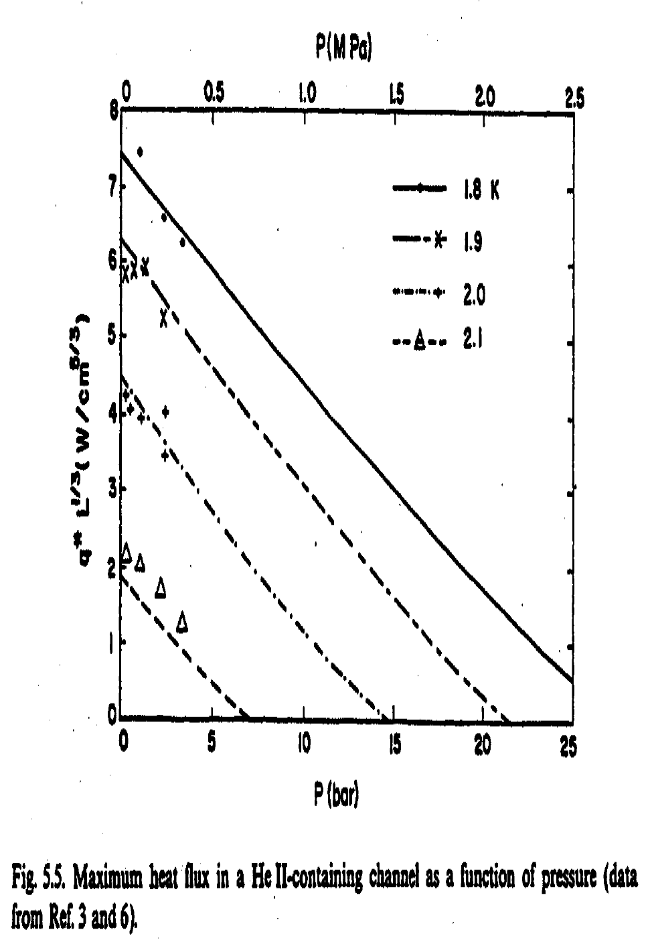
Back-up slides
Values are good for ±10% for SVP

Slide 22
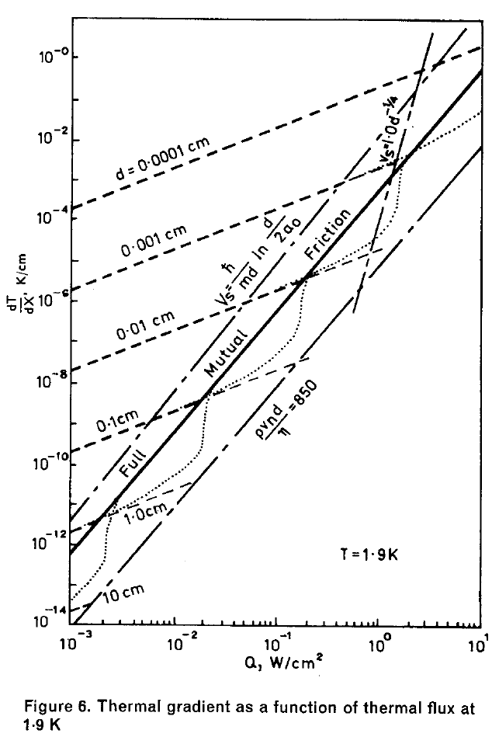
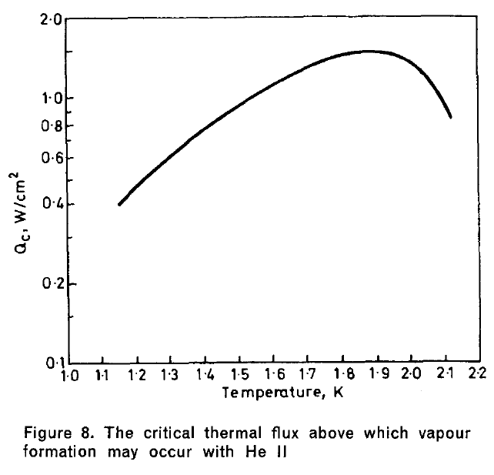
Laminar
Turbulent
Arp, Heat transport through helium II, 1970

Slide 23
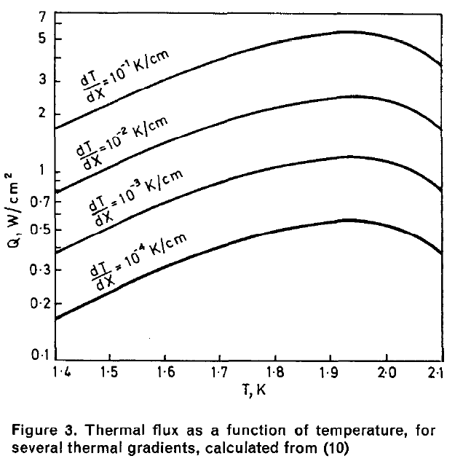
Arp, Heat transport
Through helium II, 1970

Slide 24
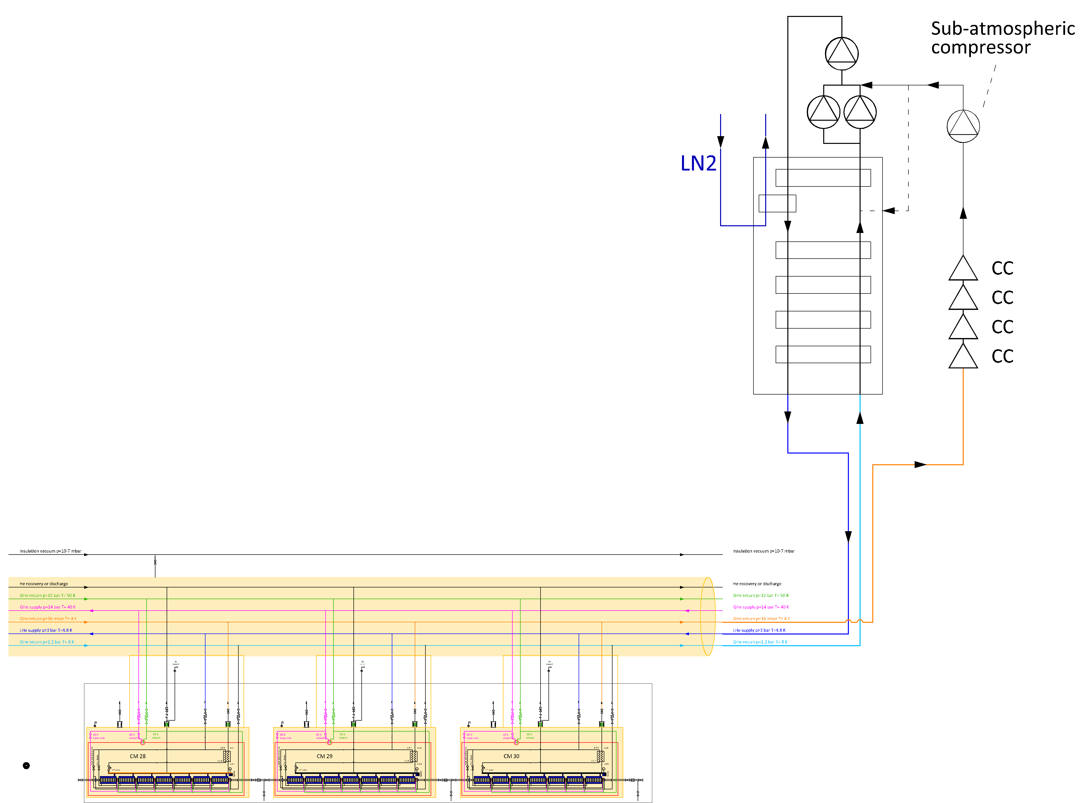
Cryoplant with mixed <2K cycle
Cryogenic distribution line
Indipendent Cryomodules

Slide 25
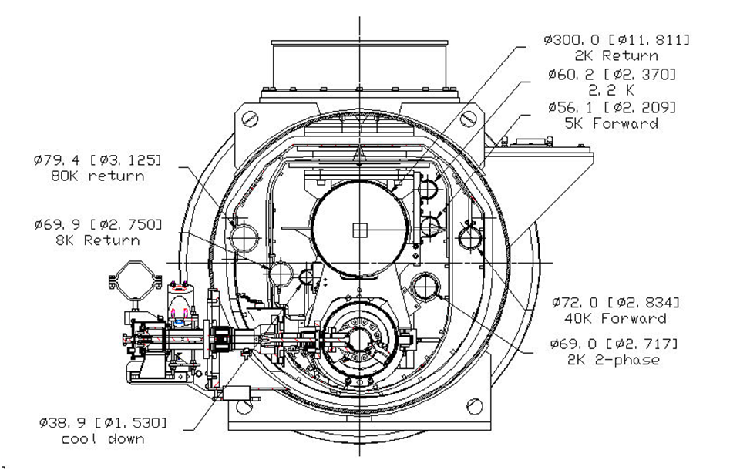
Removal of bottom shield parts
Complete elimination not feasible
Only top part left
“40-80 K” shield

Slide 26
Thermal shield at 5 K?
P. Pierini – INFN
Overall static/dynamic – Test data
 | Full set of 5 K shield |  |  | Without 5 K lower shield
 | 2 K | 5 K | 40 K | 2 K | 5 K | 40 K
Static load, W | 1.13 | 9.70 | 93.8 | 1.14 | 8.10 | 95.9
Dynamic load, W | 10.02 | 7.06 | 83.0 | 10.02 | 7.06 | 83.0
Sum (static +dynamic) | 11.15 | 16.76 | 176.8 | 11.16 | 15.16 | 178.9
Work at 300 K, W | 7838.2 | 3317.5 | 2908.4 | 7845.3 | 3000.8 | 2942.9
Sum (2K+5K+40K), W | 14064 |  |  | 13789
Power consumption kept constant !

Slide 27
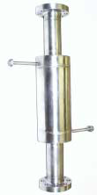
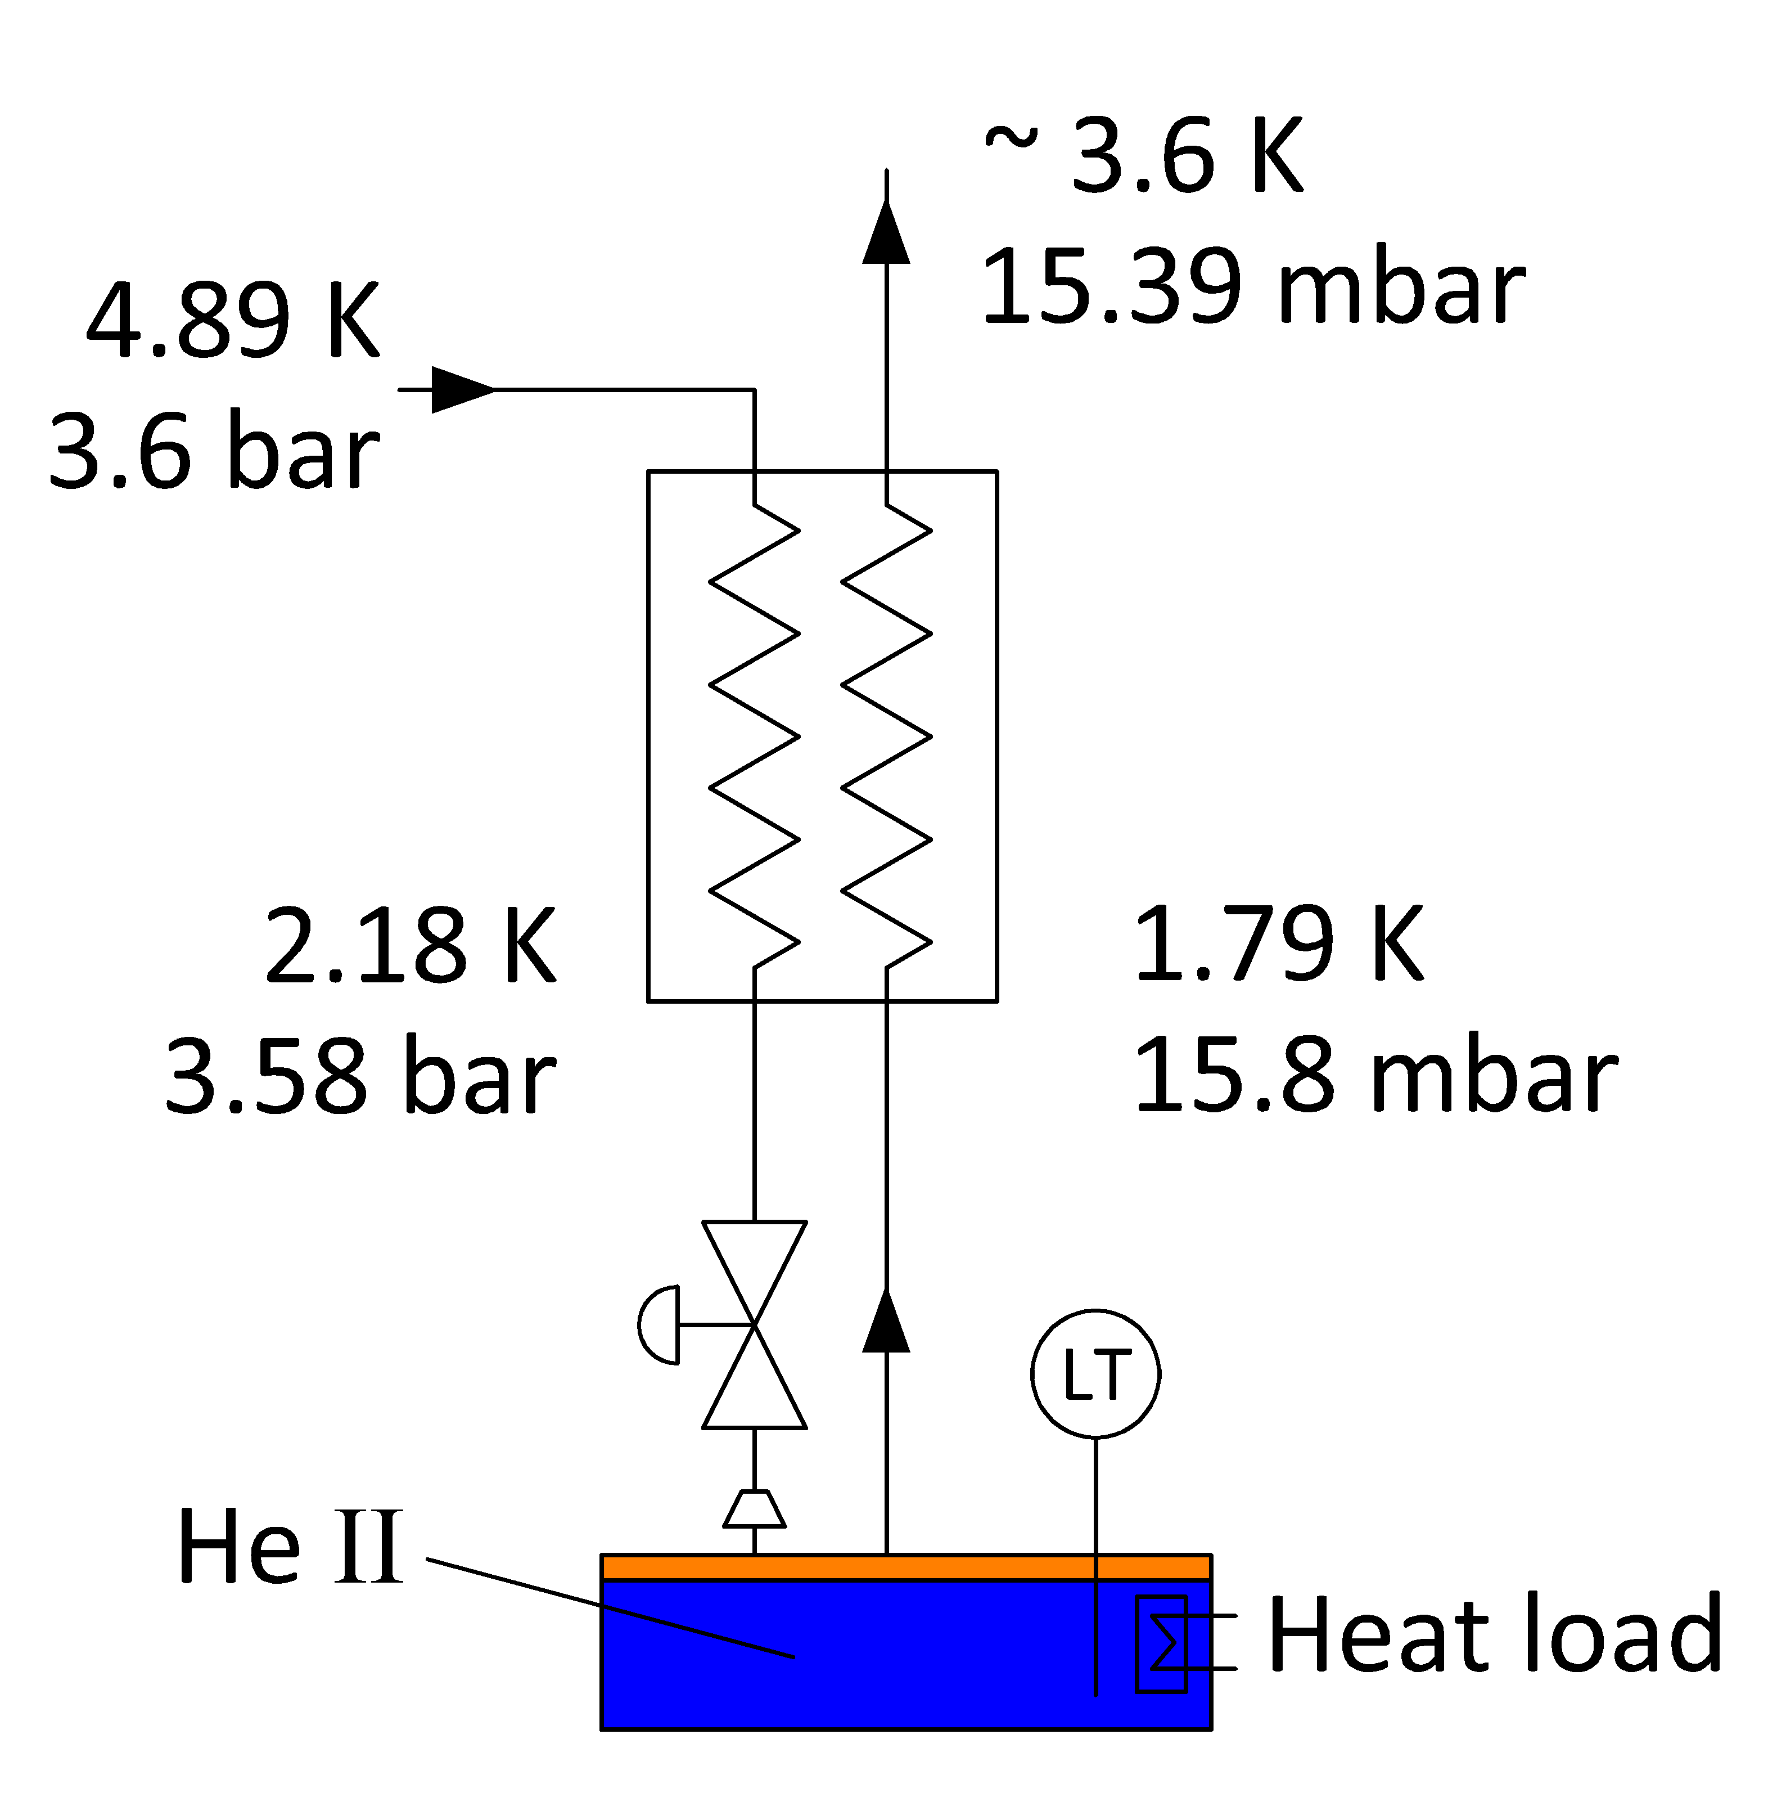
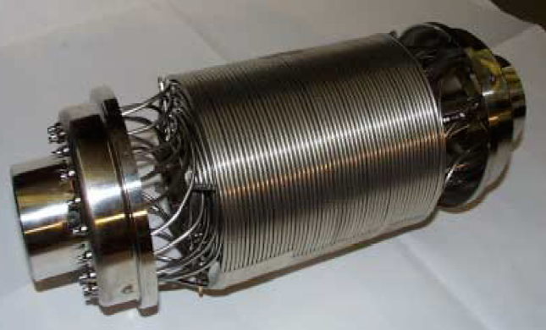
Wound tube heat exchanger
Δp_{VLP}
= 41 Pa
= 0.41 mbar

