Slide 1
Initial thoughts on the concept of SC RF for NGLS
Slava Yakovlev (FNAL)
FNAL-LBNL joint meeting on SRF Cavities and Cryomodules
March 15, 2012

Slide 2
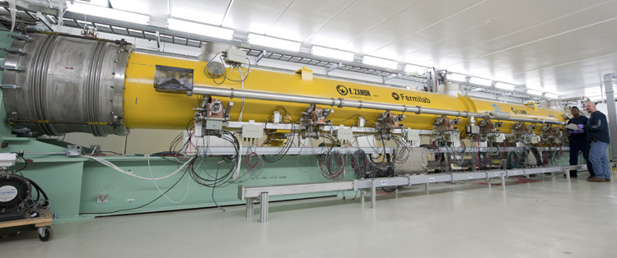
Development of the SC RF cavities and cryomodules for NGLS linac in the frame of future collaboration between LBNL and FNAL
FNAL SC technology:
1.3 GHz ILC CM
(The talks of C. Ginsburg,
A. Rowe and T. Arkan)
3.9 GHz CM
(The talk of E. Harms)

Slide 3
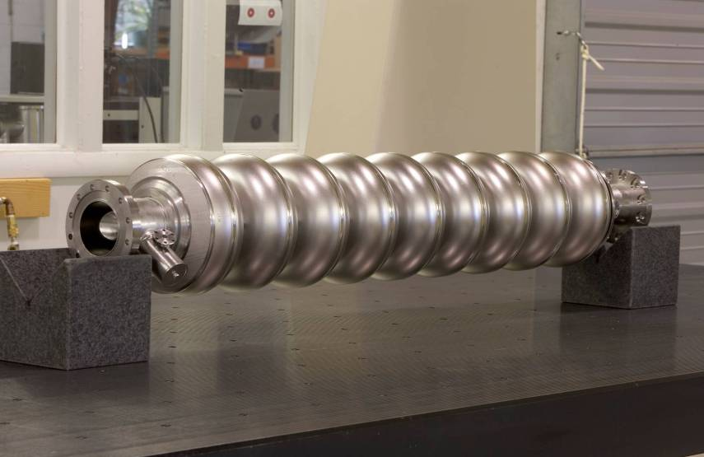
ILC RF cavity:
Operation mode - pulsed;
Pulse length – 1 msec;
Pulse repetition rate – 5 Hz;
Acceleration gradient - 33-34 MeV/m;
Bandwidth - 400 Hz;
Bunch population - 3.2 nC;
Bunch repetition rate – 3 MHz;
Pulse current – 9 mA;
Average current – 48 µA ;
Pulsed input power – 300 kW;
Average input power – 2.5 kW.

Slide 4
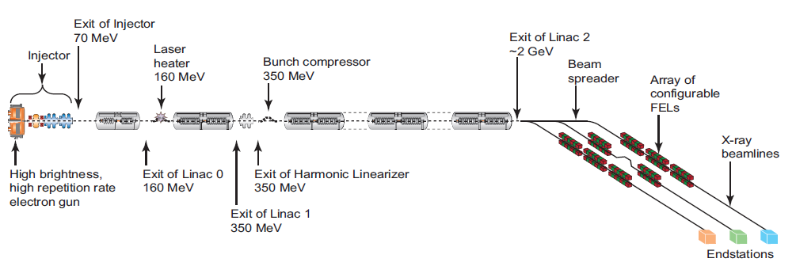
Schematic layout of the main components of the NGLS (not to scale)*.
Energy, GeV 2.4
Operation mode CW
Average current, mA 1
Bunch rep. rate, MHz 1
Bunch population, nC 1
*J.N. Corlett, et al, PAC2011

Slide 5
Issues:
Incoherent losses – HOM couplers,
Beam Line absorbers;
Resonance HOM excitation – HOM couplers;
Cavity RF load – CM;
Input power – main couplers;
Beam loading – microphonics.

Slide 6
Effects of HOMs (collective instabilities, cavity heating) depend on the beam current, beam spectrum (beam timing) and cavity HOM spectrum.
“Average” HOM power per cavity (incoherent losses):
P_{av} = k_{loss}Q_{b}I_{av}
 | Project X | SNS | ILC | NGLS
I_{av}, mA | 1 | 1 | 4.8e-2 | 1
Q_{b}, pC | 25.6* | 58 | 3200 | 1000
k_{loss}, V/pC | 2 | 1.1 | 14.6 | 14.6*
P_{av}, W/cavity | 0.051 | 0.064 | 2.2 | 14.6 (!!!)
*162.5 MHz beam sequence frequency.
**for bunch length if 0.3 mm

Slide 7
Loss factor per cavity vs. the bunch length*
R.m.s. bunch length, µm | Loss factor, V/pC/cavity
1000 | 10.8
700 | 12.0
500 | 13.1
400 | 13.8
300 | 14.6
250 | 15.3
125 | 16.9
75 | 17.3
50 | 17.9
*T. Weiland, and I. Zagorodnov, TESLA Report 2003-19

Slide 8
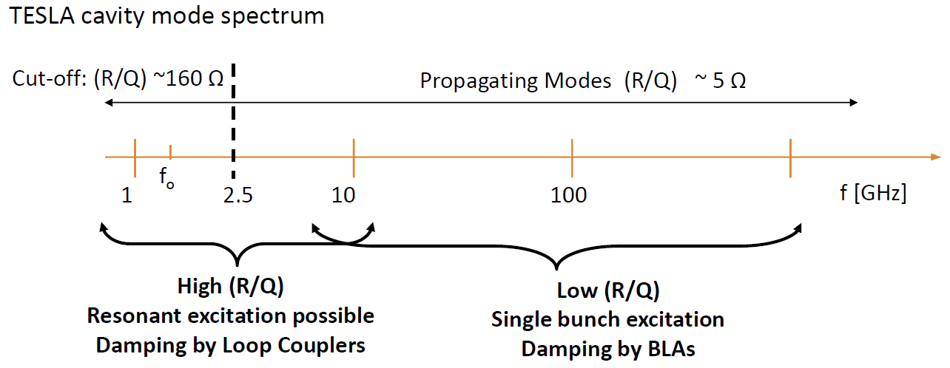
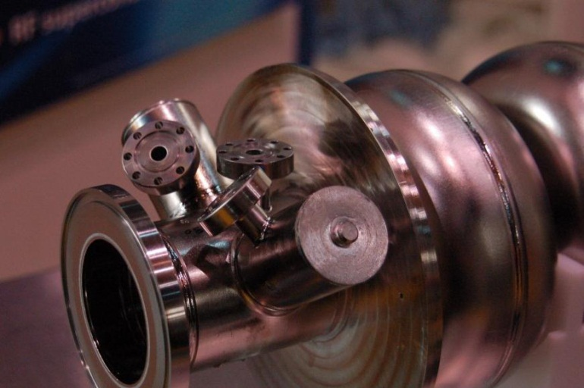
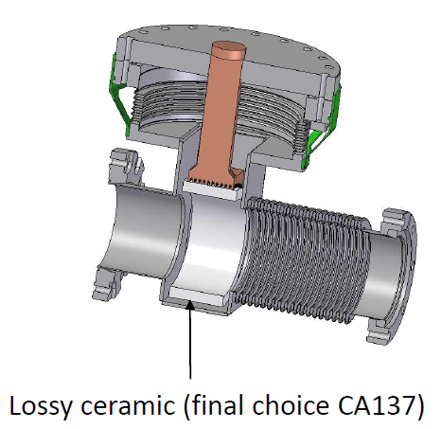
Beam Line Absorbers should be modified. HOM couplers may need modification also.
k_{loss}Q_{b}I_{av}, W/cavity:
BERLinPro - 150
KEK-cERL - 154-185
Cornell ERL – 200
NGLS -12.5

Slide 9
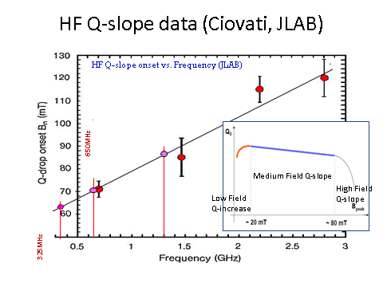
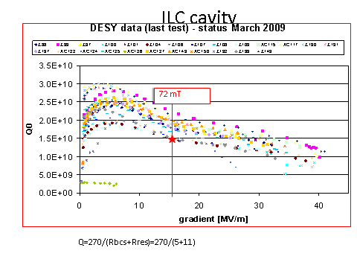
Acceleration gradient choice:
CW operation;
RF losses is an issue;
High Q required;
Operation below high field Q-slope
For f=1.3 GHz B<80 mT, or gradient
for ILC-type structure is to be <20 MeV/m;
For the gradient of ~20 MeV/m expected average Q may be <1.8e10 at 2 K;
Losses per CM are >220 W.
ILC CM is to be modified!
(chimney and two-phase
supply tube diameters – as at BESSY.
Details will be in Tom Peterson’s talk )

Slide 10
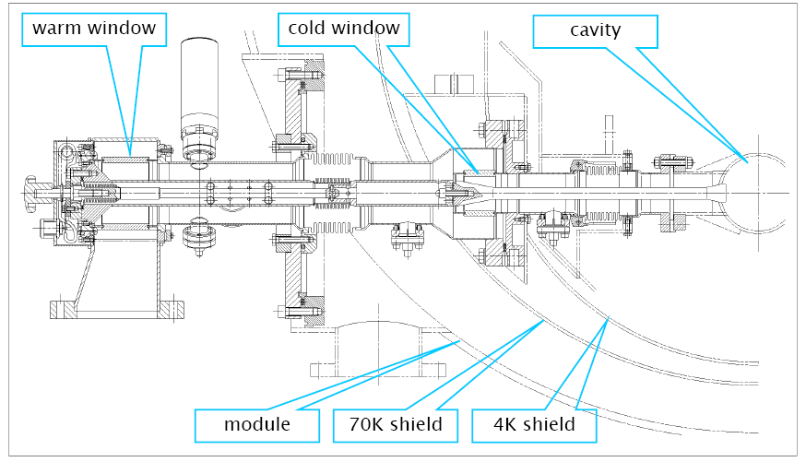
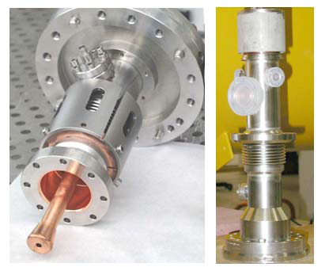
Coupler issues:
NGLS: input power - 20 kW/cavity CW.
ILC couplers (TTF-III):
300kW pulse,
2.5 kW average
.
(Details in the talk of T. Khabiboulline)
TTF-III couplers are not suitable for NGLS

Slide 11
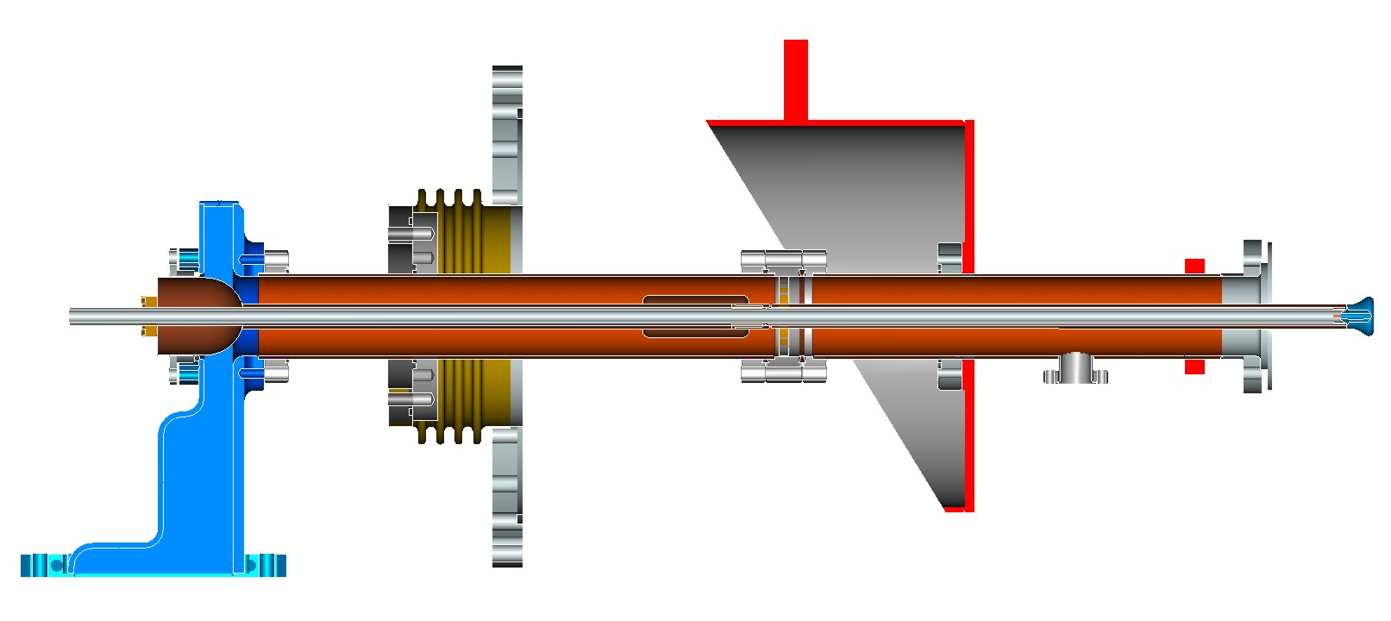
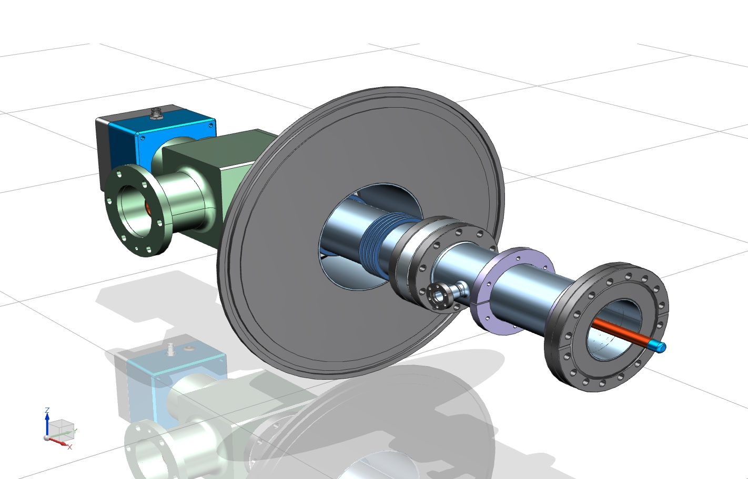
Another design is necessary.
1.3 GHz 40 kW CW coupler for Project X , preliminary mechanical design (S. Kazakov):

Slide 12
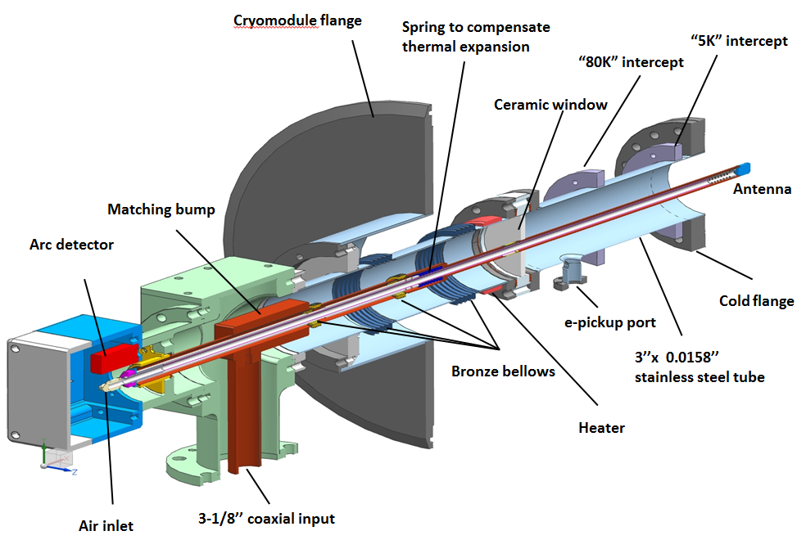
325 MHz coupler mechanical design
Details are in Timergali Khabiboulline’s presentation

Slide 13
Low beam loading:
Beam current – 1 mA;
Gain/cavity < 20 MeV
Loaded Q: 1.8e7 (possible to use lower
Q~1e7 and paying by ~10% power overhead)
Bandwidth Δf: 72 Hz;
Microphonics – cavity resonance frequency changes caused by the cavity wall vibration. Main source of vibration – He pressure fluctuations δP.
Δf_{m} = df/dP×δP×safety factor (~4), δP~0.1 mbar at 2 K. df/dP ≈120 Hz/mbar (ILC). Thus, Δf_{m} ~Δf.
  Microphonics may be an issue. He vessel may need modifications in order to reduce df/dP . Active microphonics damping may be necessary. Tuners may need re-design.

Slide 14
Microphonics Control Strategies
Microphonics can be mitigated by taking some combination of any or all of the following measures:
Providing sufficient reserve RF power to compensate for the expected peak detuning levels.
Improving the regulation of the bath pressure to minimize the magnitude of cyclic variations and transients.
Reducing the sensitivity of the cavity resonant frequency to variations in the helium bath pressure (df/dP).
Minimizing the acoustic energy transmitted to the cavity by external vibration sources.
Actively damping cavity vibrations using a fast mechanical or electromagnetic tuner driven by feedback from measurements of the cavity resonant frequency.
The optimal combination of measures may differ for different cavity types.

Slide 15
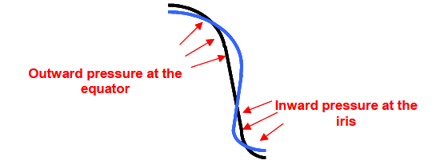
Lorentz detuning – cavity detuning caused by the cavity wall deformation by ponderomotive forces of RF field:
Δf_{Lorentz} = k_{L}G², k_{L}- Lorentz coefficient, G – acceleration gradient.
For ILC cavity k_{L}~ -1 Hz/(MeV/m)². For CW and for modest gradient (<20 MeV/m) not an issue.

Slide 16
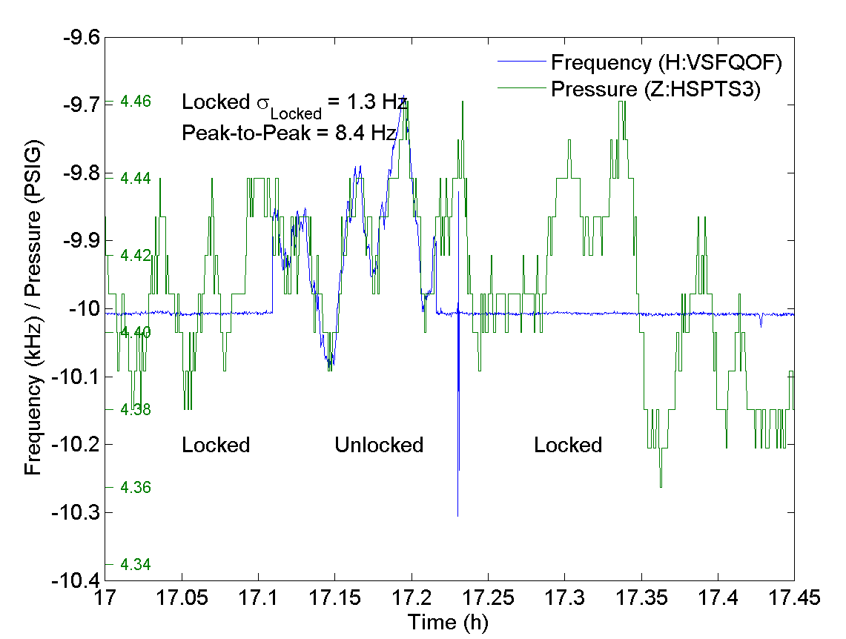
Active microphonics compensation*
  SSR1:
  Test Conditions:
  4.5K;
  Cavity bandwidth of about 1.5 Hz;
  df/dP = 140Hz/torr;
  dP_{PTP}~=5 torr
  LLRF tracking resonant frequency of cavity
Reduced pressure related variations in cavity frequency from several hundreds Hz to
Δf <= 1.3 Hz RMS
*W. Schappert, Yu. Pischalnikov (Fermilab)

Slide 17
Summary:
Possible new developments:
Modified HOM Couplers (higher incoherent losses);
New Beam Line absorbers (higher incoherent losses);
New main coupler (higher average power);
Helium vessel modification (microphonics);
Tuners (microphonics);
CM (high average RF losses) – need changes in design.
Fermilab has a culture, technology and expertise to do this work.

