Slide 1
3.9 GHz Cryomodule for FLASH
Elvin Harms (FNAL)
FNAL-LBNL joint meeting on SRF Cavities and Cryomodules
15 March, 2012

Slide 2
Introduction/Topics to Discuss
cavity design, fabrication including spare cavities
vertical and horizontal test results
performance at FLASH
lessons learned
applying our experience
2
Harms, FNAL-LBNL Meeting March 15-16, 2012 - 3.9 GHz

Slide 3
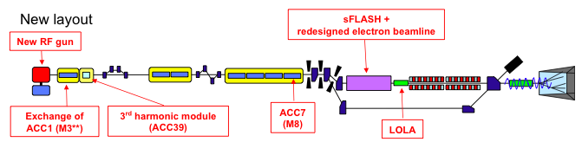
The 3.9 cavity module -What is it –What does it do?
The 3.9 GHz module, ACC39, is installed in the DESY FLASH injector just after the 1.3GHz ACC1 (first) cryo module.
It is used in conjuction with this module in order linearize the bunch energy vs. time over the bunch length.
This in turn makes “bunch compression” to very short bunches with high peak currents more efficient, or a more controlled longer bunch charge distribution.
The SASE FEL operation is more efficient and stable making seeded operation (sFlash) possible.
This is an important proof of principle not only for FLASH and XFEL but also for accelerator-photon physics, and a learning experience.
The control of the phase and amplitude of the 1.3-3.9 module pair will be difficult and very important.
3
Harms, FNAL-LBNL Meeting March 15-16, 2012 - 3.9 GHz

Slide 4
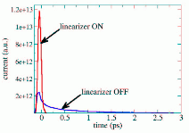
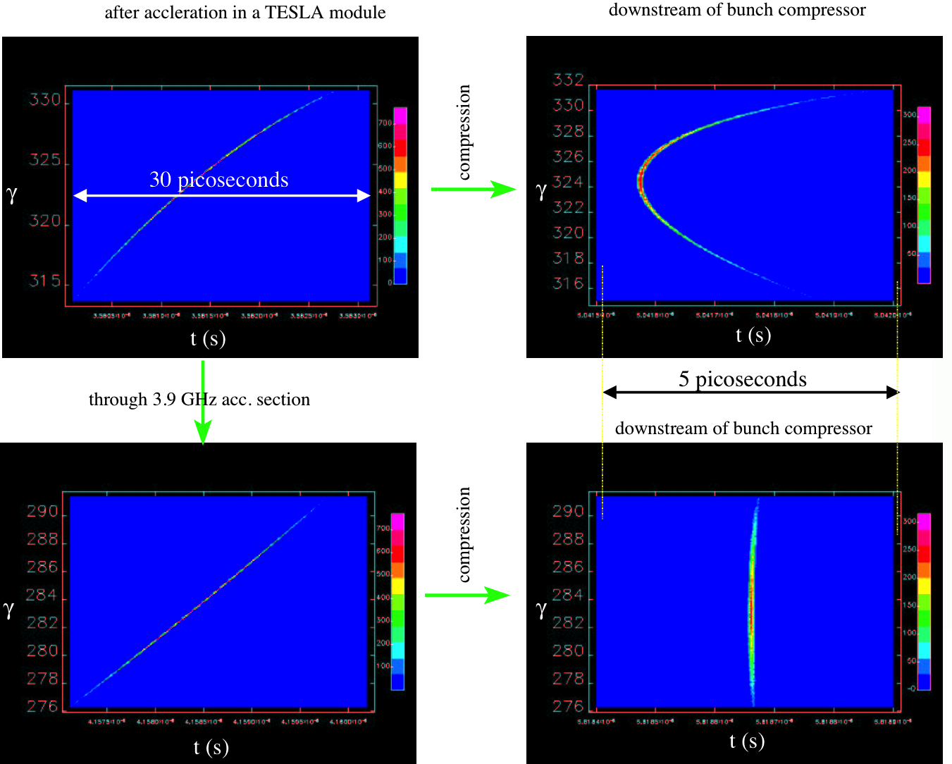
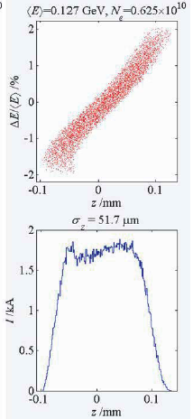
Bunch Compression with 3.9 GHz Module
After acceleration w/o
After compression w/o
Short bunch
Flat bunch ~250 fs σ
With 3rd harmonic
From M Dohlus et al
From P Piot
4
Harms, FNAL-LBNL Meeting March 15-16, 2012 - 3.9 GHz

Slide 5
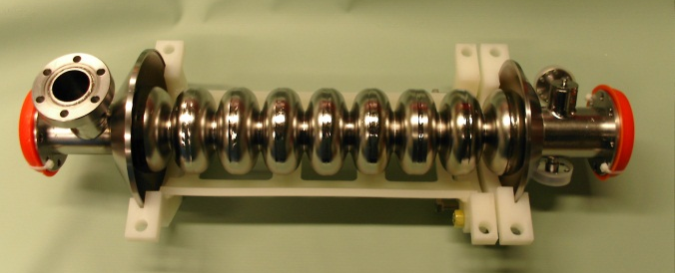
Cavity Design, Fabrication, Preparation
ACC39 is a 4-cavity cryomodule
Basic design was a 1/3 size modified version of a TTF style 1.3 GHz cavity.
8 cavities initially fabricated
  2 prototypes
  6 ‘production’
Fabrication a collaborative exercise with JLab & DESY.
E-beam welding done…
  locally at Sciaky (Cavities 1-2, 7-8 plus Helium vessels)
  at JLab (Cavities 3-6, repair on 2, 6).
Cavity prep – including ultrasonic cleaning, BCP, 800° C bake, HPR, dressing into Helium vessel, etc. all carried out at Fermilab or overseen by FNAL staff
  BCP carried out at Argonne by Fermilab staff
5
Harms, FNAL-LBNL Meeting March 15-16, 2012 - 3.9 GHz

Slide 6
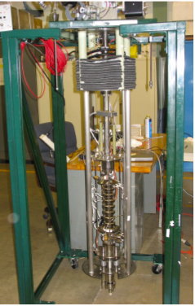
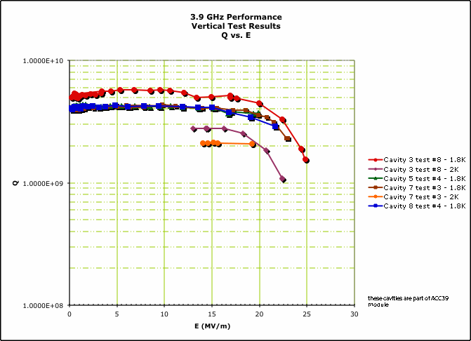
Vertical Testing/Results
All Cavities went through at least 4 vertical tests (at A0 – Photoinjector and SRF R&D facility), including
  Bare cavity
  With HOM coupler feedthroughs attached (sealed and ready for dressing)
  Some after dressing
  Some up to 16 times – R&D/troubleshooting HOM’s
  Production cavities average = 6 tests
  More than 70 tests in total carried out
Design
6
Harms, FNAL-LBNL Meeting March 15-16, 2012 - 3.9 GHz

Slide 7
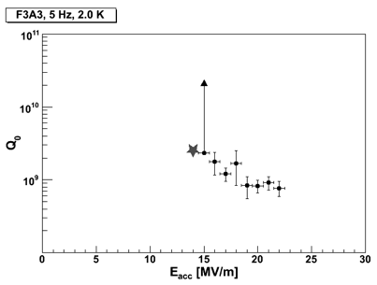
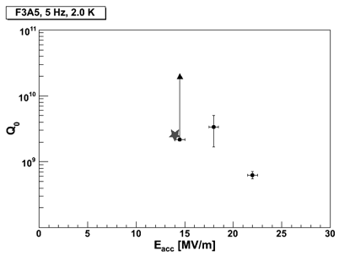
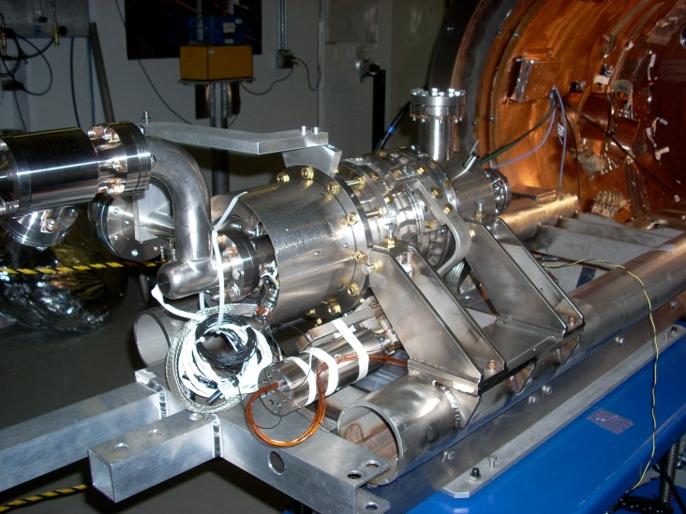
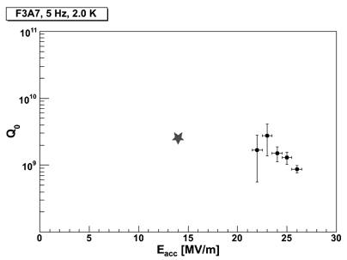
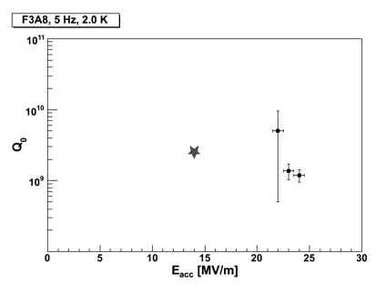
Horizontal Testing/Results
ACC39 cavities all tested at Horizontal Test Stand (HTS)
  HTS commissioning largely carried out with 3.9 GHz cavities (#5)
Design Gradient
14MV/m
F3A3 22.5 MV/m
F3A5 22.5 MV/m
F3A7 26.3 MV/m
F3A8 24 MV/m
7
Harms, FNAL-LBNL Meeting March 15-16, 2012 - 3.9 GHz

Slide 8
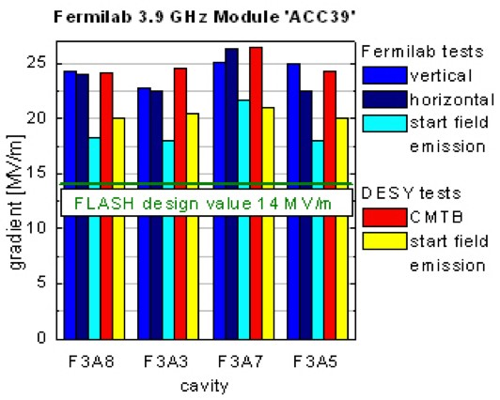
CumulativeTest Results
Entire cryomodule was first tested at DESY in their CryoModule Test Bench (CMTB) prior to installation in FLASH
  Successful assembly
  Successful transatlantic shipment
  Some rework at DESY
8
Harms, FNAL-LBNL Meeting March 15-16, 2012 - 3.9 GHz

Slide 9
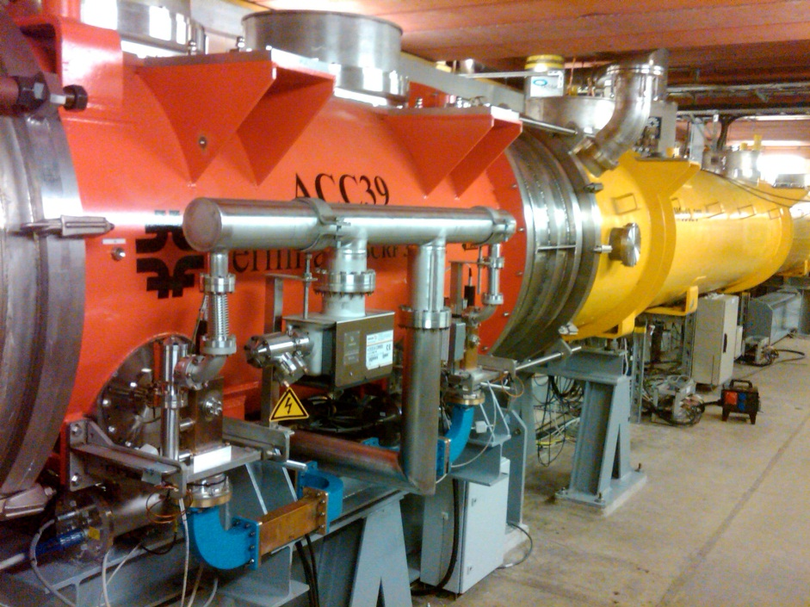
ACC39 Performance
ACC39 routinely operates at 18.9 to 19.7 MV/m
Capable to operate at 22 MV/m
  Limitation set by thermal interlocks – concern about compromising HOM’s on Cavities 3 & 5 (trimmed 2-post style)
9
Harms, FNAL-LBNL Meeting March 15-16, 2012 - 3.9 GHz

Slide 10
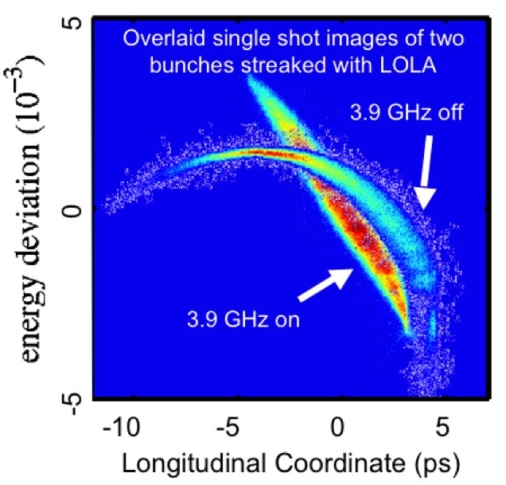
ACC39 Performance
Set up for lasing has gone from expert tune up (shifts) to nearly immediate after turn-on
10
Harms, FNAL-LBNL Meeting March 15-16, 2012 - 3.9 GHz

Slide 11
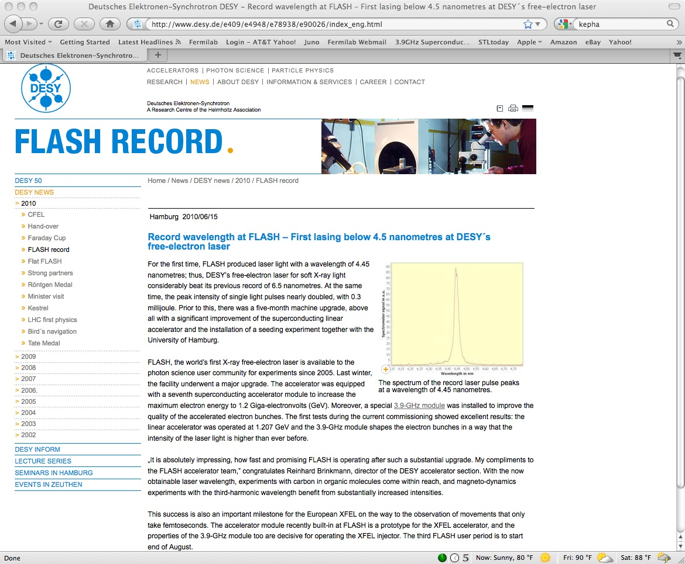
Operation in FLASH
“Moreover, a special 3.9-GHz module was installed to improve the quality of the accelerated electron bunches. The first tests during the current commissioning showed excellent results: the linear accelerator was operated at 1.207 GeV and the 3.9-GHz module shapes the electron bunches in a way that the intensity of the laser light is higher than ever before.”
This success is also an important milestone for the European XFEL on the way to the observation of movements that only take femtoseconds. The accelerator module recently built-in at FLASH is a prototype for the XFEL accelerator, and the properties of the 3.9-GHz module too are decisive for operating the XFEL injector. The third FLASH user period is to start end of August.

Slide 12
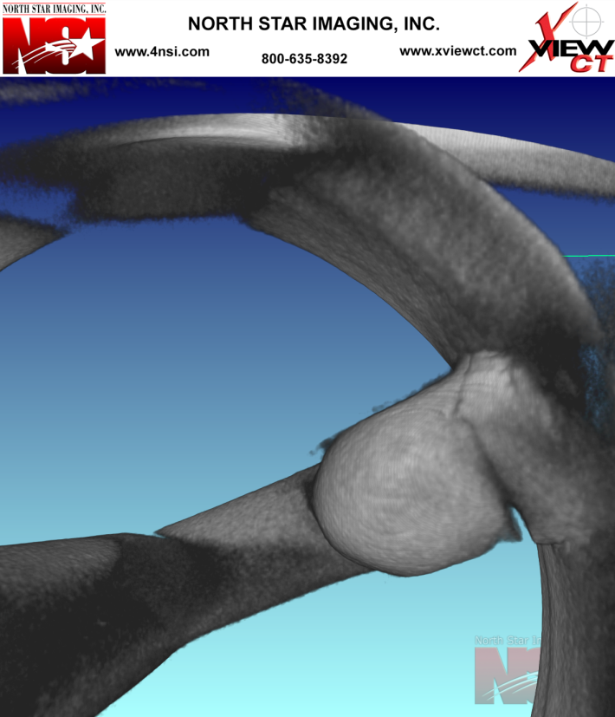
Spare Cavities
One new ‘modern’ style cavity fabricated and vertically tested – F3A9
  Single-post HOM F-piece
  >20 MV/m with no field emission, good Q₀
  ready for dressing and HTS
Two production cavities rebuilt with new ends/single post HOM’s
  Cracked HOM F-pieces prompted re-work
  Awaiting final BCP and 800° C bake
  Vertical test

Slide 13
Lessons Learned (and applied)
New infrastructure had to be built
  Commissioning in parallel with qualifying components
HOM redesign
  Not simply a scaled version
  Modeling and prototyping important
  Robust design is the end result
HOM coupler antennae
  Prototyping and testing is vital before placing order
Engineering Notes & ORC
Welding certification
  Especially Helium vessels
‘New’ technologies explored and applied

Slide 14
Why Do It & What Has It Done for Fermilab?
The 3.9 effort is part of an ongoing collaboration with DESY
In this collaboration DESY has advised Fermilab on many of the aspects of SRF development and has supplied design and assembly information.
DESY provided for Fermilab a 8 cavity module at 1.3 GHz. This Module was installed and operated in the NML facility – successful operation recently ended.
The 3.9 GHz module has been/will be a learning experience for FNAL in all aspects of beta 1 SRF cavity and module design through commissioning
Successful completion has clearly shown Fermilab’s growing competence and abilities in SRF technology
We have learned and benefited for our experiences and “Lessons Learned”
We are applying and sharing this capability
14
Harms, FNAL-LBNL Meeting March 15-16, 2012 - 3.9 GHz

Slide 15
How?
Consult with LASA, Milano on design and fabrication of 3.9 GHz cavities for XFEL
  ongoing collaboration
  participate in tests later this month
Prototype 3.9 GHz Input couplers for European XFEL assembled, inspected, and conditioned here (only 3.9 GHz coupler test stand in existence)
In negotiation for HTS testing dressed cavities (only one 3.9 GHz capable test stand in existence)
Investigating a 3.9 GHz module for NML – in discussion with an industrial partner

Slide 16
Summary
Fermilab has successfully designed and built the only 3.9 GHz multi-cavity cryomodule now in existence
ACC39 is now in routine operation at DESY/FLASH
Cavity performance well exceeded specifications
Performance is consistent with cavity tests
Cavity & Cryomodule work were valuable learning experiences for SRF development here
Acknowledged leader in this niche area – our expertise is in demand
Unique infrastructure developed – could support possible future collaborations
Investigating future application at NML/ASTA

Slide 18
Back-up Slides

Slide 19
Parameters

Slide 20
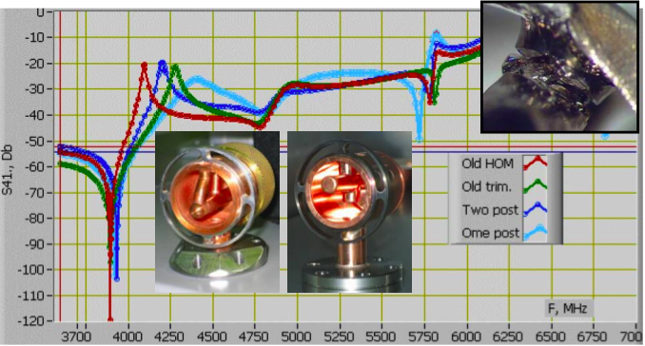
Old and New HOM 3.9 antennae
Cavities 3 and 5 are old two post design trimmed
Cavities 7 and 8 are new one post design

Slide 21
Summary of Last Vertical Tests - Design 14MV/m (with and w/o HOM antennae)
1.8K
C3 (2008_07_22 with HOM ant)
  Q @14 MV/m 2.2e9
  Max Gradient 17.6 MV/m, Q 1.2e9
C3 (2008_08_27 no HOM ant)
  Q @14 MV/m 5.2e9
  Max Gradient 22.8 MV/m, Q 1.3e9
C5 (2007_08_22 no HOM ant)
  Q @14 MV/m 5.1e9
  Max Gradient 25 MV/m, Q 2.0e9
C5 (2008_10_04 with HOM ant)
  Q @14 MV/m 4.1e9
  Max Gradient 17 MV/m, Q 3.7e9
C8 (2007_11_08 no HOM ant)
  Q @14 MV/m 4.9e9
  Max Gradient 24.2 MV/m, Q 1.5e9
C8 (2008_12_03 with HOM ant)
  Q @14 MV/m 2.8e9
  Max Gradient 20.4 MV/m, Q 1.3e9
2.0K
C3 (2008-08_27 no HOM ant)
  Q@14MV/m 2.6e9
  Max Gradient 20.3 MV/m, Q 1.7e9
C7 (2008_02_07 no HOM ant)
  Q @14 MV/m 2.3e9
  Max Gradient 25.1 MV/m, Q 1.3e9
C7 (2008_10_27 with HOM ant)
  Q @14 MV/m 2.0e9
  Max Gradient 24.8 MV/m, Q 1.2e9

Slide 22

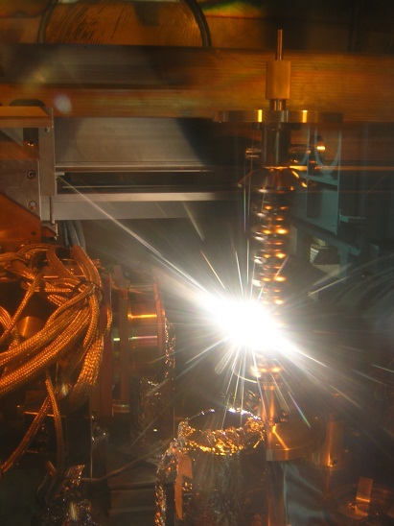
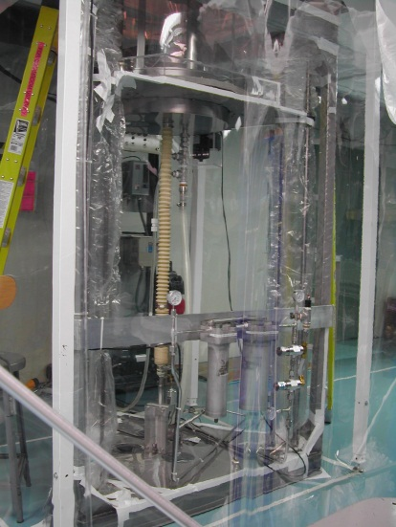
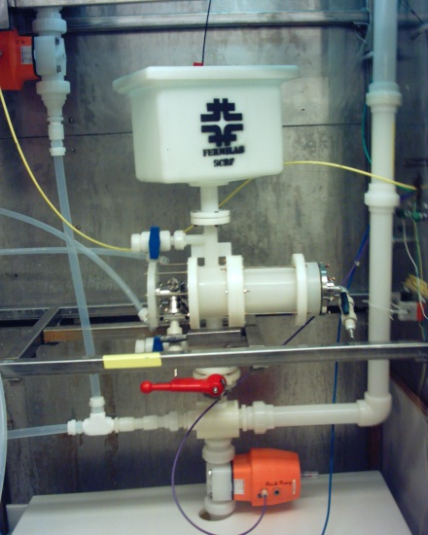
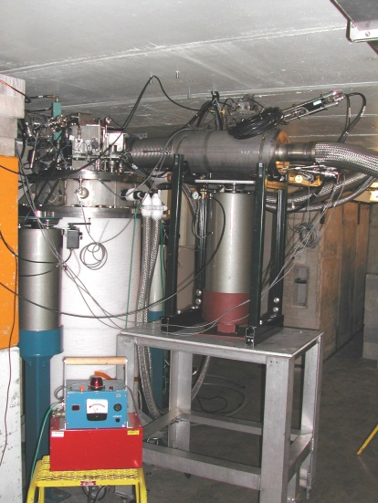
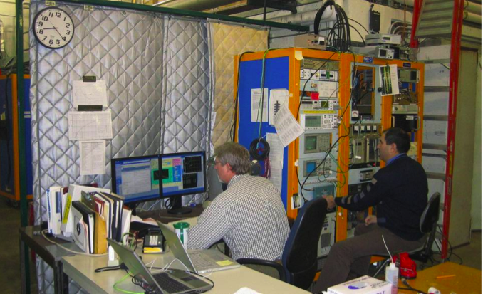
Bare Cavity Processing & Test
Bare 3.9 cavity
Weld
BCP etch
Hi Press Rinse
Vertical test & dewar
Vertical test control area

Slide 23
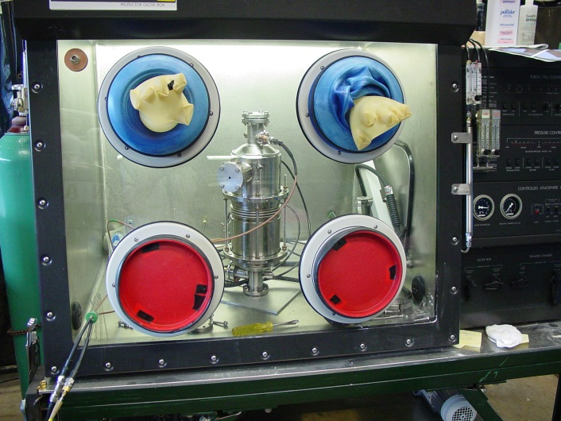
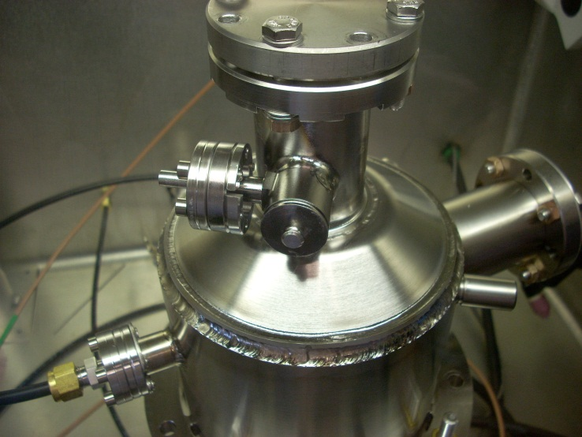

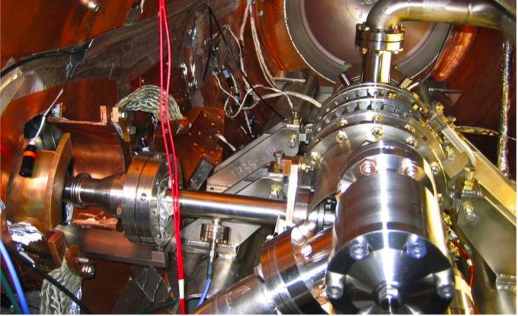
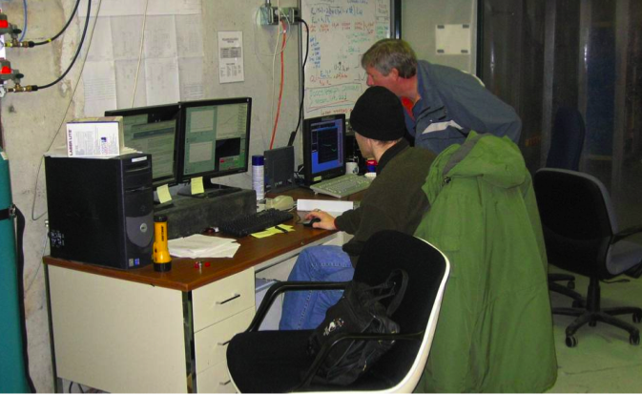
Helium vessel welding, Dressed Cavity to HTS

Slide 24
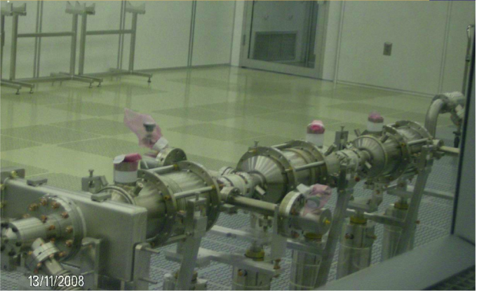
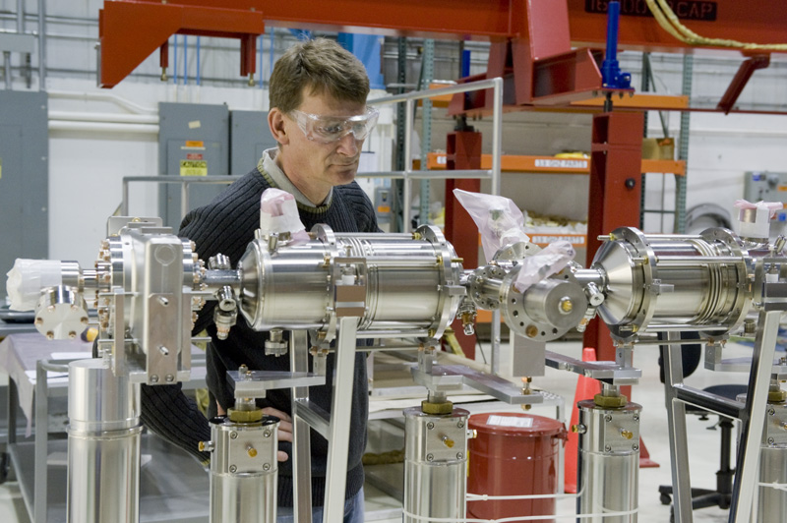
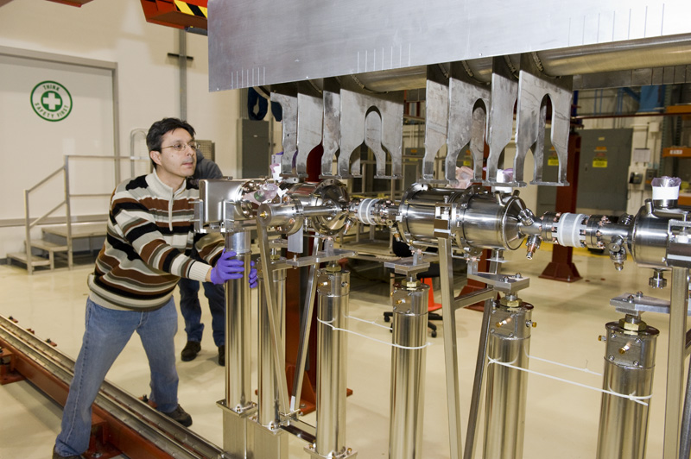
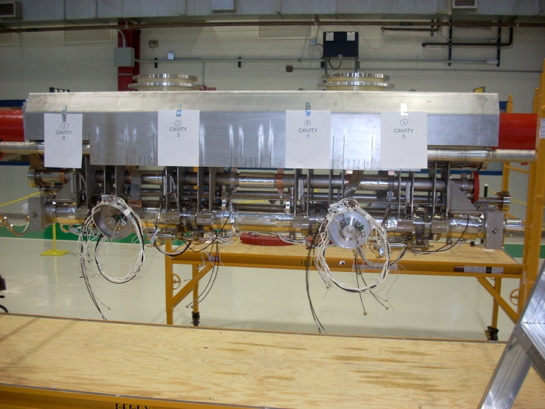
Cavity String to Cold Mass

