Slide 1
Cryomodule Assembly Facility (CAF) at Fermilab Tug Arkan (FNAL) FNAL-LBNL joint meeting on SRF Cavities and Cryomodules March 15, 2012

Slide 2
Outline
Current CAF infrastructure
1.3 GHz Cryomodule Assembly Workflow at Cryomodule Assembly Facility (CAF):
Cavity String Assembly
Cold Mass Assembly
Vacuum Vessel Assembly
Future CAF infrastructure needed for future superconducting radio frequency (SRF) cryomodules assemblies with higher throughput
Summary

Slide 3
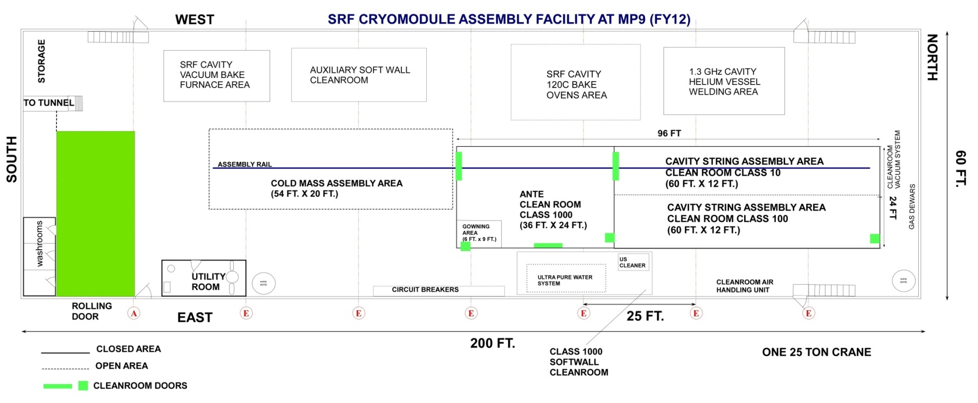
CAF-MP9
CAF-MP9 houses the string assembly clean room, the rail for
string assembly under the clean room extending to the cold
mass assembly area and the cold mass assembly fixture
adjacent to the clean room.

Slide 4
CAF-ICB
CAF-ICB houses the Vacuum Vessel Assembly area
and Final Assembly area including the Big Bertha
Cantilever Fixture.

Slide 5
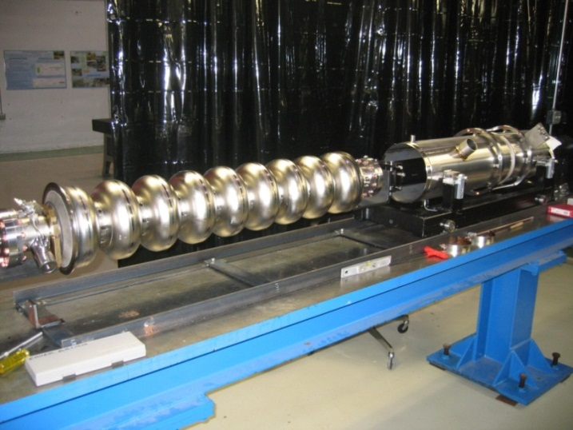
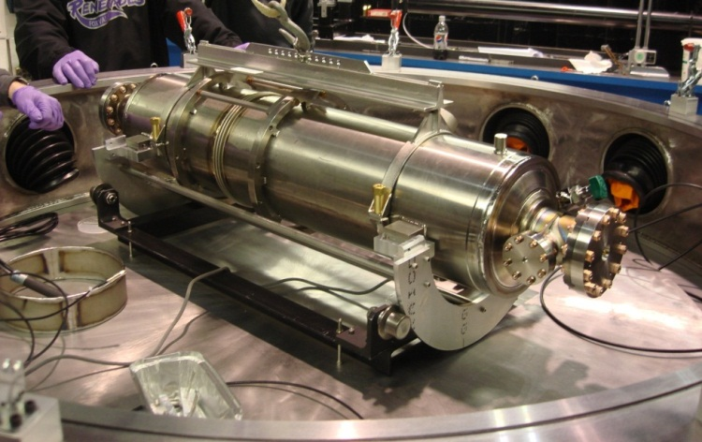
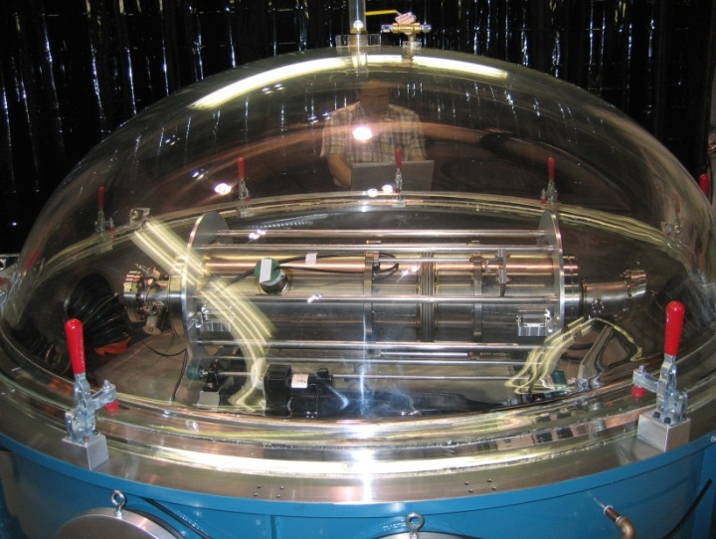
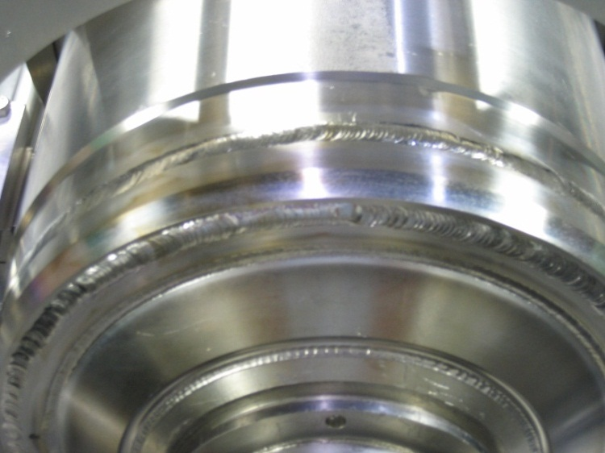
1.3GHz Cavity to Helium Vessel Welding at CAF
1.3 GHz cavities helium vessels are made of Titanium. We buy the helium vessels from an outside vendor. The vessels are built conforming to the ASME pressure vessel code.
The welding of the helium vessel to the bare cavity is done in a glove box (oxygen level less than 10 ppm) by certified Fermilab welders. The cavity welded with the helium vessel has to conform to the ASME pressure vessel code.
Cavity & Helium Vessel on the insertion fixture
Cavity being setup in the glove box
Completed welds
Cavity in the glove box

Slide 6
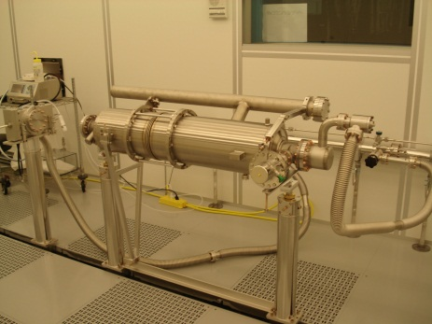
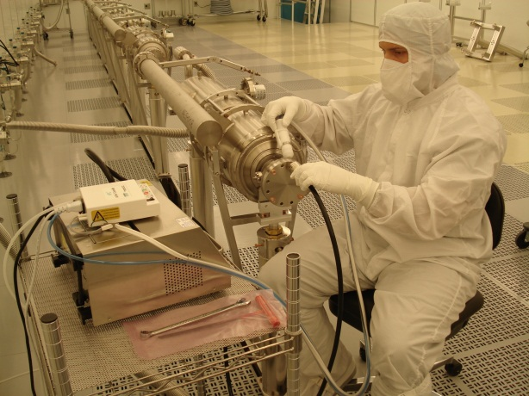
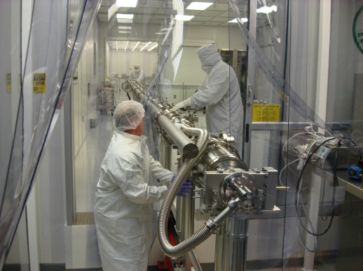
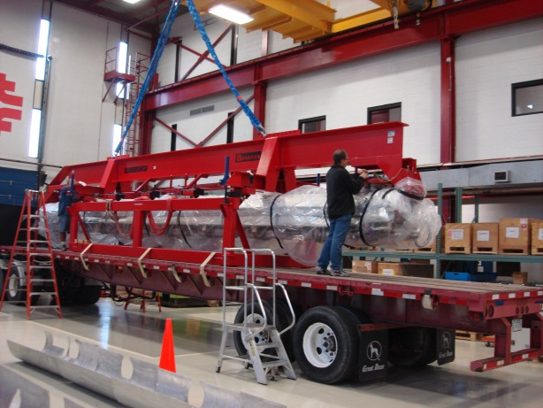
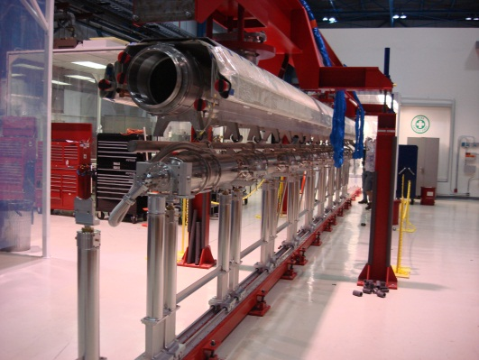
Assembly Workflow @ CAF-MP9
Receive dressed Cavities
Receive peripheral parts
Assemble dressed Cavities to form a String in the Cavity String Assembly Area (Clean Room)
Install String Assembly to Cold Mass in the Cold Mass Assembly Area
Transport the Cold Mass to CAF-ICB

Slide 7
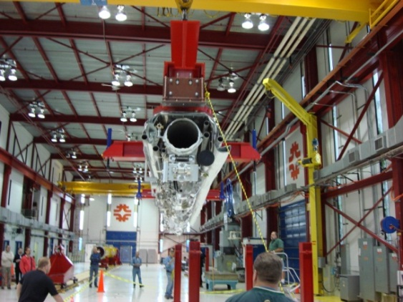
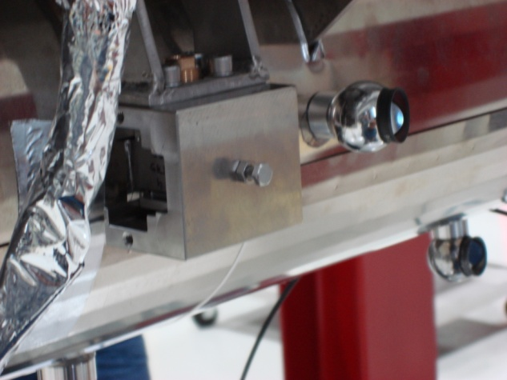
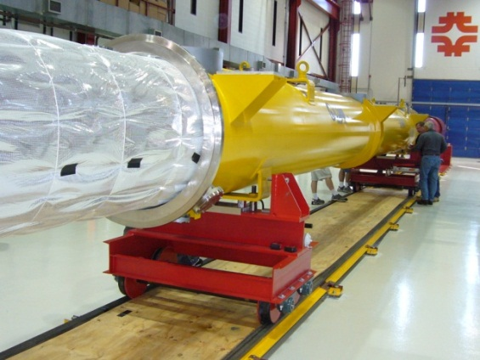
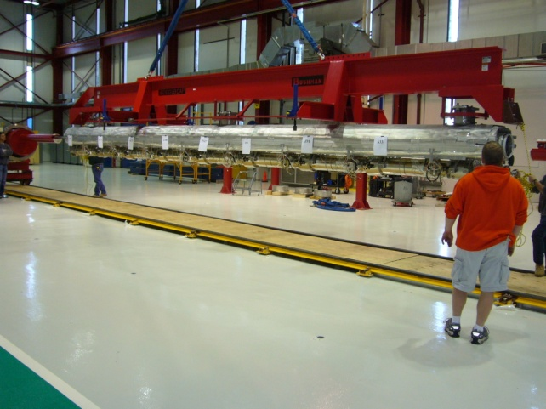
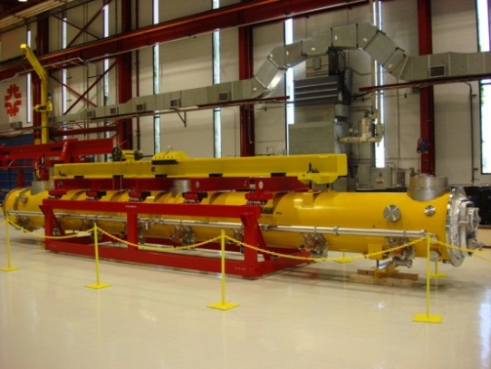
Assembly Workflow @ CAF-ICB
Install the Cold Mass back to the Cold Mass Assembly Fixture in Cold Mass Assembly Area
Align Cavity String to the Cold Mass Support
Install the String assembly with the cold mass into the Vacuum vessel in the Vacuum Vessel Assembly area
Ship Completed Cryomodule to ILCTA-NML for testing

Slide 8
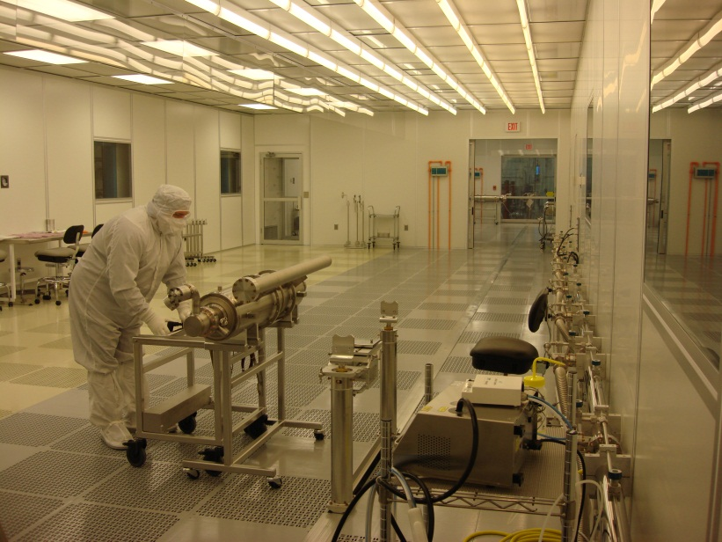
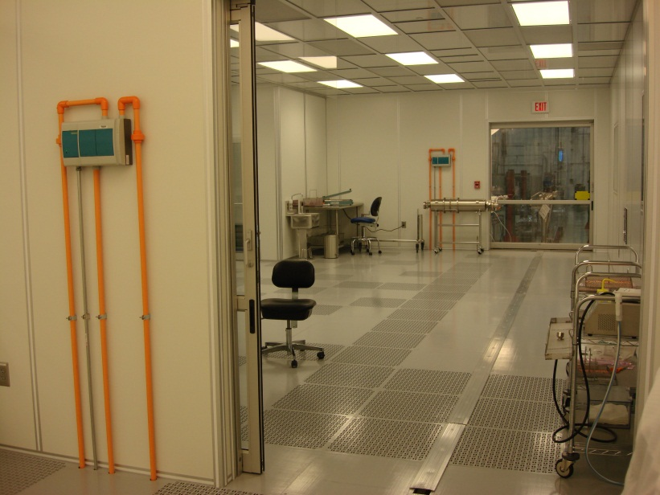
CAF-MP9 Clean Room
Cavity String Assembly Clean Room
A ~2500 square-foot clean room:
Class 1000 ante clean room area:
Preparation of the dressed cavities for transportation into the assembly clean room.
Class 10/100 sluice area
Parts and Fixtures final preparation to enter the Class 10 assembly area.
Class 100 area
Parts and Fixtures preparation for assembly.
Class 10 assembly clean room area:
Where the cavities vacuum is vented to interconnect them with bellows.
Class 100
Class 10
Class 1000
Rail

Slide 9
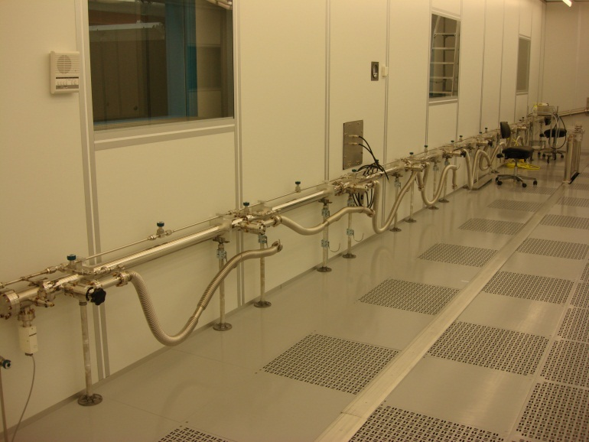
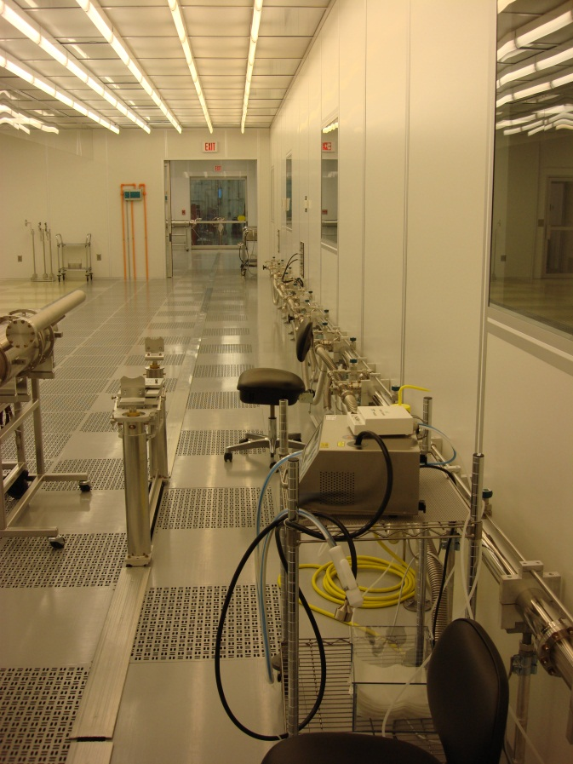
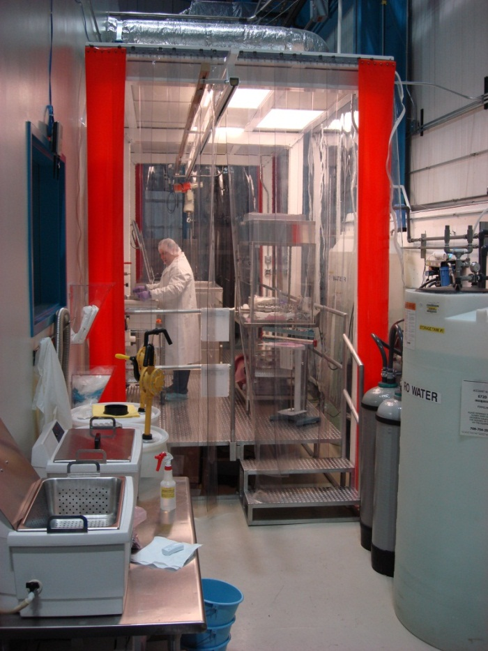
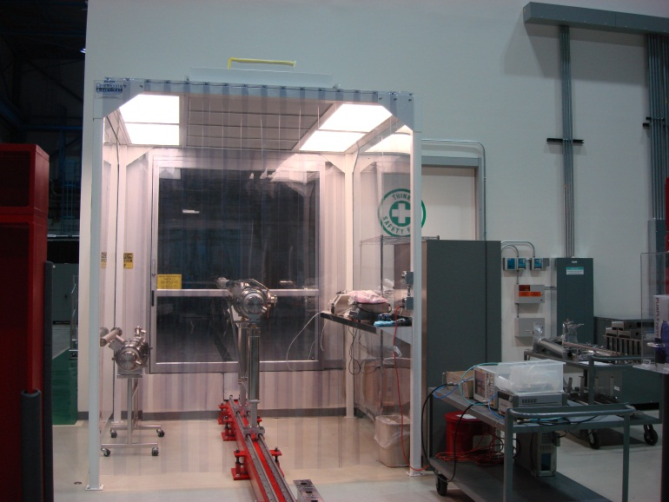
Cleanroom Infrastructure
Components ultra high vacuum (UHV) cleaning cleanroom
Vacuum / Gas Manifold
Class 1000 cleanroom for the dressed/qualified cavity preparation to enter the cleanroom

Slide 10
Cleanroom Highlights
State-of-the-art cleanroom optimized for SRF R&D. Class 10 (0.3 micron size particulate count is less than 10 for a flow sampled in a cubic foot area) cleanroom is required to assemble cavities into a string of them in order to minimize the potential of degrading the individual cavity gradient performance.
CAF cleanroom is fully functional for the SRF R&D. It has been operated and maintained meticulously since it was constructed in 2006.
We have assembled 1.3 GHz pulsed CM1, CM2 and 3.9 GHz module cavity strings in this cleanroom. We have prepared ~twenty-five 1.3 GHz dressed cavities and one SSR1 dressed cavity for the horizontal test.
We have 3 highly trained and experienced cleanroom technicians: The assembly tasks conducted at the CAF cleanroom require extreme care and strict adherence to the cleanroom working protocols.

Slide 11
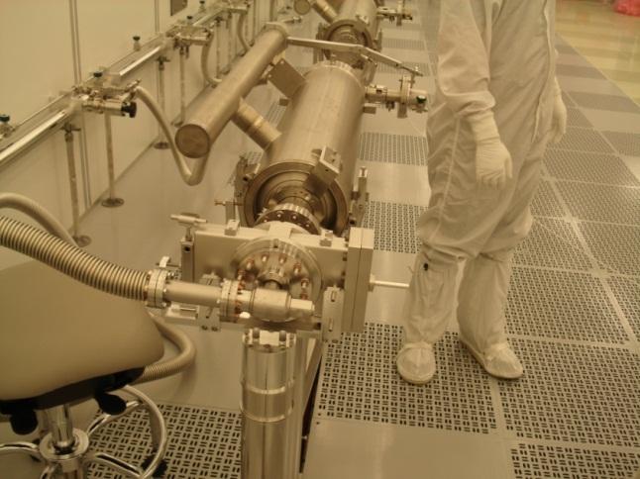
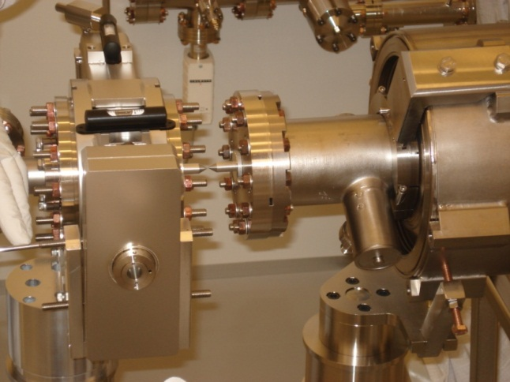
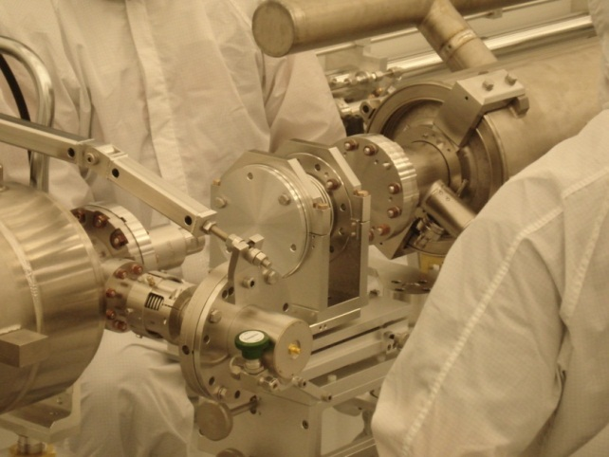
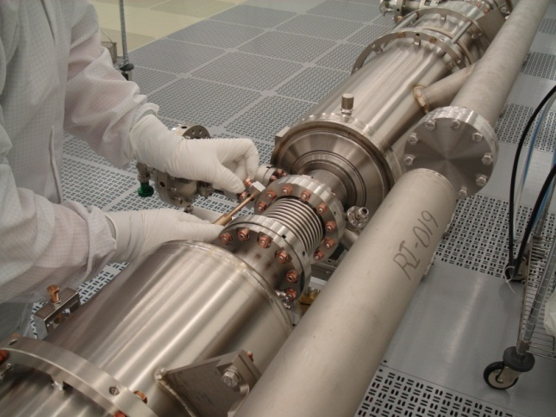
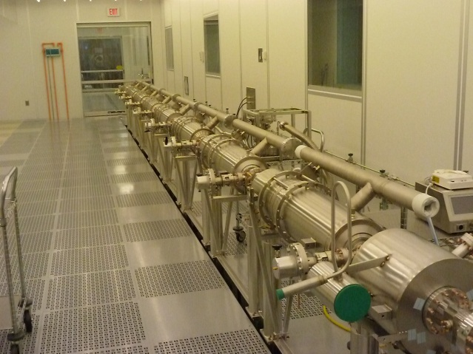
String Assembly
Gate Valve to Cavity #1 Assembly
Cavity to Cavity Assembly with the interconnect bellows (8 cavities interconnected):
Assemble vacuum hose to the cavity. Pump down and Leak check. Backfill
Align the interconnect bellows to the cavity beam pipe flanges and assemble with particulate free flange assembly (PFFA) procedures.
8 cavity string to magnet package assembly

Slide 12
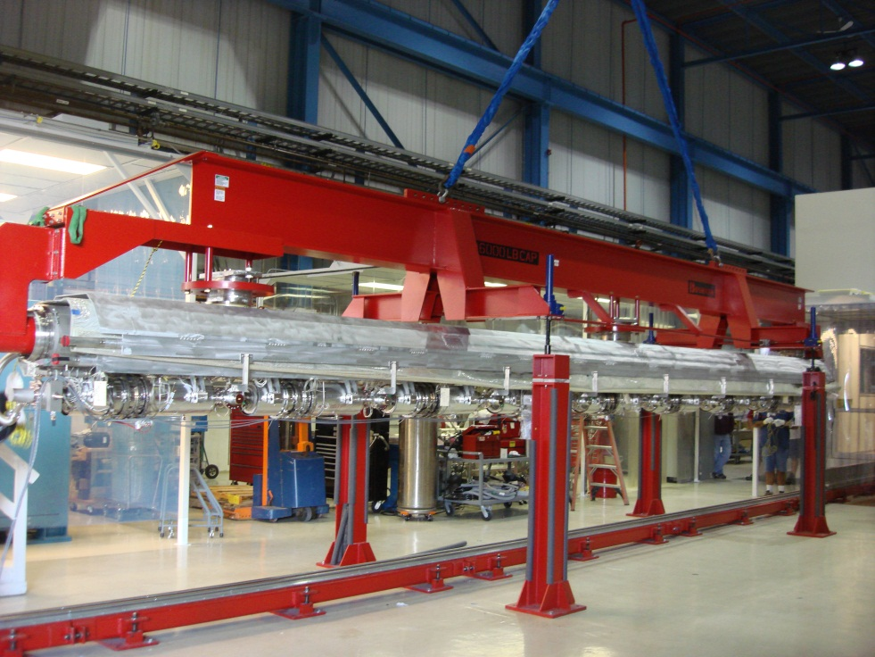
Cold Mass Assembly
Spreader bar fixture is used to support, lower and raise the gas return helium pipe (GRHP) assembly. This 300 mm diam. pipe is also used as a strongback to support the cavity string in the cold mass assembly
String assembly rail is aligned to the center of the spreader bar fixture. Once the cavity string is assembled, it is rolled out of the cleanroom for cold mass assembly

Slide 13
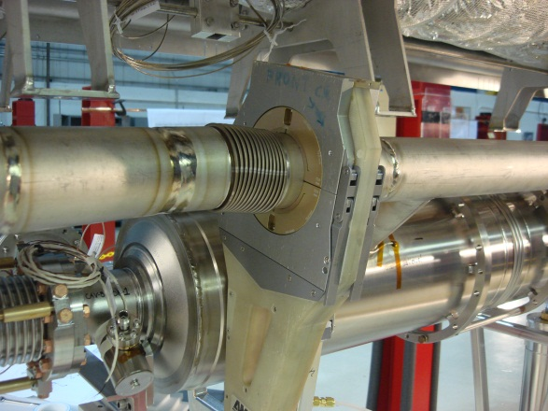
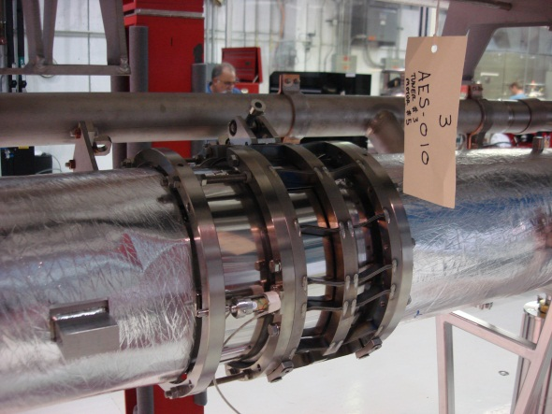
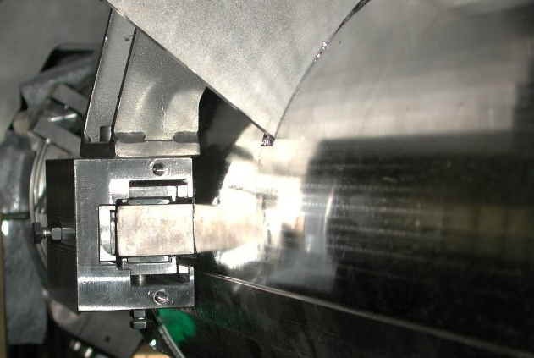
Cold Mass Assembly at CAF-MP9
Work outside of the clean room before the cavity string was lifted off the rail to the GRHP assembly:
2-phase titanium helium pipes & titanium bellows welding (done with an orbital welding machine by certified Fermilab welders with conformance to ASME piping code
Cavity magnetic shields installation
Blade Tuner / Piezo / Tuner Motor installation (extreme care to the cavity frequency conservation for proper tuner performance)
Instrumentation and RF cables installation (experienced electrical techs and RF engineers)
Cavity helium vessel lugs needle bearings and housings installation
Various leak checks / pressure tests of the helium circuit

Slide 14
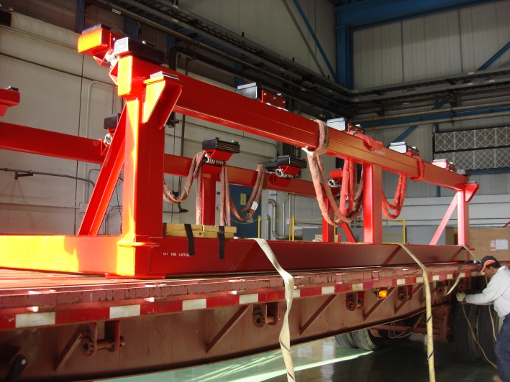
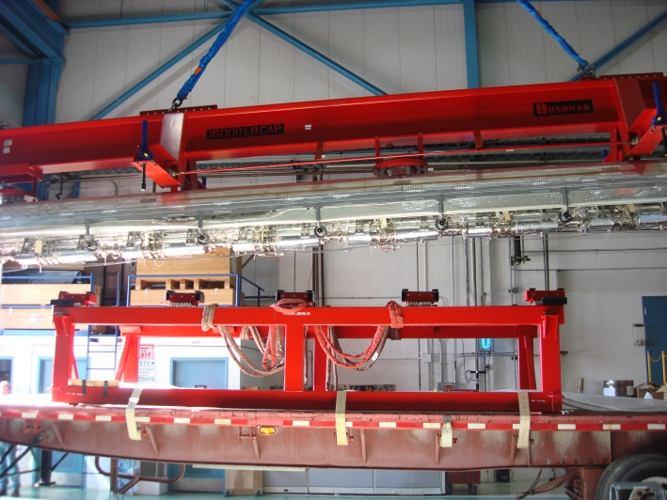
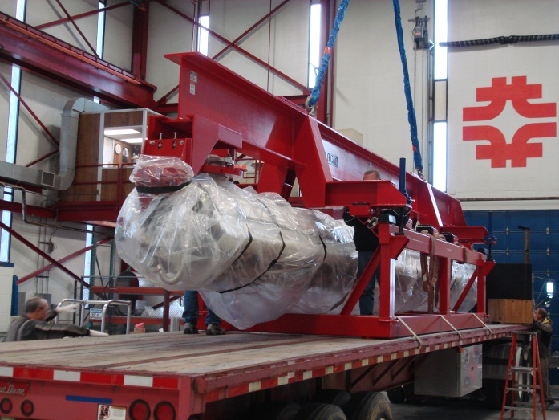
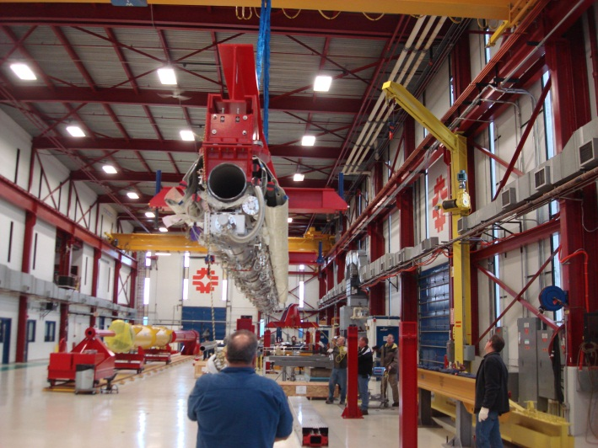
Cold Mass Transport
After the cavity string is picked up off the rail and partially assembled to the GRHP assembly, the partially assembled cold mass is transported to the Vacuum Vessel Assembly Area at CAF-ICB (~5 km from CAF-MP9).

Slide 15
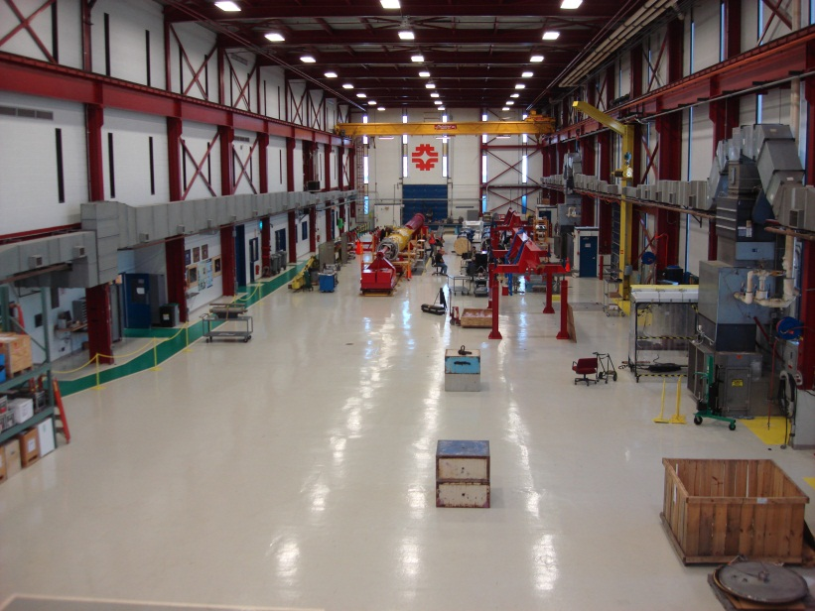
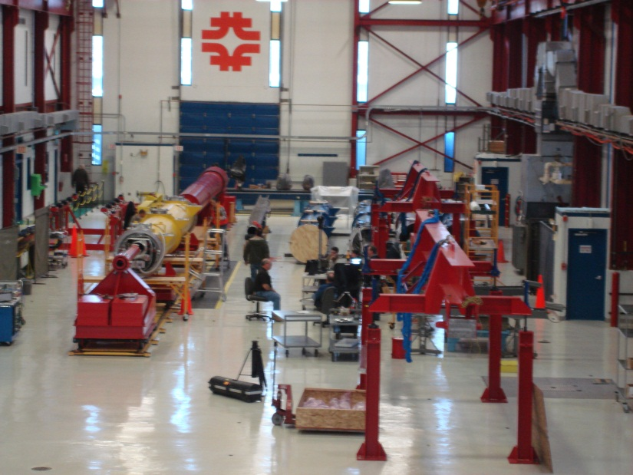
Cold Mass Assembly at CAF-ICB
Assembly Tasks:
Put the cold mass on the 4 support spreader bar fixture
Align cavity string to GRHP to 0.1 mm (laser tracker)
Complete the interconnect magnetic shielding assembly
Complete the coupler heat shields intercepts assembly
Complete cooling straps assembly to the cavities HOM
Complete the harnessing of the instrumentation wires & RF cables
Various electrical checks
Weld the magnet current leads to the magnet instrumentation box
Various leak checks of the helium circuit

Slide 16
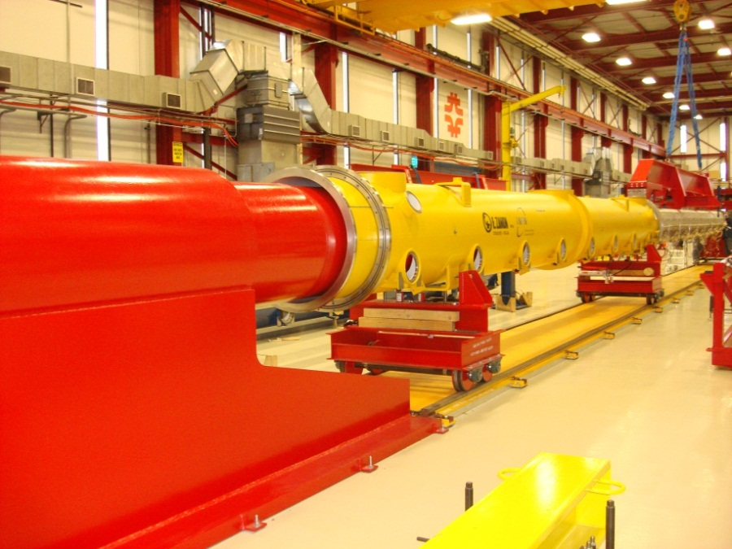
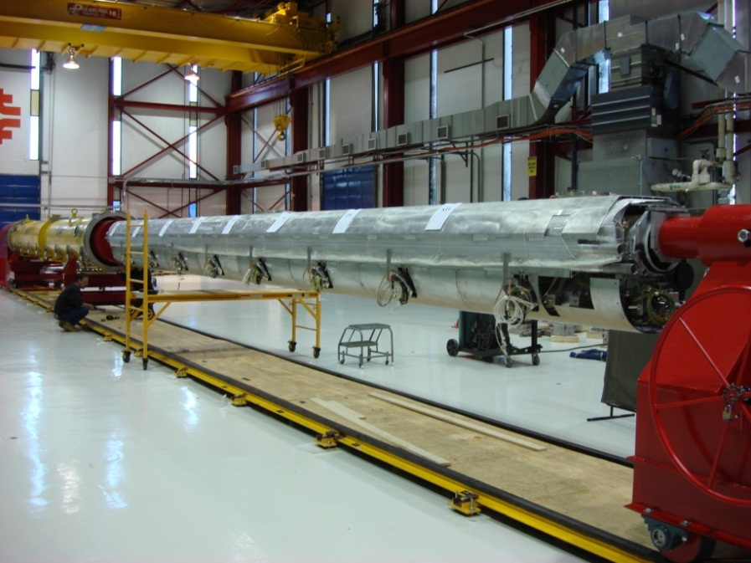
Final Assembly
The assembly fixture used in CAF-ICB is the Vacuum Vessel Assembly fixture aka “Big Bertha”
a cantilever fixture used to support the cold mass for the remainder of the assembly and then slide the vacuum vessel onto the cold mass

Slide 17
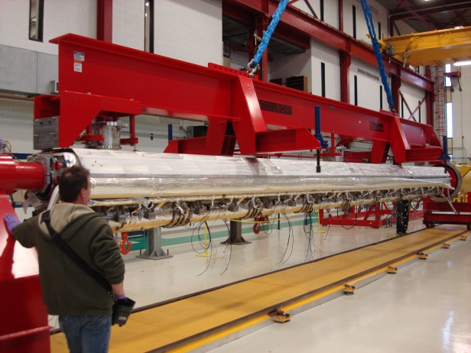
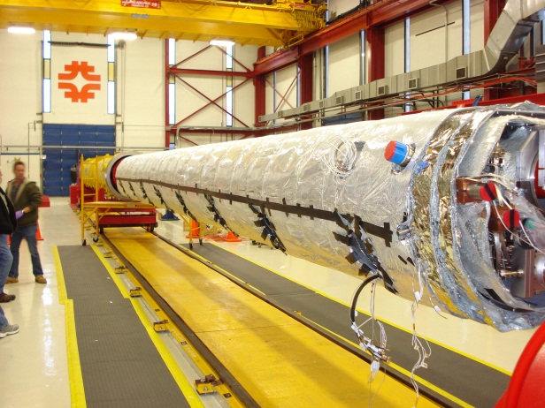
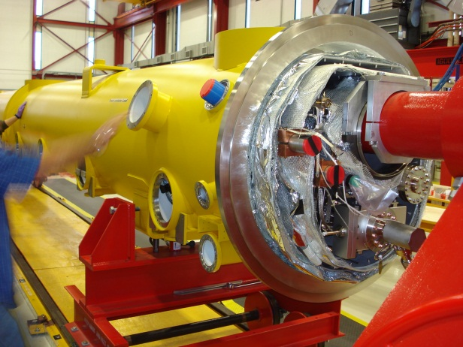
Final Assembly at CAF-ICB
Assembly tasks:
Install and weld lower 5K aluminum shields
Wrap 10 layers of multi layer insulation (MLI)
Install and weld 80K shields
Lay and wrap 30 layers of MLI
Trim insulations around main couplers, magnet and cold mass support posts
Slide vacuum vessel onto the cold mass
Align cold mass to the vacuum vessel (laser tracker)
Install warm part of the main power couplers
Route & terminate instrumentations wires and RF cables to the feedthrough flanges
Install coupler pumping lines
Pump down and leak check insulating vacuum

Slide 18
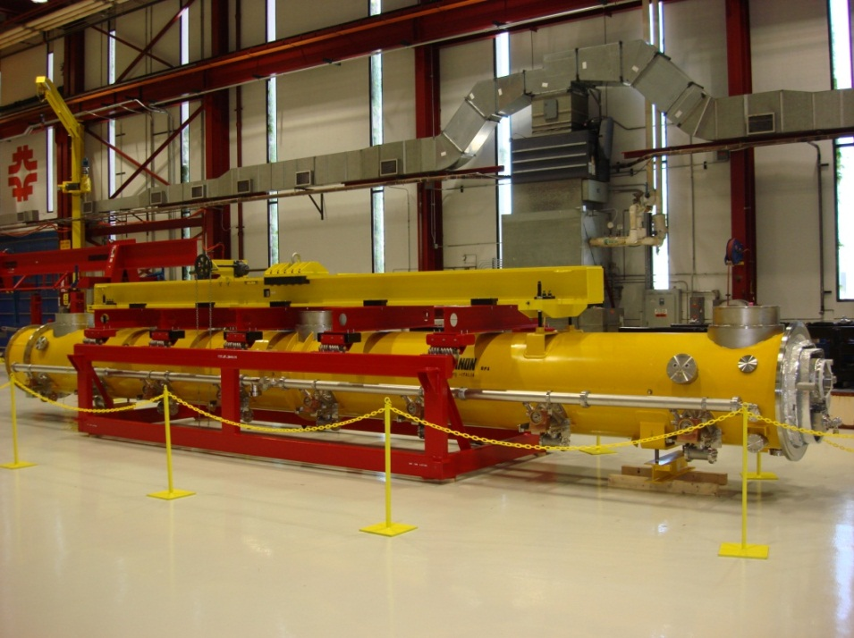
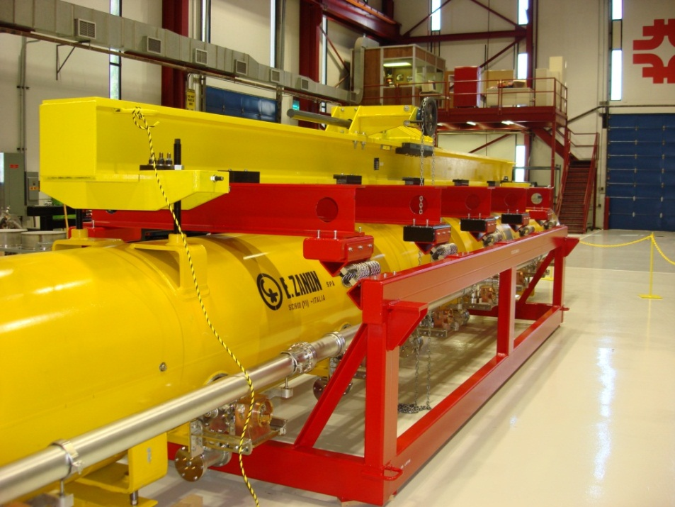
Cryomodule Transport
Fixture to transport completed Cryomodule from CAF-ICB to the ILCTA-NML

Slide 19
Cleanroom throughput
CAF-MP9 cleanroom infrastructure is setup with a throughput goal of one 1.3 GHz eight cavities string assembly per 13 days (~3 weeks) with the assumption day all the needed cavities, parts, assembly hardware are pre-cleaned and ready to be used in the Class 10 cleanroom
To increase the throughput:
Add a second team of cleanroom technicians (3 techs)
Double / modify the current vacuum/gas system for the cleanroom
Modify the rail system in the cleanroom so that cavity support fixture sliding bearings can be loaded onto the rail in Class 10 cleanroom
If all the above 3 steps are done; the assembly time can be cut to 2 weeks per string with a continuous (finish one string, roll out from the cleanroom, finish the second one, roll out of the cleanroom and so on) workflow.
In order to ramp out the CAF cleanroom throughput, we need to hire good background mechanical techs who are willing to learn the cleanroom skills and train them at least 1.5 year before they are fully qualified to work on SRF components.

Slide 20
1.3 GHz Cold Mass Assembly Throughput - I
14 days
13 days
9 days
14 days
8 days

Slide 21
1.3 GHz Cold Mass Assembly Throughput - II
Total days needed to assemble 1.3 GHz pulsed cryomodules = 45 days
CAF cold mass assembly group has 2 fully trained experienced technicians and 1 trained technician from another group helps CAF cold mass assembly team during module assembly. Total mechanical techs working on the cold mass assembly = 3
In order to increase the throughput to 1 module assembly per 6 weeks:
2 weeks for string assembly in the cleanroom
4 weeks (20 days) for cold mass assembly outside of the cleanroom
In order to reduce the 45 days to 20 days:
increase the CAF cold mass assembly group technician count to 6. The training time for a cold mass assembly technician is less than a cleanroom technician. It took approx. 6 months to train the current CAF cold mass assembly technicians.
The assumption is that both the CAF cold mass assembly areas and CAF cleanroom are simultaneously being used in order to keep up with the throughput.
Taking into account that certain tasks are not effort driven and the duration of the task cannot be reduced by adding more technician resources and also taking some riskier tasks can take more time that estimated duration, duplicate cold mass assembly fixtures and areas were already setup at CAF facilities.

Slide 22
Summary
CAF infrastructure is currently fully functional for the 1.3 GHz pulsed cryomodules assembly
We have assembled two 1.3 GHz (CM1, CM2) and one 3.9 GHz cryomodules at CAF
We have assembly travelers, quality assurance procedures well established and used on the production floor
We have a team of technicians (cleanroom, mechanical, electrical), engineers (mechanical, electrical, RF) and scientists fully qualified and experienced in SRF components assembly & quality assurance.
Cavity dressing/qualification and components preparation for cryomodule assembly will require some automation in order to increase the throughput
Cryomodule assembly higher throughput requirements will dictate hiring and training technician resources. The training time required for the SRF assemblies is long, especially for the cleanroom work

