Slide 1
CW cavity design Timergali Khabiboulline (FNAL) FNAL-LBNL joint meeting on SRF Cavities and Cryomodules March 15, 2012

Slide 2
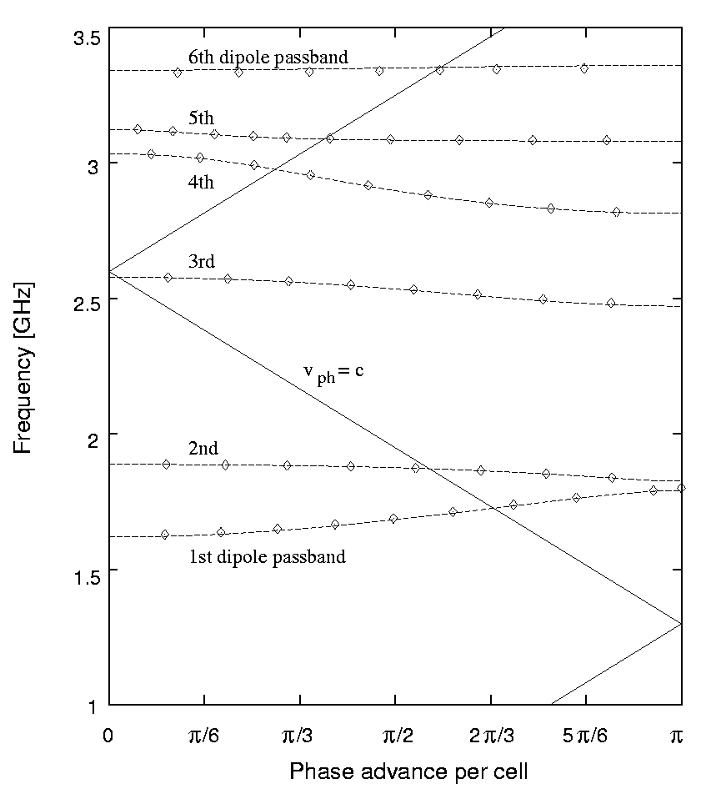
ILC cavity properties
Parameters | ILC | CW
Frequency, MHz | 1300 | 1300
Current, mA | 9 | 1
Repetition rate | 5 | -
Acc. Gradient (β=1), MV/m | 31.5 | 15-25
Q external, x10⁶ | 3.5 | 25-15
P_{RF} /cavity, kW | 300 | 16-26
Cavity Q, x10¹⁰ | 1 | 1.5
Average Cryo loss, W | 0.5 | 15-42
Filling time, ms | 0.6 | 4.3-2.5
RF pulse length, ms | 1.6 | CW
Aver. power/coupler, kW | 2.5 | 16-26
Dressed dF/dP, Hz/mBar | 120 | 120
Lorenz force detuning, Hz | -730 | -160-460
HOM power, W | 2 | 12.5
Dipole pass bands
dipole
“pass bands”
Cavity can operate in CW regime. Critical points:
Much higher cryogenic load.
Power coupler can operate up to 4 kW only. New design should be developed.
HOM power is higher. New design is needed.
Accelerating mode

Slide 3
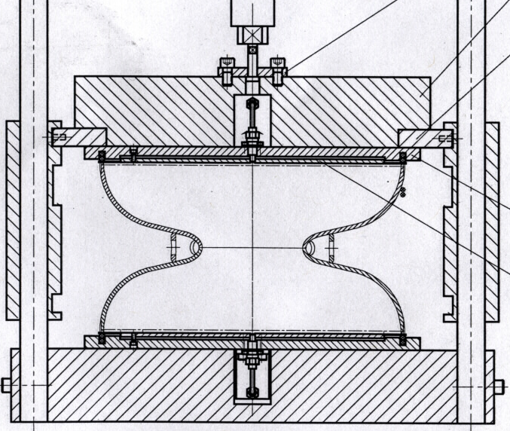
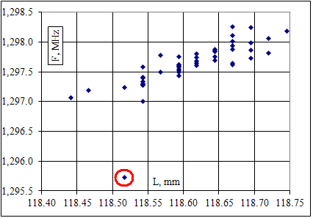
Cavity production steps
Cavity production steps:
Inspection of Nb RRR>250 blanks like eddy current scanning.
Deep drawing of half cells and trimming iris and equator area with extra length for tuning and welding shrinkage compensation. No extra length for a tuning in mid cells. Visual inspection
Frequency and length measurements. Sensitivity of the frequency to extra length is 14 MHz/mm at iris and -55 MH/mm at equator.
EB welding of two half cells at iris to form dumbbell. Partial penetration welding from both sides. If pass visual inspection:
Frequency and length measurements of the dumbbells. Both mode frequencies F₀ and F_{π} measured 3 times: 1) without perturbation F₀ and F₁, 2) with perturbation in 1st half cell F₀₁ and F₁₁ 3) with perturbation in 2nd half cell F₀₂ and F₁₂. Difference of the frequencies of two half cells can be calculated from these data:
dF=F₂-F₁=(F₀₁ - F₁₁ +F₁₂ –F₀₂)/(F₀₁ +F₁₁- F₀₂ -F₁₂))*k
Trimming calculations:
Equator trimming
Equator welding
Mechanical and RF QC of the new cavity.

Slide 4
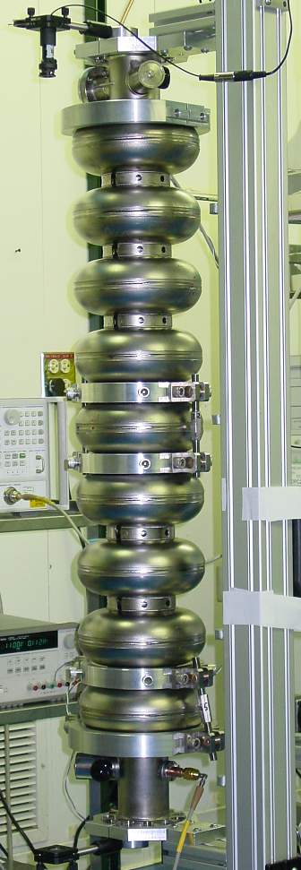
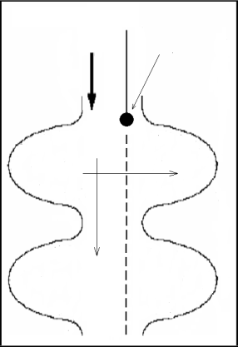
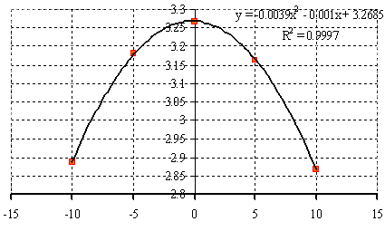
Cavity RF inspection and tuning
1. Incoming RF inspection is including:
- Frequency spectrum measurements,
Bead pull of 9 modes of 1st monopole pass band,
- Cavity alignment (cell centers) measurements based on bead-pull,
- HOM mode spectrum measurements.
- Cavity cell centers measurements technique based on bead-pull.
2. Operating mode frequency, field flatness and alignment tuning take place after high temperature heat treatment of the cavity. Work hardening included to increase larger elastic range of the cavity.
3. Additional RF QC if necessary. For example after extra EP/BCP/CBP.
“bead”
X
Z
Amplitude
Coordinate at axis X, mm

Slide 5
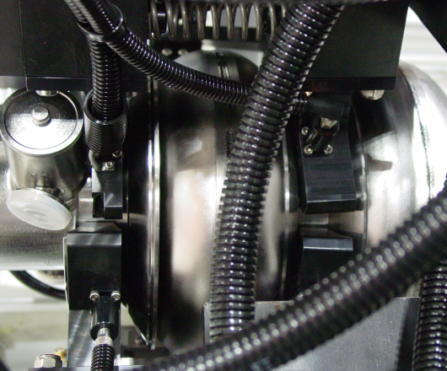
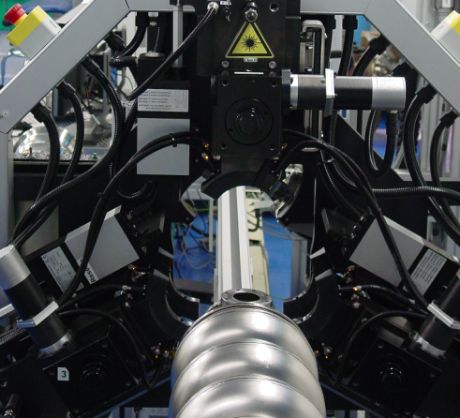
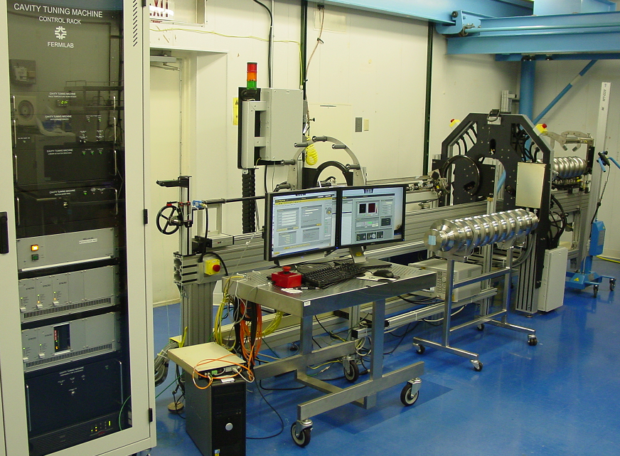
ILC/XFEL cavity RF Tuning Machine
Four Cavity Tuning Machines were built under FNAL/DESY/KEK collaboration. Mechanical components design and production made by DESY. Electronics and software developed by FNAL. Commissioning of all machines done in 2010.
High level of automation Labview based software control system allow to finish RF QC, frequency/field flatness tuning and alignment of the cavity in average of 4 hours.
Two Machines shipped to XFEL cavity production companies.
Operation of the Machine can be done in 24/7 regime.

Slide 6
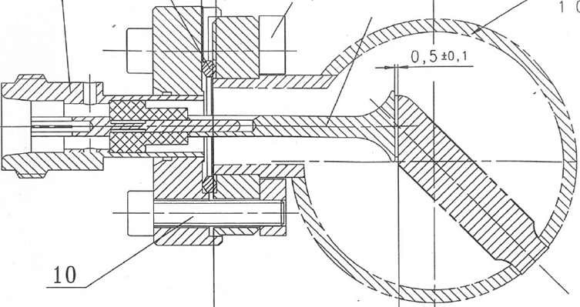
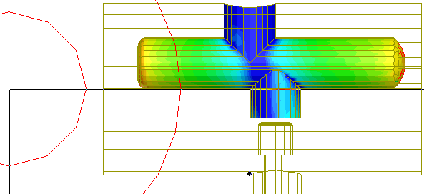
ILC cavity HOM coupler
ILC/TESLA cavity HOM coupler was developed for pulsed operation with duty factor of <1%. In CW regime ILC cavity has several issues:
Average power dissipation on HOM coupler walls can cause quenching (thermal breakdown).
Superconducting Nb tip of the HOM antenna is located in high magnetic field area. Cooling of the tip is weak and antenna tip quenches at Eacc>10 MV/m even with Sapphire insulator feed-through. New design of HOM coupler should consider moving antenna tip away from high magnetic field.
Cooling of the cables should be improved. Larger diameter cables will help.

Slide 7
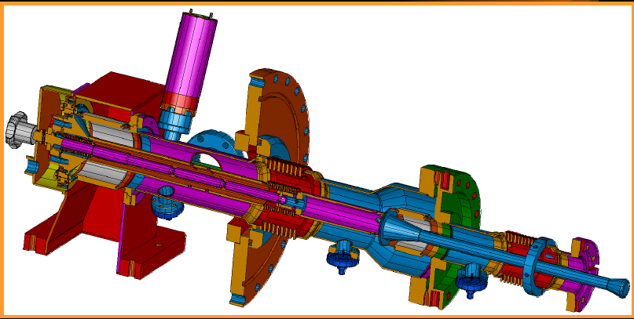
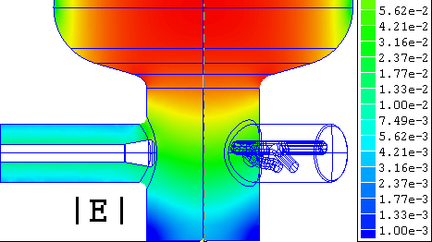
ILC cavity power coupler
ILC cavity power coupler is TTF-III design manufactured by CPI.
It can operate up to 500 kW in pulsed regime with low duty factor.
Maximum average power is 4 kW and limited by overheating of the central conductor bellows.
Coupler has two vacuum ceramic windows for improved reliability of ILC accelerator.
Adjustable coupler. Coupling tuning range is 10 dB.
Has many multipactoring levels which can be proceed away in 20-40 hours.
These couplers are working in DESY (FLASH) and tested in Fermilab (CM1)

Slide 8
ILC cavity power coupler
ILC coupler thermal analysis at 15 kW of average power. Weak point is overheating of the bellows of central conductor due to RF losses.
Copper coating

Slide 9
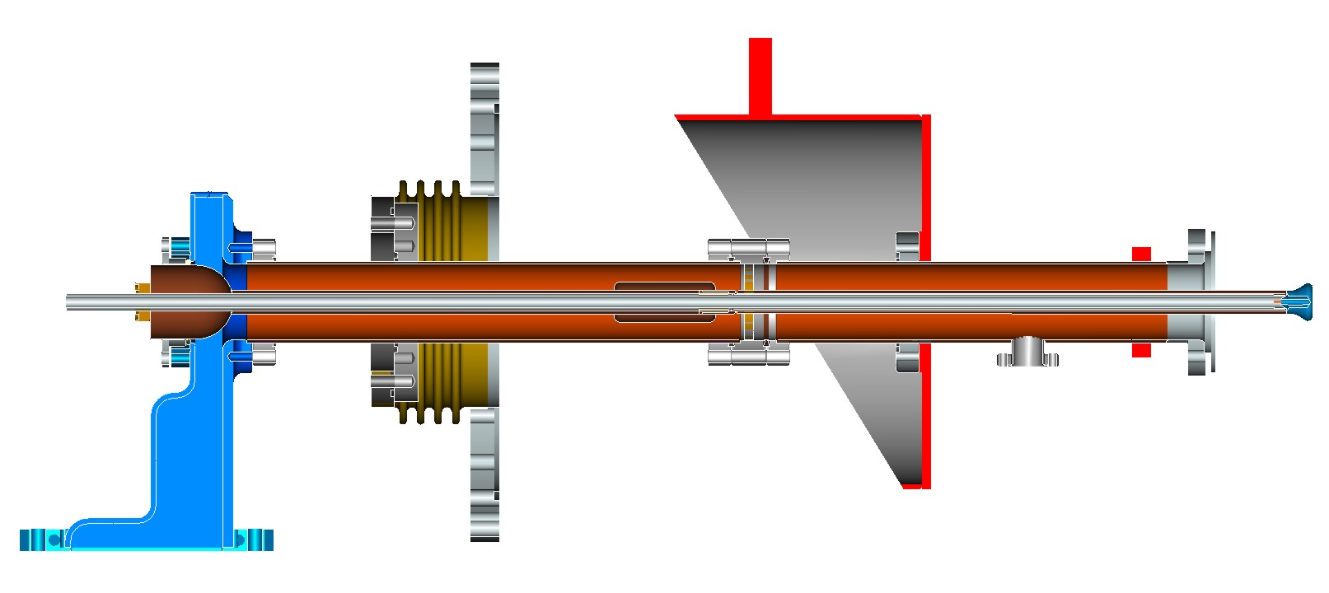
1.3 GHz CW power coupler proposal (S. Kazakov).
Design CW power 30 kW.
Pass-band = 105 MHz (S11 < 0.1).
One ceramic room temperature vacuum window, fixed coupling.
Room temperature air cooled central conductor , 10 μm copper plated outer conductor.
Pulse power (breakdown in air) maximum 1.5MW travelling wave.
Multifactor threshold > 40 kW.

Slide 10
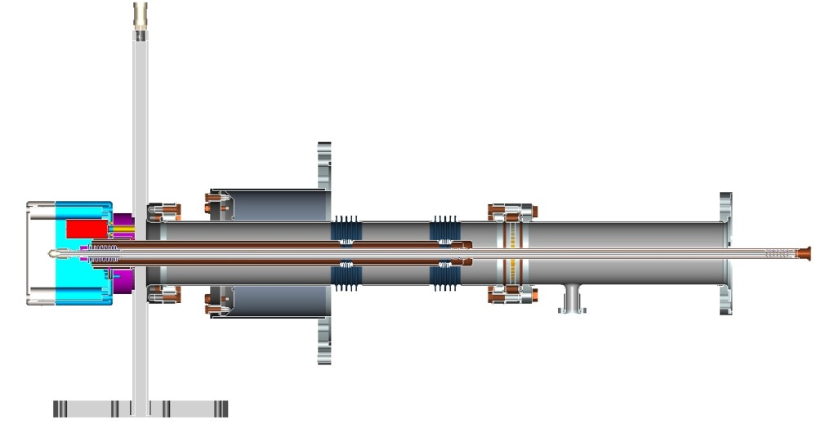
650 MHz CW cavity power coupler.
Design CW power 30kW, maximum power 120 kW
Bandwidth (s11 <0.1) 70 MHz.
One ceramic vacuum window, fixed coupling.
Room temperature central conductor, 10 μm copper plated outer conductor.
Pulse power (breakdown in air) maximum 1.1MW.
Multifactor threshold > 250 kW SW (>1MW TW) at 650 MHz.

Slide 11
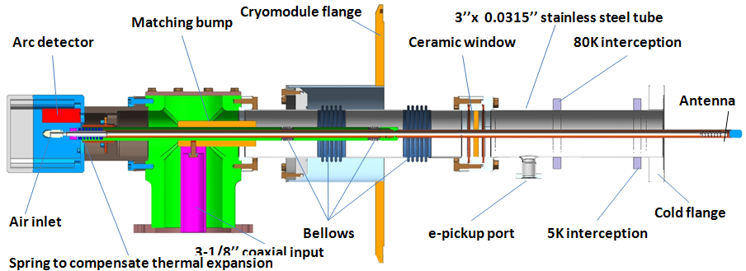
325 MHz CW cavity power coupler.
Design CW power 6kW.
One ceramic vacuum window, fixed coupling.
With air cooling, copper plated vacuum outer conductor, copper-bronze air. outer conductor it can sustain >30 kW.
Pulse power (breakdown in air) ~ 1MW.
Multifactor threshold > 6 kW SW (>25kW TW) at 325 MHz.
Pass-band (S11 < -20dB) ~ 50 MHz.

Slide 12
Conclusions
ILC/TESLA cavity can operate in CW regime at lower accelerating gradients. End assembly of the cavity is limiting factor for performance at higher gradients.
Higher cryogenic losses may require new Helium vessel.
Current ILC cavity power coupler is not suitable for CW power level above 4 kW.
Fermilab has experience designing of power couplers up to 30 kW
HOM coupler need to be modified.
Improve cooling HOM coupler.
Reduce RF losses on HOM coupler antenna tip.

