Slide 1
1.3 GHz Cavity/Cryomodule Performance
Camille M. Ginsburg (FNAL)
FNAL-LBNL joint meeting on SRF Cavities and Cryomodules
March 15, 2012

Slide 2
1.3 GHz cavity and cryomodule activity
SRF Program is guided by projects, but operates separately
Cavity processing, testing, and preparation for cryomodules
  Activities
    Cavity inspection, surface processing, test w/diagnostics
    Cavity dressing, additional processing and test w/diag.
  Goals
    Reduce cost, improve reliability and repeatability
    Develop new US cavity vendors
    Achieve ILC gradient&Q₀ (E_{acc}>35 MV/m, Q₀ >0.8E10) [VT]
    Achieve PrX gradient&Q₀ (E_{acc}>25 MV/m, Q₀ >1E10)
    Maximize Q₀ at moderate gradients (15<E_{acc}<20 MV/m) for PrX
Construction of cryomodules for NML
  Operation of 1.3 GHz cryomodules in NML
    Study cavity performance from initial qualification to CM operation

Slide 3
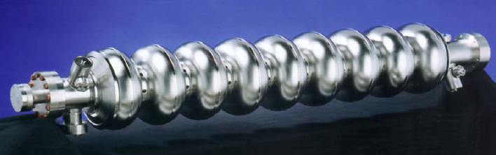
ILC 1.3 GHz SRF Cavities
e⁻ e⁺
Two 11-km linacs, one for electrons and one for positrons accelerate from injected energy of 15 GeV to the final beam energy of 250 GeV
~16000 1.3 GHz superconducting RF cavities, based on TESLA design, operating in pulsed mode
Qualification test spec: E_{acc}>35 MV/m, Q₀ >0.8E10
Operational spec: E_{acc}>31.5 MV/m, Q₀ >1E10
ILC Reference Design Report, August 2007
http://www.linearcollider.org/cms/?pid=1000437
Notes:
This design information is from the ILC Reference Design Report which was released in August 2007.
#cavities=2*[(235000 MeV*1.038m)/(31.5 MeV/m/cavity)=15488

Slide 4
Project X Linac SRF Cavities
ILC
H⁻
β=0.11
β=0.22
β=0.4
β=0.61
β=0.9
β=1.0
CW
Pulsed
162.5 MHz
2.1-10 MeV
325 MHz
10-160 MeV
650 MHz
0.16-3 GeV
1.3 GHz
3-8 GeV
Section | Freq | Energy (MeV) | Cav/mag/CM | Type
HWR (β_{G}=0.11) | 162.5 | 2.1-10 | 9 /6/1 | Half Wave, solenoid
SSR1 (β_{G}=0.22) | 325 | 10-42 | 16/8/ 2 | Single Spoke, solenoid
SSR2 (β_{G}=0.47) | 325 | 42-160 | 36/20/4 | Single Spoke, solenoid
LB 650 (β_{G}=0.61) | 650 | 160-460 | 42 /14/7 | 5-cell elliptical, doublet
HB 650 (β_{G}=0.9) | 650 | 460-3000 | 152/19/19 | 5-cell elliptical, doublet
ILC 1.3 (β_{G}=1.0) | 1300 | 3000-8000 | 224 /28 /28 | 9-cell elliptical, quad
1.3 GHz program: supplies 224 3-8 GeV section cavities
Operational performance specification: E_{acc} =25 MV/m, Q₀=1E10

Slide 5
ILC Production Yield Plot: Method
Spec in vertical test: (E_{acc}>35 MV/m, Q₀ >0.8E10)
Cavity from vendors who have manufactured a cavity that has surpassed 35 MV/m in vertical test:
  ACCEL/RI or ZANON or (AES SN>=5) or (MHI SN>=12)
Fine-grain cavity
Use the first successful (= no system problem) test
Standard EP processing: no BCP, no experimental processes
(Ignore test limitation)
Second pass
  if (Eacc(1st successful test)<35 MV/m) then
    if (2nd successful test exists) then
      plot 2nd test gradient
    else
      plot nothing [assume 2nd test didn’t happen yet]
    endif
  else
    plot 1st successful test gradient
  endif
  44 cavities for 1st pass, 33 cavities for 2nd pass for LCWS2011 (Granada, Sep. 2011)
First pass
Second pass

Slide 6
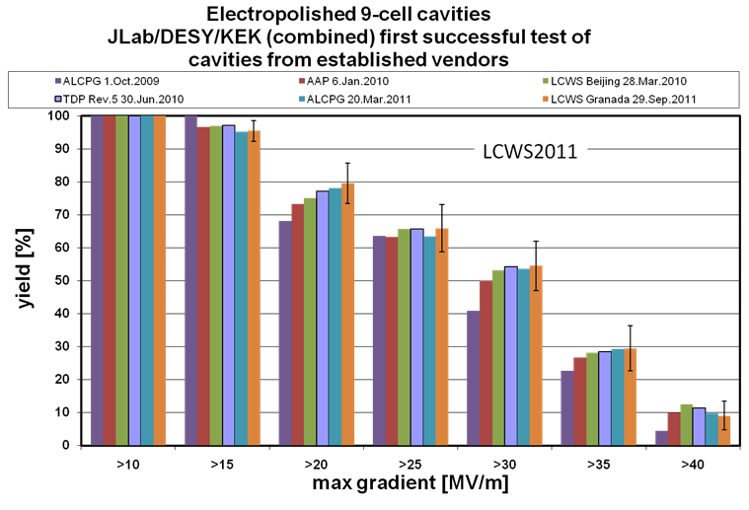
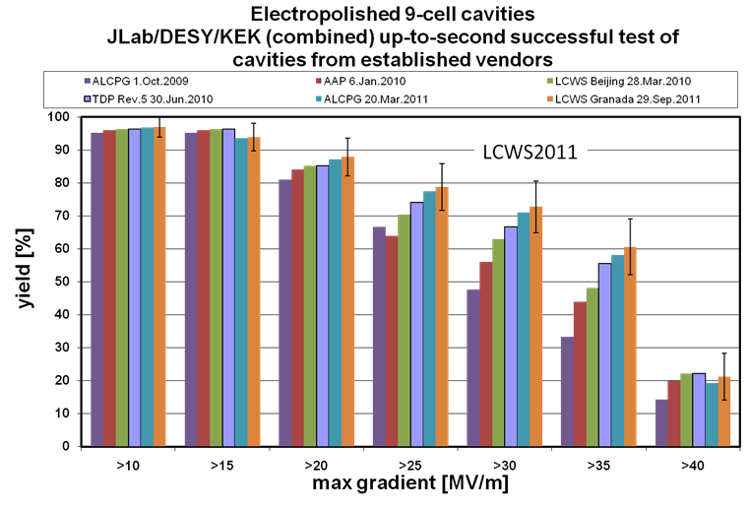
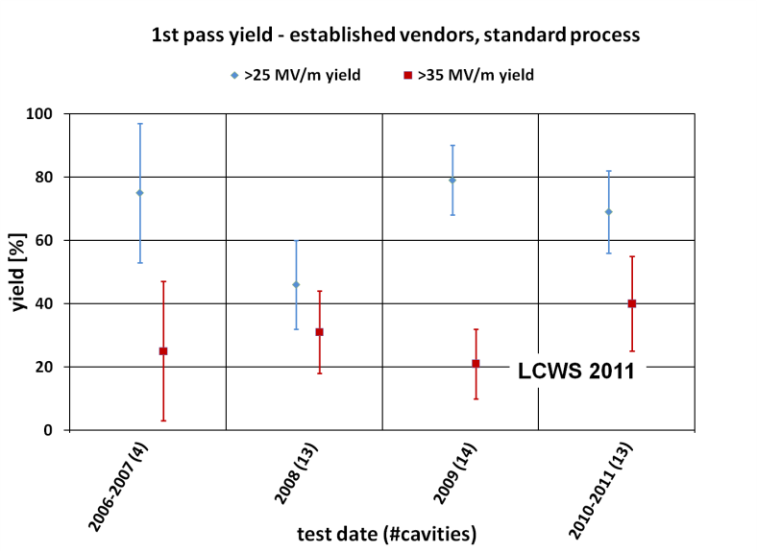
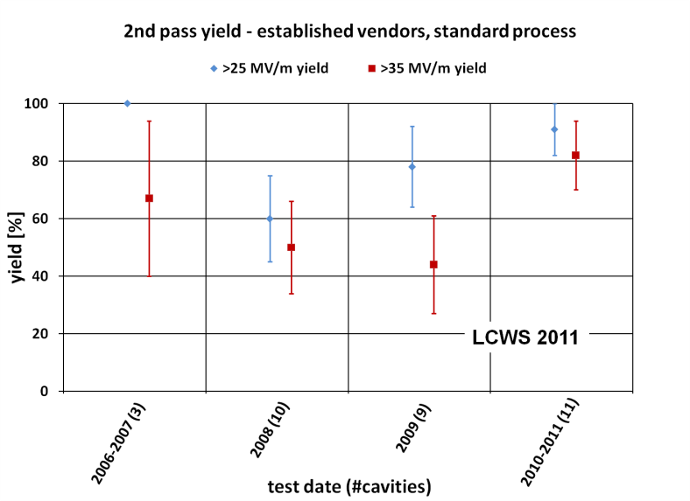
Cavity Performance Benchmark
International Workshop on Linear Colliders, Granada, Spain, September 29, 2011
Presented by K. Yokoya
http://ilcagenda.linearcollider.org/getFile.py/access?contribId=18&sessionId=1&resId=0&materialId=slides&confId=5134
2nd pass
1st pass
International cavities from established vendors using established processes
1st pass yield for >25 MV/m for integrated sample is (66 +- 7)%
for 2010-2011 alone is (69 +- 13)%

Slide 7
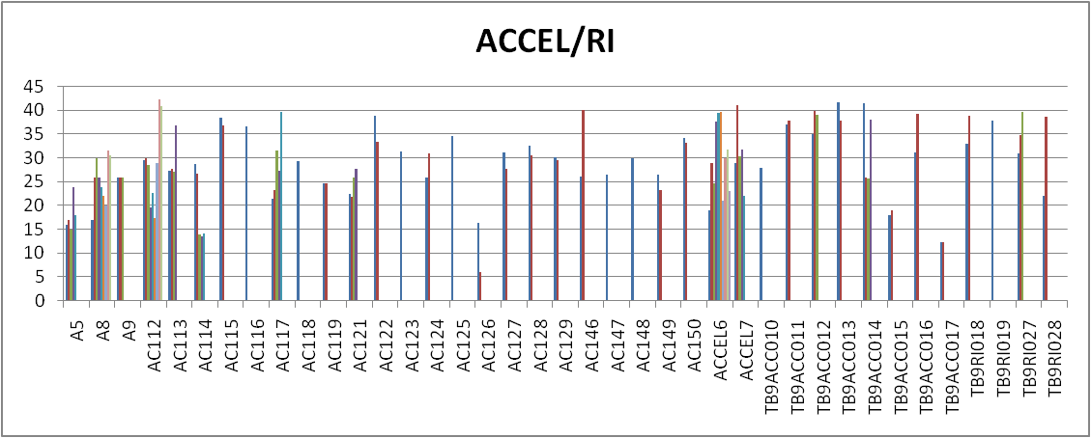
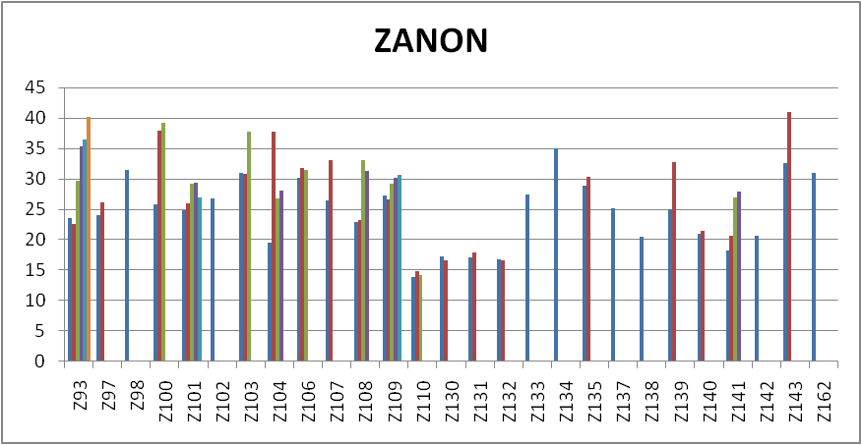
ILC Company Progress: ACCEL/RI and ZANON
25 MV/m
Established vendors
25 MV/m

Slide 8
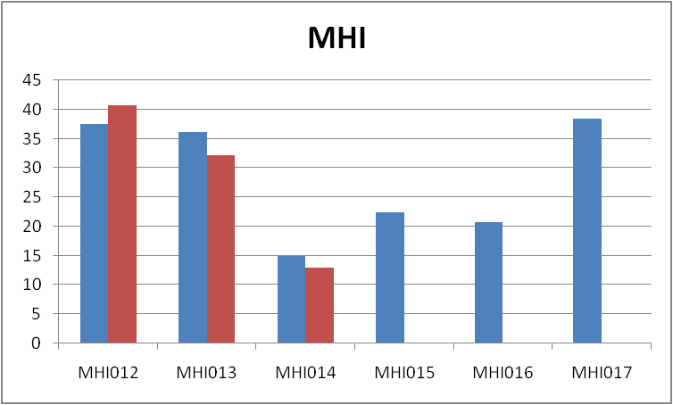
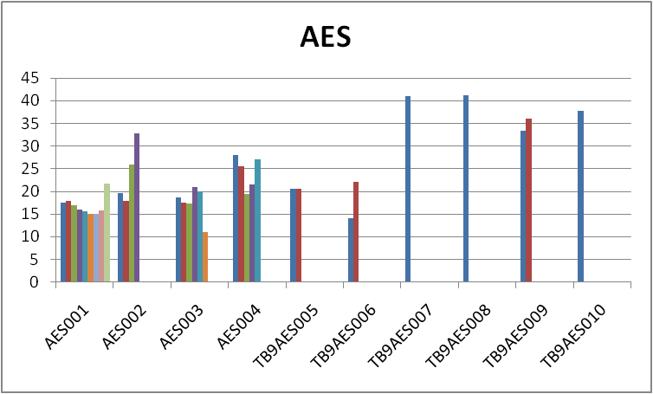
ILC Company Progress: MHI and AES
New vendors
25 MV/m
25 MV/m

Slide 9
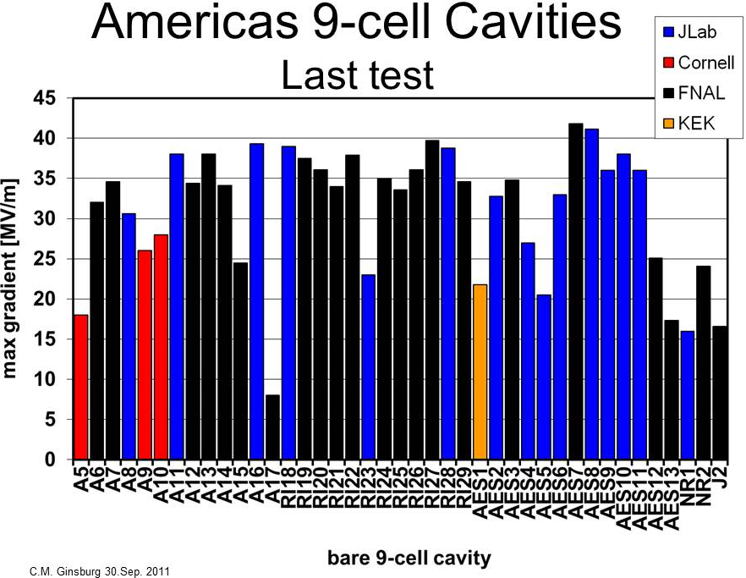
35 MV/m
25 MV/m
Many cavities reach ILC gradient; many more reach 25 MV/m

Slide 10
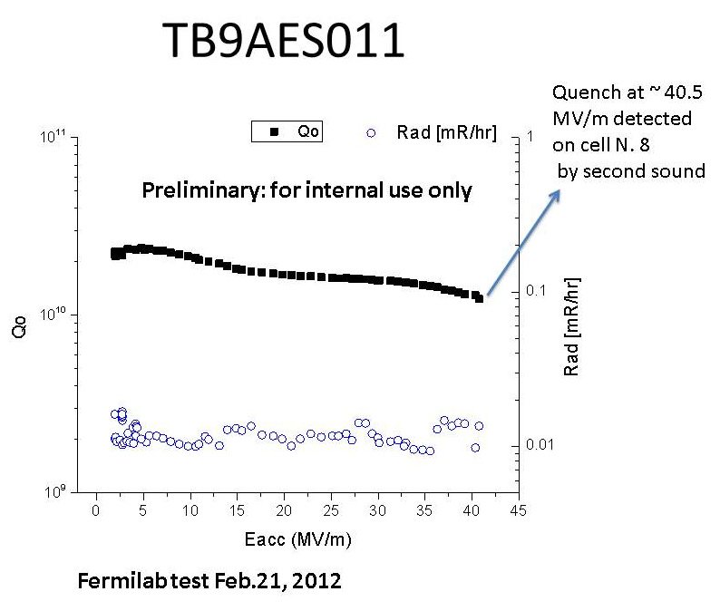
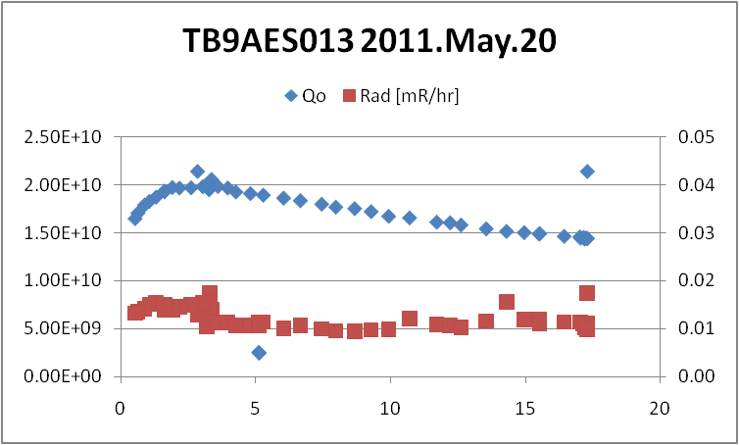
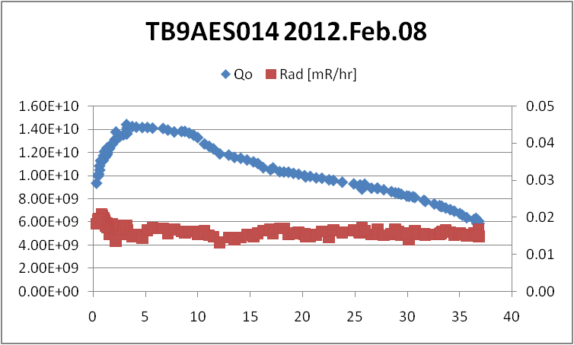
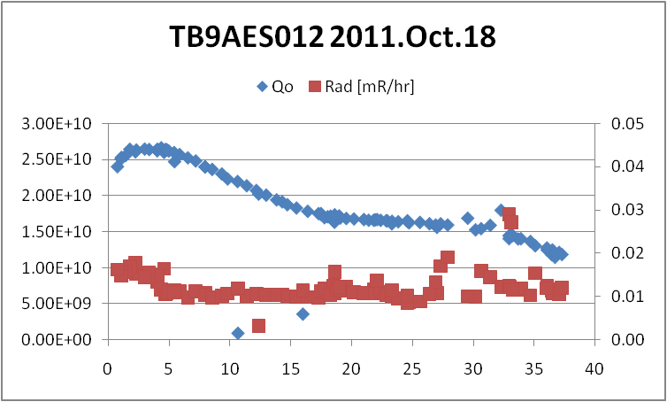
Illustrative example of recent cavity performance
AES Batch 2 (TB9AES005-10)
  4/6 reached ILC specification by 2nd pass; two had limiting features
AES Batch 3 (TB9AES011-16) – 4/6 processed & tested
  TB9AES011 (JLab EP, FNAL/ANL HPR) – 41 MV/m; Q0=1.6E10 @25 MV/m
  TB9AES012 (FNAL tumbling) – 37 MV/m; Q0=1.6E10 @25 MV/m
  TB9AES013 (FNAL/ANL EP) – 17 MV/m
  TB9AES014 (FNAL/ANL EP) – 37 MV/m; Q0=0.9E10 @25 MV/m

Slide 11
Cavity Limitations: Rule of thumb
Below ~25 MV/m, almost always can use thermometry to find a limiting isolated feature in the equator weld heat affected zone
  Additional electropolishing has no effect on cavity performance
  Mechanical repair likely to improve performance
Above ~25 MV/m, may see regions with anomalous heating
  Additional electropolishing usually helps

Slide 12
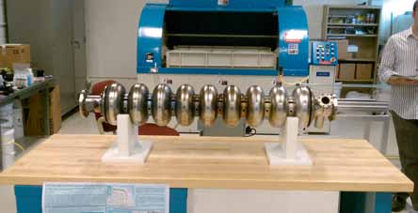
9-cell Cavity Repair/Process Development
FNAL/ANL EP process baseline for ILC cavities
  Doesn’t improve cavities with limiting features
Tumbling (Centrifugal Barrel Polishing, CBP)
    Promising results for gradients and Q0
    May make cavity performance less sensitive to manufacturing variations (not proven yet)
    Plan to develop as a new standard technique – fresh 9-cell cavities will go toward this effort
Localized Grinding (led by KEK)
  Two of three repaired Americas cavities were tested, and both were substantially improved

Slide 13
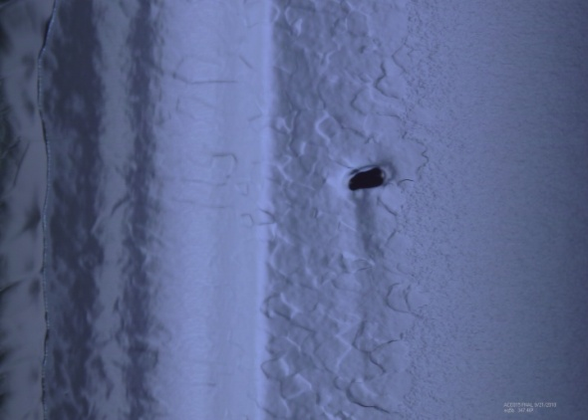
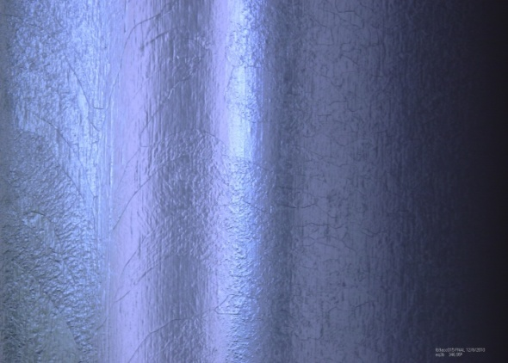
9-Cell Cavities: Tumbling Repairs
Previously limited ~here
TB9ACC015 Before CBP
Demonstrated cavity gradients > 35 MV/M
Potential for drastic reductions in acid use.
Demonstrated as a cavity repair method
We will pursue this is a production process
After CBP and 40 microns EP – Pit completely removed

Slide 14
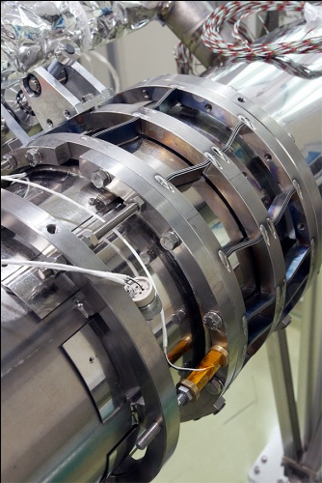
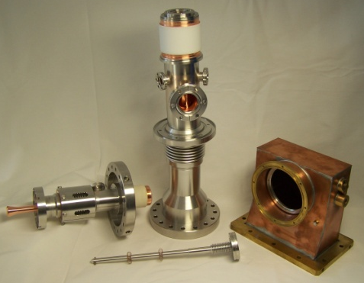
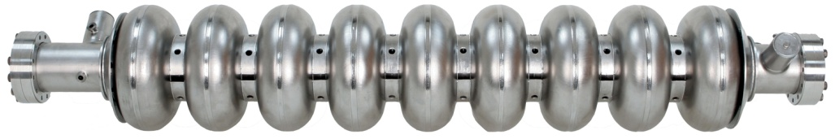
S1-Global Cryomodule
“Global” cryomodule for ILC at KEK
Compare cavity and component performance
Test integration and plug compatibility
Fermilab supplied two dressed cavities with tuners and couplers
  Also, two cavities were supplied by DESY, and four by KEK
Fermilab personnel participated in assembly, tests (no beam) and disassembly
We have received the cavities back and will study the performance
TESLA Cavity (DESY/FNAL)
TTF-III Coupler
(DESY/FNAL)
Blade Tuner (INFN/FNAL)

Slide 15
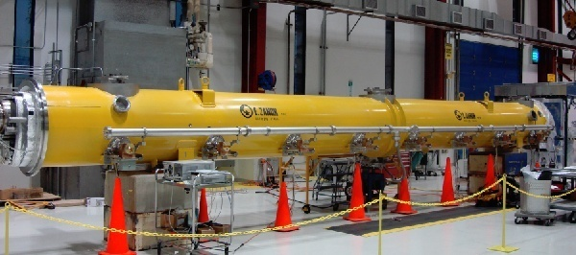
Cryomodule 1 (CM1)
Tesla-style cryomodule containing eight Tesla-style 1.3 GHz cavities, no magnet
Assembled at Fermilab from a DESY “kit” which included all parts, including cavities, from DESY and INFN
  Strong DESY assistance in assembly
Completed test operation in NML without beam

Slide 16
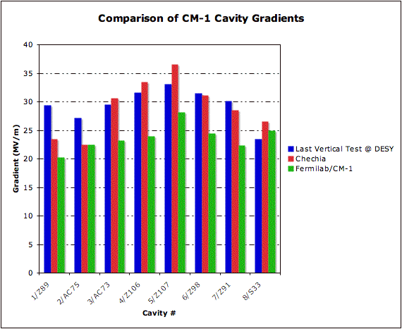
Cryomodule CM1 Performance at NML - Gradient
ILC-like operating conditions
Average 24 MV/m
Two cavities showed excess heating – to be investigated further after disassembly
 | 1 | 2 | 3 | 4 | 5 | 6 | 7 | 8 | Mean
CM-1 Peak Gradient | 20.2 | 22.5 | 23.2 | 24* | 28.2 | 24.5 | 22.3 | 25 | 23.7
*RF-limited
16

Slide 17
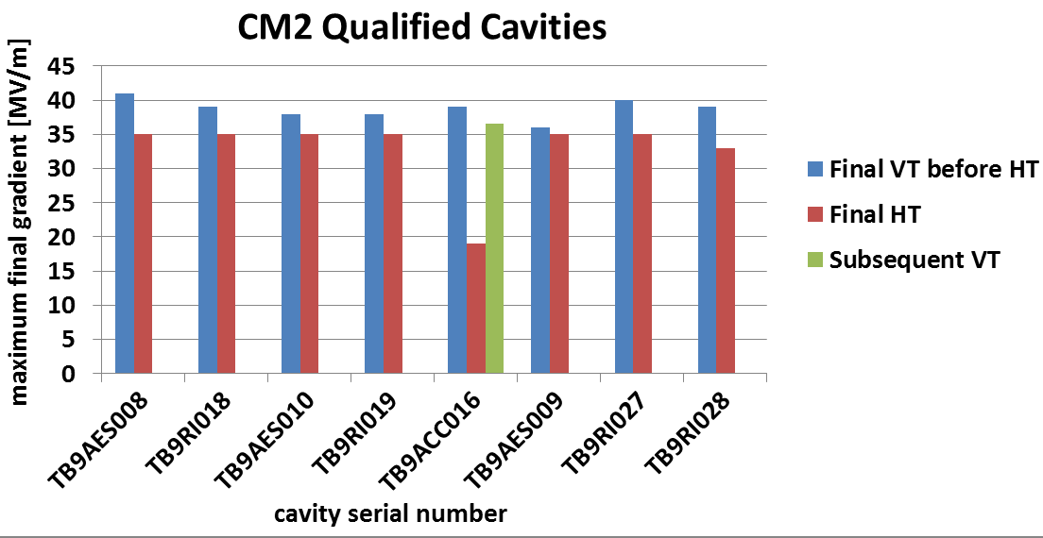
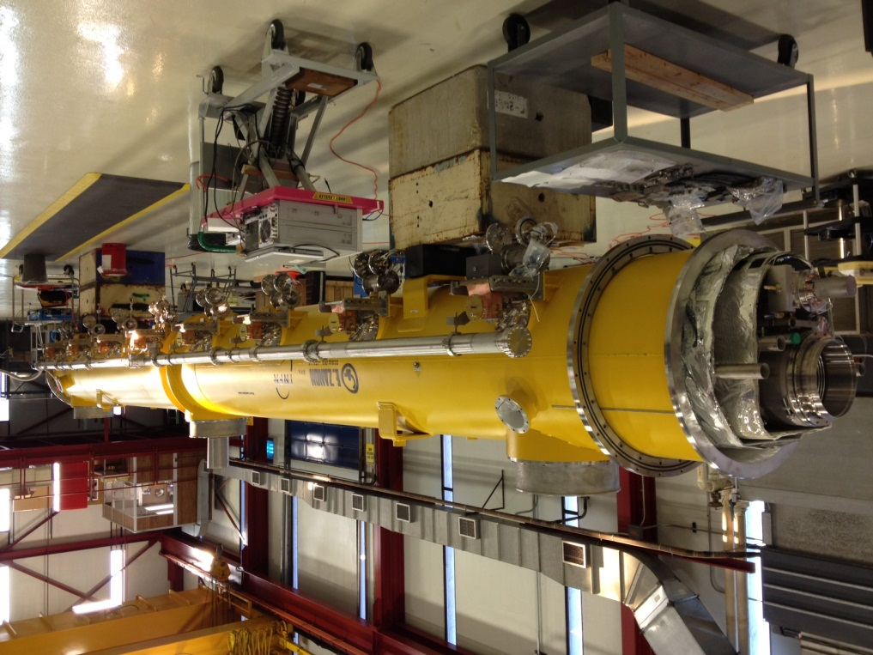
Cryomodule 2 (CM2)
For ILC:
VT spec 35 MV/m
CM Operation 31.5 MV/m (avg)
HT admin limit 35 MV/m
CM2 is an ILC 8-cavity + magnet cryomodule assembled at FNAL
CM2 cavities
  Processed and vertically tested at JLab
  Dressed and horizontally tested at FNAL
Assembly ~completed
Good chance for first ILC spec CM in US
Switch out for CM1 in NML within weeks
Test at NML first without beam, then test with beam by the end of CY12
FNAL-CM2 15.Mar.2012

Slide 18
1.3 GHz Plans and Status
Process and test cavities
  To fill CM3 and CM4
  For fundamental and applied R&D
Construct and test cryomodules
  CM2 assembly ~complete
    Install CM2 at NML (1st high gradient CM), test without and with beam
  Dress and HTS test cavities for CM3
  CM1 post mortem and rebuild for NML
  S1 global cavity post mortem and rework
Follow cavity and component performance from vertical to horizontal to cryomodule test and feedback gained knowledge
In the last ~six years, Fermilab has built up staff and substantial infrastructure to support a strong SRF program
  Substantial cavity, component, cryomodule work with productive use of national and international collaboration

Slide 19
Backup Slides

Slide 20
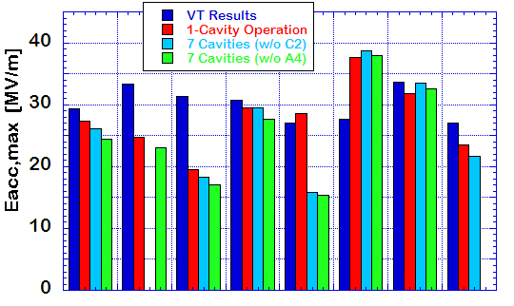
S1-Cavity Performance
ave. Eacc,max
VT : 30 MV/m
1 cav : 27 MV/m
7 cav : 26 MV/m
C
D
D
AES004
ACC011
D : Detune
C : Coupler
Z108
Z109
MHI-05
MHI-07
MHI-06
MHI-09
FNAL
DESY
KEK

