Slide 1
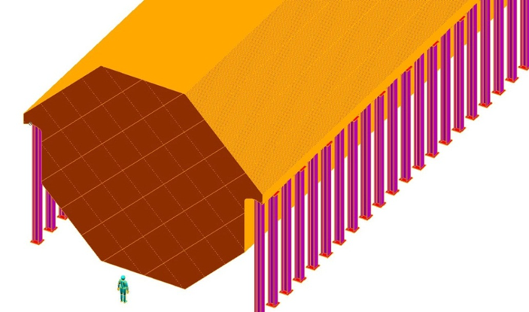
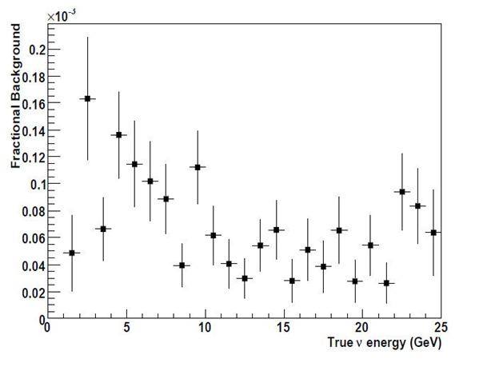
Magnetized Iron Neutrino Detector (MIND)
Re-Optimize for lower energy
MIND was optimized for the “Golden” channel at the NF (25 GeV μ storage ring)
Optimization for FD for L/E ≈ 1
  Essentially Minos ND with upgrades
    Reduce plate thickness (1 cm)
    250 kA-turn excitation (SCTL)
    XY readout between planes

Slide 2
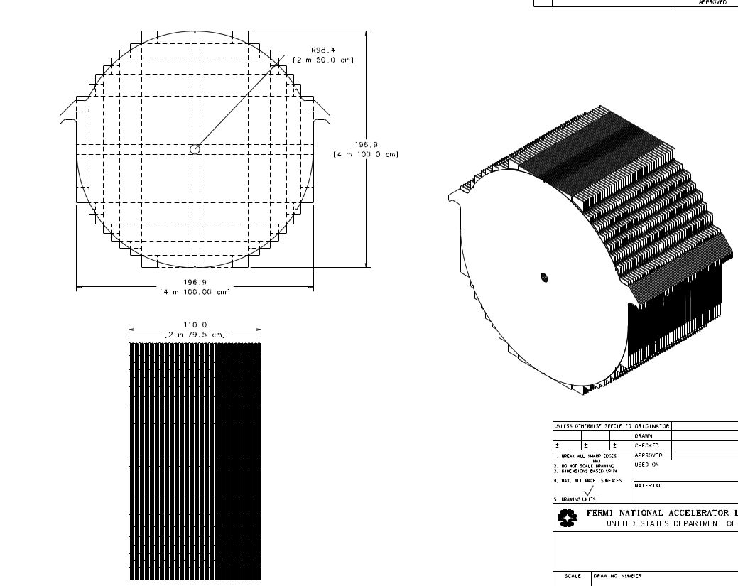
Super B Iron Neutrino Detector
SuperBIND
Herman Cease
Fermilab
1 cm plate
5 m diameter
20 cm hole for SCTL

Slide 3
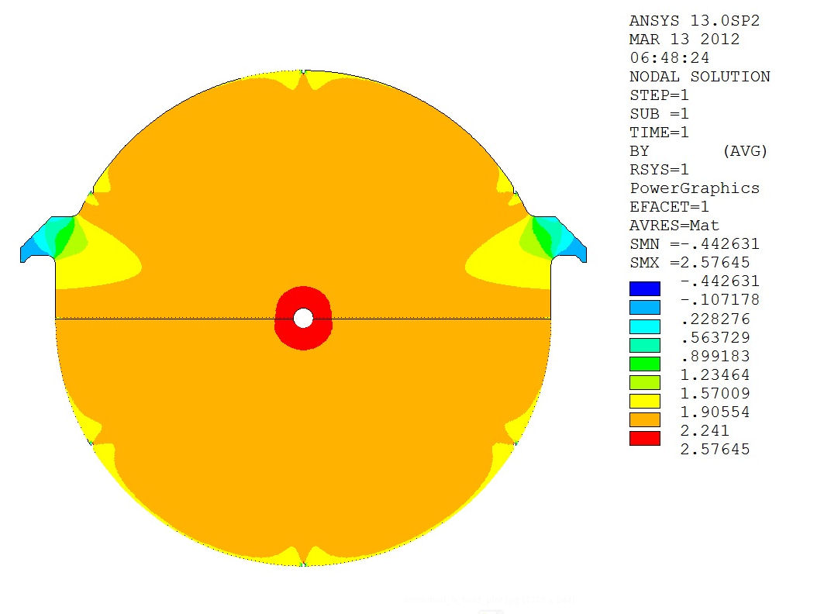
B Field Simulation
Bob Wands
Fermilab

