Slide 1
Project X Energy Station Spallation Target
March 20, 2012
D. Wootan, D. Asner
david.wootan@pnnl.gov

Slide 2
Versatile Project X Energy Station
Could support much needed testing of materials for DOE Office of Nuclear Energy programs to:
Ensure the sustainability and safety of the current fleet of reactors for current lifetime extensions from 40 to 60 years, as well as future extensions from 60 to 80 years or more,
Develop new higher performance and safer reactor fuels and materials,
Enable the development of innovative economical small reactors,
Enable the development of new advanced reactor concepts, such as those using liquid metal or molten salt coolants,
Enable the development of transmutation fuels for reducing legacy wastes requiring deep geologic storage, and
Enable the investigation of accelerator driven systems as a means for transmutation of waste from power reactors.
In addition, could support DOE Office of Science programs such as the
Fusion Program
Isotope Production Program
Basic science research such as ultra cold neutrons, exotic isotopes, etc.

Slide 3
Nuclear Energy: Experimental Station

Slide 4
Key Features of Energy Station Concept
protons
neutrons
1MW Proton beam
Liquid metal spallation target
Closed Loop Modules for irradiation testing

Slide 5
Characteristics of Energy Station Concept
1 MW CW proton beam on liquid lead or lead-bismuth spallation target produces copious neutrons with energy spectrum similar to fission spectrum but with high energy tail
1 GeV 1 mA – 3 GeV 0.33 mA proton beam
Surrounded by vessel filled with liquid lead, lead-bismuth, or sodium that provides test region and maximizes test volume (360 degrees)
Azimuthally arrayed closed loop test modules provide independently tailored irradiation environment
Varied Materials – coolant, moderator
Independent cooling system for each test section, controlled temperatures, ceramic/vacuum insulation
Modular test sections – each can be removed and the active section shipped offsite for processing
Online cleanup of Pb-Bi spallation target could also be source of beneficial isotopes
Potential in-beam testing region

Slide 6
Potential Flexible Test Matrix Capabilities
Test Zone | Characteristics
Materials | Miniaturized specimens, Instrumented, controlled temperature, pressure
ADS | Lead or lead-bismuth flowing loop, materials compatibility, corrosion, pin-type transmutation fuel and cladding tests, on-line cleanup
HTGR | Graphite structure, TRISO materials, pebble bed, compacts, He coolant
SFR | Sodium coolant loop, advanced high temperature long life materials, pin-type transmutation fuel and cladding tests
LWR | Pressurized water loop, LWR conditions, address sustainability issues
MSR | Molten salt loop, materials compatibility, corrosion, dissolved fuel
Fusion | Lithium loop, radiation damage in materials, fusion blanket tests
Other | Liquid He loop for cold neutrons, possible neutron beam extraction
Nuclear Data | Integral cross sections, isotopic burnup, fission product yields
Isotope Production | Spectrum tailoring for specific isotopes, rabbit system for rapid insertion, moderators: D2O, graphite, beryllium, metal hydride Beneficial use of leakage neutrons (²³⁸Pu, ⁶⁰Co)

Slide 7
Energy Research Station Concept
Proton beam
Proton beam
Liquid He for cold neutrons
Neutron beams
lead
Proton beam access
Cleanup system
Axial cross section
Radial cross section
Isotopes

Slide 8
Characteristics of Energy Station
Flexible, able to support multiple missions
Robust technology allows it to be designed and constructed with today’s technology in order to fill gaps in tomorrow’s technology
Spallation neutrons energy distribution similar to fast reactor fission spectrum but with high energy tail up to proton energy
H and He generation in materials higher than in reactor allowing accelerated aging testing
Continuous wave, high availability, high beam current provides potential for irradiation tests to high fluence
Ability to tailor gamma to neutron flux ratio
Ability to tailor neutron spectrum from fast to thermal
Spallation reactions on target (lead or lead-bismuth) produce broad range of reaction products similar to fission products – some gaseous and mobile, so a gas and liquid cleanup system offers removal pathway and potential source of beneficial isotopes
Beneficial isotope production and/or cold neutron beams might be done simultaneous with irradiation testing

Slide 9
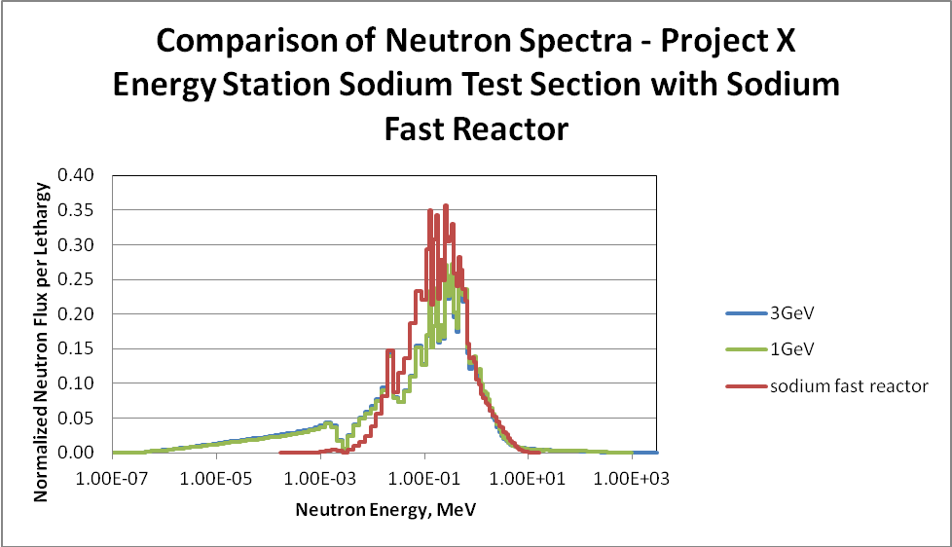
Tailored Neutron Spectrum Possible in Each Module
Sodium Module
Lead Module
Light Water Module
Graphite/He Module

Slide 10
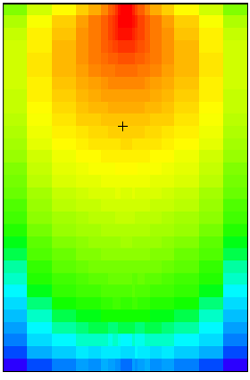
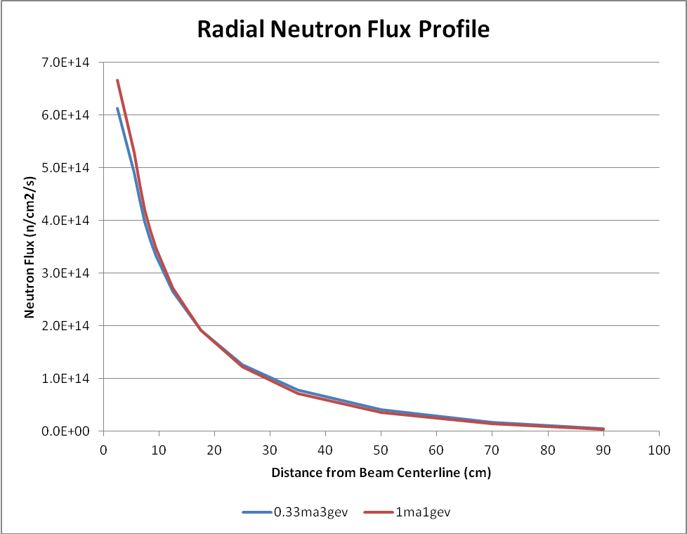
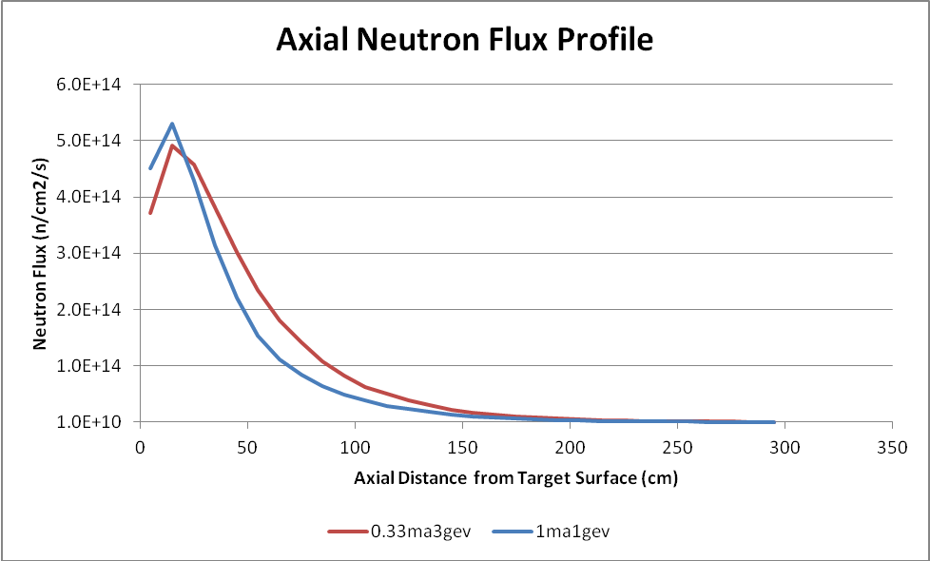
Potential Test Volumes and Neutron Flux at 1 MW
1 m
Neutron Flux Range | Dimensions 5 cm (R₁) | Available Test Volume
3e14-5e14 | 10 cm (R₂) x 50 cm (H) | ~8 liter
1e14-3e14 | 40 cm (R₂) x 90 cm (H) | ~270 liter
5e13-1e14 | 60 cm (R₂) x 110 cm (H) | ~600 liter
1e13-5e13 | 100 cm (R₂) x 180 cm (H) | ~2400 liter
3 m

Slide 11
How can the Project X Energy Station Concept Benefit the Project X Physics Station Design?

Slide 12
Program…
Material Science
The high power proton beam from Fermilab Project-X would provide a test bed for structure and target material for accelerated radiation damage and liquid metal effects
Neutron and gamma ray spectra and temperatures typical of a wide range of reactor concepts can be recreated for materials testing without building a reactor or requiring reactor fuel
These radiation environments may throw light on new materials or physics which has not been encountered so far
Chemistry/Performance of Targets
Study the chemistry/irradiation-induced changes of Lead-Bi Liquid Alloy or solid spallation target concepts in a prototypic high radiation environment
Physics
Investigate life-limiting phenomena (transmutation produced impurities, radiation damage)
The rate of incineration very long lived minor actinides or fission products in a given neutron spectrum
Neutron/photon/electron heat generation and deposition

Slide 13
Spallation Targets for Particle Physics
Common interests between NE and the particle physics research program
Isotope Production
Material Irradiation
Thermal Neutron Beams
Transmutation of radioactive waste/ Power Generation
Beginnings of conceptual design for next generation particle physics experiments involve Mega-Watt targetry design and infrastructure for muons, kaons & spallation research programs

Slide 14
Spallation Targets for Particle Physics
Proton beam
ISOL, EDM
Proton reaction cross section measurements
Proton rich isotope production
On-line targets sputter or recoil isotopes
Sealed targets that are retrieved and processed for isotopes
Fluid or gas extraction
Create neutrons for subsequent targetry
Recover proton induced reactants
Sputter
Gas
Liquid target cleanup
Spallation Neutrons
Fission product production
Neutron reaction cross section measurements
Neutron rich isotope production
On-line targets sputter or recoil isotopes
Sealed targets that are retrieved and processed for isotopes
Neutron beams - Cold neutrons, Ultra-cold neutrons
Cold Neutron Irradiation Tank (liquid He⁴ or less)
Investigate n properties reactions

Slide 15
Energy Station Applications
The CW beam from the Project-X linac will be a unique facility in the United States to address key physics and technology demonstration
Accelerator physics and technology issues:
Beam dynamics modeling and benchmarking of beam loss and halo mechanisms,
Reliability of front-end systems,
Robust SRF linac technology - RF power generation and delivery
Beam instrumentation needed to support high power and reliable operation
Potential Nuclear Physics Uses
CW accelerator/spallation similar to reactor neutron source
Isotopes, neutron beams
Access to irradiation volume

Slide 16
High Power Target Issues in Common Between Energy Station and Physics Station
Energy deposition
Secondary particle production
Target material response using FEA codes
Target cooling or replacement
Activation and radiation damage everywhere
Thermal shock
Target lifetime
Particle capture, moderation and delivery
Beam windows
Target station design, including shielding, remote handling, licensing, etc
Diagnostics in high radiation environments
Demanding environmental and safety requirements

Slide 17
Energy Station Could Benefit Design of Physics Station
Materials selection for targets, diagnostics, structures, mechanical systems typically based on limited data from fission reactor community, fusion community
Potential for much different response in high power accelerator due to high flux of high energy particles
Materials irradiation in Energy Station can address Physics target issues
Beam-Target Interface
Radiation damage/transmutation reaction impurities
Remote Handling
Liquid metal target components

