Slide 1
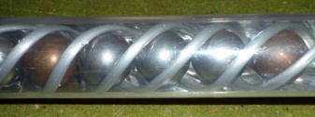
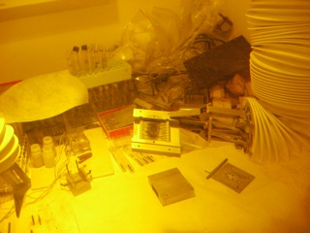
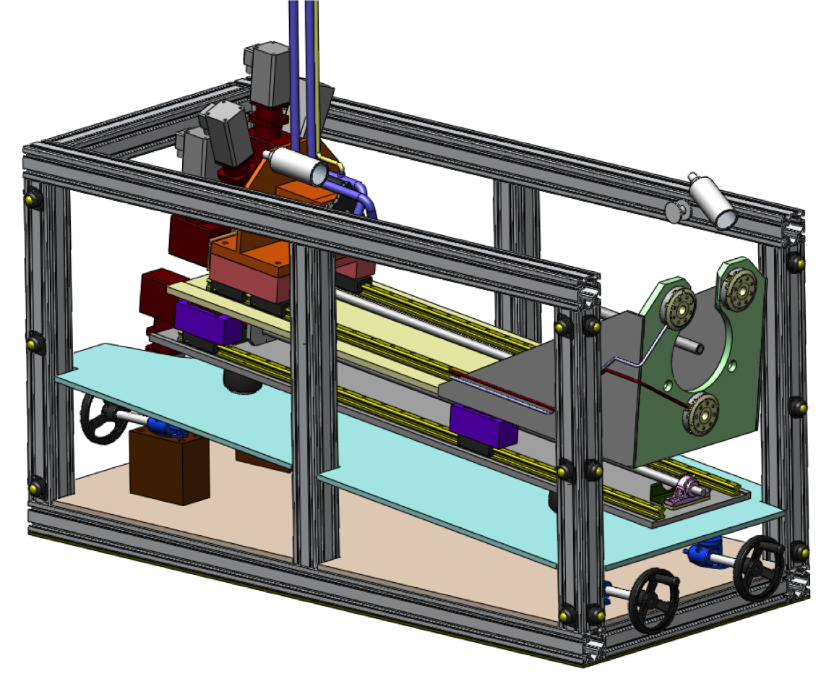
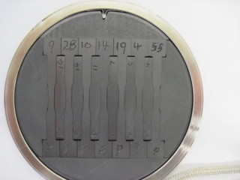
High Power Target Challenges at Fermilab
Project X Forum on Spallation Sources for Particle Physics
P. Hurh

Slide 2
Overview
High Power Target Critical Design Issues
  Thermal shock (stress waves)
  Heat removal
  Radiation damage
  Oxidation & radiation accelerated corrosion
  Physics/target survival optimization
  Residual radiation
LBNE Target R&D
  Graphite irradiation tests
  Beryllium target analysis

Slide 3
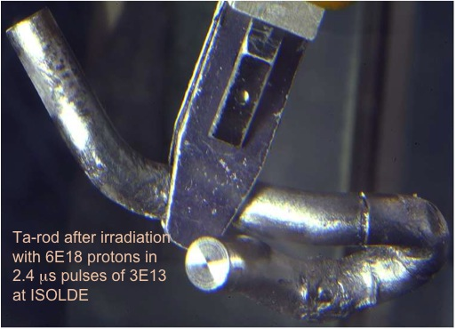
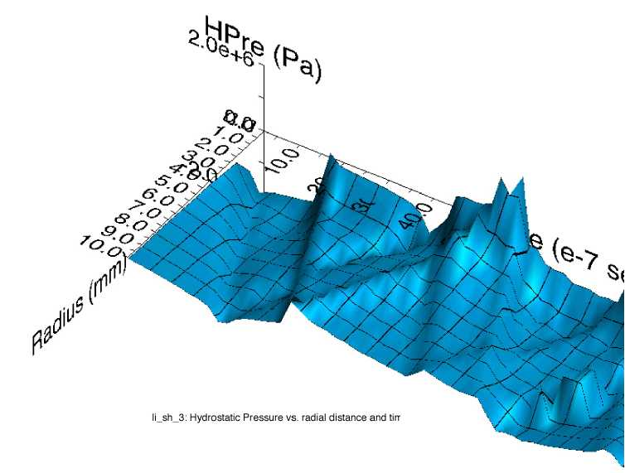
Thermal Shock
Ta-rod after irradiation with 6E18 protons in 2.4 μs pulses of 3E13 at ISOLDE (photo courtesy of J. Lettry)
Simulation of stress wave propagation in Li lens (pbar source, Fermilab)
Fast expansion of material surrounded by cooler material creates a sudden local area of compressive stress
Stress waves (not shock waves) move through the target
Plastic deformation or cracking can occur
Notes:
Ta-rod after irradiation with 6E18 protons in
2.4 μs pulses of 3E13 at ISOLDE

Slide 4
Thermal Shock
Methods to overcome thermal shock:
  Material Selection
    High specific heat
    Low coefficient of thermal expansion
    Low modulus of elasticity
    High strength (tensile and fatigue) at elevated temperature
  Segment target length
  Avoid stress concentration prone target shapes
  Pre-load in compression
  Manipulate beam parameters (spot size, intensity)
Must design for accident conditions
  Maximum intensity and smallest spot size
  Mis-steered beam on target

Slide 5
Thermal Shock in CW and Liquids
Must take thermal shock into account for CW beams:
  Quickly rotating or moving targets create pulse-like loading
Liquid targets also react poorly to pulsed beam
  Contained liquid gives rise to cavitation
  Free liquid may disperse rapidly
  Rapidly flowing targets create pulse-like loading
FRIB Target Test. Rotating graphite wheel (5,000 rpm). Courtesy of
G. Bollen,
W. Mittig, et al.

Slide 6
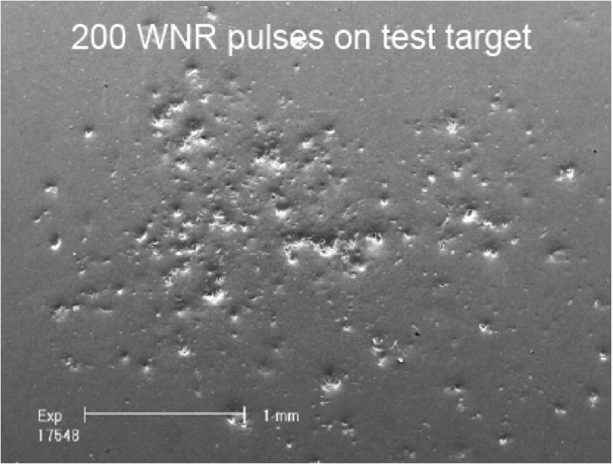
Thermal Shock in CW and Liquids
SNS Liquid Mercury Target Test. B. Reimer, et al.
MERIT Experiment (mercury jet), H. Kirk, et al.

Slide 7
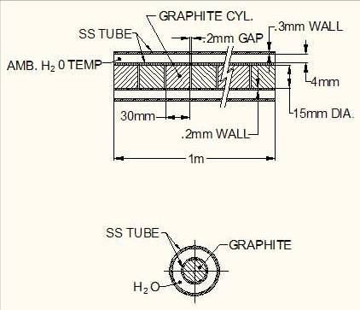
Heat Removal
25-30 kW total energy deposited (2.3 MW proton beam)
Easy to remove with water
Tritium production
Hydrogen gas production
Thermal shock in water (Water Hammer)
150 atm IHEP report (actual pressure rise will be much less due to flexibility of pipe)

Slide 8
Heat Removal
Methods of avoiding “water hammer”
  2 Phase cooling (bubbles)
  2 Phase cooling (heat pipe)
  Spray cooling (NuMI horn)
  Gas cooling
    T2K 750 kW graphite target, Helium cooling
    Mini-BooNE beryllium target, Air cooling
  Radiative Heat Transfer (FRIB, Mu2e)
    Requires relatively high temperature
  Flowing targets (SNS)

Slide 9
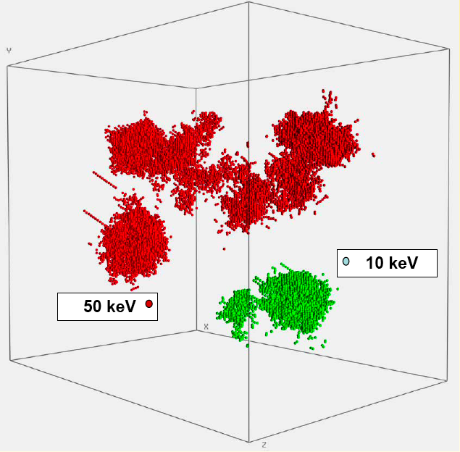
Radiation Damage
Displacements in metal crystal lattice
  Embrittlement
  Creep
  Swelling
Damage to organics/plastics
  Cross-linking (stiffens, increase properties)
  Scission (disintegrate, decrease properties)
Molecular Damage Simulations of peak damage state in iron cascades at 100K.
R. E. Stoller, ORNL.

Slide 10
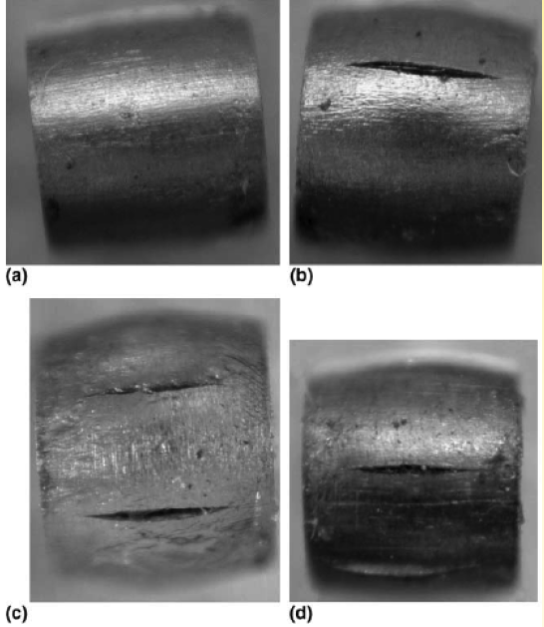
Radiation Damage
Tungsten cylinders irradiated with 800 MeV protons and compressed to 20% strain at RT.
  A) Before irradiation
  B) After 3.2 dpa
  C) After 14.9 dpa
  D) After 23.3 dpa
Data exists for neutron irradiation, less for proton irradiation
  Gas production much higher for high energy particle irradiation
S. A. Malloy, et al., Journal of Nuclear Material, 2005. (LANSCE irradiations)

Slide 11
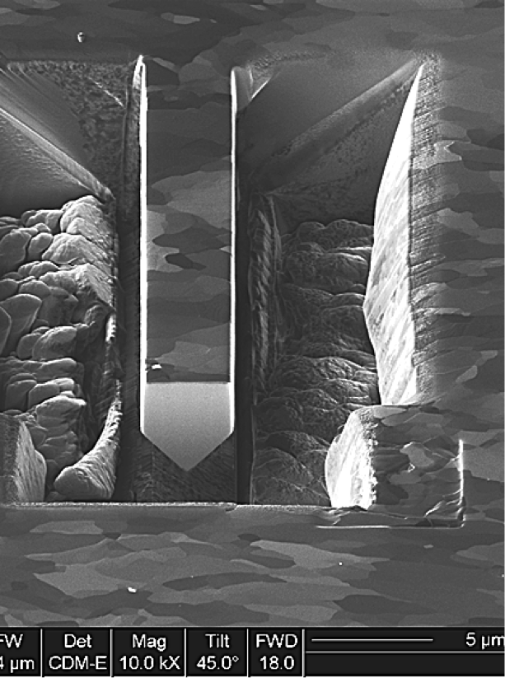
Radiation Damage
LBNE graphite radiation damage testing at BLIP (BNL)
  Low irradiation temperature (140 C)
  Low DPA (0.15)
  Large effects seen (TS, K, CTE)
  Annealing “heals” defects
Proposal for high energy proton radiation damage R&D programme
  Oxford Materials for Fusion and Fission Power
  Beryllium, Graphite, Titanium, Tungsten
  3-1/2 year programme

Slide 12
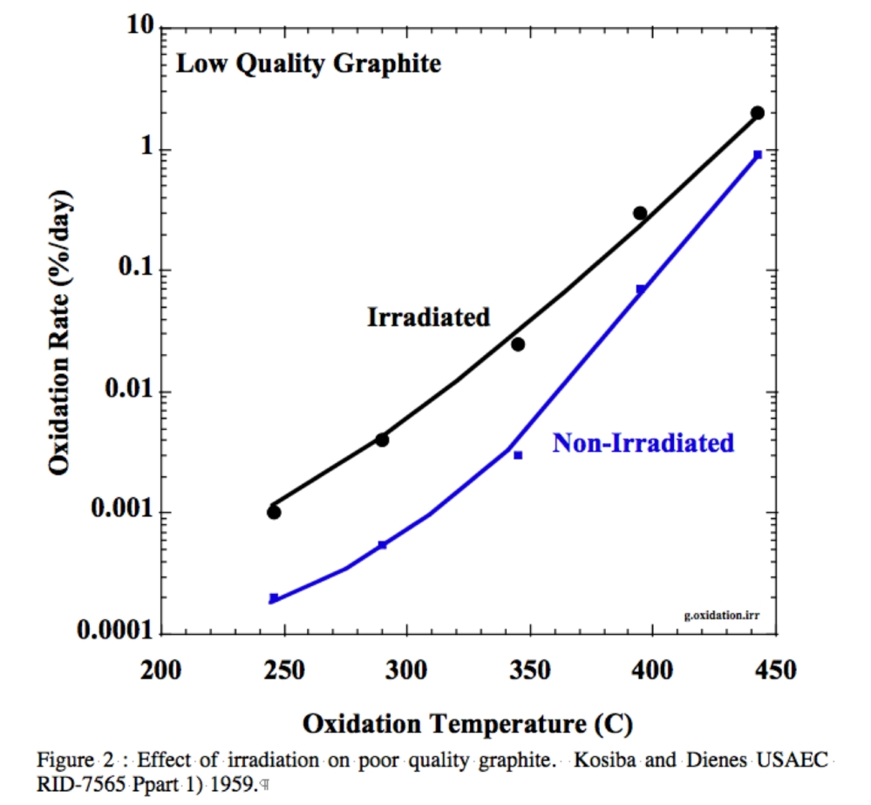
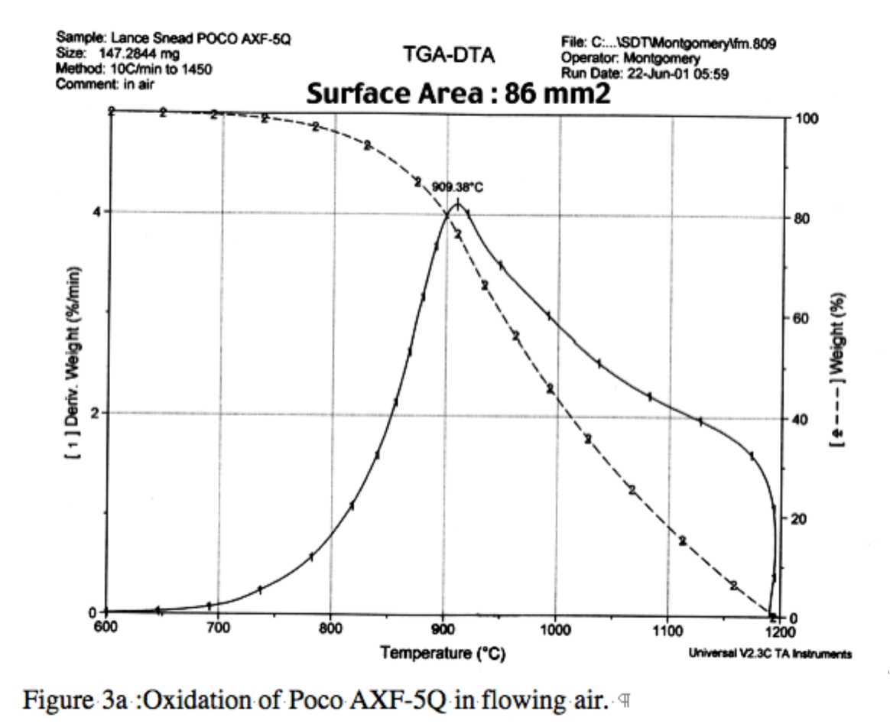
Oxidation
Oxidation reaction is very fast for carbon at high temperatures
Need sealed target jacket with beam windows and pump/purge system
Beryllium avoids this?

Slide 13
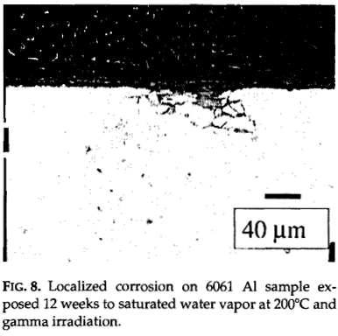
Radiation Accelerated Corrosion
Al 6061 samples displayed significant localized corrosion after 3,600 Mrad exposure
NuMI target chase air handling condensate with pH of 2
NuMI decay pipe window concerns
R.L. Sindelar, et al., Materials Characterization 43:147-157 (1999).

Slide 14
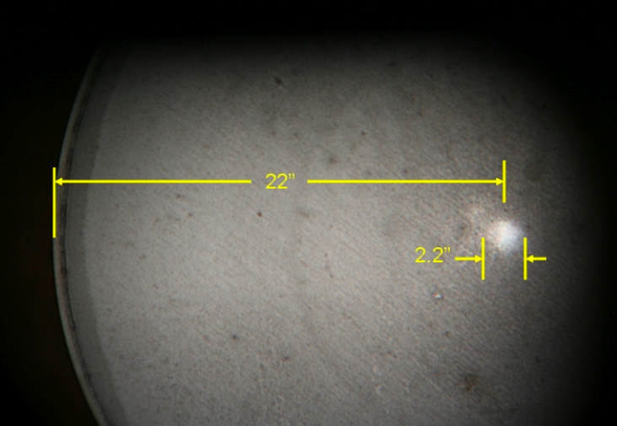
Radiation Accelerated Corrosion
Photograph of NuMI decay pipe US window showing corroded spot corresponding to beam spot

Slide 15
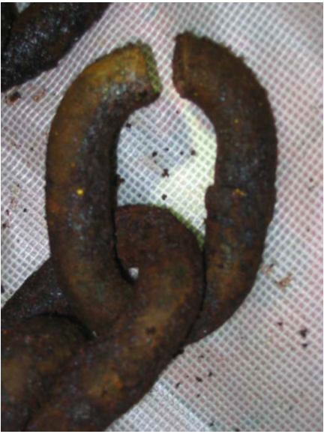
Radiation Accelerated Corrosion
MiniBooNE 25 m absorber HS steel failure
(hydrogen embrittlement from accelerated corrosion).

Slide 16
Physics/Target Survival Optimization
Physics and Target Survival are generally in opposition
  Beam spot size
  Beam power
  Target dimensions
  Optics considerations
Effects must be understood by both sides
Compromise must be reached in an iterative process

Slide 17
Physics Optimization
Physics Simulation
(Full optics or reduced set, Figure of Merit)
Energy Deposition Simulation
Target Design
Iterative process makes it difficult to isolate the design efforts
Figure of Merit helps to reduce simulation requirements
Leads to novel target ideas (multiple materials, spherical targets)

Slide 18
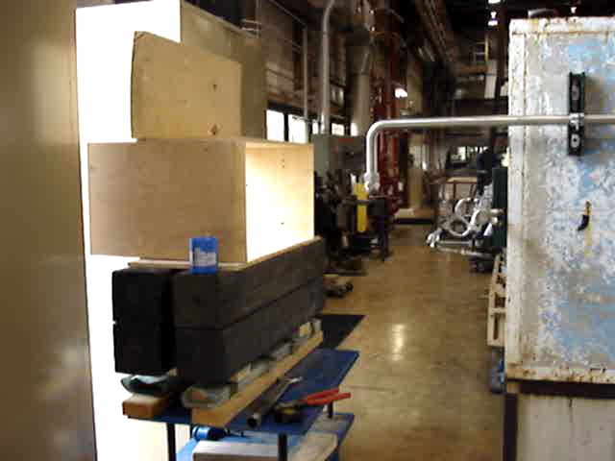
Residual Radiation- What we can’t do anymore

Slide 19
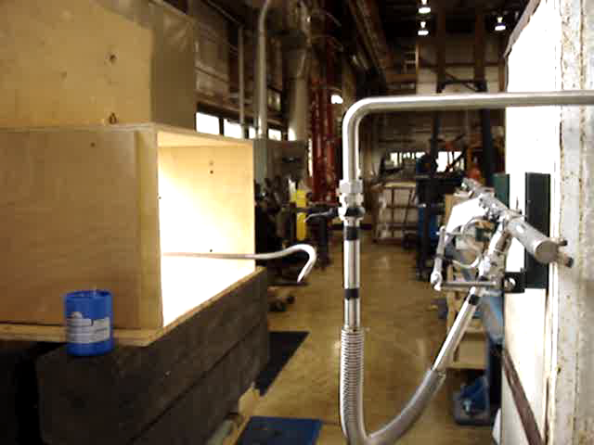
Residual Radiation- (even though it can be ingenious)

Slide 20
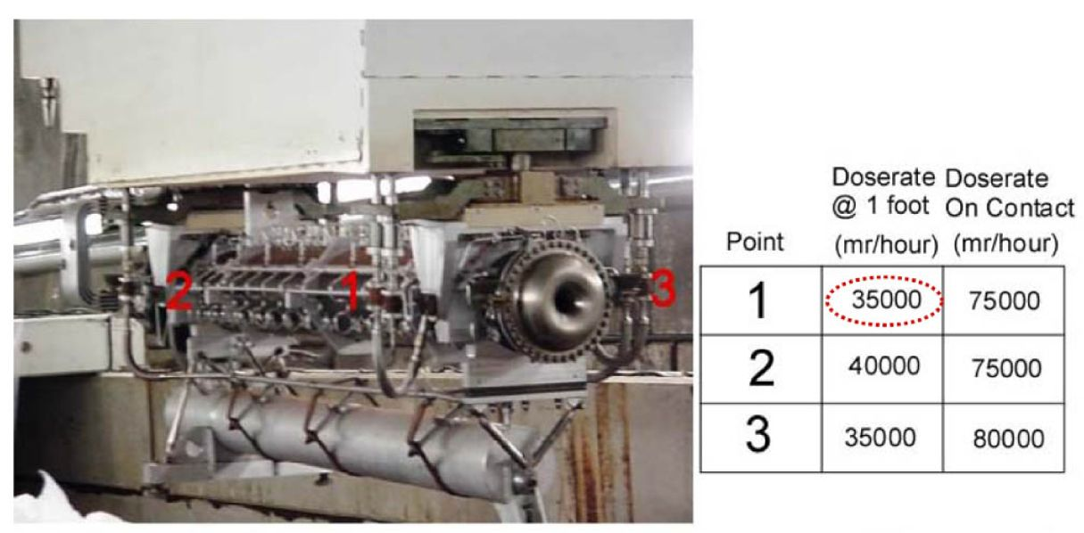
Residual Radiation
Measured dose rates for NuMI Horn 1 water line repair (250 kW proton beam)
Dose rates for 2.3 MW beam components estimated at 300-800 Rad/hr
Systems for component change-out and repair must be developed (IE Remote Handling)
Operations activities must be integrated into the conceptual design of target components

Slide 21
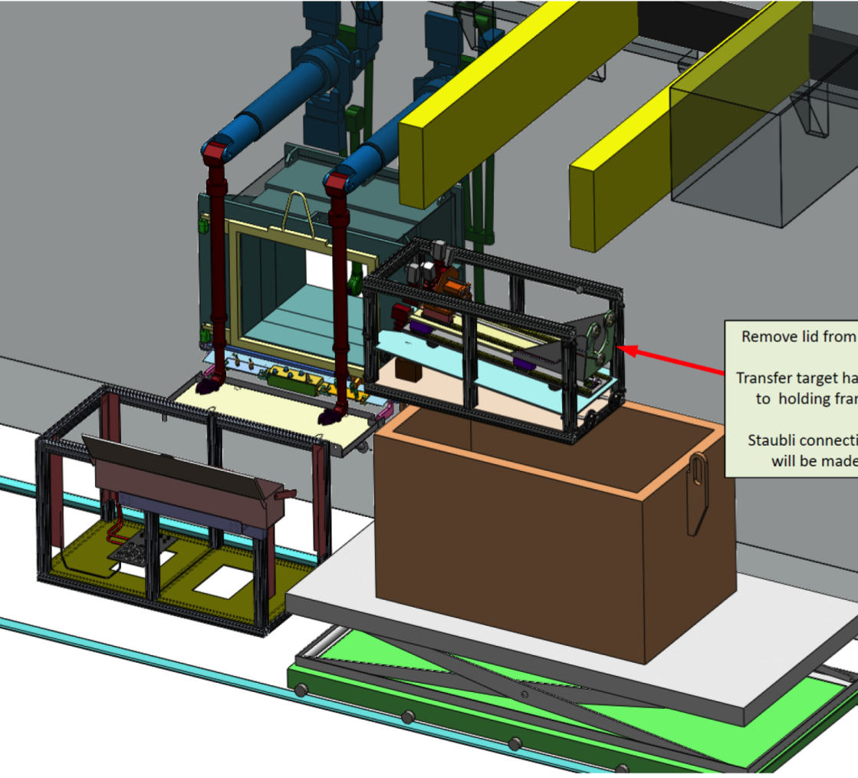
Residual Radiation
LBNE Remote Handling Equipment (courtesy of V. Graves and A. Carroll, ORNL)

Slide 22
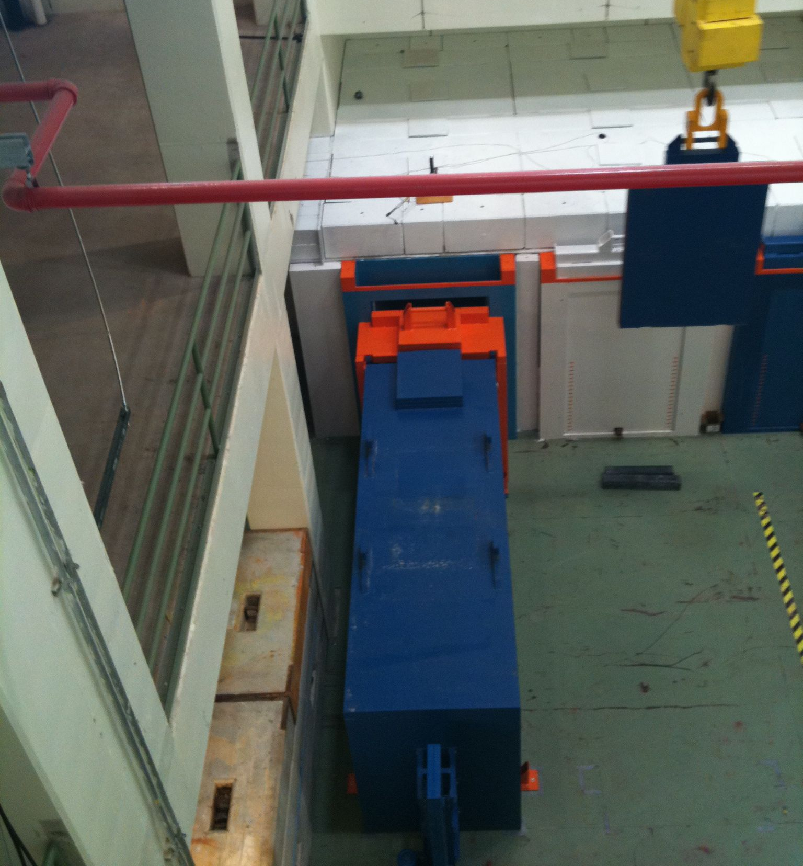
Residual Radiation- Cask transport systems

Slide 23
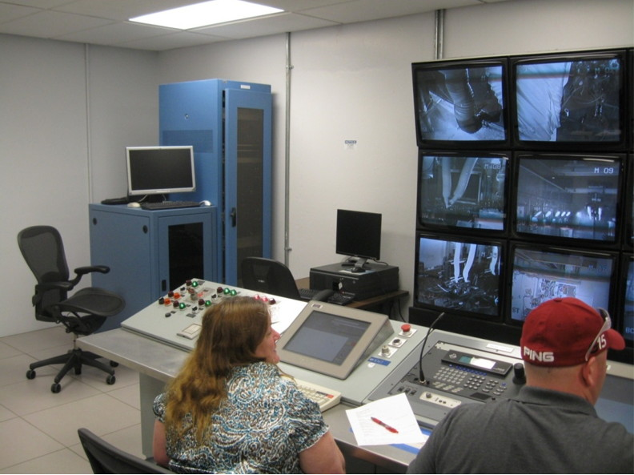
Residual Radiation- Control Room
SNS Control Room Pictured
Allows for remote control of crane via video camera
Allows for remote control of other devices (work cell door)
Houses crane electronics to avoid radiation damage

Slide 24
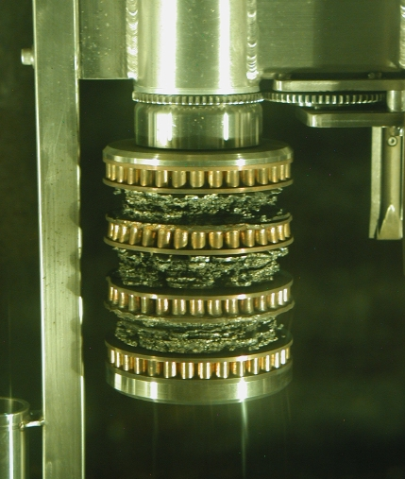
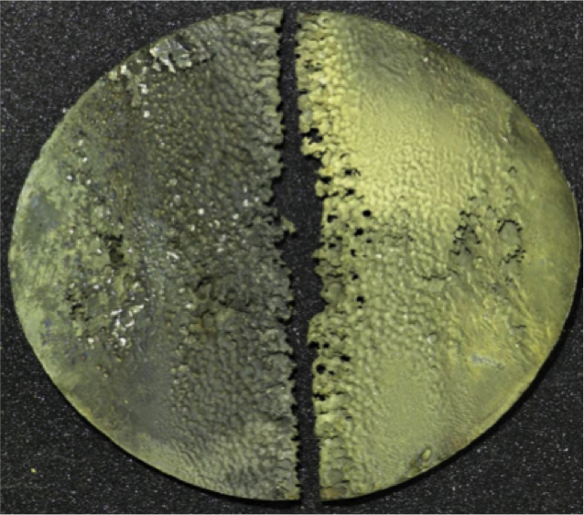
Survivability is relative
Consumable Targets
  P-bar (oxidation and thermal shock limited)
  SNS (DPA and cavitation limited)

Slide 25
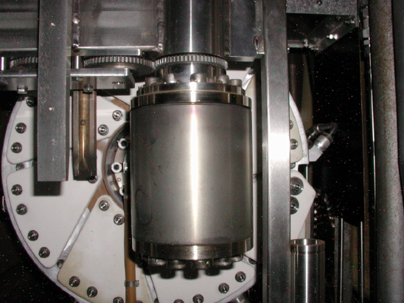
New P-bar Target
~2e19 integrated protons on target
Courtesy of
Ron LeBeau, Tony Leveling, & Ryan Schultz

Slide 26
Additional slides, if time…

Slide 27
LBNE Graphite R&D
Why Graphite?
  Excellent for thermal shock effects (lower CTE, very low E, high strength at high temperatures)
  Not toxic (no mixed waste created)
  Readily available (inexpensively) in many grades and forms
Why not Graphite?
  Rapid oxidation at high temperatures
  Radiation damage

Slide 28
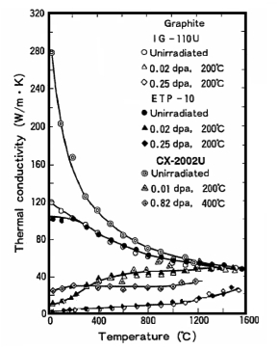
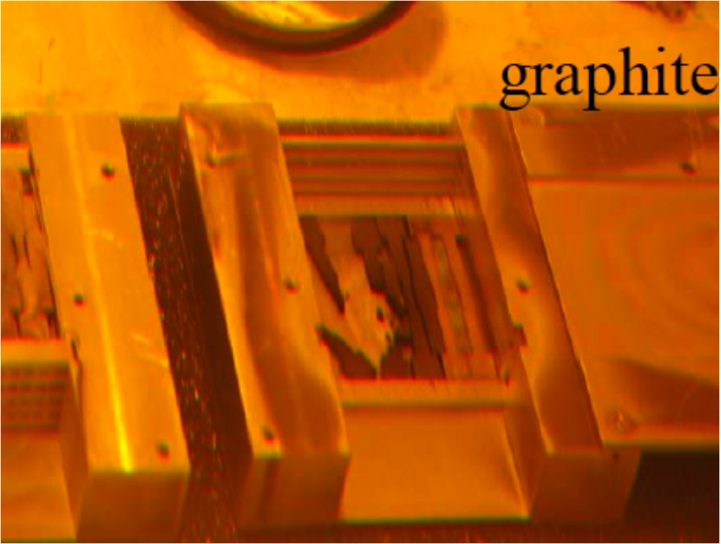
Graphite R&D: Radiation Damage
Rapid degradation of properties at relatively low levels of DPA
Evidence of complete structural failure at 1e21 p/cm² (BLIP test)
N. Maruyama and M. Harayama, “Neutron irradiation effect on … graphite materials,” Journal of Nuclear Materials, 195, 44-50 (1992)

Slide 29
Graphite R&D:
Irradiation Testing at BLIP
Working with N. Simos and H. Kirk at BNL to test samples irradiated by 181 MeV proton beam at BLIP
Testing for:
  Tensile properties (YS, UTS, …)
  Coef. of thermal expansion
  Conductivity
Most samples encapsulated in argon filled, stainless steel capsules to isolate from water cooling bath
About 150 samples in total
Tensile samples have gauge width of 3 mm and thickness of 1 mm

Slide 30
Graphite R&D:
Irradiation Testing at BLIP
Material | # Tensile | # CTE | K | Motivation
C-C Comp (3D) | 10 | 8 | ? | First BLIP test showed massive failure
POCO ZXF-5Q | 21 | 6 | .46 | NuMI/NOvA target material
Toyo-Tanso IG 430 | 42 | 6 | .51 | “Nuclear Grade” used for T2K
Carbone-Lorraine 2020 | 21 | 6 | .60 | CNGS target material
SGL R7650 | 21 | 6 | .66 | NuMI/NOvA Baffle material
Saint-Gobain AX05 hBN | 0 | 6 | .80 | Highest K wild card (low flex strength)
K Factor is a thermal shock resistance parameter used by Luca Bruno to evaluate candidate materials for targets/windows
  K=(UTS*Cp)/(E*CTE)

Slide 31
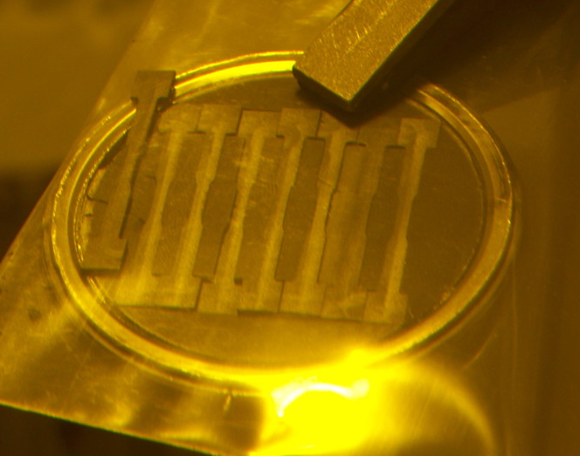
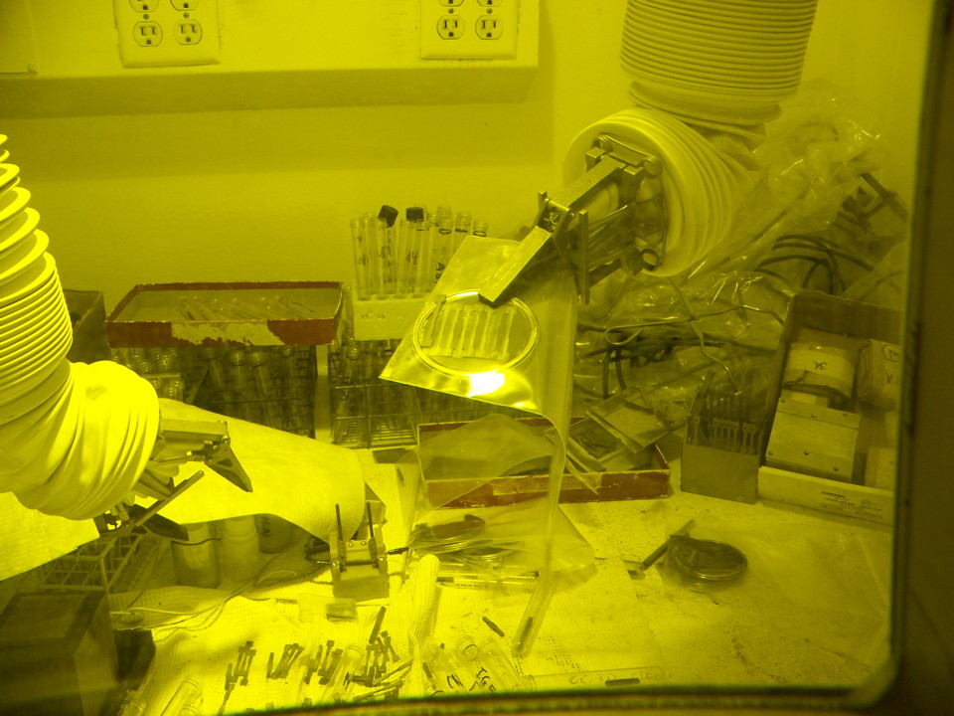
Graphite R&D:
Irradiation Testing at BLIP
Irradiation run complete
Currently finishing testing phase
Preliminary results now available
Additional testing could be done this summer
181 MeV proton beam
Peak integrated flux about 5.9e20 proton/cm²
Corresponds to 0.14 DPA

Slide 32
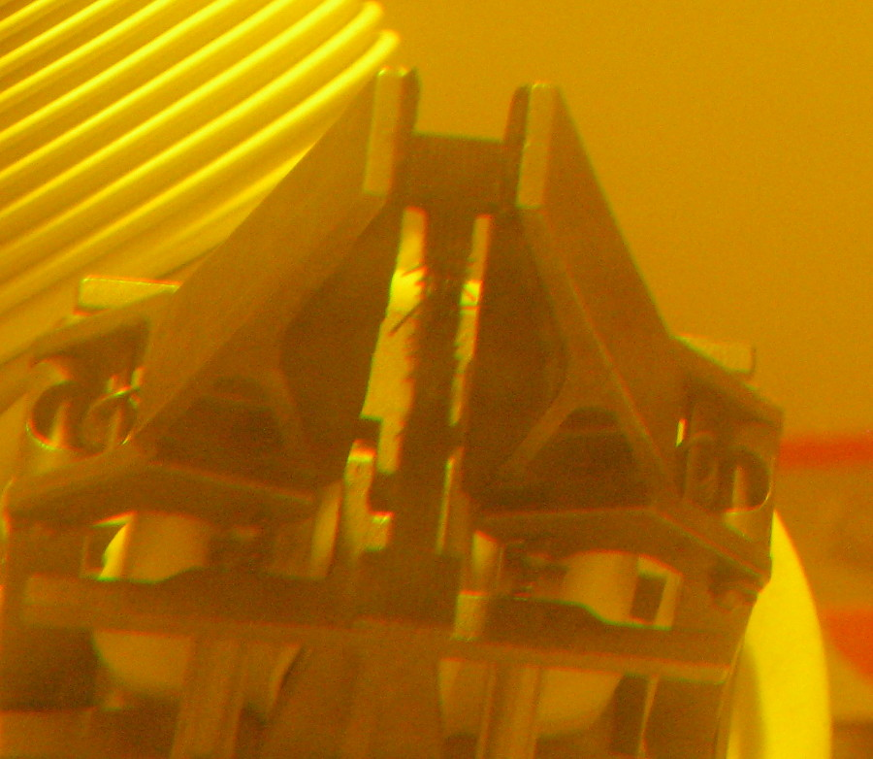
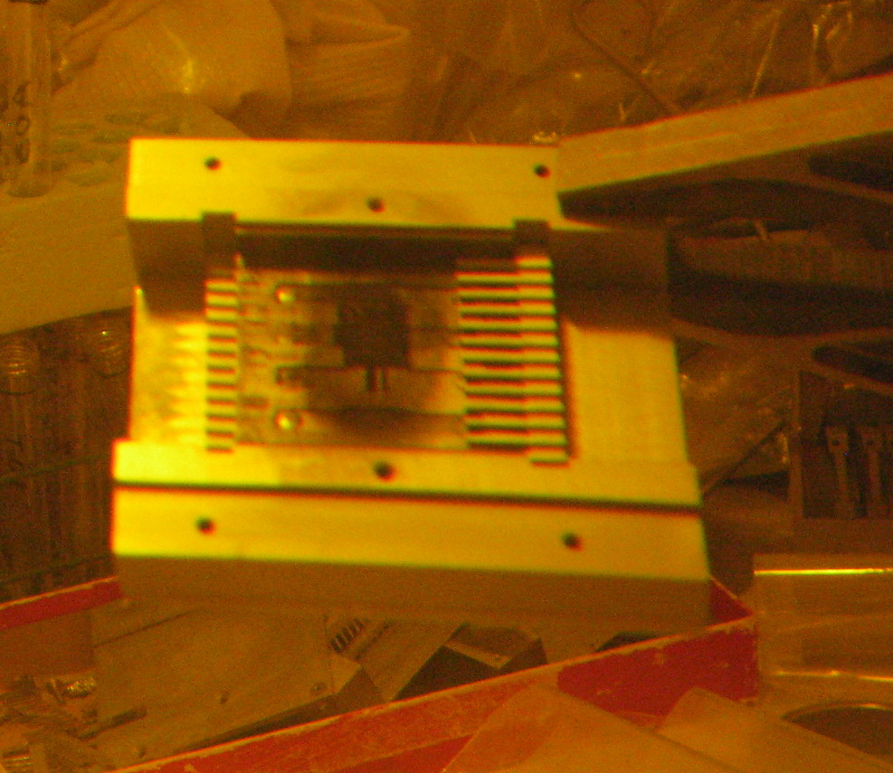
Graphite R&D:
Irradiation Testing at BLIP
Water immersed c-c samples showed structural damage (as before).
Argon encapsulated c-c and graphite samples showed little damage (not pictured here)

Slide 33
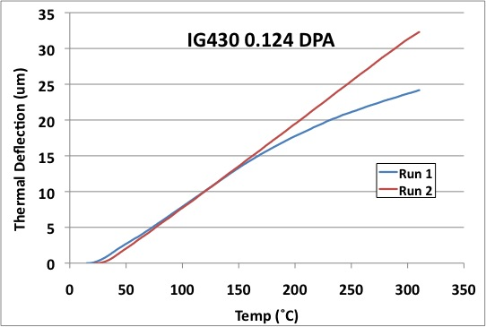
Graphite R&D:
Irradiation Testing at BLIP

Slide 34
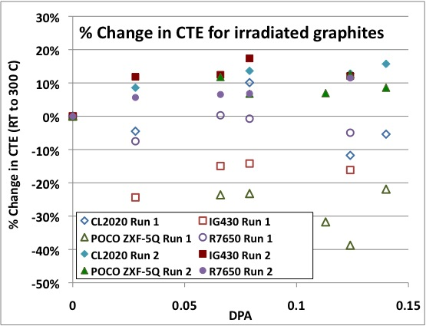
Graphite R&D:
Irradiation Testing at BLIP

Slide 35
Graphite R&D:
Irradiation Testing at BLIP
CTE of almost all graphite samples reduced after irradiation (0.07-0.14 DPA) on first thermal cycle to 300 ˚C depending on graphite type
After first cycle CTE is increased to about 10% more than un-irradiated samples, regardless of graphite type
This behavior is consistent with annealing behavior of materials. Interstitial atoms created by the irradiation drop back into the lattice. Any heating above the irradiation temperature will make the interstitials more mobile.
Since, after annealing to 300 C, we still see damage effects, low temperature annealing does not fully “heal” the material. There may be different mobilization temperatures for vacancy defects than for interstitial defects in graphite due to the HCP lattice. This needs further research.

Slide 36
Graphite R&D:
Irradiation Testing at BLIP

Slide 37
Beryllium R&D:
Conceptual Design Studies at STFC-RAL
High Power Target Group:
CJ Densham
O Caretta
TR Davenne
MD Fitton
P Loveridge
M Rooney
Graphite radiation damage issues prompted LBNE to look at Beryllium as an alternative target material for 2+ MW proton beam power
Accord with (STFC) RAL’s Target Engineering Group
  Beryllium target simulations at 2+ MW
  Integrated Be target and horn conceptual design
  Cooling technology R&D (gas, water, water spray)
  Proton beam window conceptual design
  Air cooled Be target for 700 kW
Focus On:

Slide 38
Beryllium R&D:
Be Target Simulations
Analysis encompasses:
  Physics (FLUKA) – Energy Deposition & Figure of Merit
  Thermal/Structural (ANSYS)
  Dynamic/Stress-wave (Autodyn & ANSYS)
  Off-center beam cases
Beam Parameters:
Pulse Length = 9.78 micro-sec
Proton Beam Energy (GeV) | Protons per Pulse | Repetition Period (sec) | Proton Beam Power (MW) | Beam sigma, radius (mm)
120 | 4.9e13 | 1.33 | 0.7 | 1.5-3.5
60 | 5.6e13 | 0.76 | 0.7 | 1.5-3.5
120 | 1.6e14 | 1.33 | 2.3 | 1.5-3.5
60 | 1.6e14 | .76 | 2 | 1.5-3.5

Slide 39
Beryllium R&D:
Be Target Simulations: Structural
Representative plot of equivalent stress
End of Pulse
120 GeV, 0.7 MW beam
9mm radius Be
Sy~270 MPa at 150 C

Slide 40
Beryllium R&D:
Be Target Simulations: Structural (non-dynamic)
Stresses probably too high for 2 MW cases with 1.5 mm beam sigma radius, but well within reason for 3.5 mm beam sigma radius
Room for optimization (in length as well)!

Slide 41
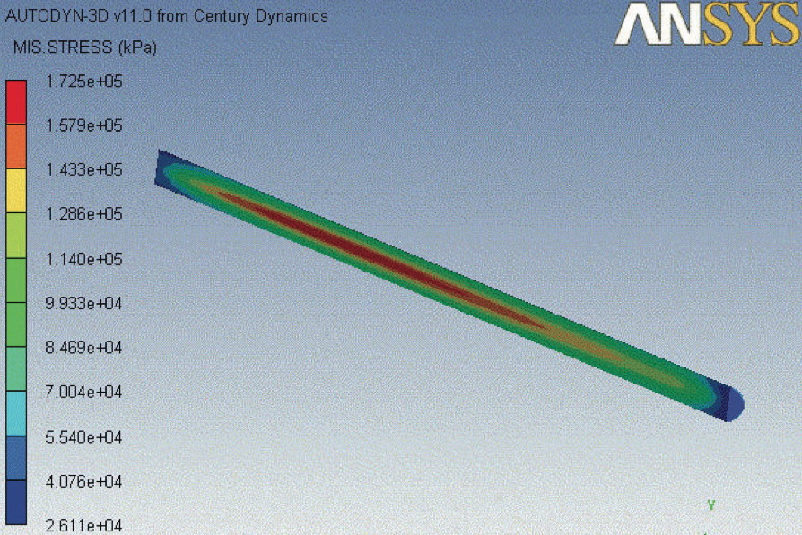
Beryllium R&D:
Be Target Simulations: Dynamic
2.3 MW
120 GeV
3.5 mm sigma spot
Compare to 88 Mpa for static case (double)
Mainly longitudinal stress- waves

Slide 42
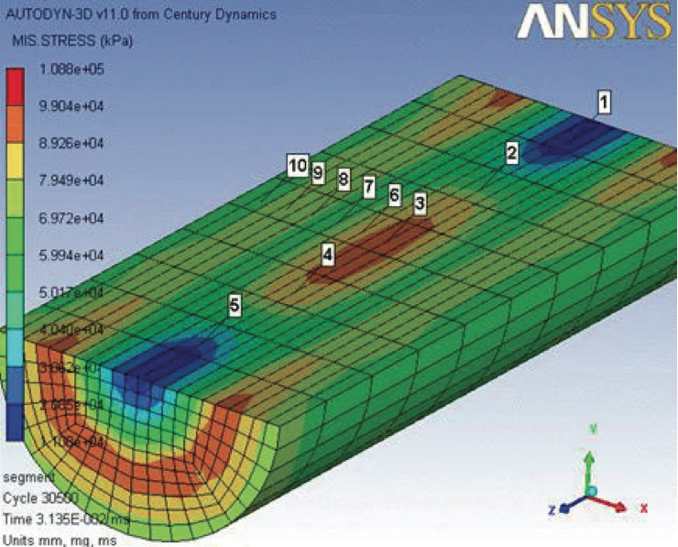
Beryllium R&D:
Be Target Simulations: Dynamic
2.3 MW
120 GeV
3.5 mm sigma spot
50 mm Segments
Peak eqv stress reduced to 109 MPa from 173 MPa

Slide 43
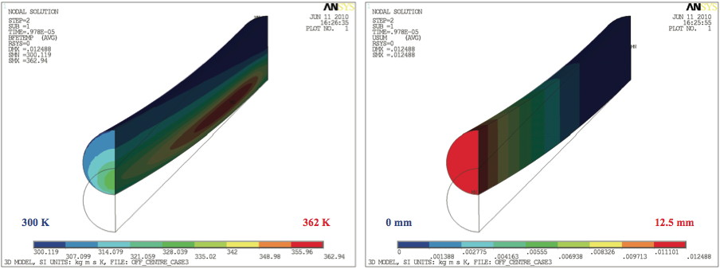
Beryllium R&D:
Be Target Simulations: Off Center Beam
2.3 MW
120 GeV
3.5 mm sigma spot
2 sigma offset
Clearance to Horn Inner Conductor is ~5mm
Bending stress and resonance is a problem
Target will need radial supports

Slide 44
Beryllium R&D:
Be Target Simulations: Spherical

Slide 45
Beryllium R&D:
Be Target Simulations: Spherical
Spherical shape advantages
  Eliminates stress concentrations
  Reduces dynamic stress
  Allows pions to escape
  Allows cooling in target central area

Slide 46
Summary
Although challenging, critical design issues have been identified for high power, solid targets
Graphite radiation damage testing at BNL
First stage Be target design study by RAL shows promise of Be target for LBNE at 2.3 MW
Future work includes:
  Continuation of graphite sample testing
  Further Be design studies
  Be target testing at new High RadMat Facility (CERN)?

Slide 47
Thanks to all
N. Simos, J. Misek, H. Kirk, J. O’Conor, C. Densham, T. Davenne, P. Loveridge, M. Fitton, M. Rooney, O. Caretta, J. Hylen, R. Campos, N. Mokhov, T. Grumstrup, R. Zwaska, V. Sidorov, A. Leveling and many others…

Slide 48
Additional slides, if time…

Slide 49
Thermal Shock
Work at RAL-Sheffield by R. Bennett and G. Skoro to study solid targets for NuFact
  Pulsed Ta & W wire testing
  Benchmark simulation techniques
  Show promise of solid W at 4 MW
Upcoming Publications:
  G.P. Skoro et al. / Journal of Nuclear Materials 409 (2011) 40–46
  Nuclear Inst. and Methods in Physics Research A, DOI:10.1016/j.nima.2011.03.036

Slide 50

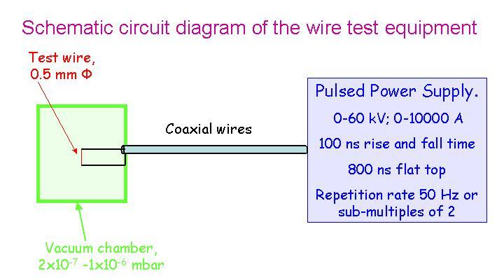
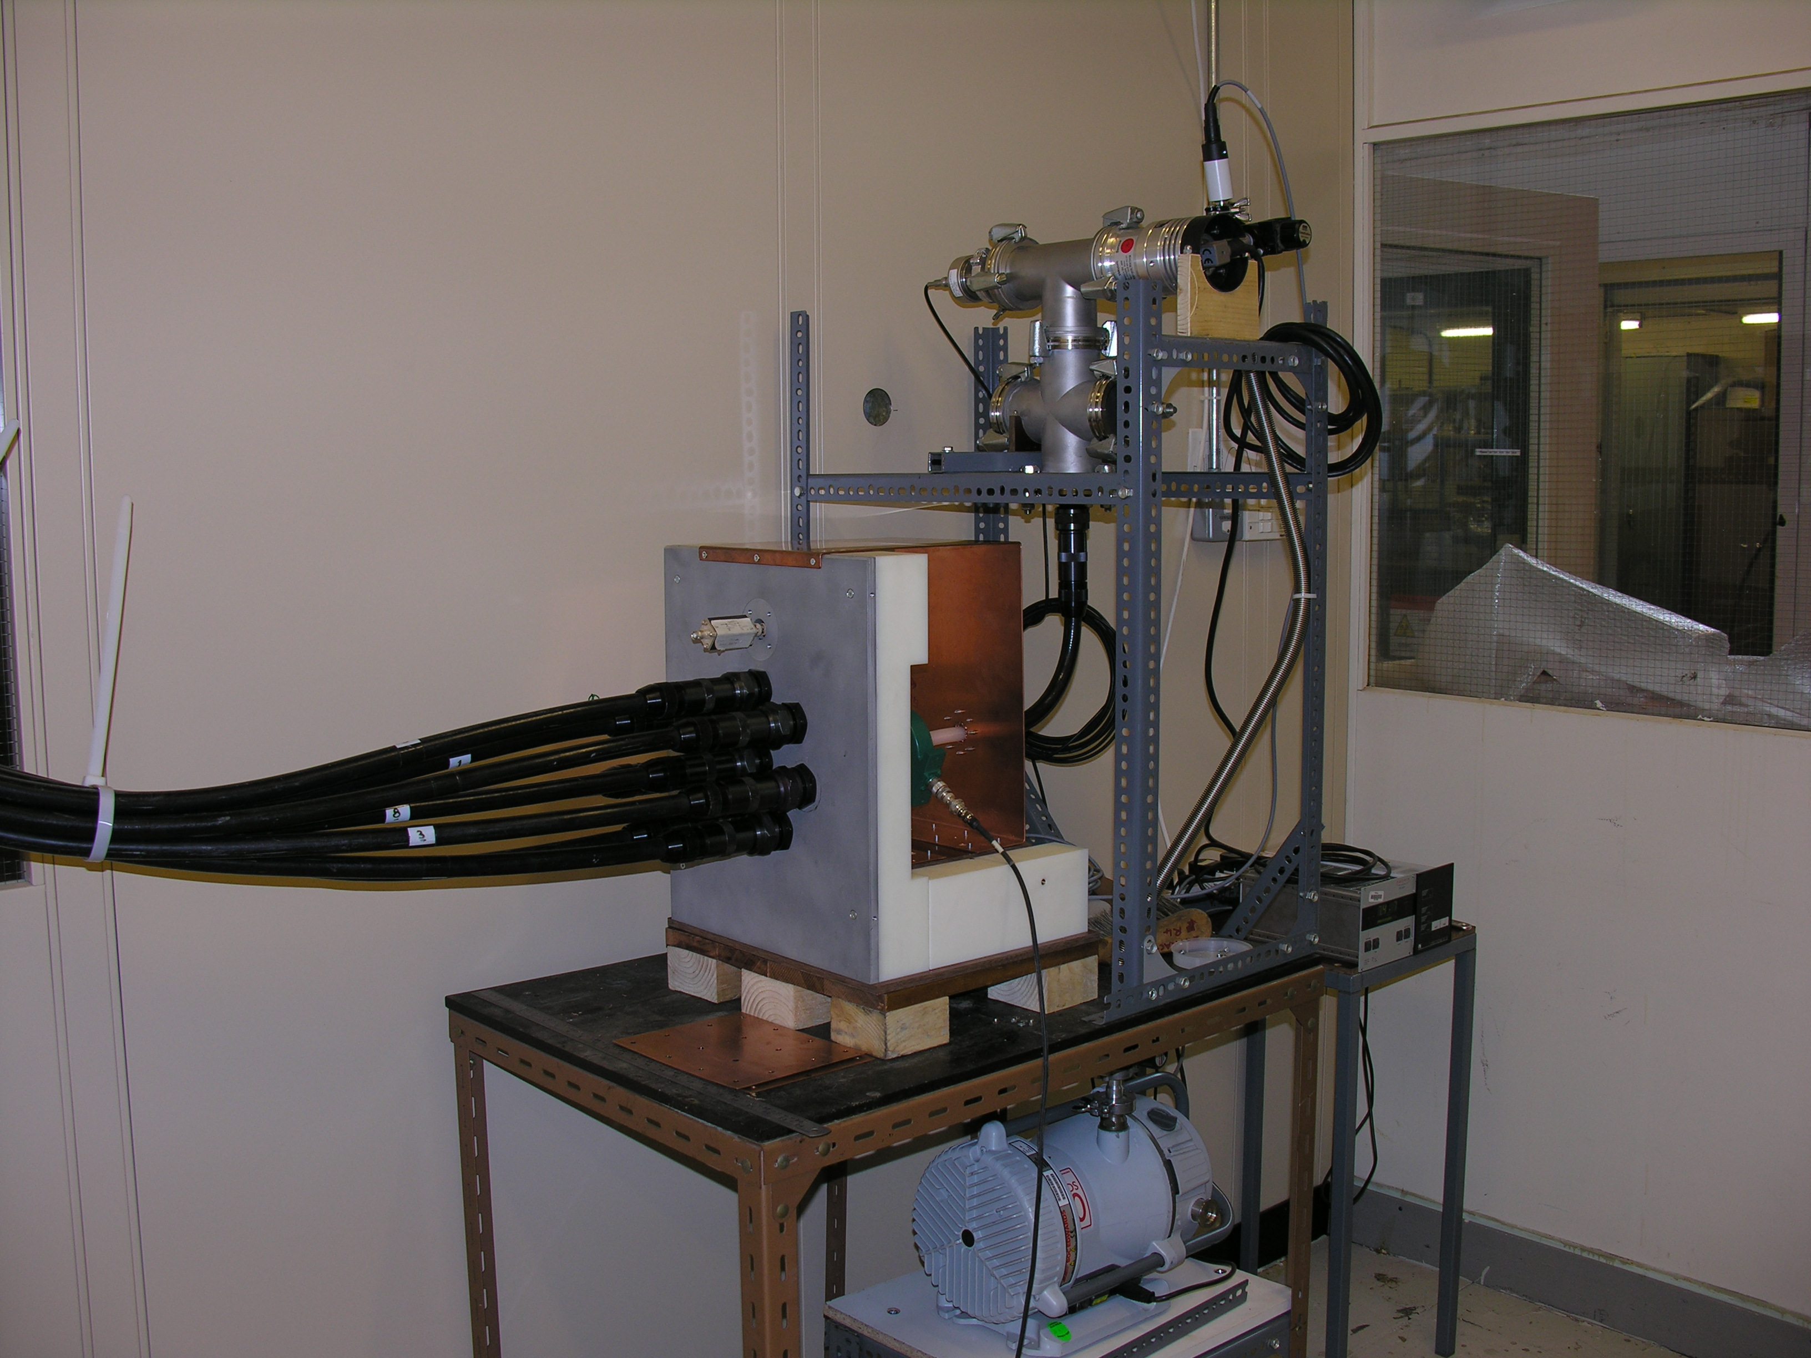
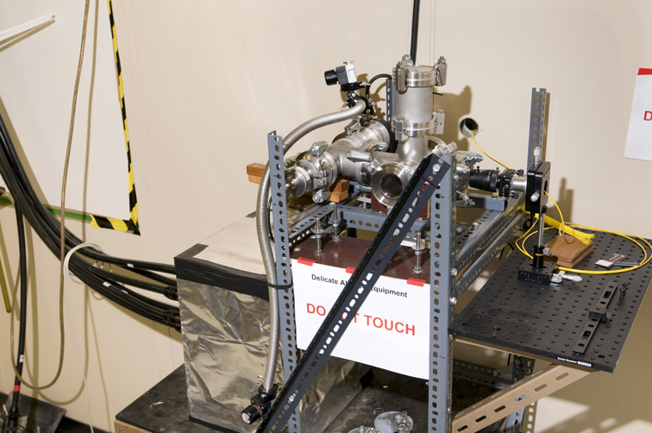
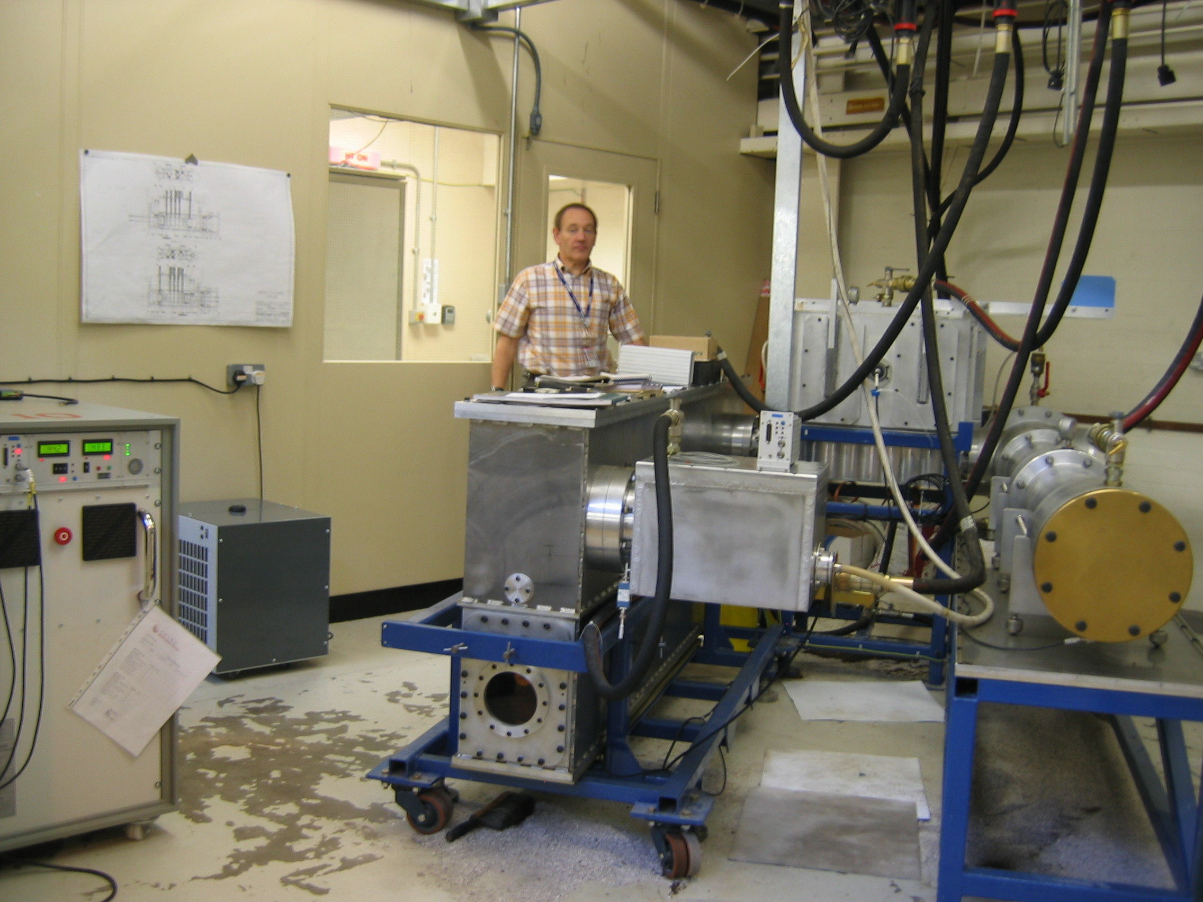
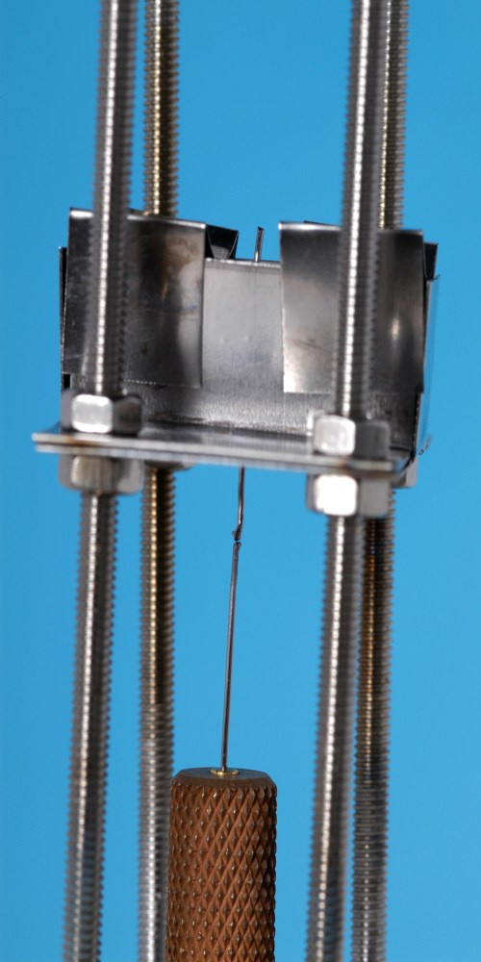
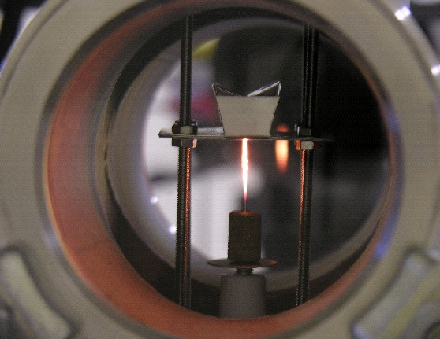
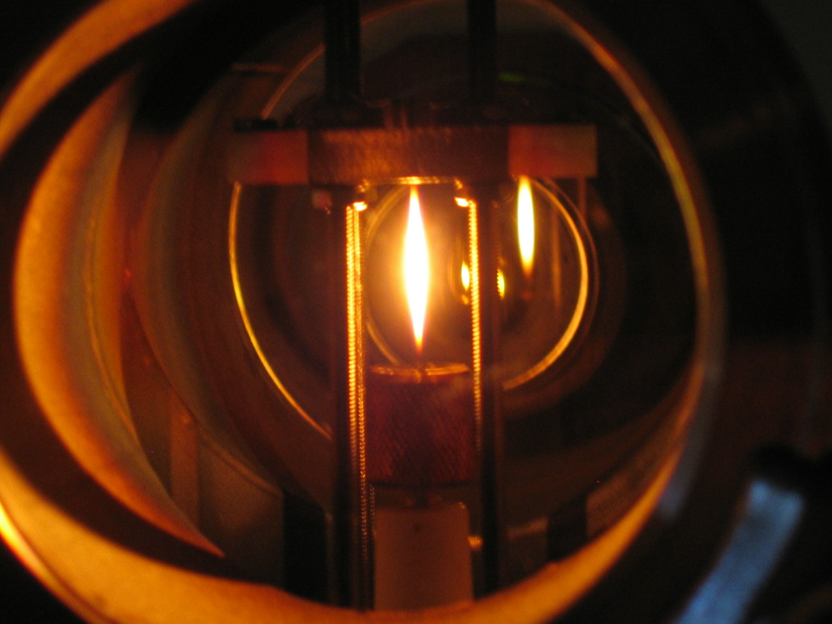
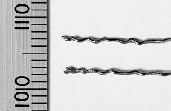
  Introduction Current pulse – wire tests at RAL
Tantalum wire – weak at high temperatures
  Tungsten – much better!!!
The Finite Element Simulations have been used to calculate equivalent beam power in a real target and to extract the corresponding lifetime.

Slide 51
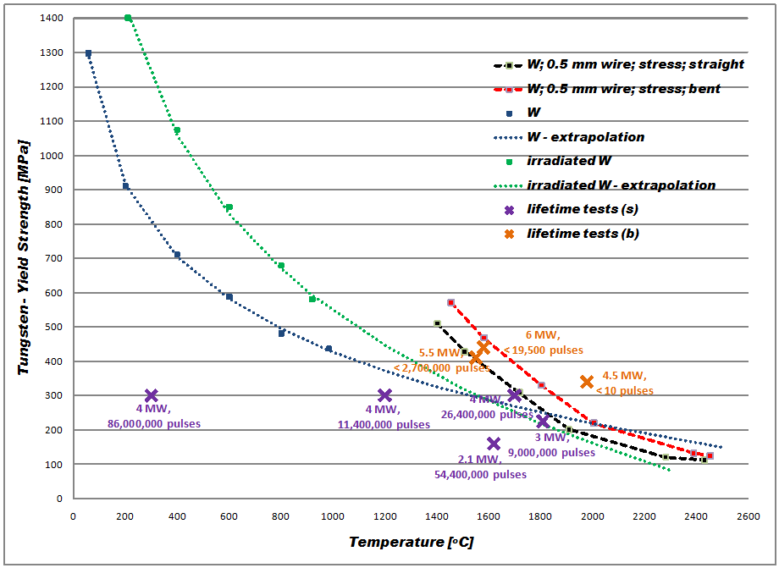
Yield strength of tungsten – our results
Combination of visual observation of the wire and LS-DYNA simulations
Stress in
NF target

Slide 52
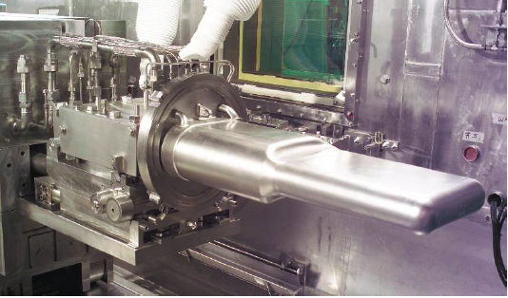
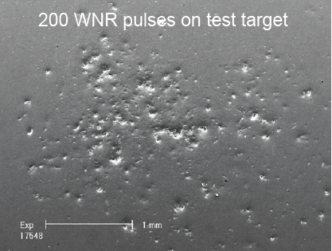
Thermal Shock
SNS Hg Target Cavitation problems
J. Haines, B. Riemer, ORNL

Slide 53

Beryllium R&D:
Be Target Simulations: FoM
Figure of Merit
  Provide simple, faster way to gauge effects of target/beam parameter changes on yield of neutrinos of interest
  Proposed by R. Zwaska
Notes:
The FoM is calculated using FLUKA to obtain the yield of pions of both signs emerging from the target into the surrounding vacuum. The specific output taken from FLUKA is the plain double differential yield of pions of both signs with respect to the kinetic energy and the transverse momentum of the pions, i.e.where,␣N = number of pions of both signs emerging from the target per primary particle on target ␣E = kinetic energy of the pions [GeV] ␣p = transverse momentum of the pions [GeV/c]We can then obtain the yield of pions per incident proton on target as a function of energy and transverse momentum. To do this a simple numerical integration of the double differential yield is carried out between the following limits :␣kinetic energy from 1.5GeV to 12GeV with 21 discrete intervals of width 0.5GeV ␣transverse momentum between 0 and 0.4GeV/c with a single intervalFigure 3.2.1 shows the resulting pion yield in histogram form. A weighting factor is then calculated for each of the 21 energy intervals which is equal to the energy at the centre of the interval raised to the power 2.5. The energy at the centre of each interval is given by :where for example for the first interval Emin=1.5GeV and Emax=2GeV. The FoM is calculated as the summation of the yield in each energy interval multiplied by the corresponding weighting factor for that interval expressed mathematically as follows.Figure 3.2.2. indicates that the majority of the pions from the target are towards the lower end of the energy range of interest. By integrating over 30intervals in transverse momentum from 0GeV/c to 1.5 GeV/c for three different energy levels the yield as a function of transverse momentum is obtained (Figure 3.2.3).

Slide 54
Beryllium R&D:
Failure Criteria – Simulation versus Reality
Predicted Peak Energy Deposition for LBNE 2.3 MW with 1.5 mm beam sigma radius was 846 J/cc and thought to cause stresses too high for Be to survive
But P-bar Target (FNAL) has a Beryllium cover that regularly sees 1000 J/cc and shows no evidence of damage
ANSYS analysis for similar conditions suggests peak equivalent stresses of 300 Mpa (elastic-plastic, temp-dependent mat’l properties, but not dynamic)
Dynamic stresses could be 30-50% higher

Slide 55
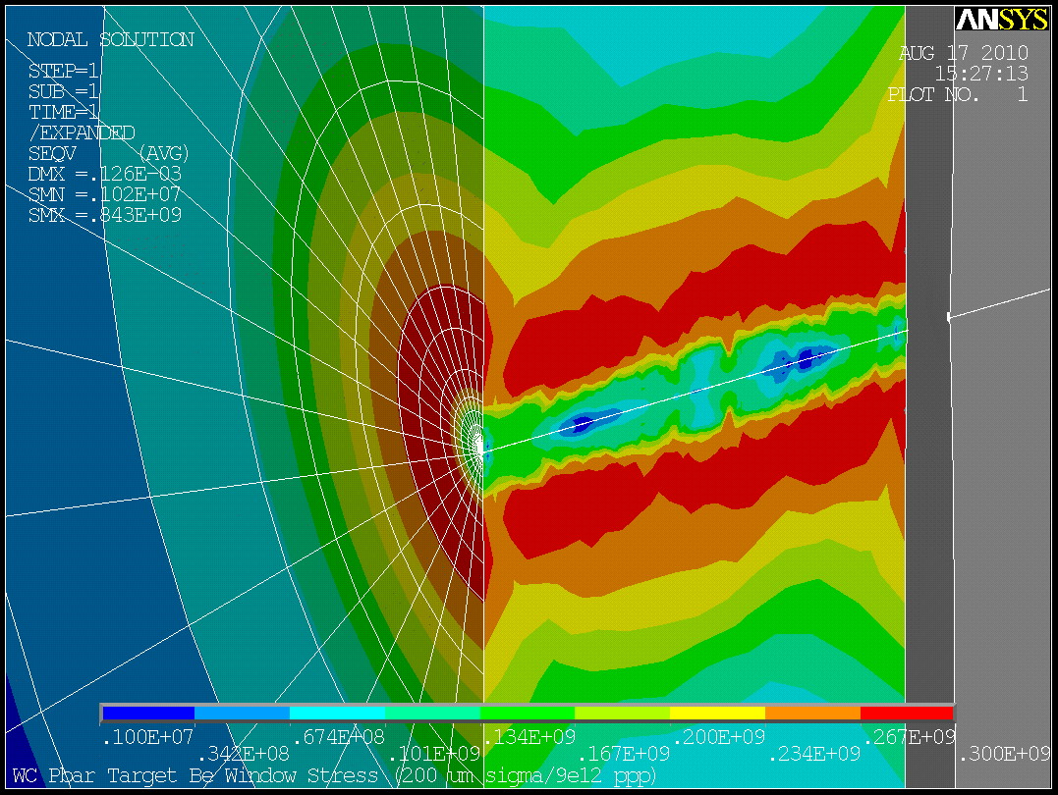
Beryllium R&D:
Failure Criteria – Simulation versus Reality
120 GeV
0.2 mm sigma
Elastic/plastic
Temp Dependent Mat’l Properties
Peak Seqv is 300 MPa
Peak Temp is ~800 C
Be Melting Temp is 1278 C
Be UTS at 600 C is ~150 MPa

Slide 56

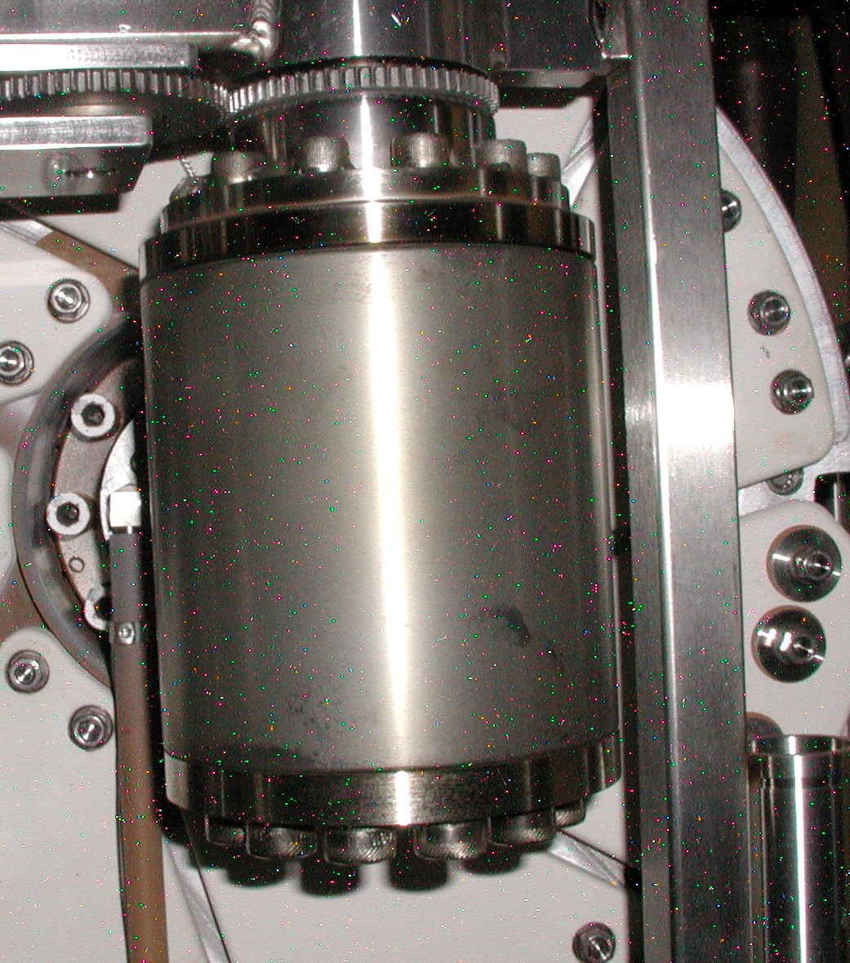
Beryllium R&D:
Failure Criteria – Simulation versus Reality
Rotated 17 degrees every pulse
Moved 1 mm vertically every 2e17 protons
Typical beam sigma was 0.195 mm (last 1-2 months of running at 0.15 mm)
Typical ppp was 8E12
This target saw about 5e6 pulses at the time photo was taken
Pbar Target 7 without Be cover. Inconel Target Material is Consumable!

Slide 57
Beryllium R&D:
Failure Criteria – Simulation versus Reality
Possible explanations
  Small areas of deformation not visible
    Analysis indicates about 0.05 mm of plastic deformation on surface in an outward “bump” with diameter of about 1 mm
  Beam profile is not gaussian
    At such small sigma, peak energy deposition would be reduced greatly if profile were flat in center of beam
  Fast energy deposition rate creates high strain rates
    Yield strength of metals increases for high strain rates

Slide 58
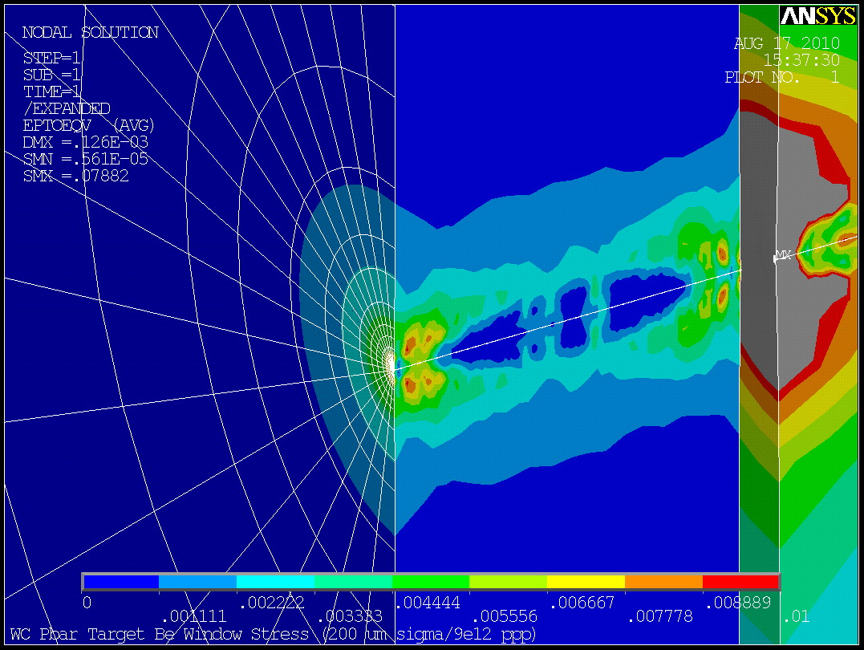
Beryllium R&D:
Failure Criteria – Simulation versus Reality
Max strain predicted is 0.01 strain
Pulse length is 1.6 micro-sec
Strain rate is over 6,000 s⁻¹
For LBNE 2.3 MW, 3.5 mm sigma, strain rate=100 s⁻¹
For LBNE 2.3 MW, 1.5 mm sigma, strain rate=340 s⁻¹

Slide 59


Beryllium R&D:
Failure Criteria – Simulation versus Reality
T Nicholas, et al., Mechanical Properties of Structural Grades of Beryllium at High Strain Rates, AFML-TR-76-168, Air Force Materials Laboratory, Wright Patterson Air Force Base, Ohio, 1976
UTS vs strain rate
S200E Be
F.L. Schierloh and S.G Babcock, Tensile Properties of Beryllium at High Strain Rates and Temperatures, AFML-TR-69-273, General Motors Tech Center, 1969
Yield and Ultimate Stresses increase by 25-40% at strain rates greater than 100 s⁻¹
Significant increased hardening as well

Slide 60


Beryllium R&D:
Failure Criteria – Simulation versus Reality
Damage seen on Be Lithium Lens Windows
Just DS of Target
Higher Temperature
Higher Stress (10,000 psi of Li pressure on other side)
Damage observed after 8 months of running at reduced spot size of 0.15 mm sigma and not at larger spot size (0.19 mm sigma)

Slide 61
Beryllium R&D:
Failure Criteria – Simulation versus Reality
More work needs to be done in this area to set limits of Be in high power proton beams
  Effects of irradiation and temperature
  Refined simulation of actual conditions
  In beam validation/benchmarking test
For now, set conservative limits and push the envelope later…

