Slide 1
Requirements for a future nedm experiment
Intensity, intensity, intensity
Magnetic field control
Courage (foolhardiness)
Not Discussed in this talk:
nedm vs. atomic edm
Nedm vs. n-nbar
Method for doing a nedm search to 10^(-29) e-cm

Slide 2
Edm’s are important
A non-zero edm of a particle in a non-degenerate state violates time reversal
Violates time reversal

Slide 3
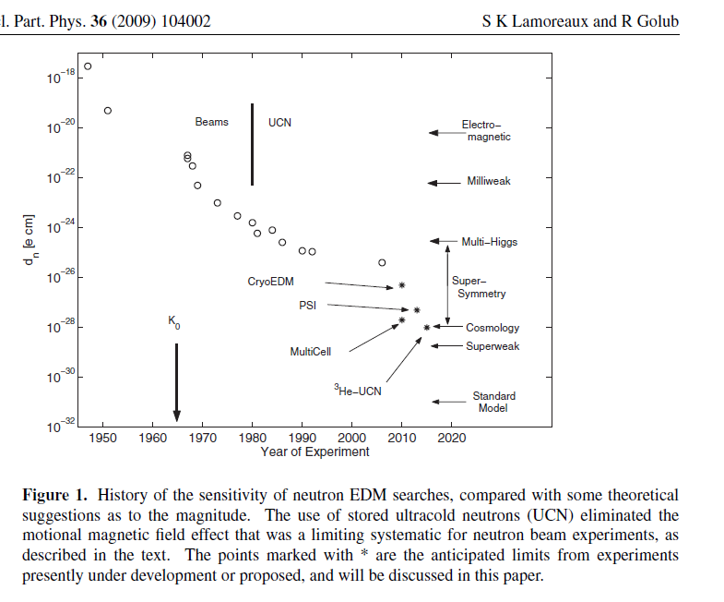

Slide 4
N=total number of neutrons measured in cell
Per cycle
Say 50 measurement cycles per day (30 minutes each)
In 1 year 50x365=18000=135^2
N=4x10^6 for x=10(-28) cm
For V=10^4 cm^3….10^4/cm^3 =>x=2x10^-29 cm

Slide 5
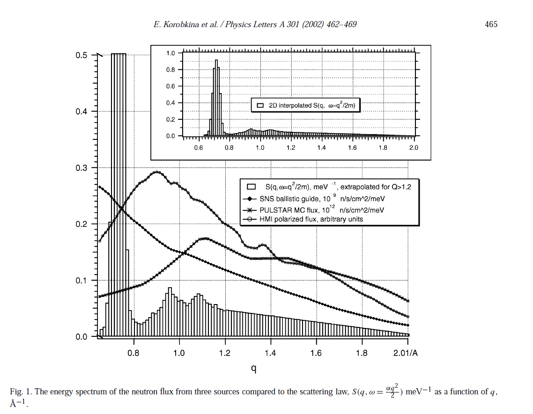
Production of UCN as a function of neutron momentum
Single phonon and multi-phonon
SNS
NCSU

Slide 6
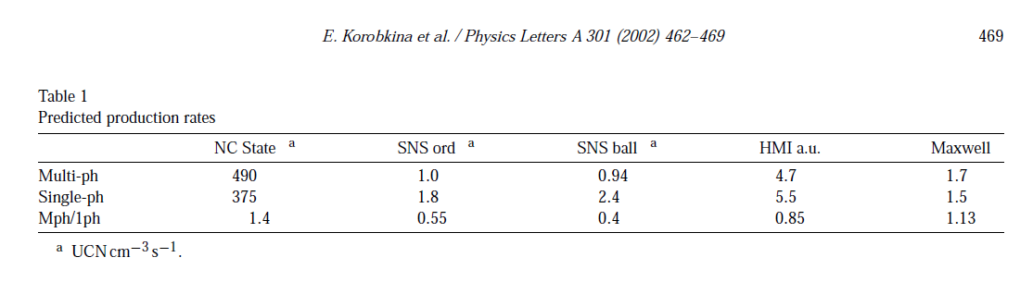

Slide 7
Magnetic field troubles
But we don’t measure in one cycle:
Fluctuations independent of E field average over
Repetitions so we require a B field noise of about
Or

Slide 8
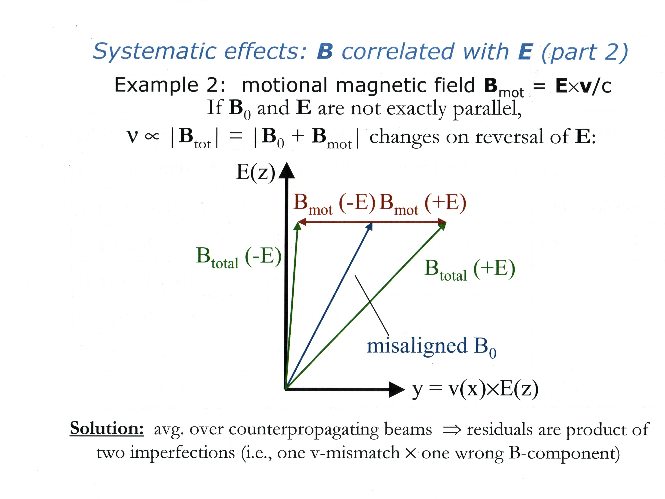

Slide 9
vxE effect averaged away
Compare 10^-24 ev for x=10^(-28)cm
Average over particles N>10^6
Second order v x E small

Slide 10
Big trouble…
Magnetic field
Perpendiculat to v
Rotates with v
BLOCH-SIEGERT
Frequency shift ~ (Beff)^2
If
However
then
Important systematic effect
E
Discovered by Cummins…molecular beam edm experiment

Slide 11
-v
+v
Geometric Phase Picture

Slide 12
Velocity autocorrelation function
BLOCH SIEGERT
(again)

Slide 13
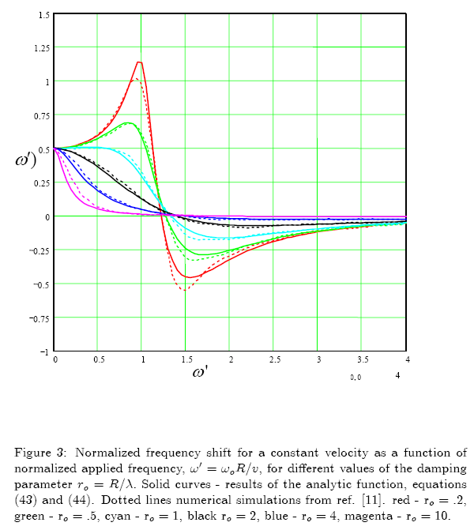

Slide 15
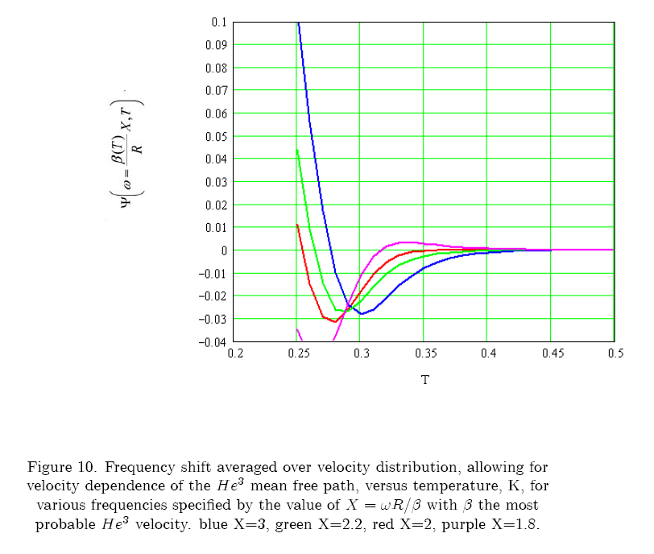

Slide 16
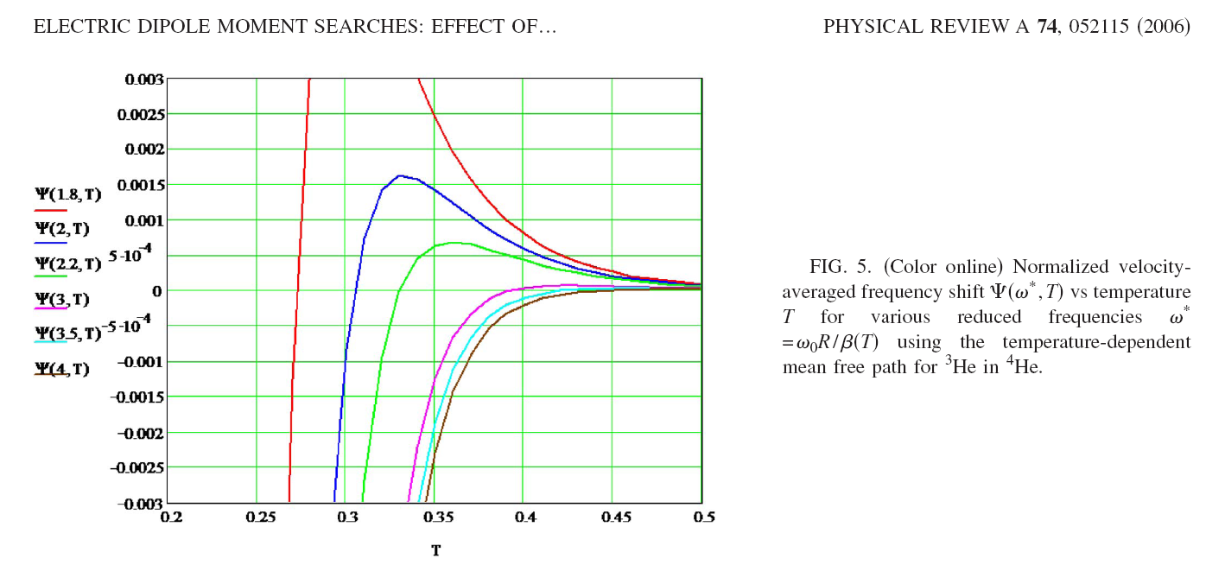
For UCN need

Slide 17
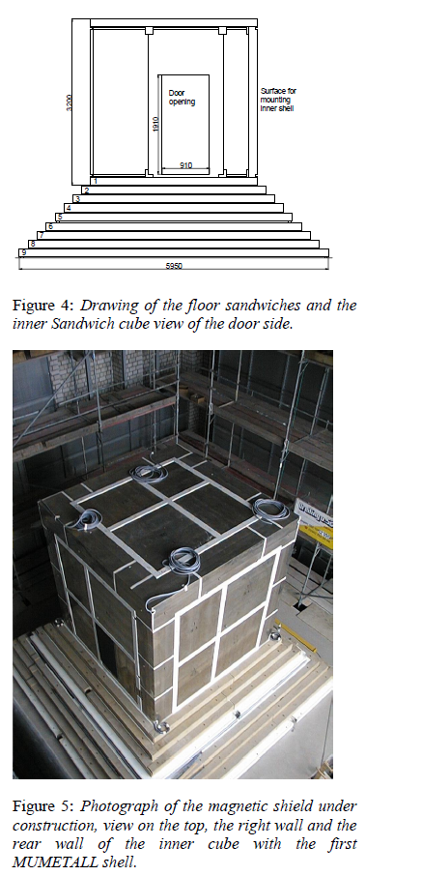
Need such a shielded room to start any new edm project,
PTB, Berlin
$10^7

Slide 18
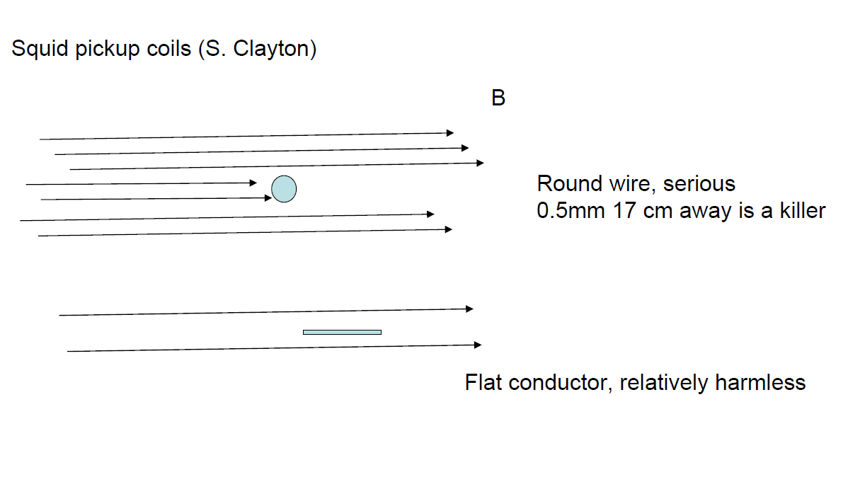
Recently discovered systematics (selected)
A current problem is the frequency shift (false edm) due to magnetic dipole perturbations (dust particles)
Few micron particles can be dangerous

Slide 19

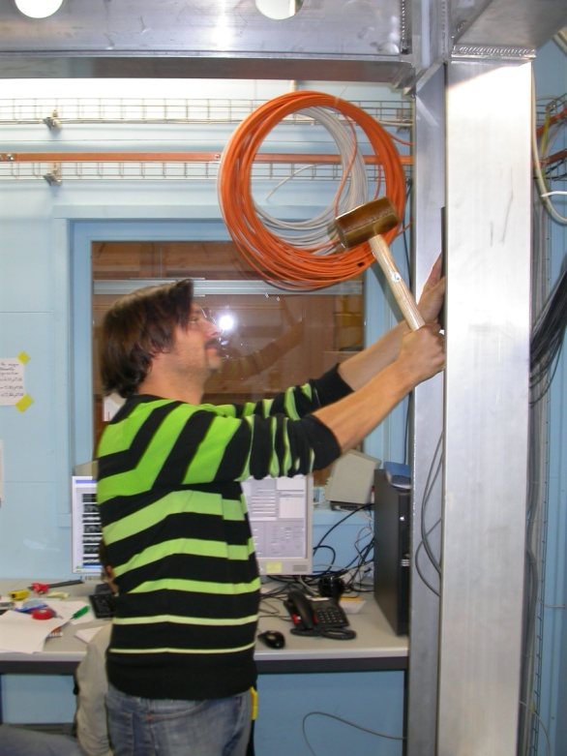
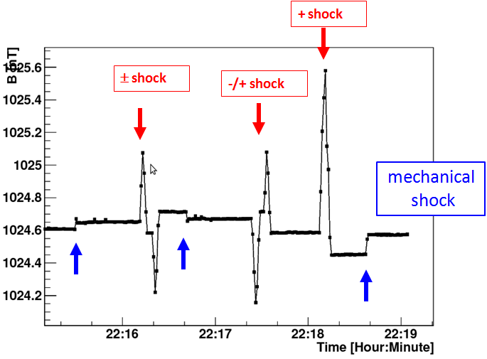
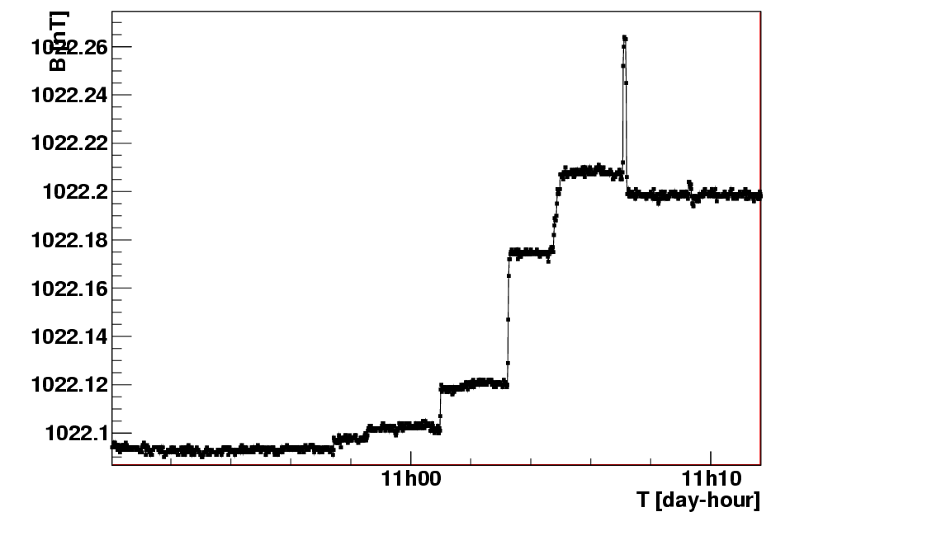
Phase II – Mu-metal effects
Magnetization due to vibrations
External magnetic event
Hit support pillars with a rubber-hammer
Nano-Tesla
‘shoulder’ bumps
Magnetic shocks produce similar effect
P. Fierlinger – PSI User Meeting

Slide 20
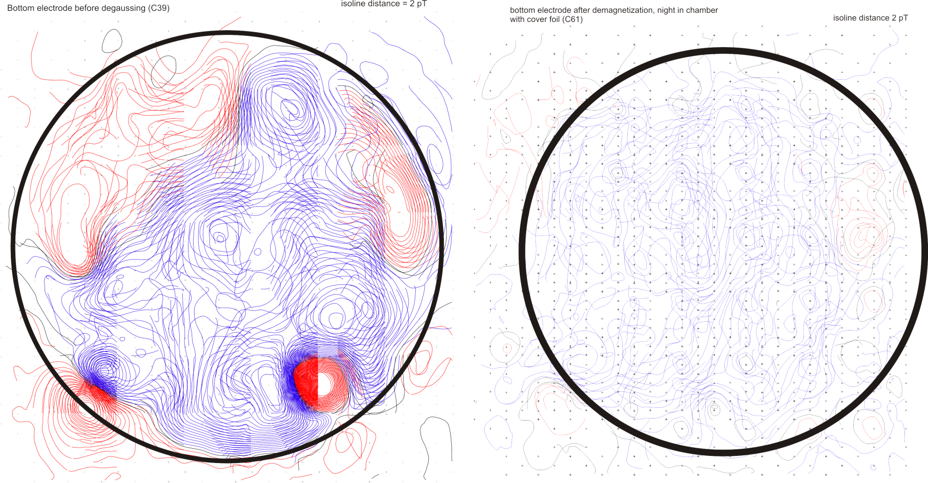
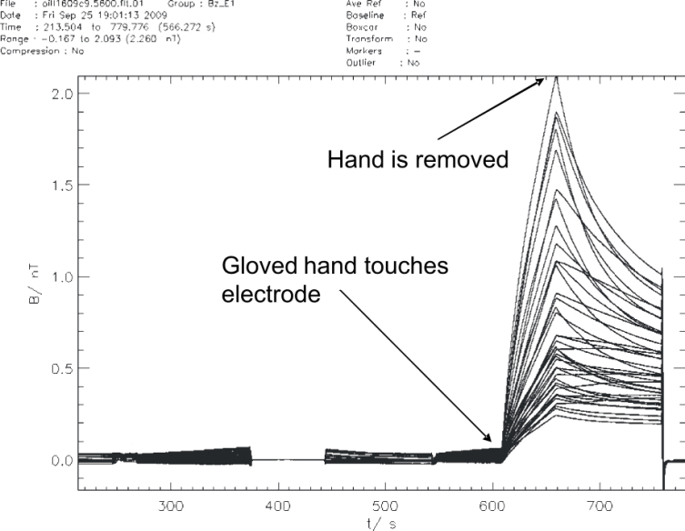
Phase II - Electrodes
Magnetic dipoles removed
Demagnetization
Thermal phenomena discovered
SQUID measurements @ PTB Berlin
10 cm
B (nT)
2
2 nT
Before:
200 pT pp
After:
20 pT pp
1
Aluminum -----Different Squids=different τ
0
Non-metallic electrodes
Time (few 100 s)
Requires 200-400 μAmps ??
P. Fierlinger – PSI User Meeting

Slide 21
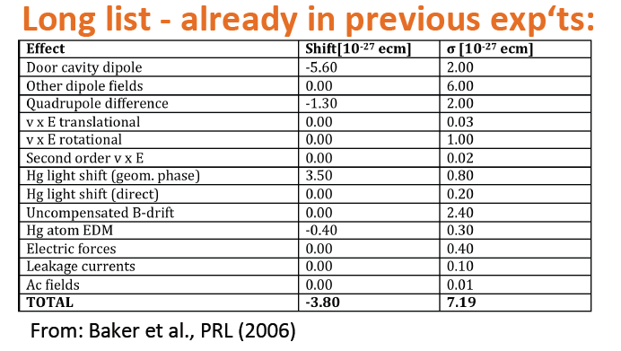
Error budget from last experiment, ILL

Slide 22
Take-away message, minimum requirements
UCN density…..3 x 10^4 UCN/cm^3
Magnetically Shielded Clean Room
Superconducting shield
Co-magnetometer
Luck (a lot)

Slide 23
