Slide 1
Standard Model Tests with Nuclei and
Energy Applications
Jerry Nolen, ANL and Guy Savard, ANL/Uof C (Standard Model)
Yousry Gohar, ANL and Shekhar Mishra, FNAL (Energy)
November 17, 2010

Slide 2
Joint Facility for Standard Model Tests with Nuclei and Energy Applications
MW-scale CW proton beams can serve a variety of functions beyond those of traditional high energy physics research, such as:
  Copious production of special short-lived isotopes to support fundamental searches for physics beyond the Standard Model using stopped beams
  Materials irradiations and target developments in support of future energy applications, especially for nuclear fission power, fusion power, and transmutation technologies
Examples of flagship experiments enabled by such a joint facility are covered in this presentation

Slide 3
Functional Layout of the Joint Facility at Project X
1 MW at 1 GeV or 3 GeV
incident beam
Selection dipole
Standard Model
Experiments
Support Services
Energy applications
Isotope Production
Material irradiation
3

Slide 4
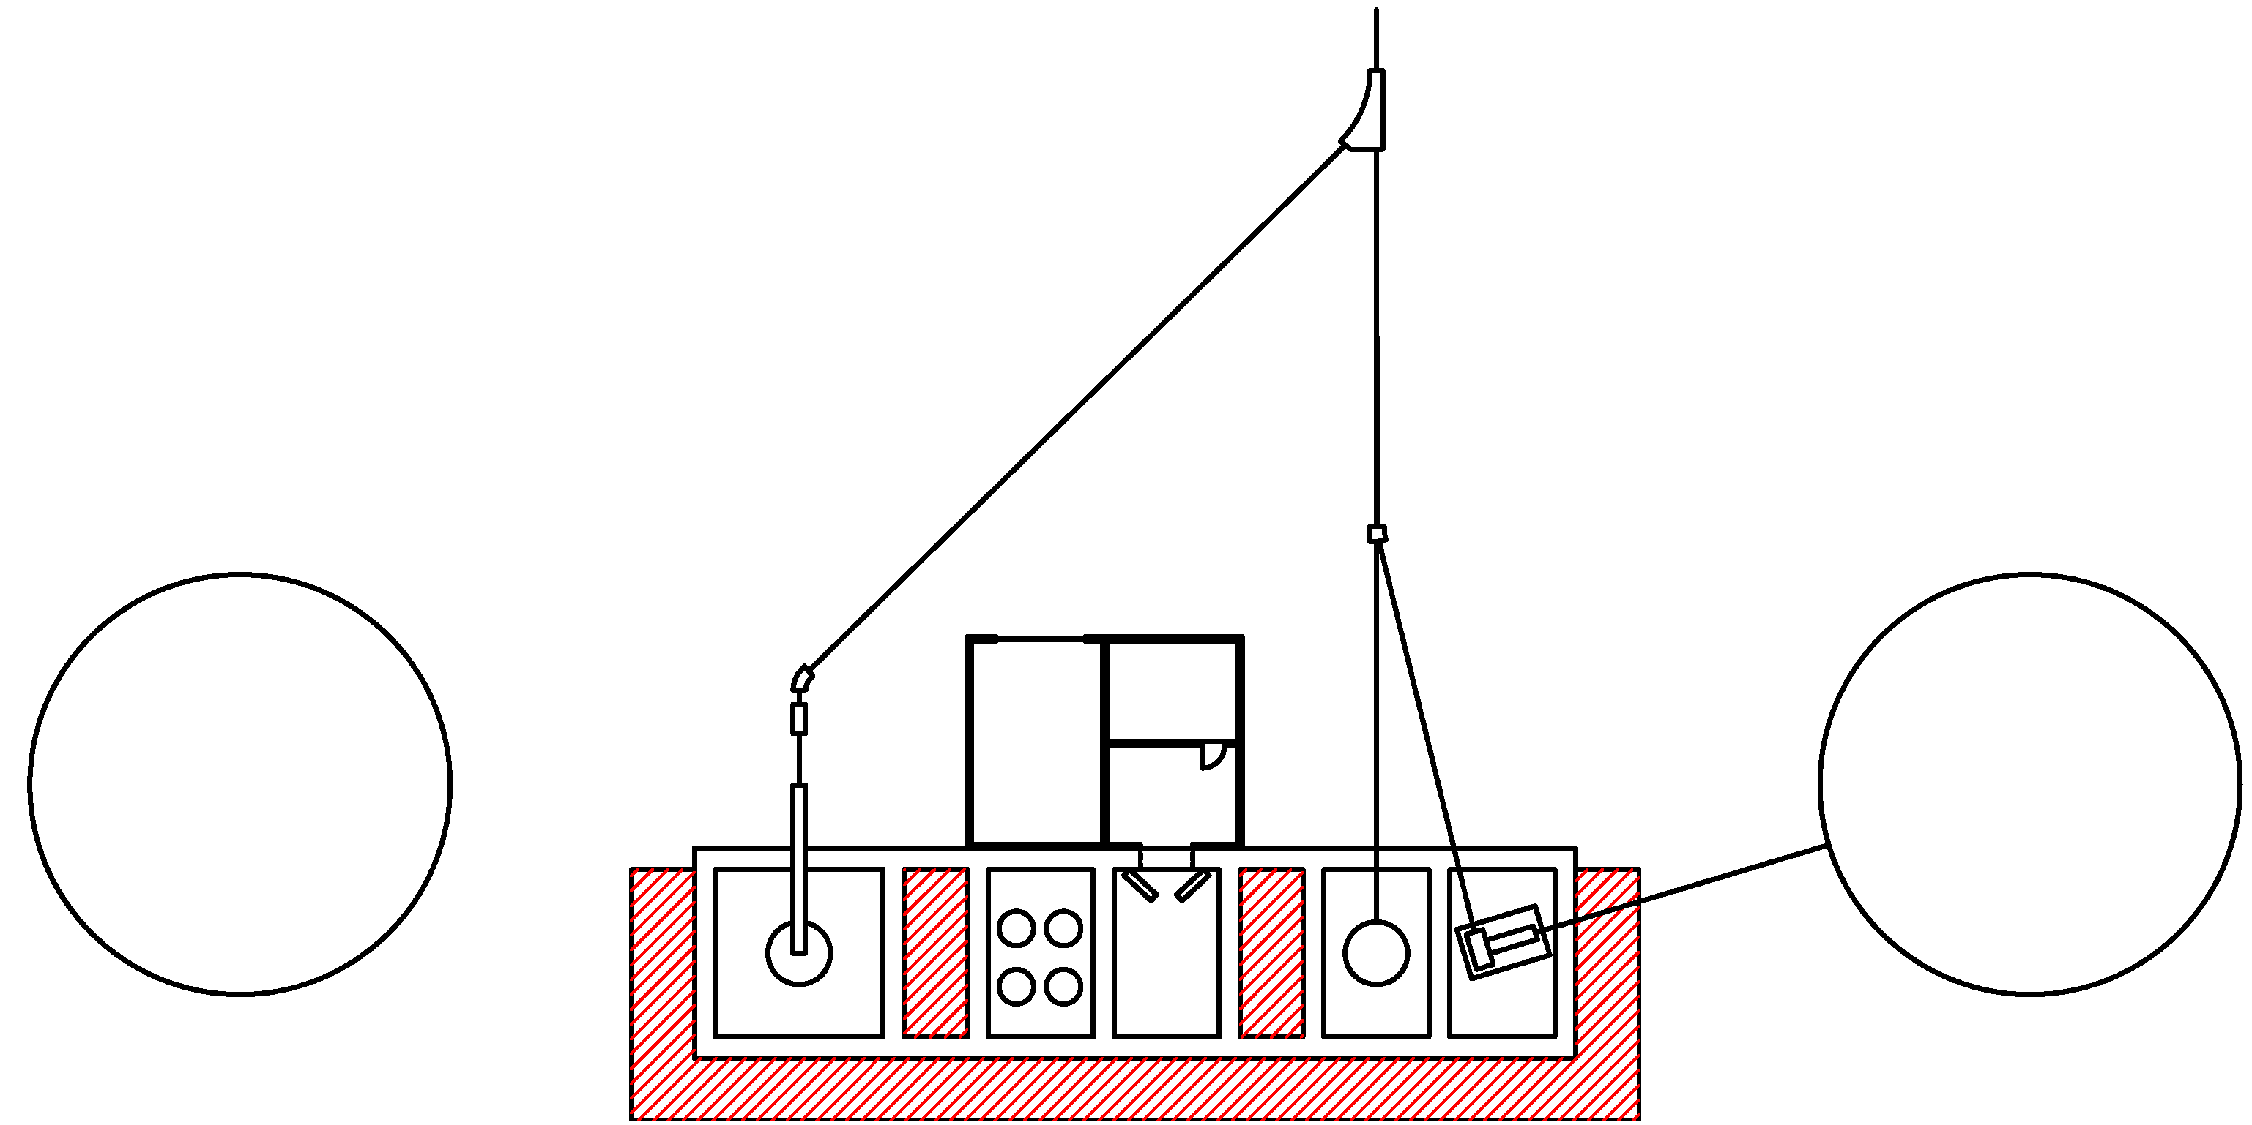
Schematic Layout of the Joint Facility at Project X
Proton Beam
1 GeV or 3 GeV, 1 MW
Energy applications
support infrastructure
Standard Model
experiments
Isotope
production
Energy applications station
Materials irradiation station

Slide 5
Project X: Source of Enhancer Isotopes
Slides from Z.T. Lu,
Argonne/UofC
Region of Enhancers
Radon (Rn) Francium (Fr) Radium (Ra)
Favorable nuclear and atomic properties
No stable isotopes
Project X will supply these isotopes in abundance

Slide 6
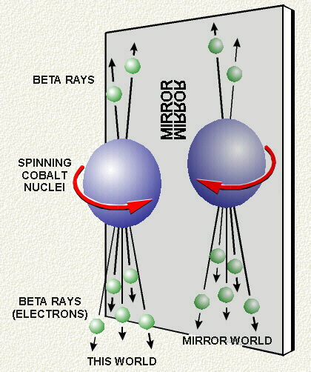
Discrete Fundamental Symmetries
Parity violation – First observation
P
Parity
Charge conjugation
CP symmetry
Time reversal
CPT – Exact symmetry in quantum field theory with Lorentz invariance
C
CP
⁶⁰Co
T
CPT
C. S. Wu et al. (1957)

Slide 7
Electric Dipole Moment (EDM) Violates Both P and T
A permanent EDM violates both time-reversal symmetry and parity
+
T
+
P
-
-
-
+
EDM
Spin
EDM
Spin
EDM
Spin
“The existence of an EDM can provide the “missing link” for explaining why the universe contains more matter than antimatter.”
“The non-observation of EDMs to-date, thus provides tight restrictions to building theories beyond the Standard Model.”
-- P5 report : The Particle Physics Roadmap (2006)
“A nonzero EDM would constitute a truly revolutionary discovery.”
-- NSAC Long Range Plan (2007)

Slide 8
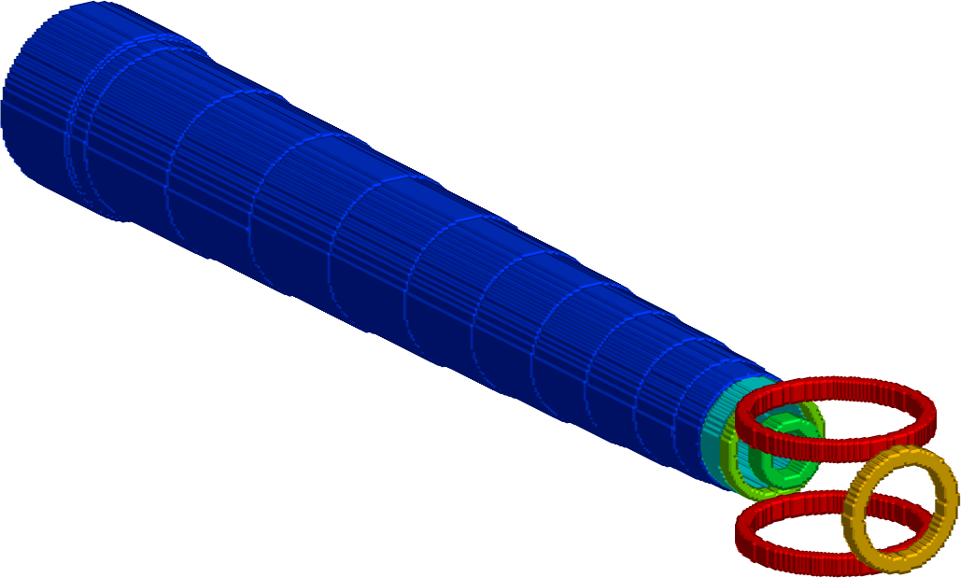
Search for EDM of ²²⁵Ra at Argonne
Status and Outlook
First atom trap of radium realized;
Guest et al. Phys Rev Lett (2007)
Search for EDM of ²²⁵Ra in 2011;
Improvements will follow.
Oven:
²²⁵Ra (+Ba)
²²⁵Ra
Nuclear Spin = ½
Electronic Spin = 0
t_{1/2} = 15 days
Zeeman
Slower
Magneto-optical
trap
Why trap ²²⁵Ra atoms
Large enhancement:
EDM (Ra) / EDM (Hg) ~ 1,000
Efficient use of the rare ²²⁵Ra atoms
High electric field (> 100 kV/cm)
Long coherence times (~ 100 s)
Negligible “v x E” systematic effect
EDM
probe
Optical
dipole trap

Slide 9
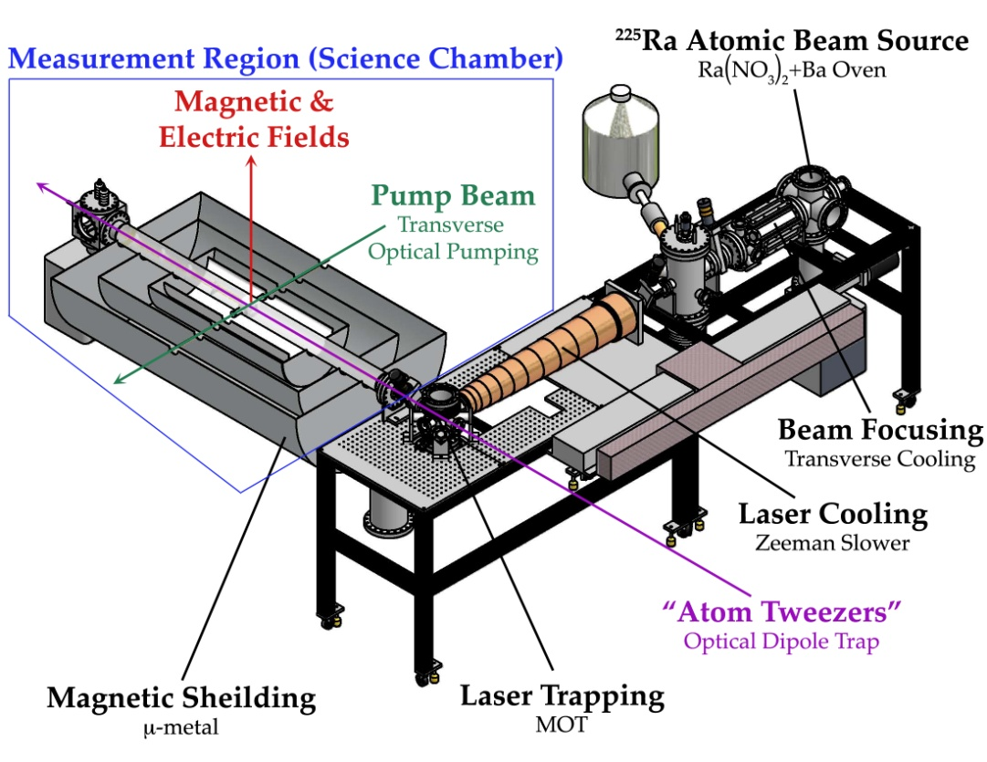
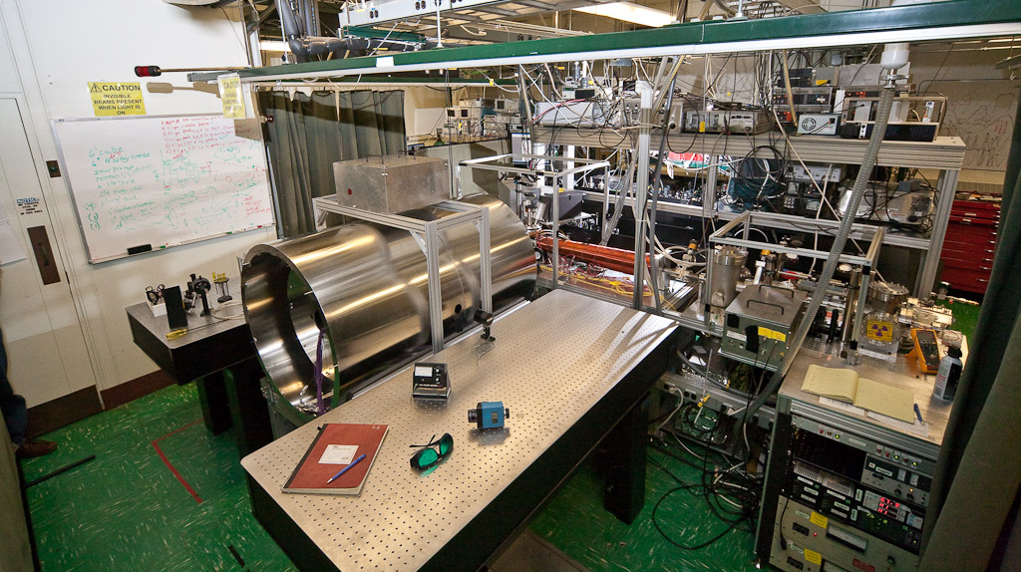
EDM search experiments are “portable”
²²⁵Ra EDM search apparatus
under construction at Argonne

Slide 10
Search for ²²⁵Ra EDM at Project X
²²⁹Th
7300 yr
Present scheme
1 mCi ²²⁹Th source → 4 x 10⁷ s⁻¹ ²²⁵Ra
Upgrade path to 10 mCi
Projected EDM sensitivity: 10⁻²⁶ – 10⁻²⁷ e-cm
Equivalent to 10⁻²⁸ – 10⁻³⁰ e-cm for ¹⁹⁹Hg
Current limit on ¹⁹⁹Hg: 2 x 10⁻²⁸ e-cm
α
²²⁵Ra
15 d
β
Search for ²²⁵Ra EDM at Project X
Project X yield: 1 x 10¹³ s⁻¹ ²²⁵Ra
Projected EDM sensitivity: 10⁻²⁸ e-cm
Equivalent to 10⁻³⁰ – 10⁻³¹ e-cm for ¹⁹⁹Hg
Study systematics at 10⁻²⁹ e-cm for ²²⁵Ra

Slide 11
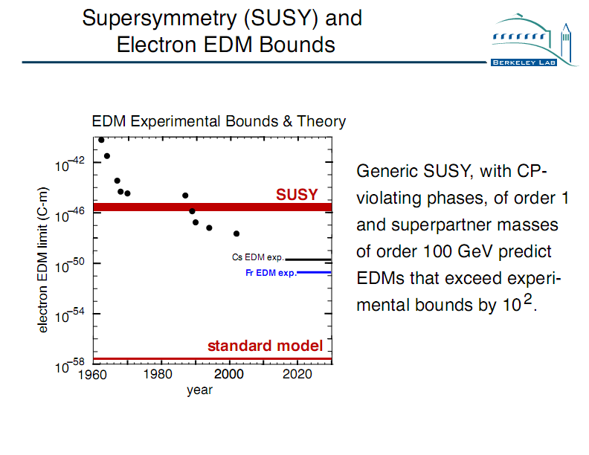
EDM search probes energy scales beyond the LHC

Slide 12
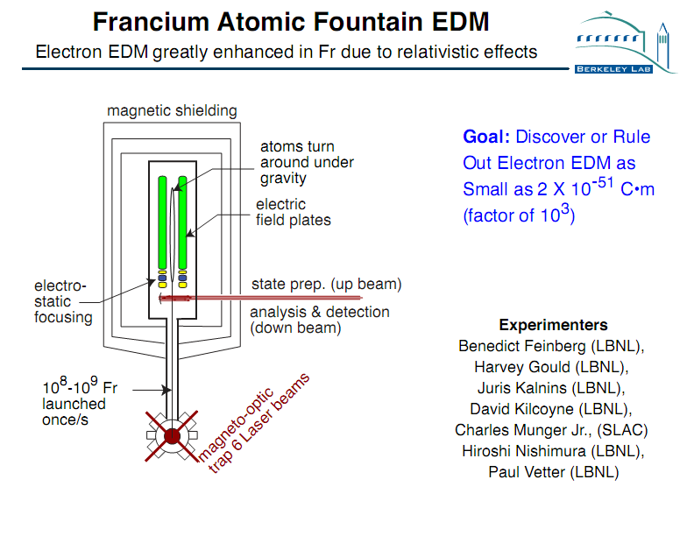

Slide 13

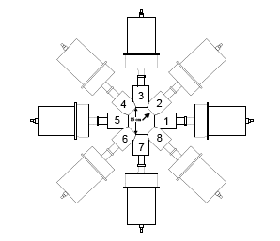
Radon-EDM Experiment
TRIUMF E929 Spokesperson
T. Chupp (Univ of Michigan)
C. Svensson (Guelph)
Funding: NSF, DOE, NRC (TRIUMF), NSERC
Produce rare ion radon beam
Collect in cell with co-magnetometer
Measure free precession
(γ anisotropy or β asymmetry)
²²³Rn (23 min) EDM projected sensitivity
Facility | ²²³Rn Yield | S_{d} (100 d)
ISAC | 10⁷ – 10⁸ s⁻¹ | 10⁻²⁶ - 10⁻²⁷ e-cm
Project X | 10¹¹ s⁻¹ | 10⁻²⁸ e-cm
~ 10⁻³⁰ e-cm
for ¹⁹⁹Hg

Slide 14
Project X: Target Spallation Production
Protons on thorium target: 1 mA x 1000 MeV = 1 MW
Predicted yields of some important isotopes:
Radon: ²¹⁹Rn >10¹⁴ ²²³Rn ~10¹¹ /s
Francium: ²¹¹Fr ~10¹³ ²²¹Fr >10¹⁴ ²²³Fr >10¹² /s
Radium: ²²³Ra >10¹⁴ ²²⁵Ra >10¹³ /s
Actinium: ²²⁵⁻²²⁹Ac >10¹⁴ /s
Yields simulated by
I.C. Gomes using MCNPX,
Project X workshop,
October 2009
Project X will enable a new generation of symmetry-test experiments, and bring exciting opportunities for discovering physics beyond the Standard Model.
Notes:
The target spallation method proposed by Argonne will produce the highest yields of these enhancer isotopes
Enable these symmetry test experiments to search for new physics at unprecedented levels of sensitivity.

Slide 15
Technology of isotope production at 1 MW
Existence proof at TRIUMF ISAC facility
  ISAC has achieved stable operation at 500 MeV, 100 microamps, 100 microamps/cm² on carbide targets
  Extrapolation to 10 cm² is feasible for thorium carbide
Remote handling is essential but existing at other facilities
  ISAC approach can be implemented with upgrade for actinides – currently being implemented for 500 kW photo-fission at TRIUMF
  MW-scale facilities in operation at SNS and JPARC
High efficiency extraction feasible due to long half-lives of important isotopes
  T_{1/2} ~days feasible by chemical separation
  T_{1/2} ~minutes feasible from hot carbides

Slide 16
Project X facility for Energy Applications
A Multi-Megawatt proton beam is
a national resource,
provides capabilities unparalleled in the world,
with potential application far beyond high-energy physics
Project X can help to meet the national need in two research thrusts:
A demonstration facility for Nuclear Energy:
  Reliable acceleration operation
  Transmutation of spent and processed nuclear fuel
  Radiation capabilities that are required for the development of materials for advanced energy systems
Development of advanced fuel cycles
16
Joint Facility

Slide 17
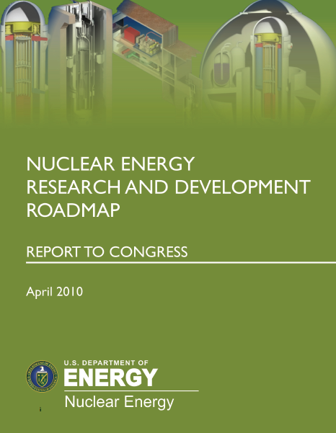
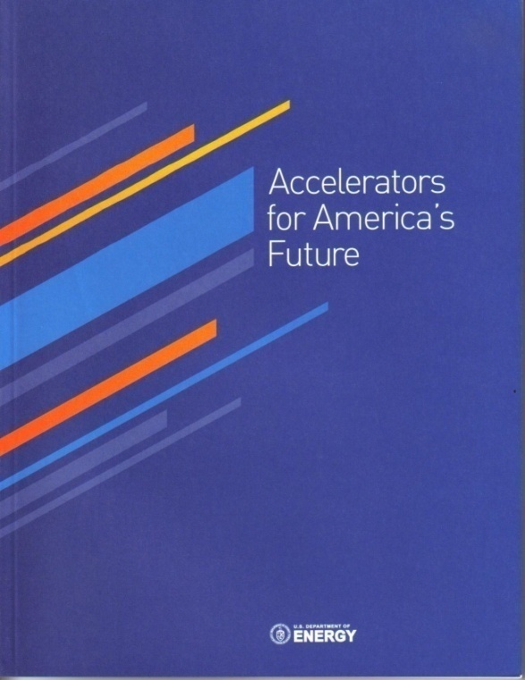
National Needs in Advanced Energy Systems are Articulated in Numerous Recent Reports
DOE/NE Report: Nuclear Energy Research and Development Roadmap
  R&D on Transmutation Systems for Sustainable Fuel Cycle Options
  R&D to develop fast-spectrum reactor technology
DOE/HEP Report: Accelerators for America’s Future
  R&D on Accelerator-Driven Systems technology focusing on high-reliability linear accelerator and liquid-metal target technology
17

Slide 18
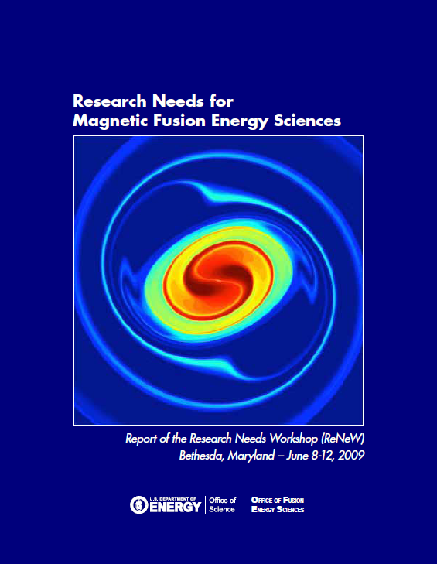
National Needs in Advanced Energy Systems in support of fusion energy development
DOE/FES Report: Research Needs for Magnetic Fusion Energy Sciences
  Thrust: Develop the material science and technology needed to harness fusion power
  “Establish a fusion-relevant neutron source to enable accelerated evaluations of the effects of radiation-induced damage to materials”
18

Slide 19
Basic Target Experiments
Demonstrate and verify the following aspects of the neutron spallation target systems:
  Neutron yield, spectra, and spatial distribution.
  Control and recovery of the spallation products.
  Chemistry control of the lead bismuth eutectic or the liquid lead to protect the structural material.
  Thermal hydraulics parameters of the target design including the velocity and the temperature distributions, and the pressure drop.
  Structural material performance including radiation damage and liquid metal effects.
  Target operation and replacement procedures
  The operation and the maintenance of auxiliary systems
Yousry Gohar - 2010

Slide 20
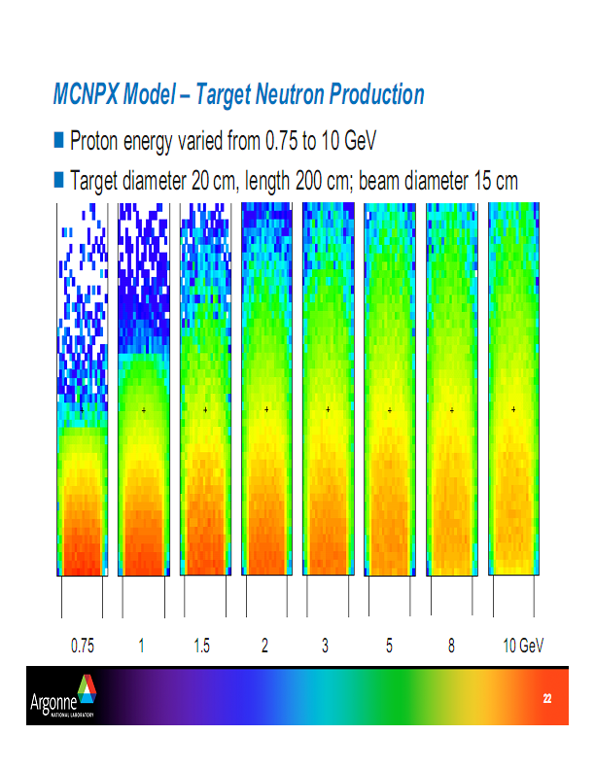
Brad Micklich, ANL
Project X Workshop
October, 2009

Slide 21
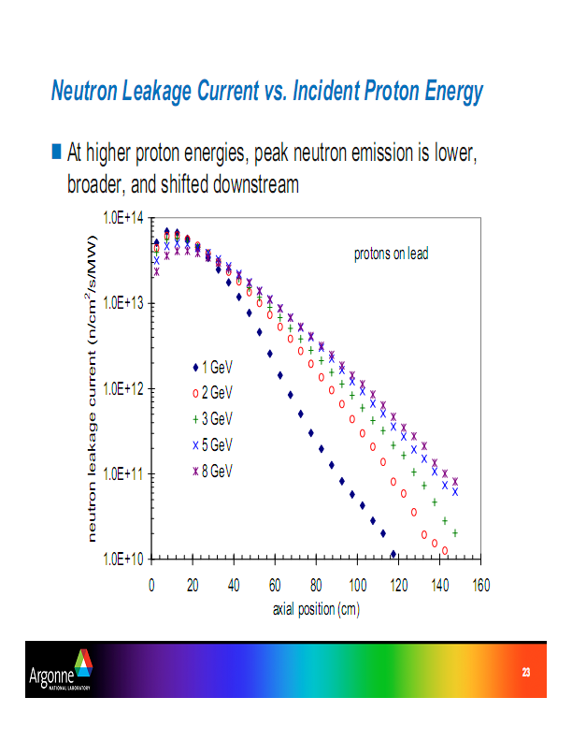
Summary
Brad Micklich, ANL
Project X Workshop
October, 2009
21

Slide 22
Summary
Flagship experiments to search for physics beyond the Standard Model
  Search for static electric dipole moments in atoms and electrons (EDM) [Experiments are small and portable]
  Requires high yields of radioactive isotopes of Rn, Fr, and Ra
  Project X extends isotope yields by factors of 10²-10⁴ over existing facilities
Provides MW-scale proton beams for essential target and materials developments in support of high priority national programs for future energy sources
  Tests of materials for fission reactors and transmutation technologies
  Evaluation of materials for fusion energy applications

