Slide 1
Spallation Neutron Source
Tony Gabriel - SID, ORNL/SNS-Retired (Thanks to Phil Ferguson and Mike Dayton)

Slide 2
At the Start of the SNS Target Systems We had 4 Major Design Goals
Design a Hg target system to produce room temperature and cold neutrons at high intensity using a one MW proton beam and that would satisfy the requirements of the scattering instruments. (60 pulses per sec of 1 micro-sec width)
Design a system that could be operated safely.
Design a system that could be built within the cost and schedule limits.
Design a system that can be maintained (Efficient remote handling is a major driving requirement).

Slide 3
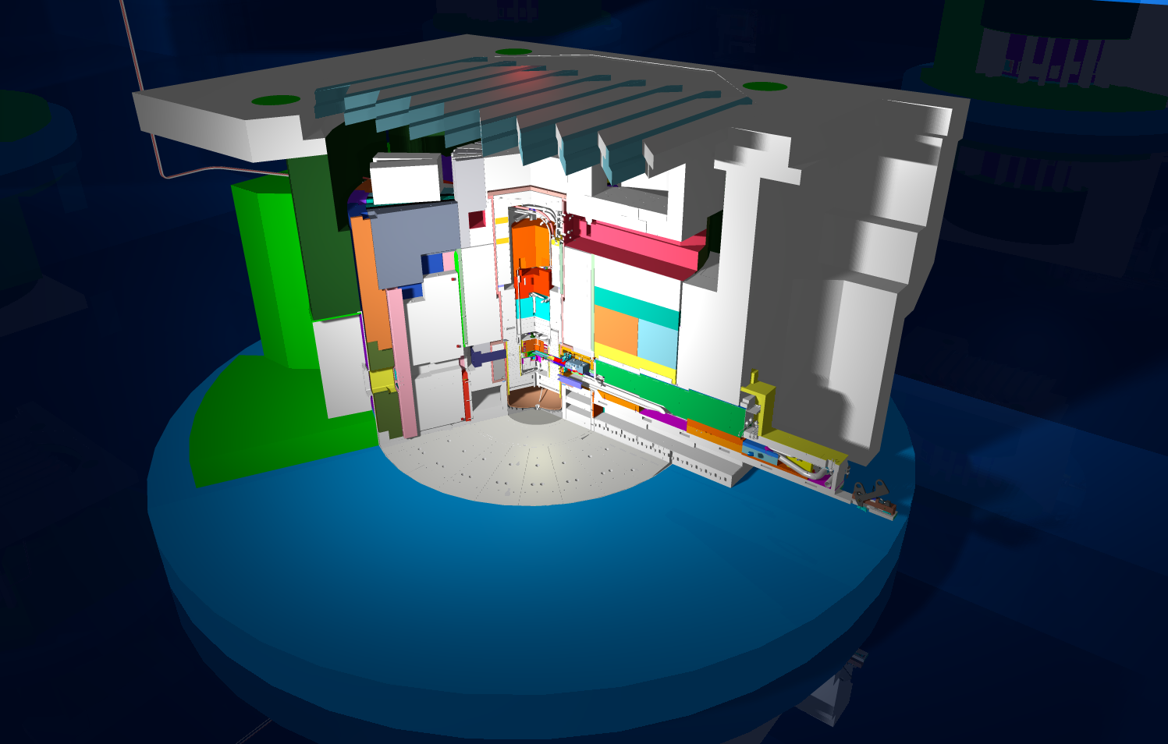
Target Monolith Components
SDER Floor
Monolith Shine Shield Beams
Top Block
Neutron Path
Shutter
Target Nose
CVI

Slide 4
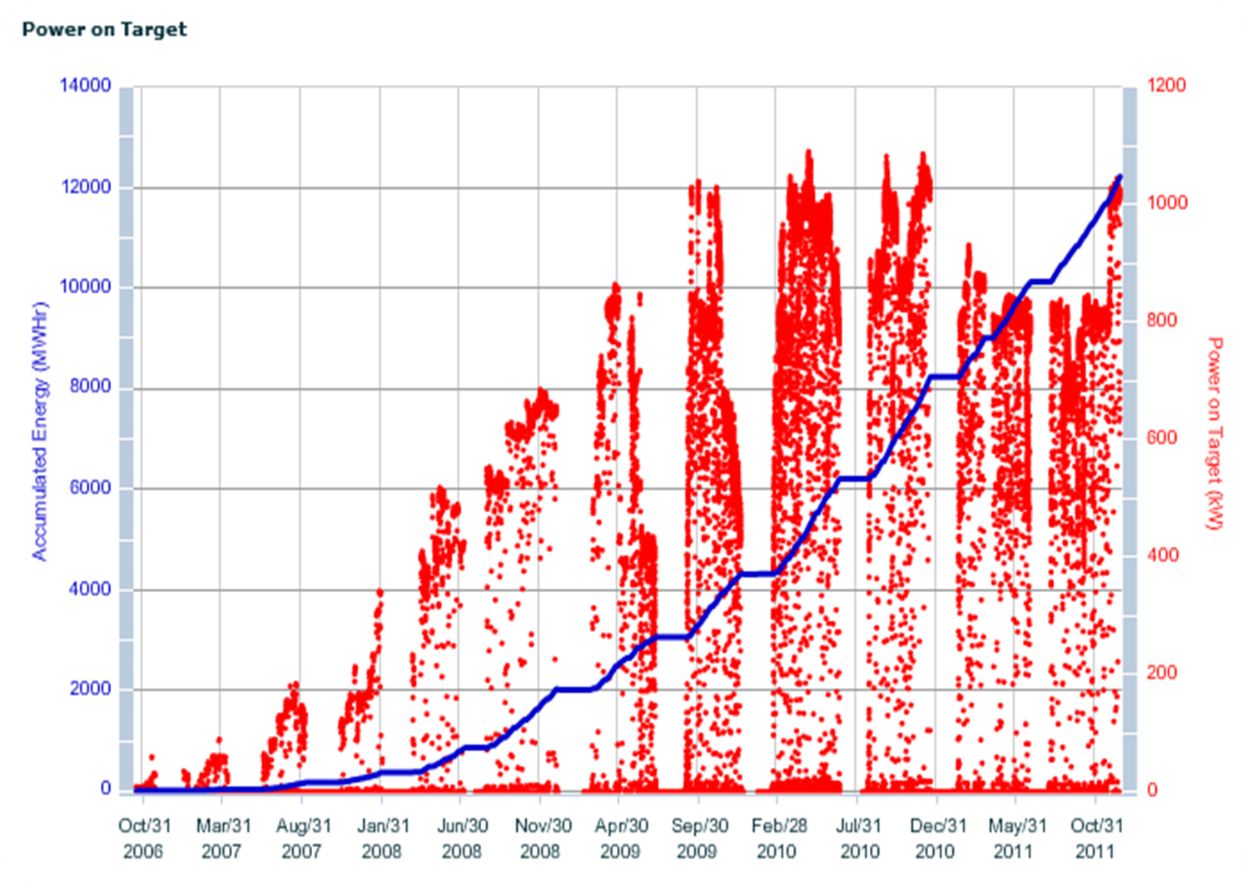
The SNS Target Team Delivered
Major Remote Handling Components
Have Been Replaced
PBW #2
BL 16 CVI & Shutter
Target #3
Target #4
Target #2
Target #1
PBW #1
BL 14
Shutter
BL 1
Shutter
BL 15
Shutter

Slide 5
Remote Handling
Since SNS operation began in 2006, a significant amount of remote handling operations have occurred
Remote handling at SNS encompasses:
Major component replacement (target, PBW, CVI, etc)
PIE operations
Target Post-Irradiation Examination relies heavily on remote handling
Waste shipment operations
Cask loading and waste handling require significant remote handling
The following provides an overview of these remote handling operations along with plans for future operations

Slide 6
Remote Handling Planning
Planning for remote handling operations utilizes the following variables:
End of life tracking for major components
A spreadsheet is maintained to track end of life for targets, PBWs, Inner Reflector Plug, Ring Injection Dump window and beam stop, etc
End of life for each item is estimated based on projected beam power, run schedules, availability, etc., and then updated monthly with actuals
Beam Line Instrument requirements
Shutter replacements and CVI installation requirements are tracked based on instrument operational need dates
These variables are then managed to ensure tooling and resource availability and to provide near and long term maintenance planning

Slide 7
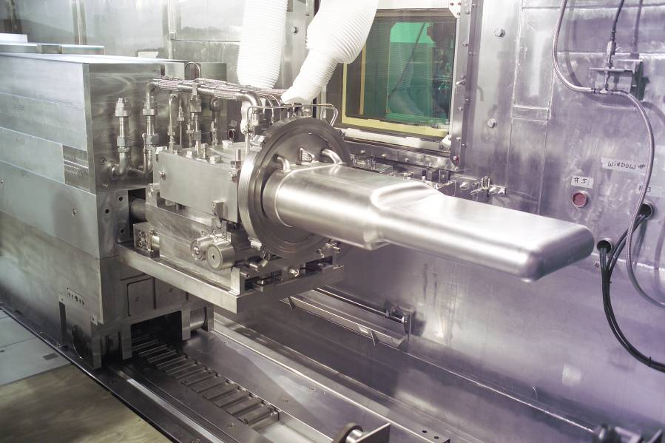
Target Module Replacement
Target Replacement
Target Maintenance Environment
Target Service Bay
Maintenance Equipment
Radiation and Contamination
Target Replacement Operations
Target Replacement Lessons Learned
Replacement of the target modules is accomplished using only remote handling tooling and procedures (hands-on operations are not possible)
While the tooling and procedures utilized enable successful replacement of the targets, continuous process improvement is employed to ensure successful replacements
SNS Target Module

Slide 8
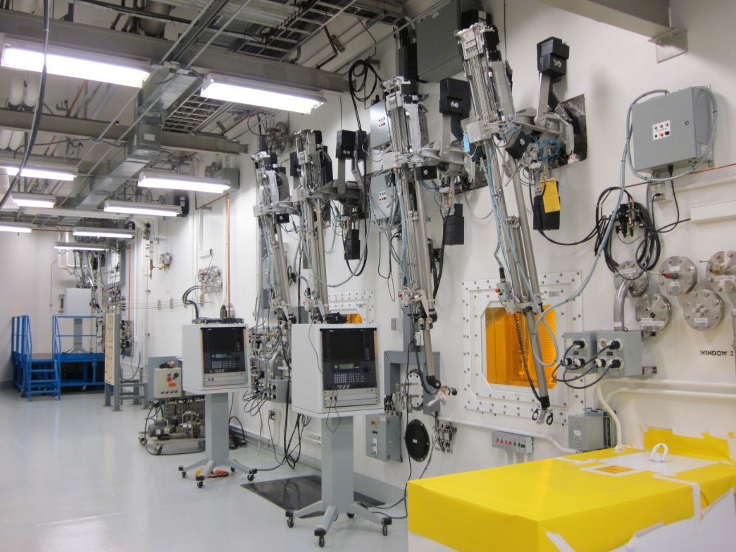
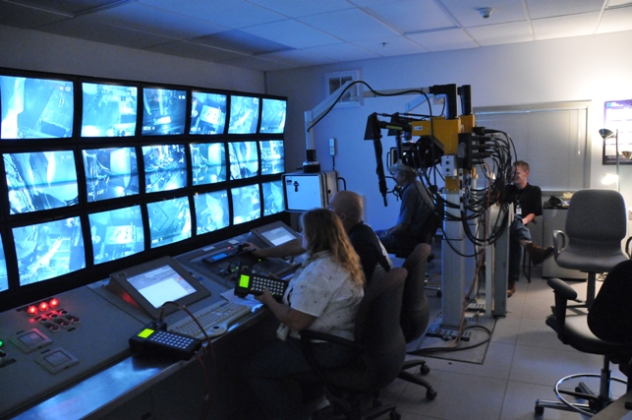
Target Module Replacement (Cont’d)
Four window workstations each containing a pair of master-slave manipulators are built-into the target Service Bay. Only one is workstation is dedicated to target change-out
A servo-manipulator is required to perform most operations including bolt torquing, tool transport, inspections and precision operations
Remote Handling Control Room
Manipulator Gallery

Slide 9
Target Module Replacement (Cont’d)
Radiation and Contamination Environment:
Experience has shown that the isotopic particulate contamination is long-lived and wide-spread inside the Service Bay
A systematic program of obtaining smears from within the Service Bay has been initiated to characterize the contamination environment
Current contaminations levels range from 10,000 dpm to 3-5,000,000 dpm
Radiation levels at various locations in the process bay are tracked during target replacements
The maximum dose rates observed during Target #3 replacement:
Mercury Pump: 21.45 R/hr (.215 Gy/hr)
Coolant Water Return Line from Carriage: 2475 R/hr (24.75 Gy/hr)
Mercury Return Line from Carriage: 2717 R/hr (27.17 Gy/hr)

Slide 10
Target Module Replacement (Cont’d)
Following each target replacement, a “lessons learned” activity is conducted to ensure continuous improvement of the replacement procedures and tooling
Enhancements to the process and tooling improvements enable replacement of a target in approximately 100 hours
Each target replacement yields new challenges and issues
Target #1: Leaking Hiltap fitting in the mercury process loop required extensive real-time testing to identify and correct
Target #2: Inadequate target bolt torquing resulted in degraded mercury seal testing results requiring additional effort to identify and correct the issue prior to target insertion
Target #3: Leaking Hiltap fitting in the water coolant loop required real-time testing to identify and correct resulting in a two day delay in completion of target replacement

Slide 11
PIE Operations
Post-Irradiation Examination (PIE) has been conducted on each of spent target modules following replacement
PIE operations have utilized the following tools:
Pressure decay testing to verify the integrity of portions of the target vessel (interstitial volume and water shroud)
Nose Sampling to remove samples of each target nose for subsequent testing
Video scope inspection to enable visual inspection of areas of interest within the mercury vessel
Non-destructive methods (decay testing and video scope) are employed prior to nose sampling

Slide 12
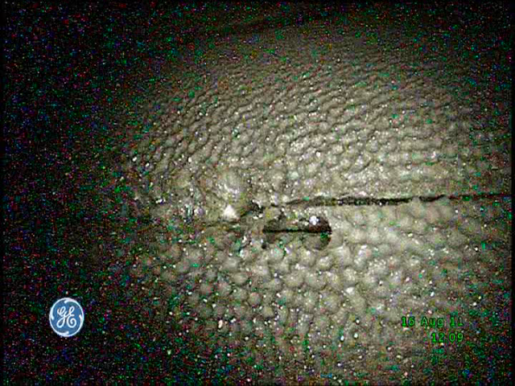
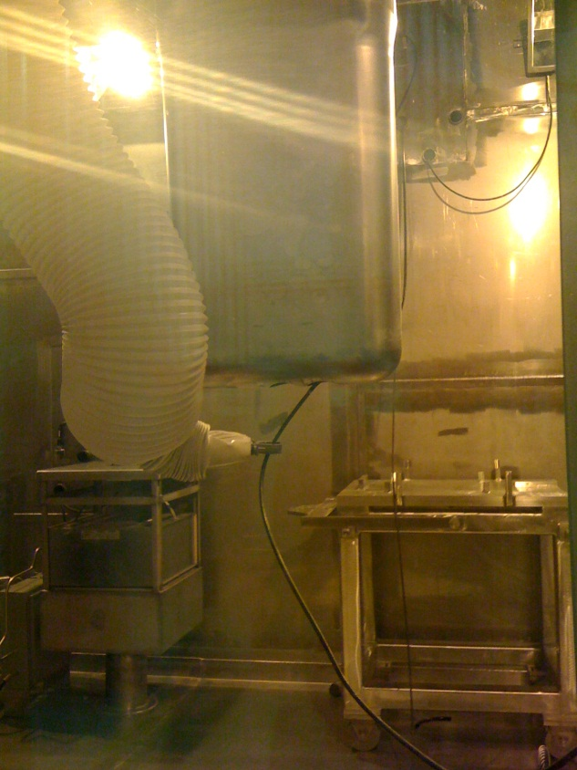
PIE Operations (Cont’d)
Target Video Scope Image:
Video scope image of the interior of the Target
Mercury Vessel at the
Nose location showing
significant cavitation damage
Video scope being inserted into target nose following sample cutting

Slide 13
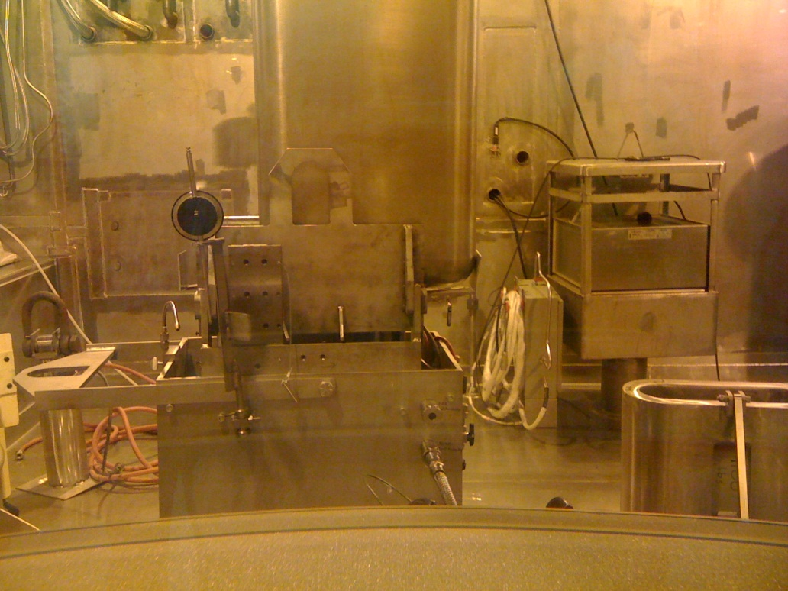
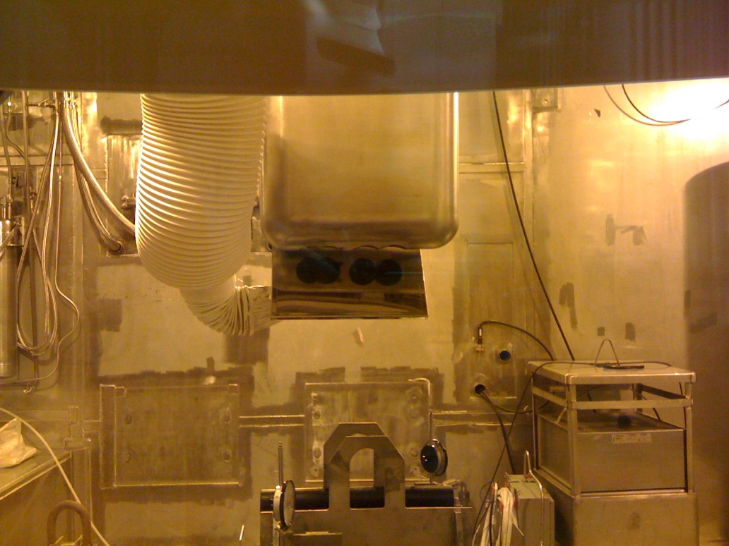
PIE Operations (Cont’d)
Target Nose Sampling Operations:
Spent Target suspended vertically
in remote-operated Nose Sampling
Cutter Assembly
View of Target nose following the fourth
cutting operation

Slide 14
Additional Slides for SNS Remote Handling
Proton Beam Window Replacement
Shutter and CVI Replacement
Waste Shipment Operations
Future Remote Handling Operations

Slide 15
Near Term and Future Remote Handling Operations
Near term:
Target #4 replacement: January 2012
PBW #3 replacement: July 2012
Target #5 and BL 9 Shutter/CVI: January 2013
Inner Reflector Plug Replacement
Anticipated to occur no sooner than January 2015
All tooling has been designed and delivered
Testing and procedure development remain
Ring Injection Dump Window and Beam Stop
Anticipated to occur no sooner than January 2016
Tooling procurement in work

Slide 16
Additional Slides for SNS Remote Handling

Slide 17
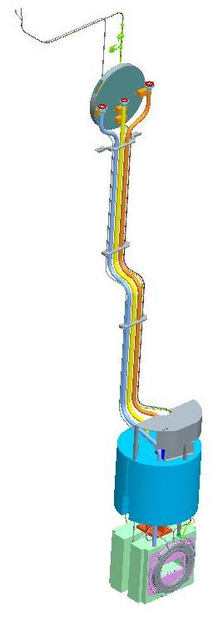
Proton Beam Window Replacement
PBW Module
~ 5.6 m tall
~ 2975 kg
Two Proton Beam Window modules have been replaced at SNS:
The initially-installed window had received just over 3000 MW-hrs of accumulated energy resulted in an approximate dpa level of 6.5
The second window had received ~ 5200 MW-hrs of energy resulting in a dpa level of approximately 10.5
The Proton Beam Windows incorporate the optics portion of the Target Imaging System enabling the viewing of the coated Target Module along with halo thermocouples to aid in beam centering
Following both installations, Core Vessel and RTBT flight tube vacuum leak testing has indicated excellent PBW inflatable seal function
Utility Piping
Guide Shield
Inflatable
Seals (NS
and FS)
Water-Cooled
Shields

Slide 18
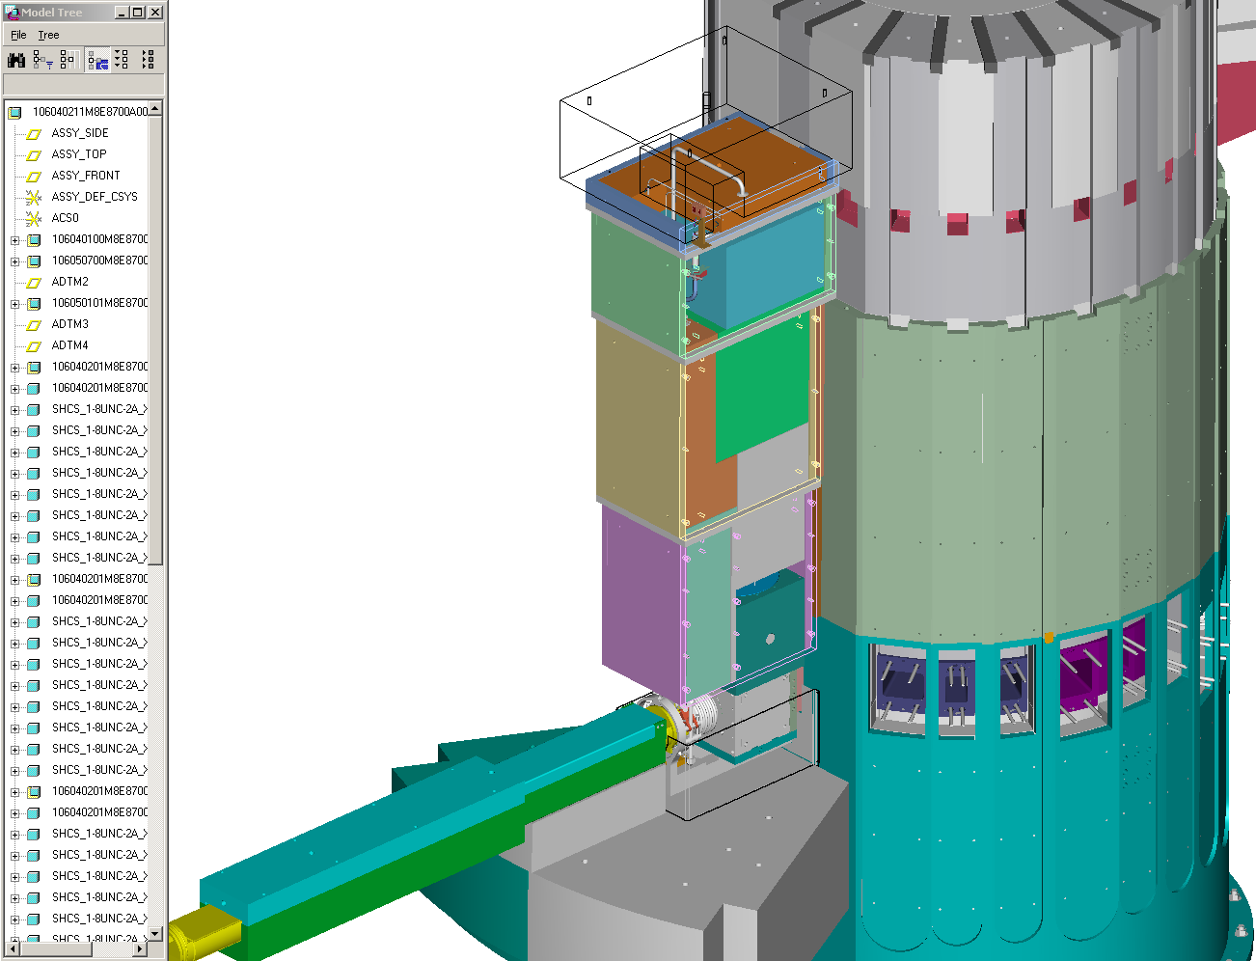
Proton Beam Window Replacement
PBW Top Block
Monolith/Core
Vessel
Replacement of a PBW module involves the following basic operations:
Removal of five shield blocks (45 tons of shielding)
Drying (water removal) of PBW module
Cutting and removal of activated utility piping
Withdrawal of PBW module from cavity
Installation of new PBW module
Connection of utility piping
Leak testing of inflatable seals and piping connections
Re-installation of shielding
PBW Shield Block 6
(brown)
PBW Shield Block 5
PBW Shield Block 4
PBW Shield Block 3
PBW Module
RTBT Flight Tube
PBW replacement requires
approximately 9 days

Slide 19
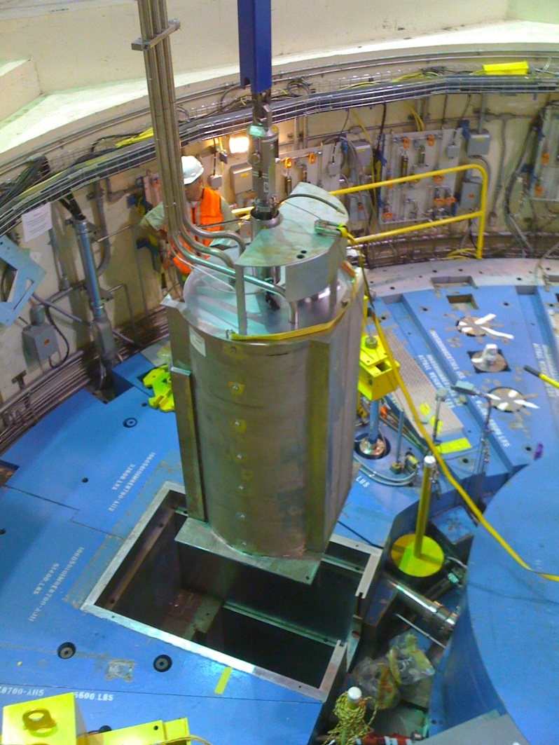
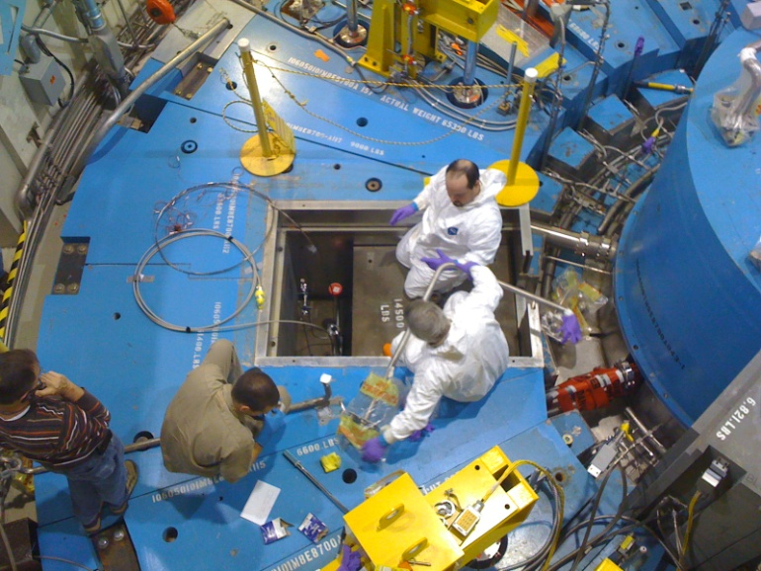
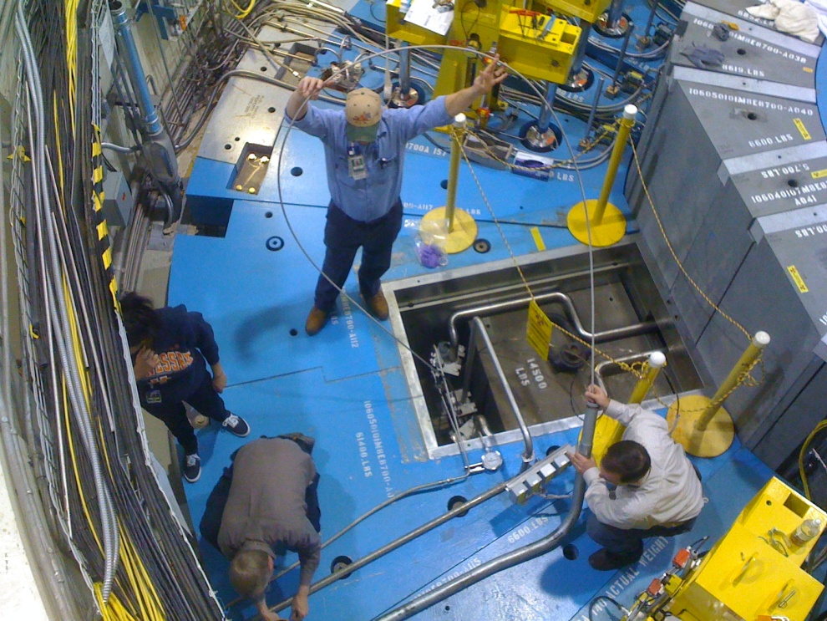
Proton Beam Window Replacement
Jumper
Installation
New PBW Installation
TIS Fiber
Optic Cable
Installation

Slide 20
Proton Beam Window Replacement
Radiological surveys are done during every aspect of PBW replacement operations. The following are some of the findings from the most recent operation:

Slide 21
Shutter and CVI Replacement
At the completion of SNS construction, seven instrument beam lines contained concrete shutter plugs in lieu of fully-functional shutters
To date, four of these beam lines have been updated to remove the shutter plug assemblies and install operational shutters
Additionally, four beam lines contained Core Vessel Insert plugs in lieu of functional inserts
The BL 16 CVI was replaced during the winter 2011 outage
The following slides give an overview of the BL 16 CVI and shutter replacement operation

Slide 22
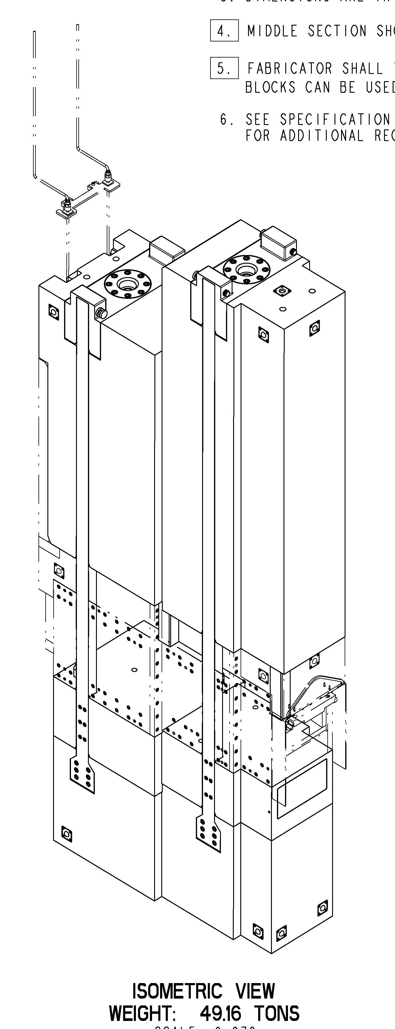
Shutter and CVI Replacement
Each beam line has its own user-operated primary shutter
12 single channel shutters
30 tons each (27,215 kg)
6 multi channel shutters
50 tons each (45,350 kg)
Each shutter incorporates a beam stop
and a helium-purged optical insert
Multi Channel
Shutter Assembly
195” x 78” x 31”
(4.9m x .8m x 2m)

Slide 23
Shutter and CVI Replacement
BL 16 CVI
~ 1900 lbs (860 kg)
22 feet tall (6.7 m)
The CVI interfaces directly with the Core Vessel and becomes part of the Vessel vacuum boundary
Aligns to the Core Vessel via two alignment pins
Secured using four 1.25” (31.75mm) diameter studs
Utilizes a double o-ring (metal) seal
These seals require 40,000 lbs (~18,100 kg) of tensile force in each stud
Tensioning methods are used to stretch the studs in lieu of torquing
Metal seals require high compressive forces
Tensioning provides more repeatable, consistent seal compression
Comprises the innermost portion of the instrument beam line
Each CVI is water cooled and purged with helium

Slide 24
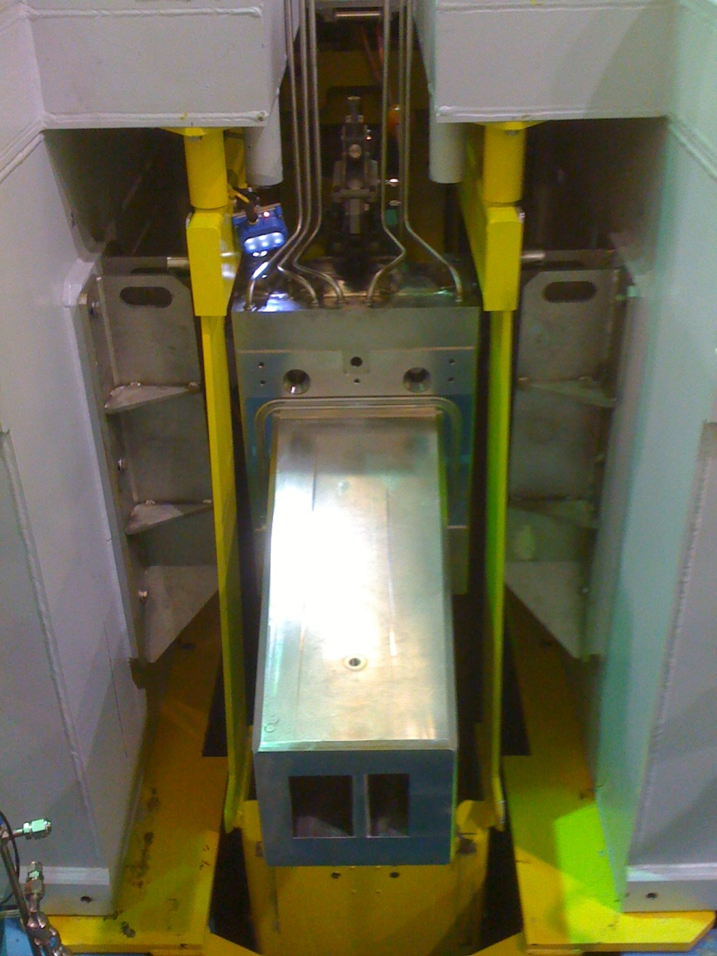
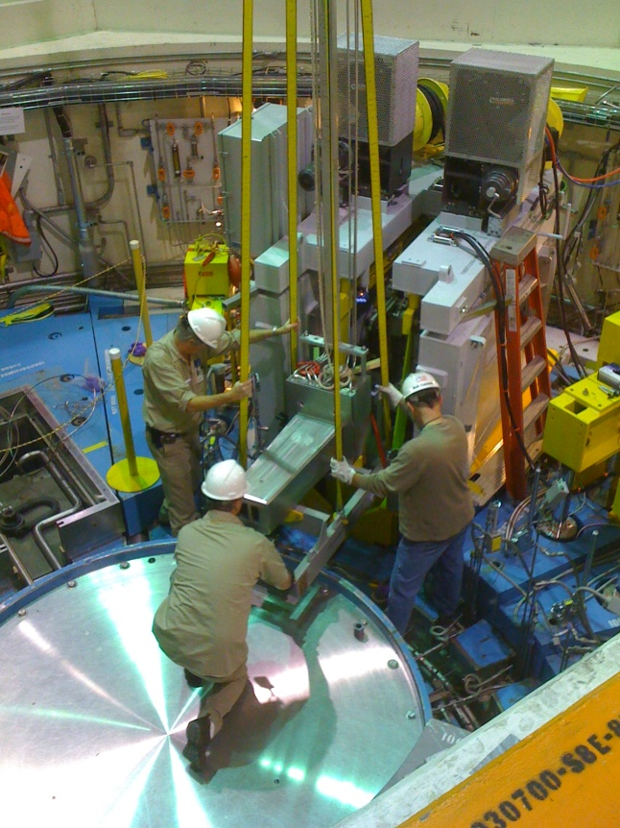
Shutter and CVI Replacement
Installation of the new BL 16 CVI proceeded following loading of the CVI into the Robot and installation of the O-ring seal:
Utility Tubing
Chamfered Clearance Holes
For Core Vessel Studs
O-Ring Seal
Loading of BL 16
CVI into Robot

Slide 25
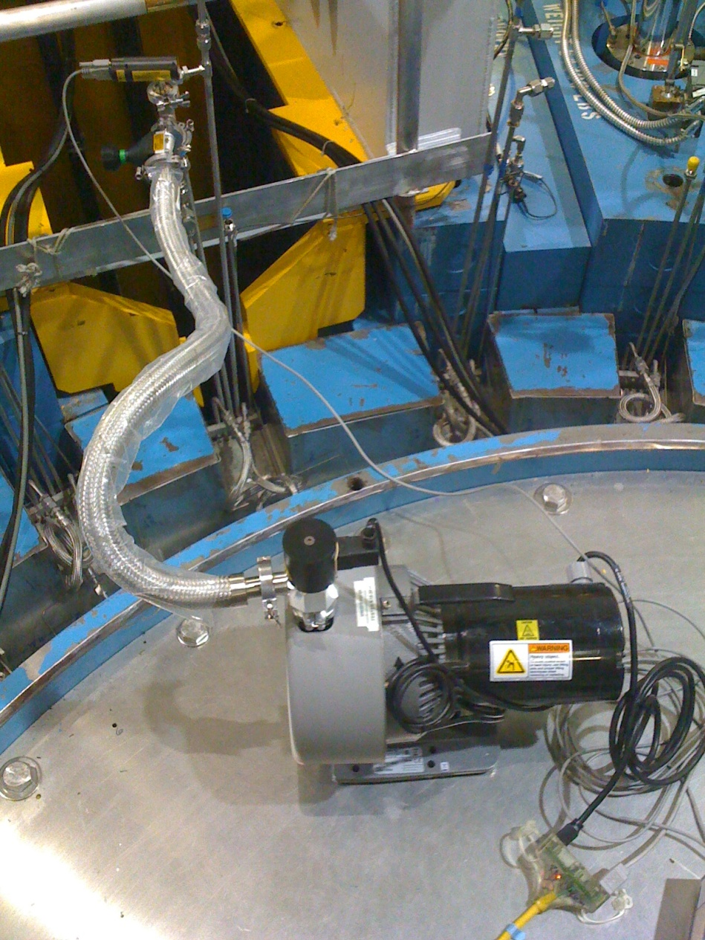
Shutter and CVI Replacement
Stud tensioning was completed followed by leak testing of the CVI O-ring seal
Leak testing involves evacuation of the interstitial region between the two o-rings followed by isolation and then a rate-of-rise test
Testing:
Test criteria: Evacuate to < 100mTorr
Isolate and measure rate-of-rise over
3-hour period
Permissible pressure rise: 50 mTorr/3 hr
Test results: 83 mTorr/3 hr
Originally installed (hands-on) CVI plug was only able
to achieve a 95 mTorr/3 hr rate, so new CVI performed
better than the initially-installed plug
Subsequent Core Vessel testing indicated an excellent
leak rate of .017 Torr-L/sec
Seal Leak Testing

Slide 26
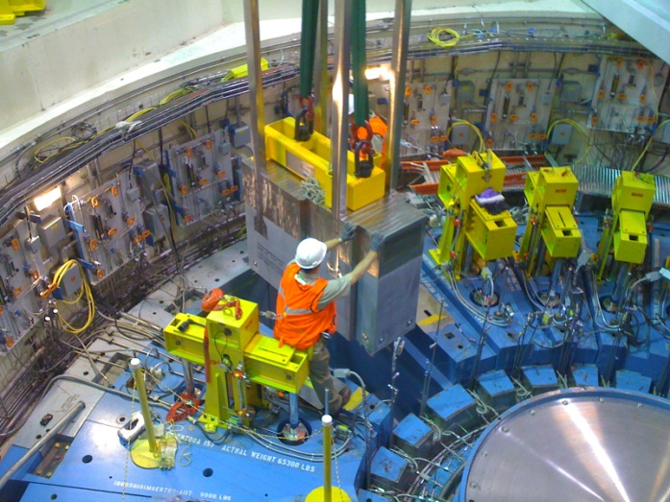
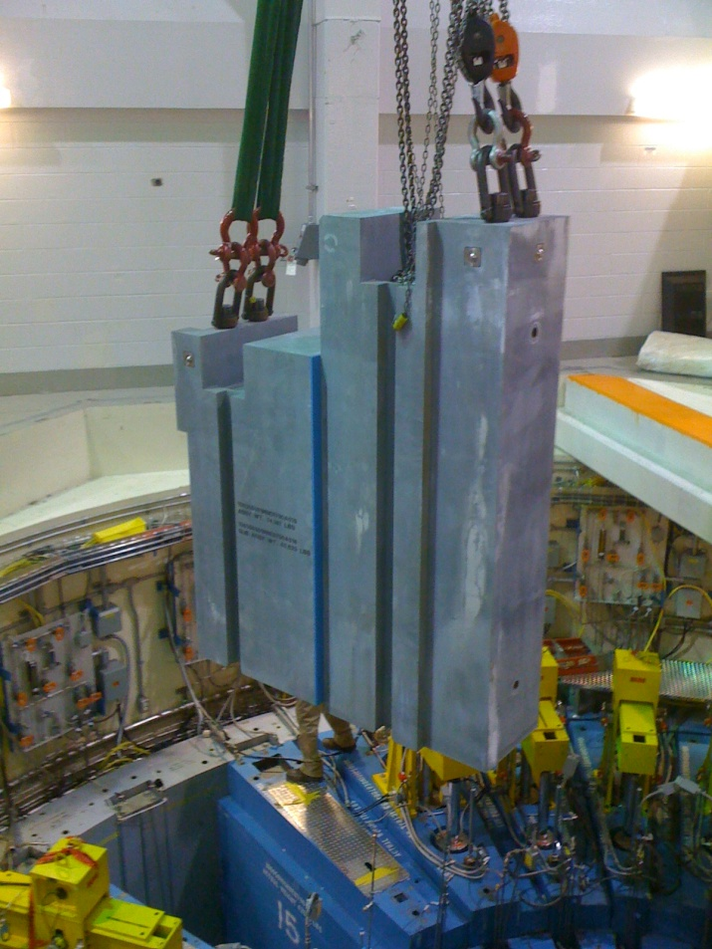
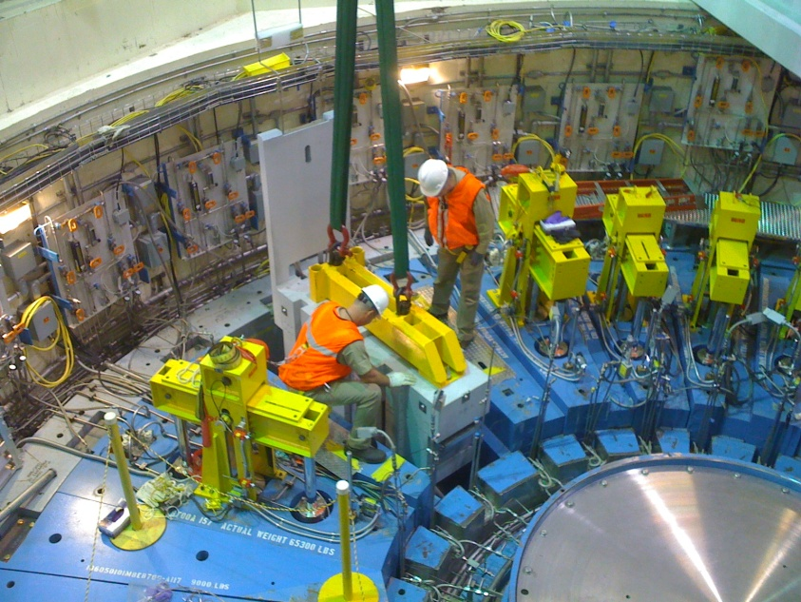
Shutter and CVI Replacement
The replacement process concluded with the installation of the new BL 16 shutter components:
Lower Segment
Installation
(31,000 lbs/14,000kg)
Upper Segment
Installation
(50,000 lbs/22,600kg)
Middle Segment
Installation
(20,000 lbs/9100kg)

Slide 27
Shutter and CVI Replacement
This operation was the first fully-remote replacement of a CVI at SNS
The replacement was completed over a period of 15 working days
Total cumulative dose for all workers involved in the replacement was 7 mR (.07 mSv)
Maximum dose for any individual was < 2 mR (.02 mSv)
While several challenges were encountered, the design of the tooling, extensive testing and innovative real-time solutions enabled a successful replacement of this critical component

Slide 28
Waste Shipment Operations
SNS is design to utilize an over-the-road waste shipment cask known as the TN-RAM for disposal operations
To date, three waste shipments have been completed:
Target #1 shipped in May 2010
PBW #1 shipped in December 2010
Target #2 shipped in May 2011
Cask loading occurs via the Service Bay and involves significant remote handling
Handling of activated components
Loading of the cask liner
Cask liner bolt torquing

Slide 29
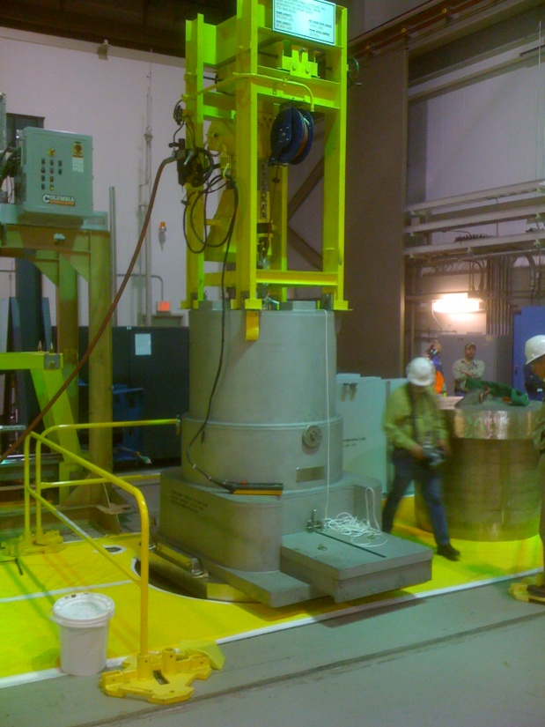
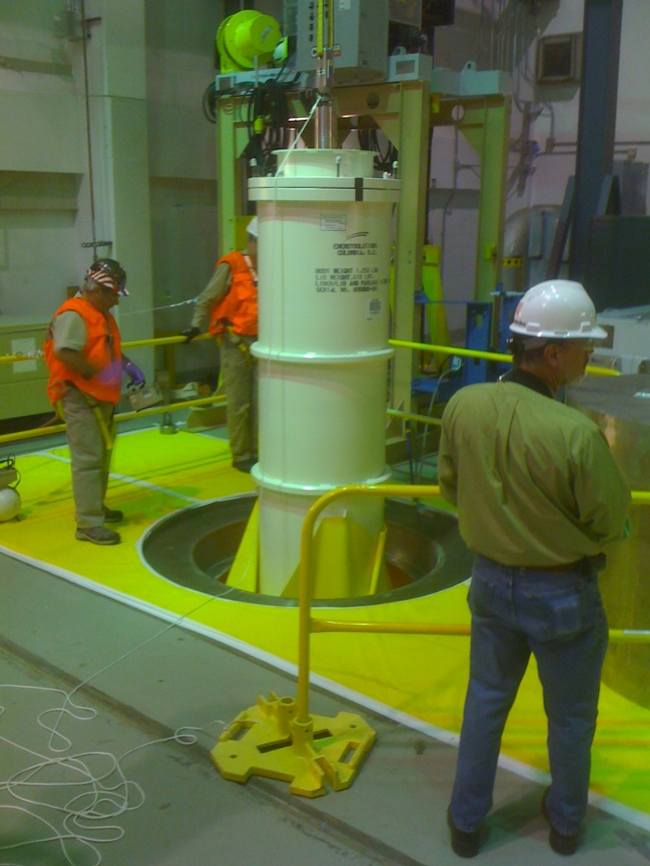
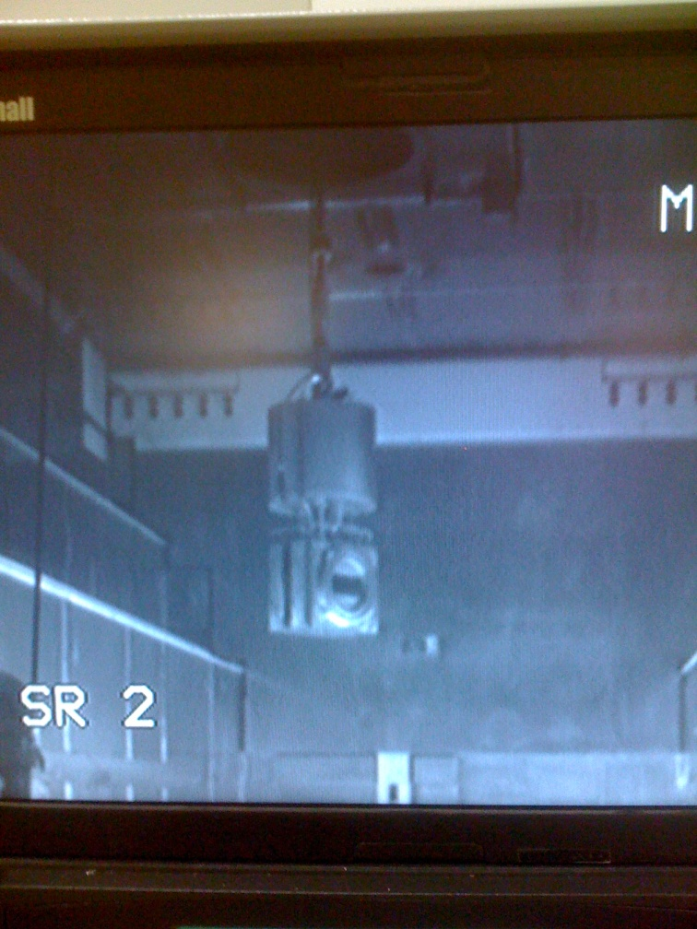
Waste Shipment Operations
PBW Cask is positioned over
Top Loading Port
PBW Waste
Preparation
PBW Cask Liner is
Loaded into the Service Bay
PBW is lowered into
Service Bay for loading
Into Liner

Slide 30
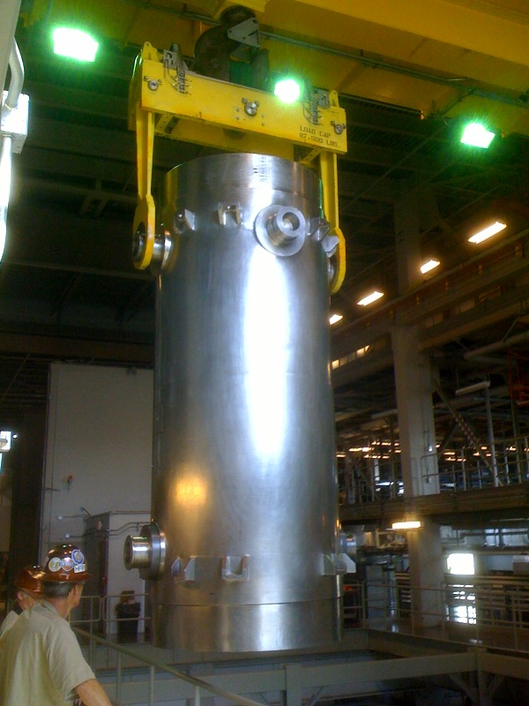
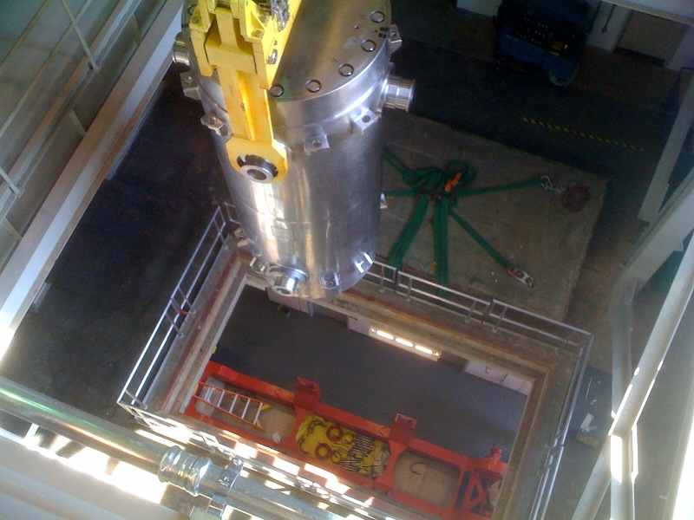
Waste Shipment Operations
Cask Lifting from Truck
Translating Cask over for Lowering
into Cask Cart

Slide 31
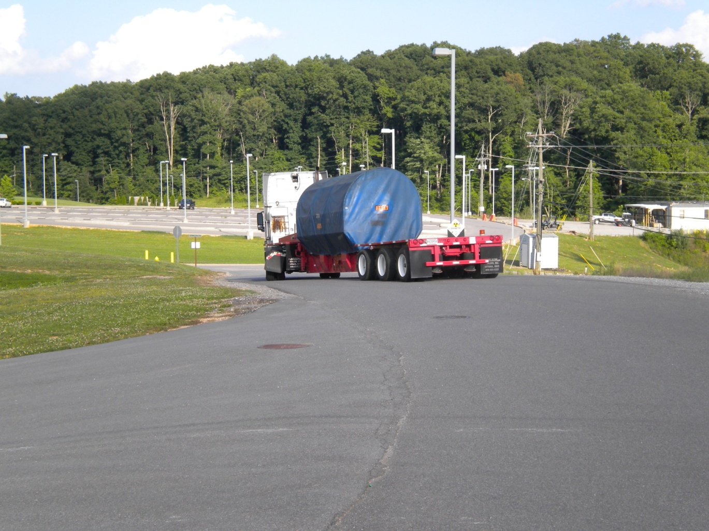
Waste Shipment Operations
Following loading of the Cask, leak testing and radiological surveys are performed to ensure DOT compliance

Slide 32
Future Remote Handling Operations
Ring Injection Dump (RID) Component Replacement
The RID contains two items that must be replaced via remote handling operations:
A window to isolate the high vacuum of the accelerator from the nominal atmospheric pressure of the RID cavity
A beam dump fabricated from copper plates to absorb the energy from the proton beam
Current life expectancy planning for these items indicate that replacement will be required no sooner than the summer outage of 2016
Procurement of the tooling required to replace these items is underway (AIP-29)
Procurement of a spare Beam Stop Assembly is also in work (AIP-29)

Slide 33
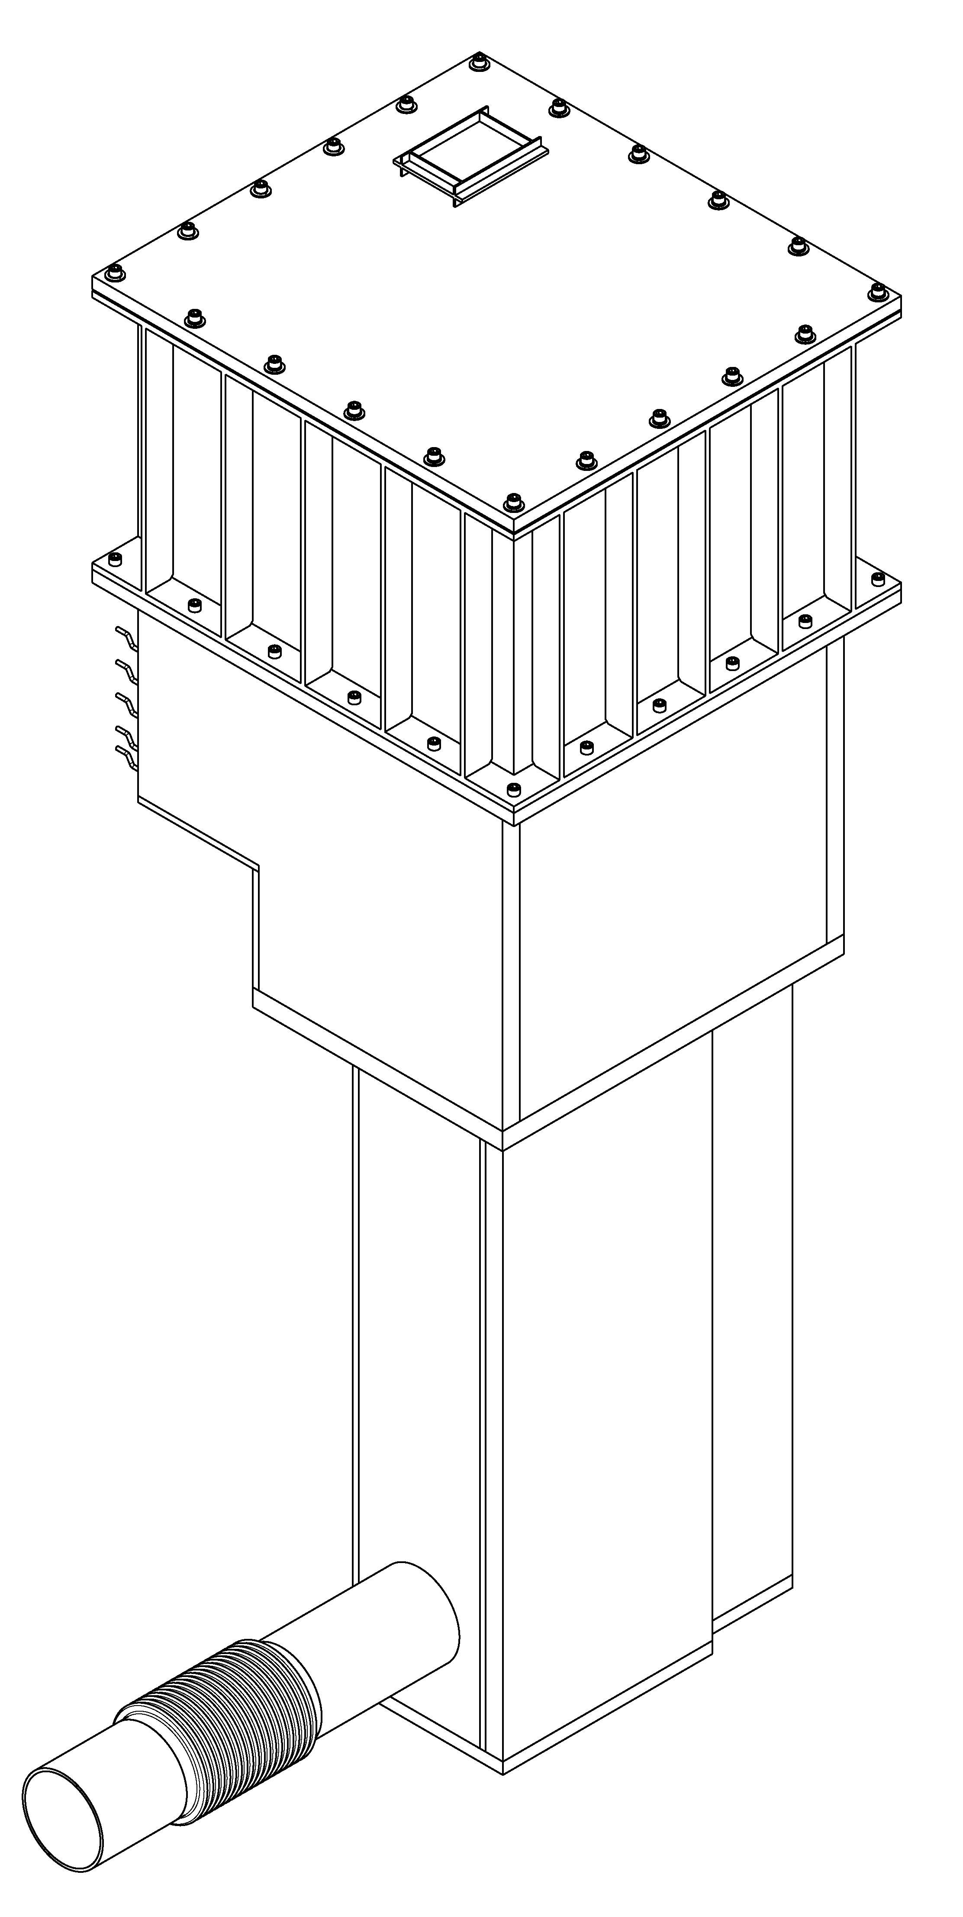
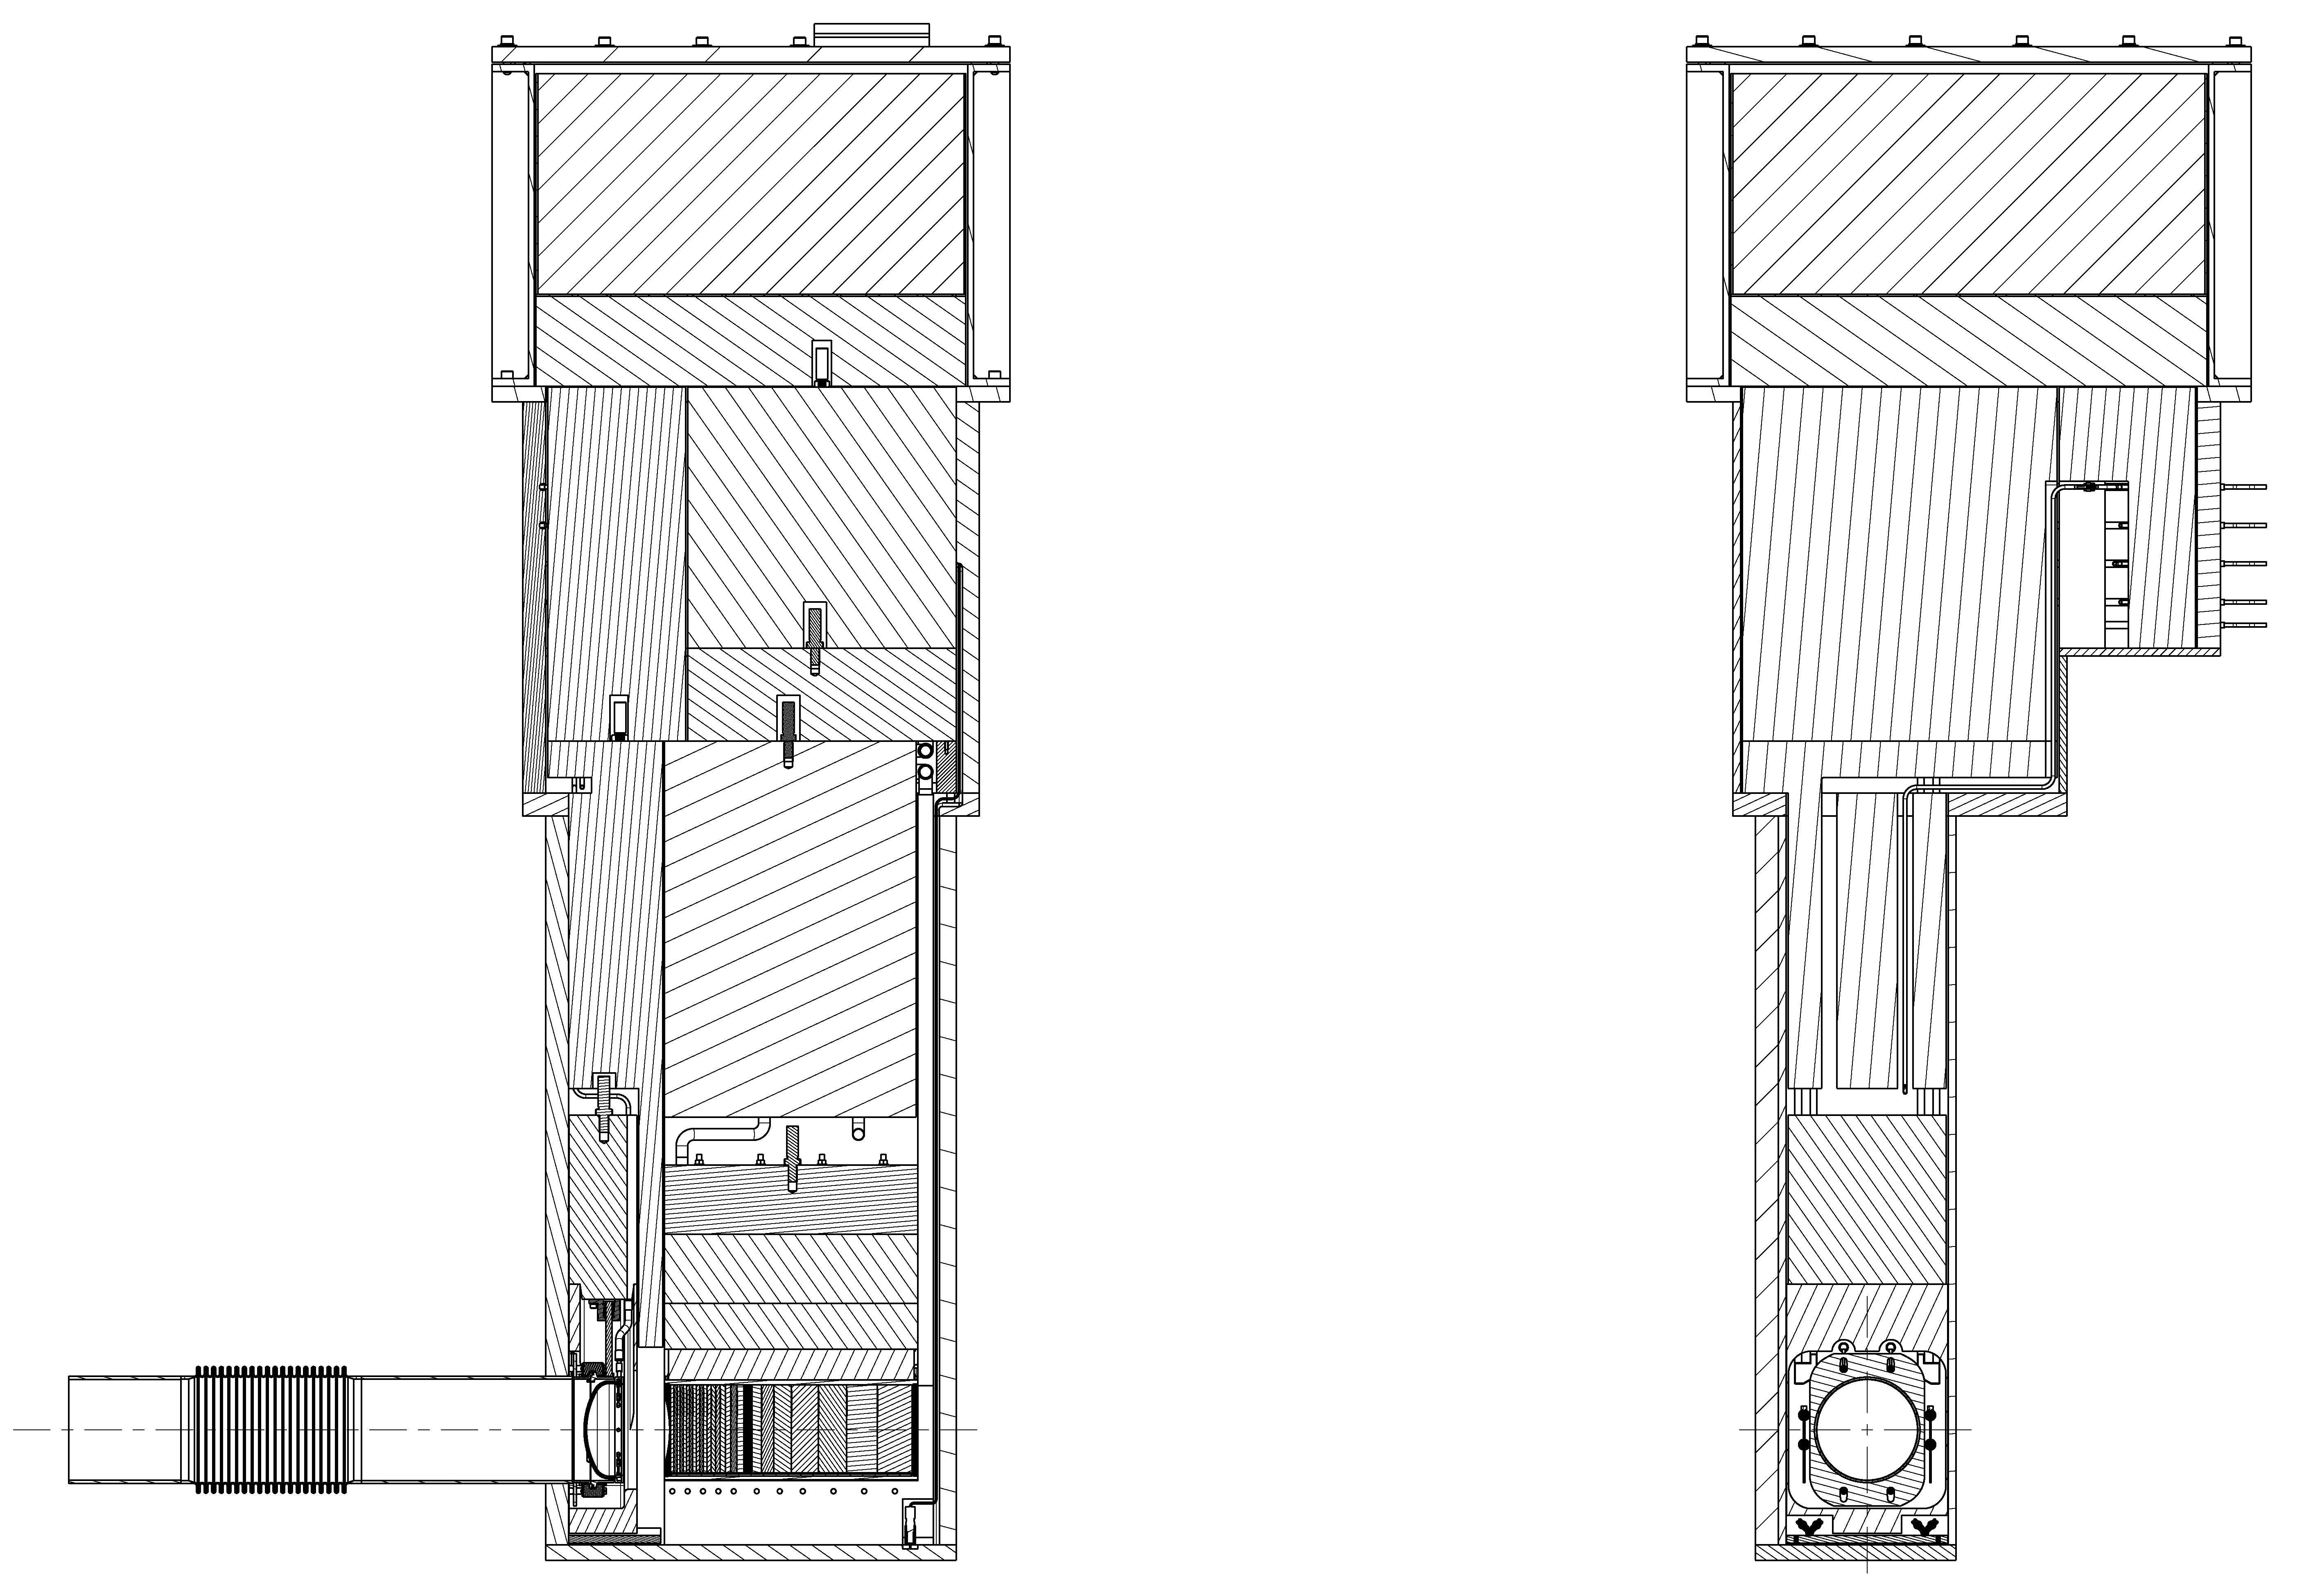
Future Remote Handling Operations
Ring Injection Dump (RID) Component Replacement
RID
Cavity
Shielding
Window
Position
Beam Stop
Position
Beam Entrance
Isometric View
Beam Entrance
Vacuum Clamp

Slide 34
Future Remote Handling Operations
Inner Reflector Plug (IRP) Replacement
The SNS IRP has a nominal life expectancy of 30,000 MW-hrs
Based on current planning, the first IRP replacement will occur no sooner than the winter outage of 2015
The remote handling tooling has been fabricated and delivered
Mockup testing and detailed procedure development remains to be completed

Slide 35
Future Remote Handling Operations
Replacement of the IRP is complex for many reasons
Target module retraction is required due to the fact that the target nose extends into the Lower Inner Plug
Target retraction itself requires 2-3 days of remote operations in the Service Bay
The IRP is vertically integrated into the Core Vessel through the Shutter Drive Equipment Room(SDER) requiring the unstacking of a significant amount of shielding
46 shield blocks + Monolith Shine Shield Beams must be removed to access the IRP
The size and weigh of the IRP requires removal in segments
The large amount of utility piping complicates removal
This piping must be accessed, cut and removed during the operation

Slide 36
Future Remote Handling Operations
SDER Showing Access to IRP
Monolith Shine Shield Beams
Pan Shield
Blocks
Shield Plate
Directly Above IRP
Hydraulic
Shutter Drives
PBW Cavity

Slide 37
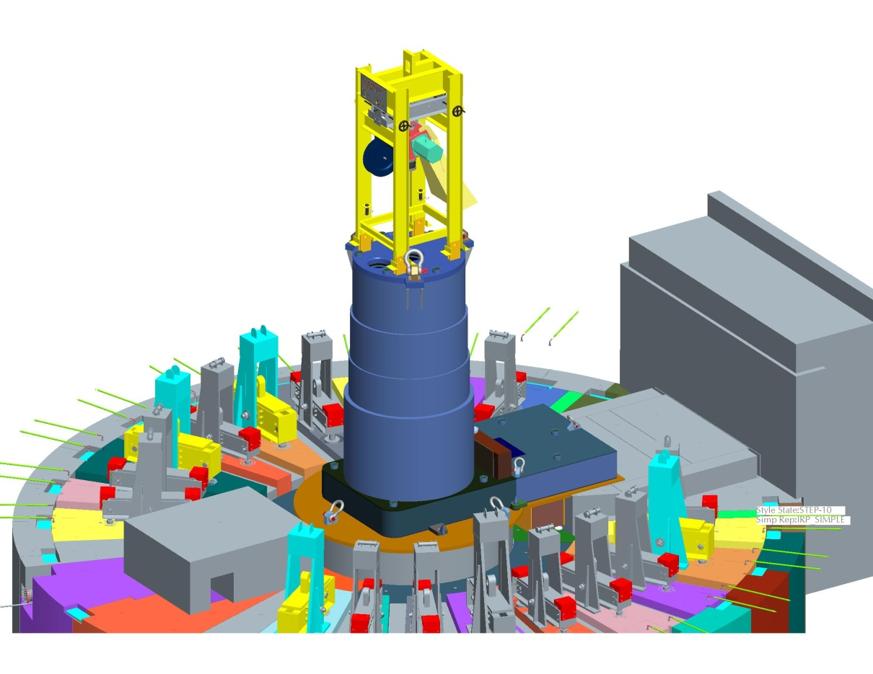
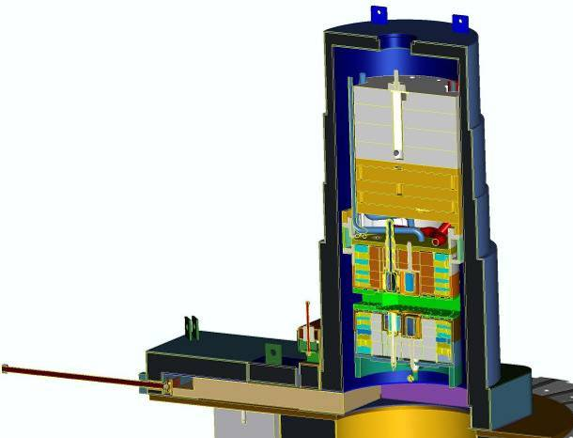
Future Remote Handling Operations
Removal of the Lower Inner Plug
Lead-Shielded Cask
Positioned over
IRP Cavity
Air-operated Chain
Hoist with Remote
Grapple Fixture
Lower Inner Plug
Is withdrawn into Cask
Weight of Cask + IRP
Segment approaches the
capacity of the 50T crane
Lead shield door provides
technician protection during
removal of Cask

