Slide 1
Experiences at LANL
G. Muhrer

Slide 2
Outline
Mark-1: (1997-2002)
physics versus engineering model
scientists versus engineers
Mark-2: (2002-2010)
What is really end of life of a target?
Mark-3: (2010 – present)
Get it done right!

Slide 3
Mark-1: physics versus engineering model

Slide 4
Mark-1:physics model (scientist – engineers)
moderator | flight paths | simplified model 1 [10⁹n/(cm²,s,sr,μA] | simplified model 5 [10⁹n/(cm²,s,sr,μA] | Δ
Thermal flux | E < 100 meV for H₂O | E < 5 meV for LH₂
flux trap HI-1 | 3,4,5 | 0.99±0.6% | 1.01±0.6% | +1.58%
flux trap HI-2 | 6,7,8 | 0.98±0.6% | 1.03±0.6% | +4.31%
flux trap LH₂ | 9,10,11 | 0.54±0.5% | 0.55±0.6% | +0.61%
flux trap HR | 16,1,2 | 0.59±0.7% | 0.60±0.8% | +1.20%
back scat. H₂O | 14,15 | 3.59±0.3% | 3.39±0.4% | -5.88%
back scat. LH₂ | 12,13 | 0.90±0.4% | 0.83±0.5% | -8.97%
Epithermal flux | 625 meV < E < 1 keV
flux trap HI-1 | 3,4,5 | 2.57±0.4% | 2.58±0.4% | +0.48%
flux trap HI-2 | 6,7,8 | 2.51±0.4% | 2.63±0.4% | +4.51%
flux trap LH₂ | 9,10,11 | 2.34±0.4% | 2.36±0.4% | +0.67%
flux trap HR | 16,1,2 | 2.34±0.4% | 2.37±0.4% | +1.10%
back scat. H₂O | 14,15 | 1.58±0.5% | 1.31±0.5% | -20.80%
back scat. LH₂ | 12,13 | 1.35±0.5% | 1.32±0.5% | -2.07%
Total flux | E < 20 MeV
flux trap HI-1 | 3,4,5 | 8.36±0.2% | 8.45±0.3% | +0.97%
flux trap HI-2 | 6,7,8 | 8.29±0.2% | 8.59±0.3% | +3.59%
flux trap LH₂ | 9,10,11 | 8.65±0.2% | 8.68±0.2% | +0.39%
flux trap HR | 16,1,2 | 7.11±0.3% | 7.16±0.3% | +0.66%
back scat. H₂O | 14,15 | 7.40±0.3% | 6.54±0.3% | -13.17%
back scat. LH₂ | 12,13 | 5.93+0.3% | 5.76±0.3% | -2.96%

Slide 5
Mark-1: physics – engineering model
moderator | flight paths | simplified model 5 [10⁹n/(cm²,s,sr,μA] | as-built model 1 [10⁹n/(cm²,s,sr,μA] | Δ
Thermal flux | E < 100 meV for H₂O | E < 5 meV for LH₂
flux trap HI-1 | 3,4,5 | 1.01±0.6% | 0.94±0.8% | -6.94%
flux trap HI-2 | 6,7,8 | 1.03±0.6% | 0.96±0.8% | -6.73%
flux trap LH₂ | 9,10,11 | 0.55±0.6% | 0.44±0.8% | -20.30%
flux trap HR | 16,1,2 | 0.60±0.8% | 0.56±1.1% | -6.28%
back scat. H₂O | 14,15 | 3.39±0.4% | 2.74±0.5% | -19.03%
back scat. LH₂ | 12,13 | 0.83±0.5% | 0.67+0.7% | -19.25%
Epithermal flux | 625 meV < E < 1 keV
flux trap HI-1 | 3,4,5 | 2.58±0.4% | 2.23±0.6% | -13.30%
flux trap HI-2 | 6,7,8 | 2.63±0.4% | 2.26±0.6% | -14.19%
flux trap LH₂ | 9,10,11 | 2.36±0.4% | 2.20±0.5% | -6.60%
flux trap HR | 16,1,2 | 2.37±0.4% | 2.09±0.5% | -11.50%
back scat. H₂O | 14,15 | 1.31±0.5% | 1.15±0.8% | -12.60%
back scat. LH₂ | 12,13 | 1.32±0.5% | 1.23±0.7% | -7.03%
Total flux | E < 20 MeV
flux trap HI-1 | 3,4,5 | 8.45±0.3% | 7.34±0.4% | -13.15%
flux trap HI-2 | 6,7,8 | 8.59±0.3% | 7.42±0.4% | -13.61%
flux trap LH₂ | 9,10,11 | 8.68±0.2% | 7.79±0.3% | -10.33%
flux trap HR | 16,1,2 | 7.16±0.3% | 6.36±0.4% | -11.12%
back scat. H₂O | 14,15 | 6.54±0.3% | 5.57±0.5% | -14.84%
back scat. LH₂ | 12,13 | 5.76±0.3% | 4.93±0.4% | -14.43%

Slide 6
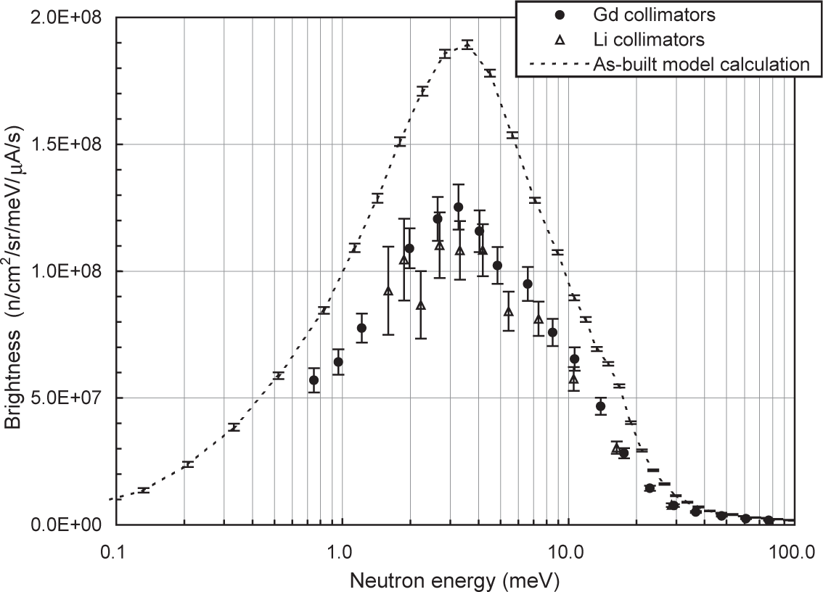
Mark-1/2:Flight path 12 (before the MACOR)

Slide 7
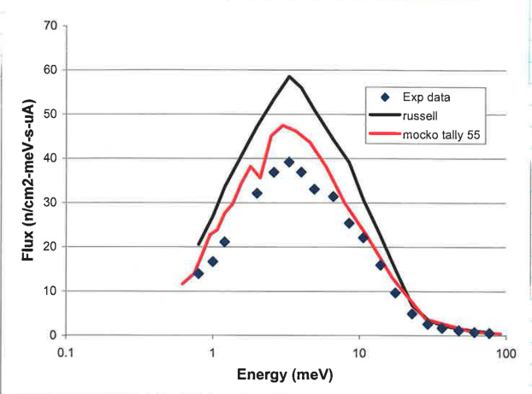
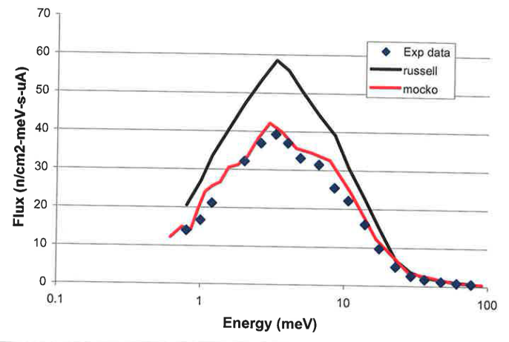
Mark-1/2:Flight path 12 (after the MACOR)
O/P=25/75
Reported deficiencies when comparing experimental to calculated values for upper-tier FPs (2002)
Updated model calculations
MACOR insulation plate (containing boron)
Ortho/para ratio dependence
Old calculation (russell) versus new calculation (mocko)
➔ now we understand the deficiencies
O/P=10/90
EXP. DATA:
P.-N. Seo, et al., Nucl. Instr. Methods A 517 (2004) pp. 285
OLD CALCULATION:
G. J. Russell et al., Proc. Of the 16th meeting on ICANS 2003, pp. 833

Slide 8
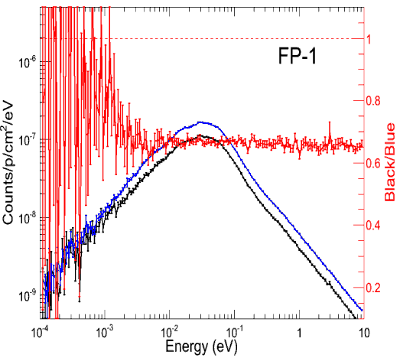
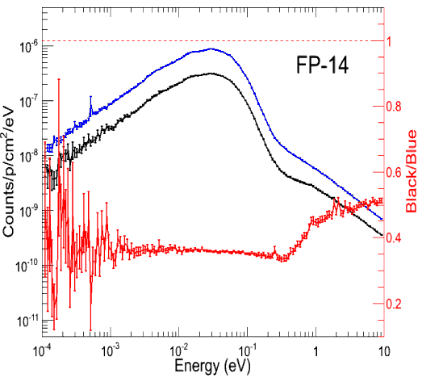
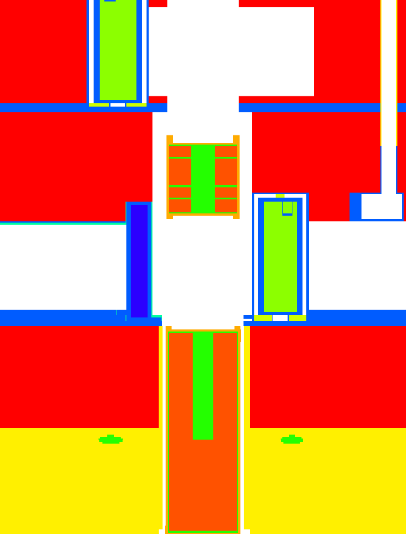
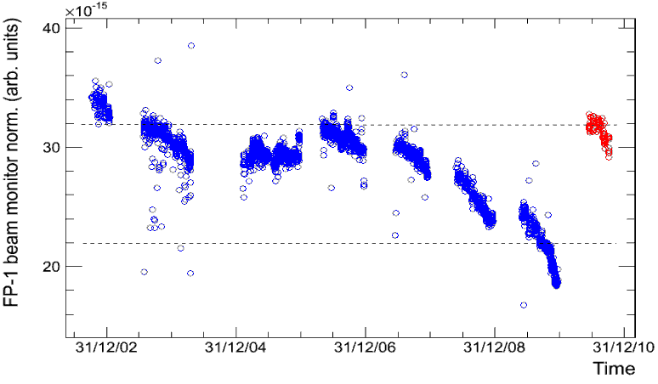
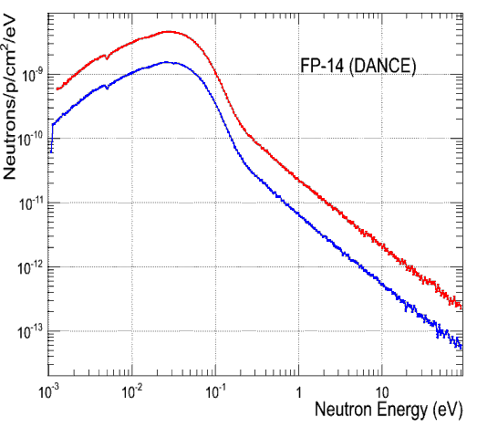
Mark-2: What is end of life for a target
LOWER-TIER
R₁=2.50 cm
R₂=1.56 cm
Depth=16.0 cm
UPPER-TIER
CALCULATED
0.38
0.61
EXPERIMENTAL
0.69
0.33

Slide 9
What happens if you do not deliver?
1) Unhappy users
2) Unhappy sponsor
3) Tighter budgets
4) Hard time to re-gain the trust of the users and the sponsors

Slide 10
How do you deliver?
1L target Mark-3 (project cost: 10 M$)
2003: Prototype experiment at LANSCE (target 2)
Result: Experiment did not agree with the simulation.
2006: Analysis of the material properties
Result: Experiment and simulation agree; Material specifications for the design.
2008: Engineering design of Mark-3
Result: Good communication between engineers and neutronic team.
2010: Installation of Mark-3
Result: Performs as advertised.
2012: End of the second run-cycle for Mark-3
Result: Still performs as advertised.

Slide 11
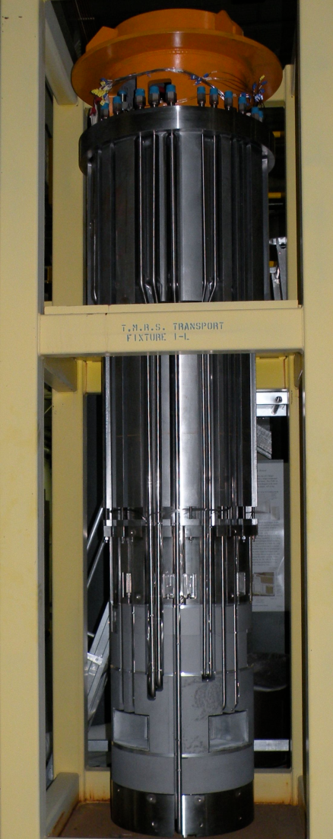
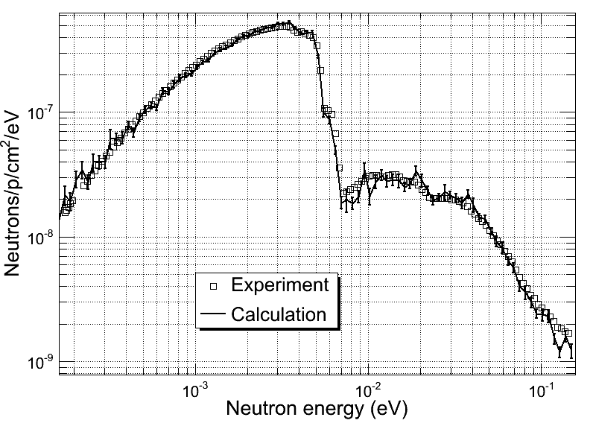
Mark-3 results

Slide 12
Lessons learned
The cheapest way to build something is to build it right the first time.
Need the right knowledge
Need the right amount of money
Short cuts are usually only cheap in the short term, but expensive in the long run.
One needs a broad range of competences
Mark-3: neutronics, chemistry, solid state physics, neutron scattering, engineering, operations
Conventional wisdom does not always help.
Success builds trust!

