Slide 1
500-kW Thorium
Target for Concept
Jerry Nolen
Physics Division,
Argonne National Laboratory
Project X Target Forum
March 20, 2012
This work was supported by the U.S. Department of Energy, Office of Nuclear Physics, under Contract No. DE-AC02-06CH11357.

Slide 2
Outline
Typical ISOL proton spallation target/ion sources (CERN/ISOLDE)
TRIUMF ISAC target/ion sources, 500 MeV p, 100 microamps
INFN Legnaro SPES facility UC2 target design, 40 MeV p, 200 microamps; tests at Oak Ridge HRIBF
500-kW thorium target concept for Project X: Rn, Fr, Ra isotopes (500 microamps)
Monte Carlo simulations of effusion from target chamber

Slide 3
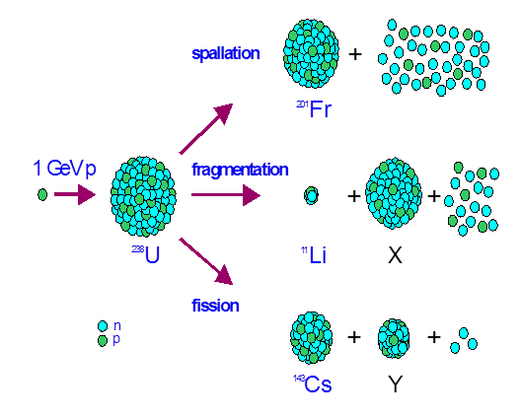
Reaction mechanisms

Slide 4
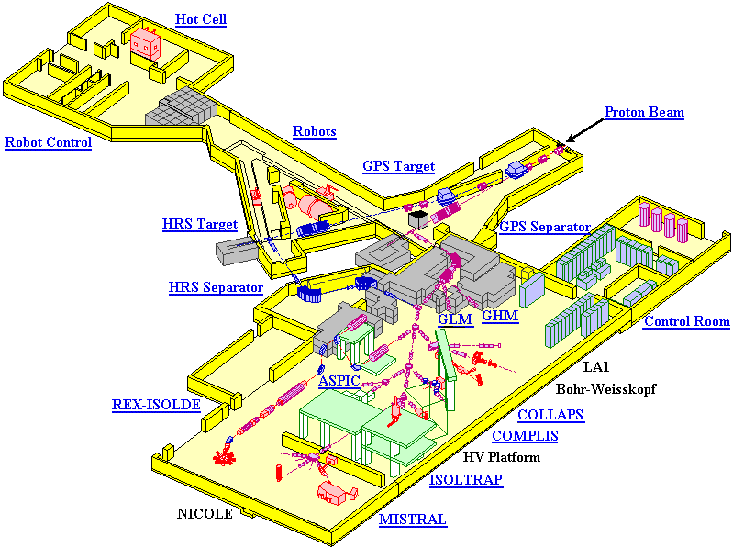
The Isotope Separator On-Line ISOLDE at the CERN/PS-BOOSTER
Proton beam:
1 -1.4 GeV
3E13 per pulse
2.4 μs pulse length
Rep. Rate 0.5 Hz Max. current 4 μA
5.6 kW beam power
Delivers yearly 3200 h of
radioactive ion-beam to 30
Experiments by means of
two target stations

Slide 5
The ISOLDE target and ion-source system
Separate systems
developed for each
element or group
of elements
Target unit for
selective production of
He, Ne, Ar, Kr, Xe
and Rn beams
Liquid metal target
materials used:
Thorium alloys
Lanthanum
Lead
Tin

Slide 6
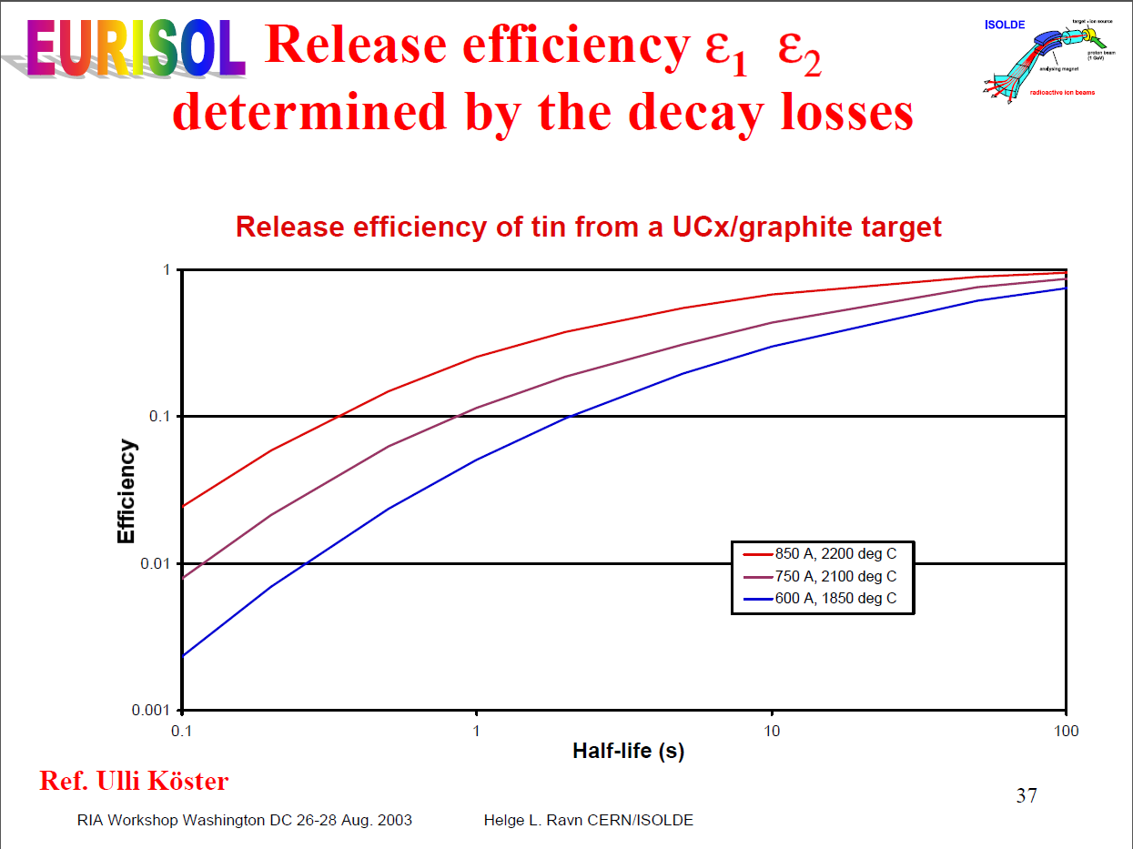

Slide 7
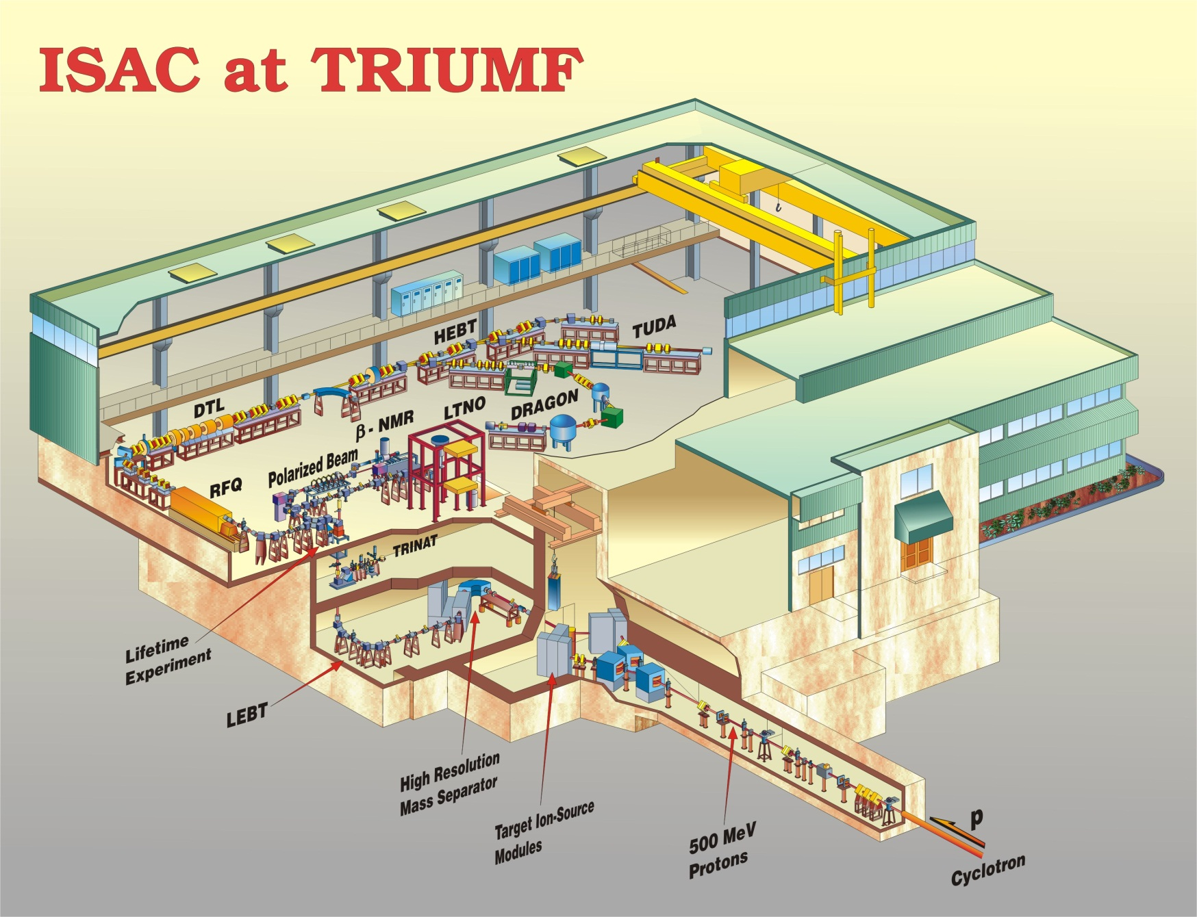
ISOL facility, ISAC @ TRIUMF: 500-MeV p, 100 μA

Slide 8
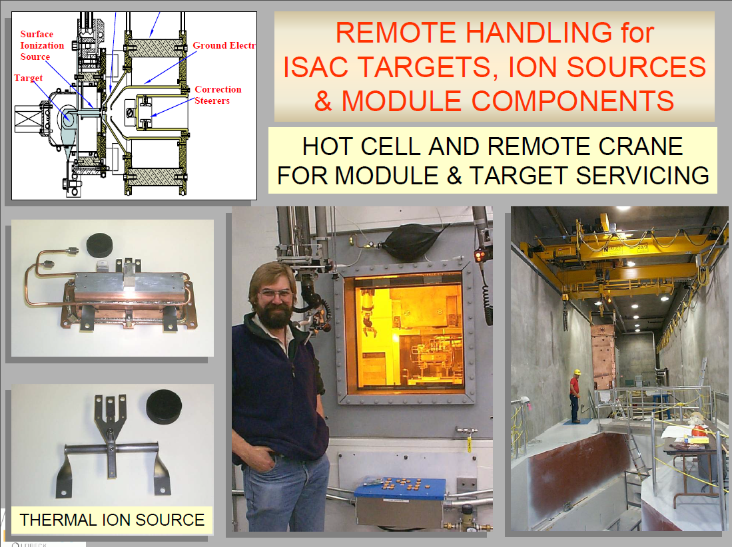
High current density targets: 100 μA, 6-mm diameter

Slide 9
UC2 target designed at INFN Legnaro
UC2 target for 40 MeV p, 400 microamps
  14 microamps/cm2
  Higher dE/dx at lower energy
  Detailed thermal simulations: thermal conductivity, thermal stresses, thermal radiation
  Prototype tested for isotope release at Oak Ridge HRIBF
Good starting point for extrapolation to Project X

Slide 10
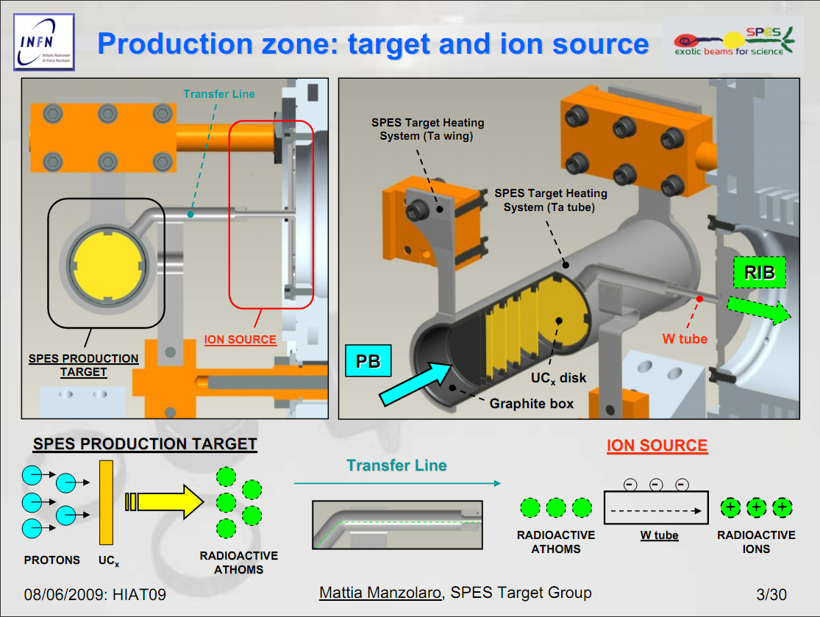

Slide 11
Extrapolation to 1-GeV, 500 μA for Project X: Rn, Fr, Ra
Operating temperature ~2000 C to release isotopes
Must radiate ~120 W/cm2 at this T
Energy loss ~1500 W/cm -> diameter ~25 cm
Optimum thickness ~200 g/cm2 thorium (~1 radiation length
Average density ~2.5 g/cm3 (1-mm thick disks 5 g/cm2 with 1-mm spacing) -> target length ~80 cm, 400 disks
Annular target, 1-cm diameter beam spot at ~12-cm radius; rotation > 1 kHz
Insulation by 1 tungsten heat shield and 5-mm graphite felt
Water cooling on outside surface

Slide 12
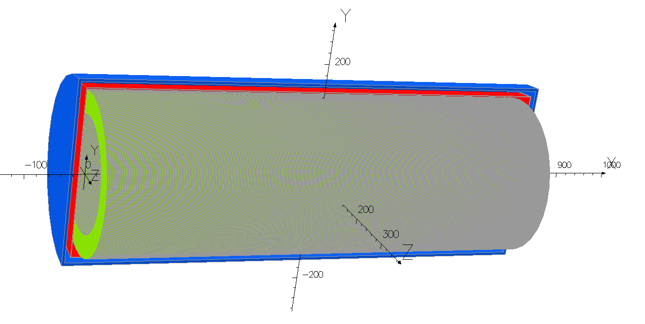
500-kW thorium target concept

Slide 13
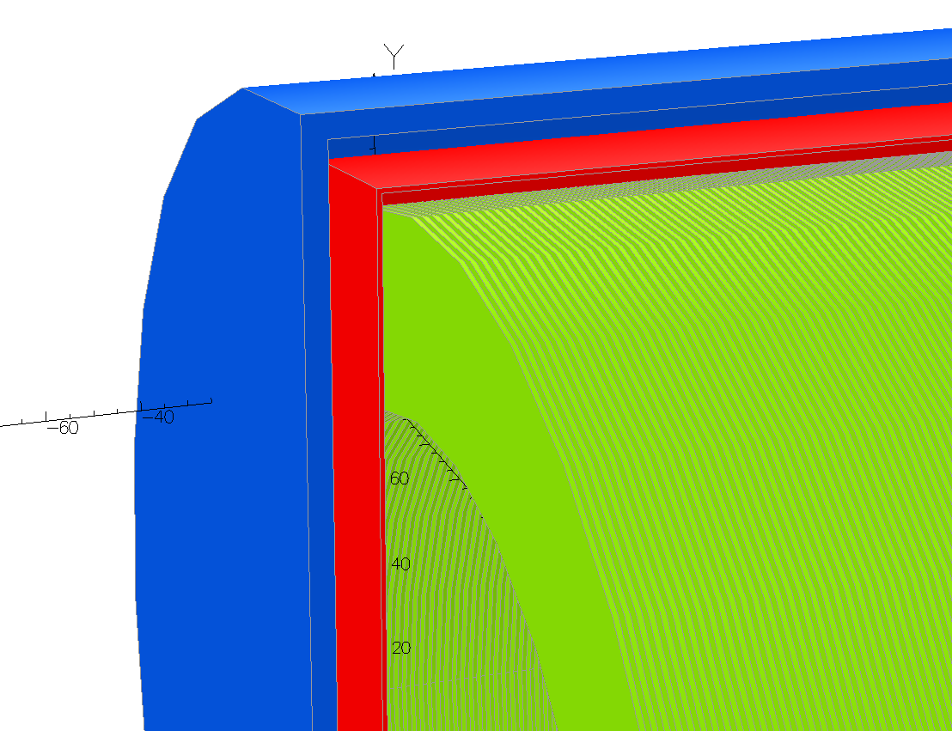
500-kW thorium target concept – close-up
Carbon felt insulation w/ graphite liner (1800 C)
and water-cooled outside (30 C)
Tungsten container, heat shield,
2200 C
1-mm thick Th rings @ 1-mm spacing, 400 total, 2000 C

Slide 14

Monte Carlo simulations of effusion – model in Geant-4

Slide 15
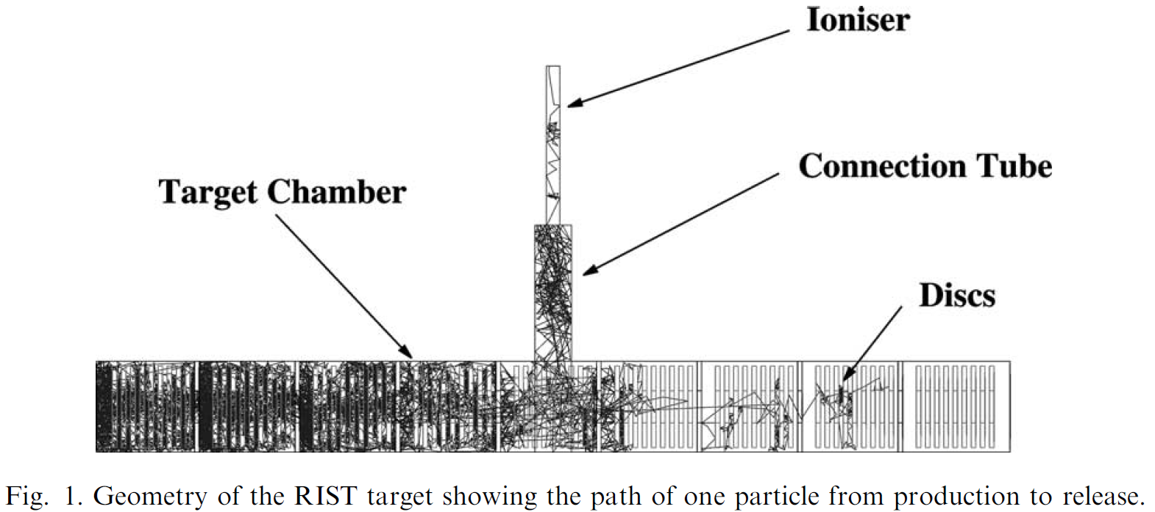
Monte Carlo simulations of effusion – model in Geant-4
Simulation of the Rutherford Lab “RIST” ISOL target design

Slide 16
Conclusion
Parameters of existing ISOL spallation targets (CERN/ISOLDE, TRIUMF/ISAC, Oak Ridge HRIBF, Legnaro INFN/SPES) can be extrapolated to much higher beam power at Project X
Issues to address
  Effusion delays from large target chamber (Monte Carlo simulations)
  Thermal conductivities and temperature limits of refractory thorium compounds: ThC2, ThO2, ThN
  Thermal simulations coupling beam power deposition with thermal conduction, radiation, and stress effects

