Slide 1
A concept for a spallation based
UCN source
SNQ Spallation Neutronen Quelle
R. Golub

Slide 2
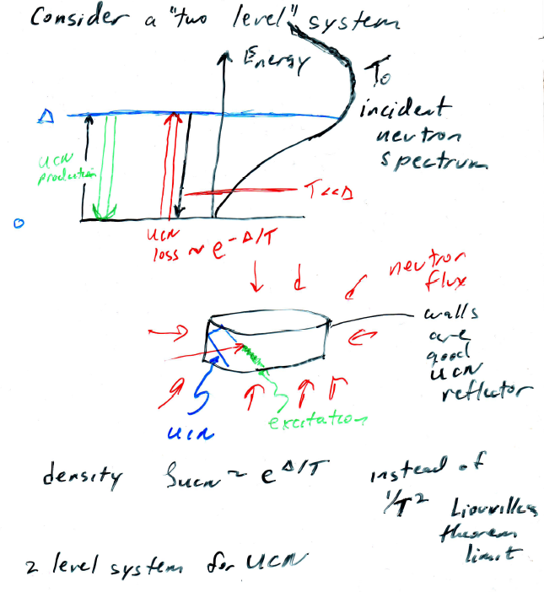

Slide 3
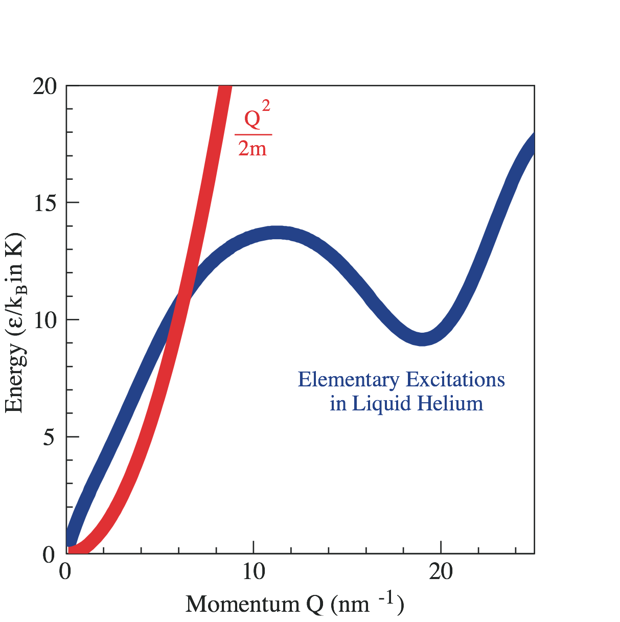
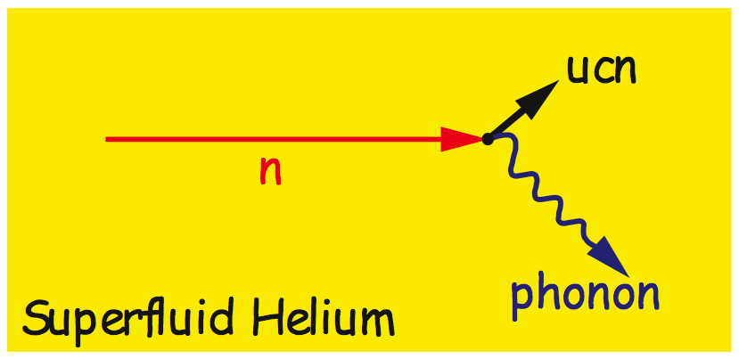
Superthermal Production of UCN
8.9 Å (12 K or
0.95 meV) neutrons can scatter in liquid helium to near rest by emission of a single phonon.
Upscattering (by 12 K phonon absorption)
~ Population of 12 K phonons ~ e^{–12 K/Tbath}
Golub and Pendlebury
Single Phonon

Slide 4
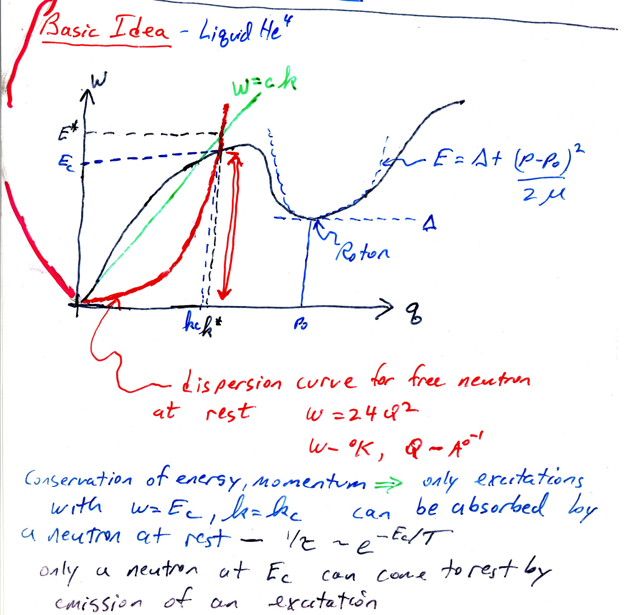
3 phonon interaction….

Slide 5
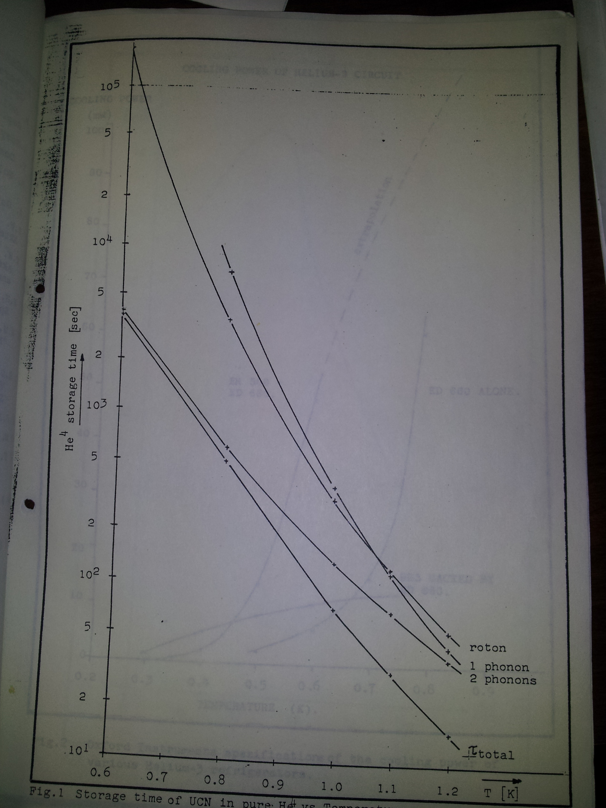

Slide 6
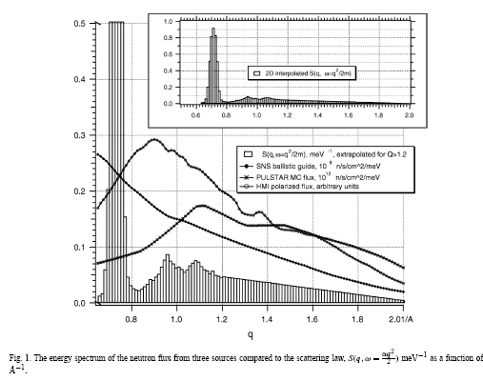
Single Phonon

Slide 8
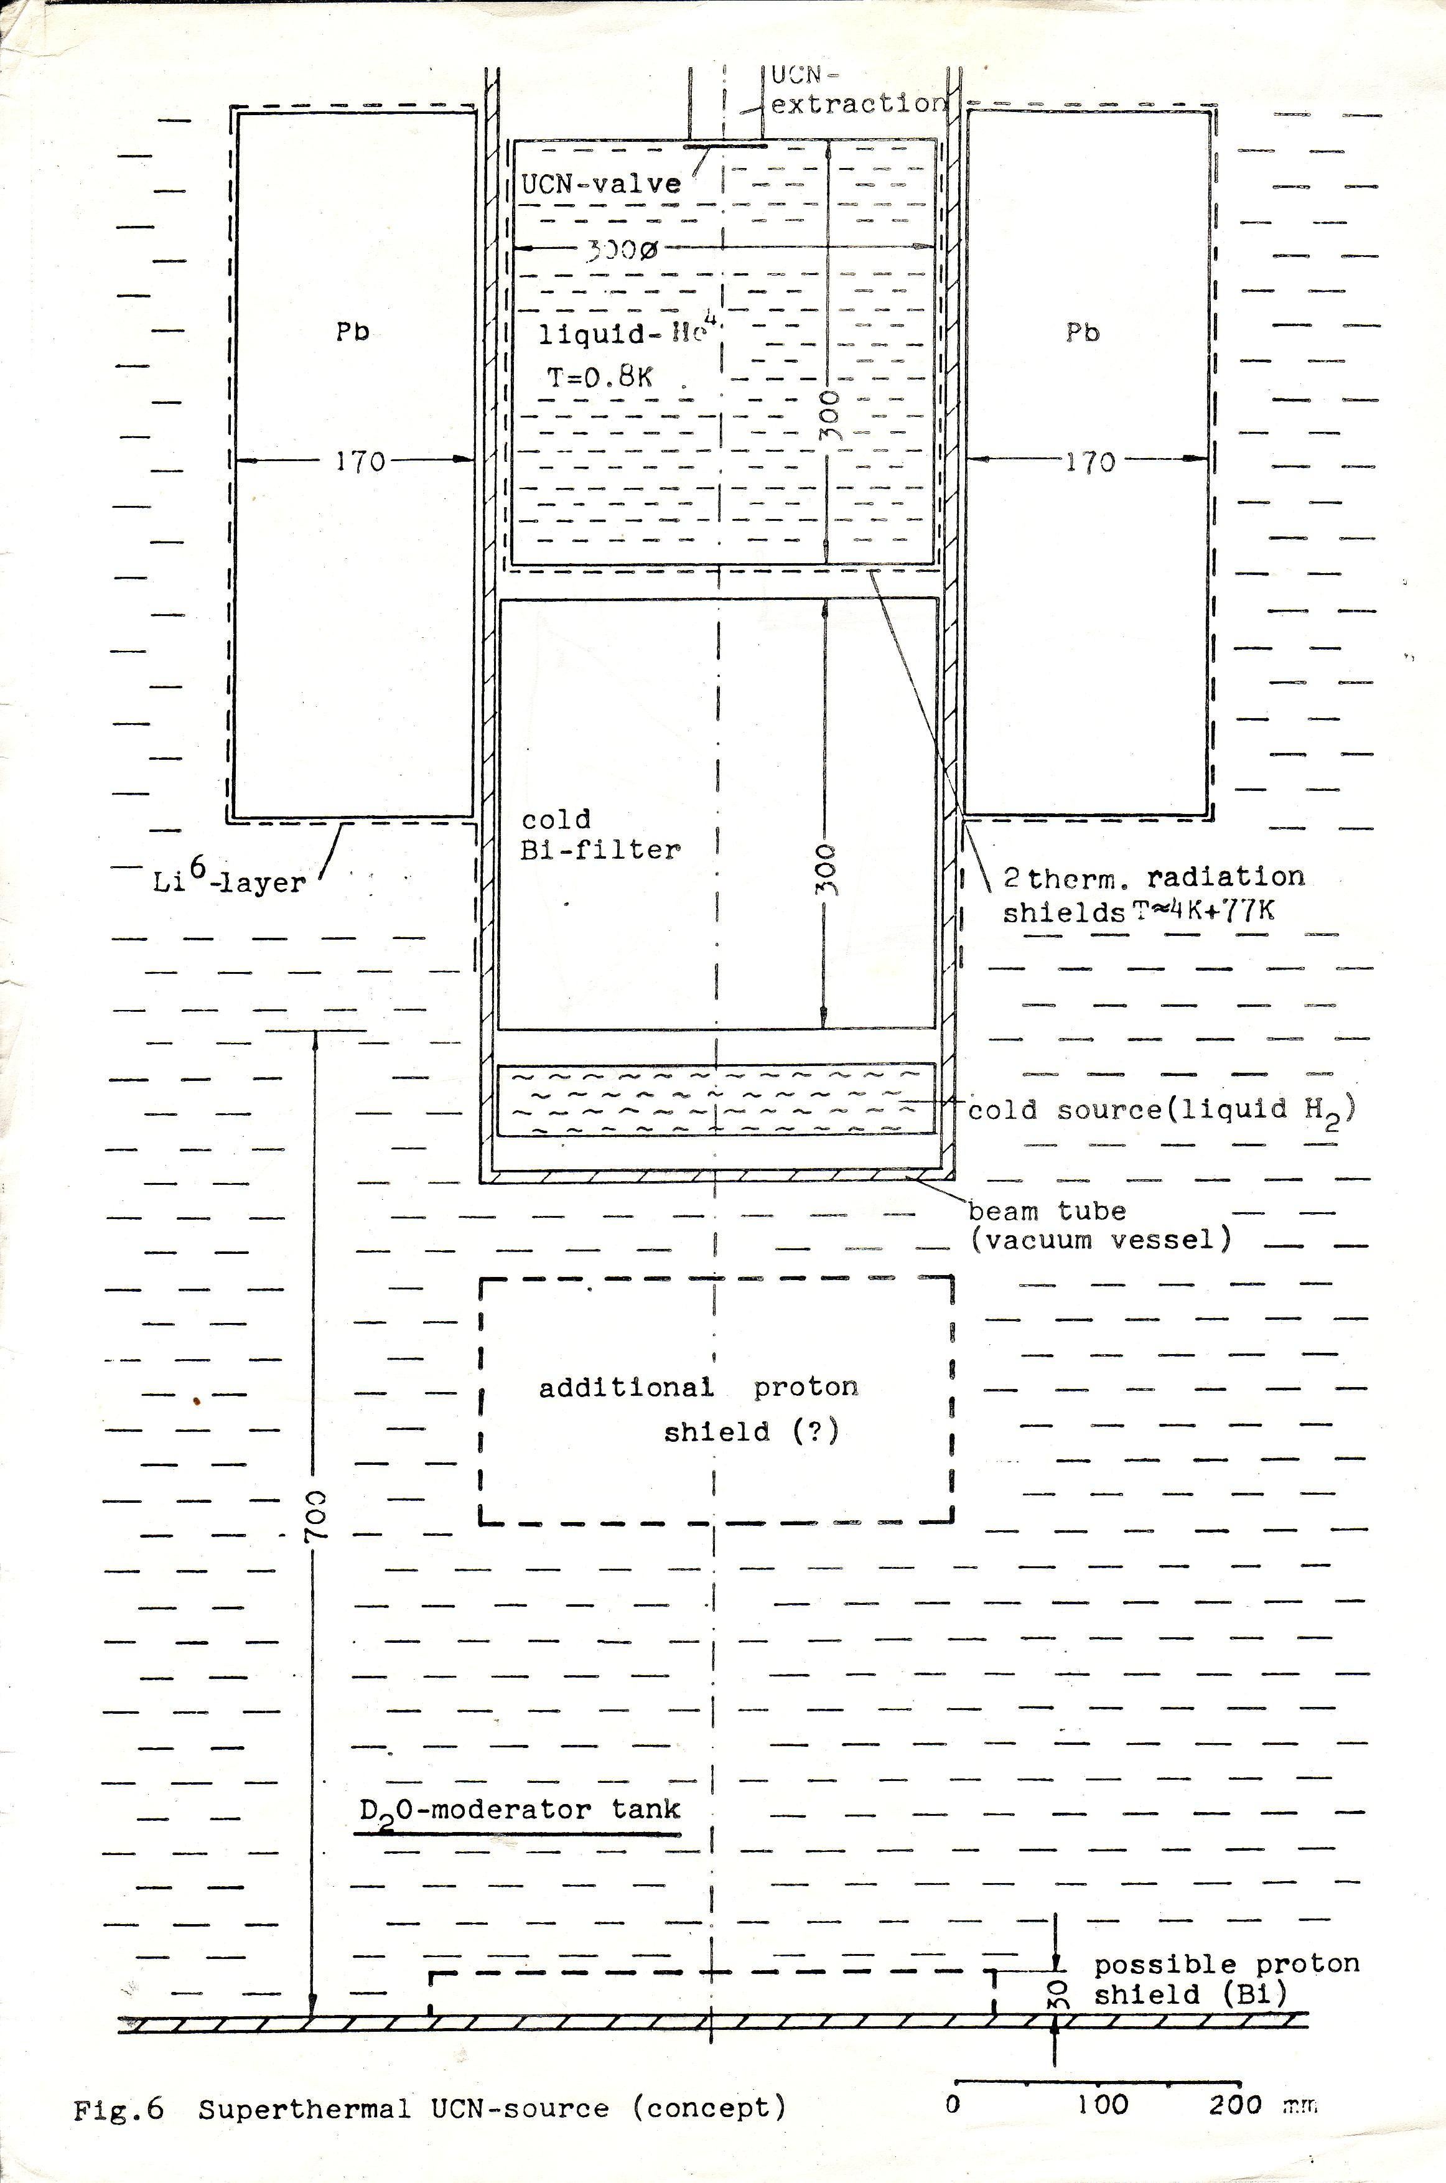

Slide 9
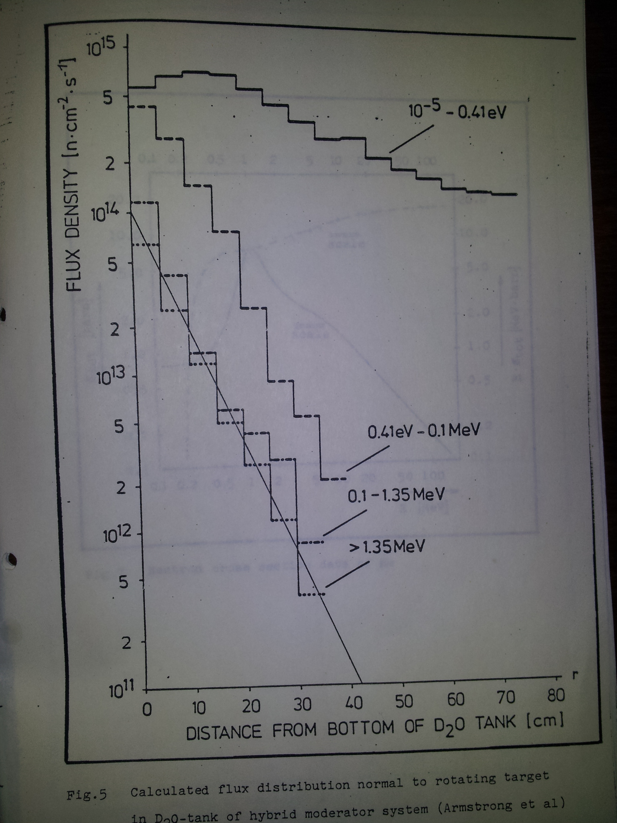
SNQ
70 cm from bottom of D20 tank
SNQ 1100 Mev protons, 5 ma, lead target

Slide 10
Add hydrogen cold source
Cooling power available

Slide 11
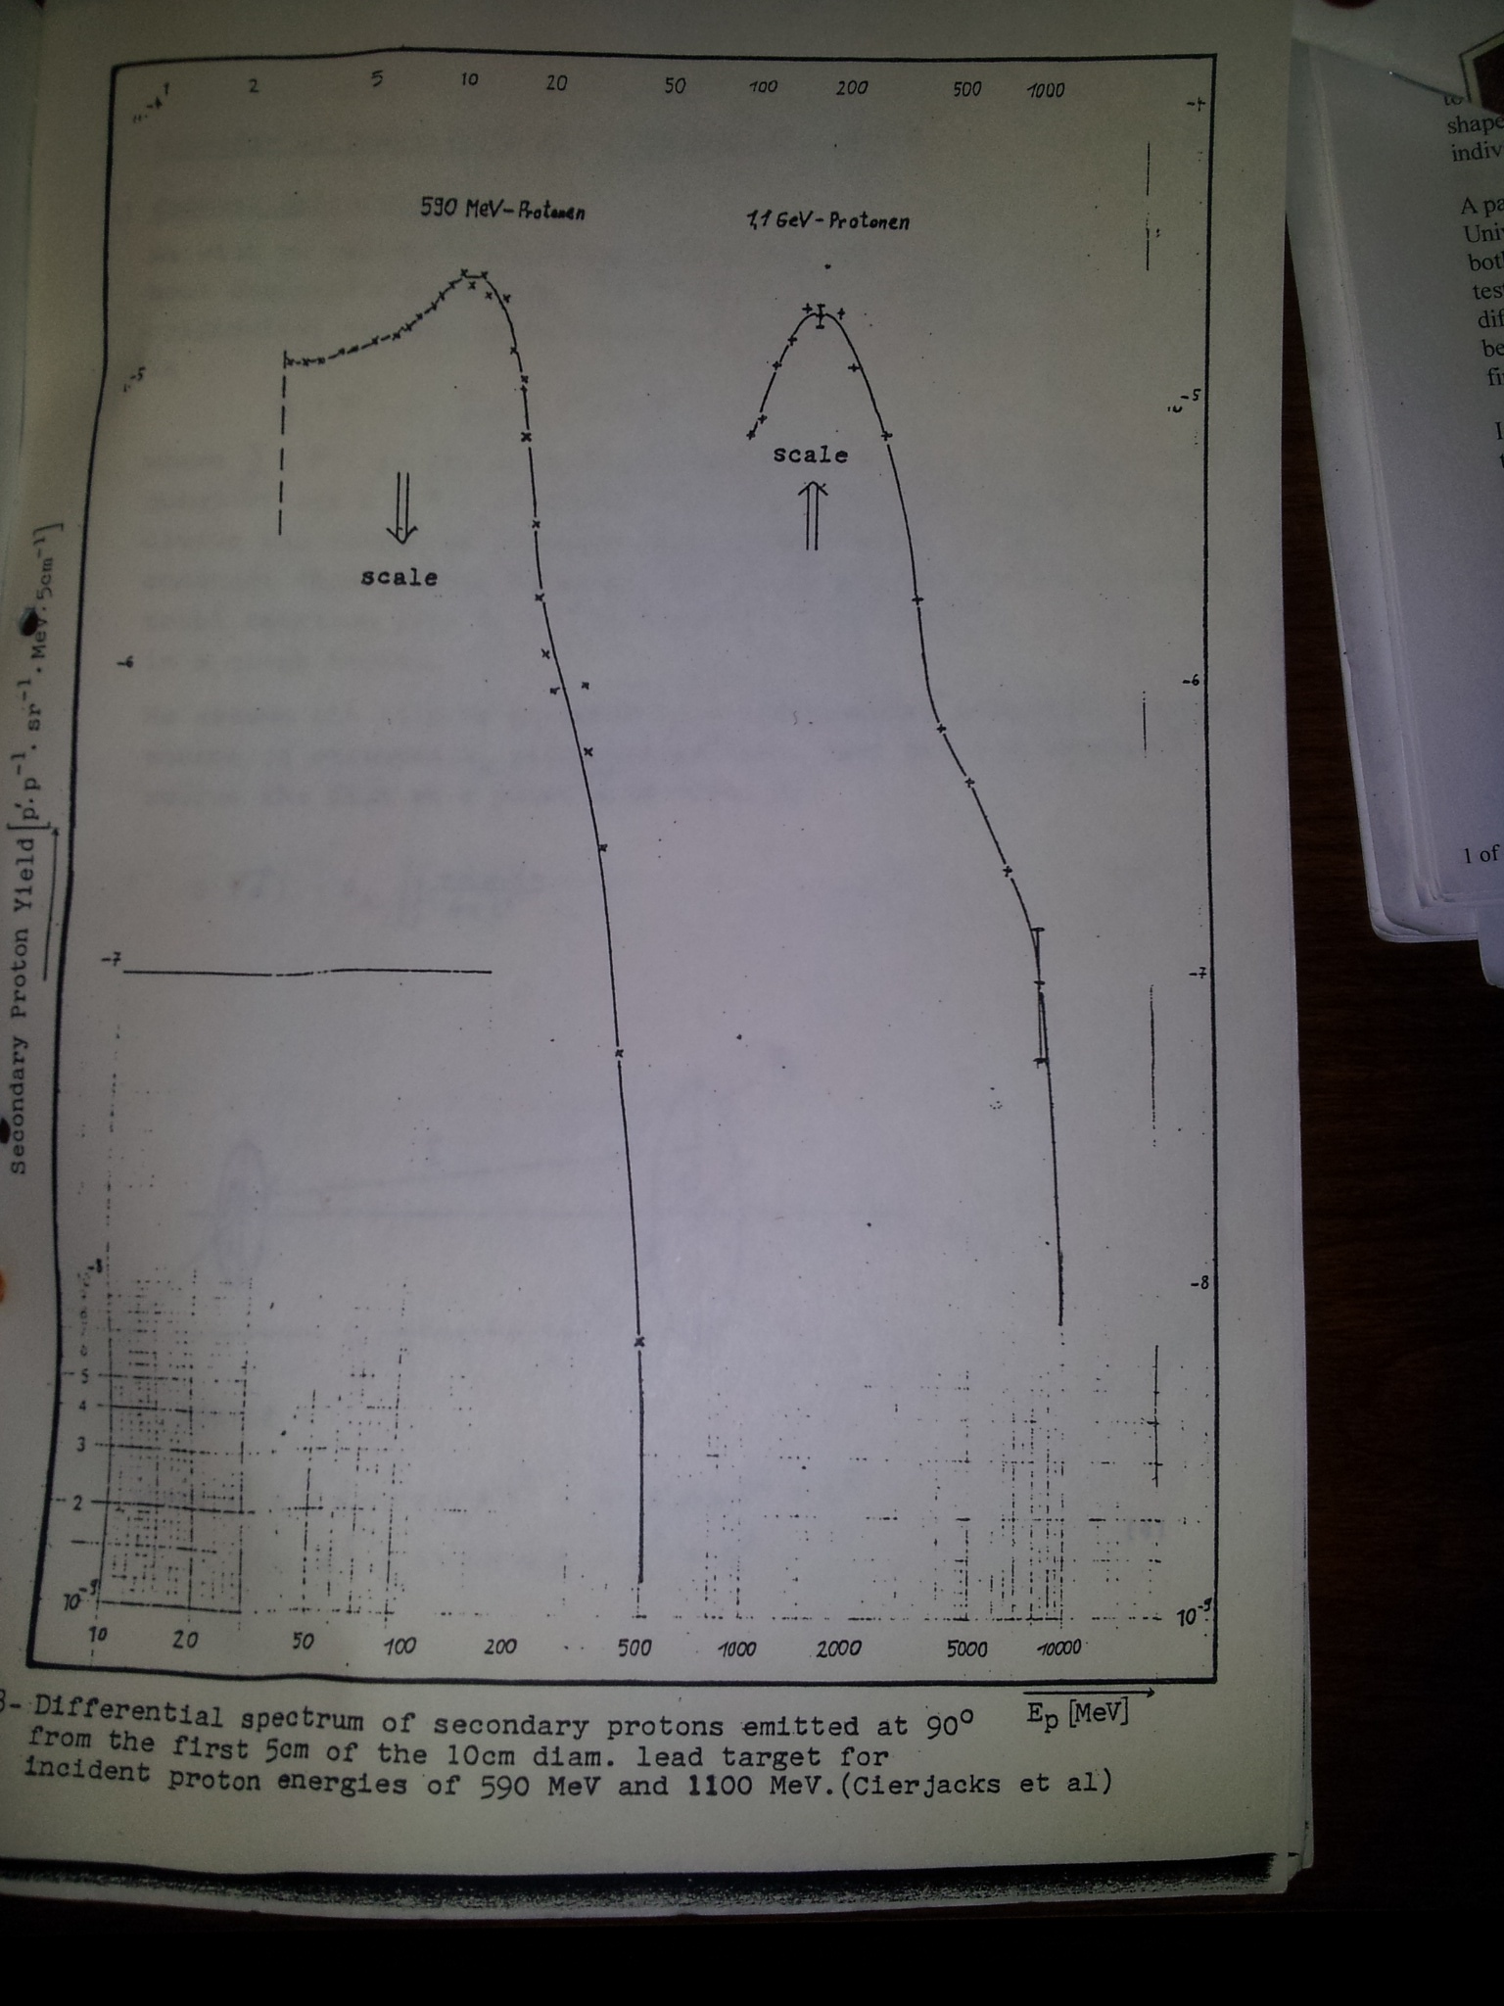
Measured
Lead,
10 cm diam.

Slide 12
