Slide 1
Steps Forward… Roadmap Discussion
R. Tschirhart
March 20th 2012

Slide 2
Themes-I
Sources and geometry modeling can largely factorize in initial concepts.
n-nbar: a) target-moderator output, b) optics, c) detector.
nEDM: stochastic -> He, analytic and ray tracing after that.
Not critical to develop a scattering kernel in MCNPX/He at this time.
Good progress on spallation source modeling for both neutrons and isotopes.
Isotopes: Next step is to model heating, integrate into ME design.
How does the case get made with respect to FRIB? This is a particle physics facility, not general purpose ISOL.

Slide 3
Themes-II
Next generation nEDM experiment should focus on an integrated design of source and detector. Large gains are conceivable. Target metric is a large increase in UCN density (e.g. 10⁴-10⁵/cm³) would be obvious to community. Lower end of range overlaps with TRIUMF--TRIUMF goal of 10⁴/cm³. Golub et al schemes can push much higher, new technique. Argument for an optimized nEDM facility is defendable. Goal of nEDM@SNS is to be statistics limited, Project X is a following opportunity that would exploit the statistically limited techniques developed at SNS.
ISOL concepts well advanced. Further evolution of the INFN (UC2) concepts is the next step. Future TRIUMF alpha emitter program limited to 10 microamps.
n-nbar:
a) Physics reach with respect to nucleon decay.
b) Detector concept development. (expt HEP can engage) .
c) Cost modeling….

Slide 4
Resources
Existing Phd/MA program in Accelerator Physics and Technology at Fermilab.
Can explore Fellowship support for PhD students and postdocs as a bridge funding mechanism until programmatic support from agencies. Explore matching funding with host institutions.
Separate Field Work Proposals to the DOE detector R&D (KA15).
nEDM enthusiasm is high with currently sponsoring particle physics agencies (DOE/NP, NSF/med+low, ) Currently not with BES and LLNL/NNSA. Will contact Contact Susan Seestrom (LANL), John Galambos (ORNL)regarding Project X collaboration.
DD/DT generator resources at LBNL.
Project MOU structure with National labs.

Slide 5
Concept Matrix | Concept Development Needed | Dependencies
ISOL (Ra,Rd,Fr) | Evolution path is clear. | Continued success of existing experiment. (exception for fountains: Cs fountain) X100-x10,000…no limit in sight, no clear need to intermediate experiment.
nEDM | UCN sources. Key issue is heating mechanisms , flux, density. | Continued development of nEDM@SNS. Simulation effort through summer 2013.
n-nbar | UCN/VCN source or beam Need FOM! Nt2 not density. Modeling interaction not important, issue is geometry. Can factorize source and detector geometry. Why do I believe I get a factor of x1000: Demonstrated source: SINQ Design for UCN neutron. Target model. Collaboration development (India). (send India collab note) | Demonstrator? (e.g. DT generator) Distraction? High-m mirrors? How to you make the case for nT?

Slide 6
Technology Matrix | Technology Development needed | Dependencies
ISOL | Continue on Th target development. | X100-x10,000…no limit in sight, no clear need to intermediate experiment. Materials studies & effussion/diffusion at ISOLDE.
nEDM | Many issues…rejecting magnetic field, HV control, etc. | nEDM@SNS
n-nbar | Control magnetic field to 1 nT over large volume. Collaborators in Japan on super mirrors. | NIST, ISIS(?) facilities in Asia.

Slide 7
Simulation Matrix | Simulation development needed | Dependencies
ISOL | Yield Validation, more than Ac. Larger volumes, effect if convolution of effussion and diffusion. | X100-x10,000…no limit in sight, no clear need to intermediate experiment.
nEDM | UCN vs Degraded beam. Key issue is heating mechanisms | Coherent phonon model. Show 10⁴-10⁵ then home free. Stochastic or analytic model.
n-nbar | UCN source or beam Need FOM! Nt2 not density. Modeling interaction not important, issue is geometry. Can factorize source and detector geometry | Demonstrator? DT generator?

Slide 8
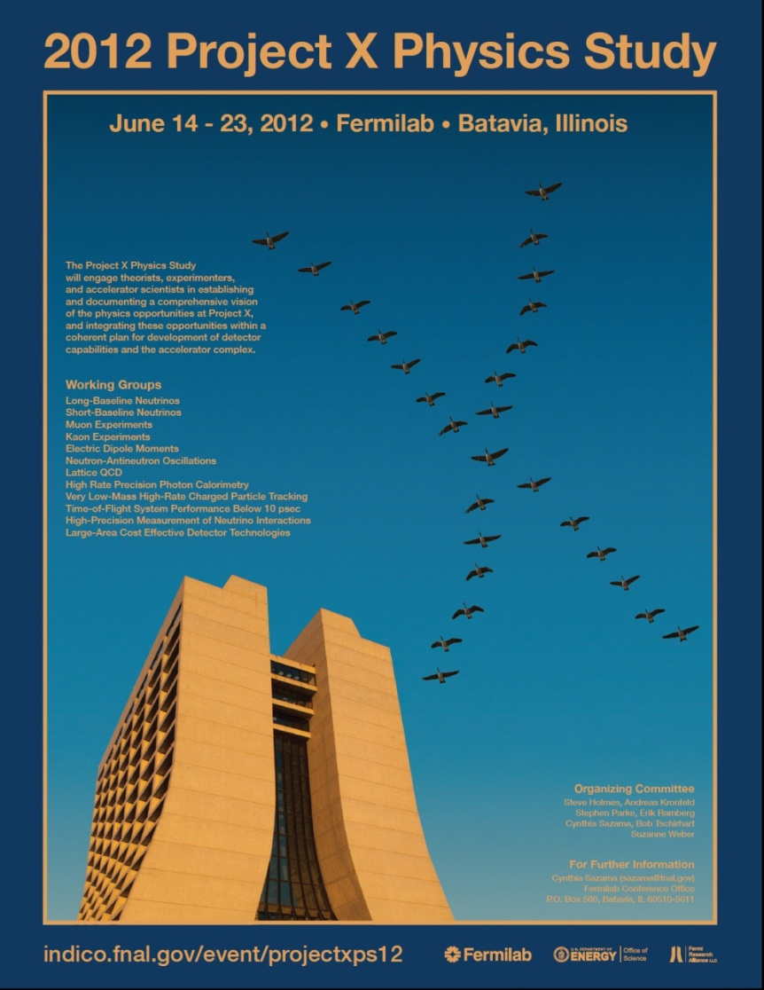
A Clear Next Step…
Goal of Project X Physics study is to continue developing physics case, and identifying critical R&D.

