Slide 1
Cryo-Module Test Stand
Status Report
on
Development
of
Cryo-ModuleTest Stand-1 (CMTS-1) for Fermi Lab
Centre for Design & Manufacture
Bhabha Atomic Research Centre

Slide 2
Cryo-Module Test Stand
Progress made so far :
List of major raw materials based on available drawings required for construction of Feed Box, Feed Cap, End Cap & Transfer Line have been prepared to initiate the procurement process which is going to take long time.
List all the Control Valves along with detailed specifications for procurement have been made.
List all the Check Valves along with detailed specifications for procurement have been made.
List all the Safety Valves along with detailed specifications for procurement have been made.
List all the Manual Valves have been made.

Slide 3
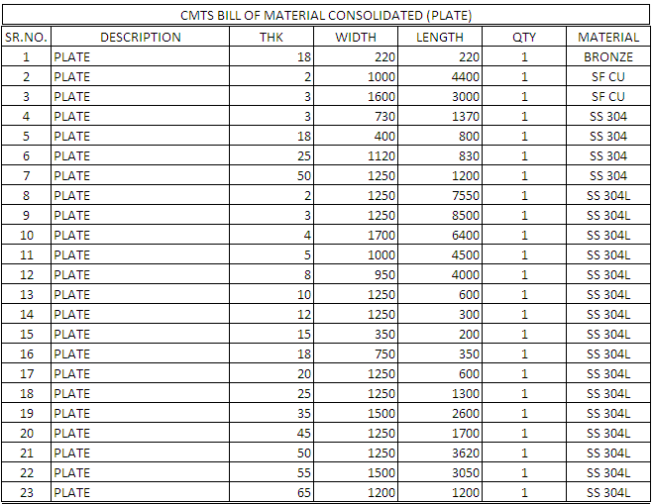
Cryo-Module Test Stand

Slide 4
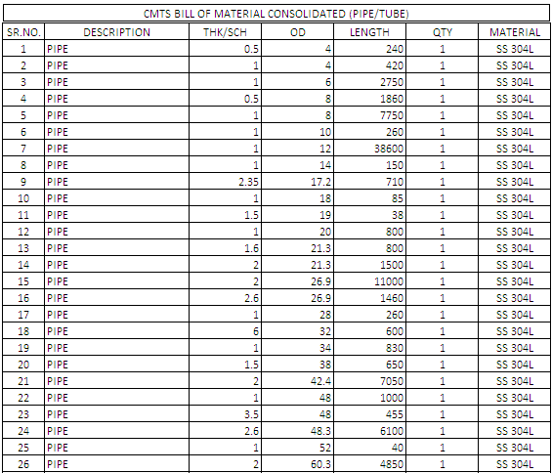
Cryo-Module Test Stand

Slide 5
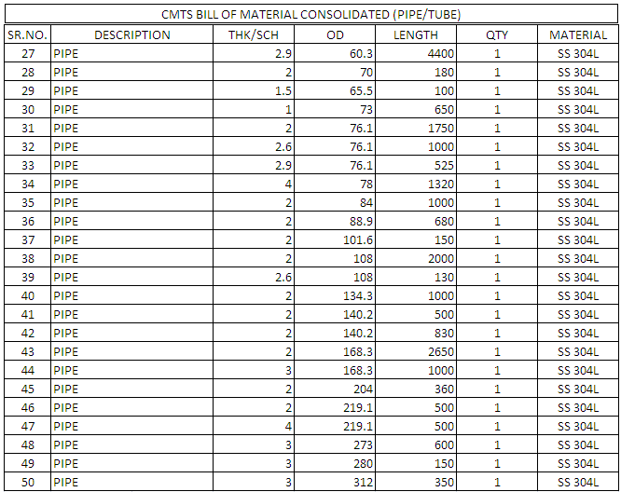
Cryo-Module Test Stand

Slide 6
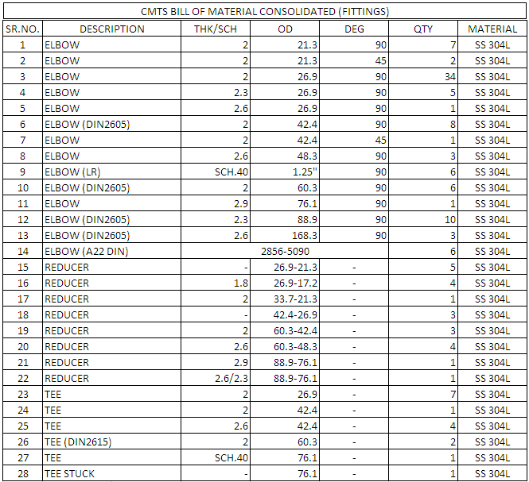
Cryo-Module Test Stand

Slide 7
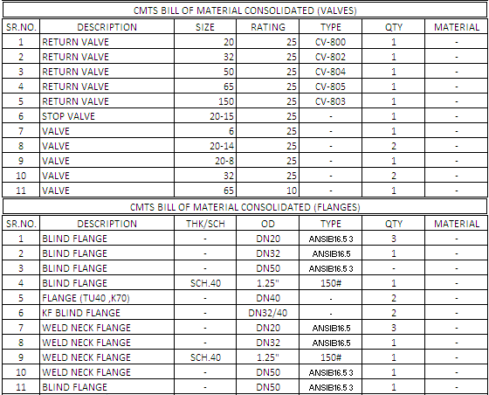
Cryo-Module Test Stand

Slide 8
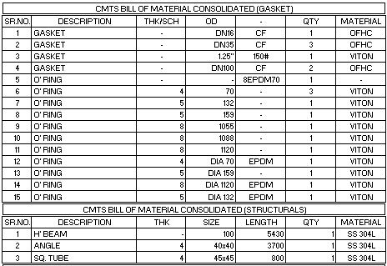
Cryo-Module Test Stand

Slide 9
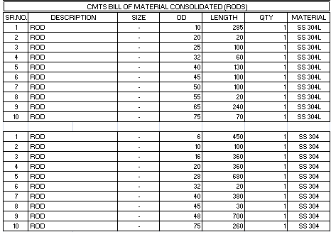
Cryo-Module Test Stand

Slide 10
Cryo-Module Test Stand
Specifications for Raw Materials:
All materials shall be of SS-304/304Lor 316/316L
Chemical composition shall be as per ASTM A-213 or A-269 for tubes and ASTM A-240 for plates
Material shall be in solution annealed condition.
Tubes shall be pickled, Hydro tested and polished before packing and dispatch.
All material shall be delivered in heat treated condition. 1. Stress relieving: 850-950°C (1560-1740°F), cooling in air 2. Solution annealing: 1000-1100°C (1830-2010°F), rapid cooling in air/water.

Slide 11
Cryo-Module Test Stand
Specifications for Raw Materials:
Inter-granular corrosion test (A-262 practice E) shall be conducted in accordance with the supplementary requirement of ASTM-A-269 or A-213 on a sample drawn on each lot of tubes.
Hardness test: Brinell or Rockwell test on one specimen from two tubes from each heat treated lot. The result shall conform to the hardness requirement table of A-213 or A-269. All 304/304L material shall have Hardness of HRB 90 max.
One flattening test shall be carried on specimen from each end of one tube in each lot. The results shall conform to the requirements of ASTM-A-213 or A-269.
One Tension test shall be carried out on a representative sample from each lot.

Slide 12
Cryo-Module Test Stand
Specifications for Raw Materials:
Impact Strength: Material should have very good impact strength both at room temperature and at cryogenic temperatures and should fulfill the requirements according to the European standards prEN 13445-2 (UFPV-2) ((min. 60 J (44 ft-lb) at -270 ºC (-455 ºF) and prEN 10216-5 (min. 60 J (44 ft-lb) at -196 ºC (-320 ºF).

Slide 13
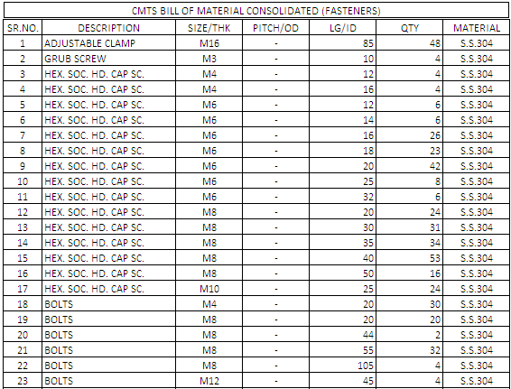
Cryo-Module Test Stand
List & Specifications of Fasteners

Slide 14
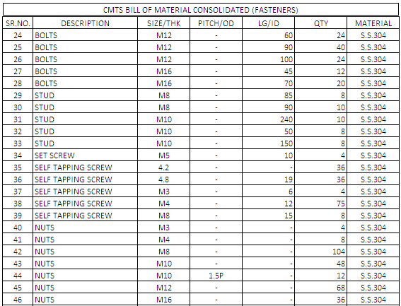
Cryo-Module Test Stand
List & Specifications of Fasteners

Slide 15
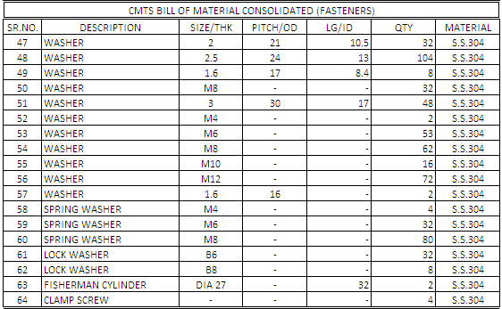
Cryo-Module Test Stand
List & Specifications of Fasteners

Slide 16
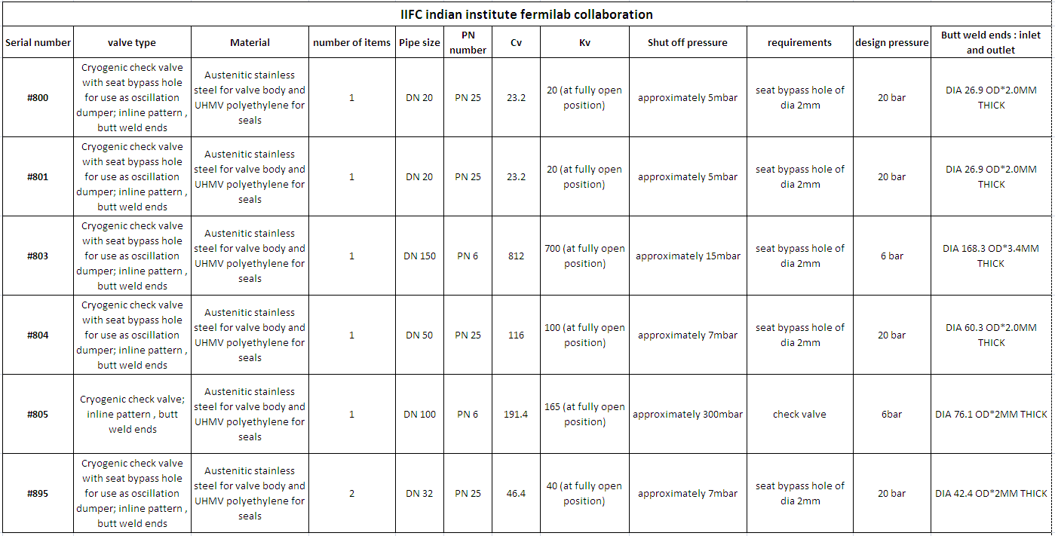
Cryo-Module Test Stand
List & Specifications of Check Valves

Slide 17
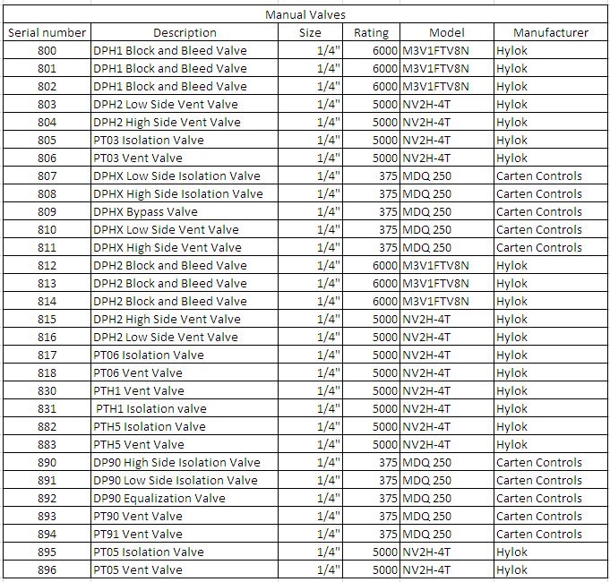
Cryo-Module Test Stand
List & Specifications of Manual Valves

Slide 18
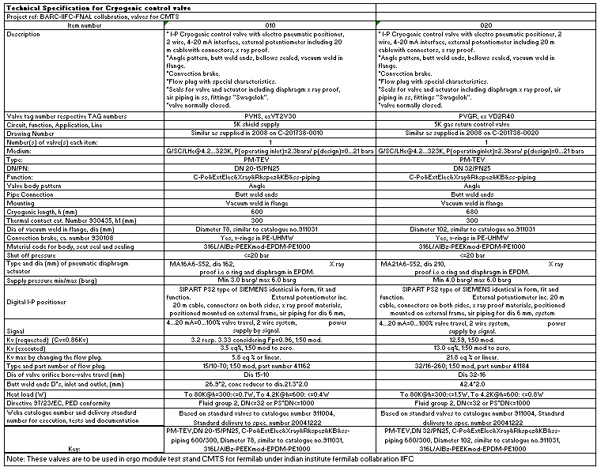
Cryo-Module Test Stand
List & Specifications of Control Valves

Slide 19
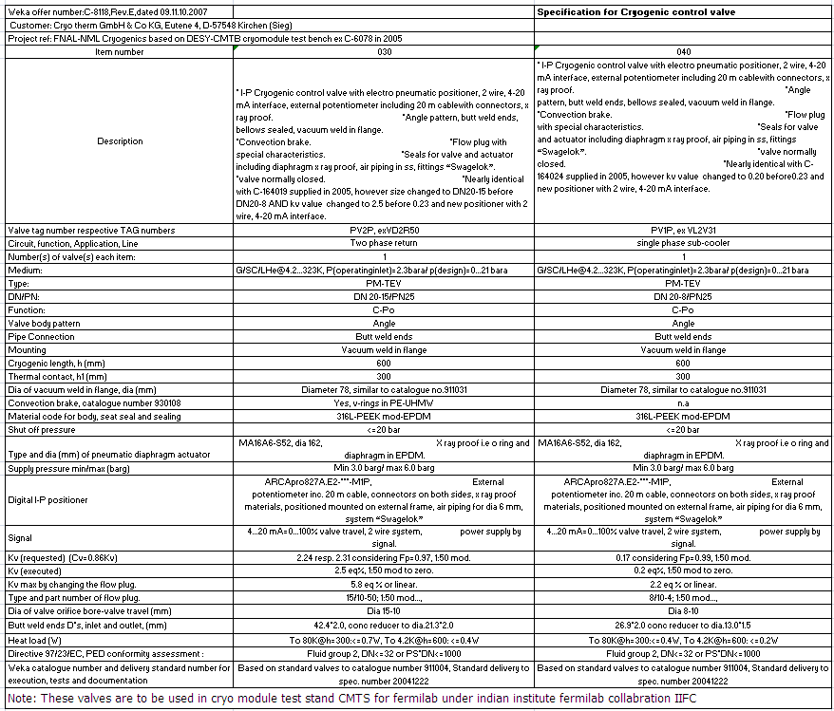
Cryo-Module Test Stand
List & Specifications of Control Valves

Slide 20
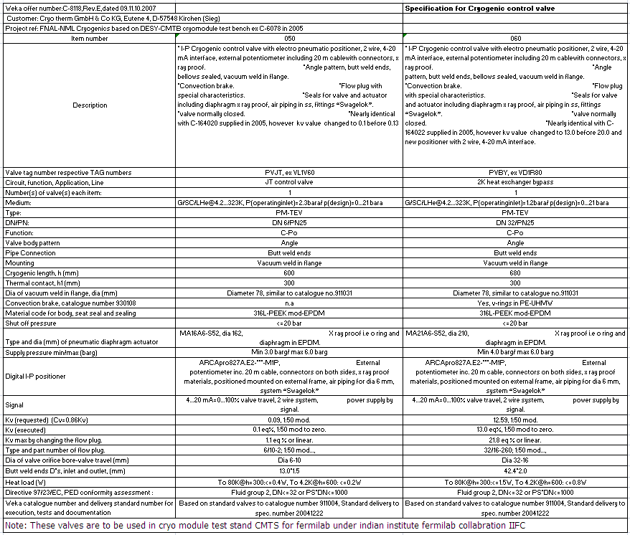
Cryo-Module Test Stand
List & Specifications of Control Valves

Slide 21
Cryo-Module Test Stand
List & Specifications of Control Valves

Slide 22
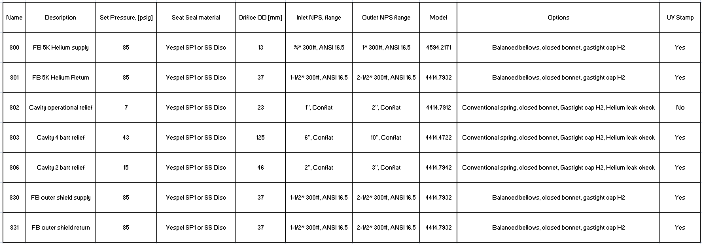
Cryo-Module Test Stand
List & Specifications of Safety Relief Valves

Slide 23
Cryo-Module Test Stand
Thanks

