Slide 1
PIP-II Report
PIP-II Team
Project Management Group
16-Mar-2022

Slide 2
WBS 121.01 Project Management
ICE Review
  Reconciliation in progress, on track for completion before ESAAB
CD-3 IPR held 01-Mar to 03-Mar-2022
  No recommendations requiring completion for ESAAB
  Recommendations besides “proceed to CD-3”:
    Advance SSA final design reviews, and perform a long-term test of a 650 MHz SSA
    Work to build schedule float between commissioning phases
    Use all available resources to finish the prototype HB650
    Evaluate cost/benefit of spending contingency on a spare HWR
    Conduct a director’s review of cavities and cryomodules prior to the next OPA review
  In addition to the recommendations, several useful comments will be tracked in iTrack

Slide 3
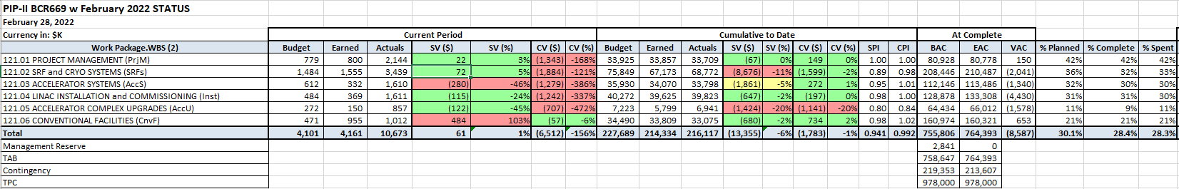
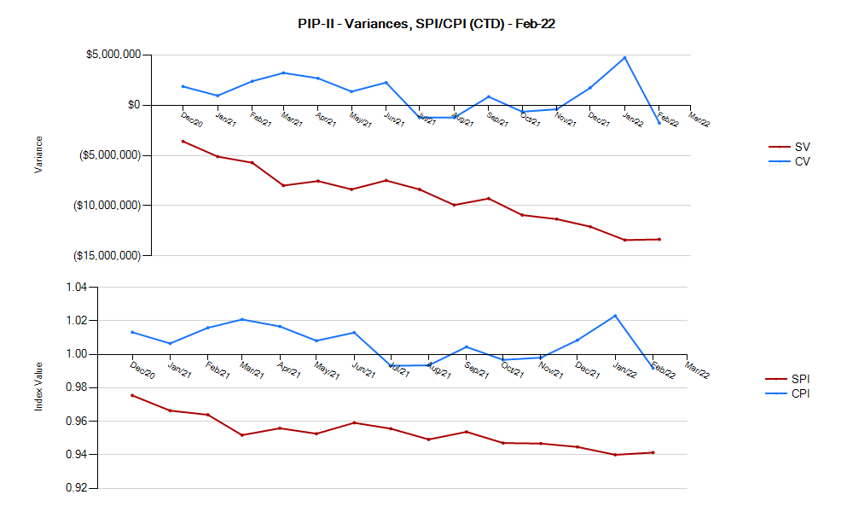
EVMS
CPI -0.03, SPI +0.001 since prior month
Current Period Red Variances:
  All areas: CV from correction of missing labor costs
  SSR2: Positive SV from design reviews, cavity procurement vendor performance
  LB650: Positive SV from cavity procurement
  HB650: Negative SV for CM assembly, tooling, vacuum vessel
  AccSys: Negative SV for Instrumentation, LLRF
  CF: Positive SV for Linac Complex and Booster Connection Design, Cryoplant Building. Negative SV for Site Work

Slide 4
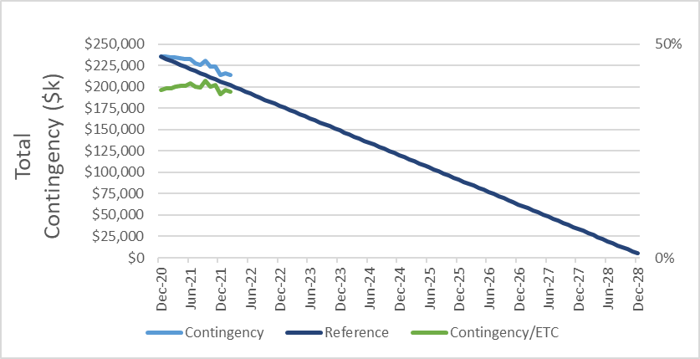
BCRs and Contingency Usage
Contingency Usage

Slide 5
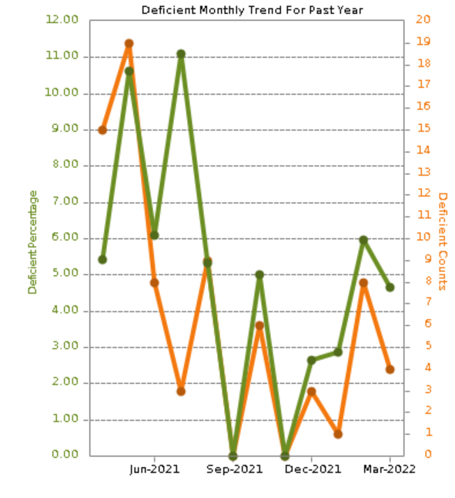
ESH
Construction
Increased site construction activity and increase in observations, normalized the trend lines. Findings included:
  2- instances of housekeeping, 1- improperly stored fall arrest harness, 1- not wearing hi-vis vest
ESH
DOE Workplace safety and reentry framework released. Relaxing masking requirements though masking still required for close quarters work. Testing requirements remain in effect for unvaccinated.

Slide 6
QA
PIP-II QA Plan Status:
Five of six PIP-II Partners have approved and released PIP-II QA Plans.
The final PIP-II QA Plan is near final. Detailed discussion held to review current comments and feedback. The Partner is addressing those comments.
QCCG – March meeting occurred on 10 March 2022.
QC Alignment Matrix is evolving. Completed the one-on-one meetings with Partners and Fermilab Technical Teams. Improvements made to the matrix for enhanced user navigation and use.
Finalizing the PIP-II Partner Traveler Exchange Process document. Received input from SPMs. Process Partner Responsibilities Matrix is integrated and in process of being populated.
An overview of Manufacturing Inspection Plans (MIPs) was provided. Discussed the definition, significance, use, and development. Partners shared examples of MIPs used in their processes with vendors.

Slide 7
International
14-March – DOE-FNAL-DAE meeting to introduce Dr. Harriet Kung to the DAE leadership:
  DOE-FNAL Participants:
    Dr. Harriet Kung, Deputy Director for Science Programs, DOE Office of Science (SC)
    Dr. Jim Siegrist, Associate Director, DOE Office of High Energy Physics
    Dr. Nigel Lockyer, Director of Fermilab
    Dr. Lia Merminga, PIP-II, Project Director
    Ms. Hema Ramamoorthi, Chief of Staff & Director for International Engagements
  DAE-BARC-RRCAT Participants:
    Dr. K.N. Vyas, Chairman, DAE
    Dr. Ajit Kumar Mohanty, Director, BARC
    Dr. Shankar Nakhe, Director RRCAT
    Dr. Srinivas Krishnagopal, Scientist and IIFC Technical Coordinator, BARC
    Dr. Purushottam Shrivastava, Scientist and IIFC Technical Coordinator, RRCAT

Slide 8
International
15 March – P2PEB#11 meeting focusing on starting execution & project updates:
  CD-3 review comments/recommendations
  closeout with impact on IKC Partners;
Work in progress to finalize docs in Spring/Summer 2022:
  PPDs with CEA and CNRS;
  PPDs with DAE;
  DAE QAP;
  Acceptance plans, Acceptance criteria & SAR1/SAR2 Acceptance Criteria checklist
  IKC Risk Register scrubbing incl. technical team:
    US and partner experts to review the total schedule impacts estimated by IKC Partners, to compare/assess it with CD-3 IPR estimation.

Slide 9

Procurements
Item |  | Req # | Est SubK Value | Status | Expected Award/Delivery Date
SSR2 Resonator Cavities |  | 305165 | $960K | Significant concerns persist on RI’s ability to make per our technical specifications. Parallel PO to Zanon in approval process currently while keeping existing PO with RI and moving out delivery to late 2022/early 2023. RI has agreed to this path. | January 2023 (delivery)
SSR2 Resonator Cavities |  | 305165 | $665K | Awarded PO# 673794 to Zanon on 1/15/2021. Delivery in July 2022. | July 2022 (delivery)
Linac Complex |  | 327242 | $72M | Approval of RFP from HCA given on 2/18/2022. Anticipate issuing RFP in April 2022 with award in October 2022. | October 2022 (award)
HB 650 Vacuum Vessel |  | 316651 | $573K | Award made on 6/28/2021. Schedule moved out by vendor again due to issues with their subcontractor staffing. Current schedule shows shipping from vendor (Ohio) by late March 18, 2022. | March 18, 2022 (delivery)
HB 650 Vacuum Vessel |  | 322645 | $189K | Award made to Wuxi October 2021 as a backup to the PHPK order. Vessel is in transit from Wuxi with expected delivery in April. Transportation issues with shipping vessels are causing unexpected delays. | April 2022 (delivery)
Helium Vessels |  | 309207 | $386K | PO# 673026 with Roark is late. We have seen partial deliveries with quality issues. Communication directly with Roark ownership to ensure we are a priority. Final delivery of all pieces to be complete by April 2022. | April 2022 (delivery)
PIP-II PMG | March 2022

Slide 10
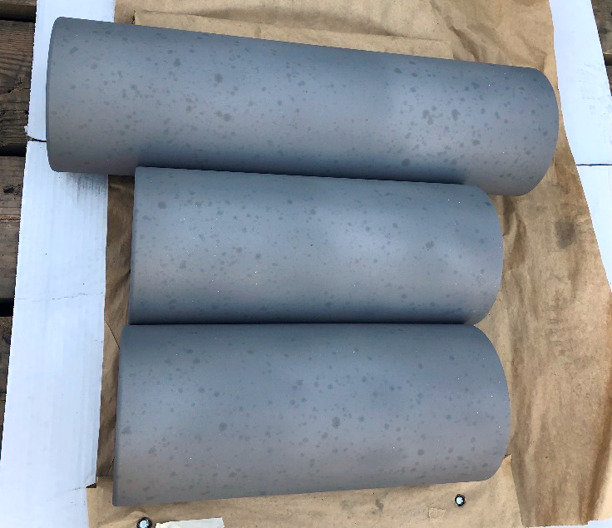
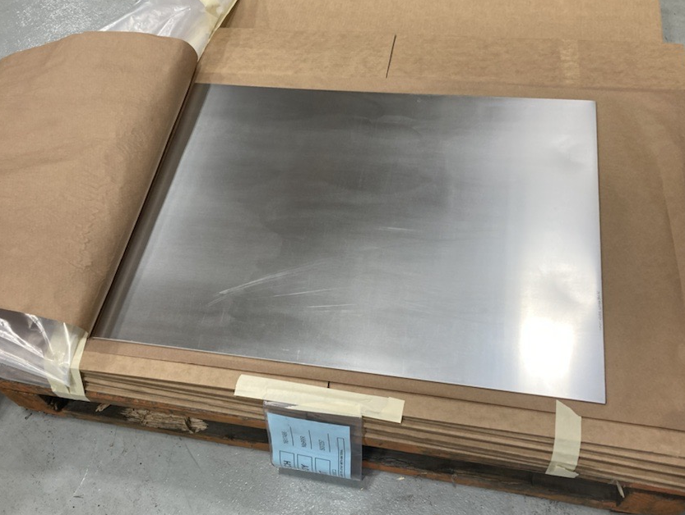
SRFCryo Systems – SSR1 HWR
HWR is in ICB. New long term storage location to be identified. MDB could be an option (door opening might be too small).
pSSR1 cold test completed:
  A full set of data was acquired and allowed to better understand the thermal design of the CM. A loss of insulation vacuum test was also performed. A report is being written to summarize the results.
SSR1 production Nb contract ongoing at ATI.
SSR1 cavities REQ in process

Slide 11
SRFCryo Systems – pSSR2
Cavity manufacturing is in progress:
  Zanon: manufacturing ongoing in advance of schedule
  RI has capacity issues and delivery is delayed.
Tuners and Couplers:
  CPI coupler production is on schedule.
Cryomodule:
  Procurement of vacuum vessel: final steps to place PO
Magnets:
  Test stand being setup in IB1, all procurements placed.
  Magnets in industry: Everson Tesla working in initial design analysis
  BARC magnets: pre-prototype magnet was powered to almost nominal field without bucking coils, still needs debugging. Delay delay from November 21 to July 22.

Slide 12
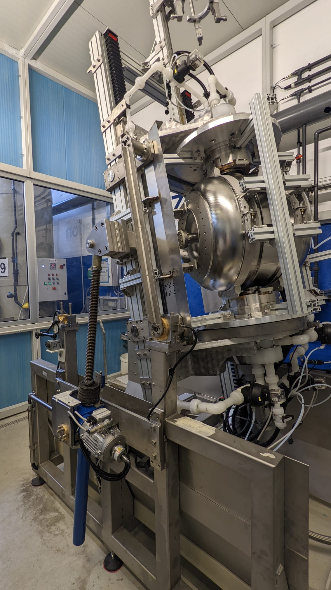
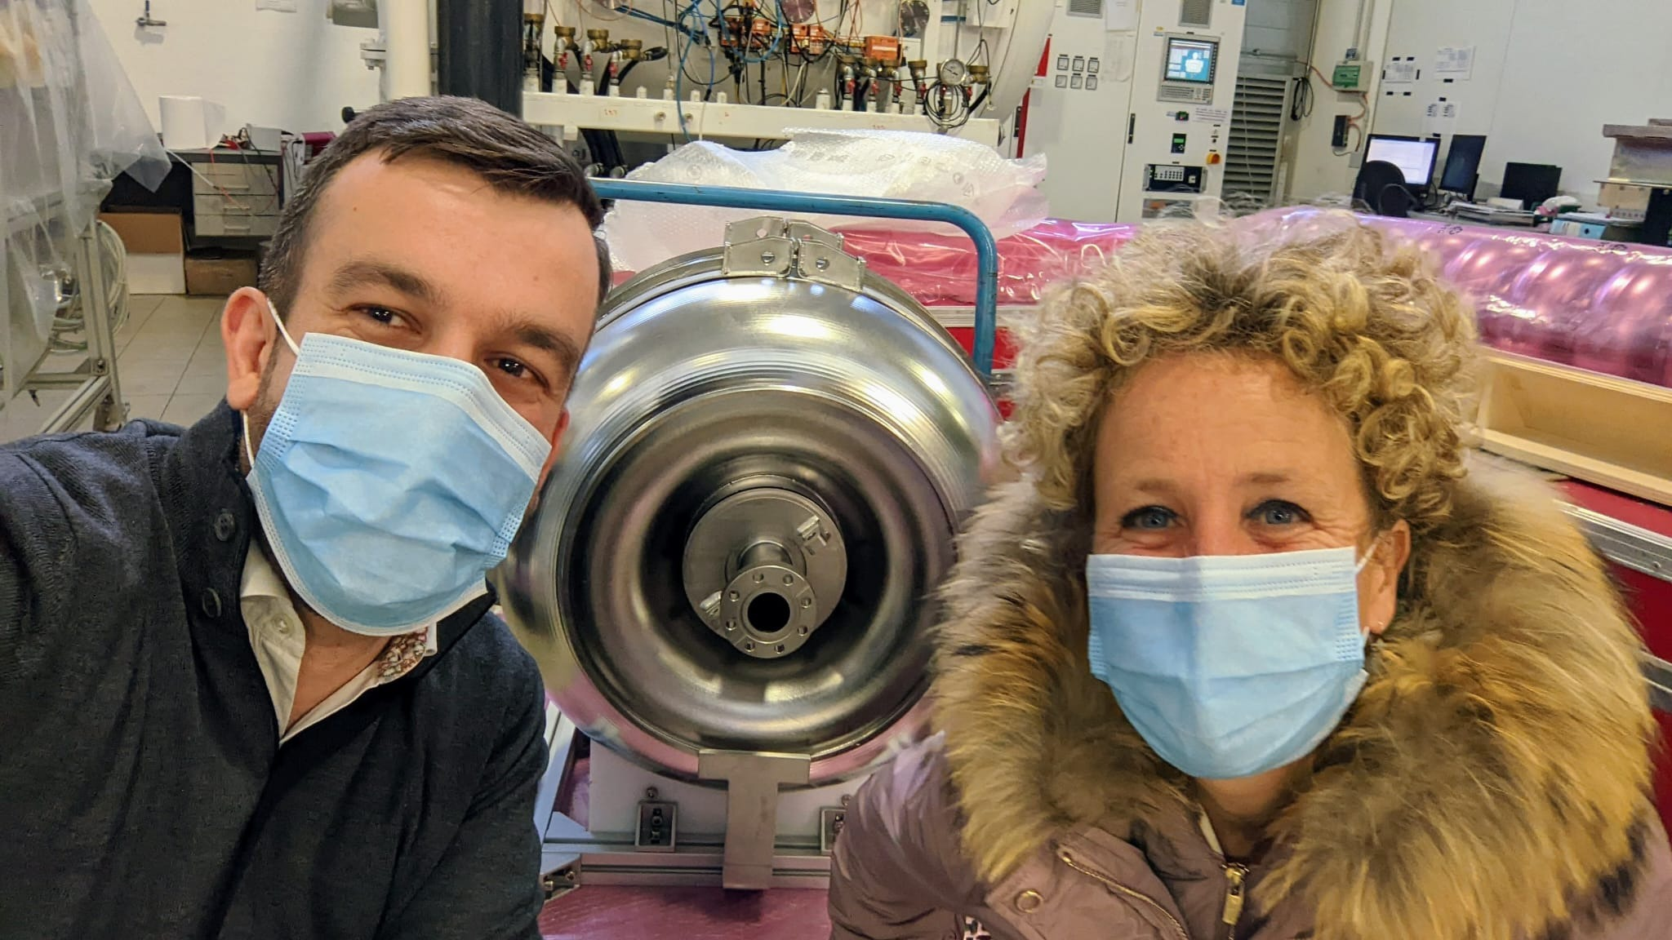
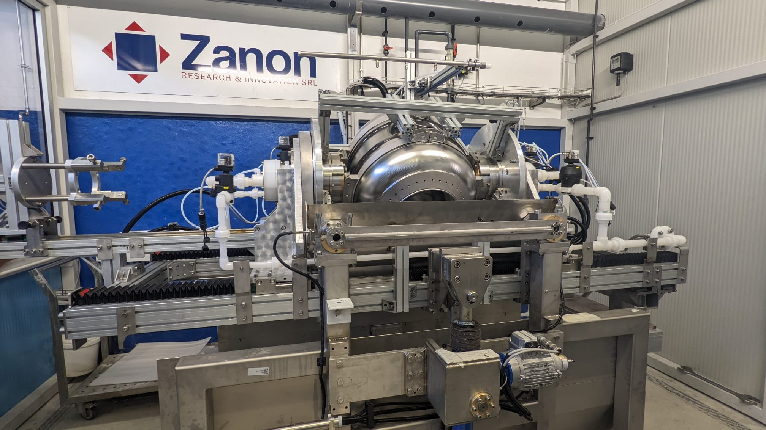
Visit at Zanon

Slide 13
SRFCryo Systems – pLB650
B61-EZ-001 VTS test completed and being prepared for STC test
B61-EZ-002 will be jacketed at Zanon. FNAL will send a He vessel and instrumentation to INFN.
4 Additional cavities are at Fermilab
  Cavities are going through the system for processing
  Full processing plan is being evaluated and discussed with INFN

Slide 14
SRFCryo Systems – pHB650
RRCAT-506, AES007, AES008 and AES009 are assembled in string
RRCAT-502 and RRCAT-504 are being re-washed after issues with installation of the power couplers

Slide 15
SRFCryo Systems – pHB650
Critical procurements
  B92 cavity manufacturing is in progress at RI. Delivery is delayed and confirms issues of capacity as shown for SSR2 cavities.
  He vessels (both HB and LB) are still delayed at Roark (additional 6 months).
  Vacuum vessel contract is in progress at PHPK (delay to end of May). Slipping month to month.
  Second vacuum vessel left WUXI on 01/28 but due to transportation issues will reach FNAl only last week of April. The vessel is currently in Korea.
  Low cold mass: parts are being manufactured in VMS.

Slide 16
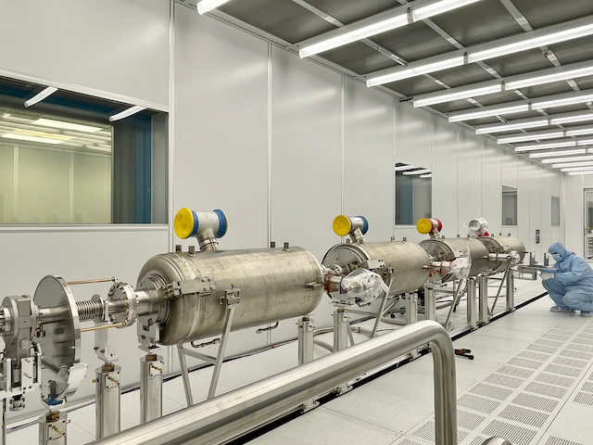
SRFCryo Systems – pHB650

Slide 17
SRFCryo Systems – Cryogenics
Cryoplant: 04/14 Cryoplant recovery system FDR
CDS focusing on drawings for components production

Slide 18
Accelerator Systems
Acc Sys overall
  Assessing paths to final designs
MPS
  Preliminary Design Review conducted, responses to recommendations developed
Magnets/Power supplies
  2nd prototype warm quadrupole coil winding in progress
  PIP2IT switcher supplies returned to AD (special process spares)
Vacuum
  Delayed vacuum valve delivery for cryomodule test stand: spare in hand, purchasing another from a domestic vendor
  Booster injection and laser profile monitor vacuum pipe designs are primary focus
  Integrated Vacuum Systems PDR planning - April
Instrumentation
  Continuing Laser profile monitor mechanical design and technology choice (review recommendation)
  Solidifying uTCA architecture/implementation
  Wrapping up determination of network bandwidth requirements with Controls and LLRF
Safety Systems
  Cryoplant building ODH system final design work ongoing (IERC issues investigated and non-factors)

Slide 19
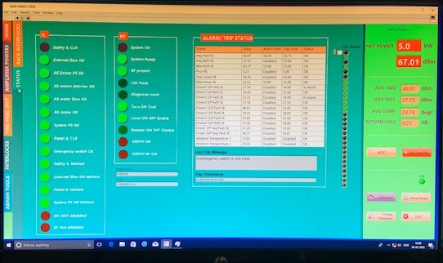
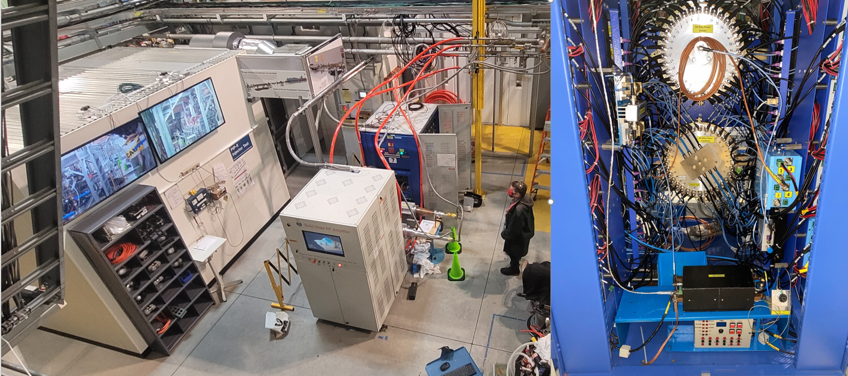
Accelerator Systems
HPRF/RF distribution
  2nd 40 kW 650 MHz SSA powered to 5 kW
    Investigating unbalanced output between cabinets
  7 kW FDR, 20 kW PDR conducted
    Joint closeout this morning
  40 kW, 650 MHz PDR scheduled for 29/30 March
  Circulator delivery delayed – weekly updates from vendor
LLRF
  RFPI preliminary design hand-off to Lodz University of Technology, Poland
    Working through full approval of work for others agreement
  Considering similar path for Master Oscillator/Phase Reference Line design
  Visit by Polish colleagues this spring
Controls
  EPICS training planned for 21 March – 1 April (Osprey)
  Planning for Timing-DAQ Integrated PDR in April
40 kW 650 MHz SSA @ 5 kW
40 kW 650 MHz SSA @ CMTF

Slide 20
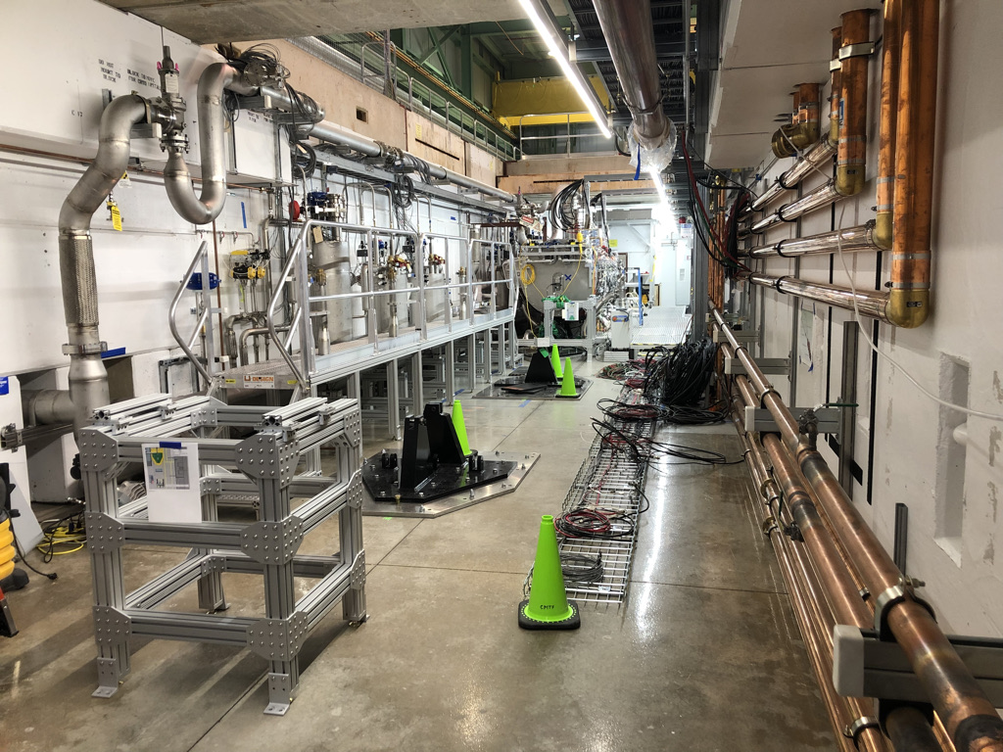
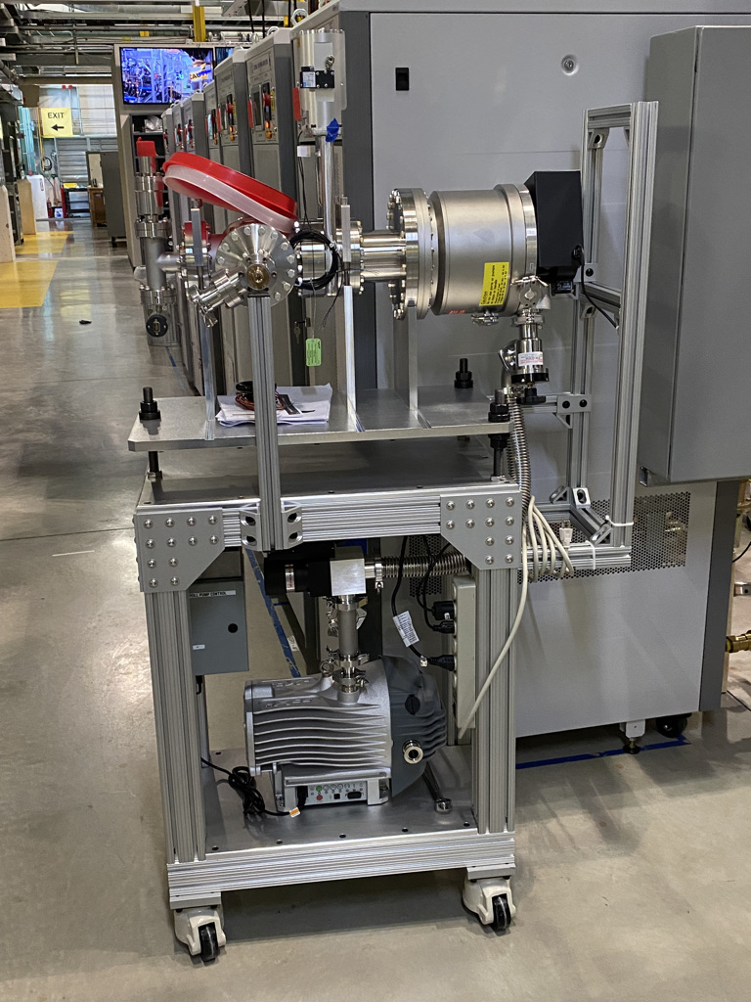
Installation and Commissioning
Warm Front End
  Long-term Kicker driver testing scheduled to begin in April
  Absorber new lid was received and being Quality Checked
  Still pursuing EE support
Test Infrastructure – 650 Mhz Test Stand
  All infrastructure essentially complete until pHB650 cryomodule arrives
  650 SSA installation/testing underway outside cave
  Assembly of vacuum stations continued
  PO issued for walking platform over floor cable tray on West side of tunnel - delivery expected in April
New walking platform will cover tray along West aisle
Insulating Vac Station partially assembled
Notes:
vacuum leak check is the last step for QC of the lid

Slide 21
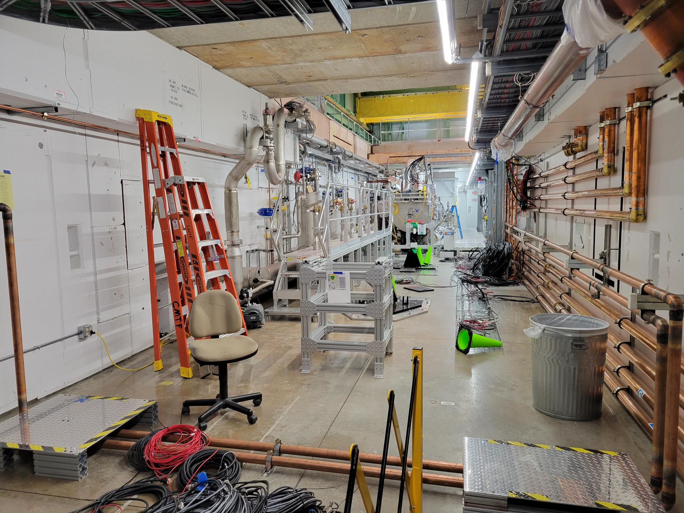
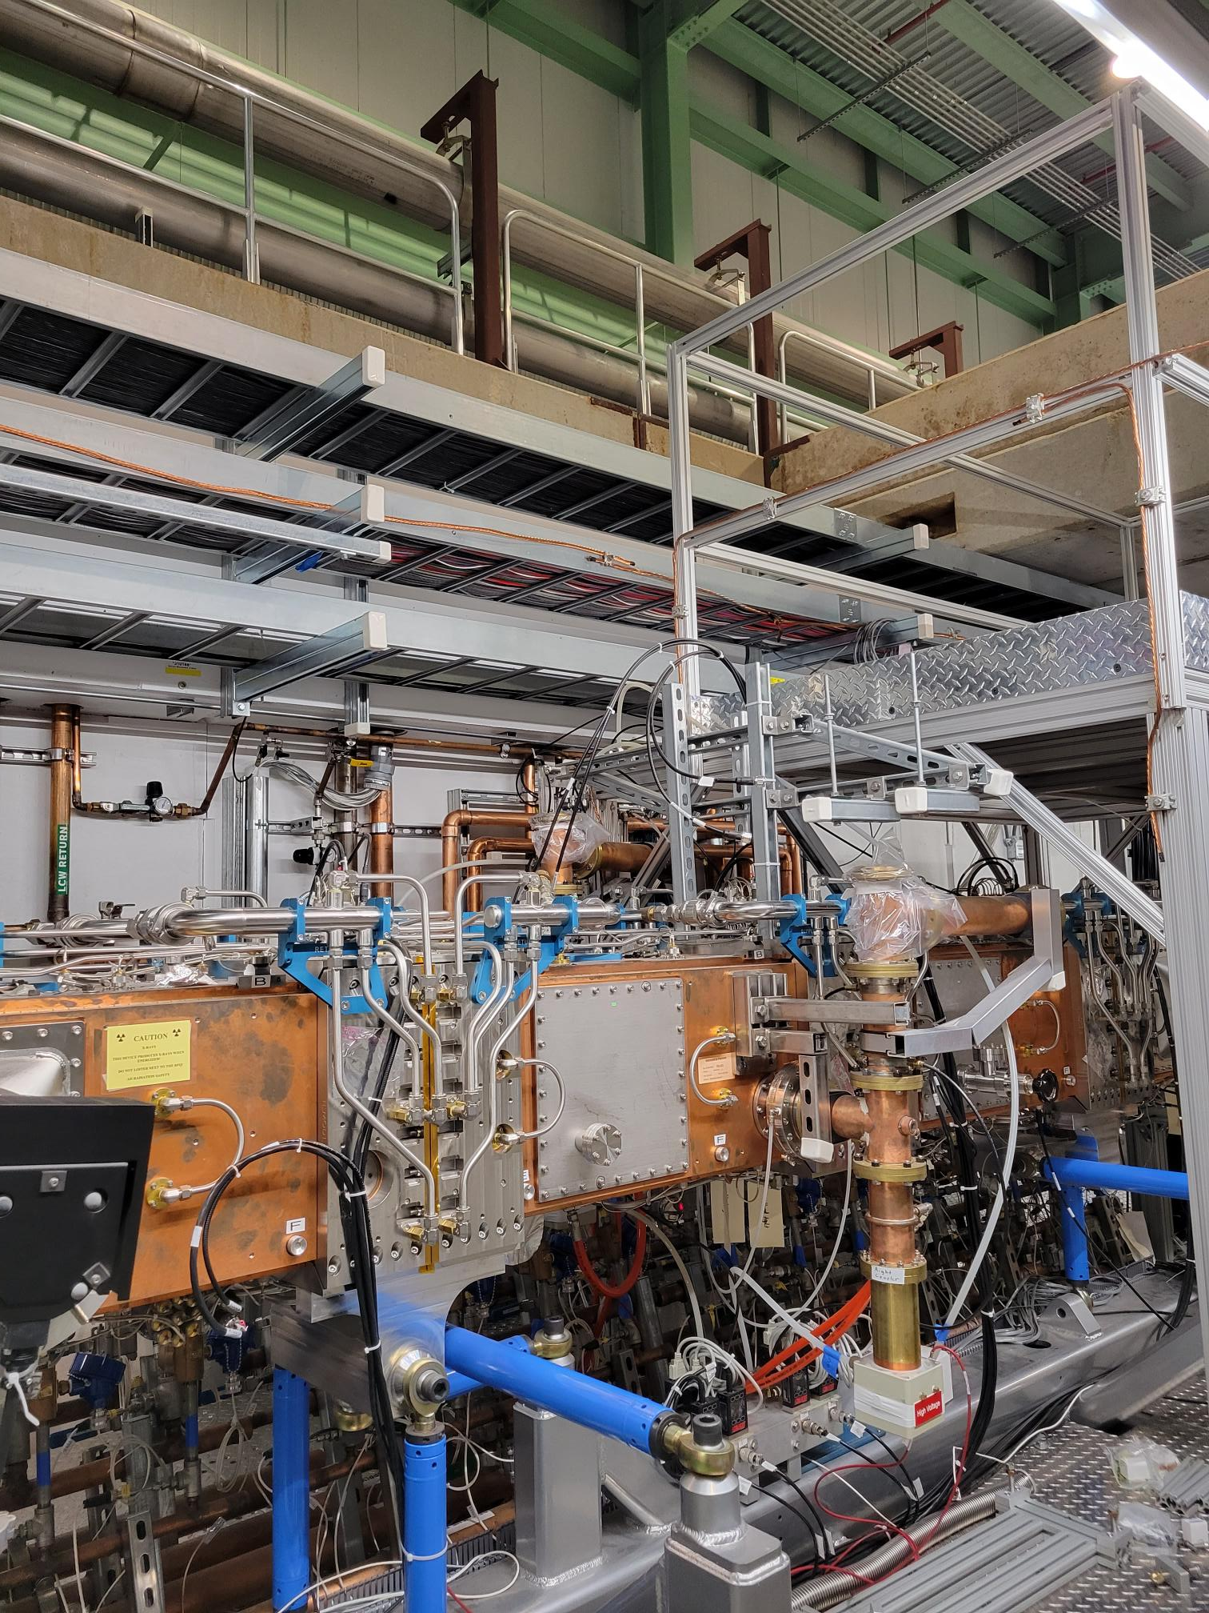
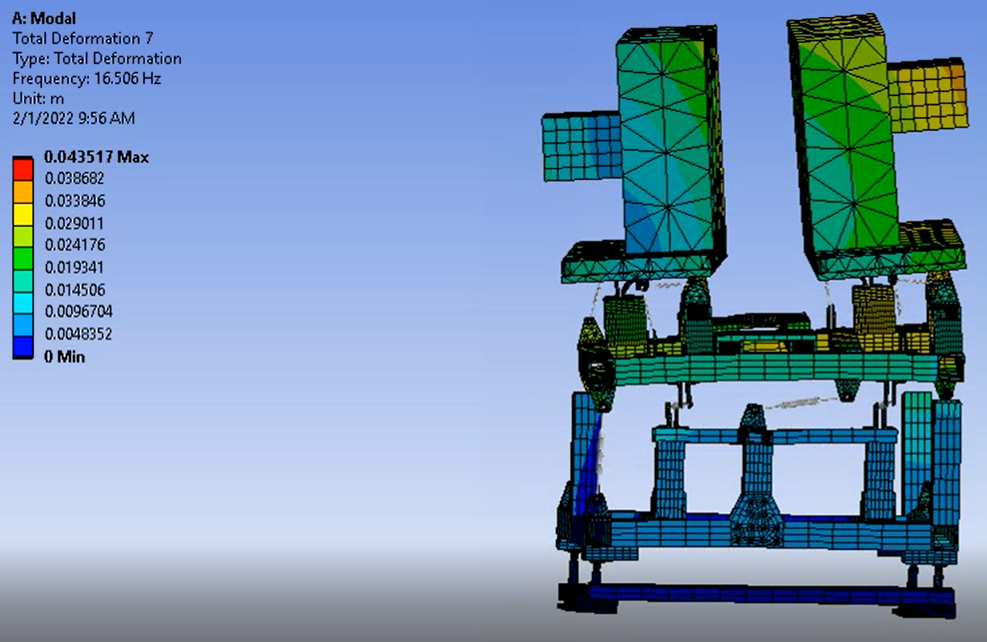
Installation and Commissioning
Linac Installation
  PIP2IT removal,
    RFQ RF Distribution removed
  CAD
    Continuing to support CF/Fluids CAD integration
  Warm Unit Structure Design
    Continuing work towards final design
    Focus on modal analysis
  Installation Process
    Design work continues
    RFI for CDS Installation in work
650 Test stand area with upstream HWR stand removed
RFQ Distribution removed
650 MHz Warm Unit Modal Analysis

Slide 22
Installation and Commissioning
Building Infrastructure
  Mechanical
    Final Design Review Report received
      Finalizing responses to Review Report
    Consulting with CF on Utility Plant Building
      Inspected compressed air system layout
      Reviewed 3D Layout of PCW System
  Electrical
    Transformer Technical Note on Harmonics is complete
    Relay Racks
      Finalizing discussions with CF on design and specification for procurement
    Cable database (DB)
      Document underway to capture DB experience and lessons learned and to accept the Database
      Currently adding real PIP-II locations in the DB so we can start capturing real data
    Room Data Sheet update is complete
    Updates for the ion source cabinets were passed to the A/E and incorporated in the design

Slide 23
Installation and Commissioning
Beam Commissioning
  Progress continues on the conceptual design of the Movable Instrumentation Cart
    Itemization of costs have begun
Accelerator Physics
  Progress on linac simulations
    work on updating the beam dynamics in final linac layout being done
    Collected fields and models for the latest linac design
Booster studies
  Gamma transition parameters in the Booster were experimentally defined
    Tune swing
    Quad sweep rate
    Maximum quad current/voltage swing
Shielding assessment
  Preliminary Shielding Assessment for the linac complex is with the Shielding Assessment Review Panel
    Panel questions/concerns were addressed in most recent SA version
    TLM document created outlining the segmentation of the system and trip settings
  Simulations of the Booster connection and energy extension nearing completion
    SA document being written

Slide 24
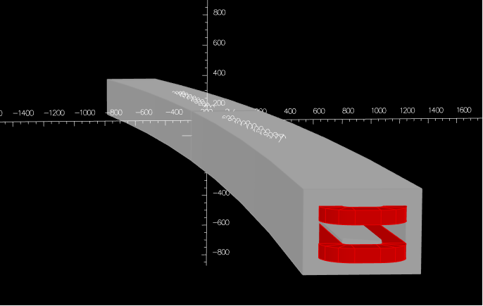
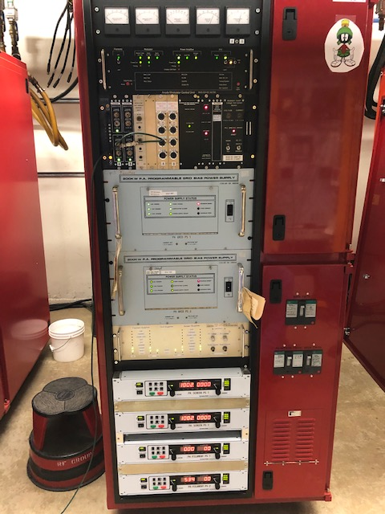
Accelerator Complex
Beam Transfer/Absorber Line
  Finalizing the BTL Collimator Design.
  Working on the 25 KW absorber drawings.
Booster
  Working on the stripline connections of the ORBUMP magnets.
  Started the Booster Gradient magnet design.
  Preparing for Booster Gradient magnet testing in E4R.
    Installing gates and interlocks.
MI/RR/Booster RF
  MI prototype modulator ready for testing with the test station.
  Preparing for the RR 53 MHz cavity PDR Review.
  Ordering parts for the 200 KW PAs. Scheduled to receive the parts of the first batch by the end of April. Received 7 vacuum tubes (out of 40 total).
3-D model of the Booster Gradient Magnet
MI Prototype Modulator ready for testing

Slide 25
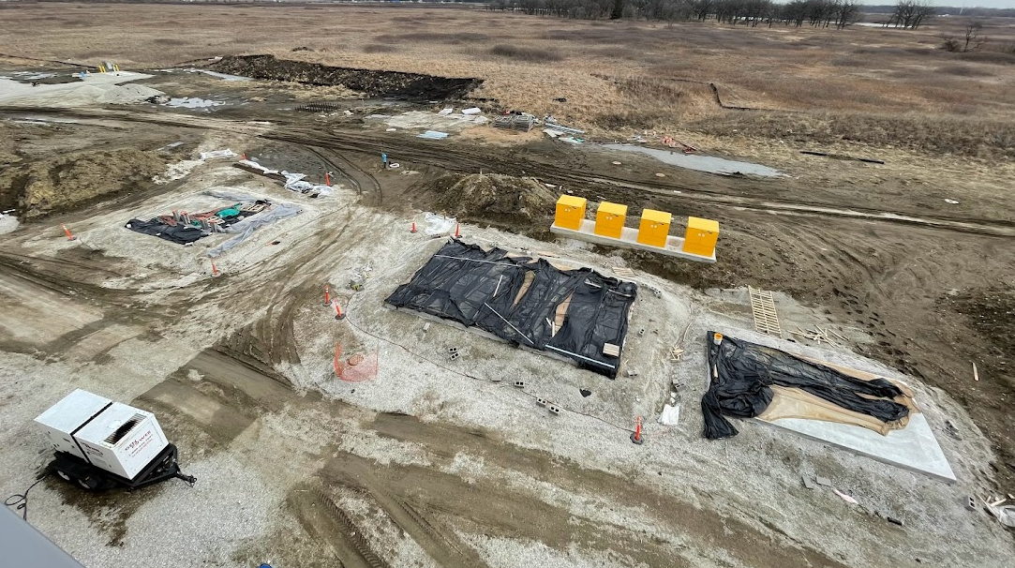
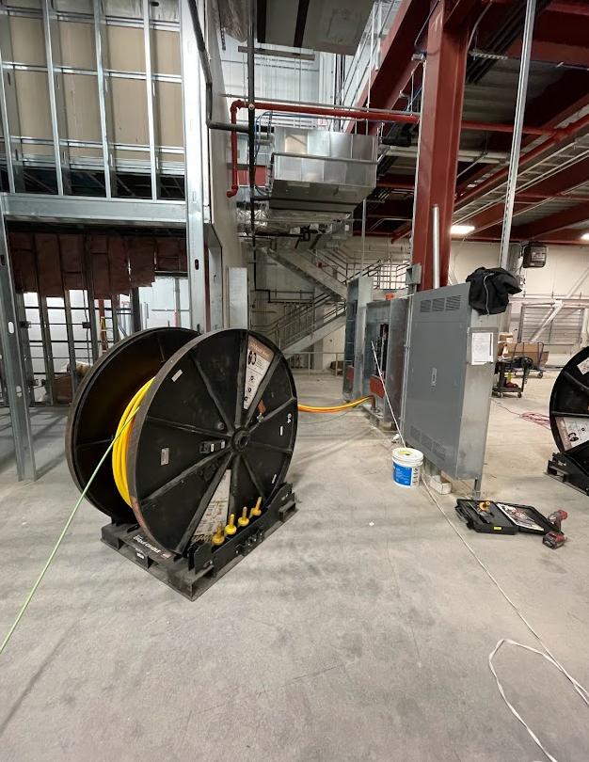
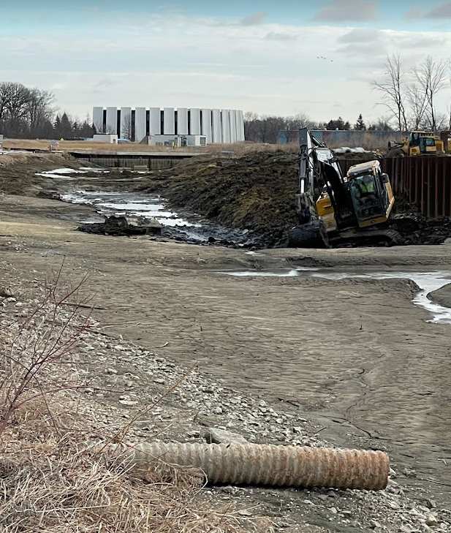
Conventional Facilities
WBS 121.06.07.02 - Cryogenic Plant Building
  Electrical equipment ship dates slipped due to production delays. 1st batch shipped on February 11th, but further slippage has been reported with some gear not shipped until late May 2022.
  Developing recovery plan
  Completion now anticipated for July 2022
WBS 121.06.07.01 - Site Work
  Sediment removal at AZero pond work continues
  Completion scheduled for October 2022
WBS 121.06.05 - Linac Complex
  Design completed in February 2022
  RFP documents approved by DOE
  Anticipate issuing for proposals in April 2022
WBS 121.06.06 - Booster Connection
  Design completed in February 2022

Slide 26
Technical Integration
  Approved DCRs:
    No new DCR’s
    DCR-2022-001: “HB650 jacketed cavity chimney to tee connection revision - UKRI specific” has been approved
  Requirements Updates
    ED016058-- PIP-II Ion Source Power Cabinets FRS developed & released
    ED0003531-C PIP-II Cryogenic Plant L3 FRS updated
  ISD Development
    50 ISDs have been identified across the project and all have been completed
      19 ISDs are for systems at the FDR stage (an ISD is a deliverable for a system Final Design Review)
      All others have been completed with the latest information known at this time and will be updated as they approach their FDRs and interfaces are further refined
  Integration Reviews
    Recently completed Integration Reviews
      CF Process/Tunnel-Gallery Integrated Review PDR and RF Integrated Systems Review FDR (both held February 22nd)
    Upcoming Integration Reviews
      Timing-DAQ Integrated Systems Review PDR (April 12th)
      Vacuum Systems Integrated System Review PDR (April 19th)
      Controls Integrated System Review PDR (April 25th)

