Slide 1
MAP Program Management Group Meeting
M.A.Palmer
March 15, 2012

Slide 2
Outline
Introduction
Overview of Recent Developments
  The MAP Collaboration Meeting
  MICE CC-related reviews (solenoid test facility, CC cryostat)
  MAP L1 management update
  Budget developments
  Review planning
Issues for Discussion
  FY13-14, and out year, planning exercise
  Coordination with the NSF
  Program metrics
  Test Facilities (program integration, planning/scheduling, support)
  MAP interface with the muon collider physics/detector effort
  Snowmass `13
AOB

Slide 3
Introduction
Goals for today
  Provide a (very) quick look at what has happened since our previous meeting
  Solicit input and suggestions on several high priority issues
  a want to allow for discussion time, so have not requested folks to prepare detailed presentations

Slide 4
Overview of Recent Developments

Slide 5
MAP Collaboration Meeting
March 4-8 at SLAC
113 registered participants
5 days covering
  Component Development
  Design & Simulation
  MICE
  IDS-NF, Project X, MDI and MC Params
  Physics and Detector
A great deal of progress was reported – see
https://indico.fnal.gov/conferenceDisplay.py?confId=5097
4 invited talks covering (HTS Magnet Development, SLAC Accelerator R&D Program, ILC SRF Development, Muon Physics Program in Japan)
Many thanks to
  Those at SLAC for hosting! Particularly Tom Markiewicz and Naomi Nagahashi
  Our L1 managers and Ron Lipton for organizing the daily programs

Slide 6
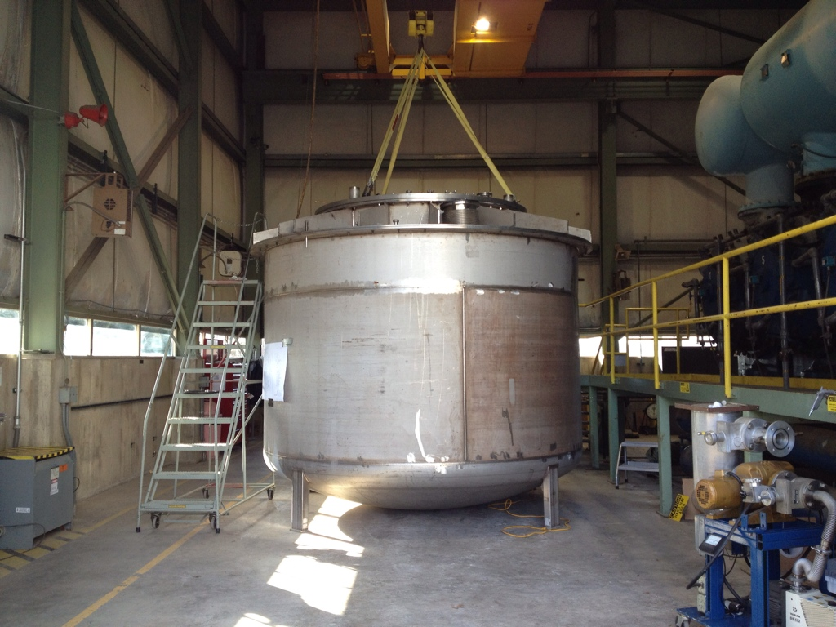
MICE Coupling Coil Reviews
Solenoid Test Facility Review
  Feb 22 at FNAL
  A number of issues raised, including
    Resources
    LBNL-FNAL interface
    Demanding schedule
CC Cryostat Review
  Feb 29 – Mar 1 at LBNL
  Strong emphasis on careful step-by-step checks and developing a realistic schedule
  The initial analysis suggests that we can aim for delivery of RFCCs to RAL on the FY15 timescale, thus supporting an 2016 experimental run. Further discussions underway.
Many thanks to the organizers – the results of both reviews offer significant benefit for the program

Slide 7
MAP L1 Management Update
Folks may know that Rick Fernow will be retiring shortly so there was a need to find a replacement for him as L1 Design & Simulation manager
We have just confirmed that Rob Ryne (LBNL) will be taking over
We expect to execute a transition through the end of this fiscal year

Slide 8
Budget Developments
Have been in communication with Bruce Strauss
  Offers some hope of FY13 correction
  The profiles shown will be going to the DOE FY14 budget retreat
Also possibility to pick
up some of ILC RF resources

Slide 9
Review Planning
Stuart and I are trying to find viable MuPAC dates
Have encountered problems with all proposed dates in May and June
However, we can ill afford to let this review slip past June because we will need to incorporate the feedback we receive into the plans detailed for the DOE review!
a We may have to make some difficult compromises soon
Hoping to hear more about the DOE Review plans after a DOE visit on April 10th.

Slide 10
MuPAC Review Details
2 days a 6 presentation “sessions” of ~1.5hrs
  Assume 3x 25’+5’ talks in each
  ~18 talks total
    11 L2 presentations
    2 Det/Phys
    4 Overview/special topics
Hard hitting presentations
Review: May 30-31 (Wed-Thurs)
Practice Talks: May 17-18 (Thurs-Fri, after IPAC papers due but before conference ;-)
Comments and questions…

Slide 11
Issues for Discussion

Slide 12
FY13-14 and Out Year Planning - I
Major goals of the
“needed” profile
  Ensure $$ for CC
  production and
  testing is available
  for the fastest
  technically
  achievable schedule
  Expand RF effort (eg, build on overlaps between high gradient RF work and our RF in magnetic fields efforts, add MTA RF scientist, etc) a largely FY14-15
  Add design manpower (eg, IDS-NF and collider studies)
  a largely FY14-15
  Possibility of starting new demonstration effort on the FY15 timescale

Slide 13
FY13-14 and Out Year Planning - II
Major goals of the
augmented profile
  Ensure $$ for CC
  production and
  testing is available
  for the fastest
  technically achievable
  schedule
  Expand the RF team
  to ensure rapid progress
  (multi-institutional breadth)
  Provide sufficient manpower to make significant progress on critical design efforts (including cooling, collider, MDI,…)
  Start work towards a new demonstration effort in FY14 (with a full-blown effort underway in FY15)
  Bolster experimental support
  Enable sufficient progress on the FY15 timescale for a significant review/optimization of our research thrusts

Slide 14
Coordination with the NSF
There has been some indication of interest from the NSF in Muon Collider participation (as opposed to primarily MICE activities)
  Potentially important for the NSF university groups participating in MAP
  NSF briefing on MAP plans now scheduled for April 9
  Additional possibility to explore is support for physics/detector effort where a few post-docs/graduate students could make a major impact between now and Snowmass
Given the budget situation, we need to leverage such support if at all possible

Slide 15
Program Metrics
Informed by DOE (again) that clearly stated performance metrics and regular progress updates are a key issue as we move forward
  They need clear measures of our progress to work with
Efforts conducted directly by members of the program will require clear plans and milestones
Highly visible and challenging deliverables such as MICE magnets and RF system are closely tied to our ability to access and effectively utilize laboratory level resources
  Effective coordination between divisions and the MAP are absolutely essential

Slide 16
Example: MTA and RF R&D
A number of detailed tests are underway and being planned
These must move forward efficiently and quickly to ensure that other portions of the program (eg, MICE) can be successfully accomplished
Still reviewing:
  Coordination and scheduling issues
  RF Eng. and R&D support
  Technical support
This is an extremely critical topic – we need to be able to complete a sequence of very detailed tests over the next months years to support and guide the remainder of the program

Slide 17
Test Facilities
MuCool Test Area & Solenoid Test Facility
  Propose that we fully integrate an operational coordinator for each of these into the MAP L2 management structure
  The coordinator should come from the division hosting the facility
  This coordinator would work closely with the relevant L1 and L2 managers (as well as myself) and the division representatives to ensure that we can arrive at coordinated and realistic plan to:
    Achieve our program goals
    Work within the resource constraints of the divisions involved
  The same approach would apply to any future efforts where multi-year research or testing activities are planned

Slide 18
Proposed MAP Interface with the μ−Collider Physics and Detector Effort
Lepton Collider Physics Framework
(proposed successor to ALCPG)
Simulation
ILC
CLIC
MC
MC Physics/Simulation
(R. Lipton)
Physics
Simulation
Detector R&D
Muon Accelerator Program
MAP L1
MDI
MC Interface

Slide 19
Snowmass 2013
We need to agree on our approach
  Intensity Frontier
    Neutrino Factory Options
  Energy Frontier
    Higgs Factory
    1.5 TeV Muon Collider
    3 TeV Muon Collider
  Must focus on where we are heading with the R&D program
  Expect to form a task force soon to start outlining the key elements of our effort

Slide 20
Conclusion
Any other business to cover?

Slide 21
Backup slides follow

Slide 22
FY13-FY14 Planning for Reviews
Planning exercise needs to get underway immediately
Want to take the approach that we are targeting the nominal Year 3/4 ($16.9M/$17.5M) funding level with suitable inflation adjustments
  Plot an aggressive path for MICE magnets and RF development
  Make the case for expanding into at least one other “major demonstration” area (eg, HTS solenoid) before the end of FY14!
  Maintain our general technical and accelerator development support (in general, target a flat funding profile to take maximum advantage of new funds for deliverables and targeted efforts)
We can then show what will be sacrificed in the FY13 Presidential Budget request (propose that we use $11.2M/$12M for that comparison)
  Assumes that we won’t have any significant further guidance between now and the review
  Will have to carefully review how to state this at the review, but I want us to be able to show clearly what is being sacrificed
Can we get a first pass roll-up in place by ~April 15?
Also need to prepare SBIR solicitation guidance (by March?)

Slide 23
Funding Comparisons
FY13 proposed funding only up by 9% from FY08
Actual inflation rates used

