Slide 1
Cable Imaging & Analysis Capabilities at LBNL
ASC 2022 Honolulu 4MOr1B-02
Algirdas Baskys, Ian Pong, Charlie Sanabria, Elizabeth Lee
(ipong@lbl.gov)
Lawrence Berkeley National Laboratory

Slide 2
Outline
System overview
Imaging and Image analysis
3 Case studies
Conclusions
Acknowledgement:
The authors gratefully acknowledge the contributions of Daryl Barth, Dan Dieterich, Hugh Higley, Mariusz Juchno, and Abdi Salehi who procured and set up the Keyence system, including the prisms and computer storage, and of Jonathan Lee, Ethan Sprague, and Edward Stafford, intern students who helped processed some of the acquired data.
The work performed at Lawrence Berkeley National Laboratory was supported by the Office of High Energy and Nuclear Physics, U. S. Department of Energy, under contract No. DE-AC02-05CH11231. This work was supported by the U.S. Department of Energy, Office of Science, Office of High Energy Physics, through the US LHC Accelerator Upgrade Project (AUP) and by the High Luminosity LHC project at CERN.

Slide 3
Rutherford Cabling at LBNL

Slide 4
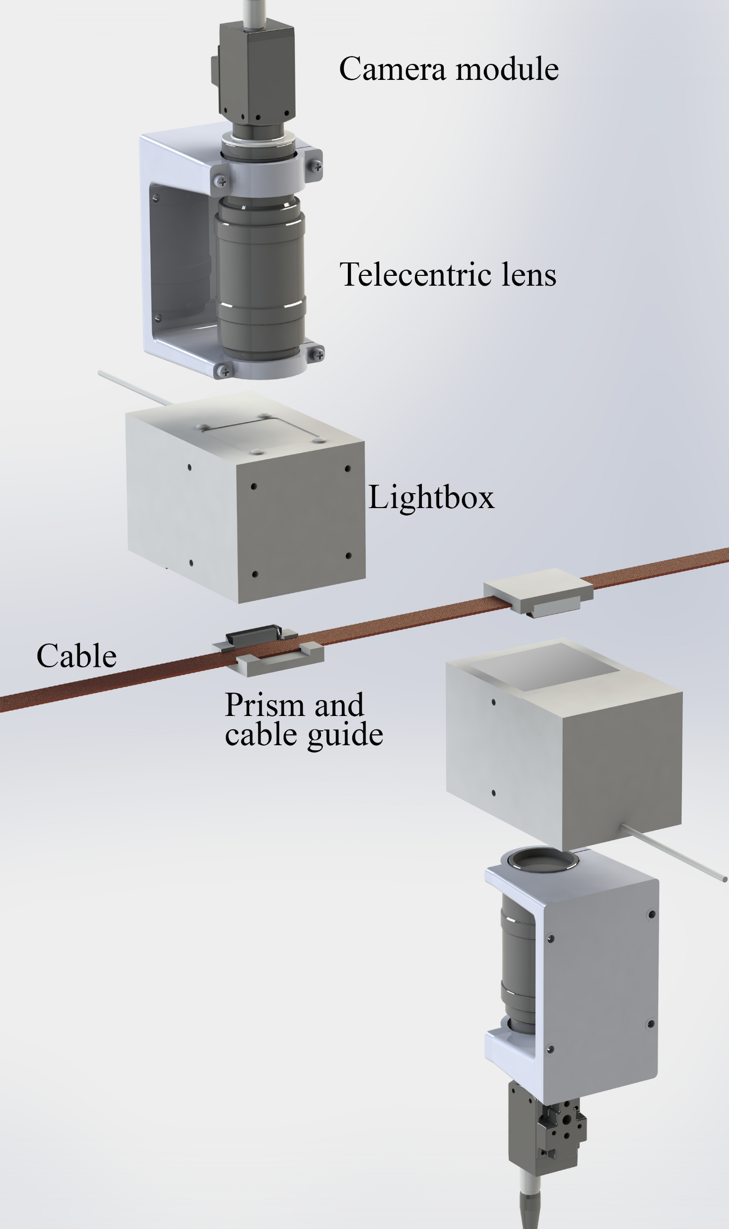
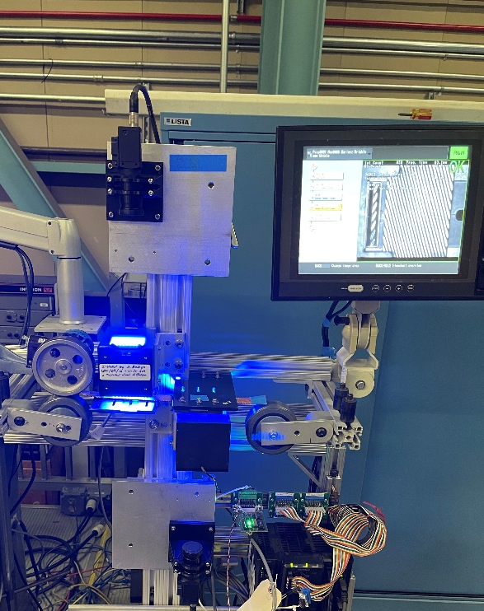
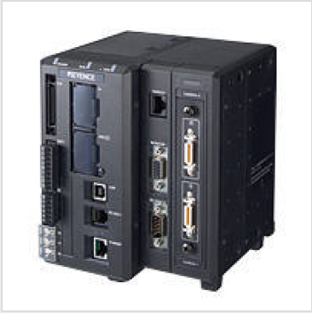
Cable Imaging System Overview
Keyence imaging system :
Images all 4 sides
Camera 1: Top Face + Minor Edge
Camera 2: Bottom Face + Major Edge
Image field of view ~2 cm
Complete coverage of the cable, capture triggered by encoder
~ 60 GB of images (~46,000 images) per typical 460 m cabling run
Images analyzed offline (automated analysis using Python scripts)
Non-destructive!

Slide 5
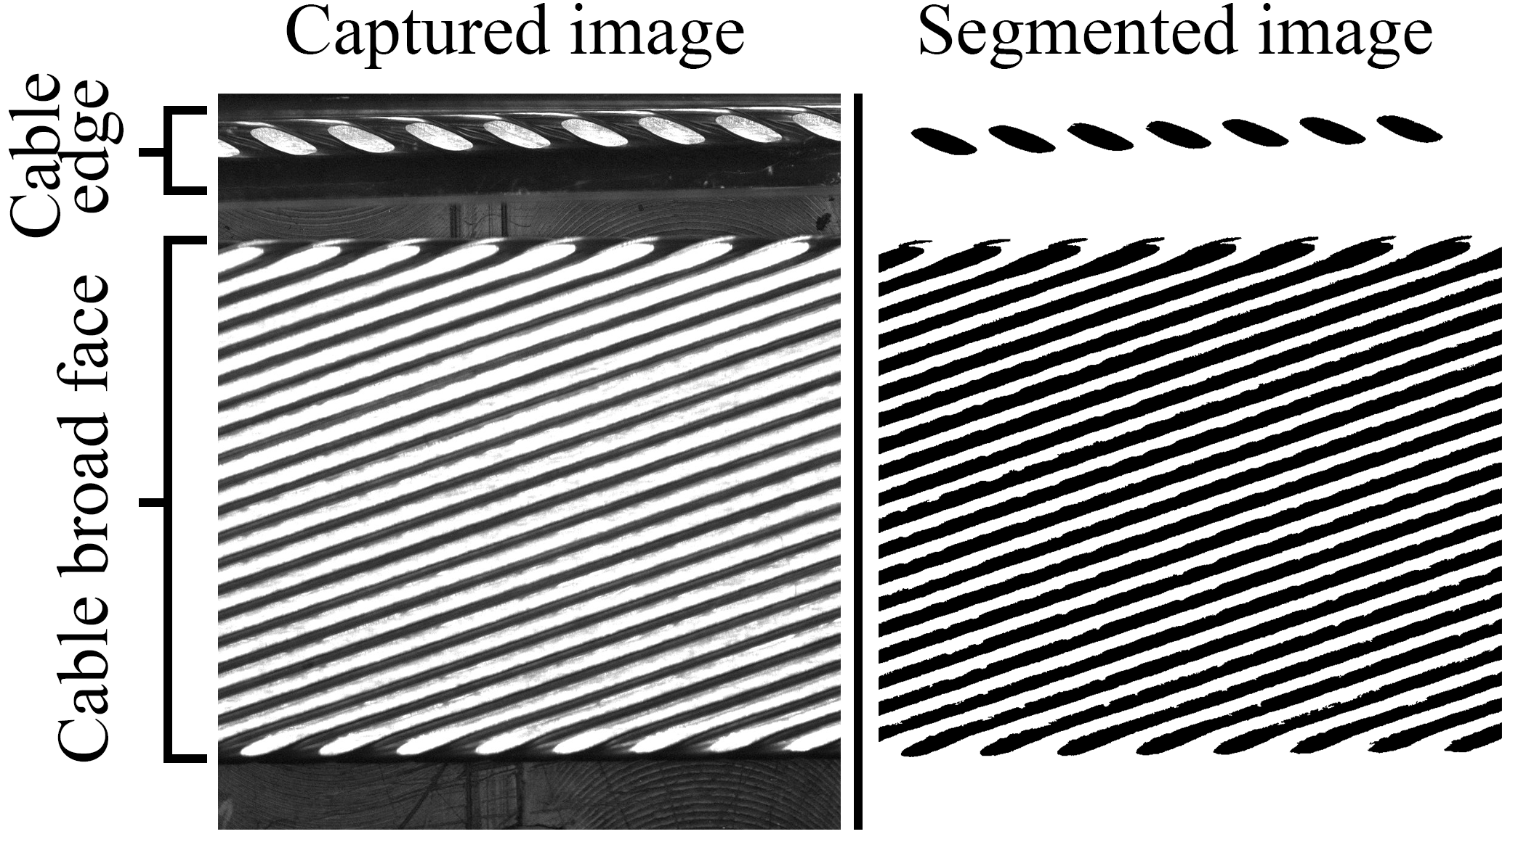
Cable Imaging
Typical image from the camera
Cable edge via a prism
Step 1: images segmented, isolating the flattened strand faces in the compacted cable
Step 2: two separate analyses performed on the cable face and cable edge images.

Slide 6
Cable Image Analysis
Facet major and minor axis dimensions and length along the cable
On average images cover ~ 2 cm length, ~ 6 facets
Strand angle (cable twist-pitch), adjusted by the cable alignment
Strand-to-strand distance

Slide 7
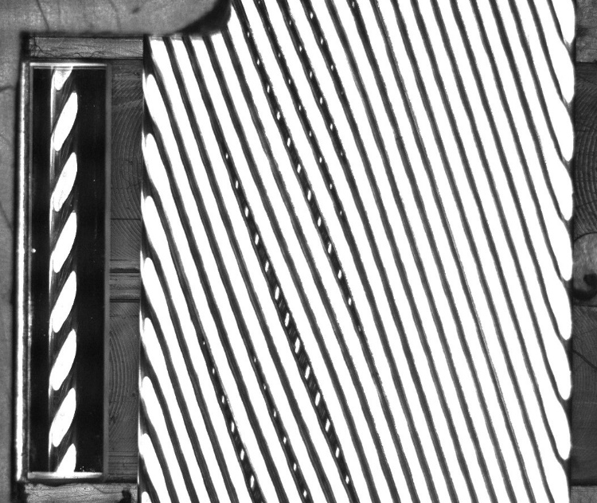
Defects Detection
Detection of critical defects (cross-overs) and less critical defects done via dedicated subroutines, suspect images are flagged for review
Cross-overs
Popped strands
Gaps

Slide 8
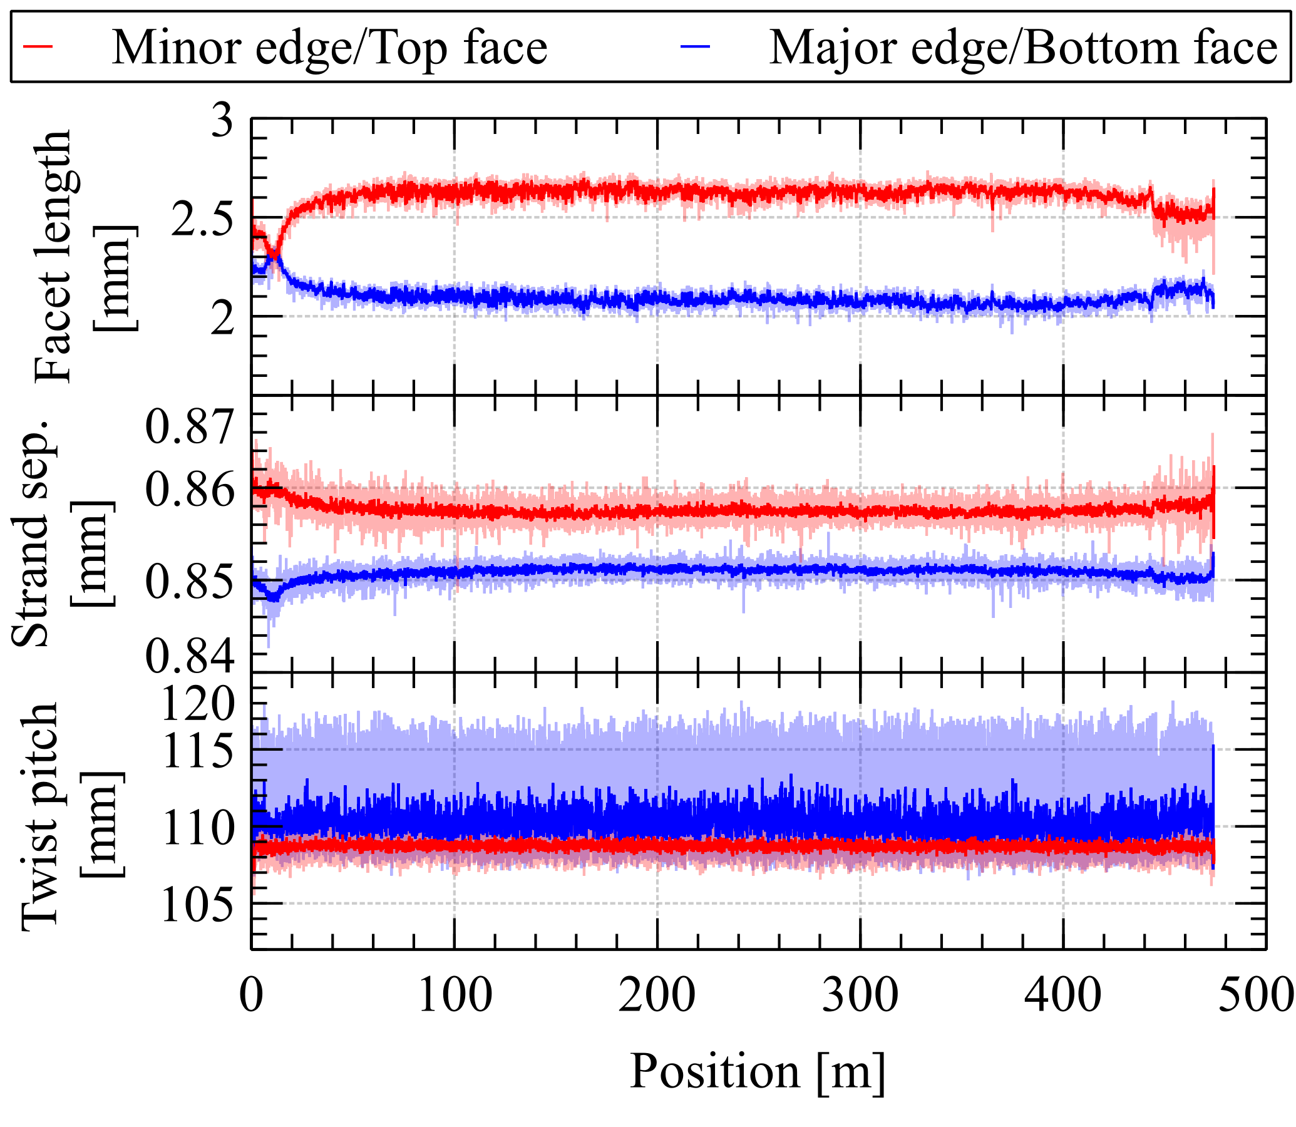
Typical data
Cable parameters stable throughout the cable production after initial transient
Cable facets larger at the minor edge
Top and bottom face strand separation different
Variations in facet length, strand separation and twist-pitch have strong coupling

Slide 9
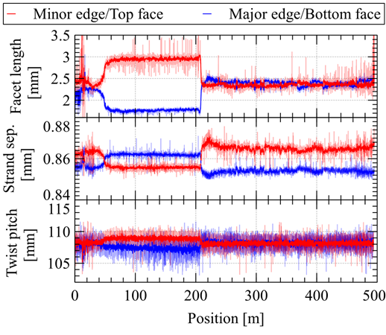
Case Study 1: Lubrication Rate Change
Typical production: lubrication delivered by a peristaltic pump
Example: pump failed after ~200 m
Lubricant was then applied manually (in excess due to poorer control)
Facet divergence prior to pump failure, recovery after
Corresponding changes in strand separation and twist pitch
Lesson: Importance of lubrication
Takeaway: non-destructive correlation of process changes during cable fab to the cable parameters

Slide 10
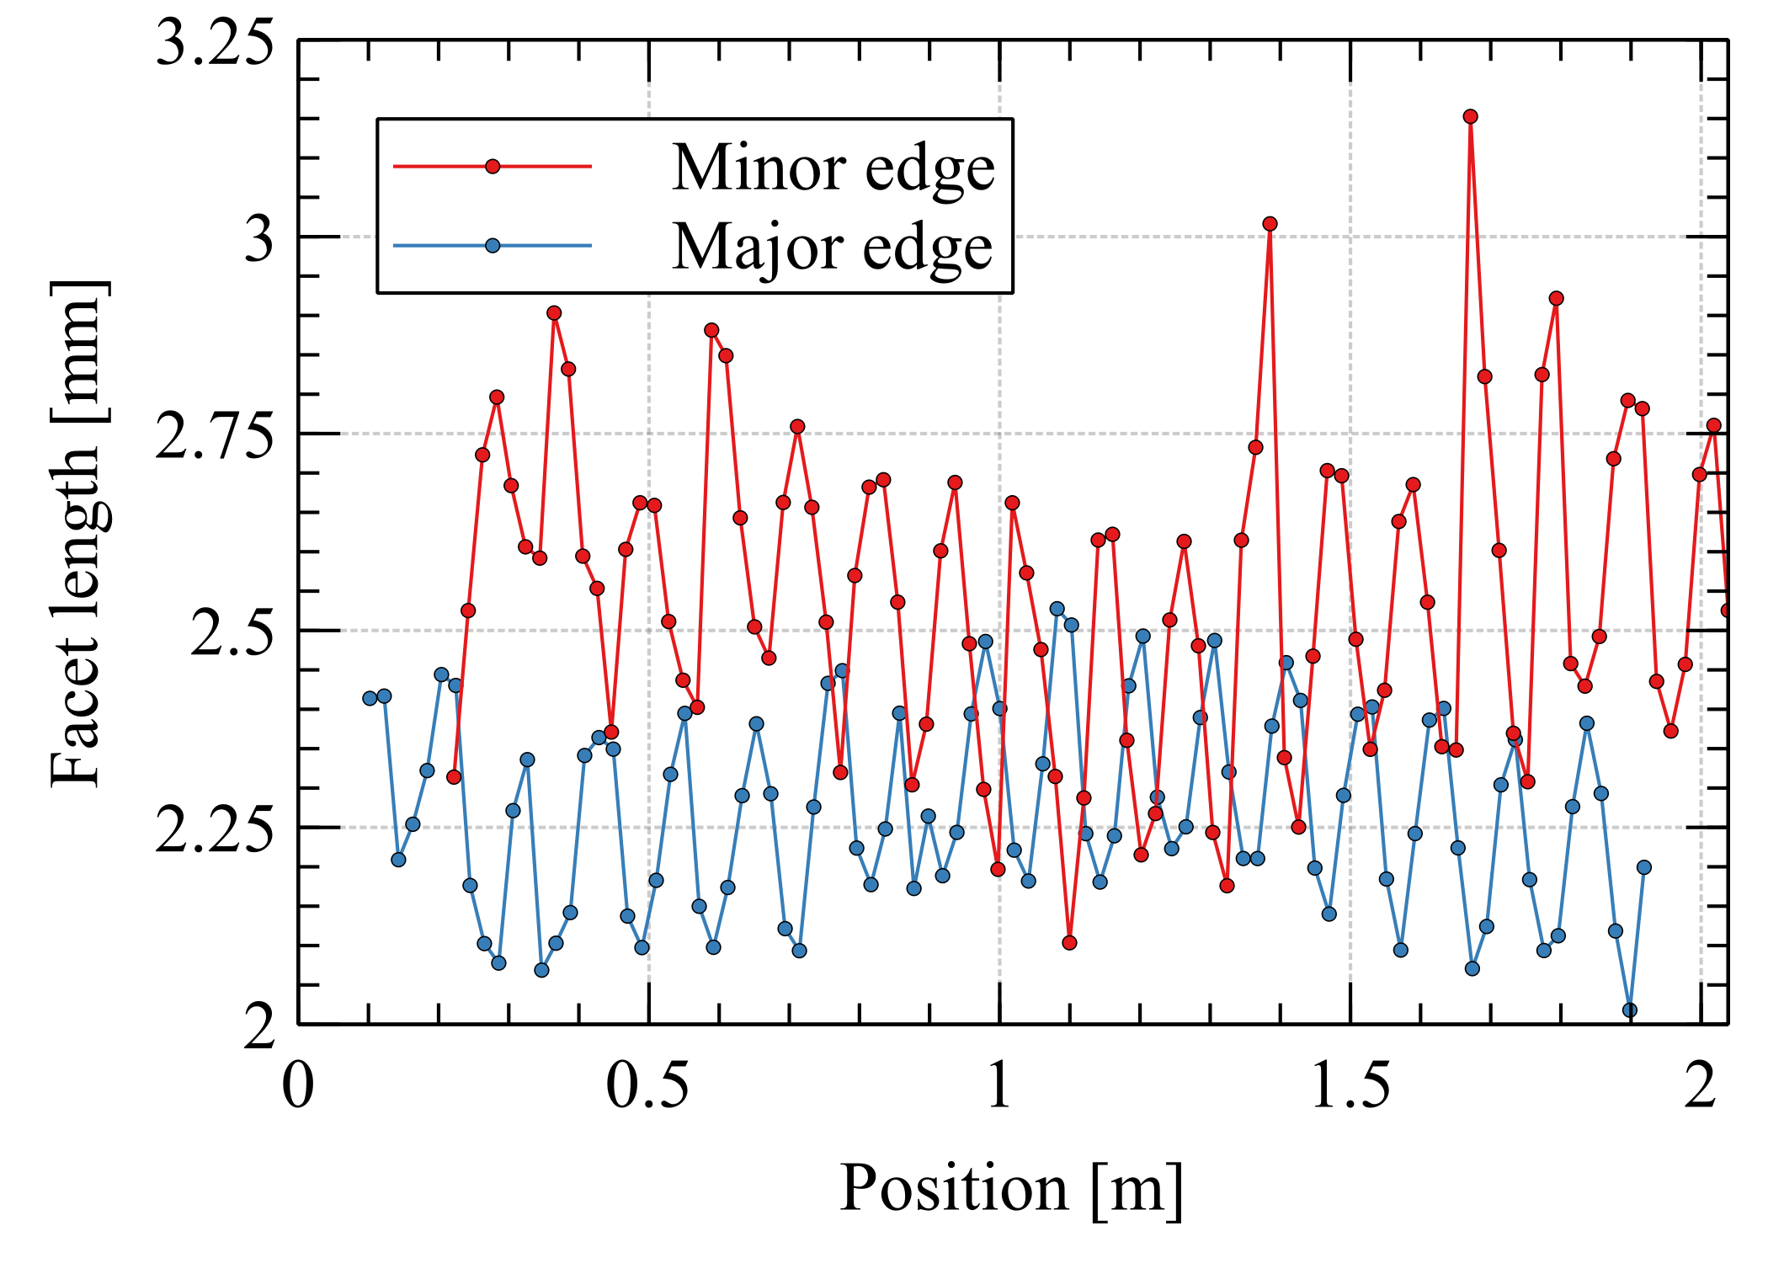
Case Study 2: Uneven Strand Tension
Typical production: startup samples to “qualify” setup
Example: a large periodic oscillation in the facet size was observed
Periodicity matches twist-pitch length
Root cause: incorrect strand tension in just one of 40 strands on the machine
Takeaway: superb sensitivity

Slide 11
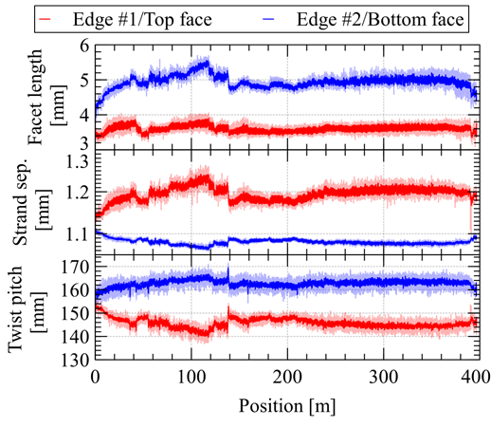
Case Study 3: Hardware Component Effect
Typical analysis: as shown previously
This example: frequency analysis (Fast Fourier Transform, FFT)
A prototype no-keystone cable: facet divergence, gaps between strands on top face, half-pitch difference
Adjustments made mid-run, esp. <150 m
Correlation found with roller-mandrel alignment and drive train
Takeaway: FFT can indicate potential problems with machine hardware components

Slide 12
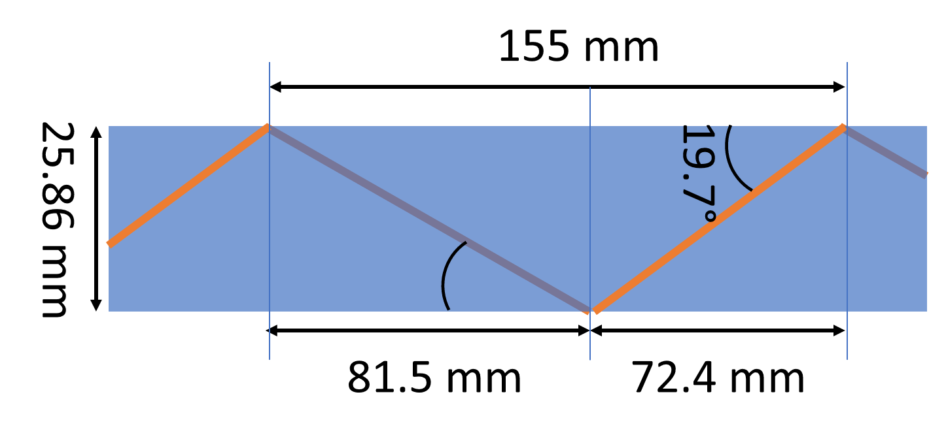
Case Study 3: Hardware Component Effect
Facet size
imbalance
Gaps visible on top cable face
Half-pitch mismatch
Roller aperture
Mandrel tip

Slide 13
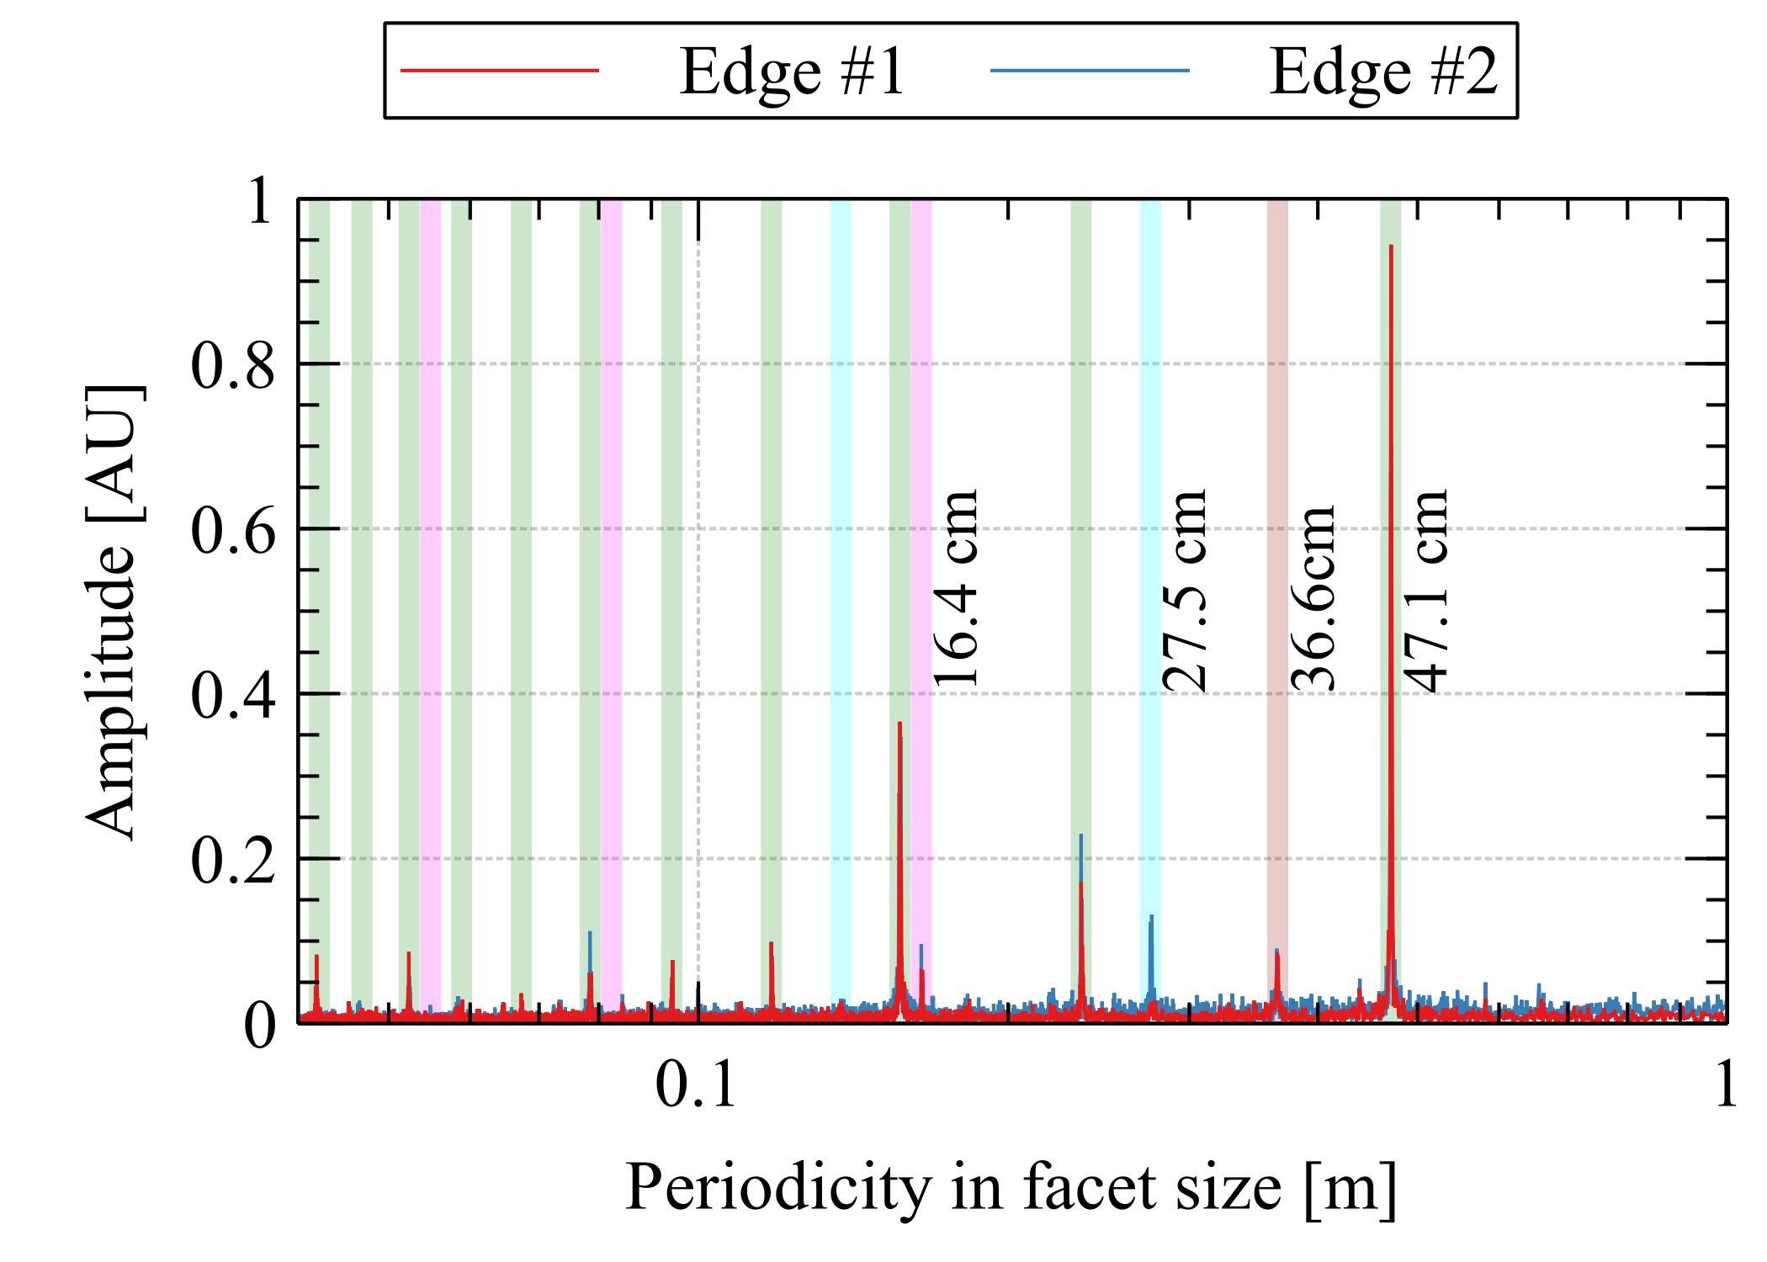
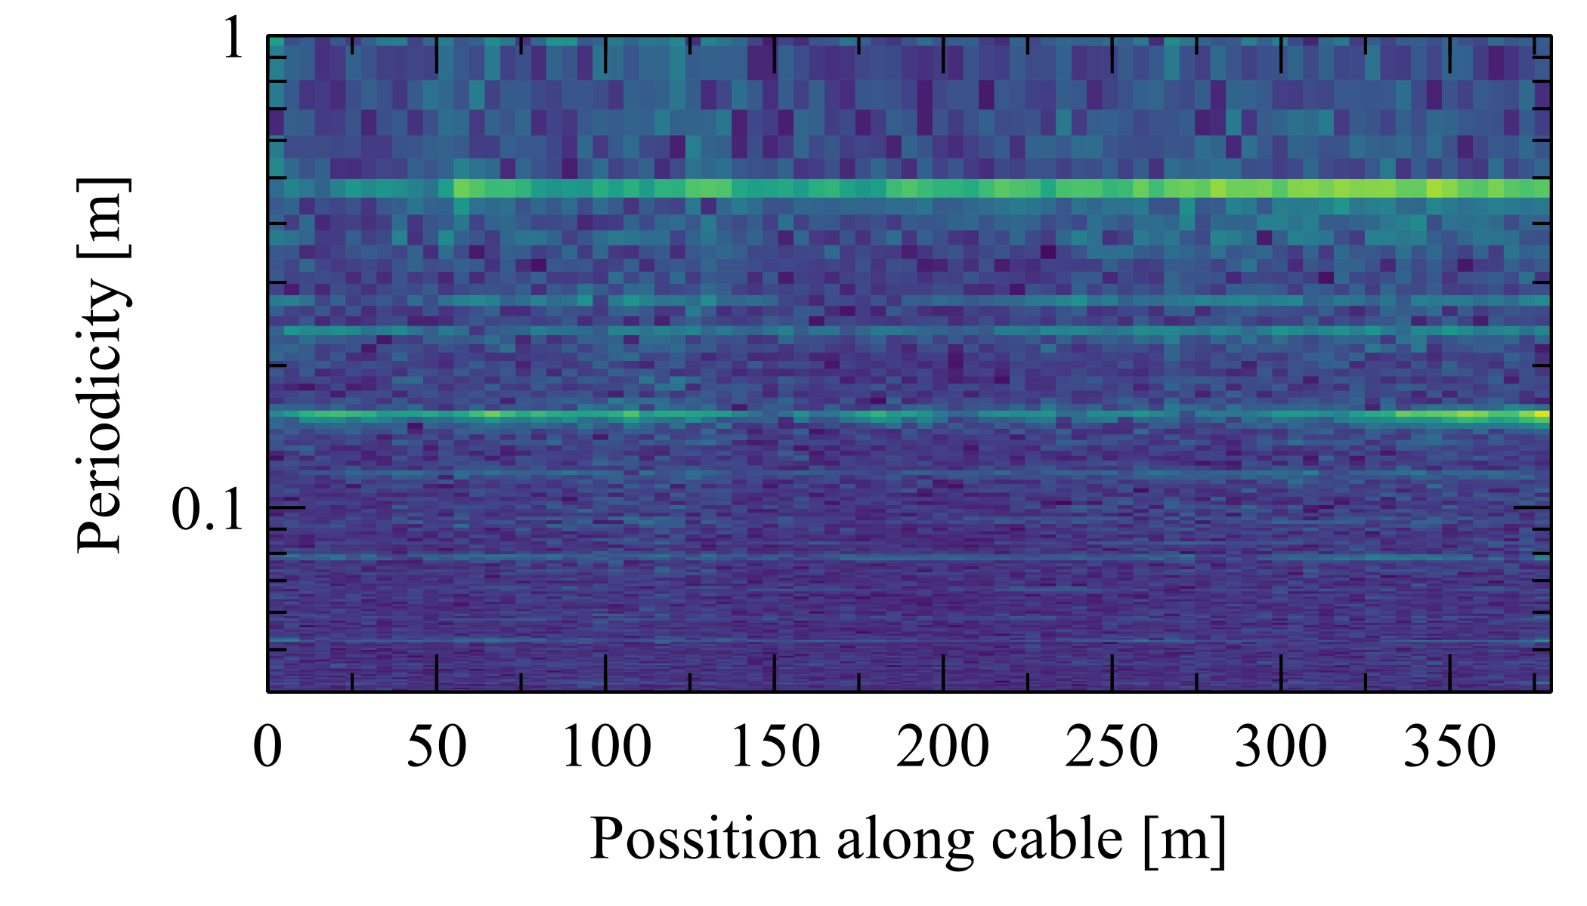
Case Study 3: Hardware Component Effect

Slide 14
Conclusions
Image analysis is a powerful QC tool
Including superb sensitivity for strand tension anomalies
Insights into
Strand deformation state within the cable
The state of the components of cabling machine
Strand facet sizes as a predictor for RRR values
Presently: offline analysis. But hybrid approach is being considered to provide real-time feedback

Slide 15
Backup slides: cross-over detection
Gaps between strands
Distance
Angle

Slide 16
Case Study 3: Hardware Component Effect
Additional frequency analysis (Fast Fourier Transform) can indicate potential problems with machinery.
Spectrum shown is dominated by the peak at 47.1 cm and its harmonics corresponding to the vertical roller circumference indicating a potential problem.
After roller investigation the problem was narrowed down to the compliance in the roller drive train due to large forces experienced.
Other peaks corresponding to twist-pitch periodicity and guide roller diameters were identified at much lower amplitude.
Spectrogram can even indicate how the amplitudes at given periodicities change during cable manufacture.

