Slide 1

Residual-Resistivity-Ratio Measurement System for Rutherford Cable Extracted Strand
Algirdas Baskys, Ian Pong, Michael Naus, Charlie Sanabria, Jonathan Lee, Scott Myers, Heng Pan, Jordan Taylor, Marcos Turqueti, Li Wang, Xiaorong Wang
Lawrence Berkeley National Laboratory
Special thanks to Tom Lipton

Slide 2
Outline
Motivation
System: Sample holder, cryostat, measurement
Measurements
Conclusions
This work was supported by the U.S. Department of Energy, Office of Science, Office of High Energy Physics, through the US LHC Accelerator Upgrade Project (AUP) and by the High Luminosity LHC project at CERN.

Slide 3
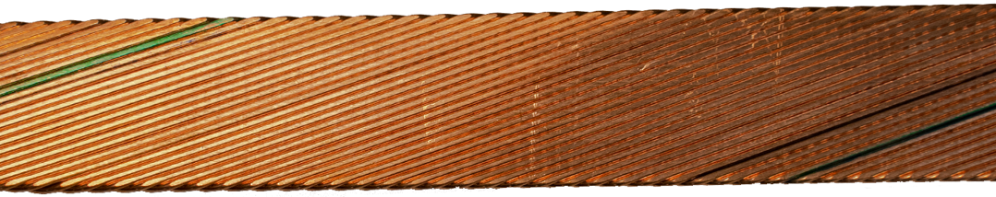
Motivation
RRR (Residual Resistivity Ratio) of a cable’s matrix Cu plays an important role in magnet stability at low fields¹
  Common Spec: RRR > 100
  RRR = ρ_{RoomTemp} / ρ_{Cold}
In Rutherford cable, RRR varies along an individual cable strand due to large deformation at cable edges
  Exacerbated if the cable has a non-zero keystone angle (e.g., AUP = 0.4°)
Rutherford Cable
Minor Edge
Major Edge
[Colored strands indicate strand ID. Used at cable point & tail only]
Cable Cross-Section
[¹B. Bordini et al., IEEE Trans. on Appl. Supercond., vol. 22, no. 3 June 2012]

Slide 4
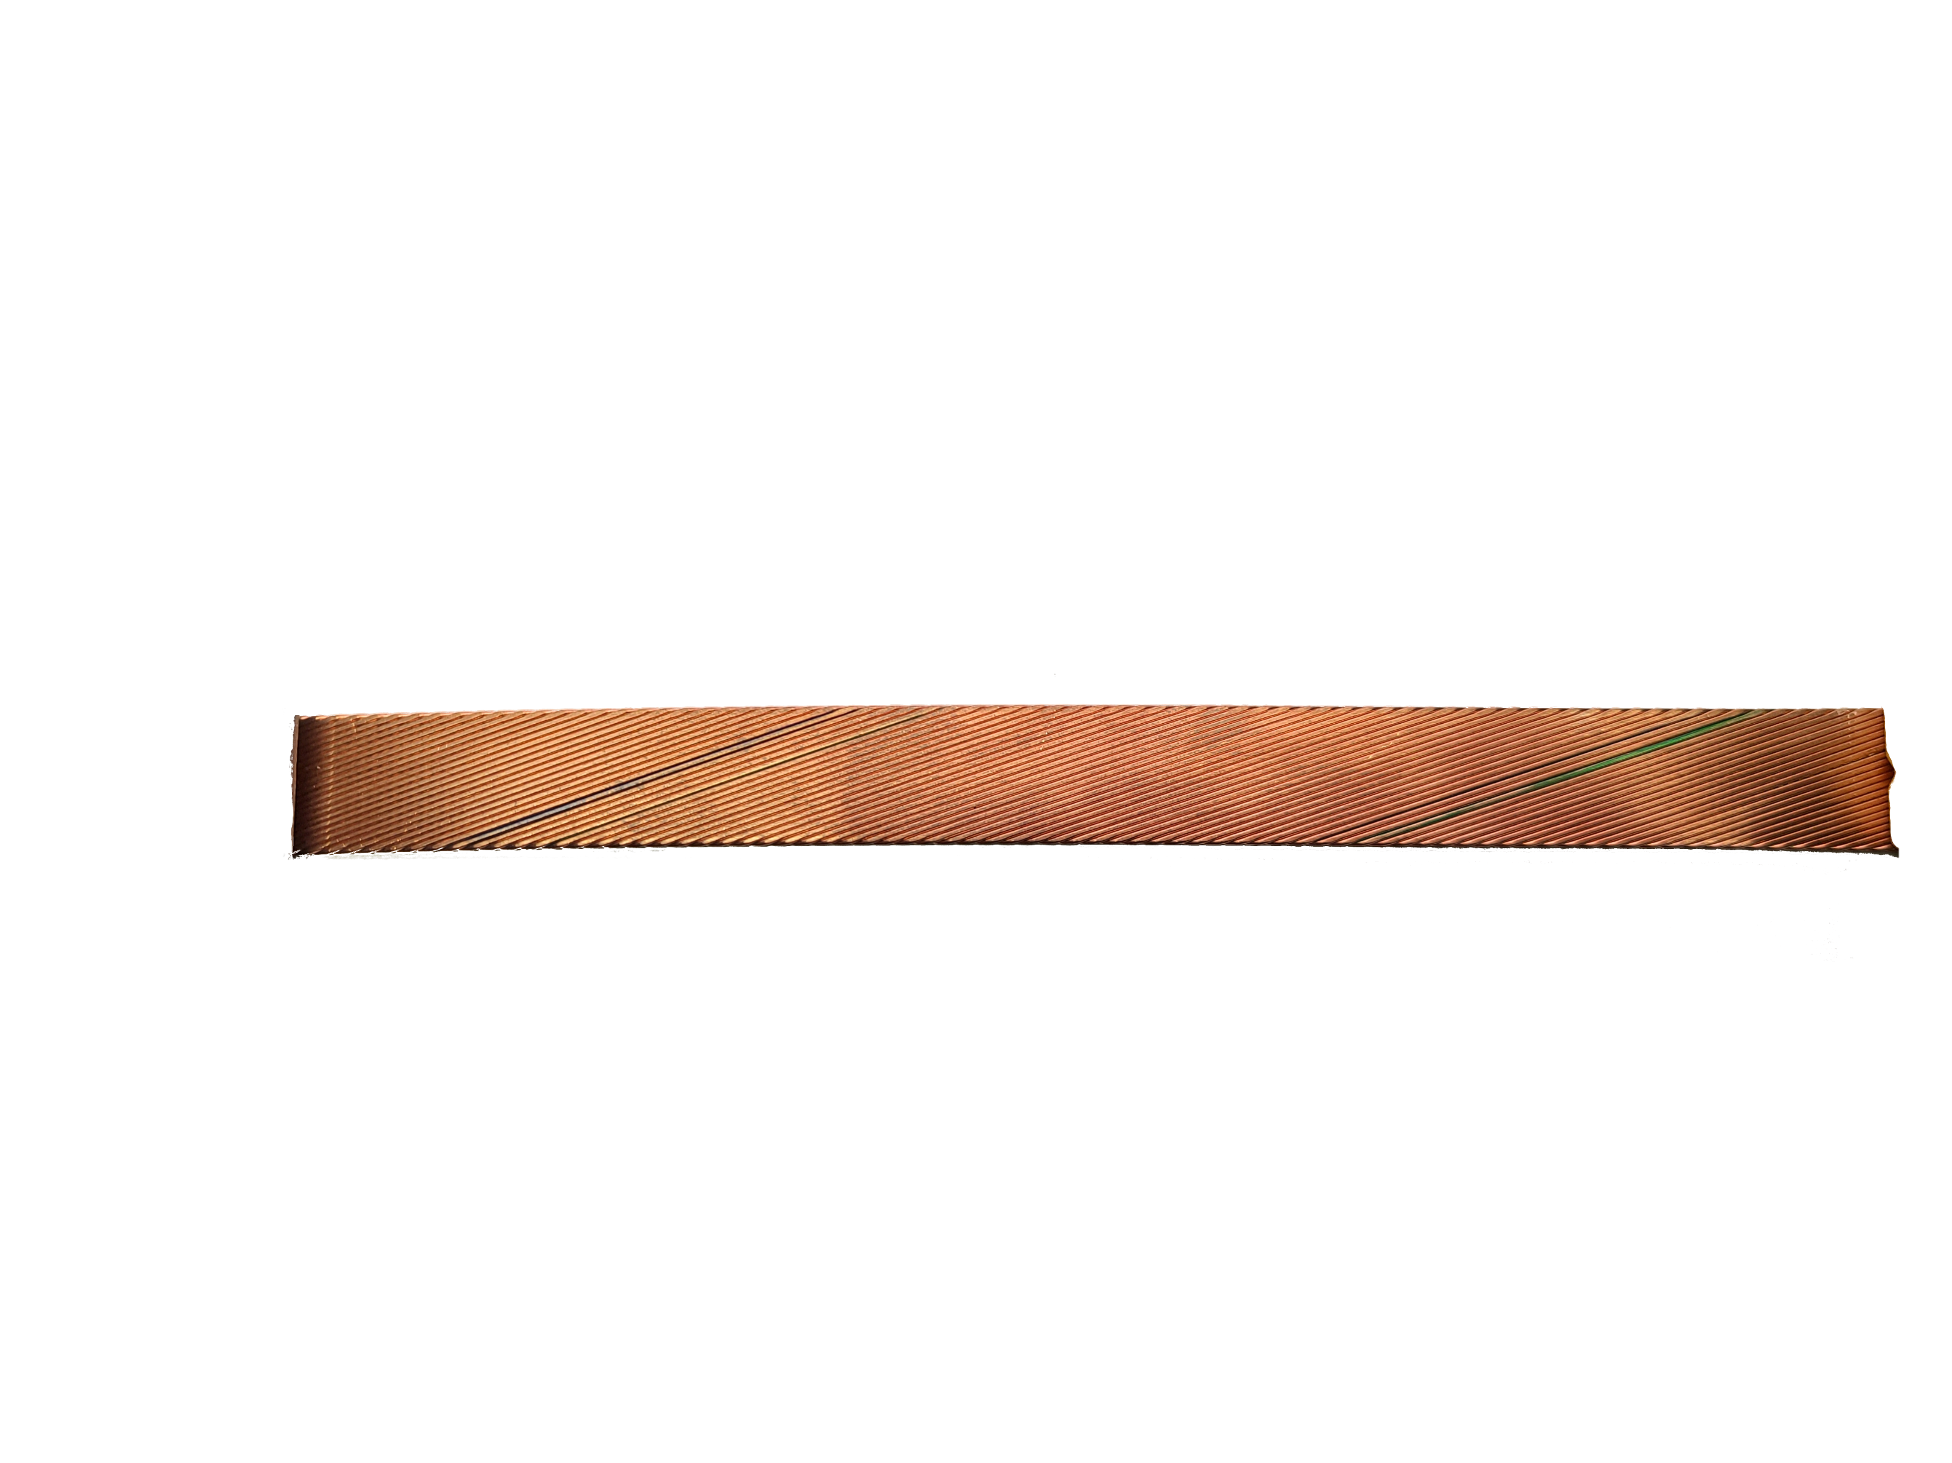
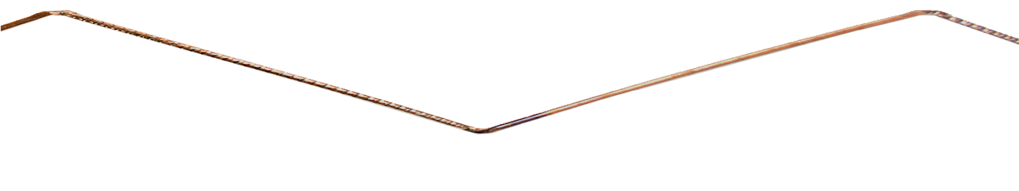
Motivation
Major Edge
Minor Edge
Bottom Straight
Top Straight
Minor Edge
Major Edge
Common practice for extracted strand RRR measurements:
  Straighten the extracted strand, leading to inaccurate RRR values
    2nd, extra deformation at edge locations → Lower RRR values
  Do not measure RRR at cable edges (“kinks”) & straight sections separately
System Goals
  Measure extracted strand RRR in as-used condition (i.e., kinks not-straightened)
  Measure RRR of individual strand sections: kinks & straights separately
  Improved repeatability through sample fixturing
  Measure many samples simultaneously and easily

Slide 5
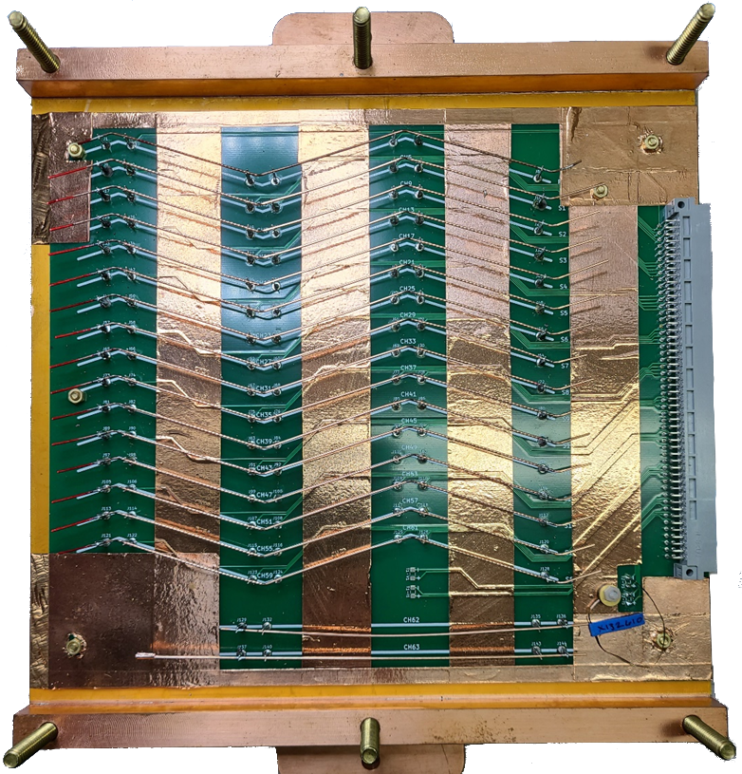
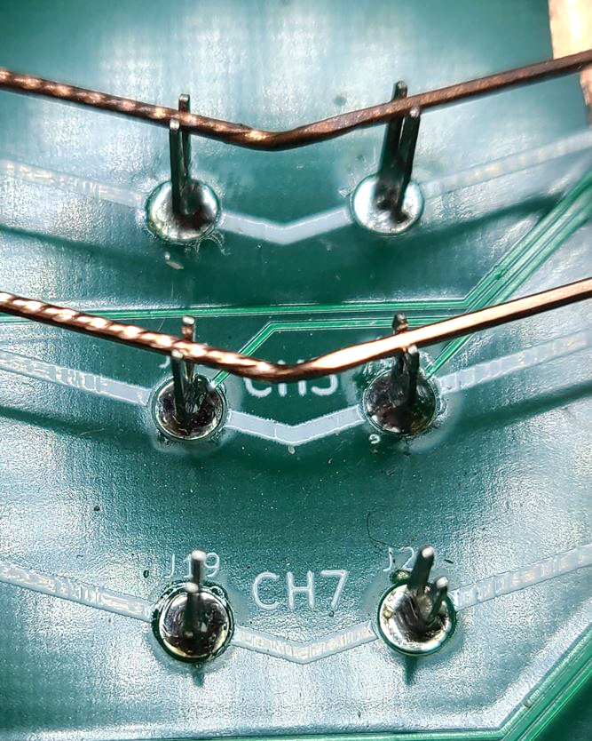
System: Sample Holder
Sample holder is printed circuit board (PCB)
PCB design must match cable design
  Current & voltage pin locations conform to cable width & twist pitch
Current & voltage pins are V-slotted
  Accommodates range of wire diameters
  Current taps are soldered
  Voltage taps are friction fit to strand

Slide 6
System: Sample Holder (cont’d)
Dedicated location for reference sample
  Confirms measurement system health
  Measured with each new sample set
  Stays on PCB
Dedicated locations for straight-sample, heat treat witness wires
  Confirms HT health – Temp & Atmosphere
15 extracted sample strand locations
PCB mounted to 7mm thick Cu plate

Slide 7
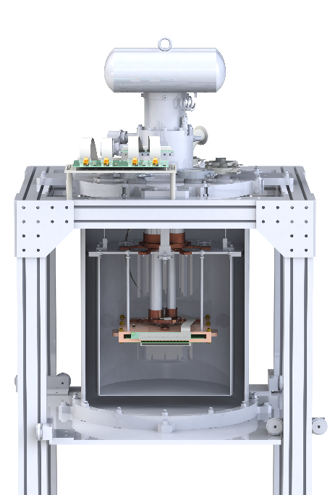
System: Cryostat
Cu plate design allows for stacking several together
Internal flex cable with 100 lines/conductors
  Printed on Kapton substrate for low heat loss
Outer SS vacuum jacket & inner Al radiation shield
Two cooling stages
  Two heaters on 2nd stage for temperature control
Cryomech PT415 cryocooler
  Cooling power: 1.5W @ 4.2K W, 40W @ 45K
  LHe-free operation
Cryocooler
Data Cables
SS Shell
Al Shell
Flex Cable
PCB + Cu

Slide 8
System: Measurement
System is controlled with LabView software
Thermal EMF mitigated by averaging positive & negative polarity
  Typically, ±0.5 A for AUP wire
  Measurements are compliant to IEC 61788-04
Whole PCB (63 channels) scanned in ~1 s at each polarity
Voltages measured with nanovoltmeter
Temperature ramp rate is controlled through the SC transition
  Two heaters on 2nd stage (50 W max)
  Typically, 0.1 K/min to 20 K

Slide 9
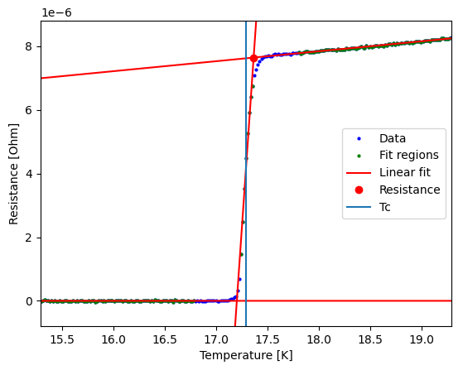
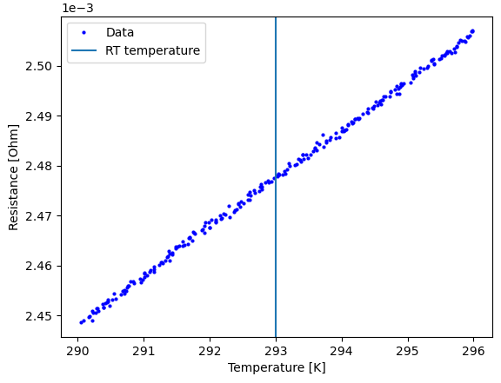
Example Resistive Traces
Resistance Trace @ Cold
Resistance Trace @ 20°C
For AUP, cold & room temp resistances at SC transition and 20°C, respectively
Python script calculates resistances at cold and room temperatures
  → Calculates RRR

Slide 10
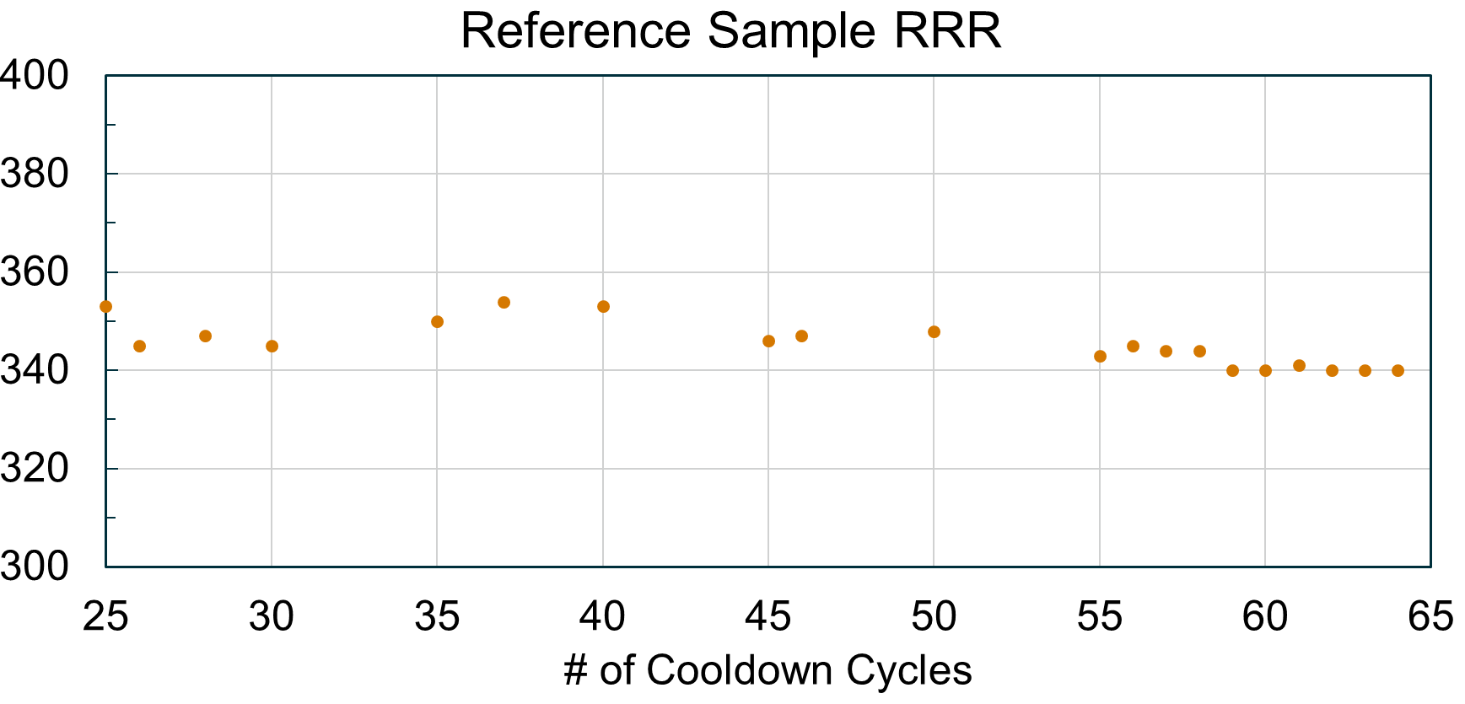
Repeatability: Reference Sample
New Script Analysis
New PCB
Reference sample RRR has been quite stable over past 40 cooldowns
  Python script analysis starting at Cycle #55; Manual analysis before.
  Sample had been moved on PCB prior to this, causing a shift in values

Slide 11
Repeatability: Same Samples, Different Slots
Samples were measured, then remeasured at a different location on PCB
  % Difference from 1st measure is shown
  Color-coding indicates change direction
  RRR values ~300 ± 100
Differences: Largest ~3% (~10), Median -0.7%
New (2nd) measurements tended to be lower
  Cold work from handling?
Matsushita² found COV = 1.7% - 4.0%
  Straight samples stayed at PCB location (not moved)
  Round robin sending PCBs between 6 labs
Lower
RRR Remeasure
Higher
²Matsushita et al., IEEE Trans. Appl. Supercon., vol. 28, no. 2, pp. 1-5, March 2018

Slide 12
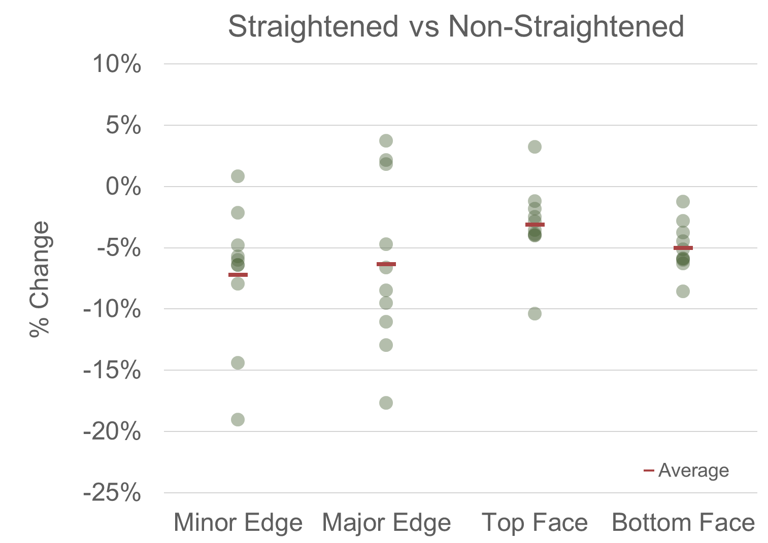
Straightened versus Non-Straightened Strand
RRR was slightly lower in straightened strand as compared to non-straightened
  ~5% lower at all wire segment locations
2 cables, 5 strands per cable
  10 total samples compared thus far
  More samples to come
Both strand types of a given cable were heat treated together
  Measured separately due to form factors
RRR values ~300 ± 100
[ (Straightened - (Non-Straight)) / (Non-Straight) ]

Slide 13
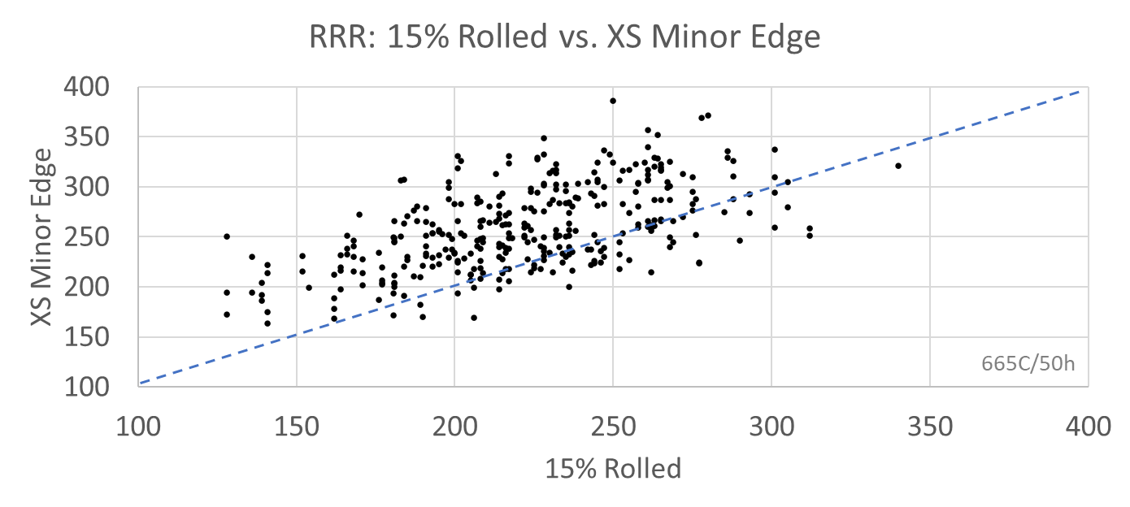
Correlation to Other Measurements
Lance Cooley
For AUP, 15% rolled (vendor-measured) and Minor Edge RRR (LBNL) are correlated
  15% rolled is more conservative. Vendor ρ_{Cold} at 20-22 K, not SC transition
  An indicator of future Minor Edge RRR in finished cable

Slide 14
Repeatability: AUP + RRR Process
Samples extracted from same cabled strand but on opposite ends, in separate sessions, then HT’d independently & measured independently
RRR values are very consistent despite numerous variables at play
ITER benchmarking found σ_{RRR} ~20 (COV ~14%) for internal-Sn strand³
³I.Pong et al., IEEE Trans. Appl. Supercond., vol. 22, no. 3, pp. 4802606, June 2012

Slide 15
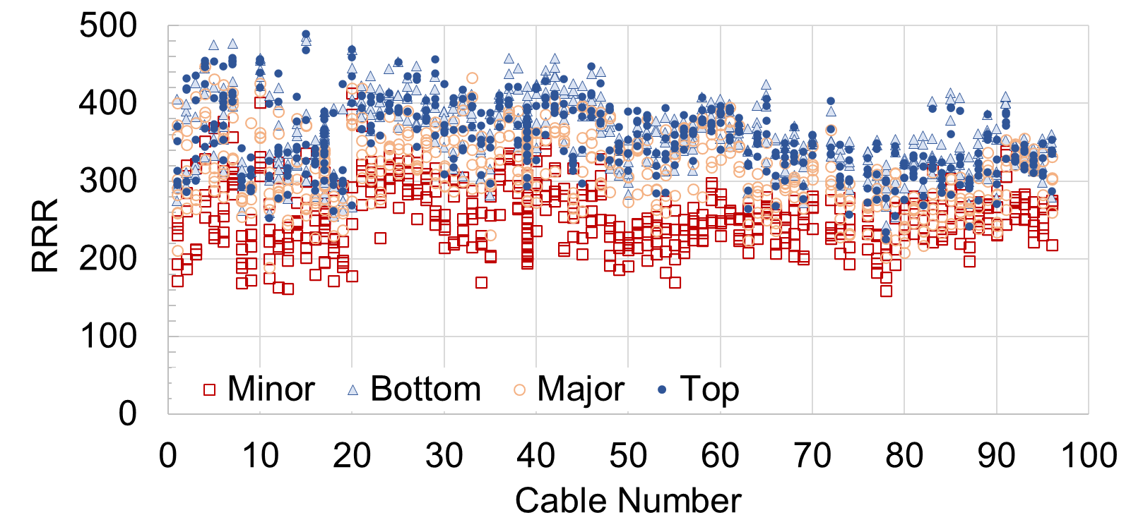
AUP Extracted Strand Trend
Edges show RRR suppression at edges/kinks
  Minor Edge worse than Major Edge
5 extracted strands/cable & 3 cables per measurement

Slide 16
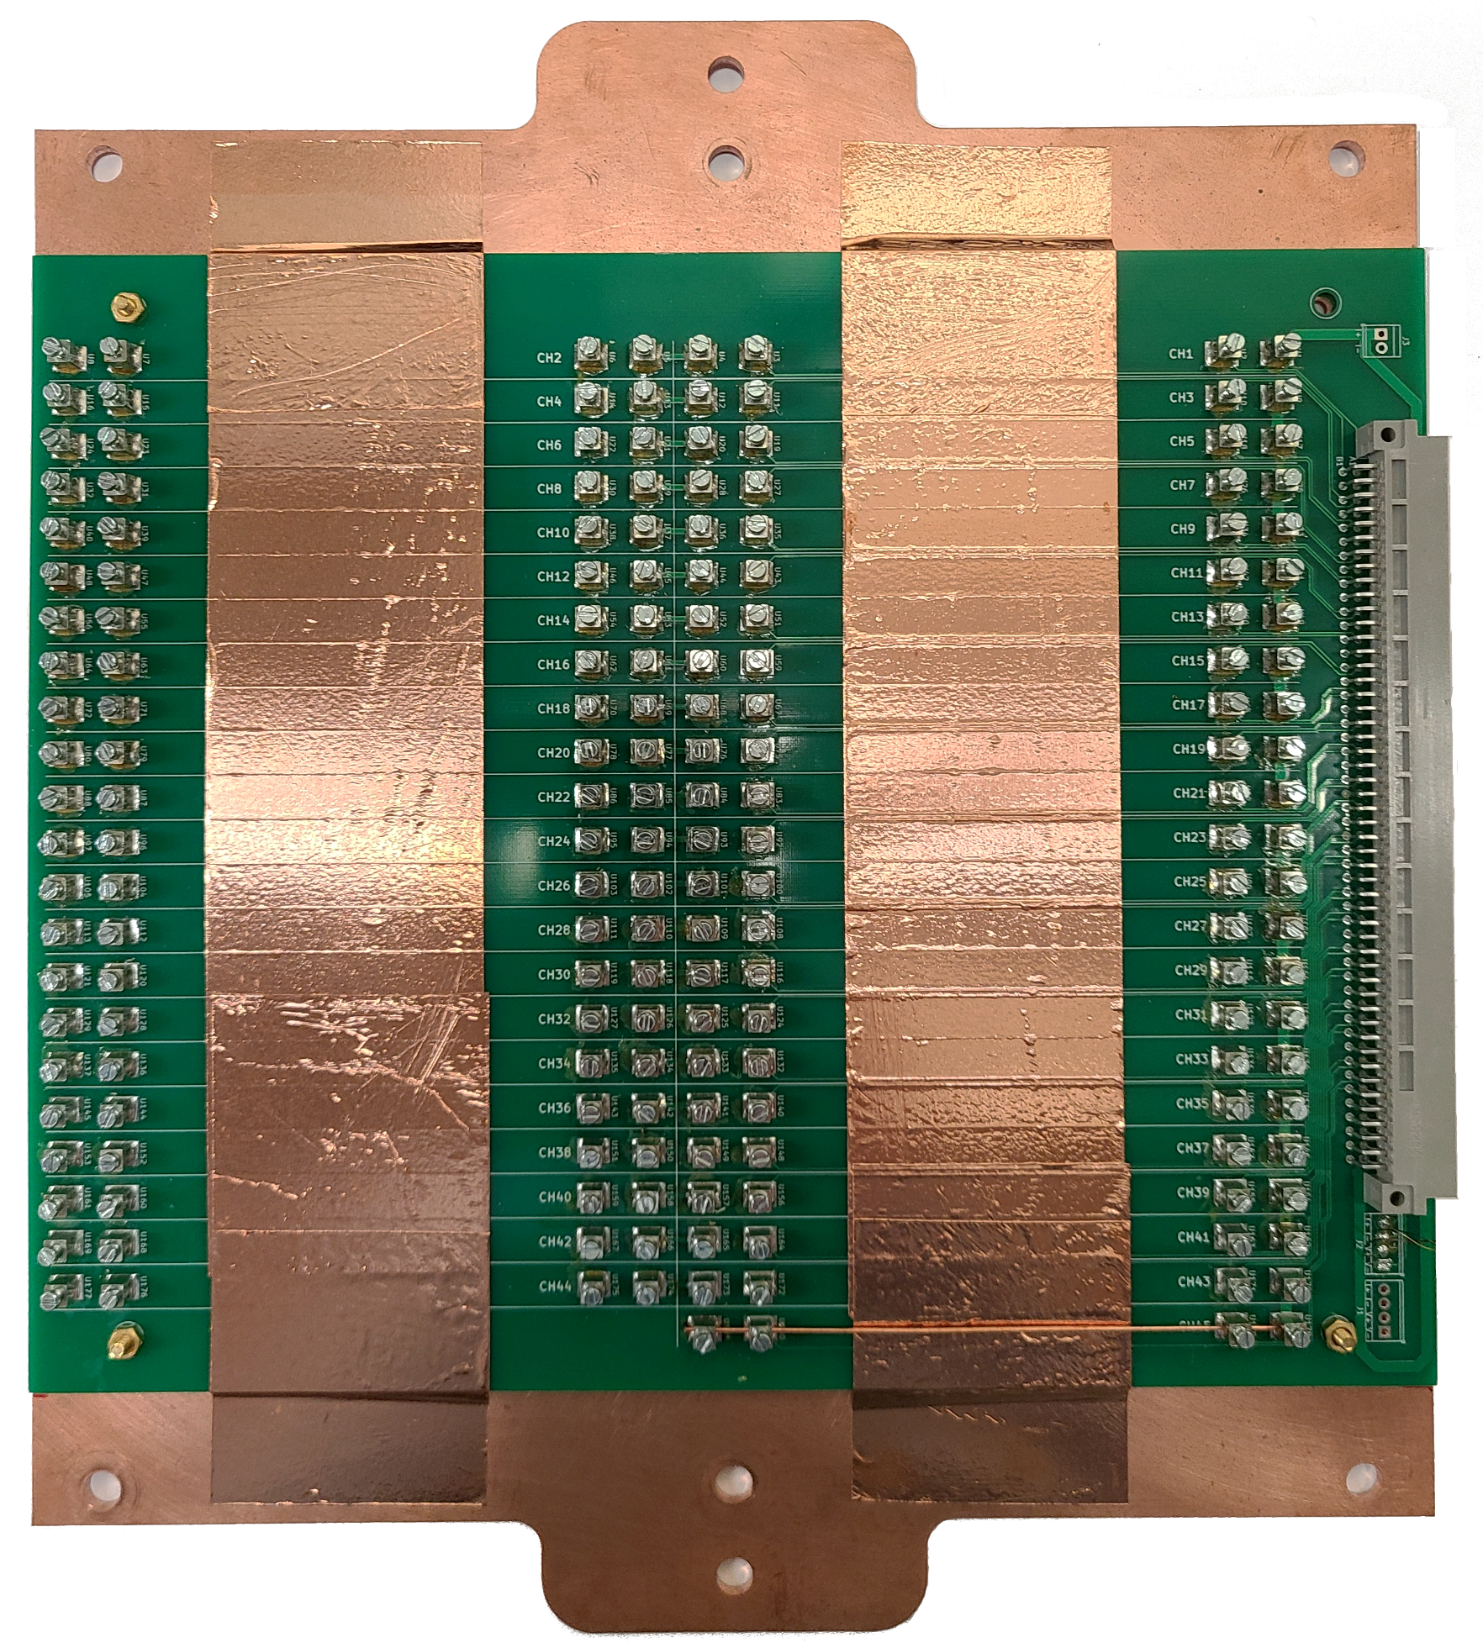
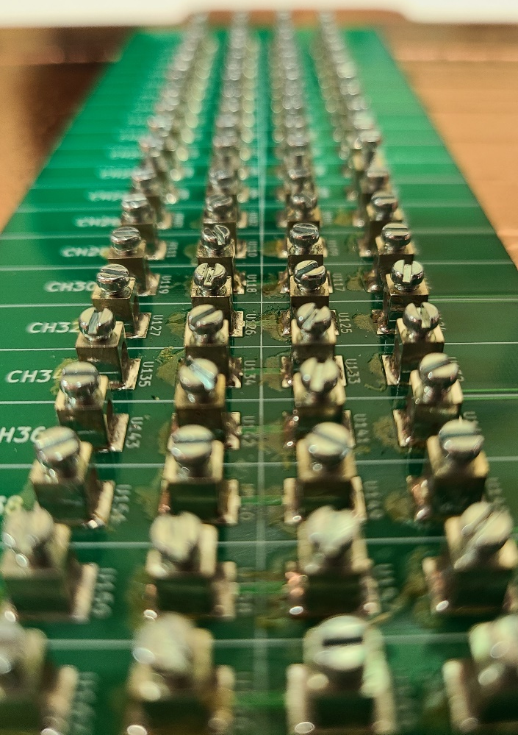
Straight Sample PCB
45 samples per board
Quickly & efficiently measure many samples
  Heat treat studies
  Wire design studies
  Quality control
Current & voltage pins = screw posts

Slide 17
Summary
Common RRR methods do not differentiate segments of extracted strands, rather it is ‘whole strand’
  Kinks/Edge locations versus straight sections
A novel extracted strand RRR measurement system has been built to independently & easily measure each strand segment
RRR measurements are internally and externally consistent
Data indicates straightened XS have lower RRR
System facilitates RRR cabling quality control, strand problem investigations, and/or other studies

Slide 18
Fin

Slide 19
Back-Up Slides

Slide 20
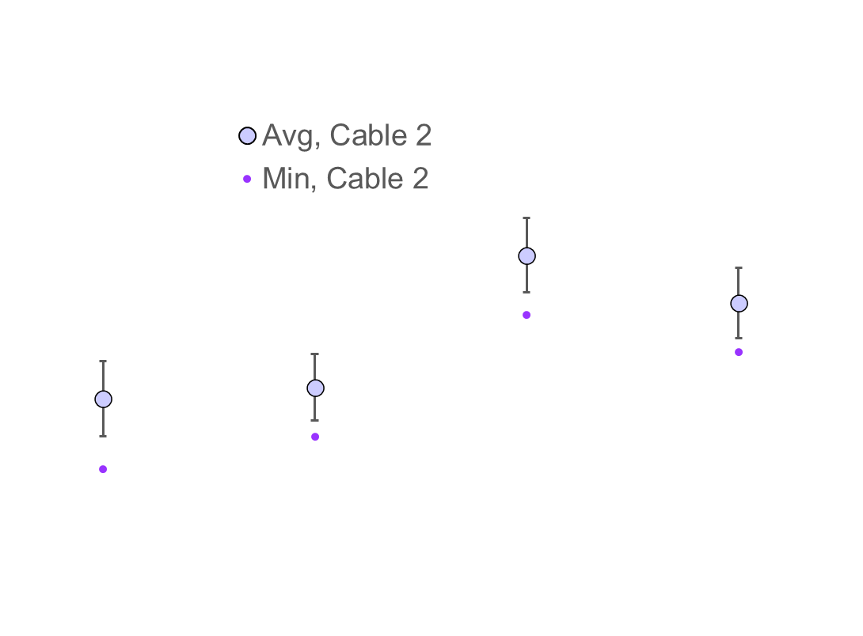
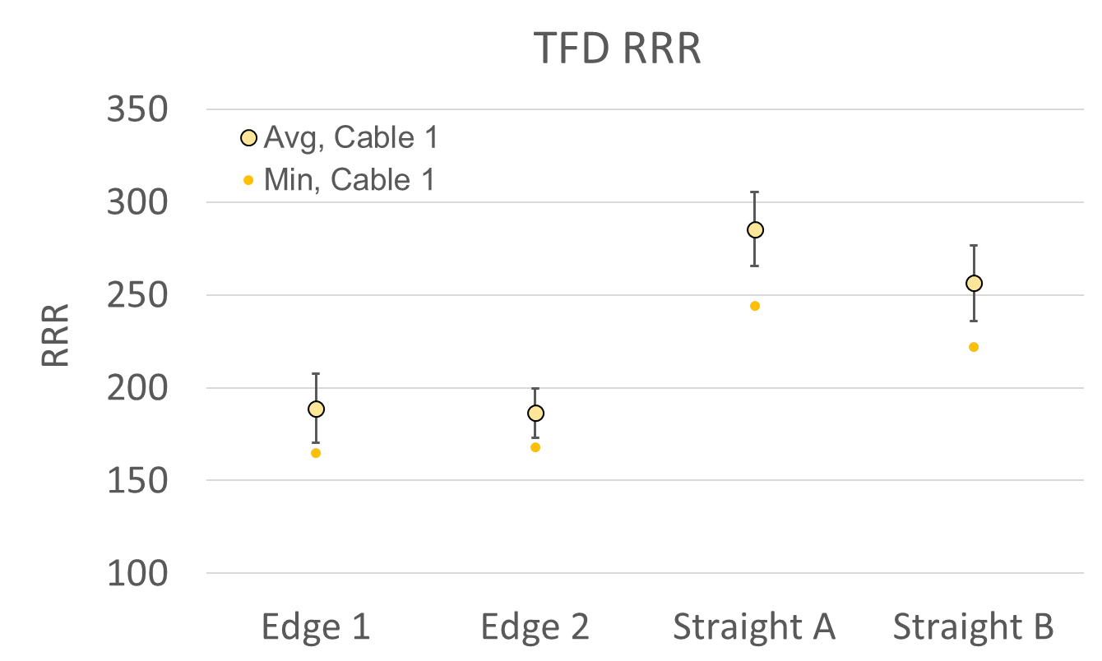
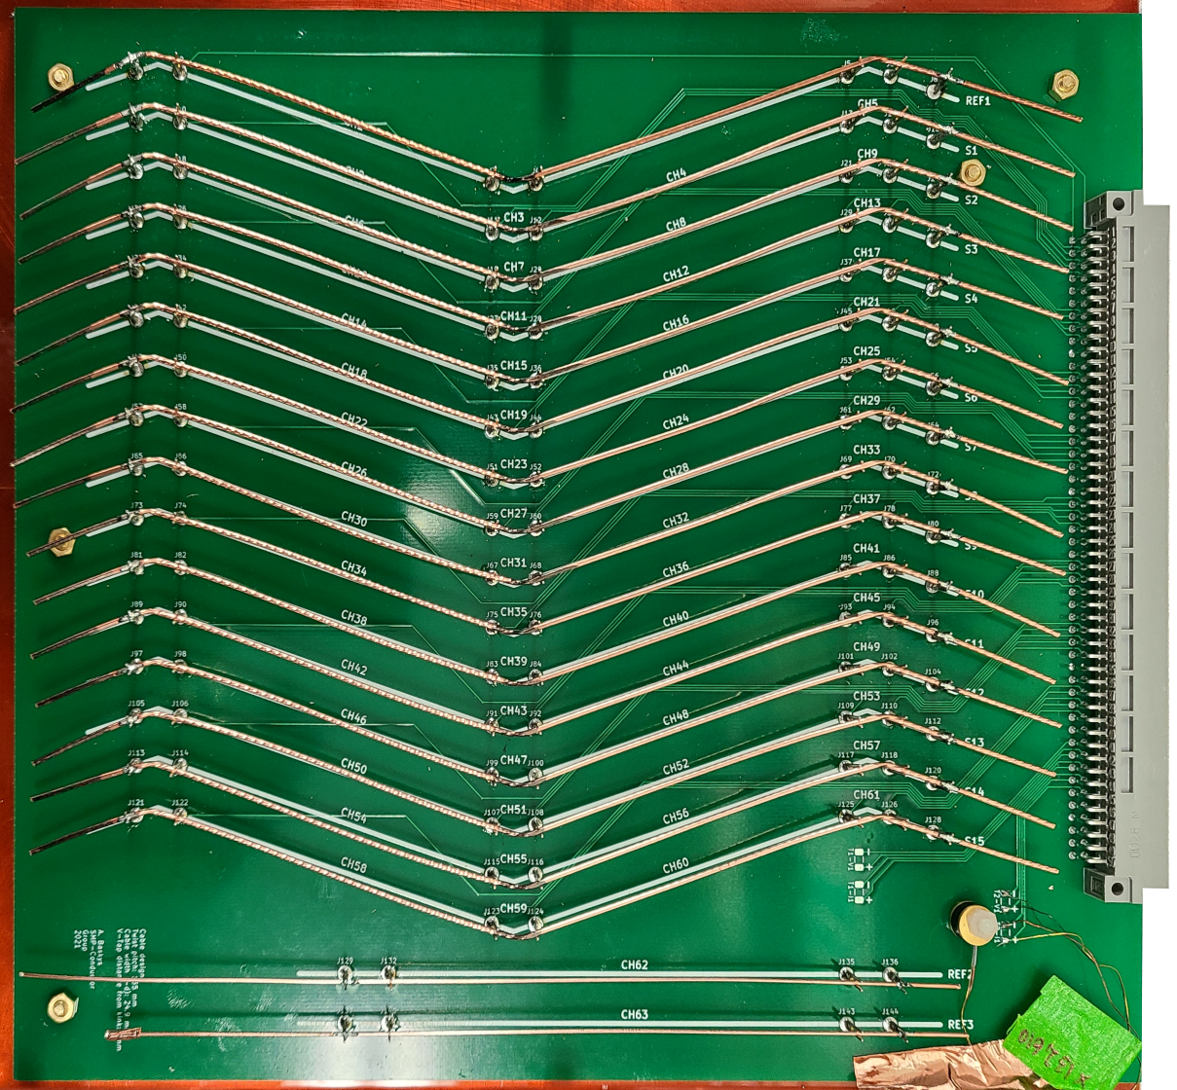
Example: Test Facility Dipole (TFD)
Can quickly track RRR impact of cable mfg changes during cable development

Slide 21
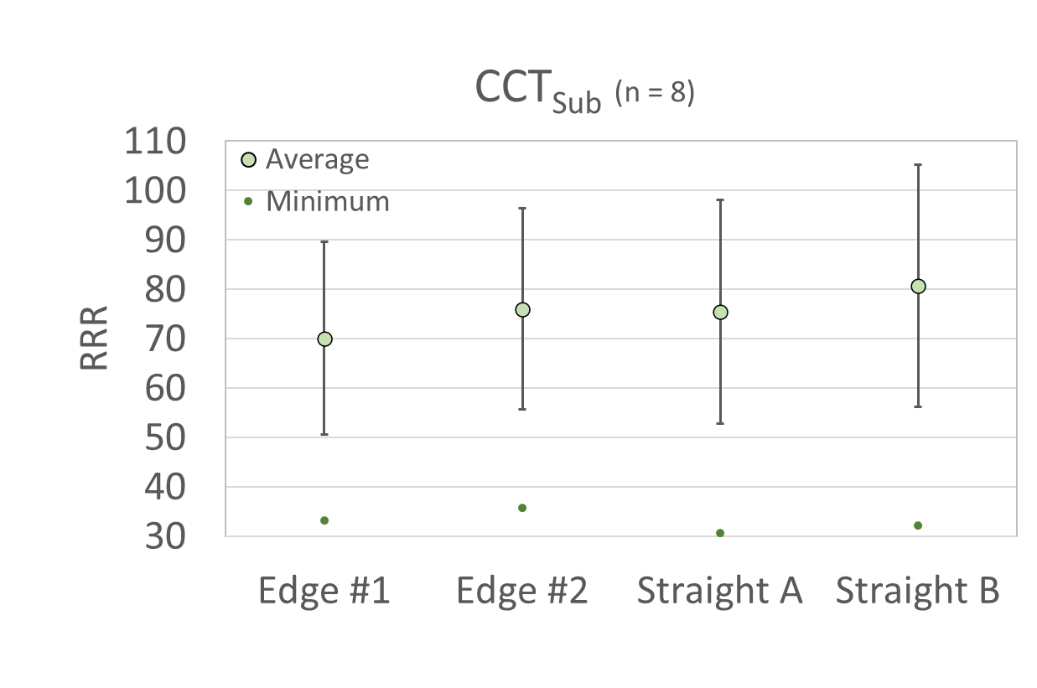
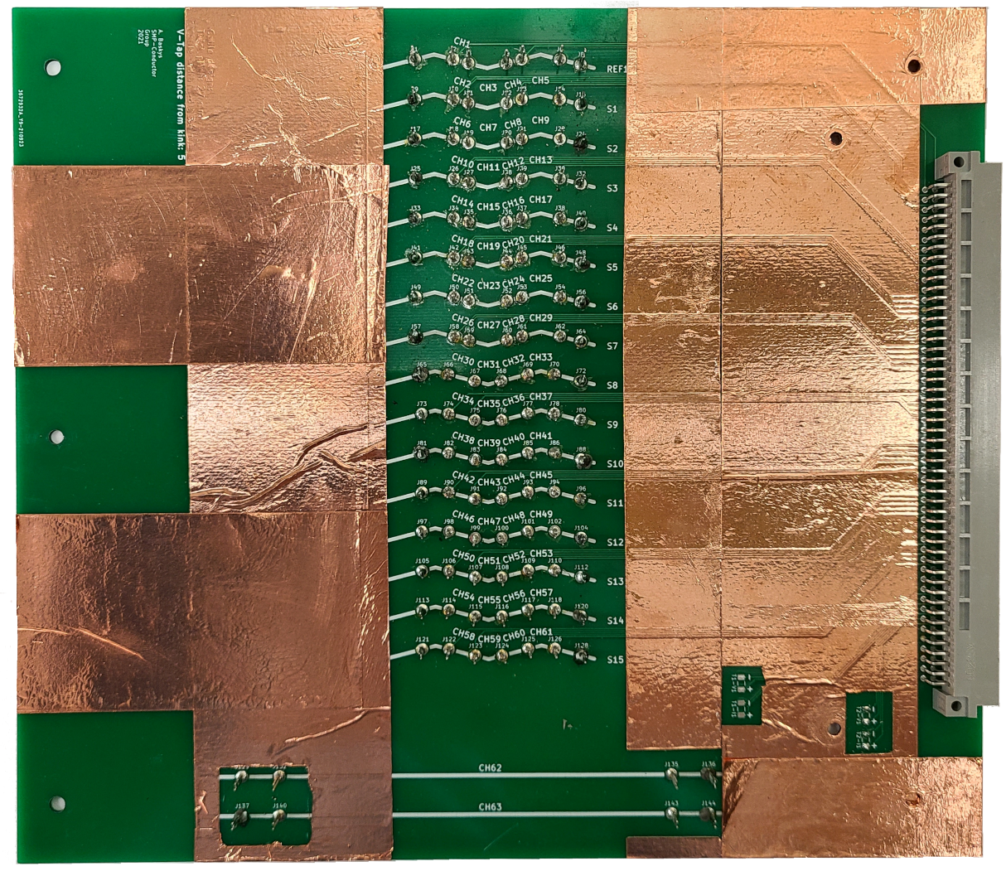
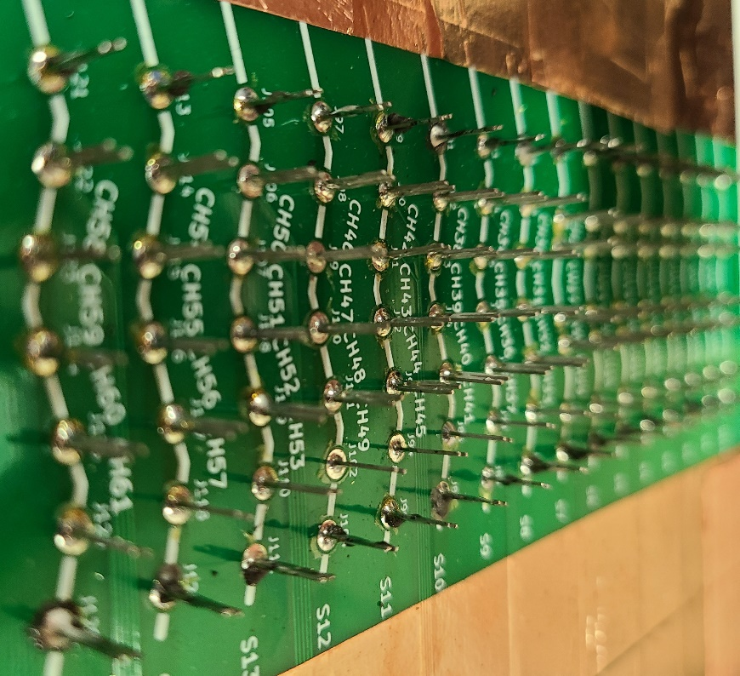
Example: Canted Cosine Theta SubScale (CCT_{Sub})
Investigation of poorly performing strand for I_{c} showed low RRR
RRR_{Edge} ≈ RRR_{Straight}

Slide 22
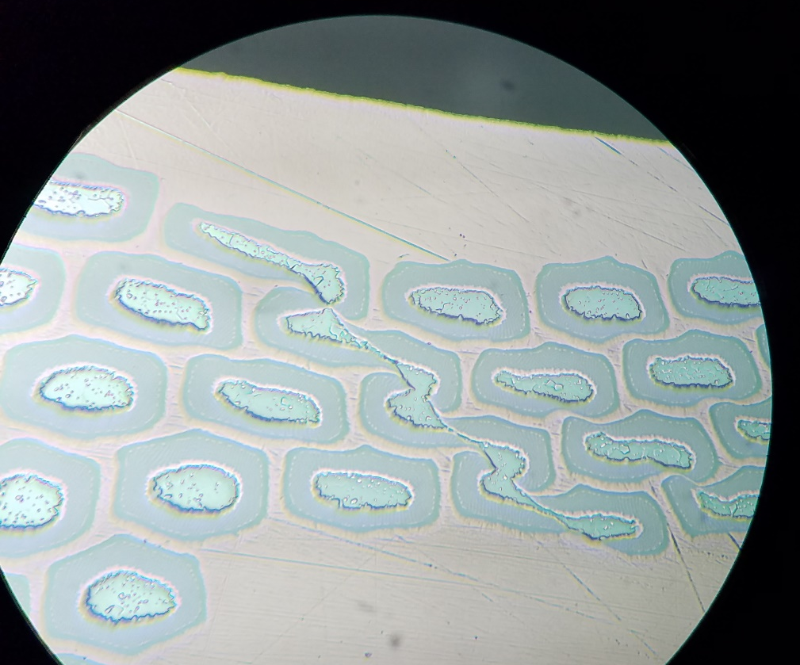
Sheared Subelements

Slide 23
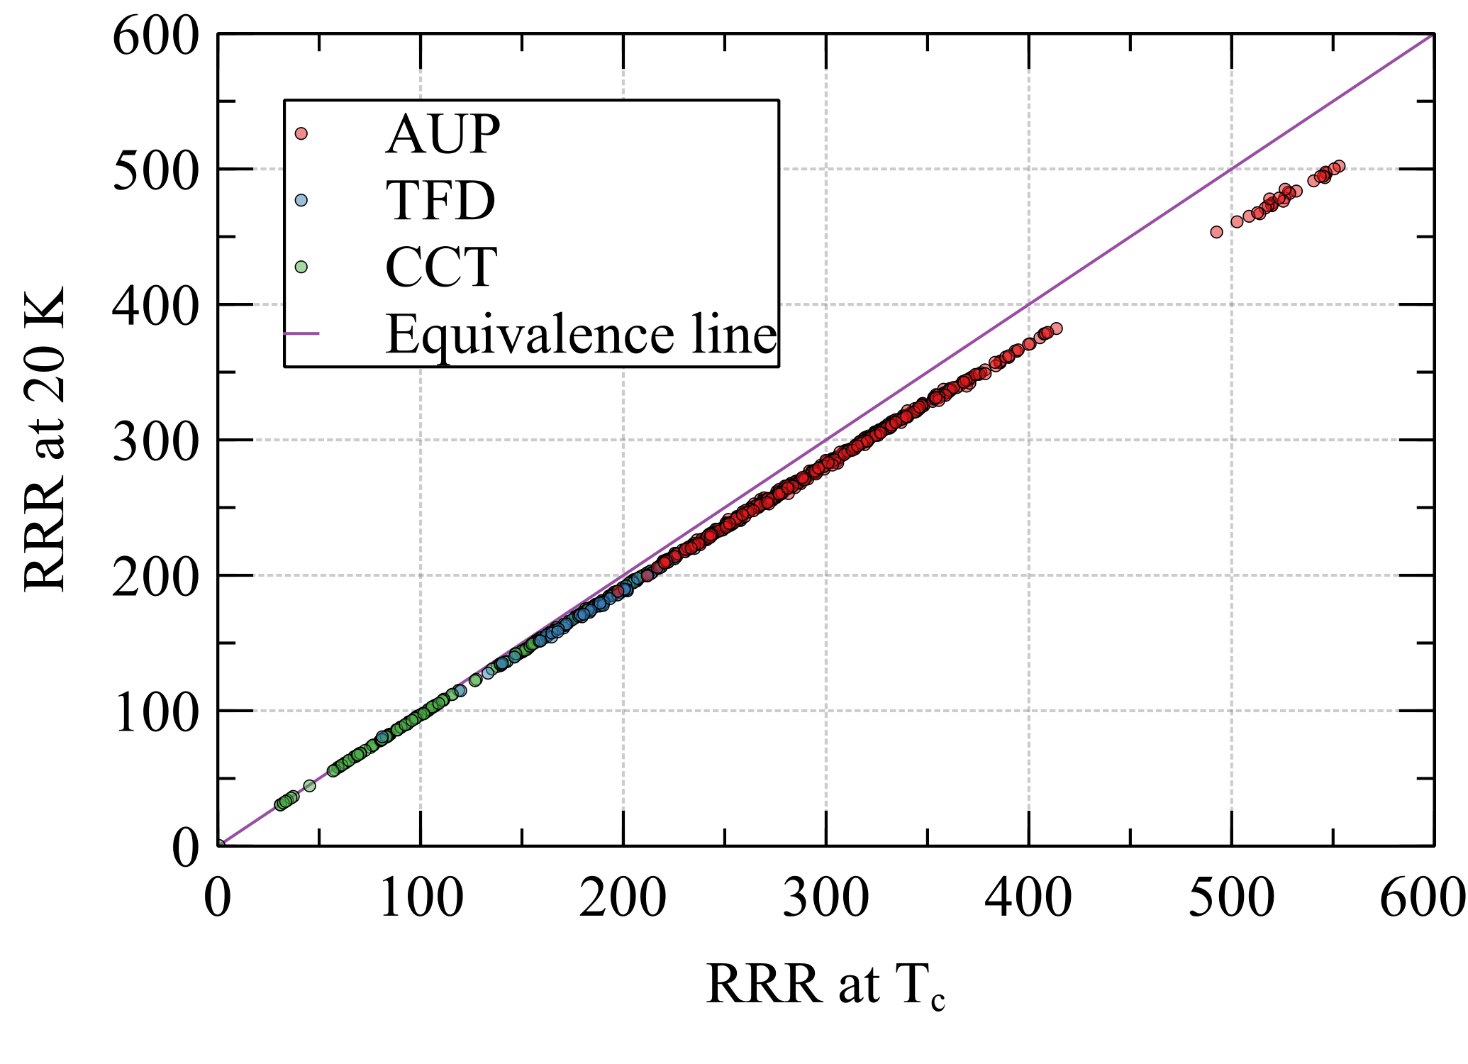
RRR @ Tc vs. @ 20 K

Slide 24
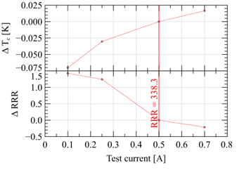
RRR versus Test Current

Slide 25
AUP Cable Cross-Section

