Slide 1
Numerical assessment of the inhomogeneous temperature field and the quality of heat extraction from Nb₃Sn impregnated magnets for the High Luminosity upgrade of the LHC
2LOr2A – HL-LHC: Nb₃Sn Magnets II
Patricia Borges de Sousa, Kirtana Puthran, Marta Sabaté-Gilarte, Francesco Cerutti, Susana Izquierdo Bermudez, Ezio Todesco, and Rob van Weelderen
2LOr2A-03
Applied Superconductivity Conference, 23-28 October 2022, Honolulu, Hawaii, USA

Slide 2
Framework
In the context of the High-Luminosity upgrade of the LHC at CERN, a robust multi-region CFD numerical toolkit for the modelling of heat transfer in complex cryogenic system geometries involving He II has been developed
Initial work aimed to provide thermal design requirements early enough in the MQXF design phase such that they could be implemented in the mechanical design
The work presented here is a continuation of previous studies, implementing updated MQXF geometry and dose maps (April 2022) as well as a fully upgraded numerical toolkit

Slide 3
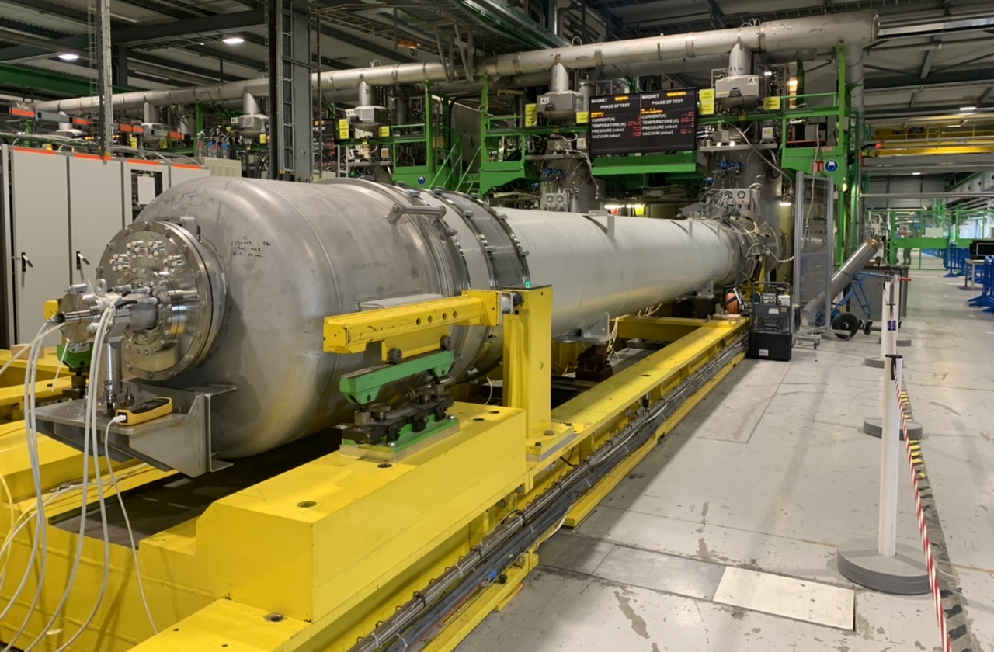
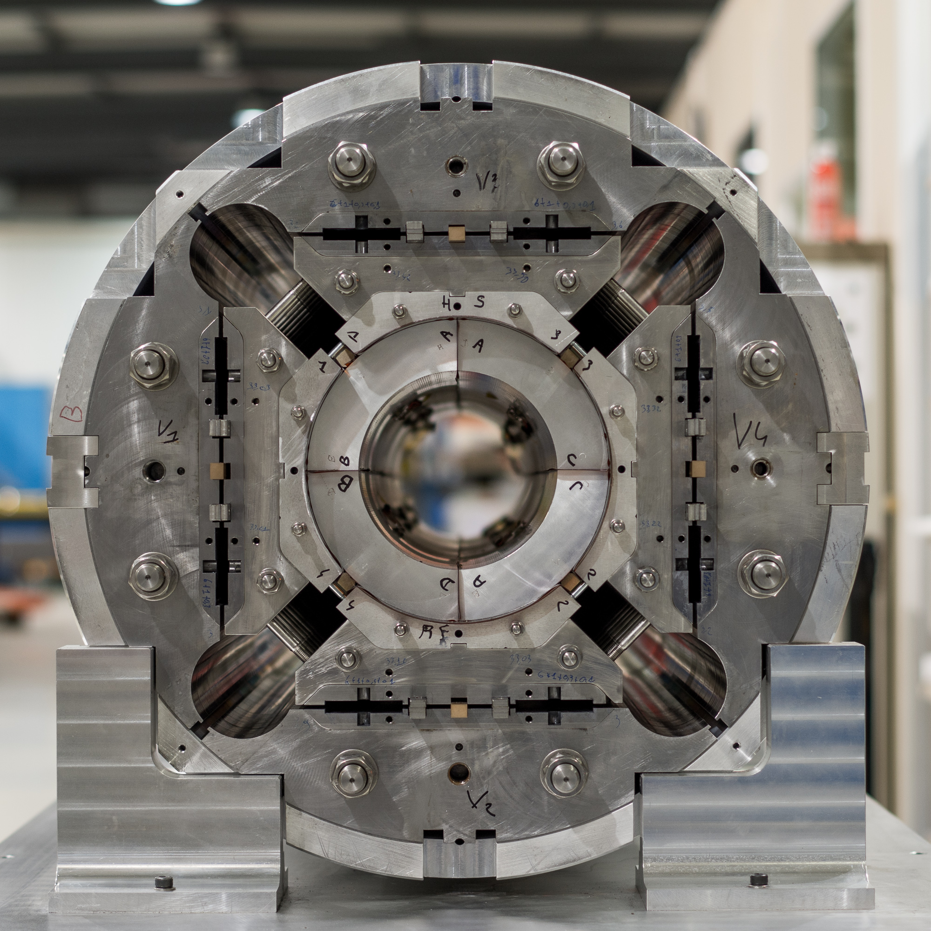
Thermal mapping of HL-LHC inner triplets
Context:
Previously established temperature margins along the full cross-section of Nb₃Sn magnets and enveloping cold masses need to be reevaluated to reflect changes in both power deposition and geometry, and to validate the heat extraction design.
Objective:
Systematic assessment of temperature fields and resulting theoretical margins in the magnet coils and validation of the heat extraction design of the cold mass under peak power deposition conditions at nominal luminosity
Tools:
A 2D numerical framework has been developed to model the temperature distribution in the combined solid-superfluid He system of each magnet and enveloping cold mass using open-source software.

Slide 4
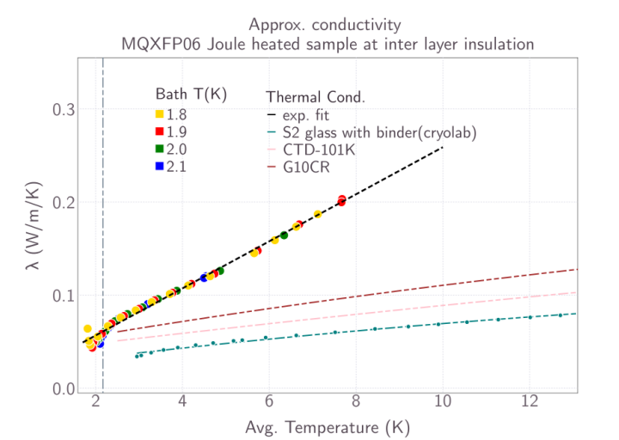
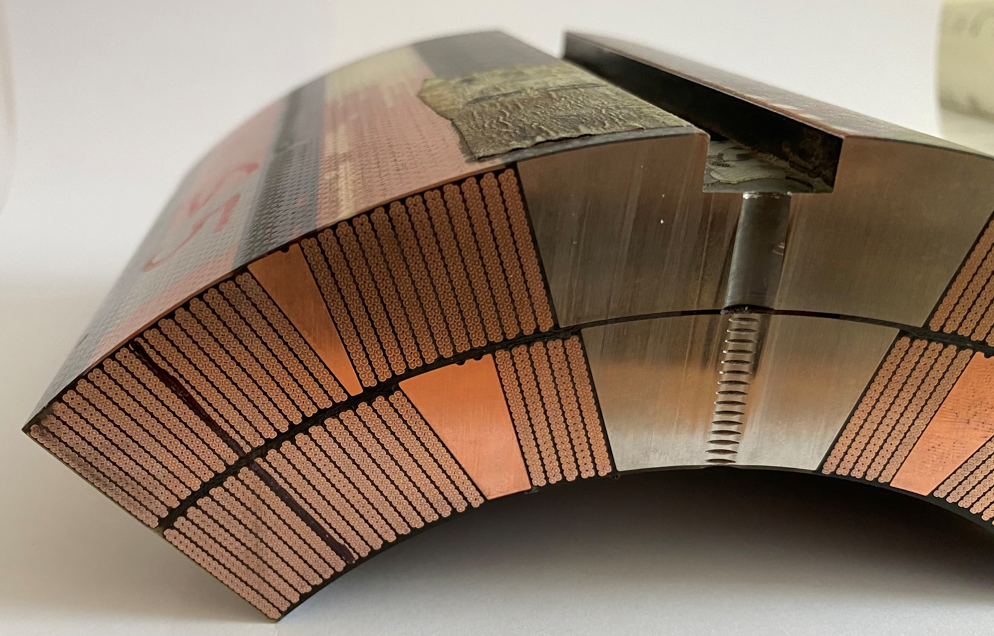
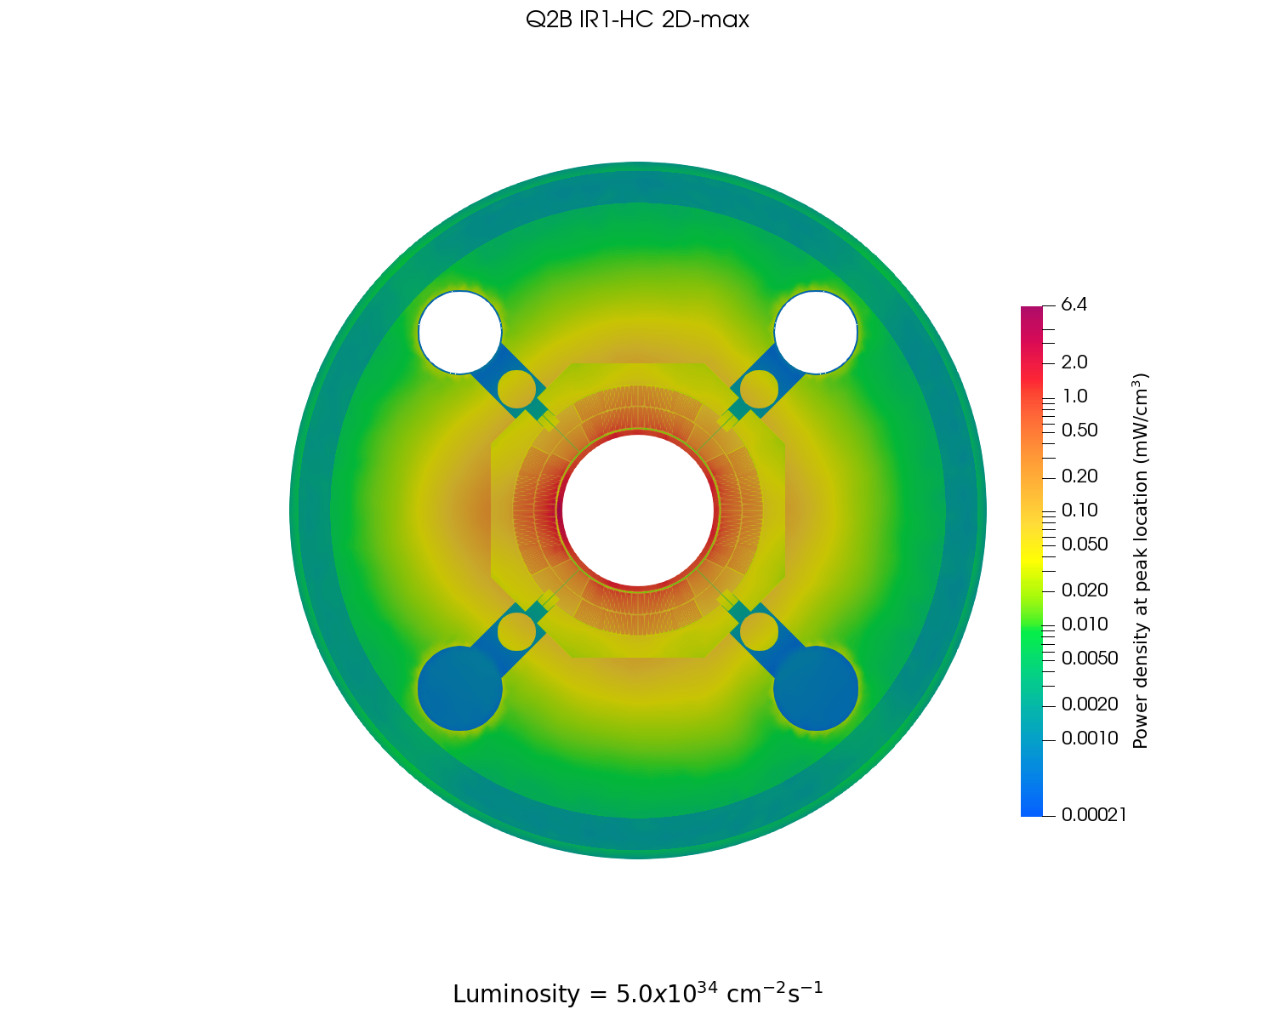
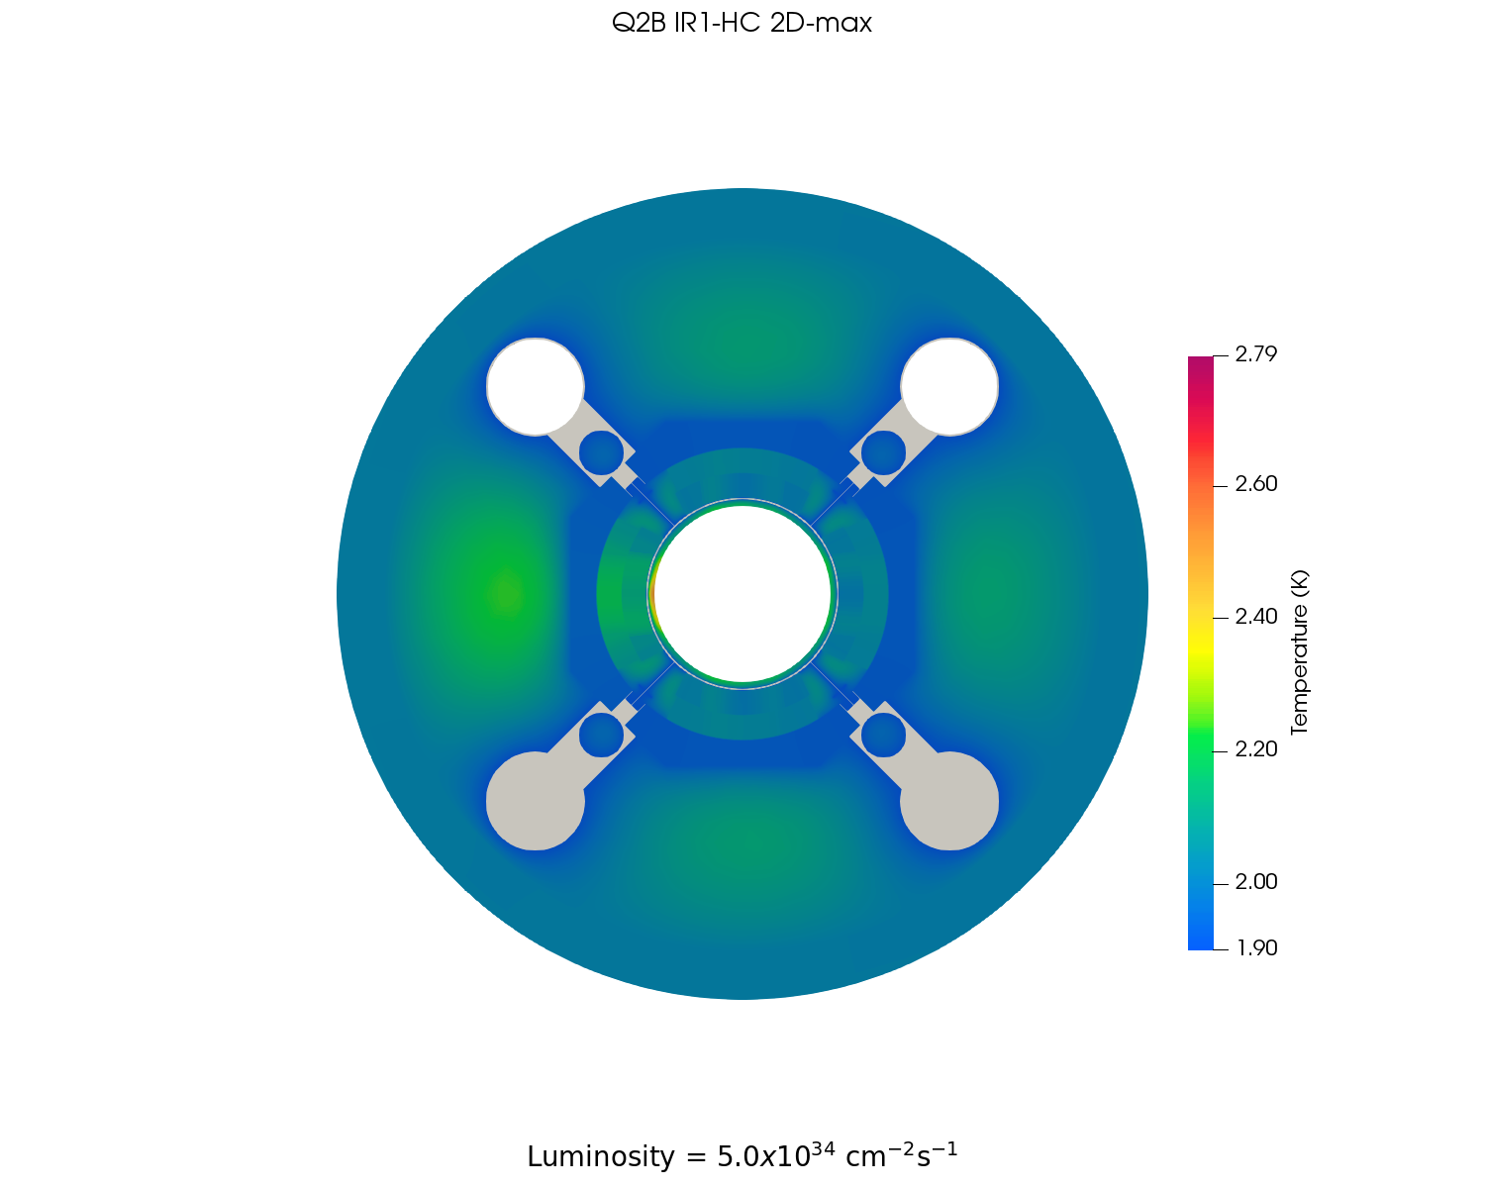
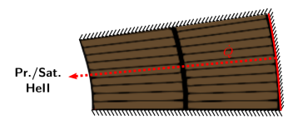
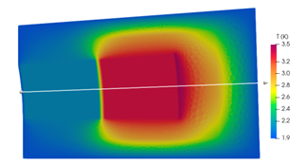
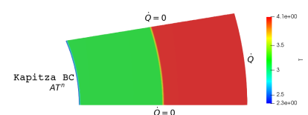
Experimental evaluation of heat transfer of coil samples in He II
Extraction of material properties and interface resistance from exp. data
Numerical toolkit used to validate heat extraction strategy and temperature margins of full-scale magnets and cold masses
Numerical toolkit created, applied to experimental-size samples
Validation of numerical toolkit by comparing exp. results with simulation using extracted props.

Slide 5
Numerical toolkit used to validate heat extraction of full-scale magnets and cold masses
Libraries and solver implemented in OpenFOAM v7
Geometry of magnet/cold mass created via Python API for Salome 9.7, easily adjustable for parametric studies
Currently, toolkit can handle 2D geometries and stagnant He II conditions and He II → He I transition (no flow)
Dose maps can be mapped onto the geometry and converted into peak power deposition; as dose scales linearly with luminosity, peak power can be easily scaled
Alternatively, direct heat input can be applied to any part of the geometry for dedicated studies

Slide 6
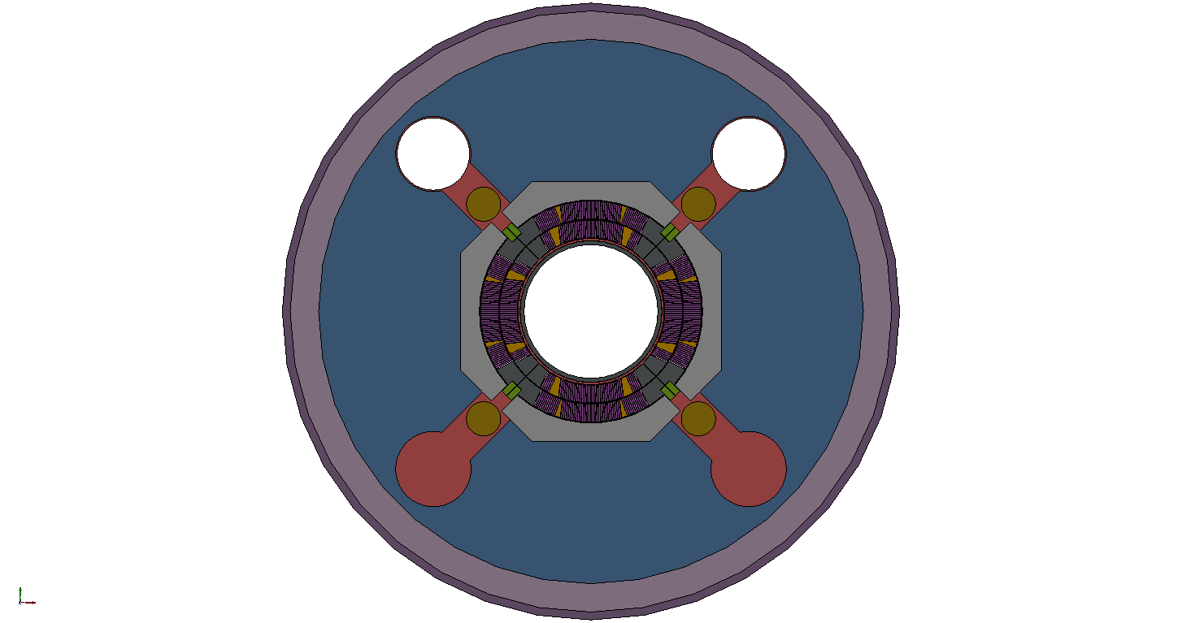
Geometry MQXF coil + cold mass (I)
Geometry created with dimensions in warm (300 K) conditions
Coil described in detail, simplifications mainly on iron yoke (bladder structure omitted), main He pathways included
He II heat extraction passages in Titanium pole/G10 keys (Ø8 mm hole every 50 mm) converted to 1 mm slit in 2D geometry
Mesh composed of 3.5M cells, prisms; coil pack refined → especial refinement on thin insulation layers
MQXF v7 + cold mass
(ST0703448)
Simplified geometry for simulation (coded in Python and Salome)
Resulting 2D meshed geometry (coded in Python and Salome)

Slide 7
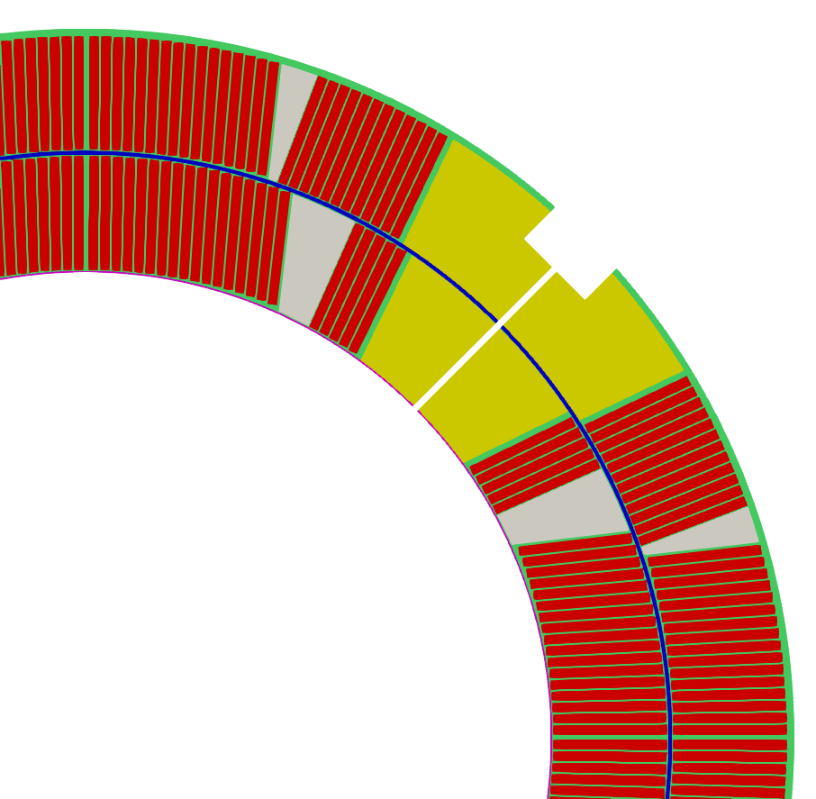
Geometry MQXF coil + cold mass (II)
Outer + ground insulation
Outer vessel
Inter-cable insulation
Al shell
Titanium pole (w/ He slit shown)
G10 keys
Coil wedge
Cold bore
Interlayer insulation
Inner insulation
Axial rods
Iron yoke
Nb₃Sn cables
Al collar

Slide 8
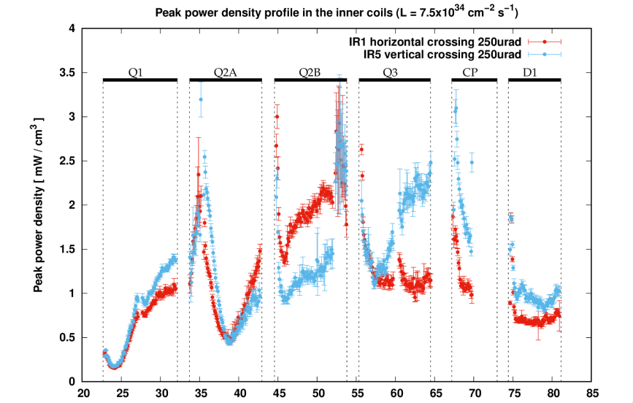
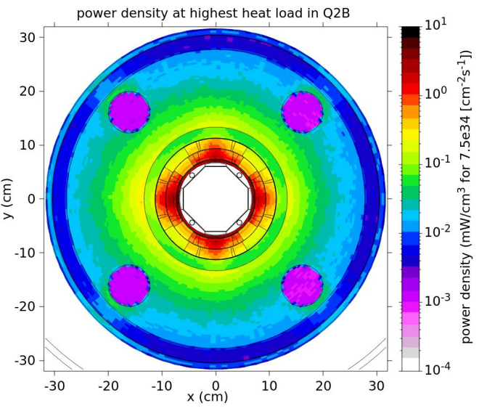
Input for heat deposition from dose calculations (I)
For each magnet/cold mass, the cross-section that corresponds to the highest dose (and consequently heat load) is selected
12 cross-sections selected (Q1/2/3 A and B, vertical and horizontal crossings)
Distance from interaction point [m]
Source: Review of estimates of energy deposition, M. Sabate-Gilarte

Slide 9
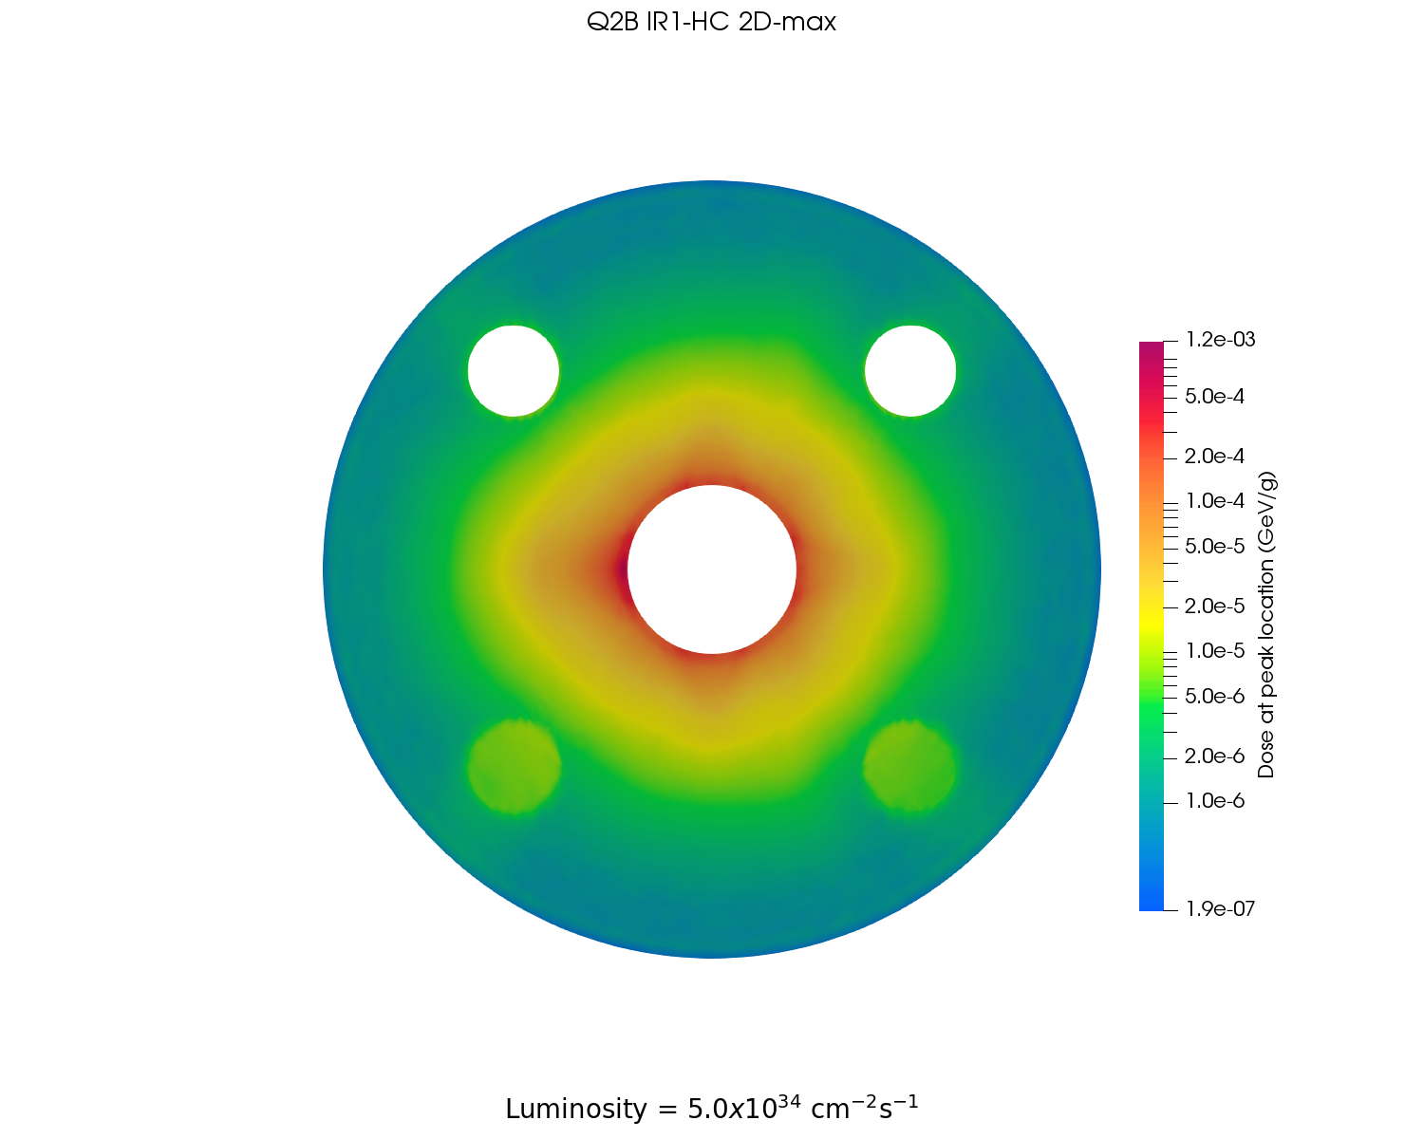
Input for heat deposition provided dose calculations (II)
For each magnet/cold mass, the dose at peak location for nominal luminosity (7 TeV, 5.0x10³⁴ cm⁻²s⁻¹) provided by FLUKA is mapped onto the mesh
Mapped dose is converted to 2D power density (mW/cm³) map at the peak (maximum) location according to each component’s density
Mesh is split into two regions, a He II region and a solid region. The solid region is composed of many different zones each with their own material properties
Q2B IR1-HC – dose @ peak loc.
Q2B IR1-HC – power dep. @ peak loc.
He II region (connected passages via poles)
Solid region (17 parts)
Luminosity 5.0x10³⁴ cm⁻²s⁻¹ Cold bore included

Slide 10
He II region and (composite) solid region
Mesh is split into two regions: a He II region and a solid region
The solid region is composed of many different zones each with their own temperature-dependent material properties
NB2: 8 mm holes every 50 mm converted to 1 mm slit in 2D
NB1: annular space 1.2 mm
NB3: cold bore insulation thickness of 510 µm
Helium region Connected passageways via Titanium poles/keys
Solid region 16 areas with different properties

Slide 11
Boundary conditions for calculations
Outer surface (inside of cold bore and outside of shell):
Zero gradient $\frac{∂}{∂n}φ=0$
Pressurized He II to saturated He II HEX:
Fixed value T = 1.9 K
Solid-to-Helium interface:
Kapitza-resistance mediated interface $h_{K}^{0}=A{T_{He}}^{n}$, $A$ and $n$ derived from MQXF experimental data
On full cross-section:
Resulting mapped power density computed from FLUKA, different for each magnet

Slide 12
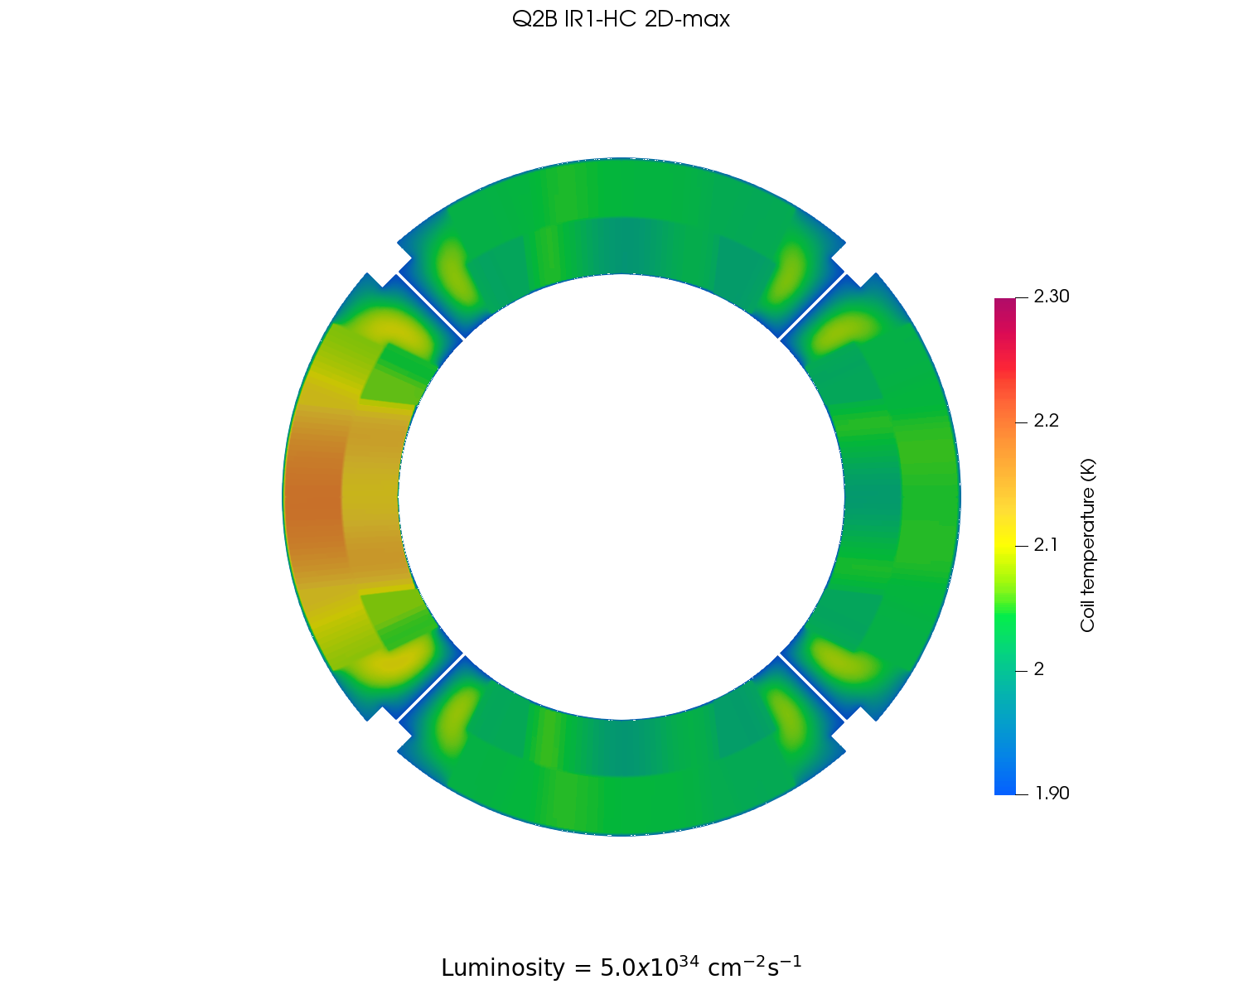
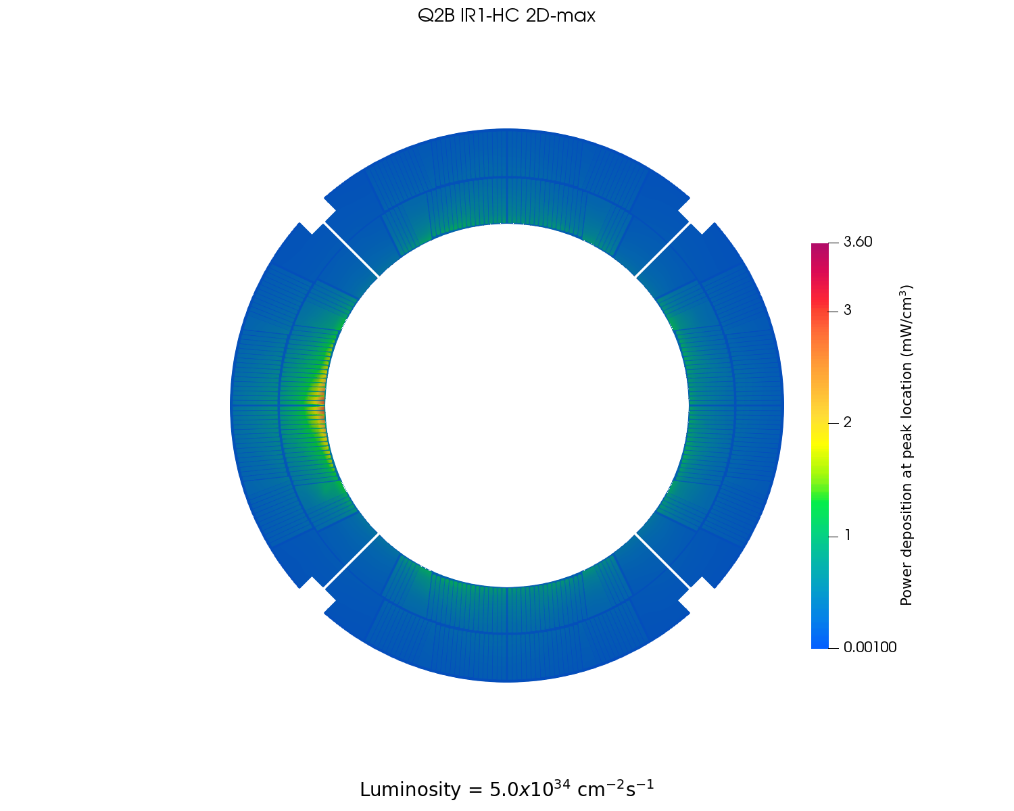
Results: example Q2B IR1-HC @ nominal luminosity
Dose at peak location
Temperature distribution at peak location
Power deposition at peak location
Power deposition at peak location (coil detail)
Temp. distribution at peak location (coil detail)
Max T in cold bore
Maximum coil temperature 2.2 K
NB: Cold bore included, dose for luminosity = 5.0x10³⁴ cm⁻²s⁻¹

Slide 13
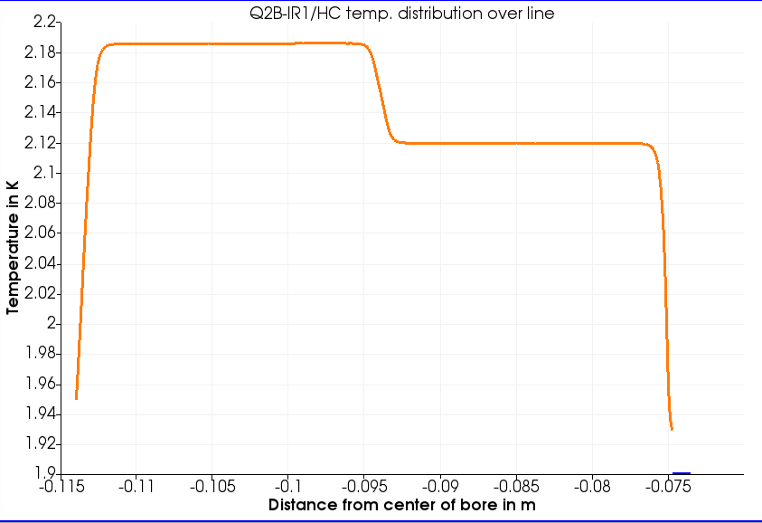
Results: example Q2B IR1-HC @ nominal luminosity
Temp. distribution at peak location (coil detail)
outer coil layer
inner coil layer
interlayer insulation
inner insulation
outer + ground insulation
He II
Kapitza resistance

Slide 14
Results: example Q2B IR1-HC @ nominal luminosity
Temp. distribution at peak location (coil detail)
For the described geometry, boundary conditions and considering the peak power deposition generated by a luminosity of 5x10³⁴ cm⁻²s⁻¹ for each of the 12 magnet cross-sections, we find:
Max. T in the coil = 2.3 K
Max. T in cold mass = 2.8 K (on cold bore)
He II T gradient O(100 µK)
T gradient dominated by inner insulation, interlayer insulation and Kapitza
Max T in cold bore

Slide 15
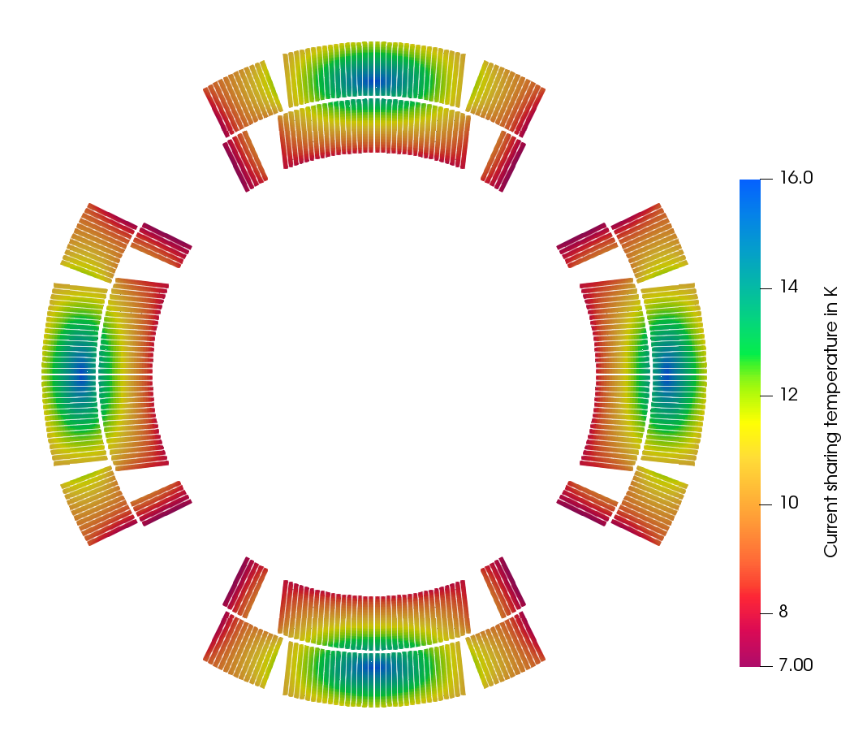
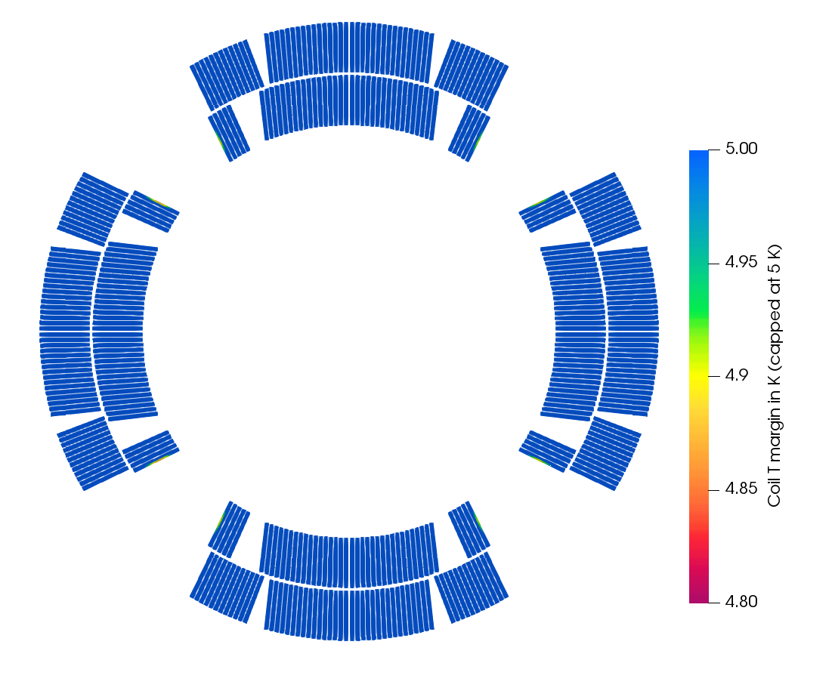
Resulting temperature margin for MQXF magnets
Based on the assumption of a homogeneous $T_{op}$ at 1.9 K, margins for an ideal magnet
$T_{op}$distribution considering conduction pathways and dose-generated heat deposition
Min T margin = 4.88 K
Current sharing temp. MQXF @ $J_{op}$, $B_{op}$, $T_{op}$
Temperature profile Q2B IR1-HC @ nom. lum.
Temperature margin Q2B IR1-HC @ nom. lum.
(scale truncated at 5 K!)
NB: Cold bore included, dose for luminosity = 5.0x10³⁴ cm⁻²s⁻¹

Slide 16
Resulting temperature margin for MQXF magnets
Min T margin = 4.88 K
Based on the assumption of a homogeneous $T_{op}$ at 1.9 K
For the described geometry, boundary conditions and considering the peak power deposition generated by a luminosity of 5x10³⁴ cm⁻²s⁻¹ for each of the 12 magnet cross-sections, we find:
Min. T margin in the coil = 4.78 K
Invariably located on the 8 turn(s) closest to the pole
The rest of the coil pack for each magnet cross-section has a temperature margin higher than 5 K
Current sharing temp. MQXF @ $J_{op}$, $B_{op}$, $T_{op}$
Temperature margin Q2B IR1-HC @ nom. lum.
(scale truncated at 5 K!)

Slide 17
Summary (I)
Robust, easily adaptable numerical toolkit has been consolidated to produce results in a timeframe that allows for parametric investigation of geometry, operational temperature, and power deposition on magnet systems cooled by stagnant, pressurized He II
The heat extraction pathways for the HL-LHC inner triplet magnets have been validated for the latest geometry, considering a steady-state power deposition at peak location for nominal operating conditions (5.0x10³⁴ cm⁻²s⁻¹, 7 TeV), at 1.9 K cold source

Slide 18
Summary (II)
The temperature field in MQXF coil and cold-mass cross-sections has been updated w.r.t. previous assessments, considering the influence of the dose-generated power deposition for the peak position in each magnet
The maximum calculated coil temperature is 2.3 K, while the rest of the cold mass sees a localized maximum ≤ 2.8 K, located on the cold bore
Considering the calculated temperature distribution, for the design $B_{op}$, $J_{op}$, and cold source at 1.9 K, the minimum temperature margin is calculated to be between 4.78 K and 4.92 K
MQXF cross-sections at peak dose, 7 TeV, 5.0x10³⁴ cm⁻²s⁻¹,1.9 K cold source
 | On coil pack | On cold mass
Maximum power density | 3.6 mW/cm³ | 6.4 mW/cm³
Maximum temperature | 2.30 K | 2.79 K
Minimum temp. margin | 4.78 K | N/A

Slide 19
Outlook
Consolidated strategy can be applied to investigate temperature distribution & margins, as well as to validate the heat extraction strategy, on other geometries including non-impregnated coil structures
Simulations of a 2D longitudinal section of the cold masses will be carried out to better evaluate the gradient along the pressurized He II region with real He passageways (8 mm holes every 50 mm)
Next major step is to move to a 3D (simplified) geometry: magnet configurations that rely on reduced He content and/or long conduction paths can profit from a 3D picture of temperature distribution

Slide 20
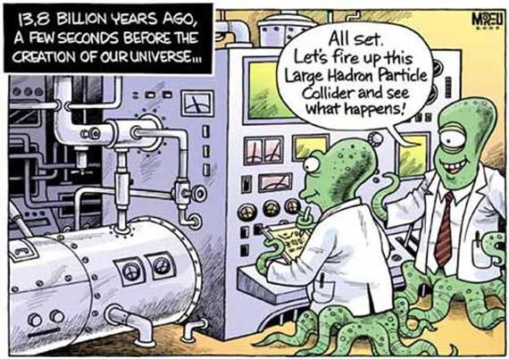
Thank you for your attention!

Slide 21
Results at peak location for IR1/HC Luminosity = 5.0 x 10³⁴ cm⁻²s⁻¹ Energy = 7 TeV
Dose map cold mass in GeV/cm³
Power deposition cold mass in mW/cm³
Power deposition (coil detail) in mW/cm³
Temperature profile cold mass in K
Temperature profile (coil detail) in K

Slide 22
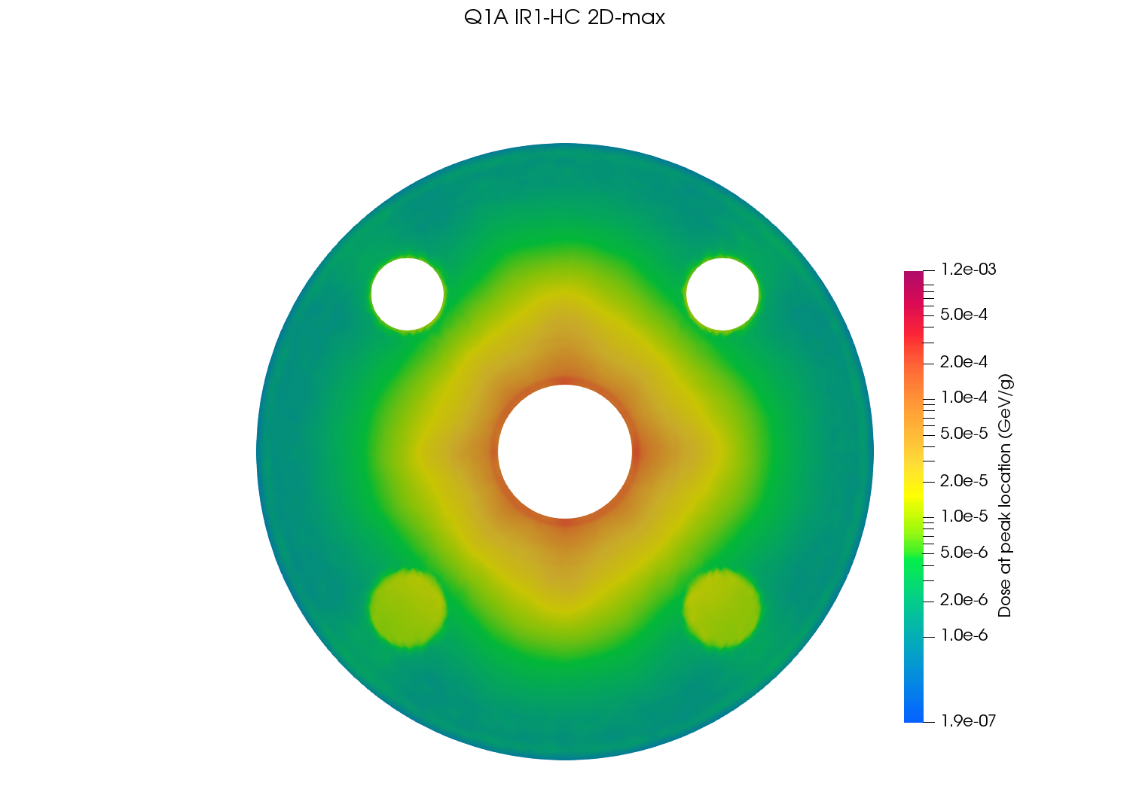
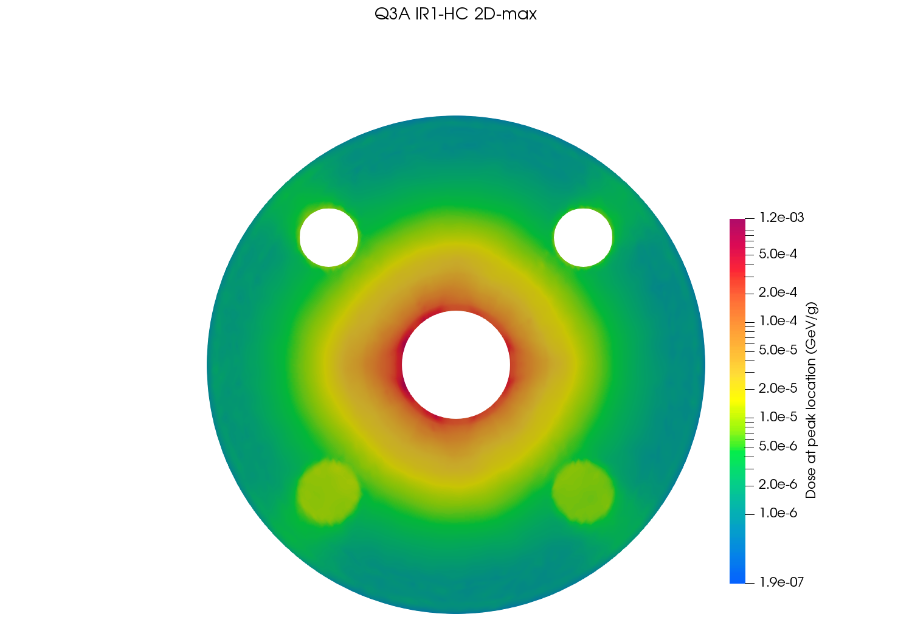
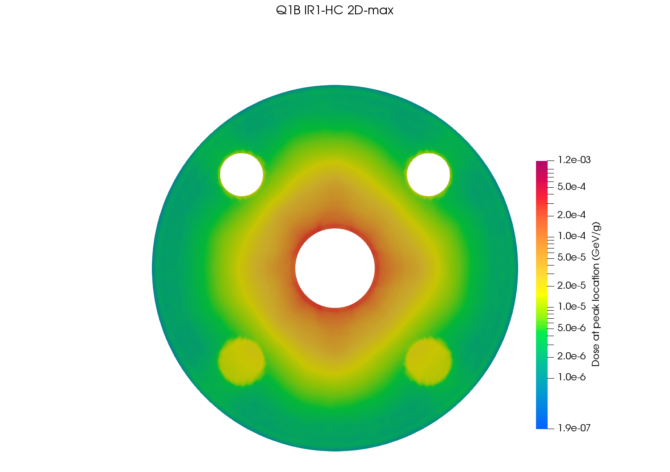
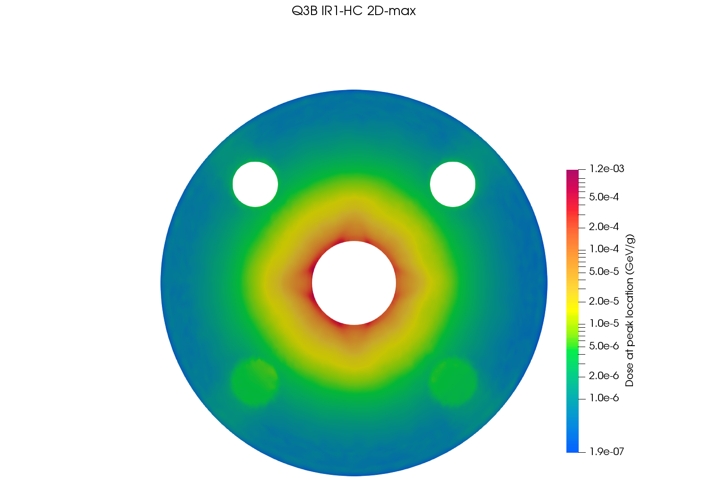
Dose maps at peak location – IR1/HC

Slide 23
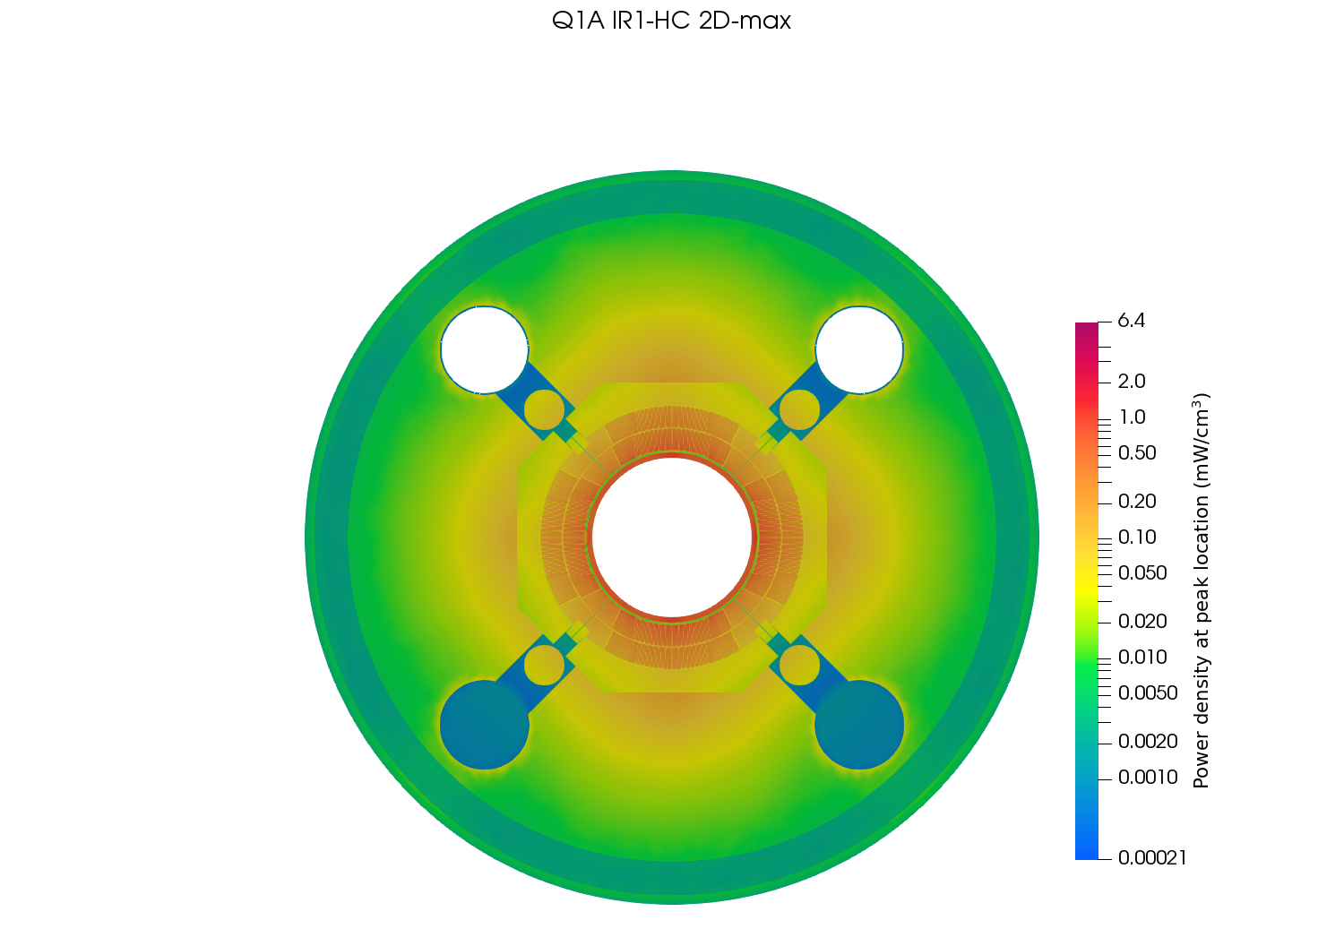
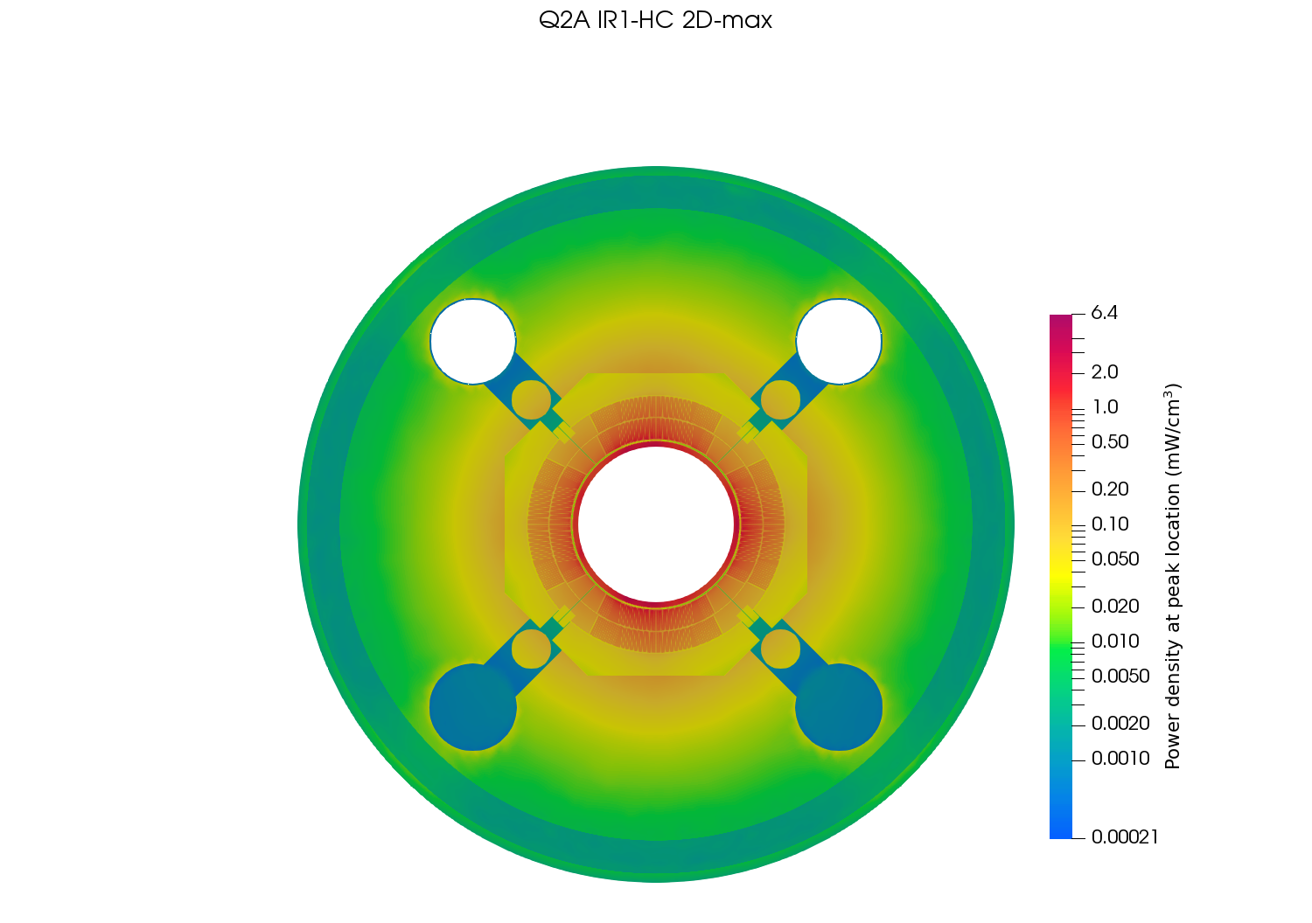
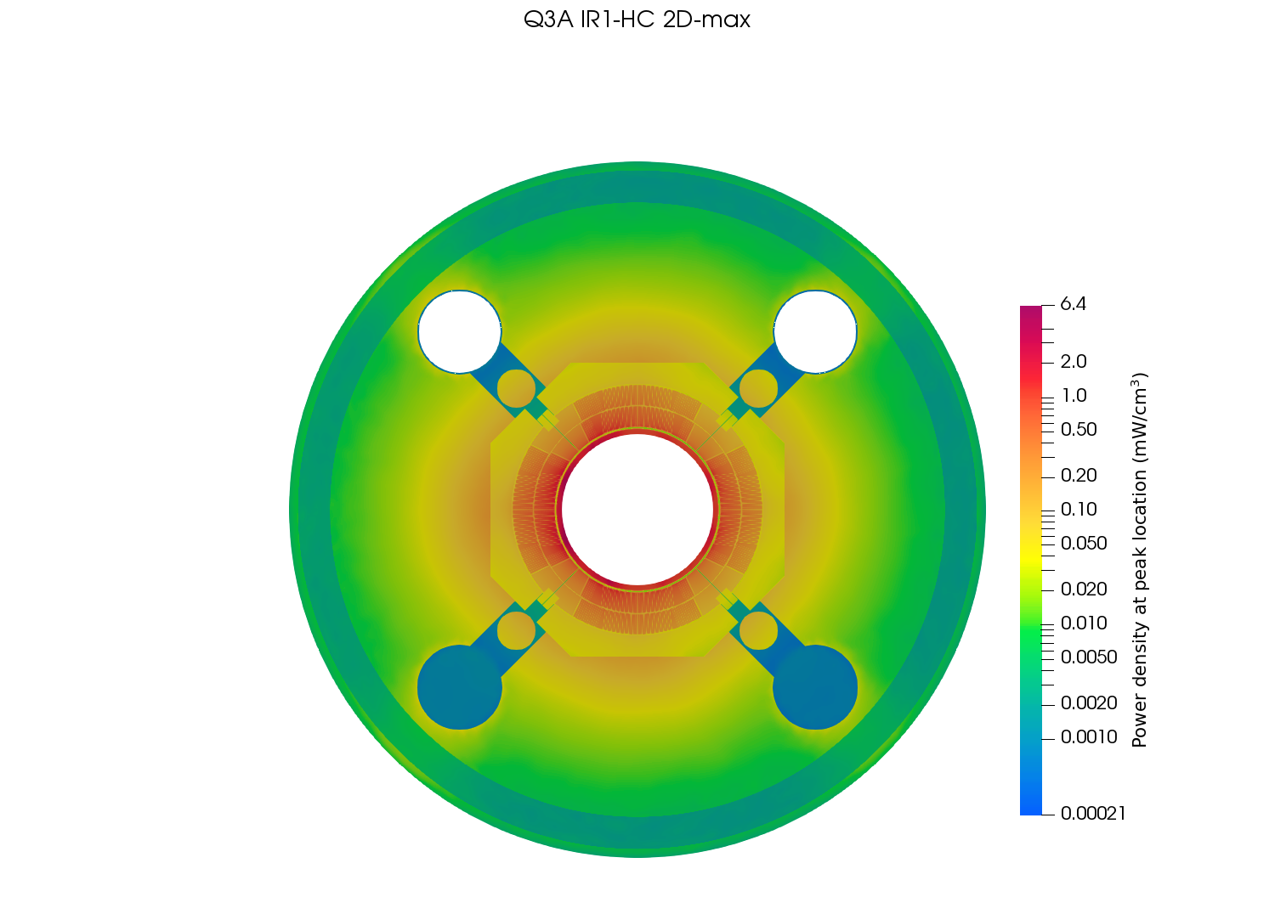
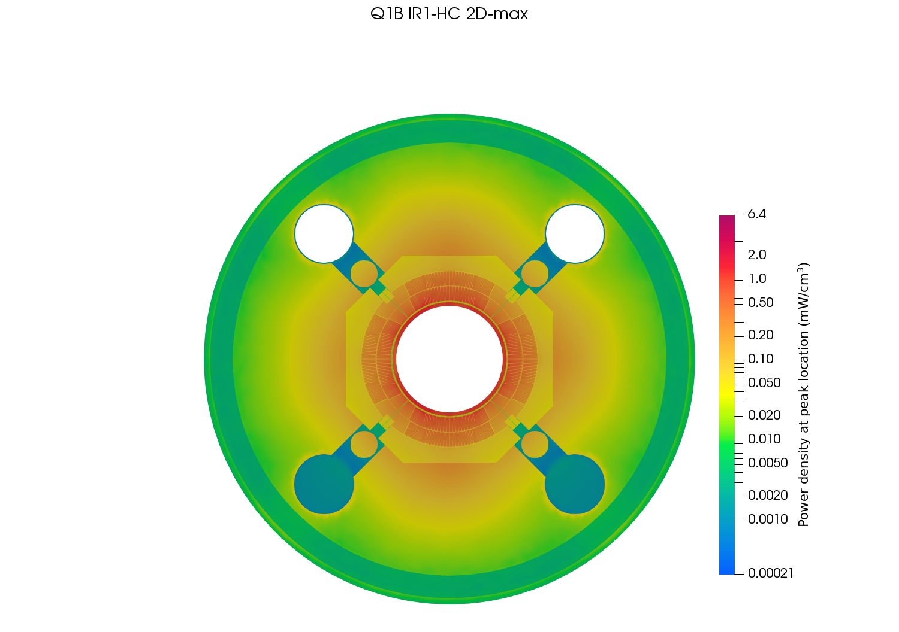
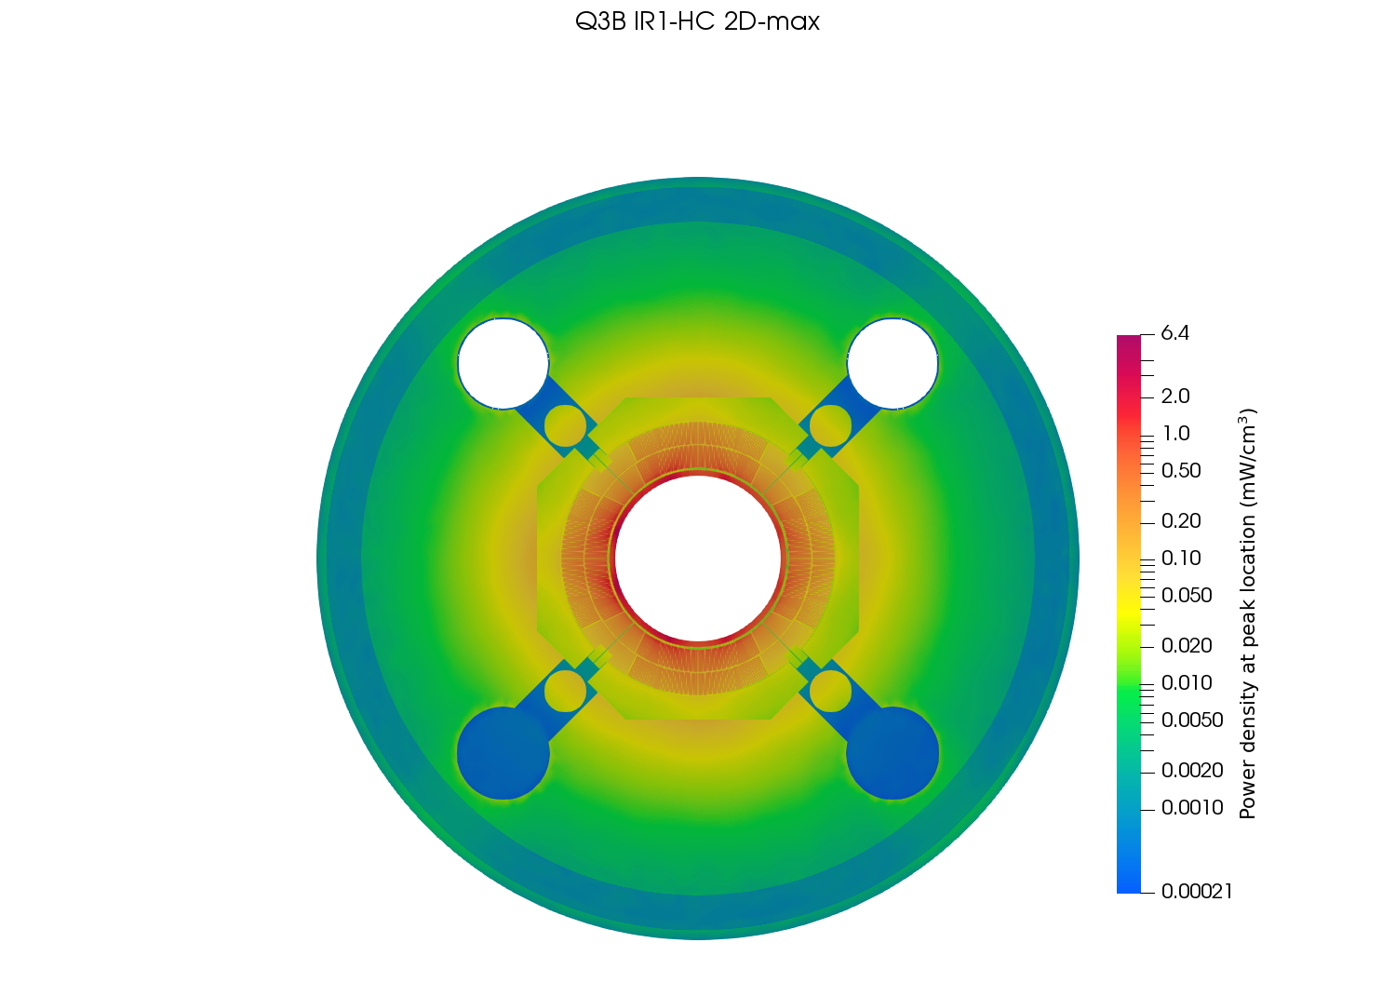
Power deposition at peak location – IR1/HC

Slide 24
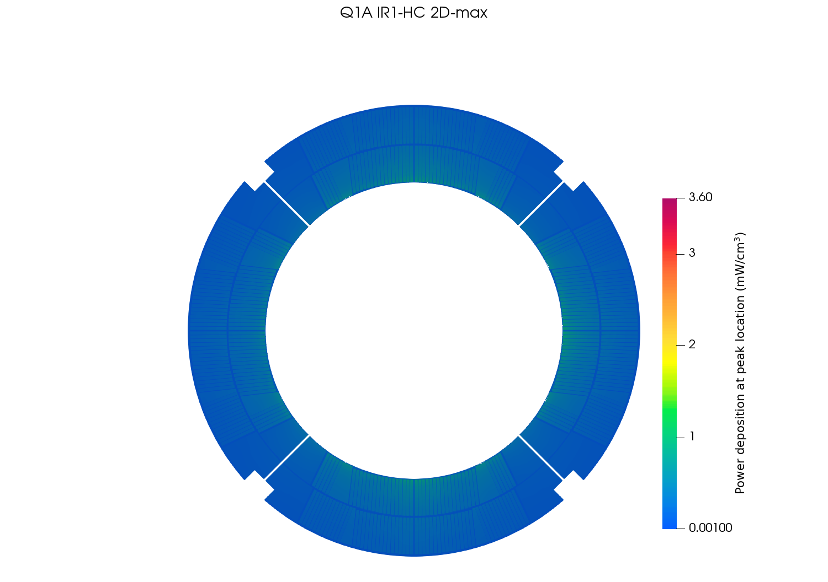
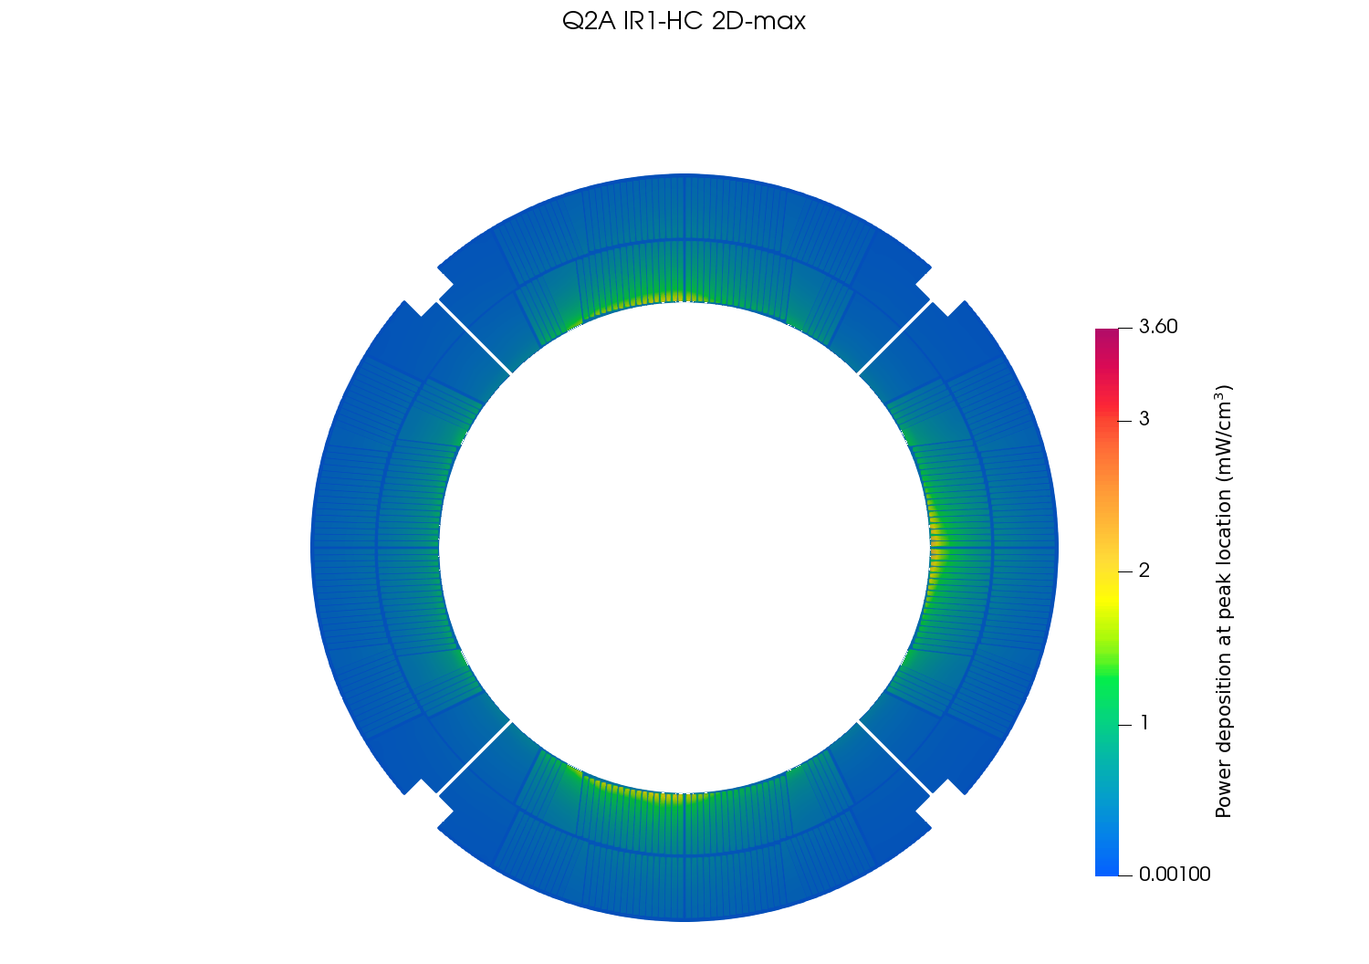
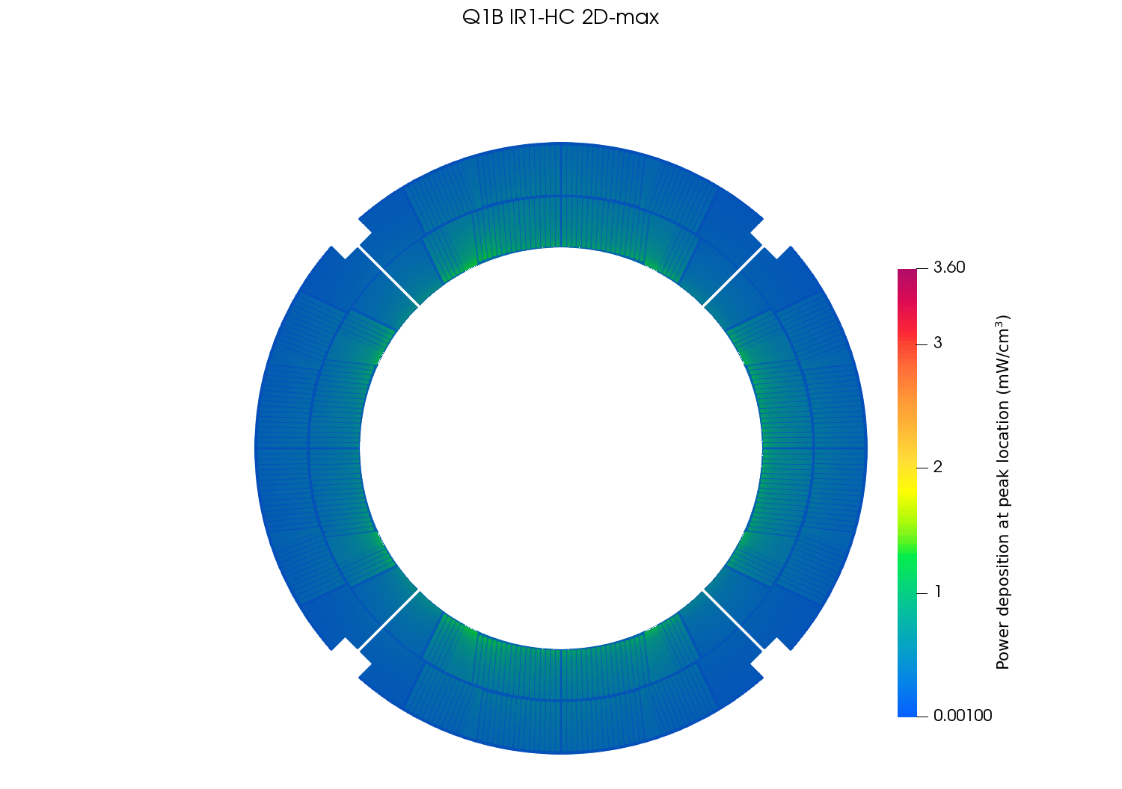
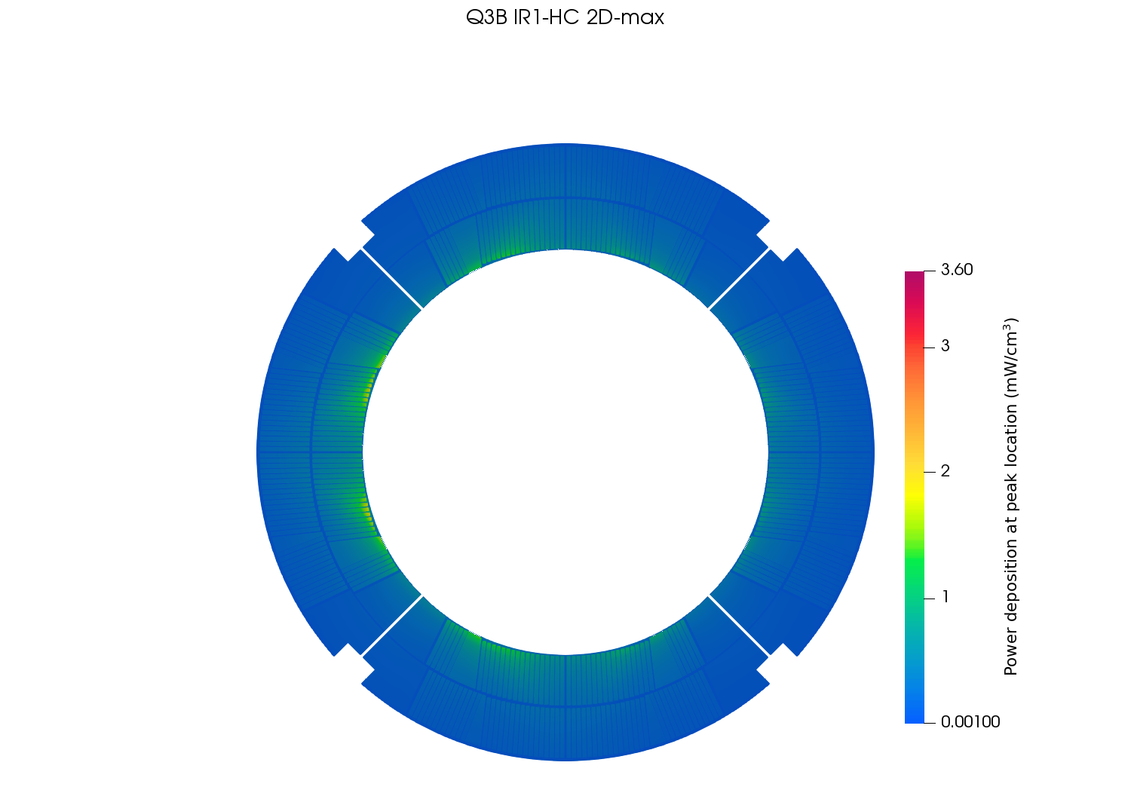
Power deposition at peak location (coil) – IR1/HC

Slide 25
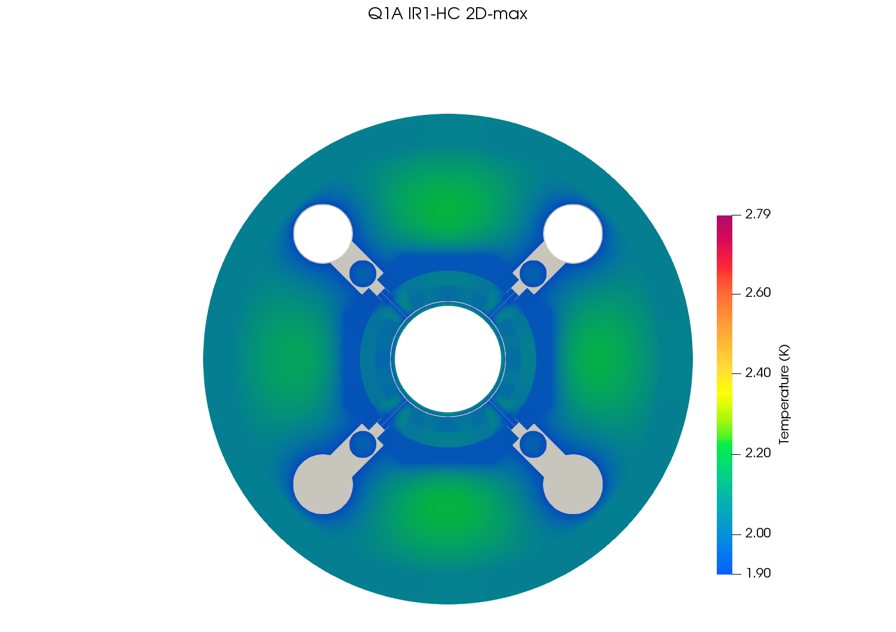
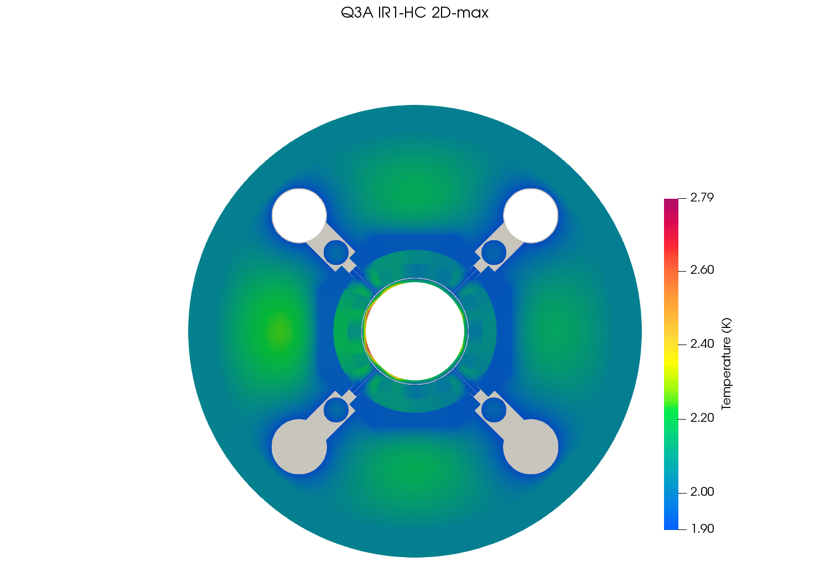
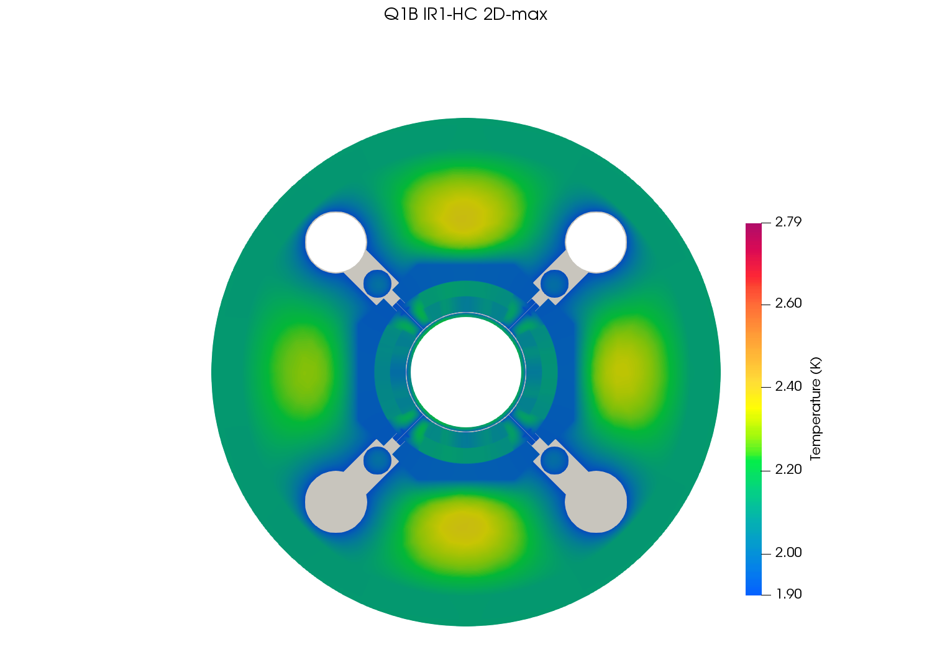
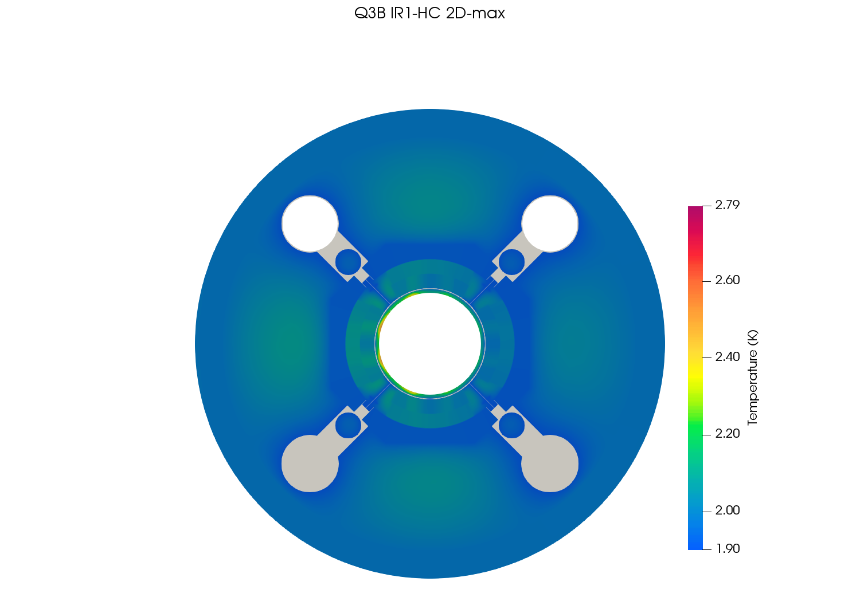
Temperature profile at peak location – IR1/HC

Slide 26
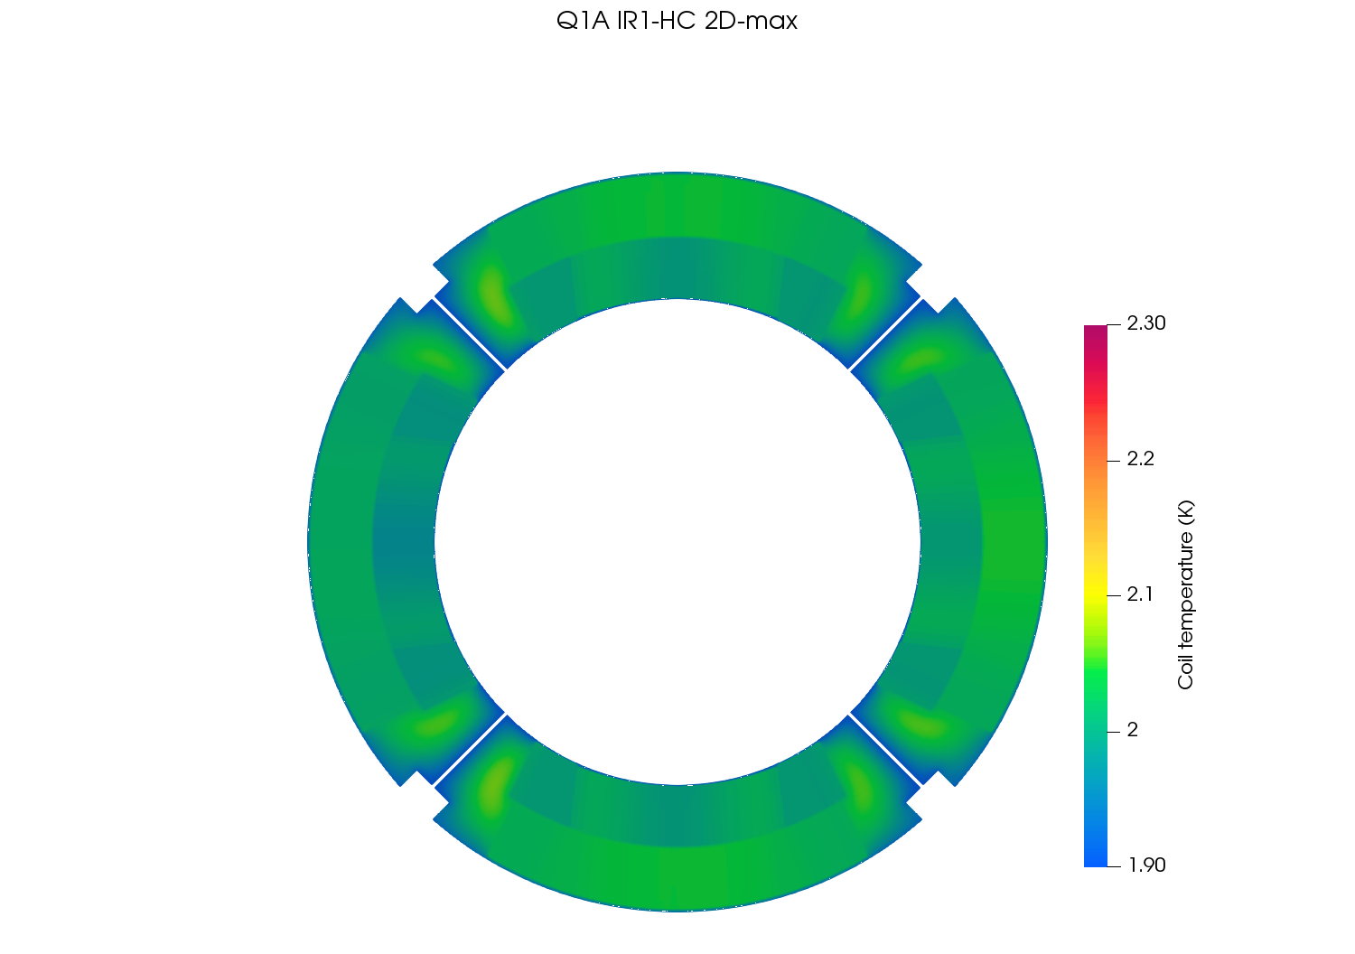
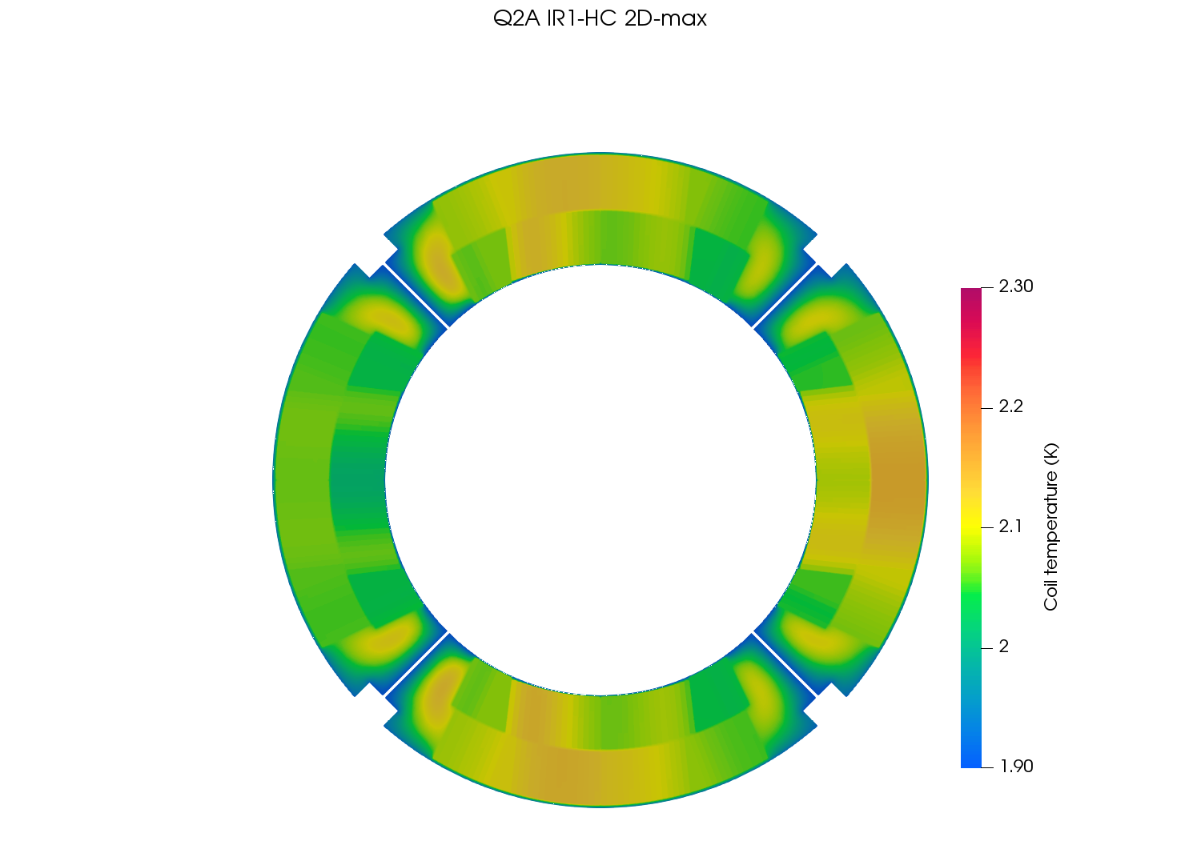
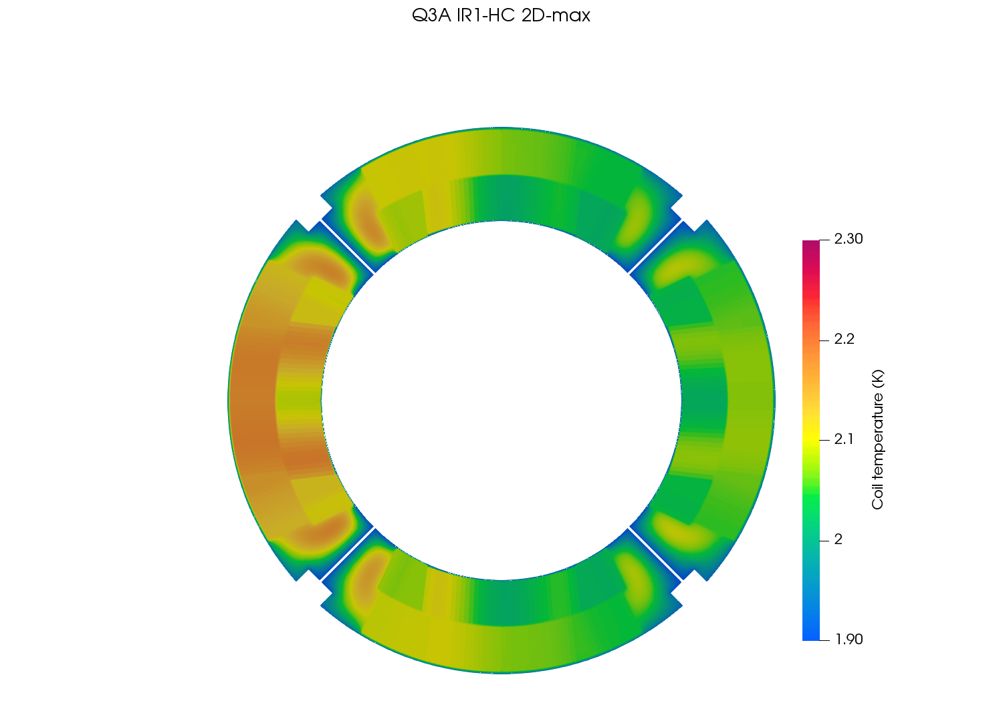
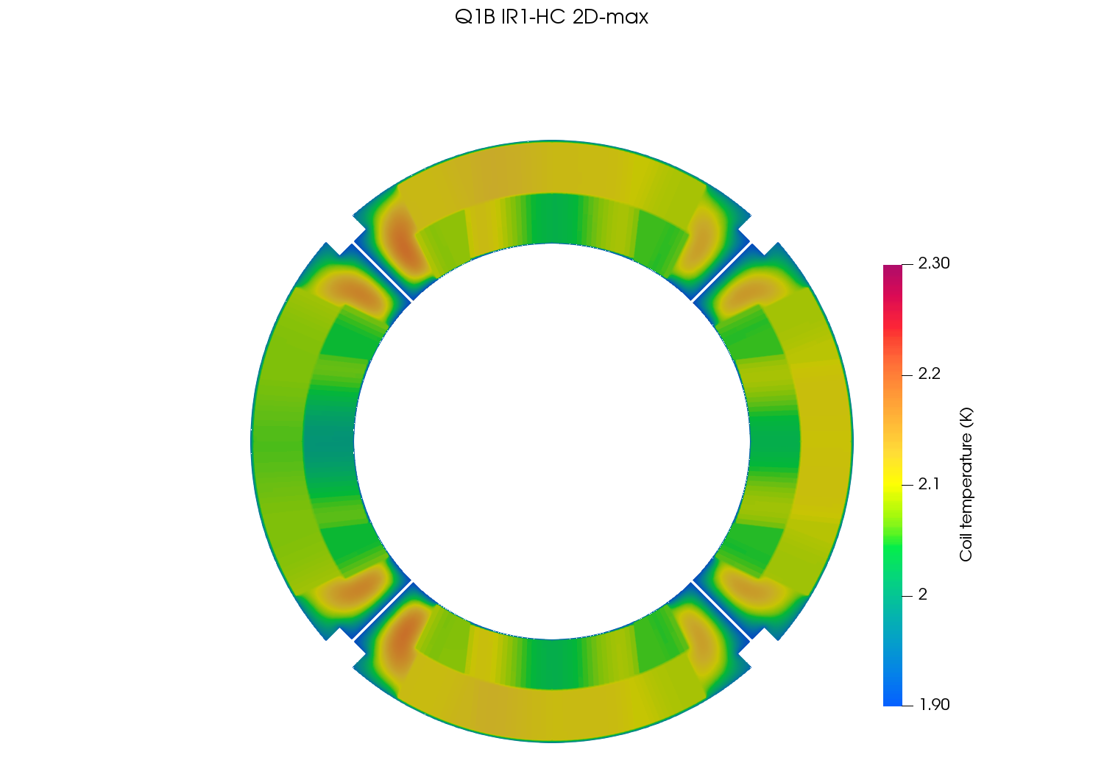
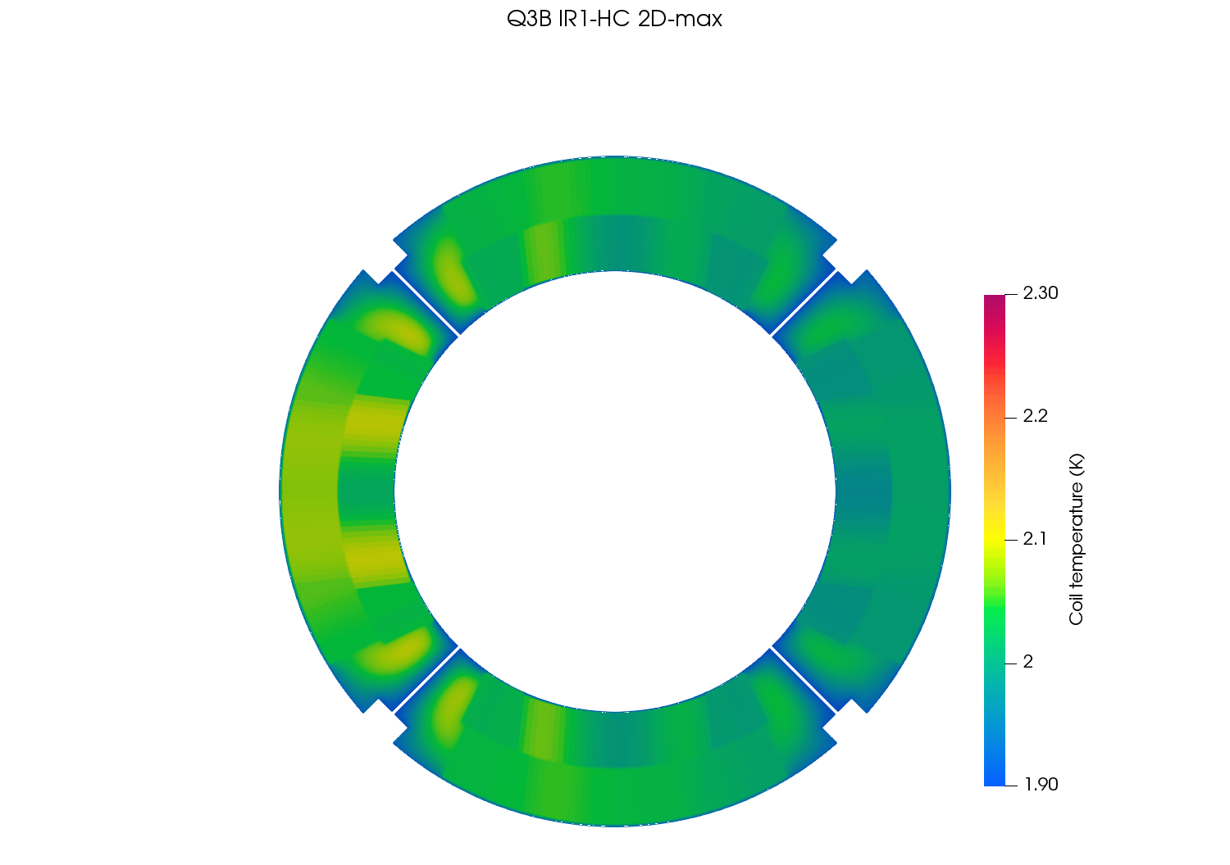
Temperature profile at peak location (coil) – IR1/HC

Slide 27
Results at peak location for IR5/VC Luminosity = 5.0 x 10³⁴ cm⁻²s⁻¹ Energy = 7 TeV
Dose map cold mass in GeV/cm³
Power deposition cold mass in mW/cm³
Power deposition (coil detail) in mW/cm³
Temperature profile cold mass in K
Temperature profile (coil detail) in K

Slide 28
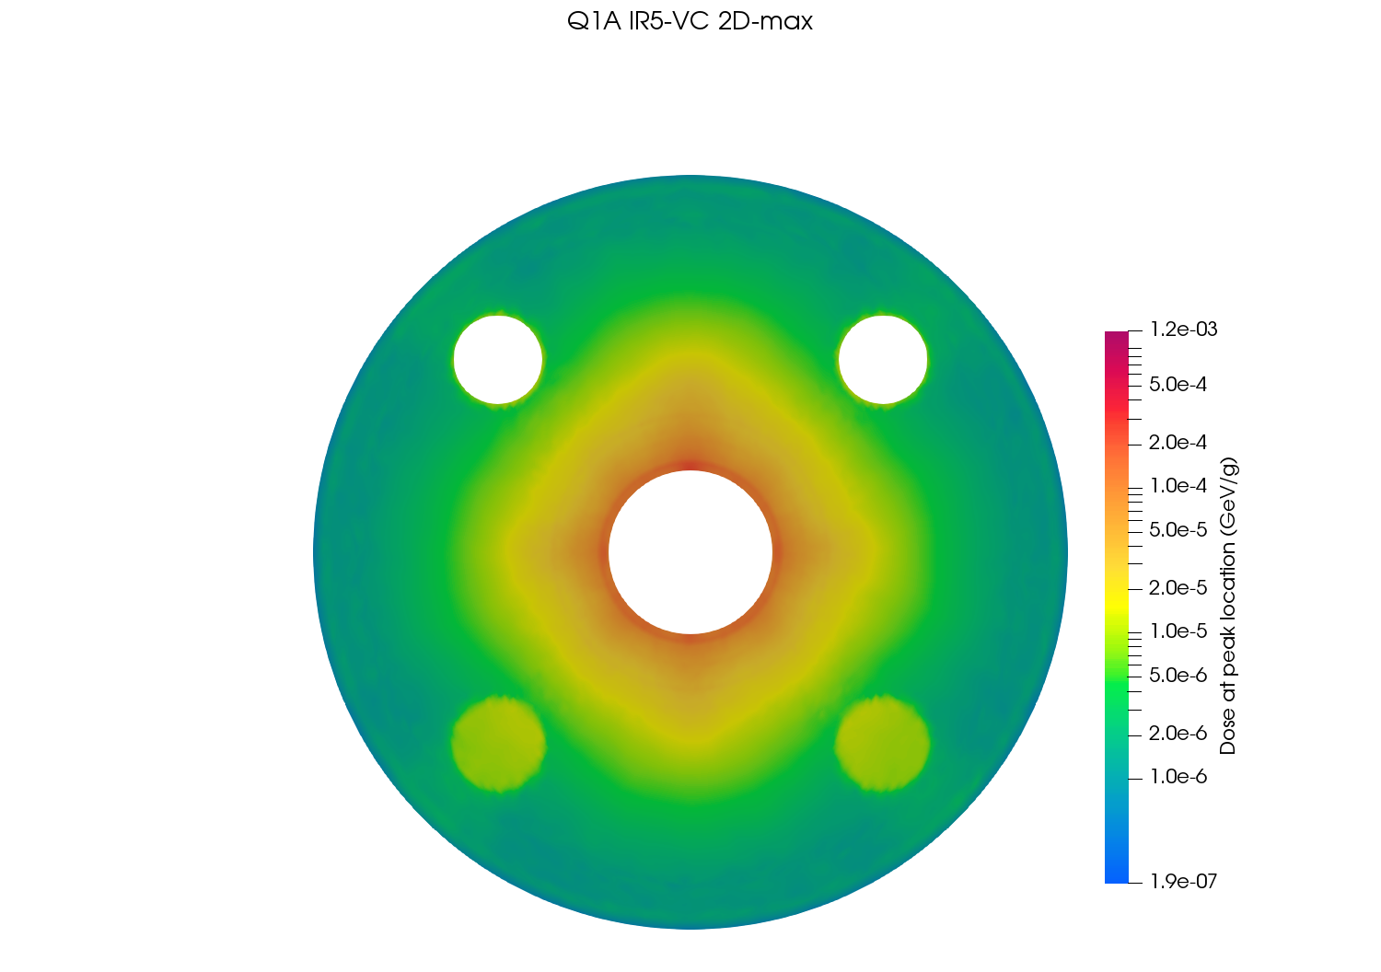
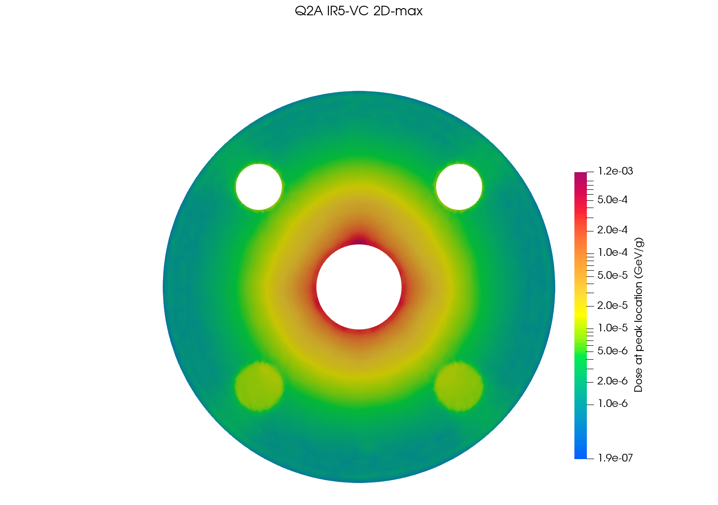
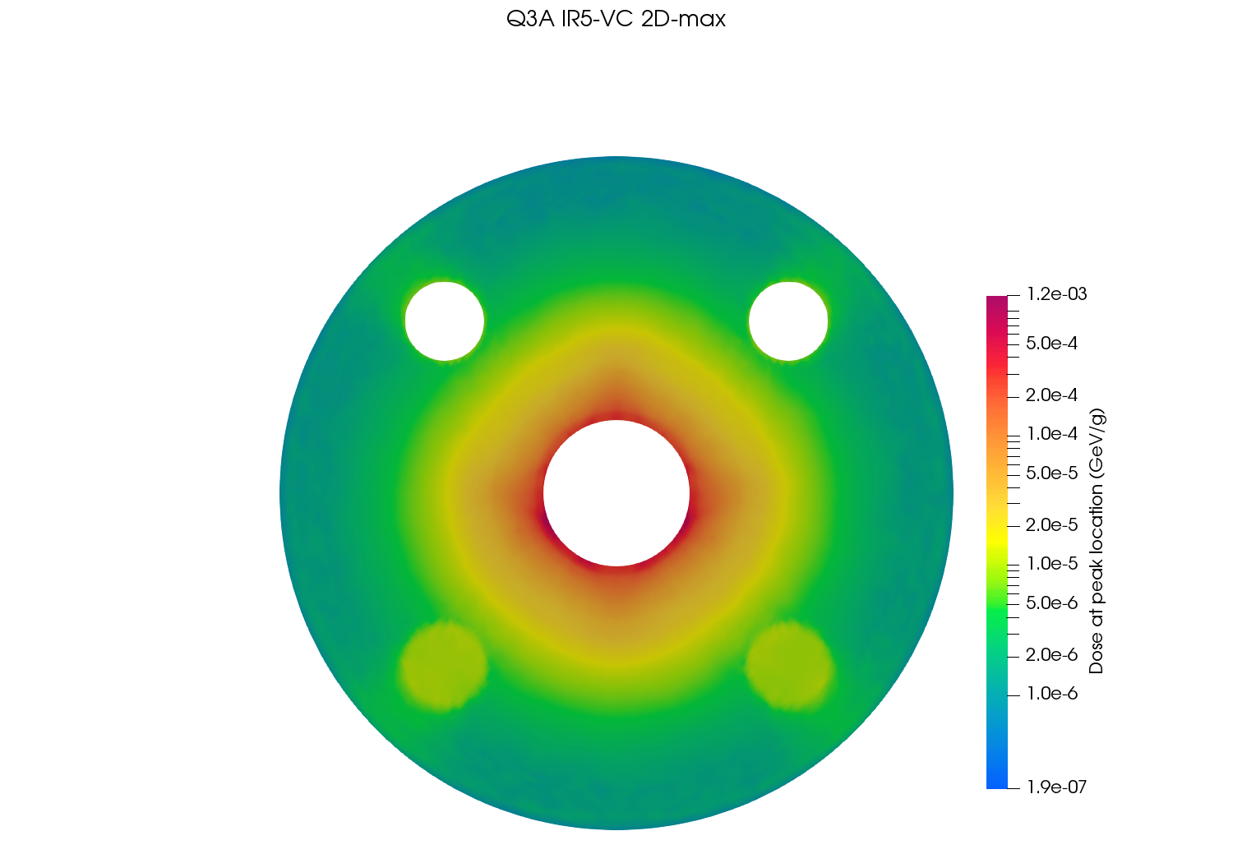
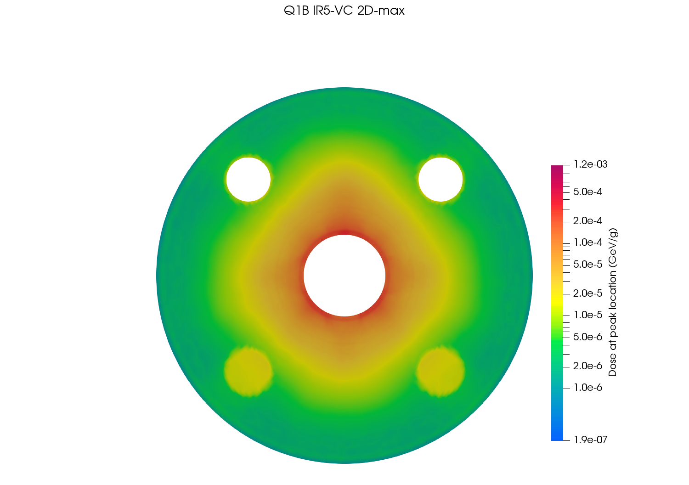
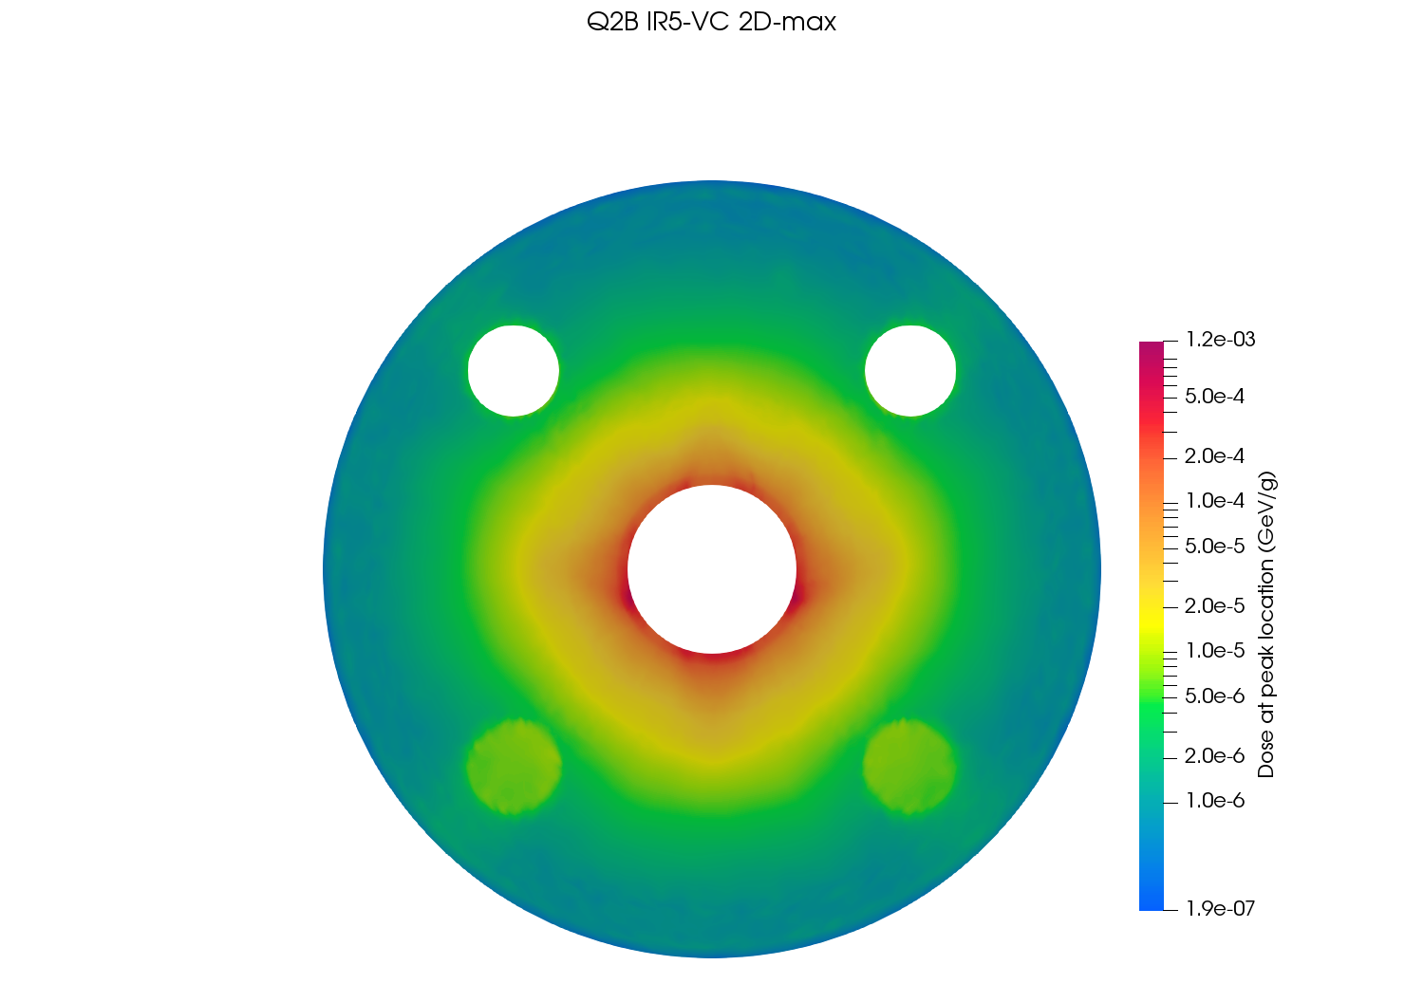
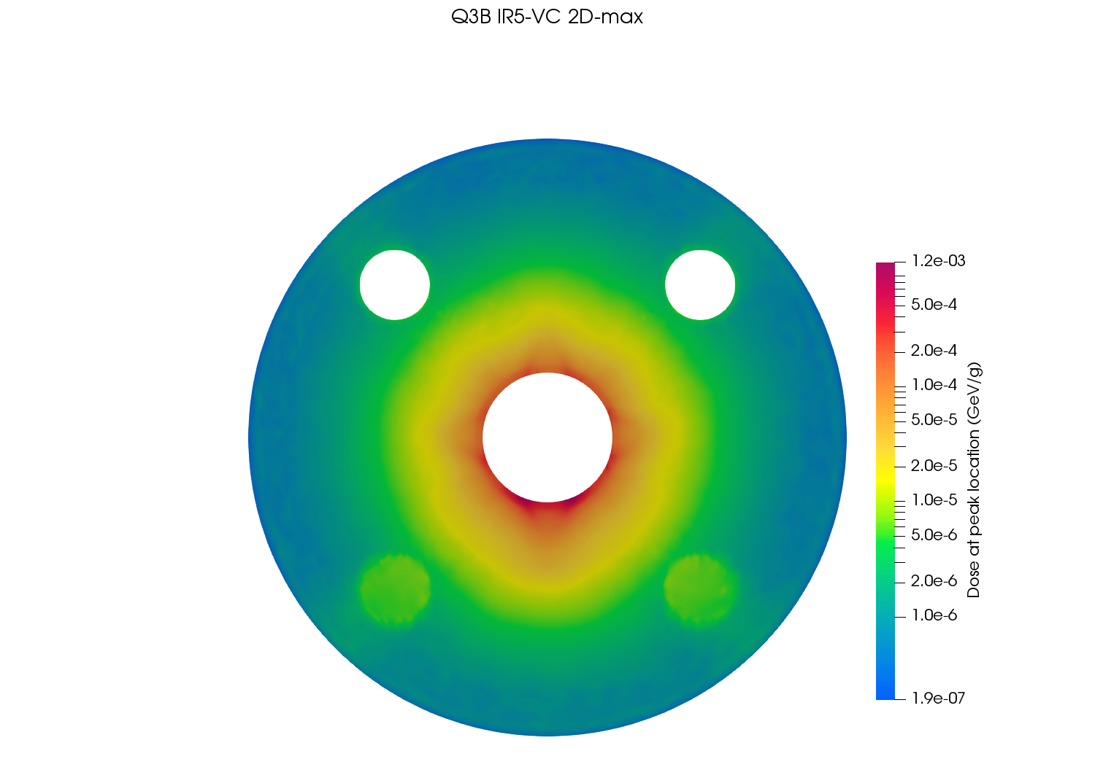
Dose maps at peak location – IR5/VC

Slide 29
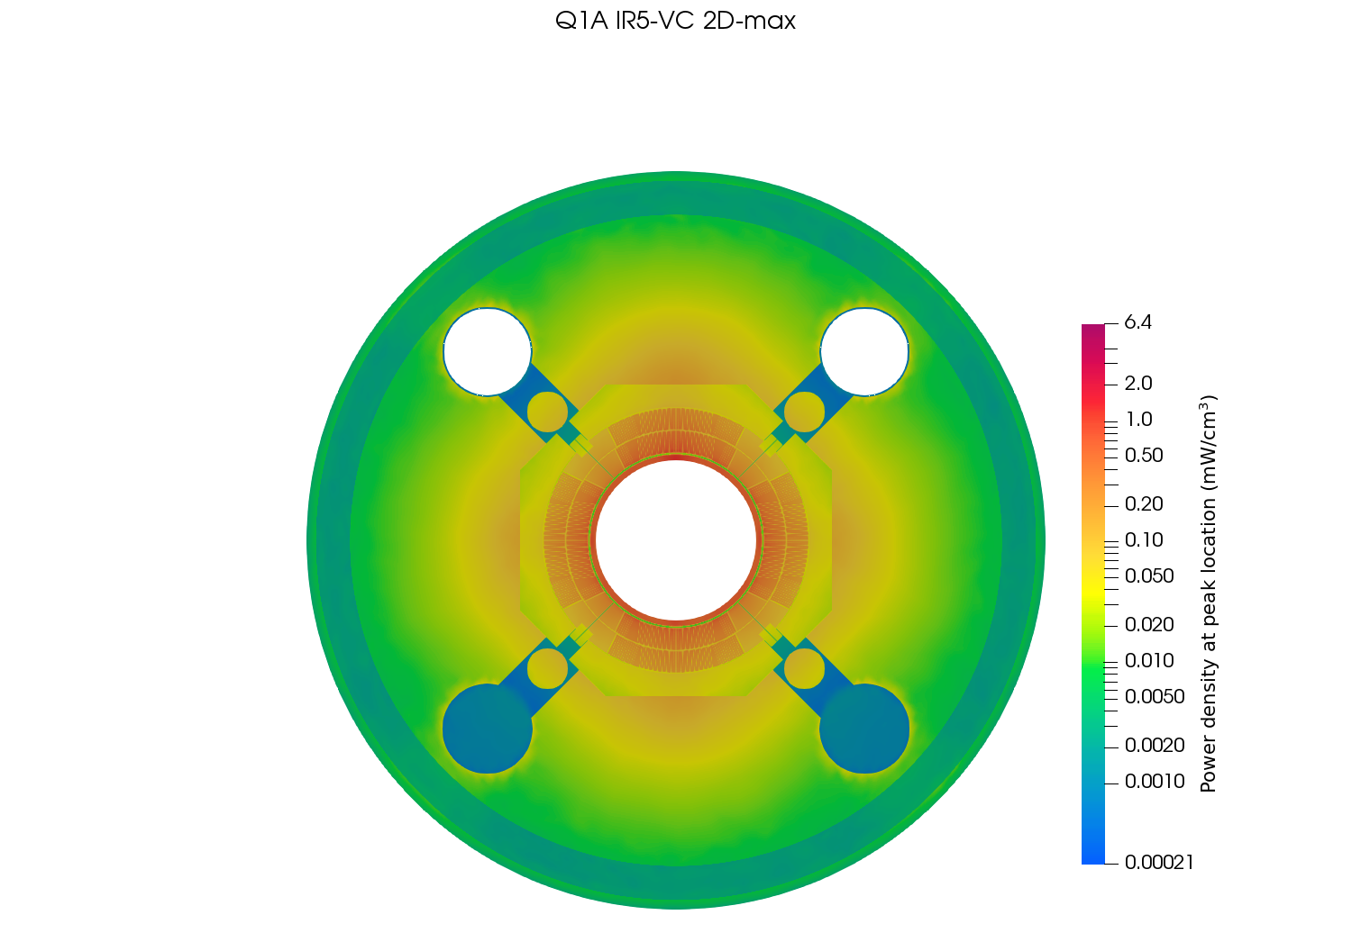
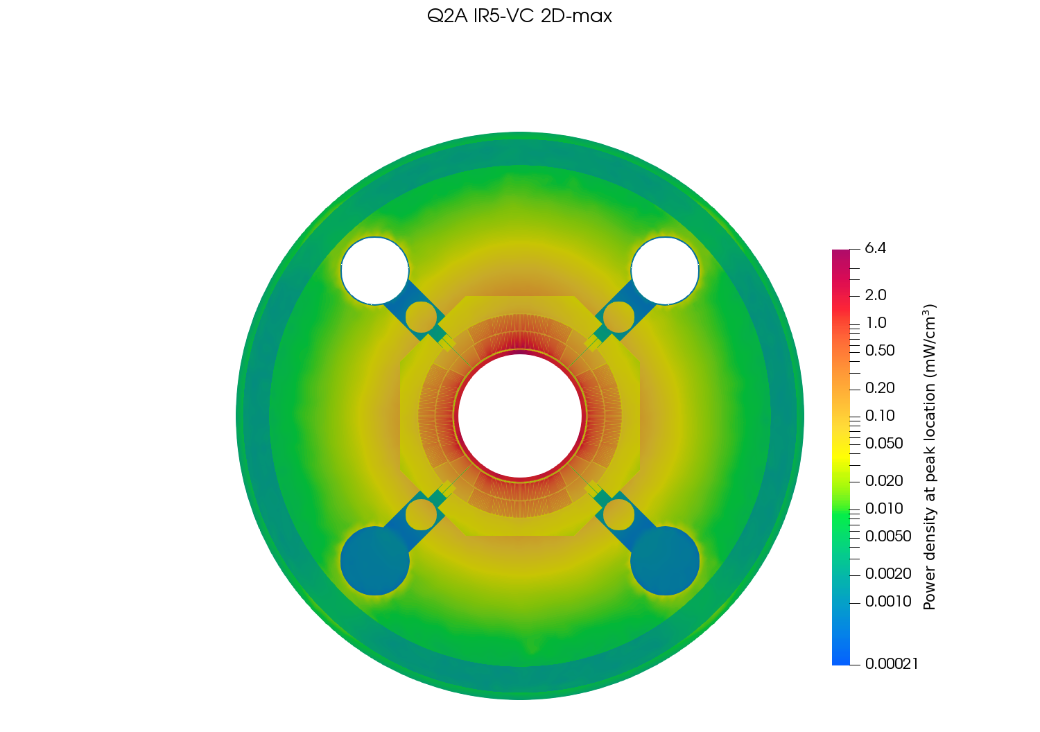
Power deposition at peak location – IR5/VC

Slide 30
Power deposition at peak location (coil) – IR5/VC

Slide 31
Temperature profile at peak location – IR5/VC

Slide 32
Temperature profile at peak location (coil) – IR5/VC

