Slide 1
Heavy Higgs Limits
Alex Schuy

Slide 2
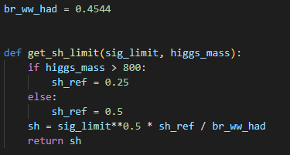
Overview
Simulated with Madgraph + Pythia + Delphes
Process: mu+ mu- > H5z vm vm~, (H5z > w+ w-, w+ > j j, w- > j j)
100k events
Mass = (500, 600, 700, 800, 900, 1000, 2000, 3000) GeV
Same delphes card, etc. as for EFT study
Same event selection as for nunu channel of EFT study
6/10/30 TeV CM energy

Slide 3
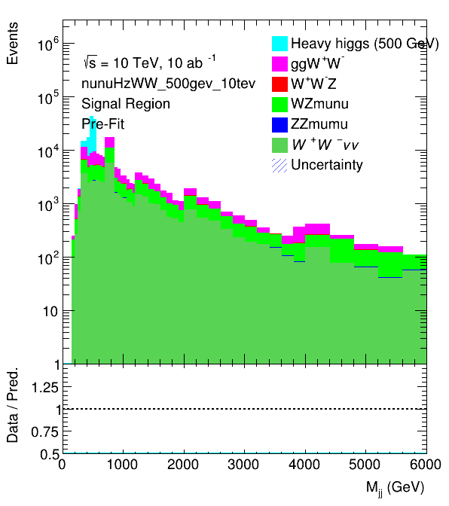
Input Histograms

Slide 4
sh limits
Higgs mass (GeV) | sh limits (6 TeV CM) | sh limits (10 TeV CM) | sh limits (30 TeV CM)
500 | $$0.11$$ | $$0.071$$ | $$0.062$$
600 | $$0.075$$ | $$0.048$$ | $$0.042$$
700 | $$0.059$$ | $$0.038$$ | $$0.034$$
800 | $$0.043$$ | $$0.029$$ | $$0.026$$
900 | $$0.069$$ | $$0.045$$ | $$0.041$$
1000 | $$0.055$$ | $$0.036$$ | $$0.034$$
2000 | $$0.018$$ | $$0.012$$ | $$0.011$$
3000 | $$0.012$$ | $$0.006$$ | $$0.006$$

