Slide 1
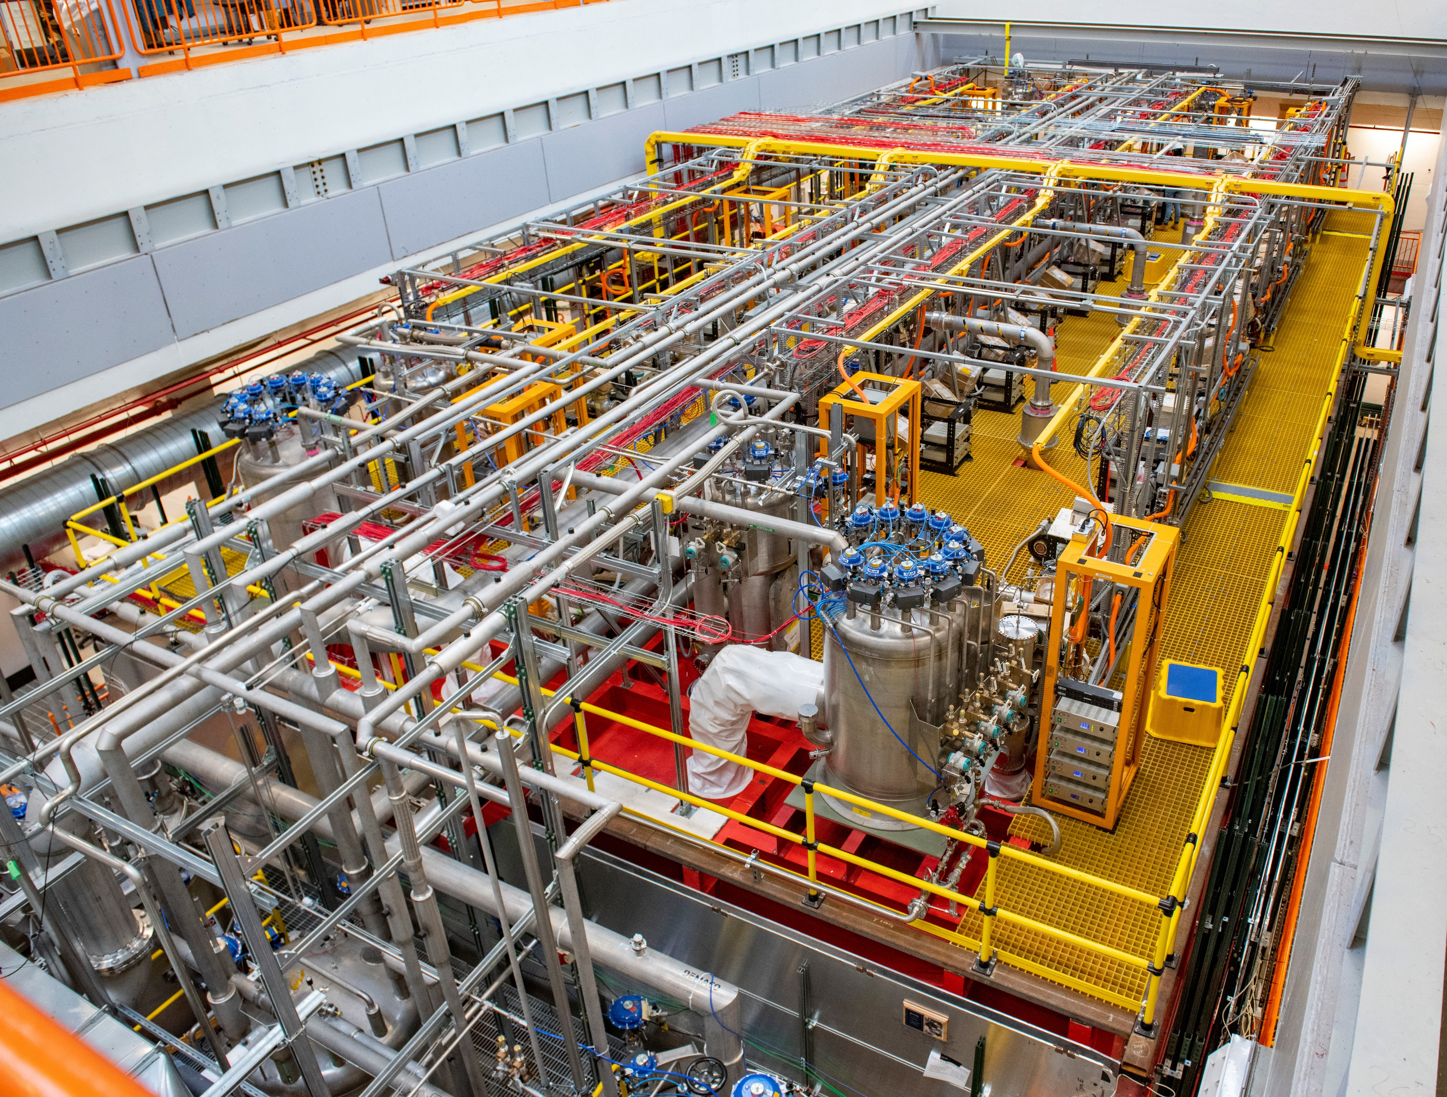
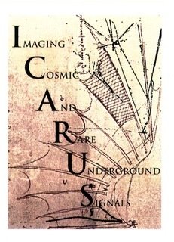


ICARUS
Towards the Physics Run
F. Poppi
(INFN and University of Bologna)
On behalf of the ICARUS Collaboration
FNAL 55° Annual Users Meeting

Slide 2
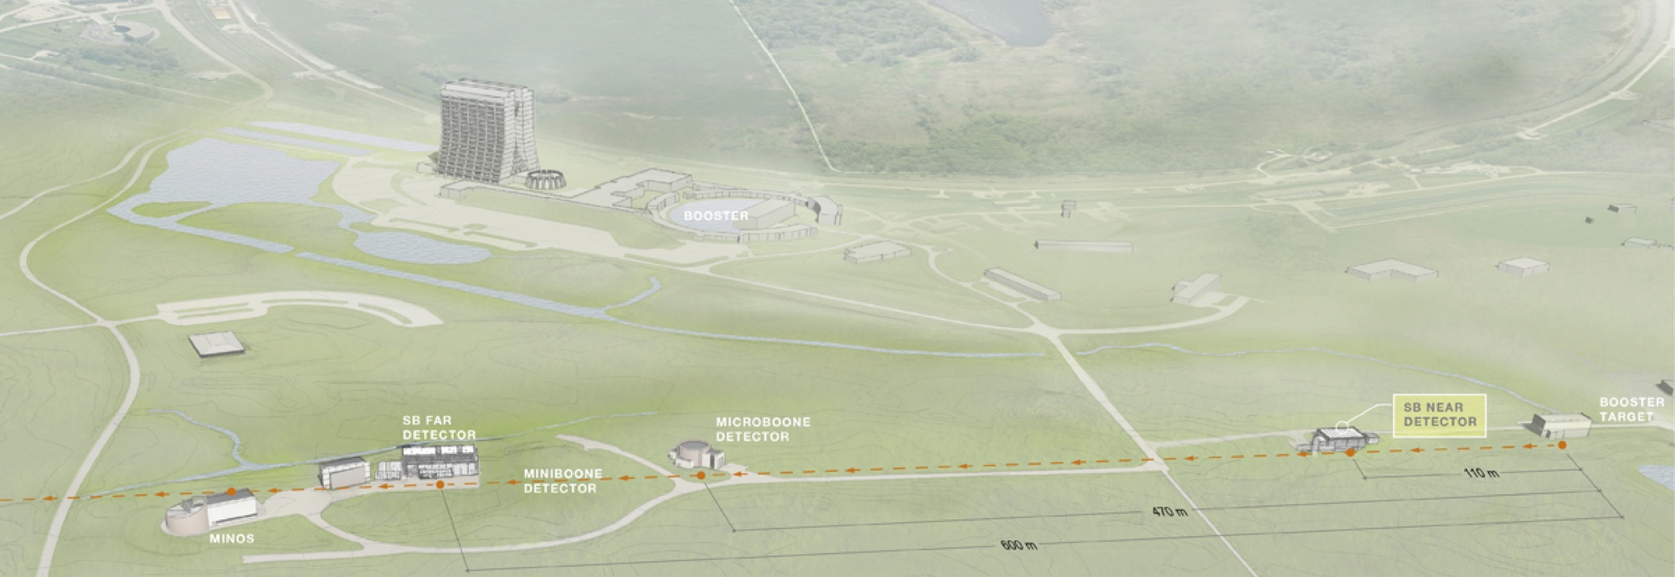
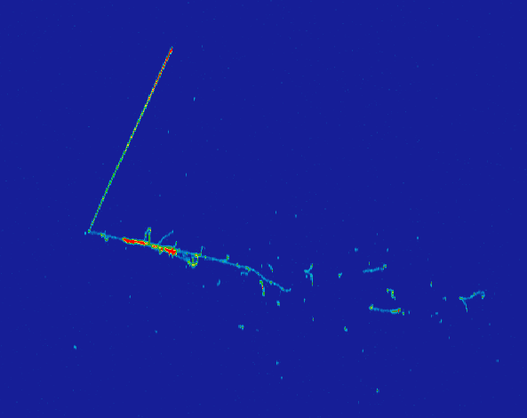
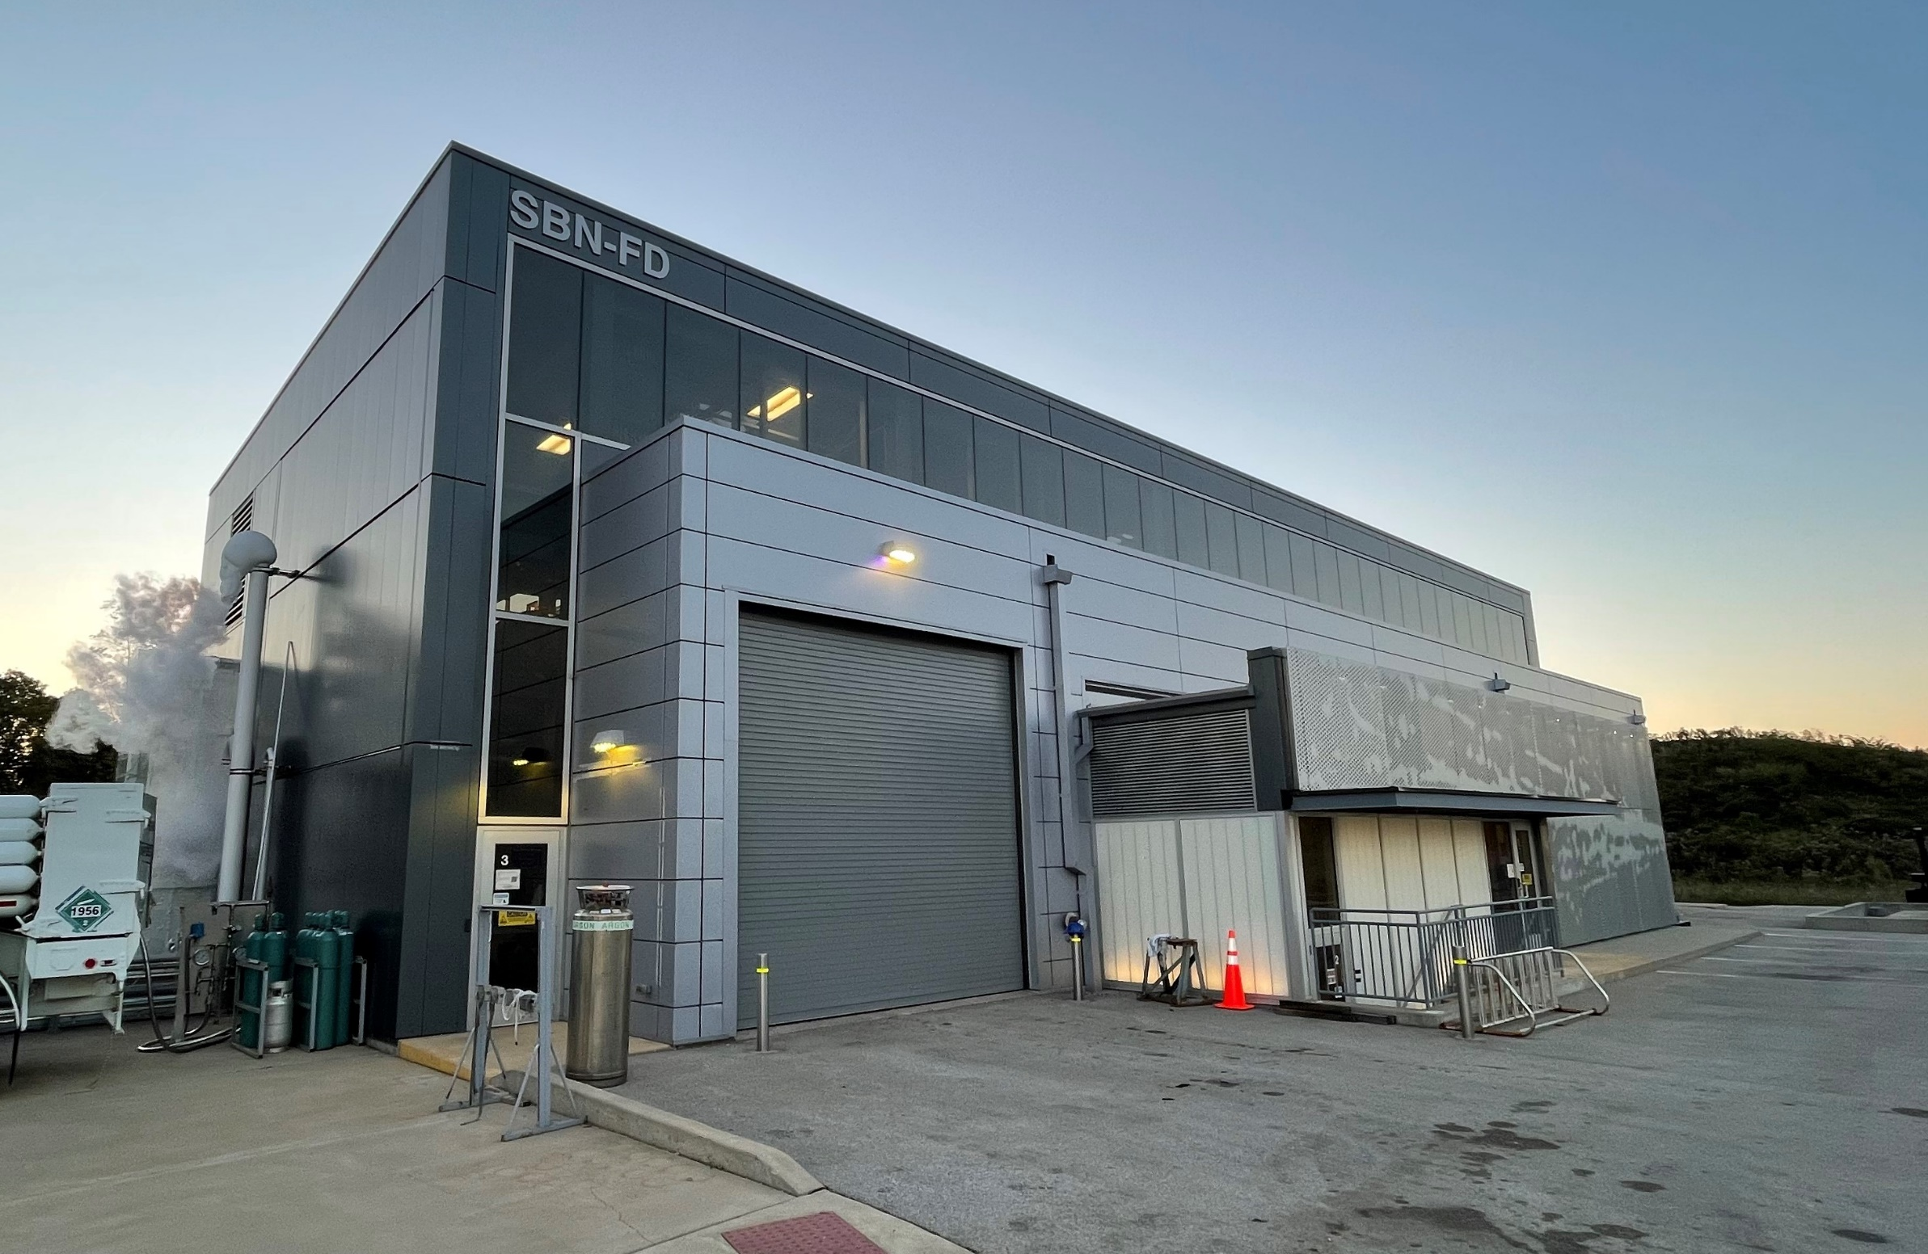
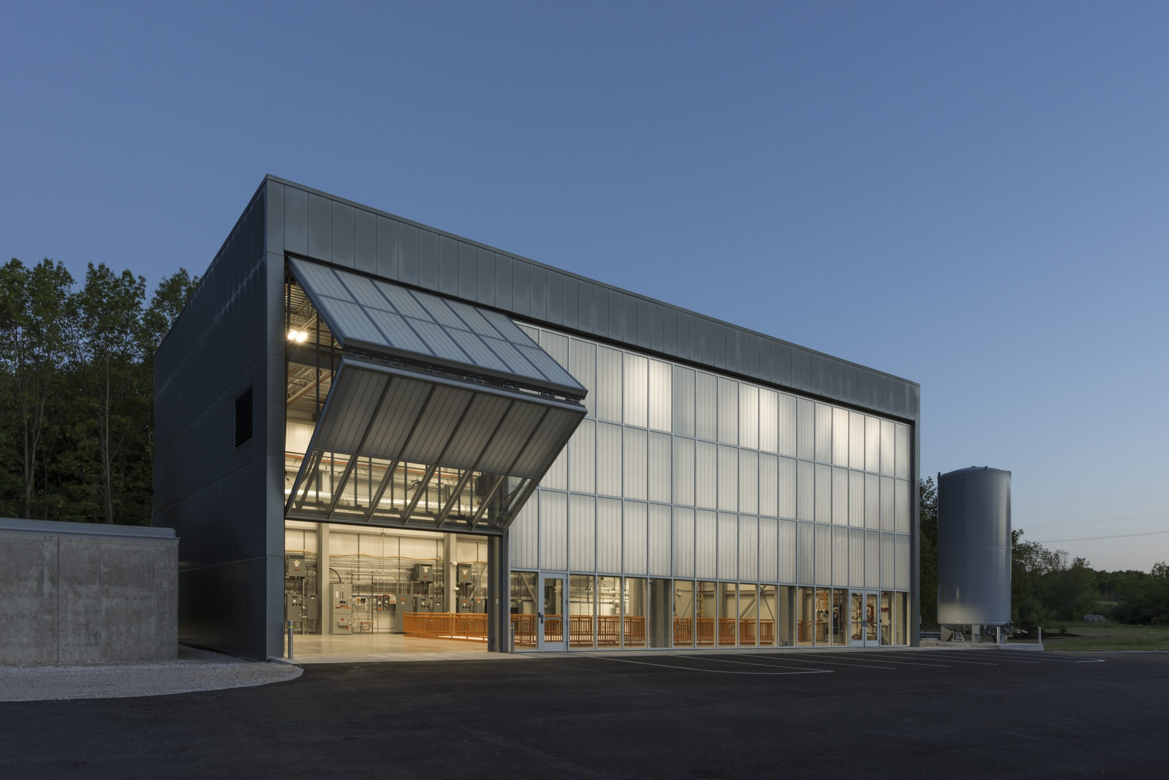
MI60
NuMI
SBN ND
MI12
BNB
Soudan
ICARUS is the Far Detector in the Short Baseline Neutrino Program (SBN) at FNAL.
SBN consists of three liquid argon TPCs (LArTPCs) sampling the same neutrino beam (BNB) at different distances, searching for sterile neutrino oscillations at the ~eV² mass scale.
It is also located 6 degrees off-axis on NuMI beam, accessing the electron-neutrino rich component of the spectrum.
NuMI grants ICARUS the access to a rich physics program including the study of the Neutrino-4 anomaly,
ν-Ar cross-section measurements and rich BSM searches (Higgs portal scalars, neutrino tridents, light dark matter, …).

Slide 3
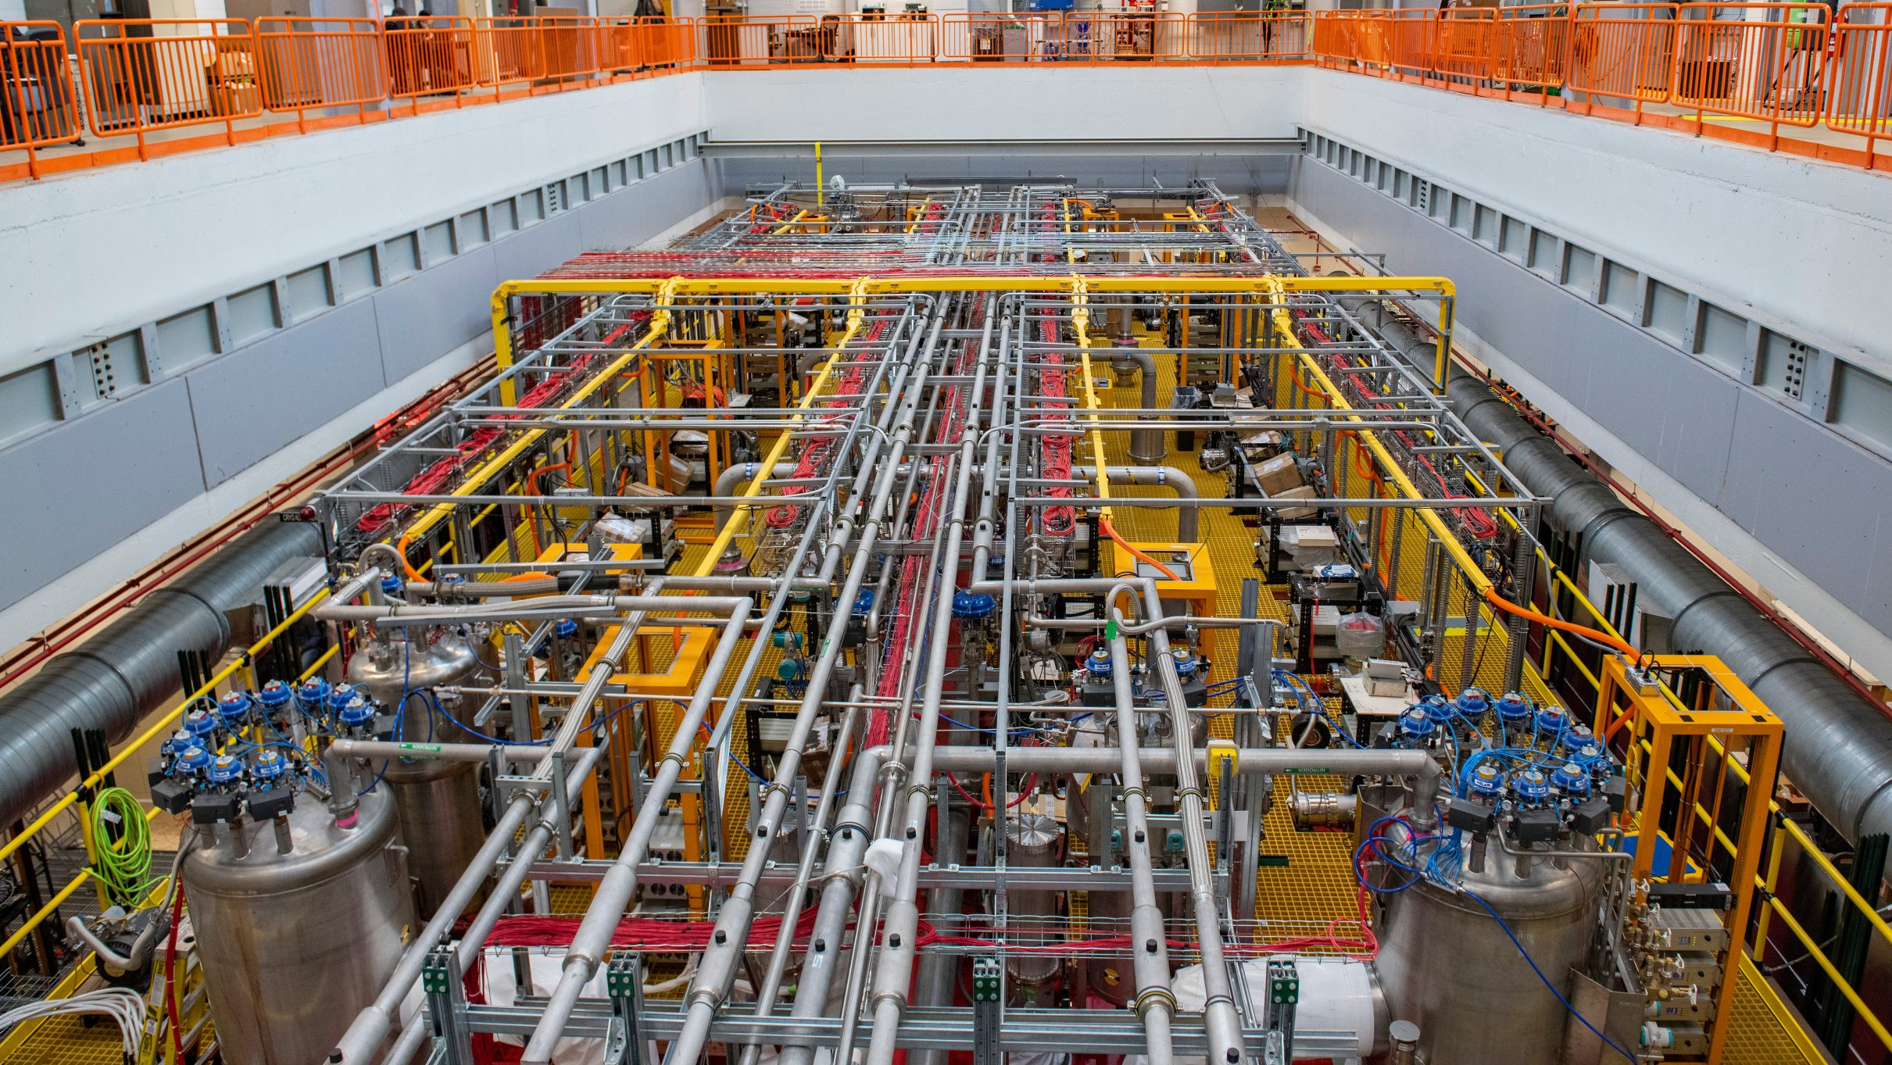

SBN Program
The SBN program will test the light sterile neutrino hypothesis, providing a definitive coverage of the LSND/MiniBooNE anomaly parameter space in 3 years.
SBN will probe simultaneously both the $ν_{e}$ appearance and the $ν_{μ}$ disappearance channels.

Slide 4
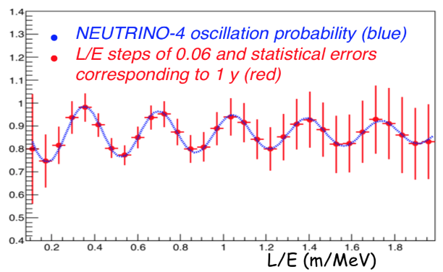


Neutrino-4 oscillation signal
The Neutrino-4 collaboration claimed a reactor neutrino disppearance signal with a modulation with L/E ~1-3 m/MeV.
ICARUS can confirm or refute the Neutrino-4 anomaly by means of two different channels:
- $ν_{μ}$ disappearance channel from BNB focusing on QE contained $ν_{μ}$CC;
- $ν_{e}$ disappearance channel in the NuMI beam, selecting QE contained $ν_{e}$CC.
By complementing these channels with off-beam sample, ICARUS can observe such a modulation in less then one year.
$ν_{e}$ survival probability and ICARUS measurements, assuming 1 year data taking for Neutrino-4 best fit

Slide 5
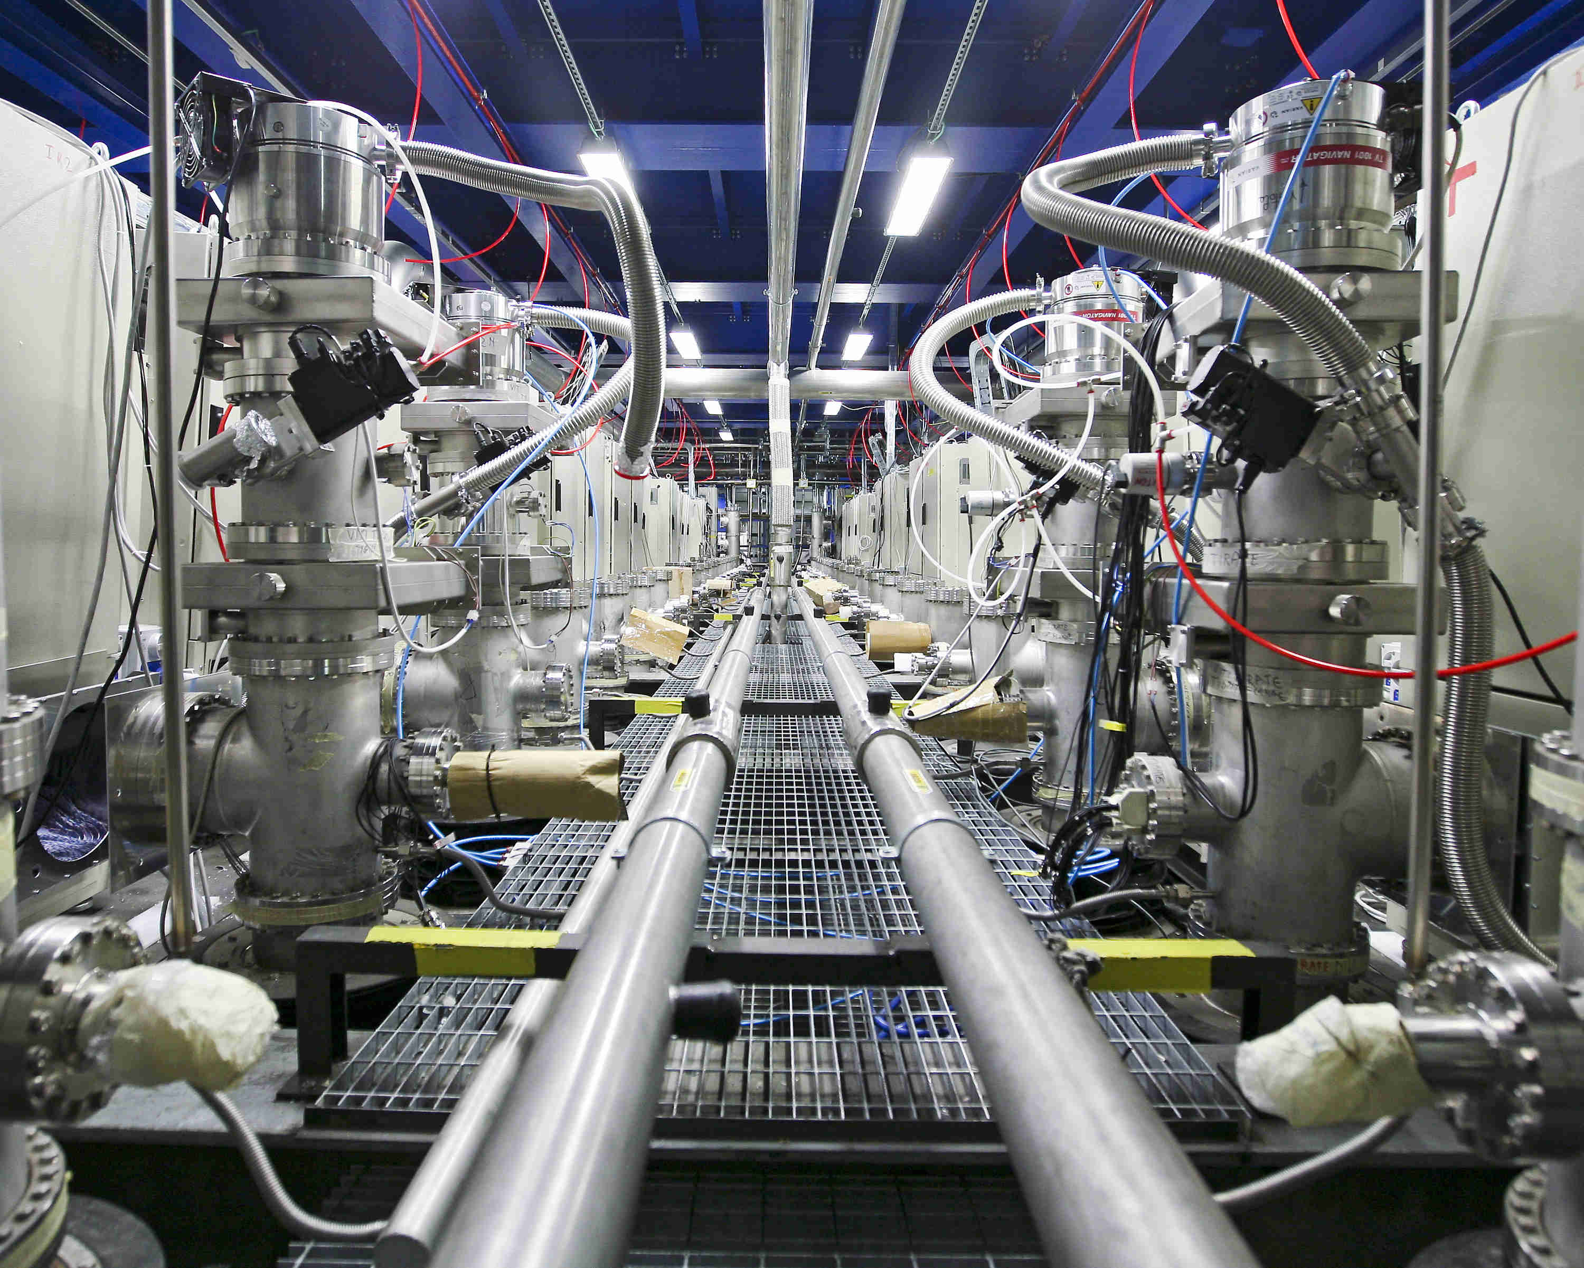
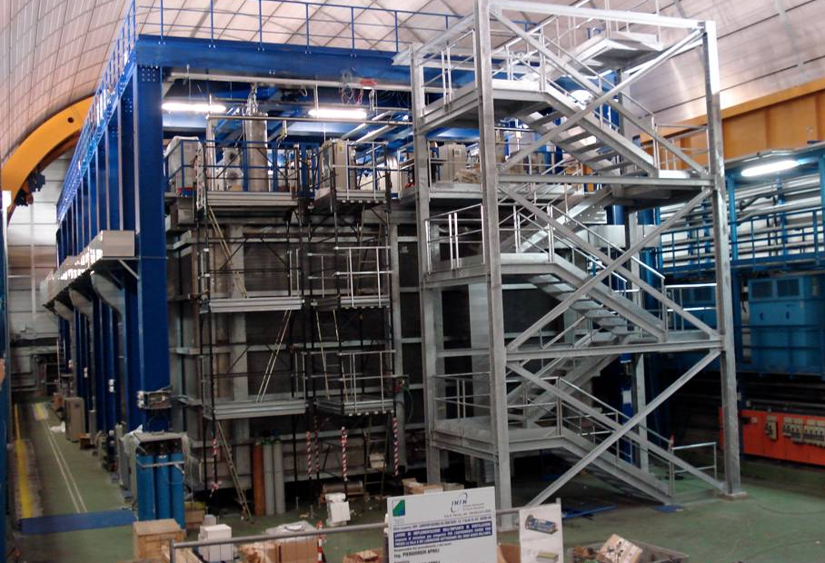
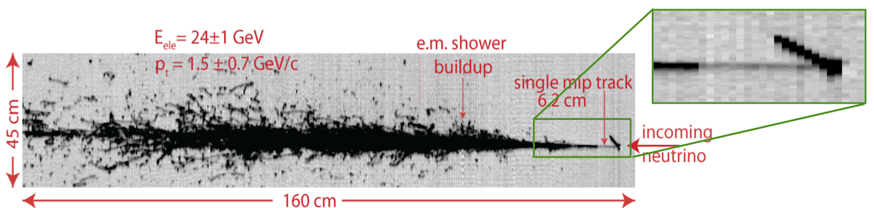
ICARUS first life
The Liquid-Argon Time Projection Chamber:
a new concept for neutrino detectors (C. Rubbia)
First test runs at Pavia
ICARUS T600 begins operations at Gran Sasso
ICARUS ends operations at Gran Sasso
16 May 1977
2001
2010
2014

Slide 6
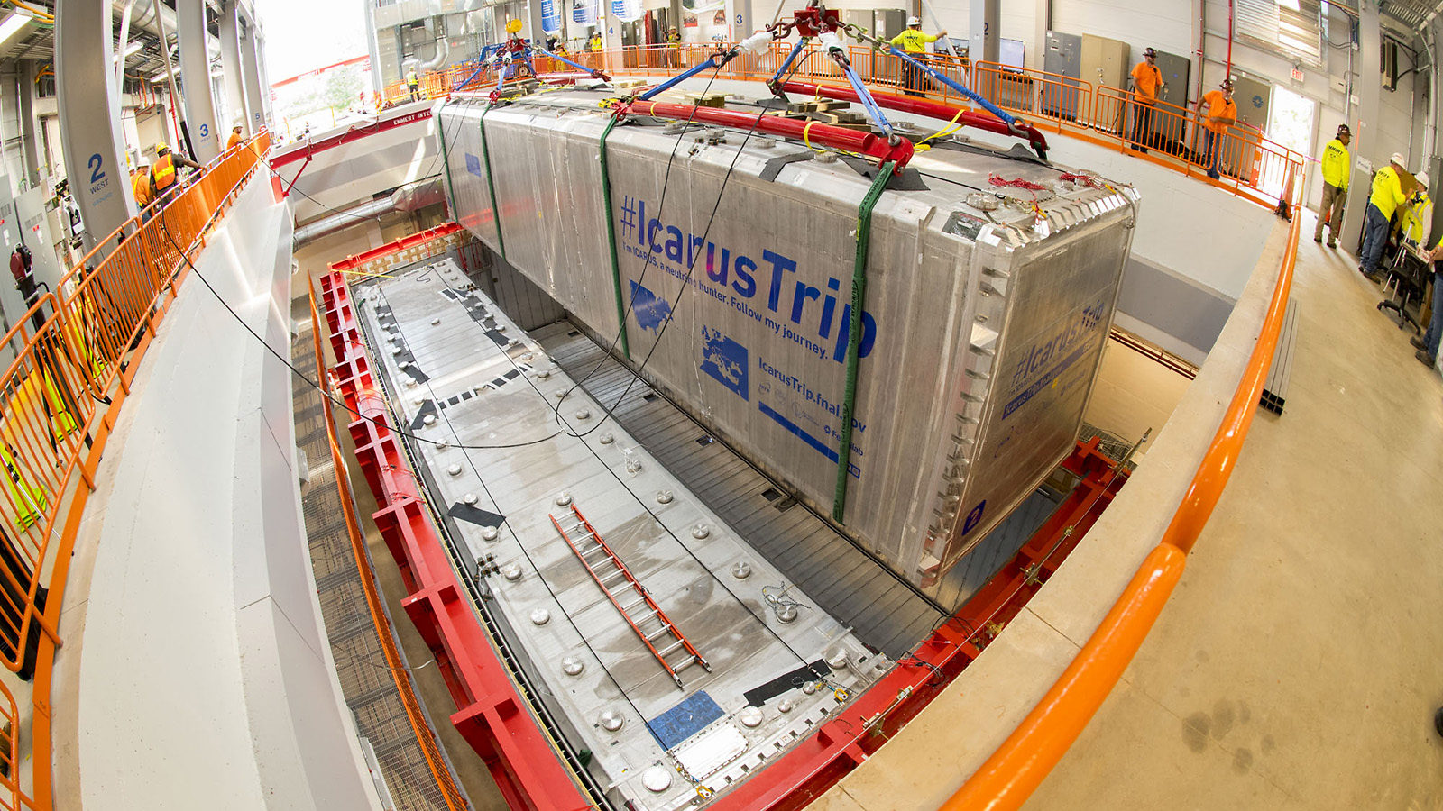
ICARUS T600
Total mass of 760 t of Lar, active mass of 476 t.
Two identical cryostats (T300 modules).
Each module is divided in 2 TPCs with 1.5 m drift, 3 wire planes and a common 75kV cathode.
Fully instrumented with 360 PMTs coated TPB.
Almost fully covered by a Cosmic Ray Tagging System (CRT).
3 m concrete overburden.

Slide 7
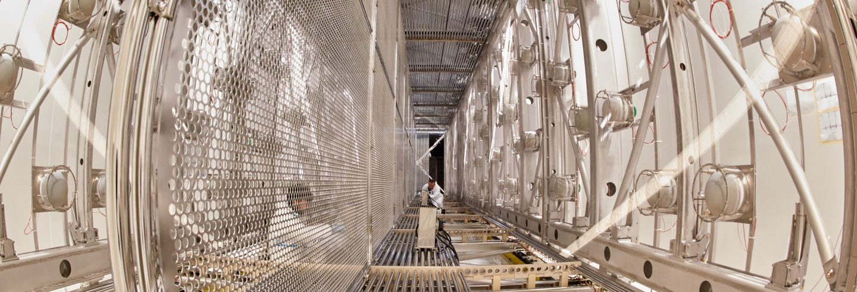
TPC upgrades
Preliminary
Induction 1: 6.74
Induction 2: 8.64
Collection: 9.05
Upgrade of the warm TPC readout electronics:
new front-end based on analogue low noise/charge sensitive pre-amplifier;
more compact layout of analog and digital electronics in a single flange;
shorter signal shaping time (~1.3 μs).
S/N after coherent
noise removal
7

Slide 8
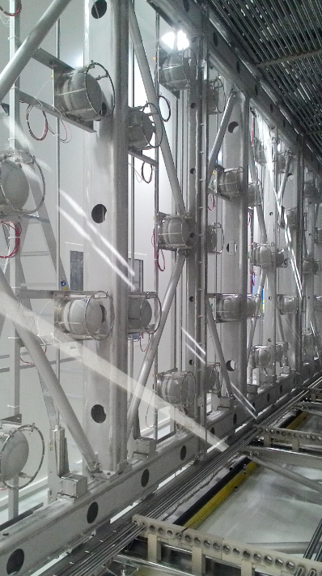
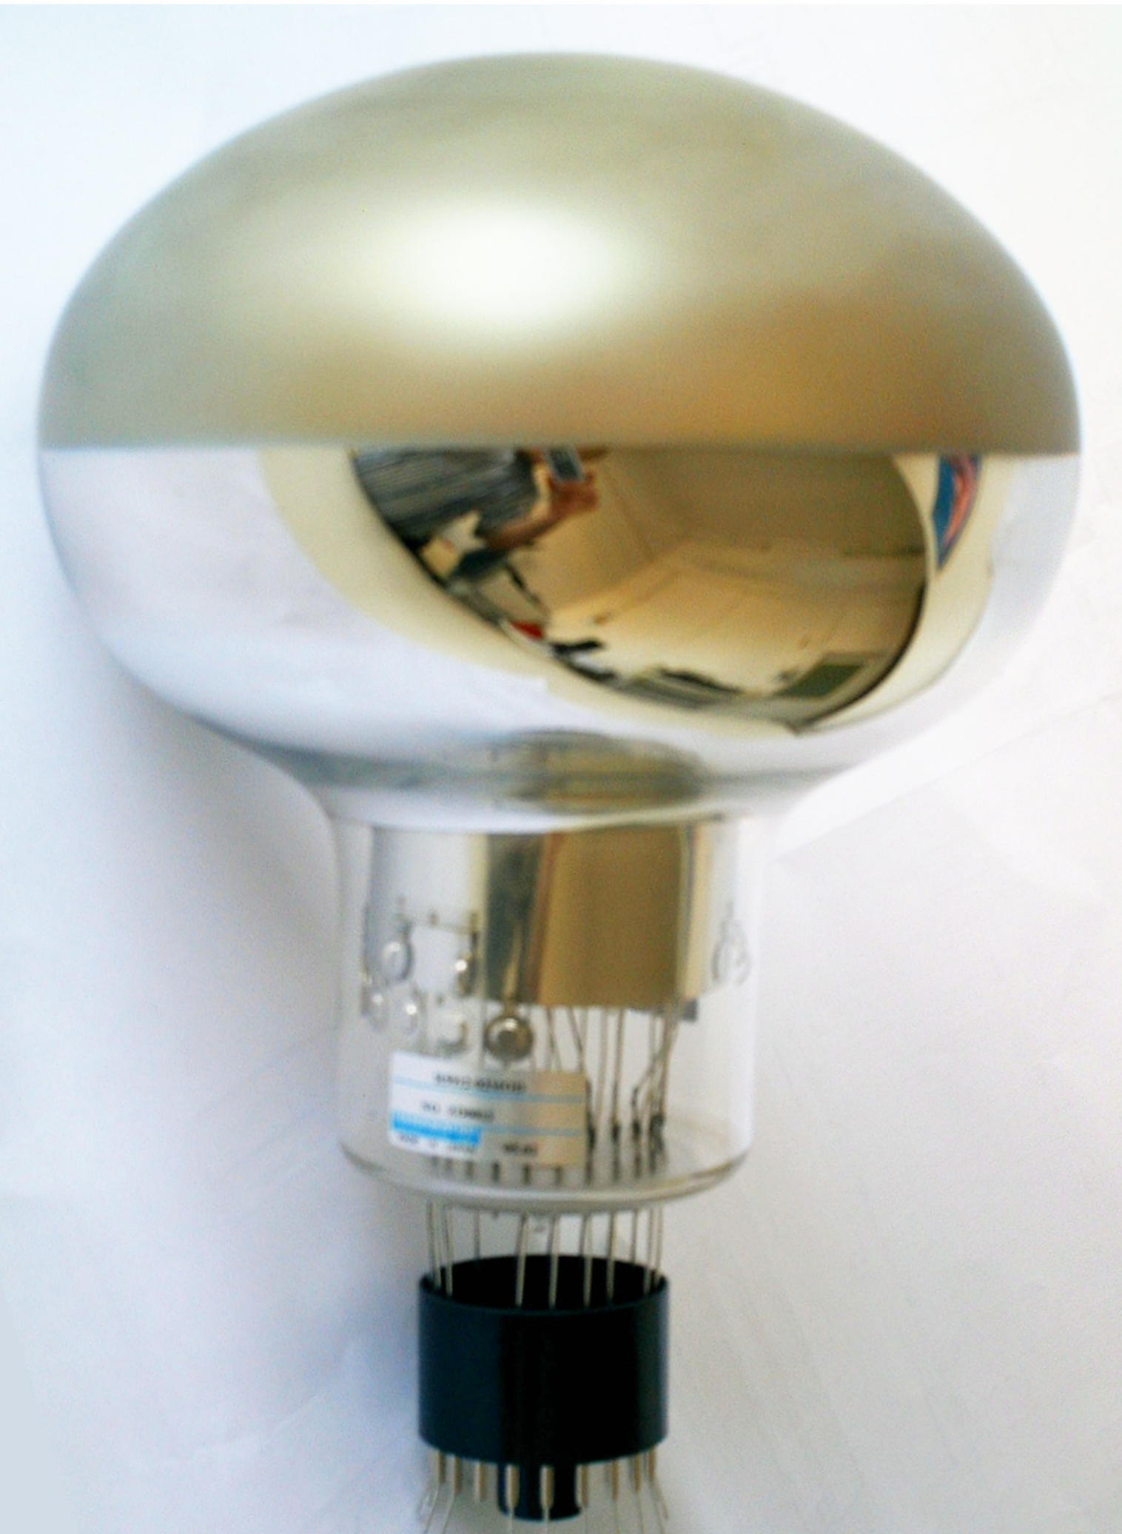
Light collection system upgrades
Increased coverage of the detector surface with 360 8″ PMTs (5% photocathode coverage of the TPC wire area) provides:
ns event timing resolution;
<50 cm event spatial resolution.
The PMT light detection system is working smoothly and all the gains have been equalized.
Distribution of time difference between
PMT signals and trigger time
Hamamatsu
R5912-MOD
Preliminary
PMT supporting system

Slide 9
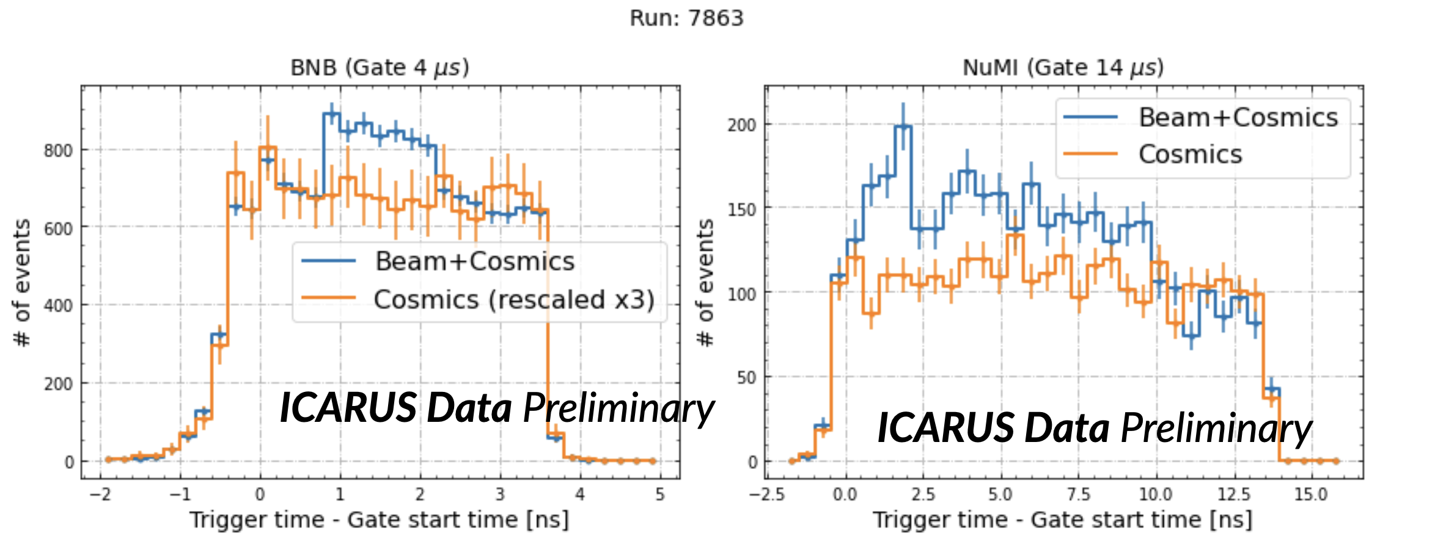
Trigger
The main ICARUS trigger signal is generated by majority of discriminated PMT pair signals in coincidence with BNB and NuMI beam spill gates (1.6 and 9.5 μs respectively).
The current trigger requirement is 400 ADC/13 pe threshold for PMTs digitization and majority of 5 pairs.
Excess of PMT flashes in the BNB (left) and NuMI (right) gates
Correct timing of beam signals was verified by looking for excess PMT light over the cosmic background rate in minimum-bias runs.

Slide 10
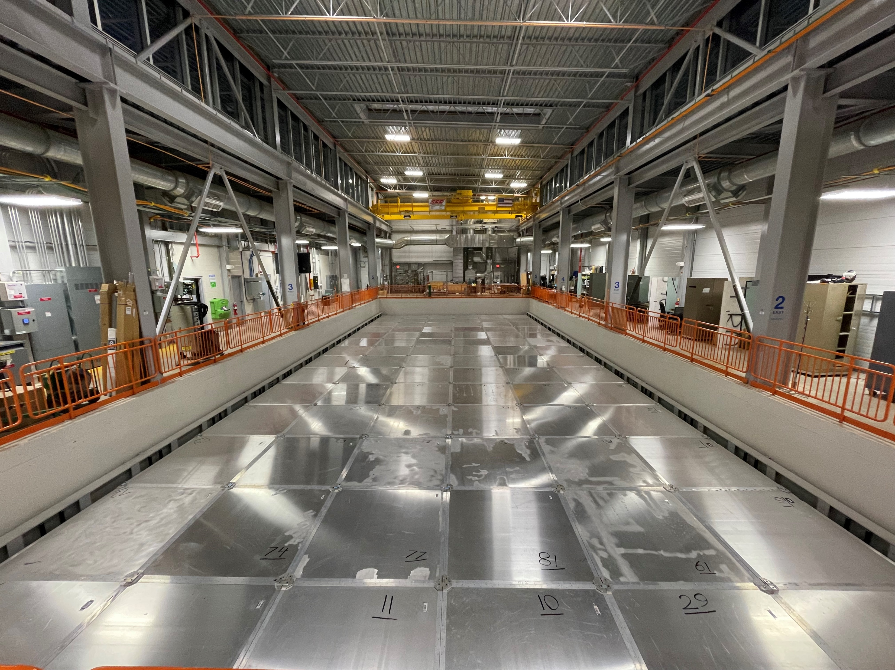
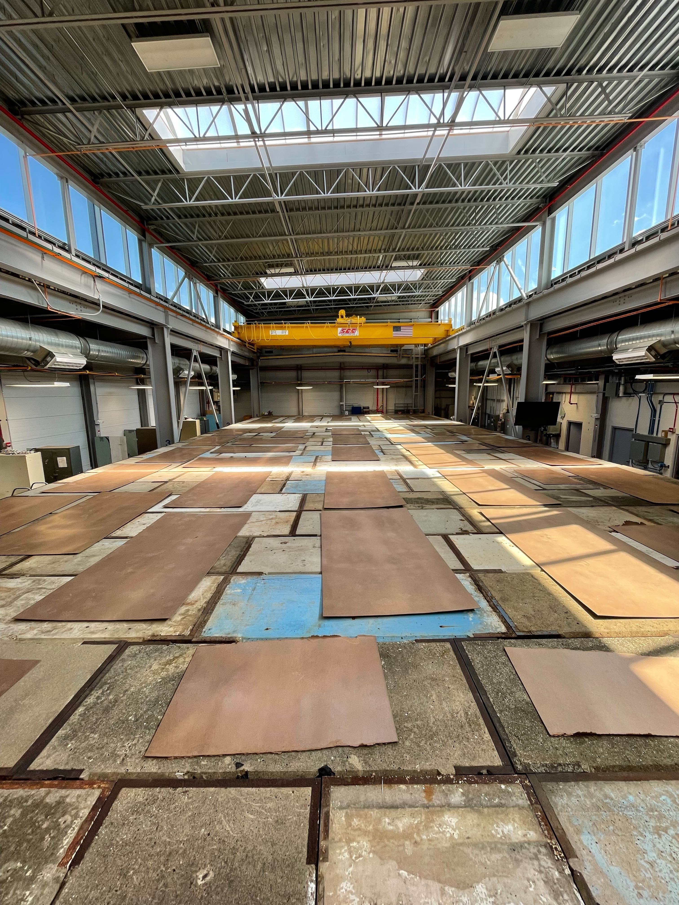
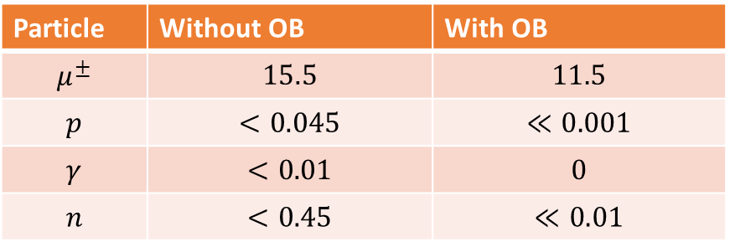
Cosmic Background
ICARUS is on the surface and thus exposed to a huge cosmic activity.
Cosmic activity can be divided in:
In-time: cosmic particles entering the detector during the beam spill.
Out-of-time: cosmic particles crossing the detector during the drift time.
Without shielding, ICARUS would be overwhelmed by the hadronic and soft energy component of the cosmic background.
In order to mitigate as much as possible the contribution of the cosmics, ICARUS is instrumented with:
3 m concrete overburden (6m water equivalent);
A 4π coverage of the detector with Cosmic Ray Tagging modules (CRT):
Bottom CRT, Side CRT and Top CRT.
Expected number of particles crossing the active Lar during the drift time
Particle | Without OB | With OB
$$μ^{±}$$ | $$15.5$$ | $$11.5$$
$$p$$ | $$<0.045$$ | $$≪0.001$$
$$γ$$ | $$<0.01$$ | $$0$$
$$n$$ | $$<0.45$$ | $$≪0.01$$
10

Slide 11
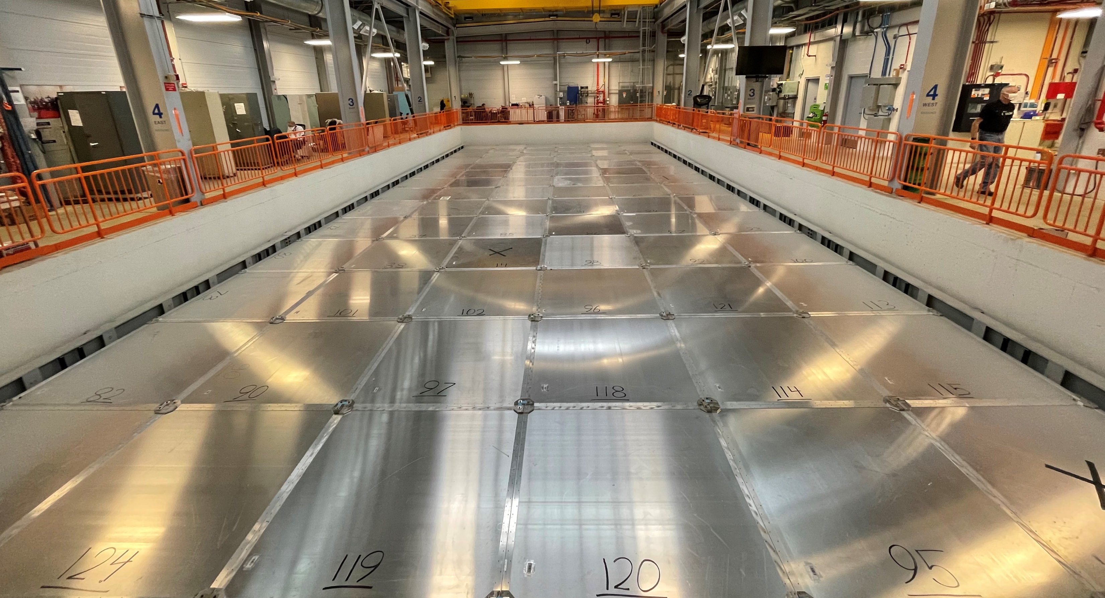
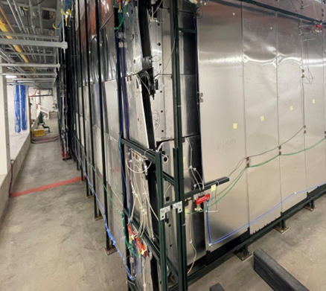
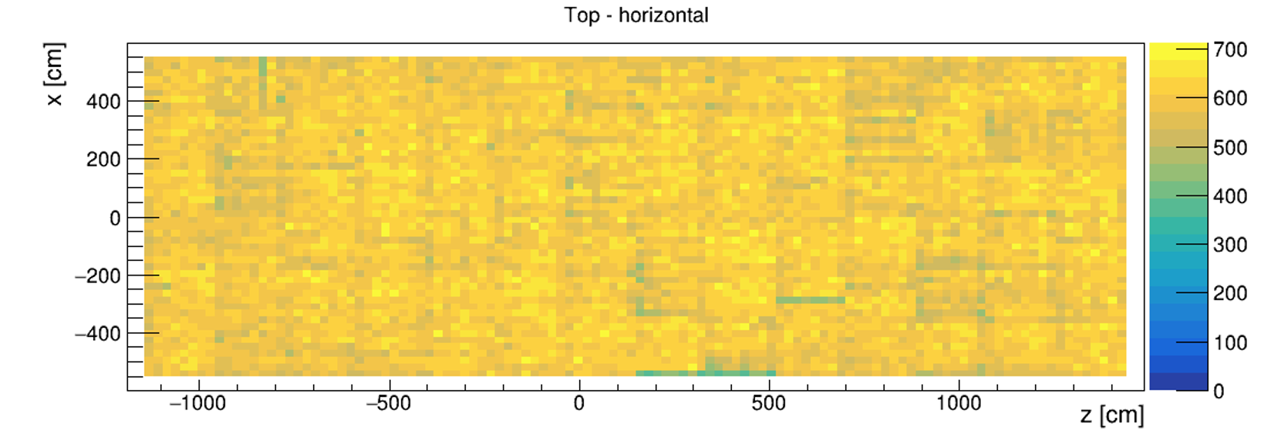
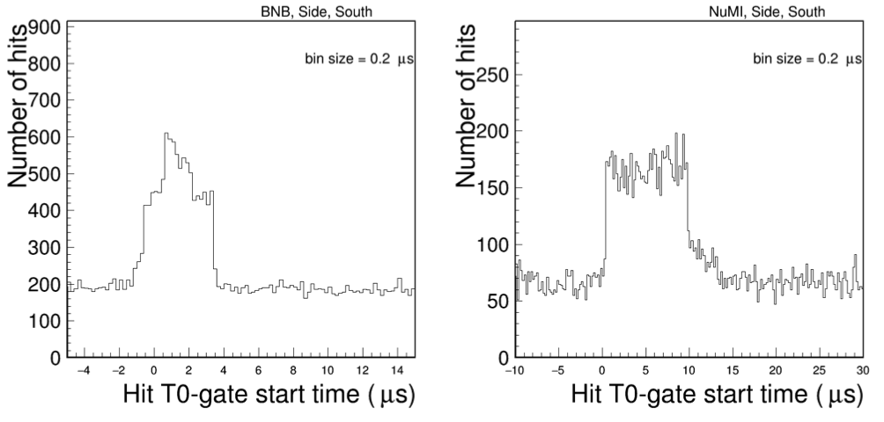
Cosmic Ray Tagger (CRT)
The CRT system is composed of plastic scintillator bars readout by SiPMs.
Side CRTs have been repurposed from MINOS modules.
Top CRT modules were assembled at LNF (Italy) and installed by end of December 2021.
The system provides spatial (~cm) and timing (~ns) coordinates of the track crossing point.
Excess CRT activity during the beam gate for the south wall
Geometrical Top CRT Hits distribution
Preliminary
1.6 μs
BNB beam spill
4 μs trigger gate
11

Slide 12
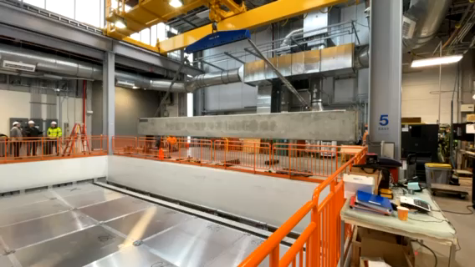
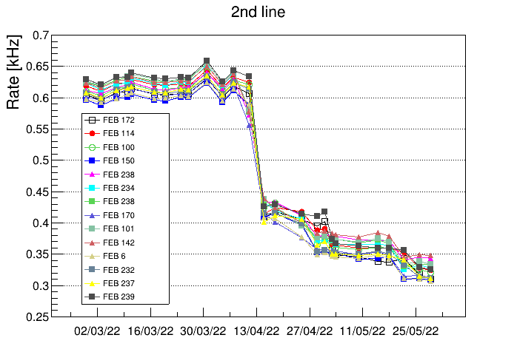
Overburden
The overburden is composed of three layer of concrete blocks of 1m height each. The total mass of the three layer is 5 million pounds.
The installation of the last concrete block was completed June 7.
Preliminary
The reduction of the cosmic rate is sensible:
horizontal Top CRT modules rate decreased from 600 Hz to 330 Hz, in agreement with the expected cosmic rate after the removal of the soft energy component.
Horizontal Top CRT rates
12

Slide 13
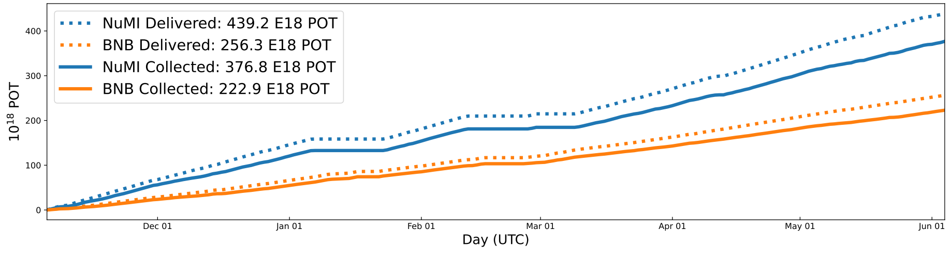
Commissioning
The detector is in nominal operating conditions since August 28th 2020, 24/7 shifts since February 14th 2020 (remote only since March 17th 2020).
Steady data taking with neutrino beams since March 2021, in parallel with commissioning activities. First BNB neutrino full time (24/7) neutrino run May 31st - June 27th 2021.
Top CRT was fully integrated in the data taking since February 2022.
The commissioning phase of the detector was succesfully concluded by the end of May 2022.
The physics data taking began June 7th, after the completion of the concrete Overburden.
ICARUS POT collection on BNB and NuMI during the Commissioning phase

Slide 14

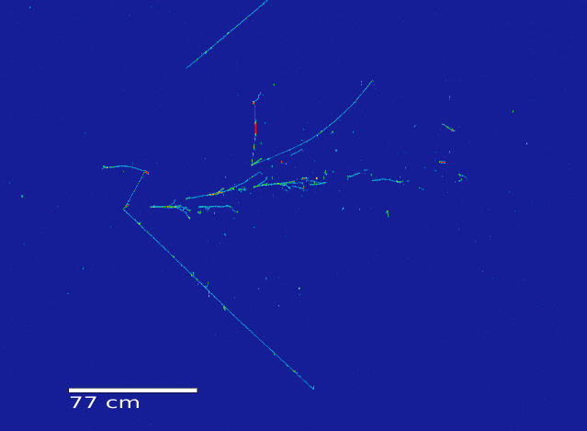
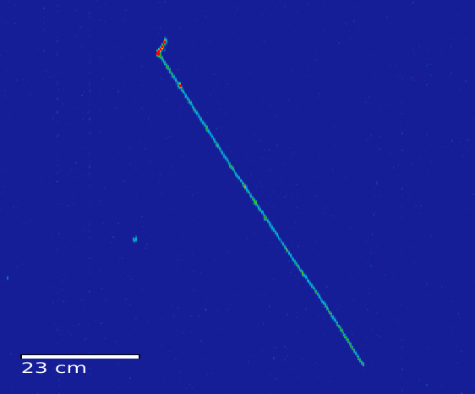
ICARUS@FNAL First Neutrinos
ICARUS has been collecting beam data since 2021.
A visual event scanning campaign has been performed to create a neutrino candidates dataset.
$ν_{μ}$CC with hadronic activity from BNB
QE like $ν_{μ}$CC from BNB

Slide 15
TPC event reconstruction
The default reconstruction uses Pandora (github.com/PandoraPFA), a pattern recognition software integrated in LArSoft:
clusters the signals from the wire planes into reconstructed particles in 3D;
reconstructs vertex;
forms reconstructed particles hierarchy;
provides a classifications of the particles as track-like or shower-like.
Sample data event selected by visual scanning with reconstruction overlaid
Preliminary
15

Slide 16
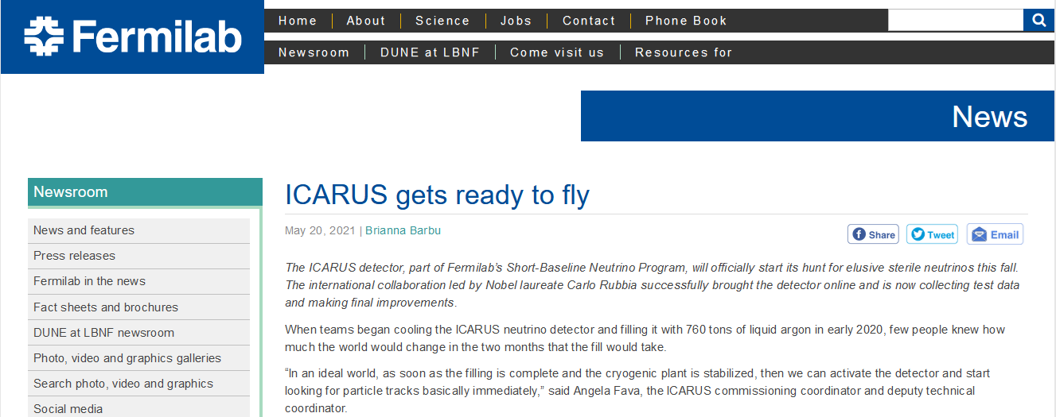
Conclusions
ICARUS completed its commissioning phase by the end of May 2022.
The Overburden installation was completed by June 7 2022.
ICARUS Run 1 started and it will cover a 40-days period until the beam summer shutdown (July 10 2022). The detector will contineously take data both on the BNB and NuMI beams.
May 05 2021: «ICARUS gets ready to fly»

Slide 17

Conclusions
ICARUS completed its commissioning phase by the end of May 2022.
The Overburden installation was completed by June 7 2022.
ICARUS Run 1 started and it will cover a 40-days period until the beam summer shutdown (July 10 2022). The detector will contineously take data both on the BNB and NuMI beams.
May 05 2021: «ICARUS gets ready to fly»
June 2022:
ICARUS starts Physics Data taking

Slide 18

Neutrino
Thank you!
Stay tuned… more to come!

Slide 19
Backup

Slide 20
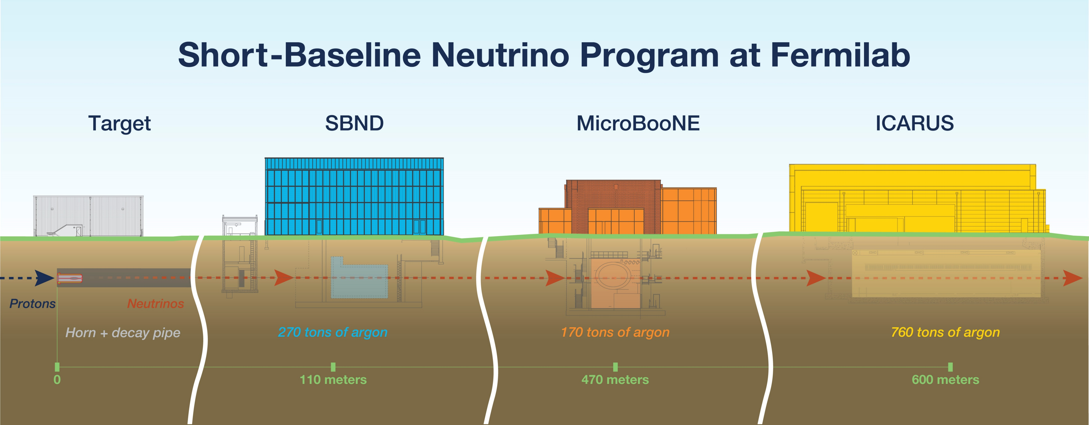

Slide 21
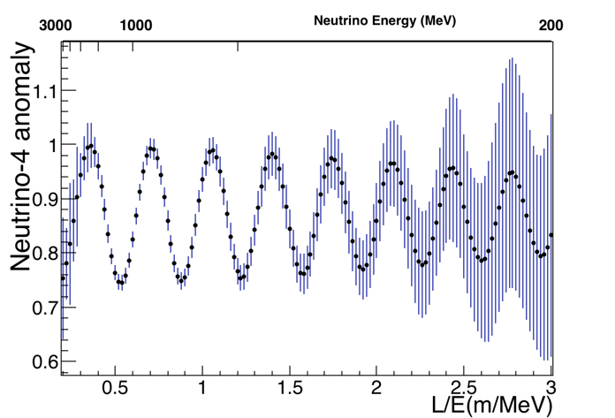
Neutrino 4 - anomaly
Expected Neutrino-4 disappearance signal for L averaged position (blue) and at center (red)
Survival oscillation probability in 3 years for Neutrino-4 best fit (only stats)
Bottom cover

Slide 22
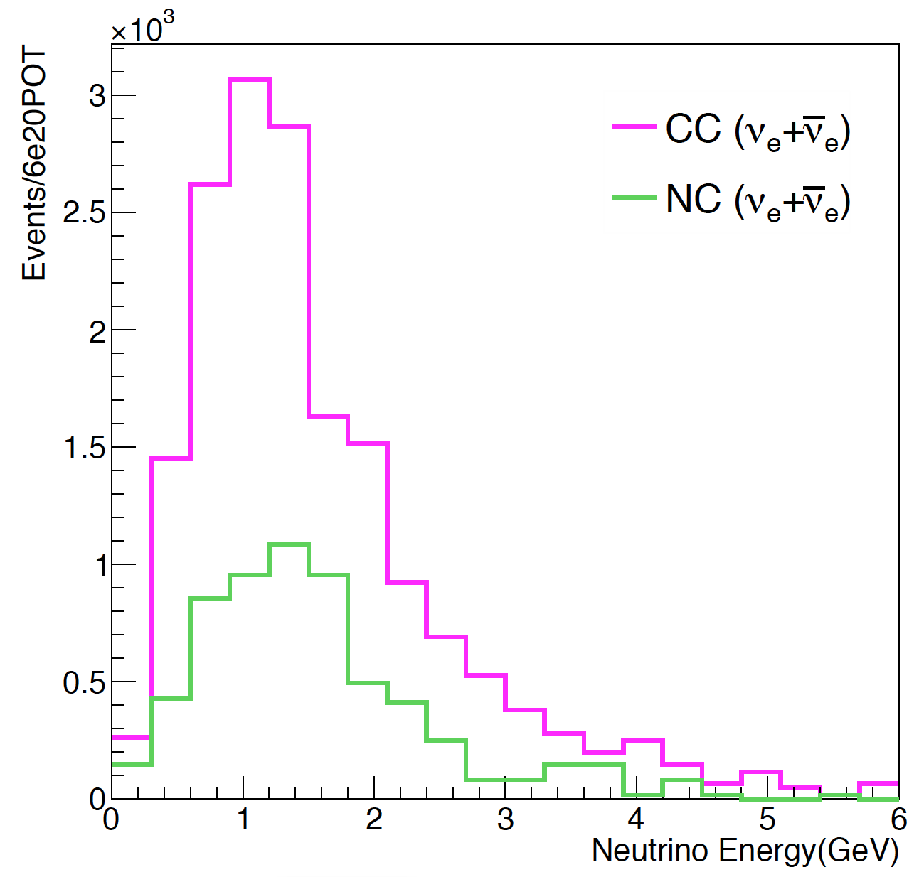
Physics searches with NuMI
𝝼_{μ} from NuMI at ICARUS
𝝼_{e} from NuMI at ICARUS
Bottom cover

Slide 23
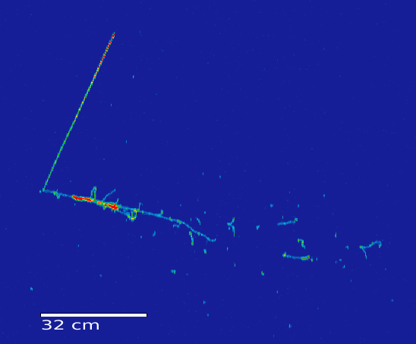

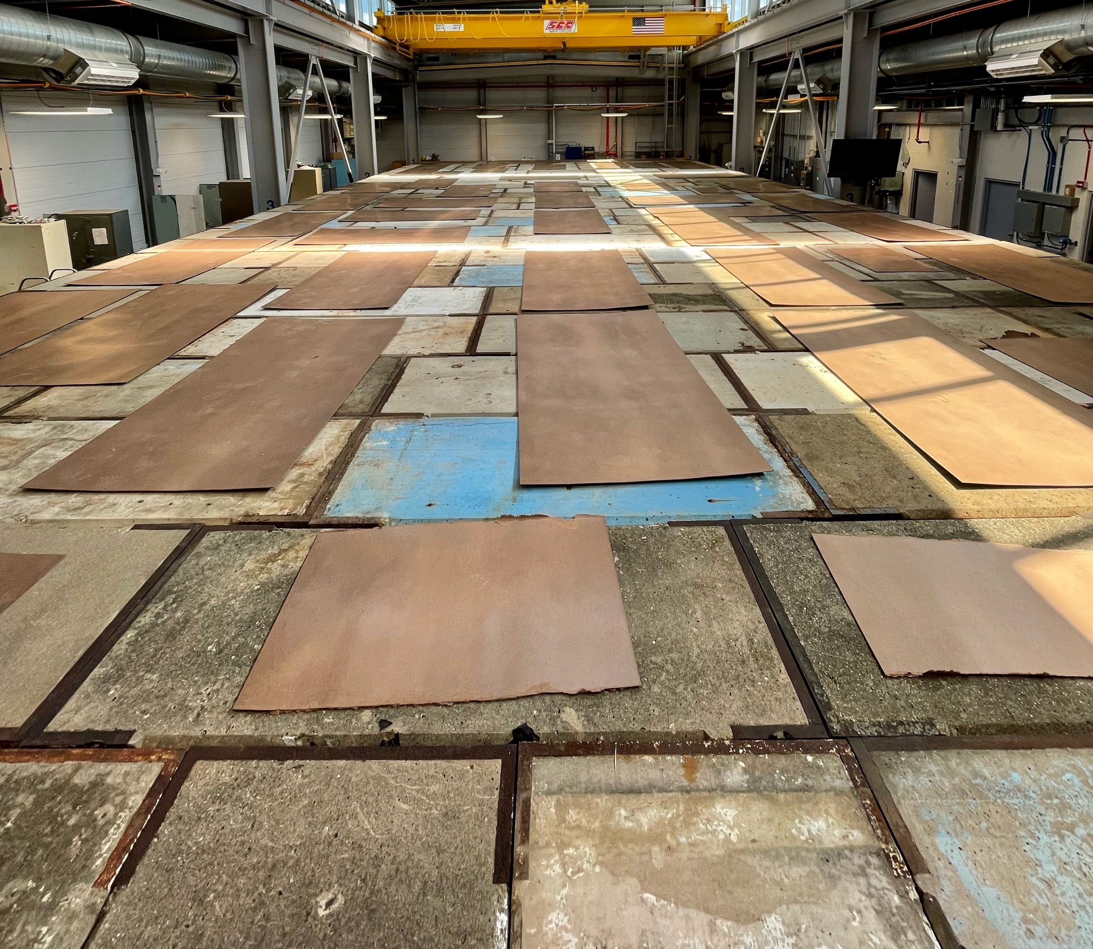
ICARUS new life
ICARUS undergoes refurbishment at CERN
ICARUS moves to its new home at Fermilab
ICARUS starts taking data: first neutrinos at FNAL
The overburden is completed:
ICARUS starts Run 1
2015
2017
2020
2021
June 2022
Bottom cover

Slide 24
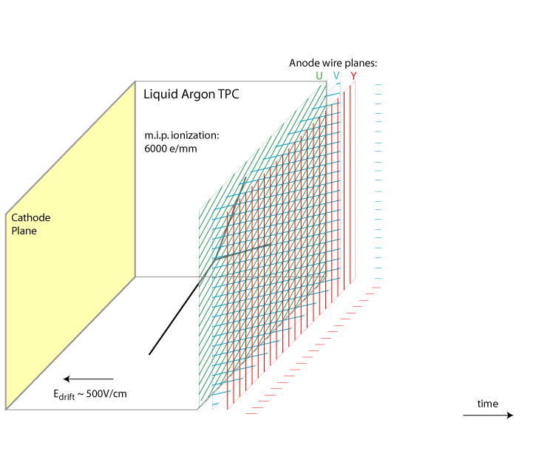

LArTPCs
ICARUS pioneered the LArTPC technology.
The detector is a massive and homogeneous target with excellent tracking and calorimetric capabilities.
Scintillation light:
128 nm wavelength, 40k ph/MeV.
Ionization electrons:
42k e/MeV, drifted by E towards
the anode plane in 0.96 ms.
VUV γ
Ar
e
E
24

Slide 25
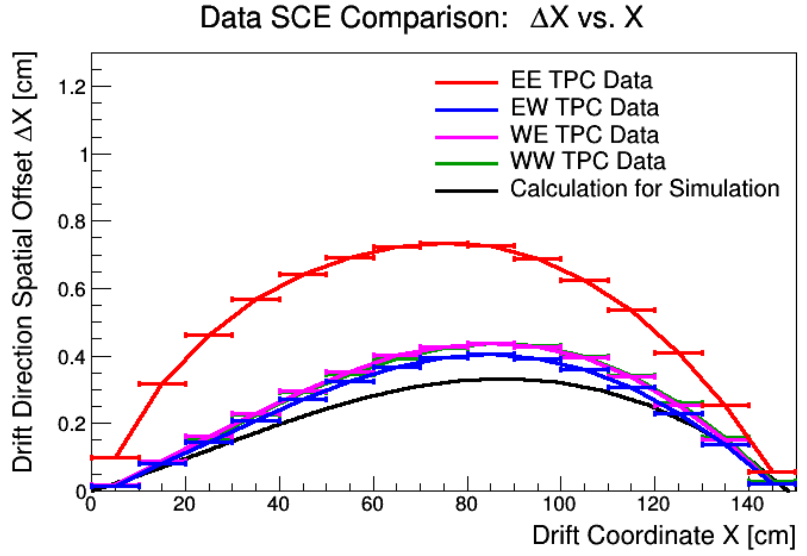
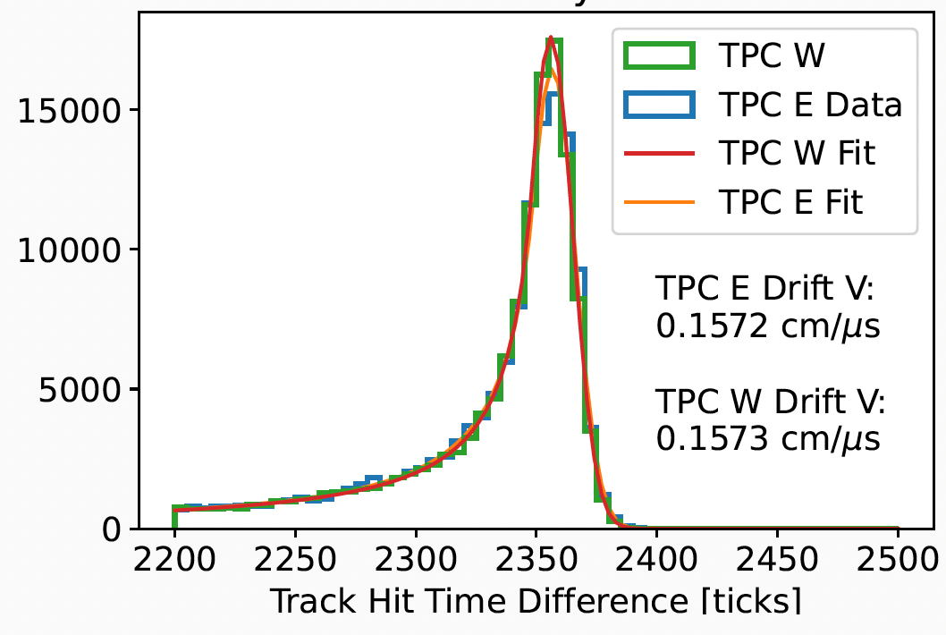
TPC performance
Spatial distortions in drift direction due to space charge
Drift velocity in West cryostat
Space charge effects (SCE) measured using anode-cathode-crossing cosmic muon tracks, looking at spatial distortions in drift direction. Good agreement with simulation, apart from one TPC where E field distortions associated with a possible field cage short are being investigated.

Slide 26
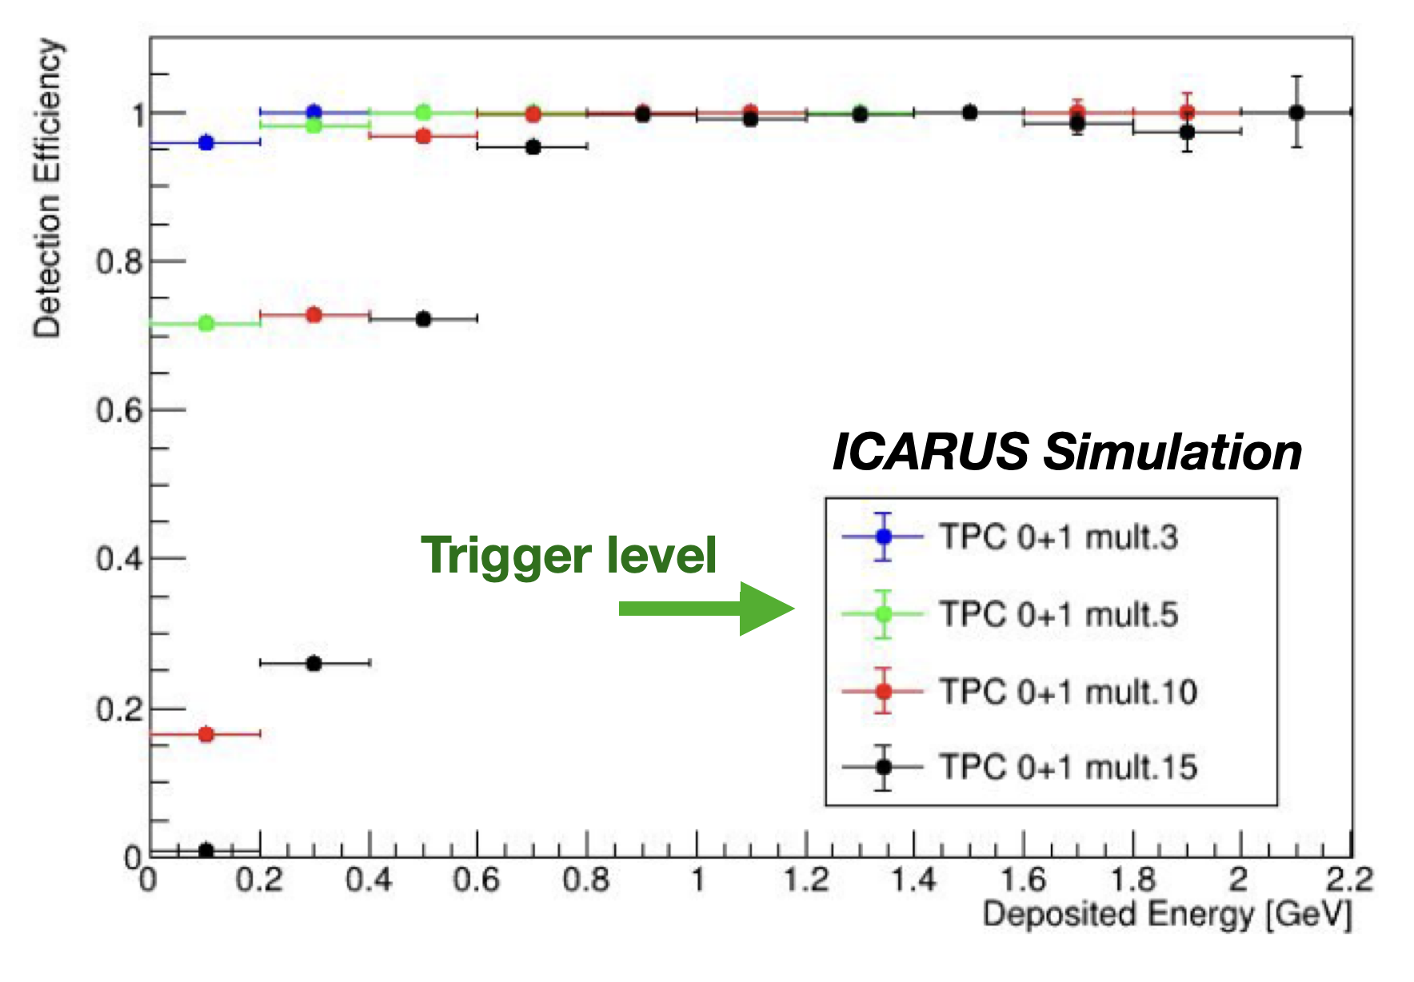
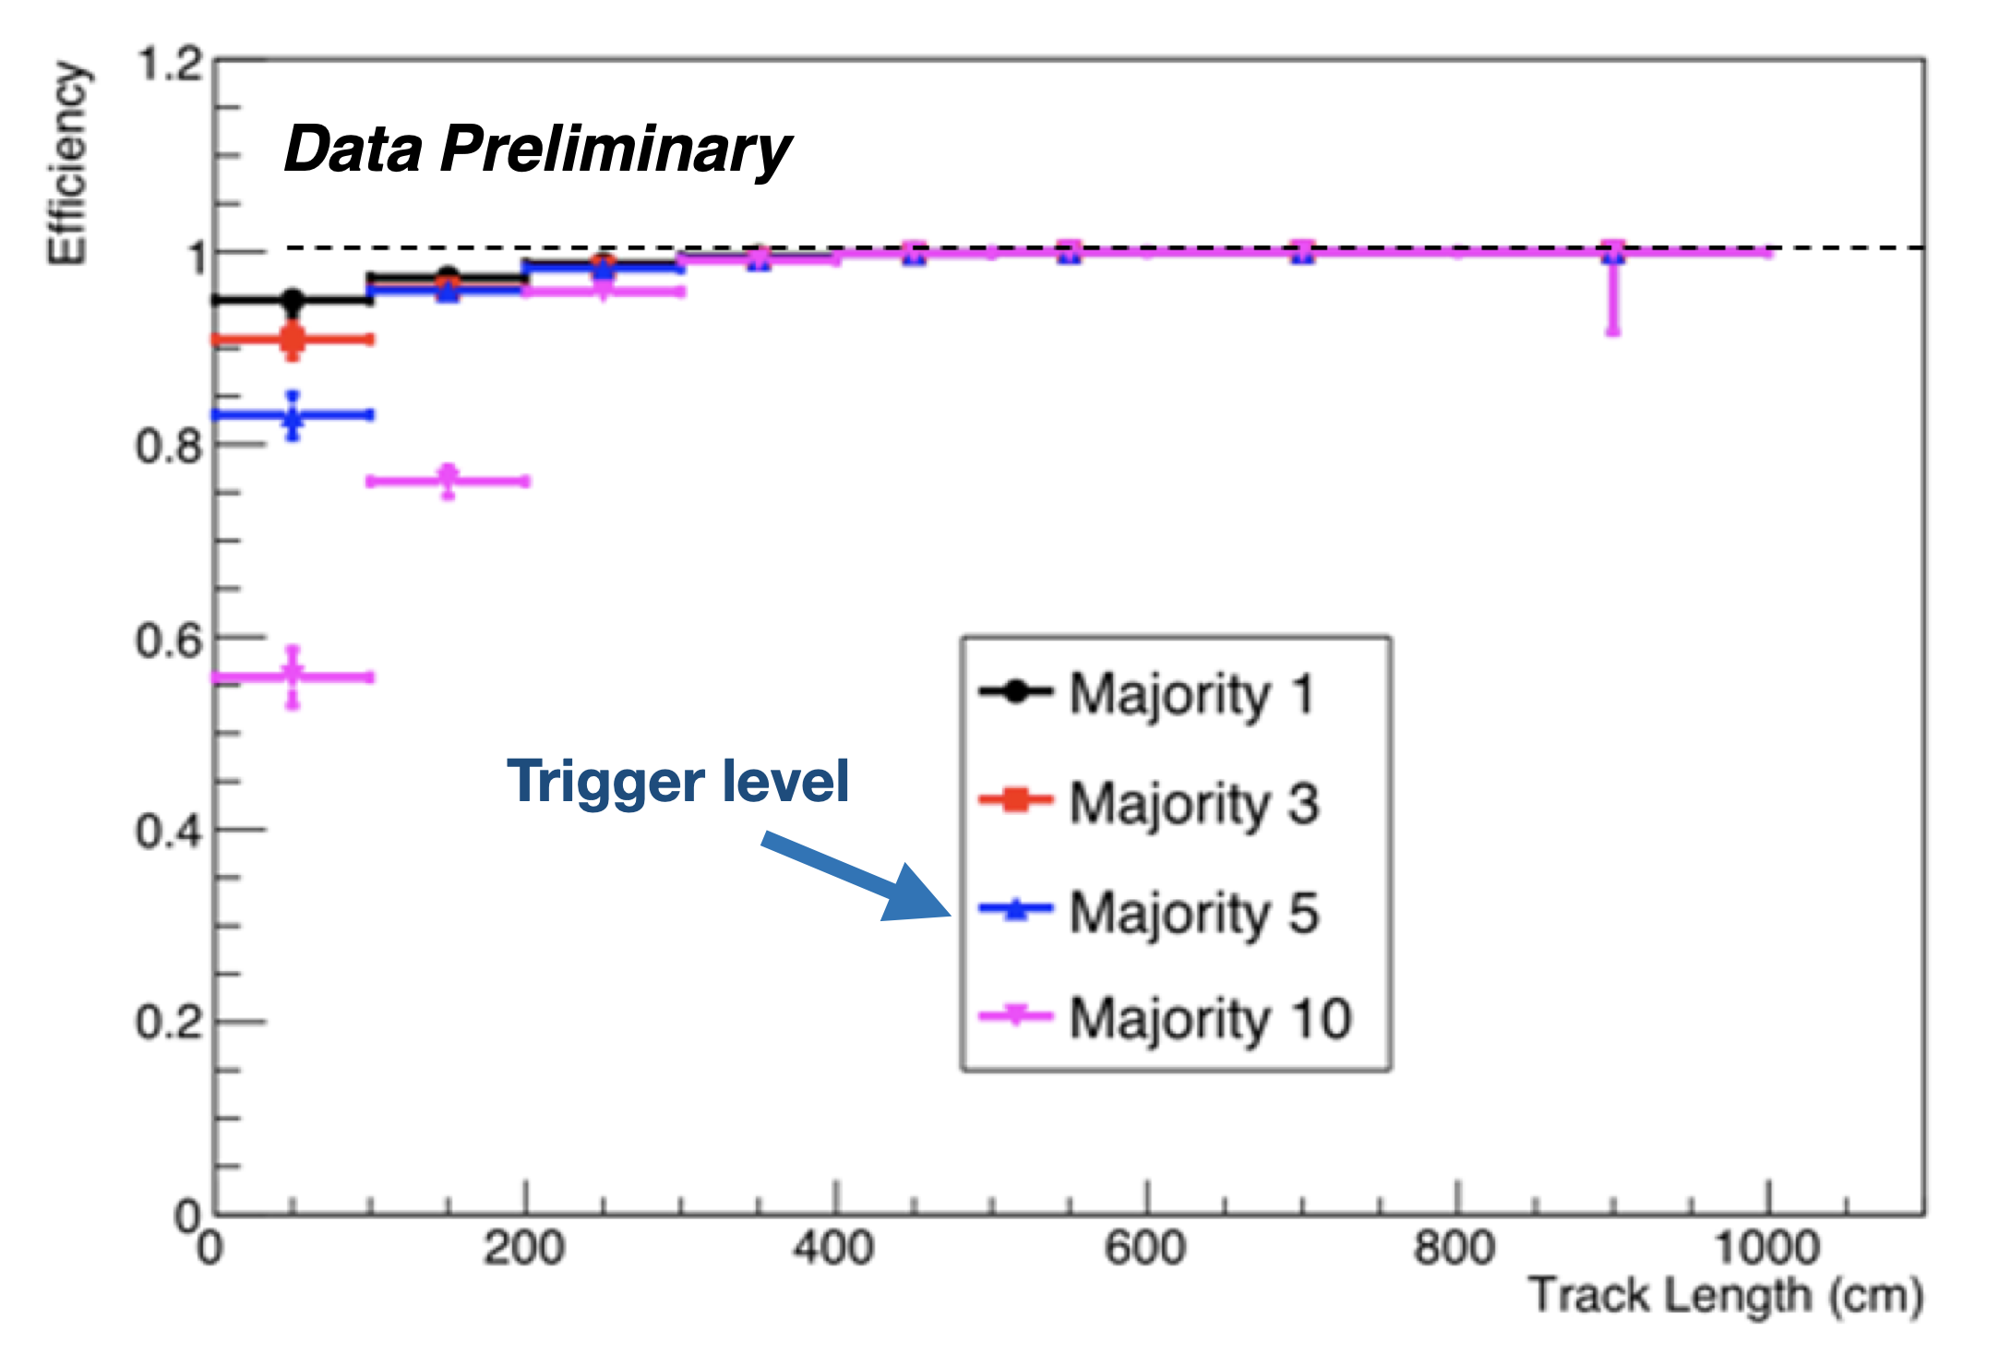
Trigger efficiency studies
Trigger efficiency on ν_{μ}CC from MonteCarlo
Trigger efficiency measured on crossing cosmic μ

Slide 27
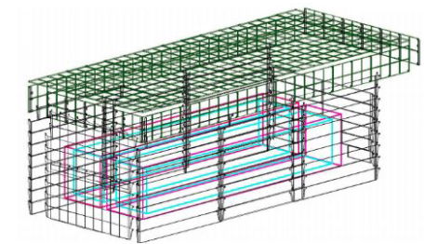
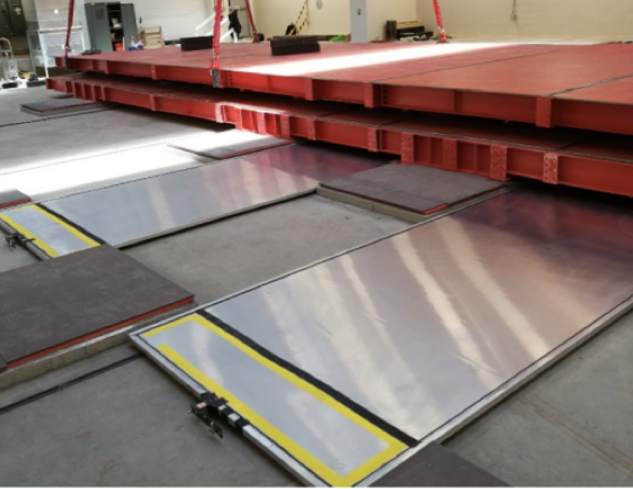
CRT - Backup
Modules repurposed from
the Double Chooz
experiment.
Two layers of parallel
scintillator strips.
Modules are composed of 32 strips, each 5 cm wide.
Readout by a 64-pixel multi-anode PMT.
Bottom CRT

Slide 28
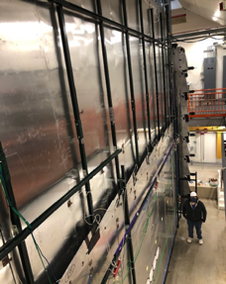
Cosmic Ray Tagger (CRT)
Side CRT
Side CRTs have been repurposed from the MINOS modules.
20 parallel scintillator strips per module readout by SiPMs.
Double layer X-X configuration, with the exception of the (upstream) south wall (X-Y).
1.6 μs
BNB beam spill
9.5 μs
NuMI beam spill
4 μs trigger gate
12 μs trigger gate
28
Excess CRT activity during the beam gate for the south wall

Slide 29
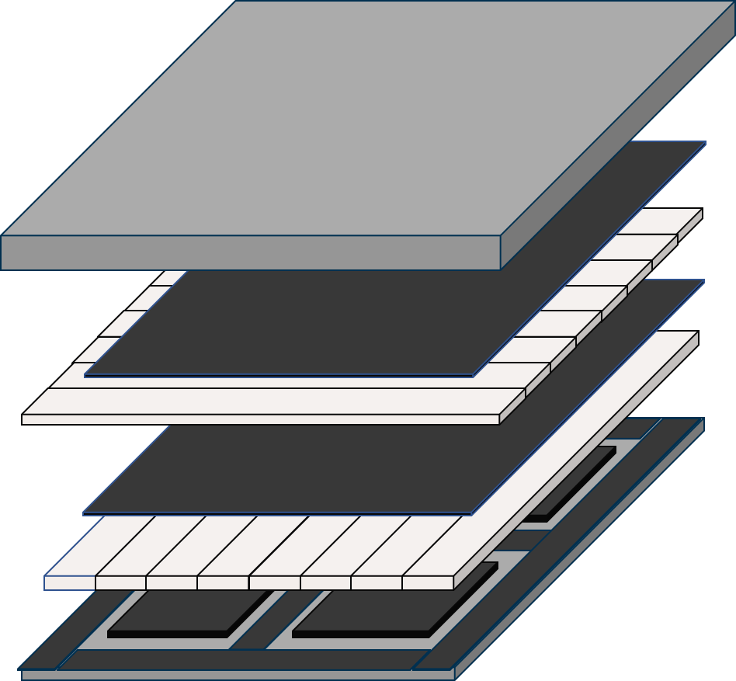
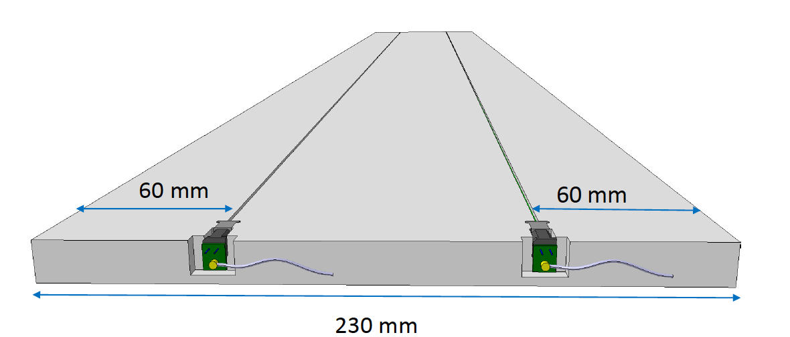
Cosmic Ray Tagger (CRT)
Top CRT
The Top CRT is composed of 39 vertical modules and 84 horizontal modules covering ICARUS surface and tagging alone 80% of the incoming cosmic muons.
Each module is an hodoscope consisting of 2 orthogonal layers of eight 23 cm wide scintillator bars, readout on one end by one SiPM.
The Top CRT modules were assembled and tested at the Frascati National Laboratories. The modules were shipped to FNAL during the pandemic and they were fully installed by December 2021.
Bottom cover

Slide 30
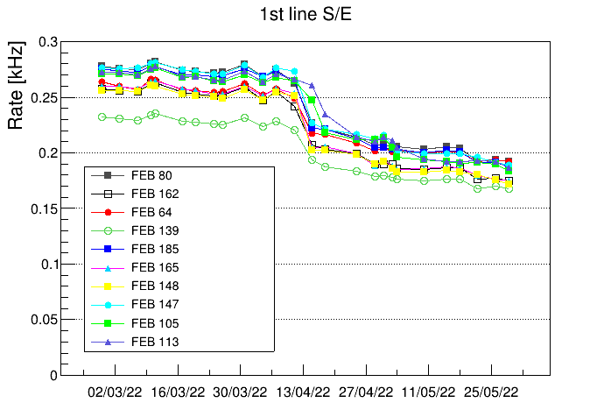
Top CRT rates vs time
Vertical Top CRT rates
Horizontal Top CRT rates
Bottom cover

Slide 31
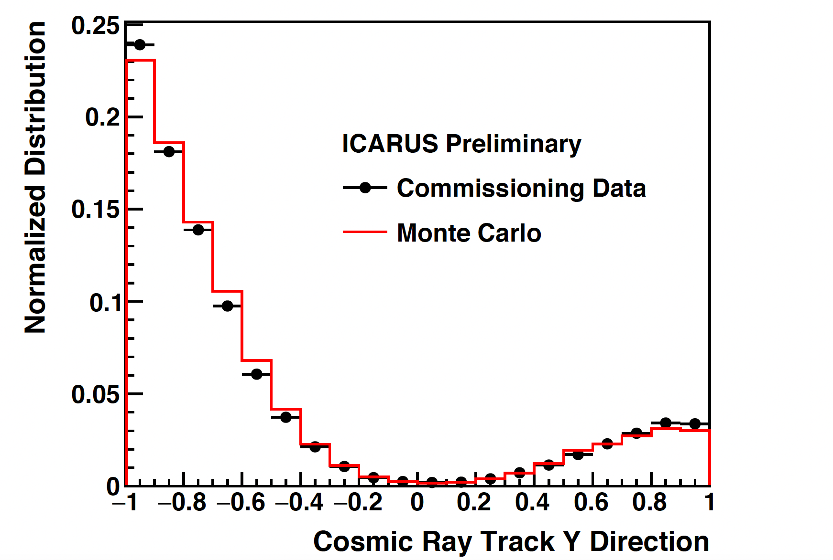
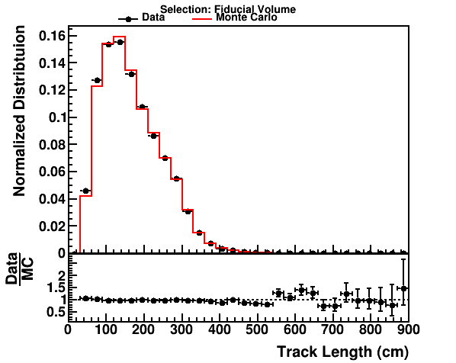
Track reconstruction: MC/Data comparison

